Slide 1
120 Hour Summary
Patrick Dowdle
June 1, 2022

Slide 2
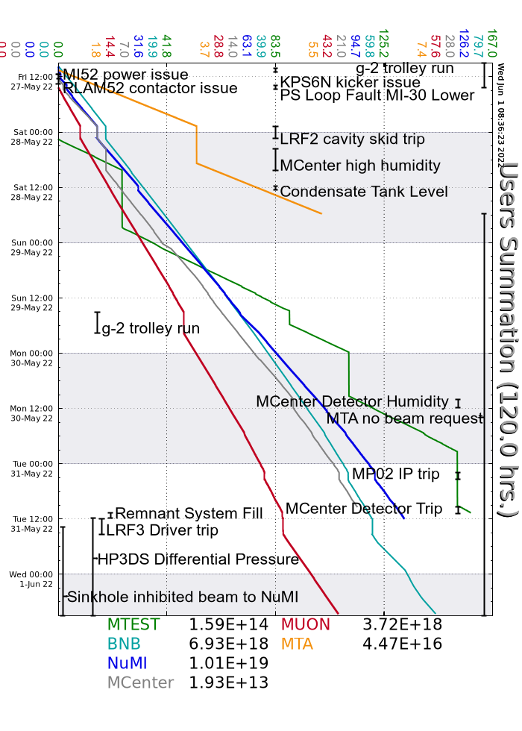
Summary
In general:
Tuning to keep the machines efficient
Supporting machine studies
Adjusting BNB intensity as needed to keep G:RD1139 below its limit
Friday:
Tripped breaker at MI52 took down power supplies, DE recovered
Another RLAM52 contactor issue resolved itself again
MI30Ltripped its breaker again, Dave K. added diagnostics
LRF2 Cavity skid tripped on low level, made an access to check for leaks (didn’t find any), Linac group found small leak on mixing valve tightened the collar down
Saturday:
CUB chiller tripped causing increased temps leading to NuMI A&B Munters tripping DM recovered the system
Sunday:
MIRF5 kept tripping on Repeated RFGE, Ops bypassed the station, RF group is aware
Node N60TOR issue caused the NuMI permit to trip on NuMI power low, power cycled the crate to recover

Slide 3
Summary
Monday:
N60TOR problems resurfaced. The bit to the permit was masked
LRF3 persistent driver trips, Linac group came in and adjusted filament current and screen voltage
Tuesday:
LRF3 driver problems continued, the anode cable was re-terminated
Remnant system was filled which require the system to be turned off
While down, a leaking pump at F4 held off beam. The other pump leaks as well so the plan is to get a replacement today
A sinkhole has re-appeared above the NuMI line, Ops and RSO have placed locks on LAM60/61
Wednesday:
Prepared M05 for access for glycol cleanup
Access to F1 was made for vacuum work
Current Conditions:
Muon Campus: 1.05 E12 POT
BNB: 7 E16 p/hr

