Slide 1
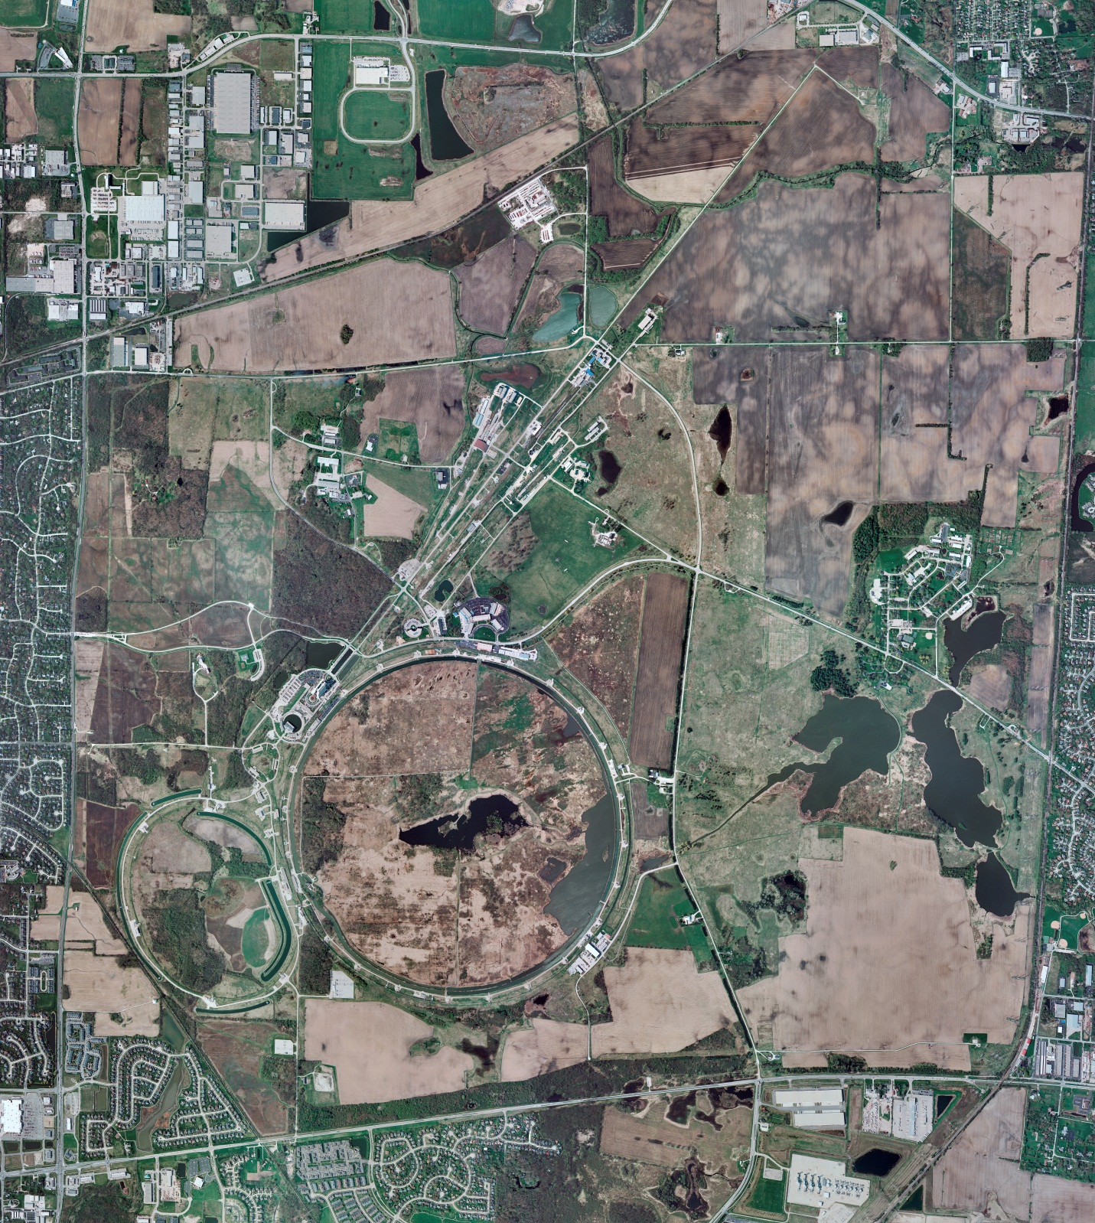
Helium Cryogenics
Status 6/3/2022 J.Makara
CMTF: SCP cryo system cold and operating fine
CMTS: 1.3 GHz HECM21 controlled warmup to RT in progress
PIP2TS: SSR1 at RT
HB650 installation prep continues
MCTF: cryo system shut down at RT except LN2 Tank cold
MDB/HTS: at RT
MDB/STC: at RT
MDB Magnet: at RT
NML/FAST: Cryo system cooldown was halted to conserve LN2
CC1/CC2/CM: CC1, CC2 at RT
and CM warmed up to RT to conserve LN2
IB1: cryo system is shut down at RT for maintenance/development
HAB: BA comprs and Fridge shut down at RT and isolated; system under dry N2 purge
STF: isolated and not active
Muon Campus: A0 comprs (3) online with MC-1 g-2 cryogenic system cold at 5 K and running fine
Misc: Helium deliveries in liquid dewars or gas cylinders are allocation limited causing anxieties.
LN2 deliveries once again of great concern due to supply issues

