Slide 1
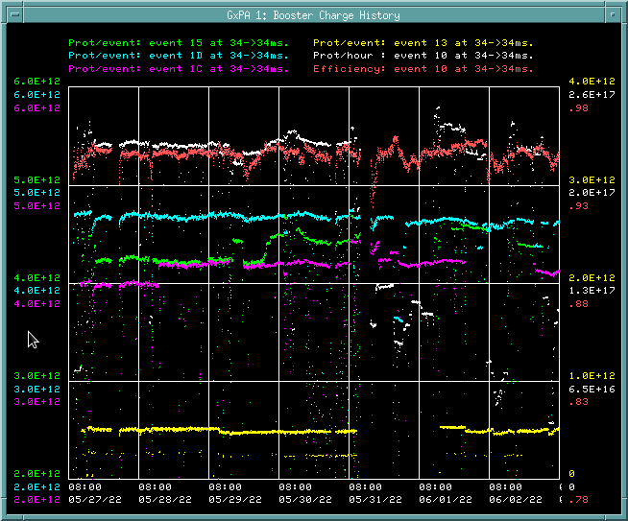
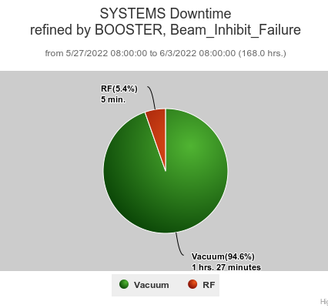
Booster Operations 5/27/22 – 6/3/22
Downtime: 1.55hrs. total
MP02 Ion pump cable short
Misc RF trips
Studies this week:
New Damper testing on $17.
This week:
Currently 94-95% eff. on cycles. $15 ~4.6 E12 p/p, 95%eff to NuMI(off now), $1C ~4.2E12 p/p to Muon(off now), $1D @ ~4.6 E12 p/p to BNB, @5Hz, SY120 ~4.6E11 p/p. ~2.90E19 protons total for the week
General tuning over week with reduced losses. Reduced throughput this week due to downstream demand.
BRF2(Mod Replaced) recovered last Friday morning, BRF16(Bias repair) back on-line yesterday afternoon, all RF stations available.
Thanks to Operations for tuning efforts over week.
Requests/Plans:
Open request for brief periods (2)$17 cycles in time-line.
Days shift studies planned for later in June

