Slide 1
Muon Campus Status
D. Vander Meulen
June 3, 2022

Slide 2
This Week …
Continuing to look at why G-2 CTags are low. Recycler looking at their 2.5 MHz RF, Muon Campus tuning, and G-2 looking at their equipment. Improvements have been made, but more work is needed.
8 GeV proton studies Thursday. High intensity beam for Tune Tracker system tests, Delivery Ring aperture, chromaticity, and injection loss studies. Studies ended when network troubles started.
LCW leak rate continues to climb. Make up is now between 210 – 240 gal/day. The leak is not a threat to operations and will be delt with during the summer shutdown.

Slide 3
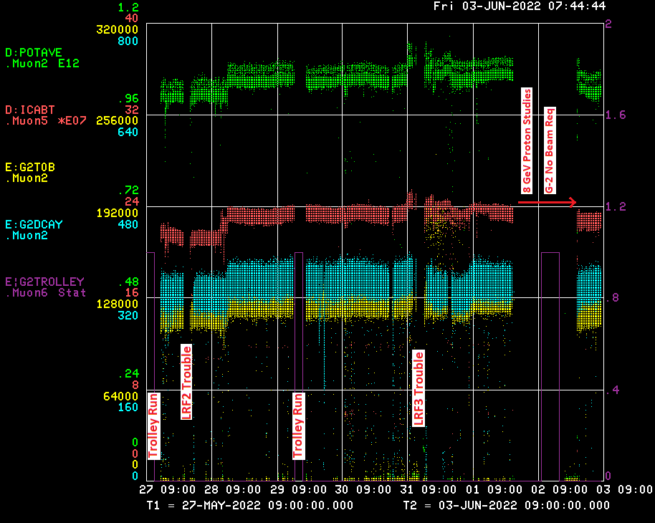

Slide 4
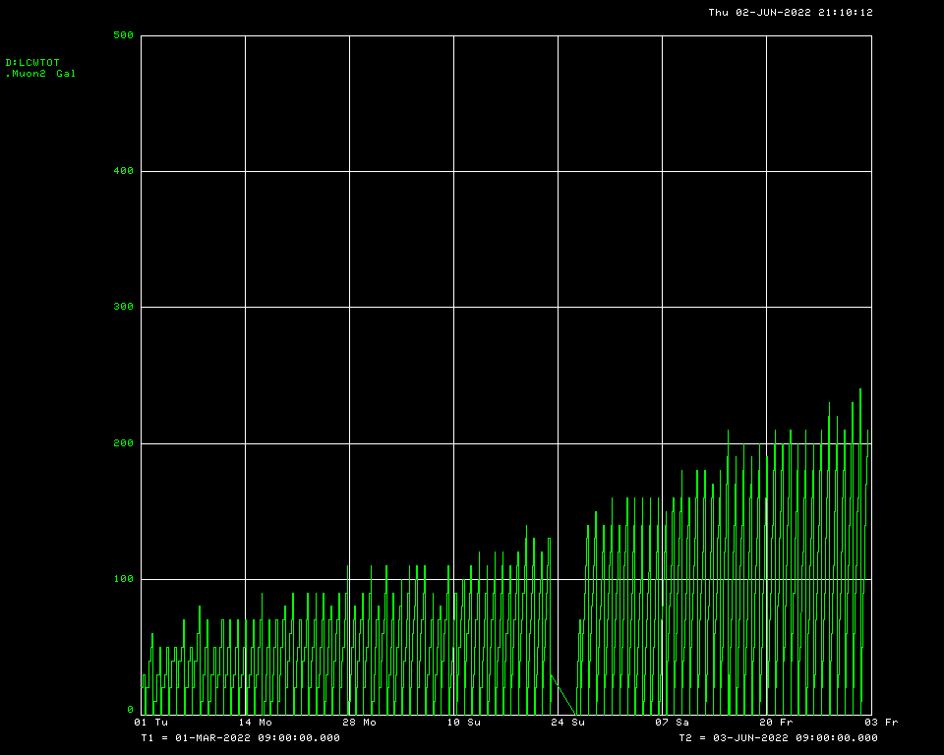
LCW Make Up Trend

Slide 5
Down Time ...
Muon Campus:
None
G-2: Trolley runs: 9hrs 51min
Controls Connectivity Problem: 2hrs 14min
No Beam Request: 22hrs (pend)

Slide 6
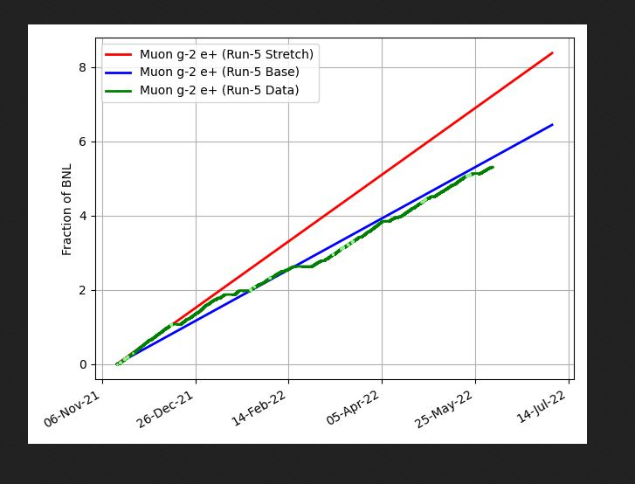
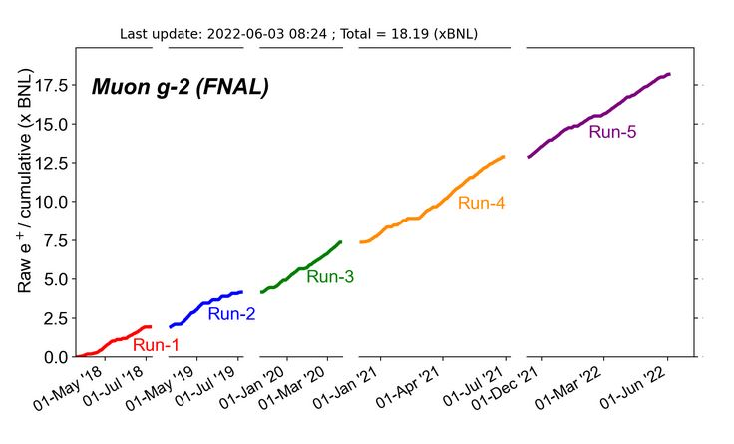
G-2 Performance – Integrated for Run 5
Run 5 # POT
G-2 Experiment POT Run Goal: ~4.2E20 POT
Run 5 period is Nov 2021 – June 2022
Run 5: Goal of ~x6 BNL
Total Run: Goal of x20 BNL
Run 5 Integrated ~ x 5.12 BNL
Total Integrated ~ x 18.19 BNL

Slide 7
Weekend Plan …
Run to G-2 as requested.

