Slide 1
48 Hour Summary
Patrick Dowdle
June 3, 2022

Slide 2
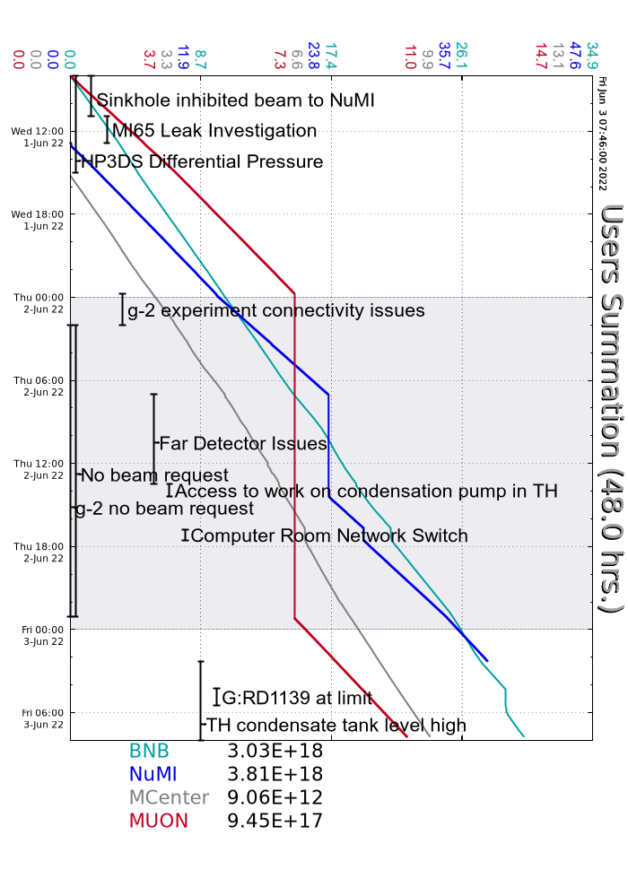
Summary
In general:
Tuning to keep the machines efficient
Supporting machine studies
Adjusting BNB intensity as needed to keep G:RD1139 below its limit
Wednesday:
MI65 access for leak inspection, found sprayer on Q118
The F4 LCW pump was replaced, resumed beam to SWYD
Thursday:
MI65TH access to check on the condensate pump
Secured MTA and MC1
Network switch took down ACNET and the E-log
Friday:
NuMI condensate tank hit its upper limit, beam was halted and the TH is being accessed

