Slide 1
Main Injector/Recycler Machine Report
Nino Chelidze
AD 0900 Scheduling Meeting
Friday, June 3, 2022

Slide 2
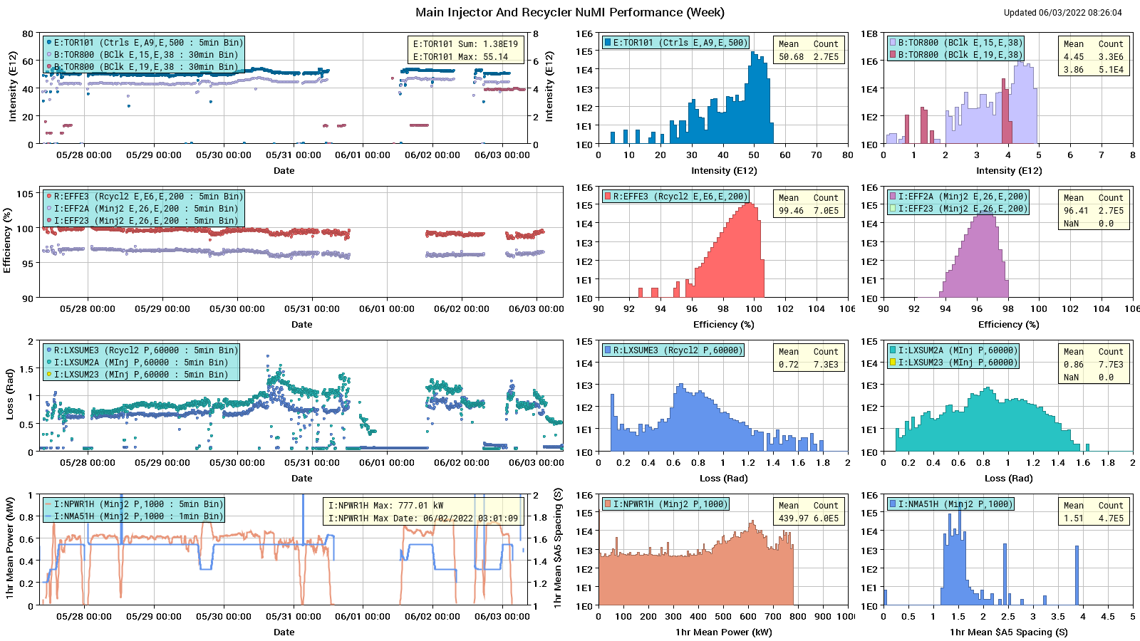
HEP Beam to NuMI

Slide 3
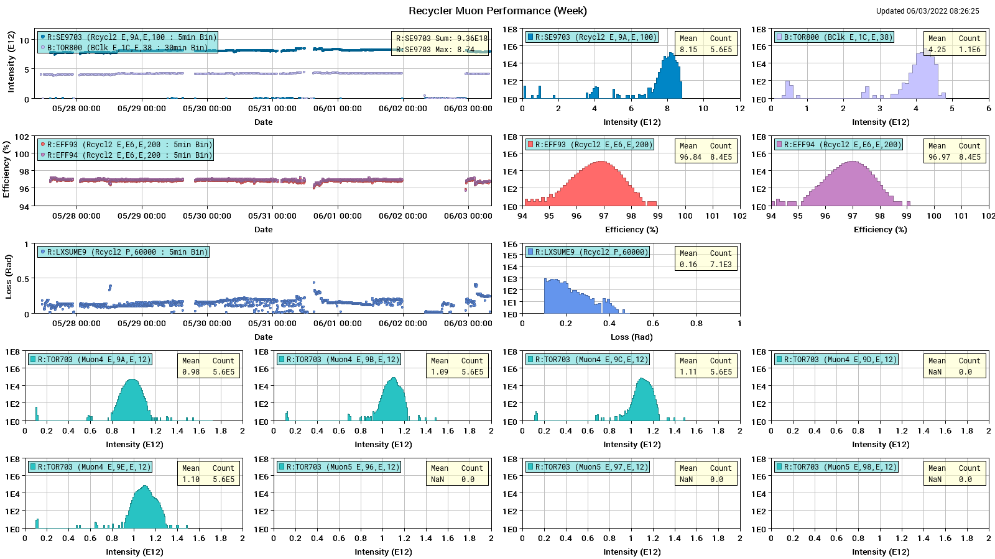
Protons to g-2

Slide 4
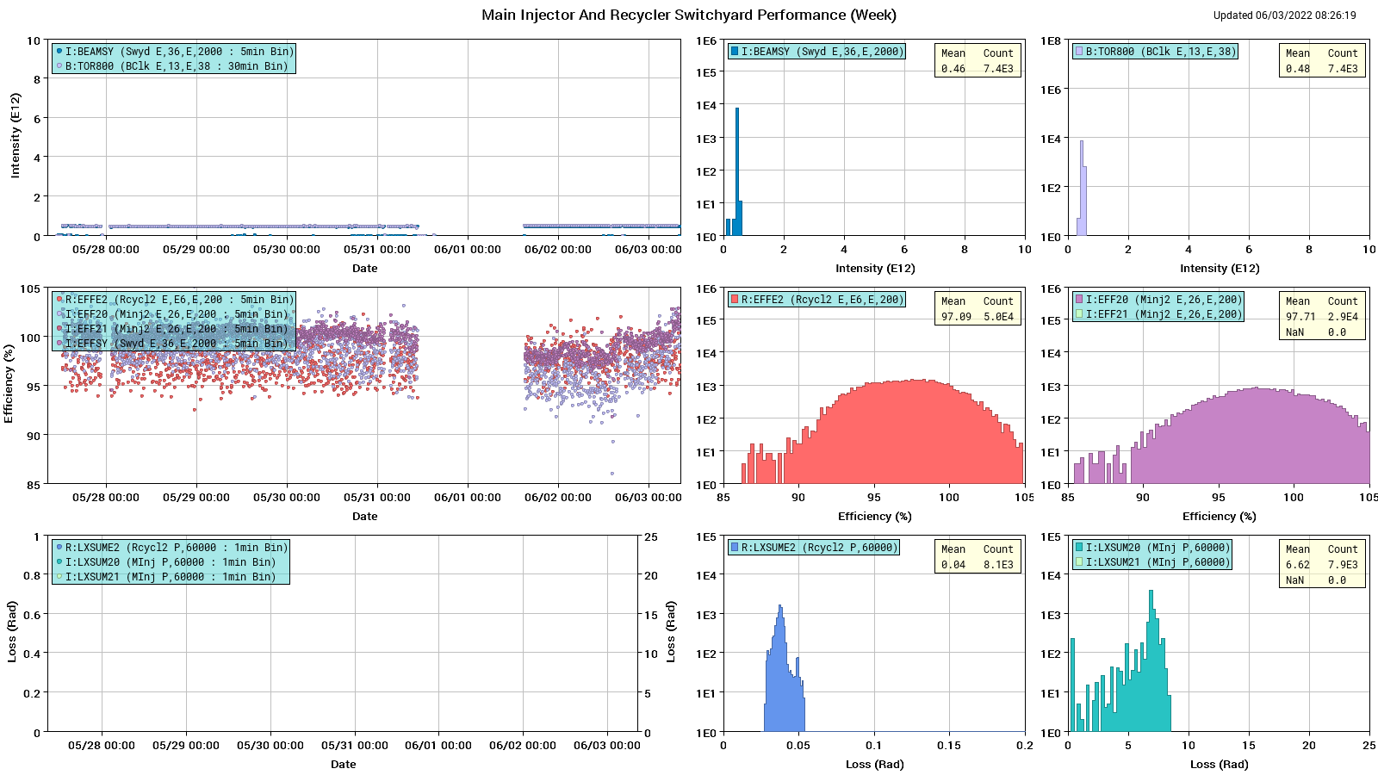
Protons: MI to SY

Slide 5
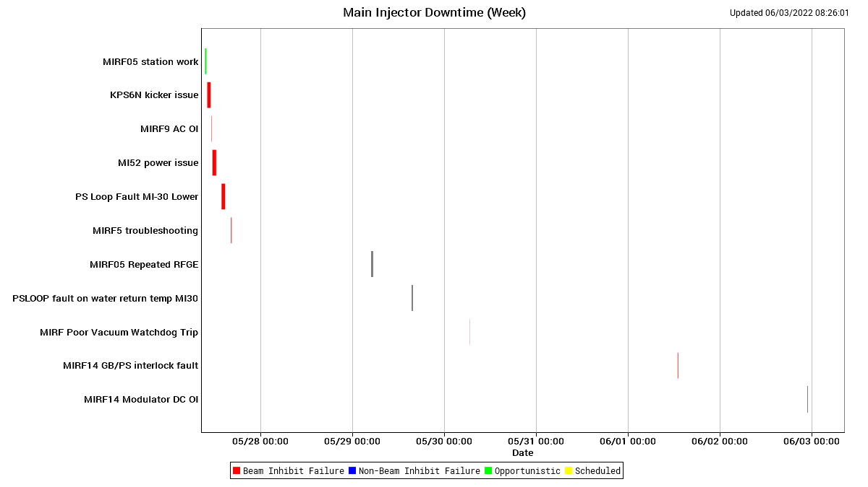
MI Down Time

Slide 6
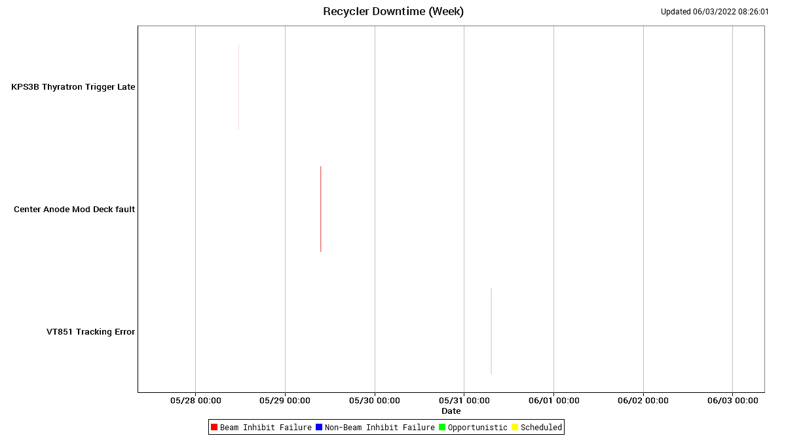
RR Down Time

Slide 7
This Week
Running fine from MI/RR side
RF Station 5 down – RF group will report
RF Station 14 – swapped the module on Tuesday due to multiple trips
MI10 – PS QMI-10 water leak – minor, will be addressed during shutdown unless it gets worse
Studies this week and next
Thank you for supporting continued studies
RR: $E0/$E1 studies under SY event (parasitic)
RR: Tune scans measuring affect of MI bend/quad ramps on beam in RR (2 pulses of $2$A) once every week about 4 hours

