Slide 1
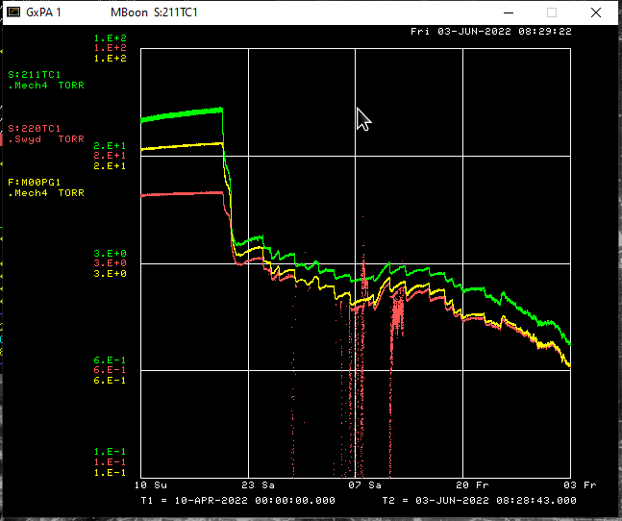
F-Manhole Vacuum Since 04/20/22

