Slide 1
Photodiode Laser Measurements
May 24, 2022

Slide 2
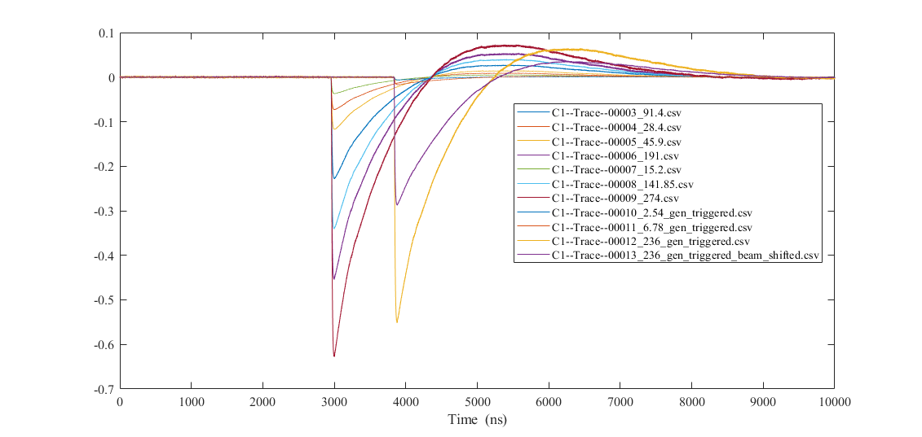
Raw Data (baseline subtracted)
_gen_triggered_ versions
Data collected with 5 GHz, 20 GS/s Lecroy scope located outside the laser room

Slide 3
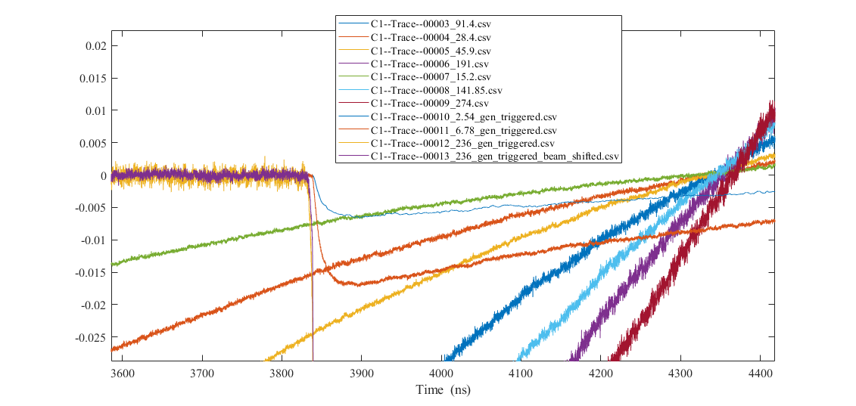
Raw Data (baseline subtracted)
Zoomed in at start of
_gen_triggered_ versions

Slide 4
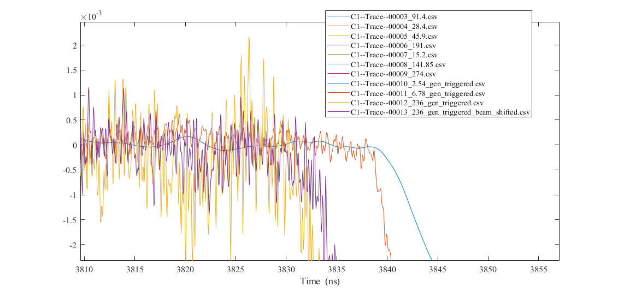
Raw Data (baseline subtracted)
Problem here with 2.54?!
Seems to have been filtered or heavily averaged
No recollection of this happening

Slide 5
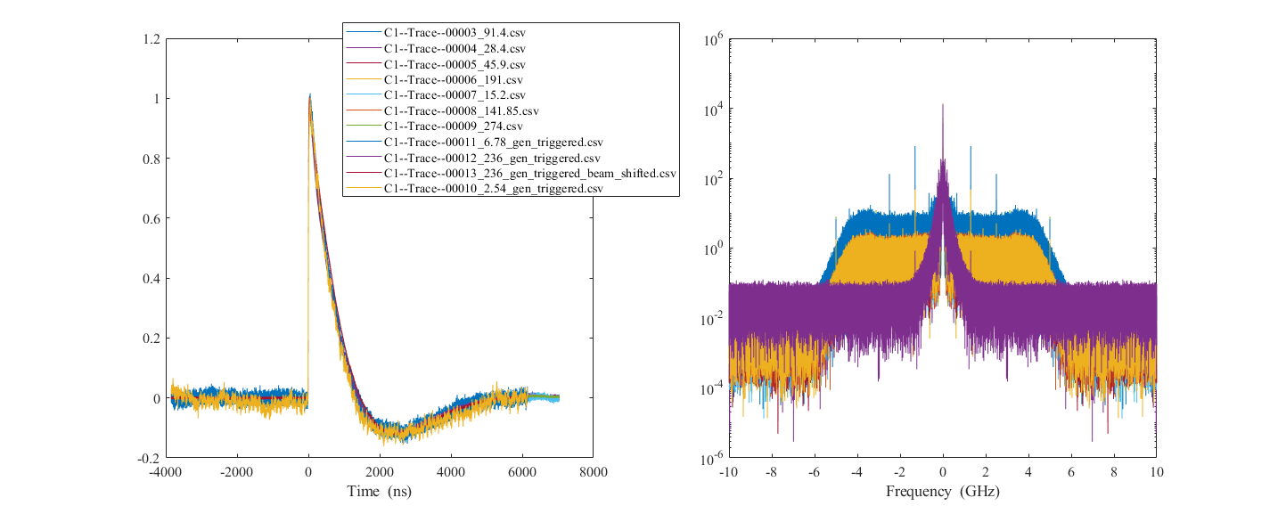
Normalized and Time-aligned Data
Can see the bizarre filtering of 2.54 here (purple trace on top)
All other spectra go out to the 5 GHz BW of the scope

Slide 6
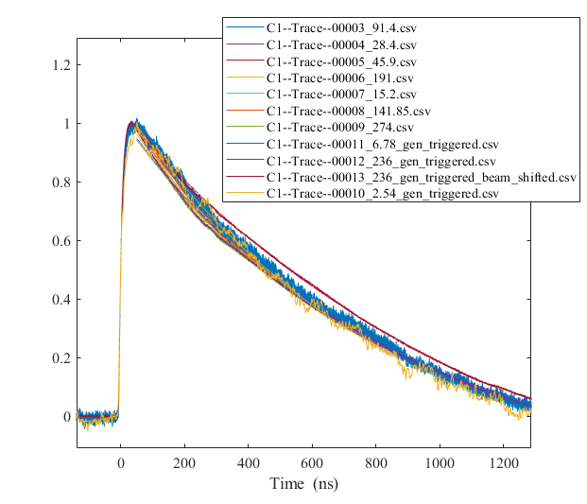
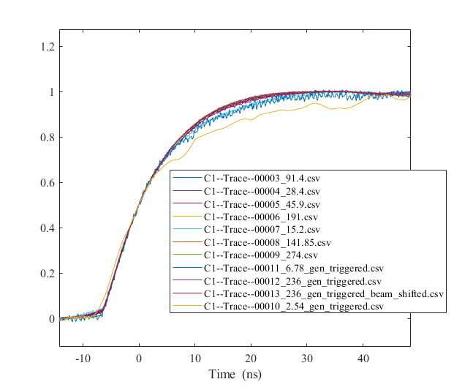
Normalized and Time-aligned Data
Knee

Slide 7
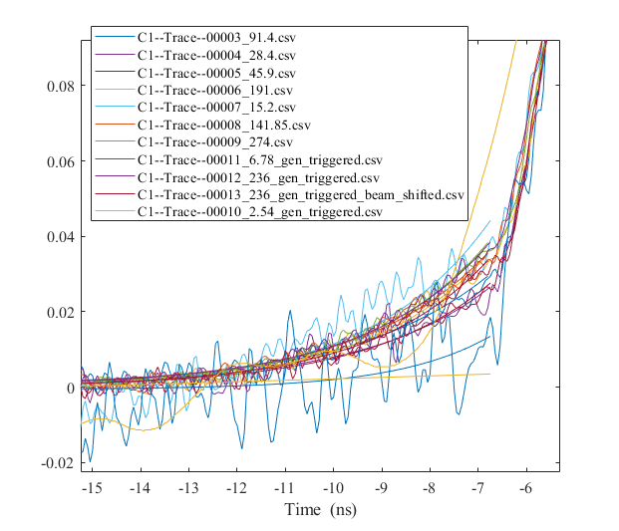
Normalized and Time-aligned Data
Fit the initial increase below the ‘knee’ to an exponential
a0 * exp(t/a1) + a2
Knee

Slide 8
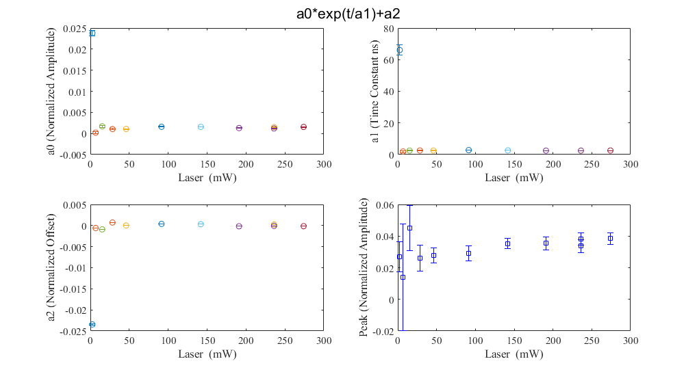
Normalized and Time-aligned Data
The 2.54 sample once again looks different (circles)
~Value at knee

Slide 9
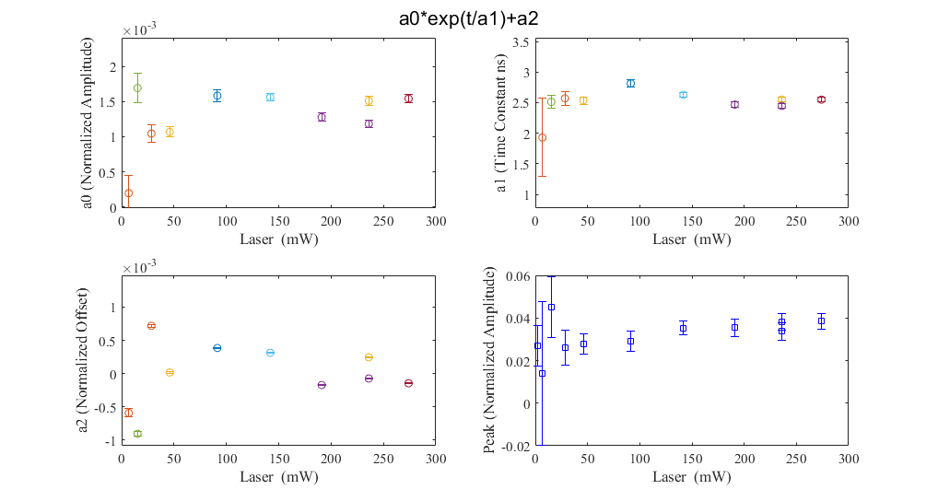
Normalized and Time-aligned Data
Fit parameter plots are rescaled to ignore the 2.54 case
~Value at knee
Upward trend?

Slide 10
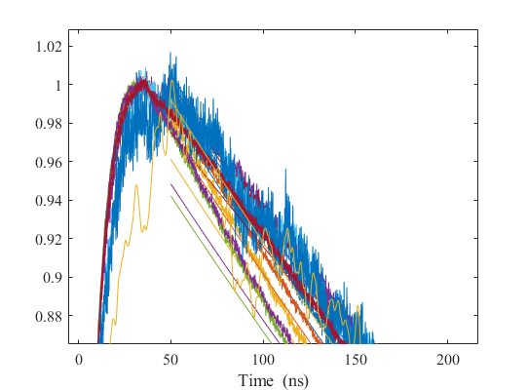
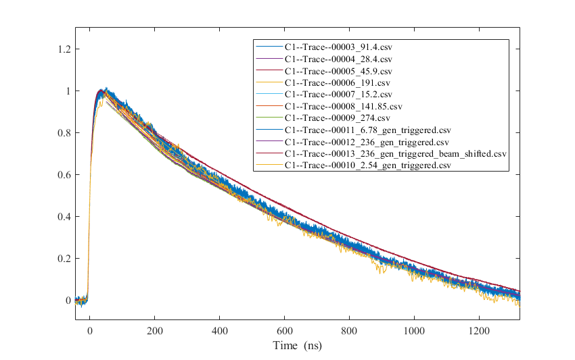
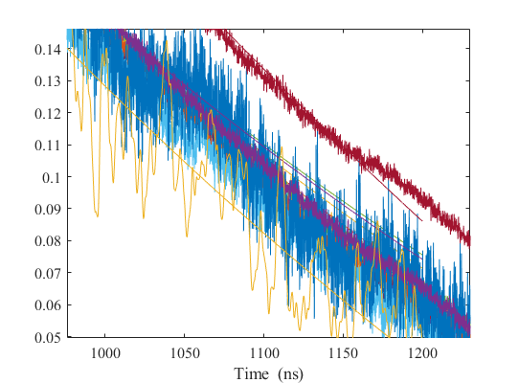
Fit Decay from 50 to 1200 ns

Slide 11
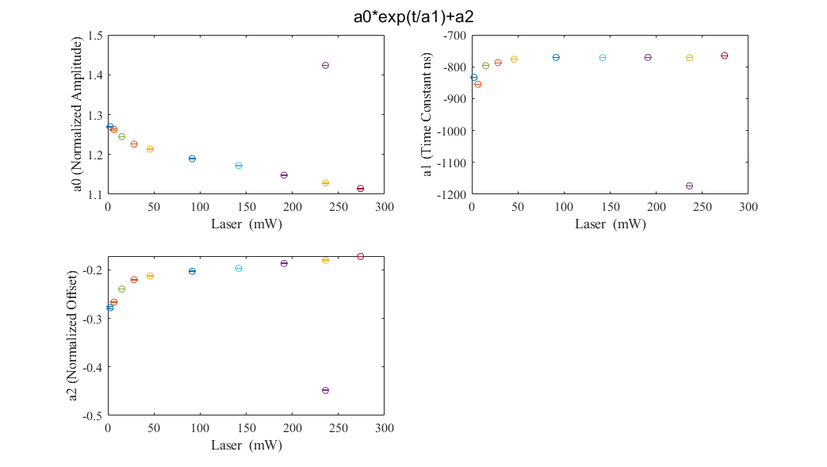
Fit Decay from 50 to 1200 ns
Shifted Laser Beam
Fit parameters are correlated

Slide 12
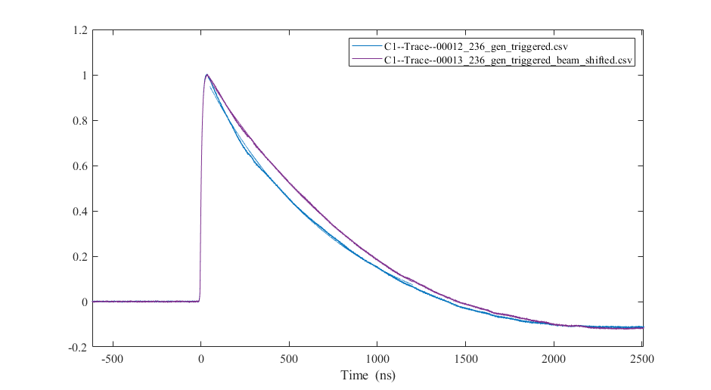
Fit Decay from 50 to 1200 ns
Normal vs. Shifted Laser Beam

Slide 13
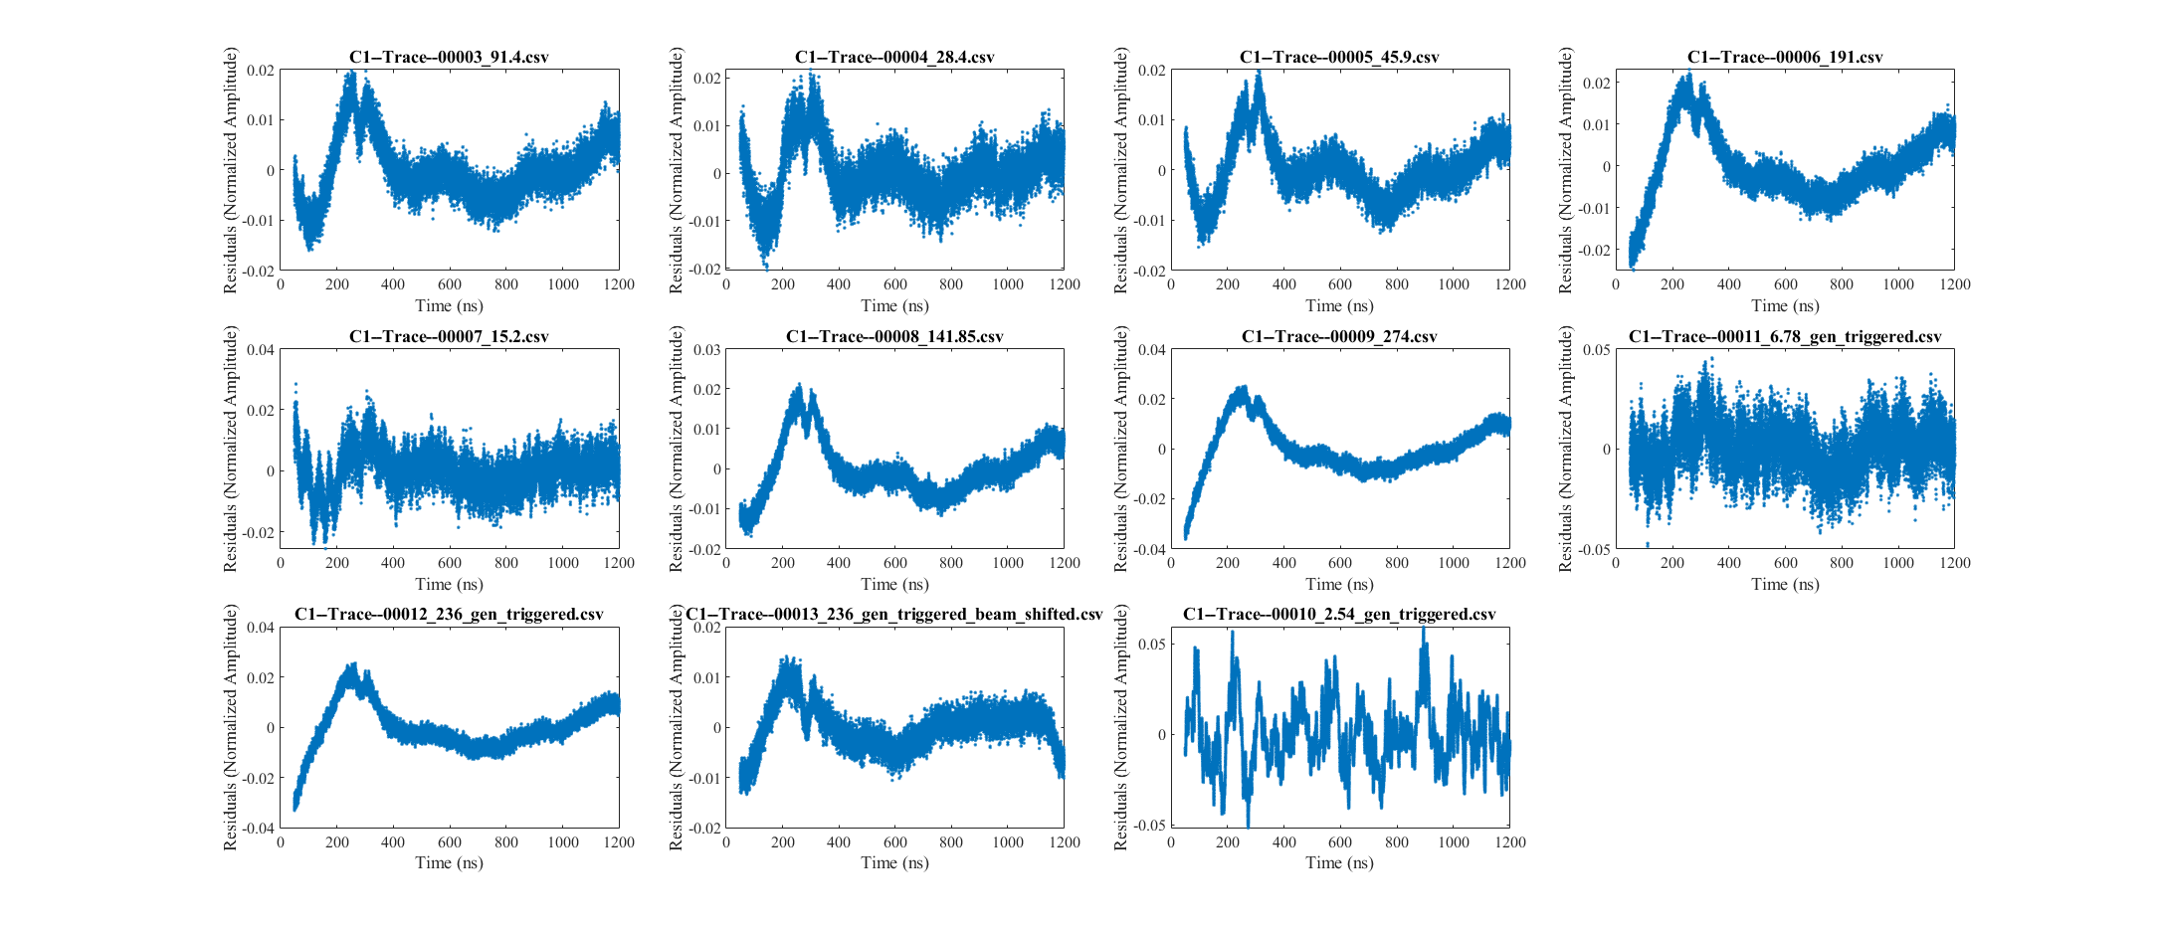
Fit Decay from 50 to 1200 ns
These are residuals
Lots of non-exponential structure

Slide 14
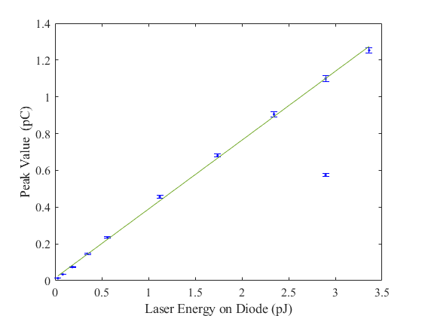
Fit of Response
Peak Value assumes 2 pF capacitance
Laser Energy assumes 1e-3 ND3 attenuation

