Slide 1
48 Hour Summary
Kevin McDonough
June 8, 2022

Slide 2
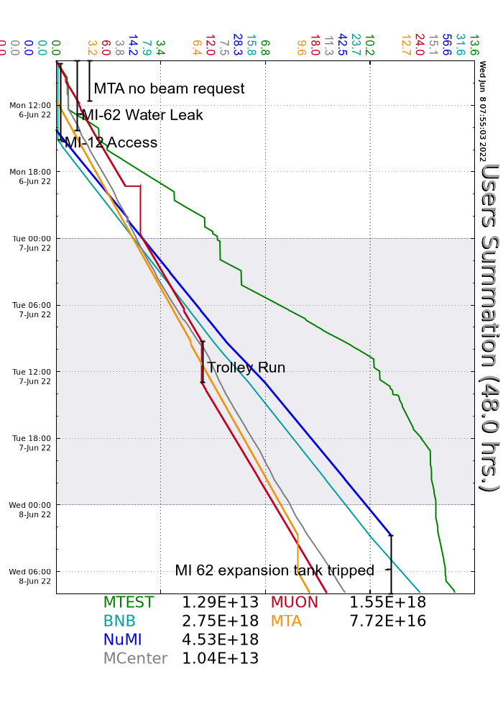
Summary
MONDAY
NuMI access to fix leaks, system also filled today
F1 manhole access, vacuum work
MTA started taking beam, will take beam for 84 hours
NuMI and BNB beam resumed in the afternoon
MI-62 expansion tank came into alarm low - there is still a leak in that system.
Tuesday
MI-20 cooling tower shut down for repairs
Column 2 back online for Remnants system, and Fluids group made up to the Remnant system
Fluids group made up to MI62 system twice
g-2 trolley run
MI-62 LCW system will trip NUMI supplies off ~0300.
Wednesday
MI62 LCW level took down NuMI around 0300, leak to be addressed today.
Racked out MI65 after individual LOTO done for quads by EE Sup.

