Slide 1
MQXFA08b Response to Recommendations
Soren Prestemon, for the AUP Structures Team
14-June-2022
LBNL

Slide 2
MQXFA11 Review recommendations
Review existing pole gap data at 50 in-lb and 75 in-lb to verify whether an adjustment is needed in the target pole gap specification as a result of the new collar clamping method (since prior gap specification was based on 75 in-lb and the new method likely results in a lower average torque).
Response: Indeed the new method applies less torque (75 vs 125 in-lbs) during the coilpack squaring process. A review of previous data, however, suggests the impact on the pole key gap is negligeable; the gap changes primarily at the initial, low torque values.
MQXFA08b will also perform measurements at 75- and 125 in-lbs. during the Fuji coil pack build for reference.

Slide 3
MQXFA11 Review recommendations
If the interception of force through the pole key is considered as a possible contributor to the performance degradation in MQXFA07 and MQXFA08, it shall be addressed in MQXFA11.
Response: The source of performance degradation in MQXFA07 and 08 has proven elusive. Nevertheless we seek to address any element that may have contributed. The interception of azimuthal force at the collars is one possible candidate that might contribute. We are addressing it by increasing the pole key gap by 200 micron/side.
Updated spec (DocDB 4009):
The average pole key gap (per side) along the magnet length shall be +0.400 ±0.050 mm in each quadrant.
The minimum pole key gap (per side) in any quadrant and in any longitudinal location shall be > +0.300 mm.

Slide 4
MQXFA11 Review recommendations
In case the decision is to increase the pole gap, a closer follow up of the first coil packs and magnets magnetic measurements is needed to assess that it does not have a significant impact on the field quality or field angle. A detailed comparison of the magnetic measurements of MQXFA10-first build up (non-uniform gaps) and MQXFA10-second build up (uniform gaps) is advised, to assess the importance of the squareness of the coil pack and the uncertainty of the coil position within the magnet.

Slide 5
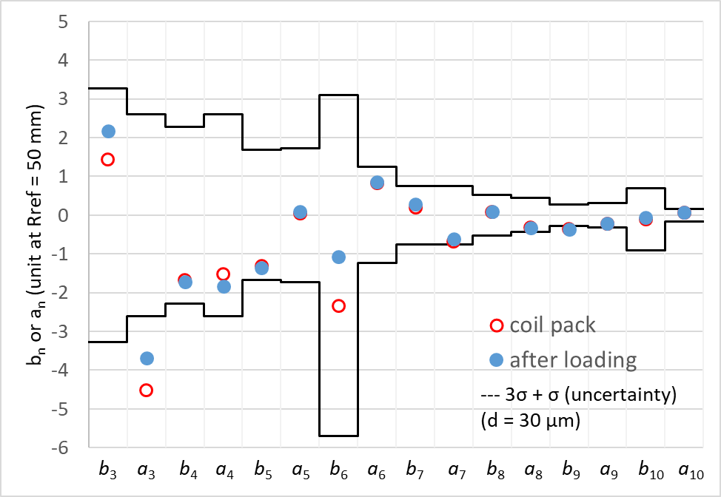
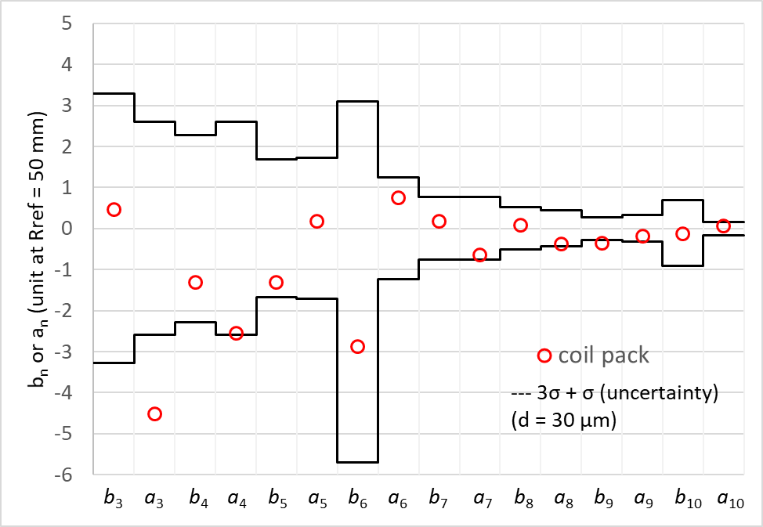
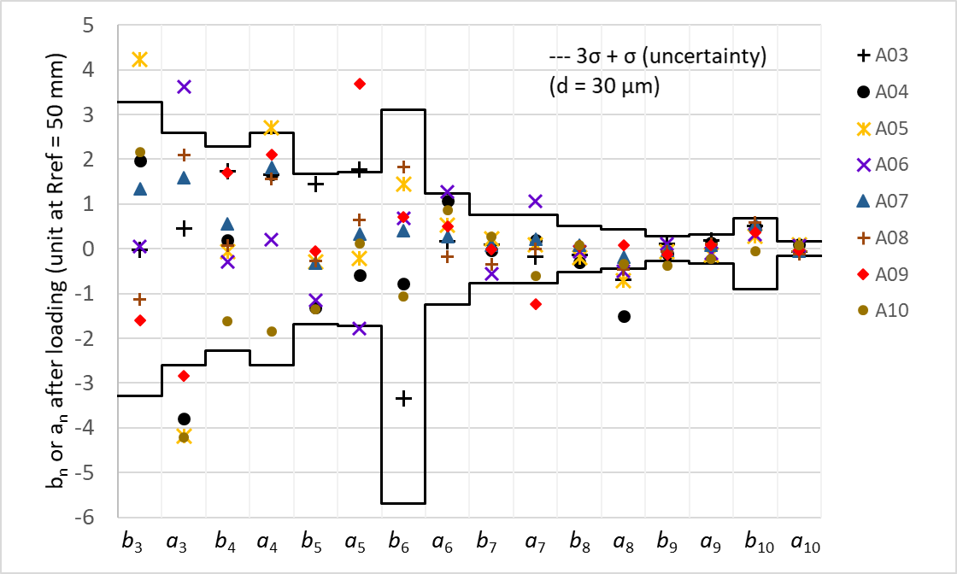
Data from MQXFA10
MQXFA10-second build up
Upper and lower bounds provided by Susana Izquierdo Bermudez according to the Triplet Field Quality Table version 4, May 20 2015 (https://edms.cern.ch/ui/file/2031083/1.0/HL_Acceptance_criteria_part-A_MQXFA_v1.0.pdf)
MQXFA10-first build up

Slide 6
MQXFA11 Review recommendations
Determine whether it is possible for AUP to adopt the CERN method for applying preload via bladders in the cooling holes in conjunction with standard bladders elsewhere in the yoke. This has been demonstrated to permit greater margin in coil stress and should be able to be implemented with exact configurations of CERN bladders and spacers in these regions of the magnet.
Response: In principle it is possible for AUP to adopt the CERN method, but there are some concerns, and some tooling is required. We have purchased longer lead items needed to try the technique with AUP magnets, and are working on the BOM for the remaining components (e.g. various toolings for the bladder operations). The project has not made the decision to adopt - or not – the technique at this point.
Also trying to coordinate with CERN for their style bladders to be adapted and used for MQXFA, since we do not have enough bladder stock to incorporate these into our processes

Slide 7
MQXFA11 Review recommendations
Change method of securing screws. Belleville washers which are available in 316 Stainless are an option. Other methods of securing screws can be considered.
Response: We have an RFQ out for the Belleville washers and should have an order placed in the coming weeks. Will incorporate them moving forward.

