Slide 1
Main Injector/Recycler Machine Report
Nino Chelidze
AD 0900 Scheduling Meeting
Friday, June 10, 2022

Slide 2
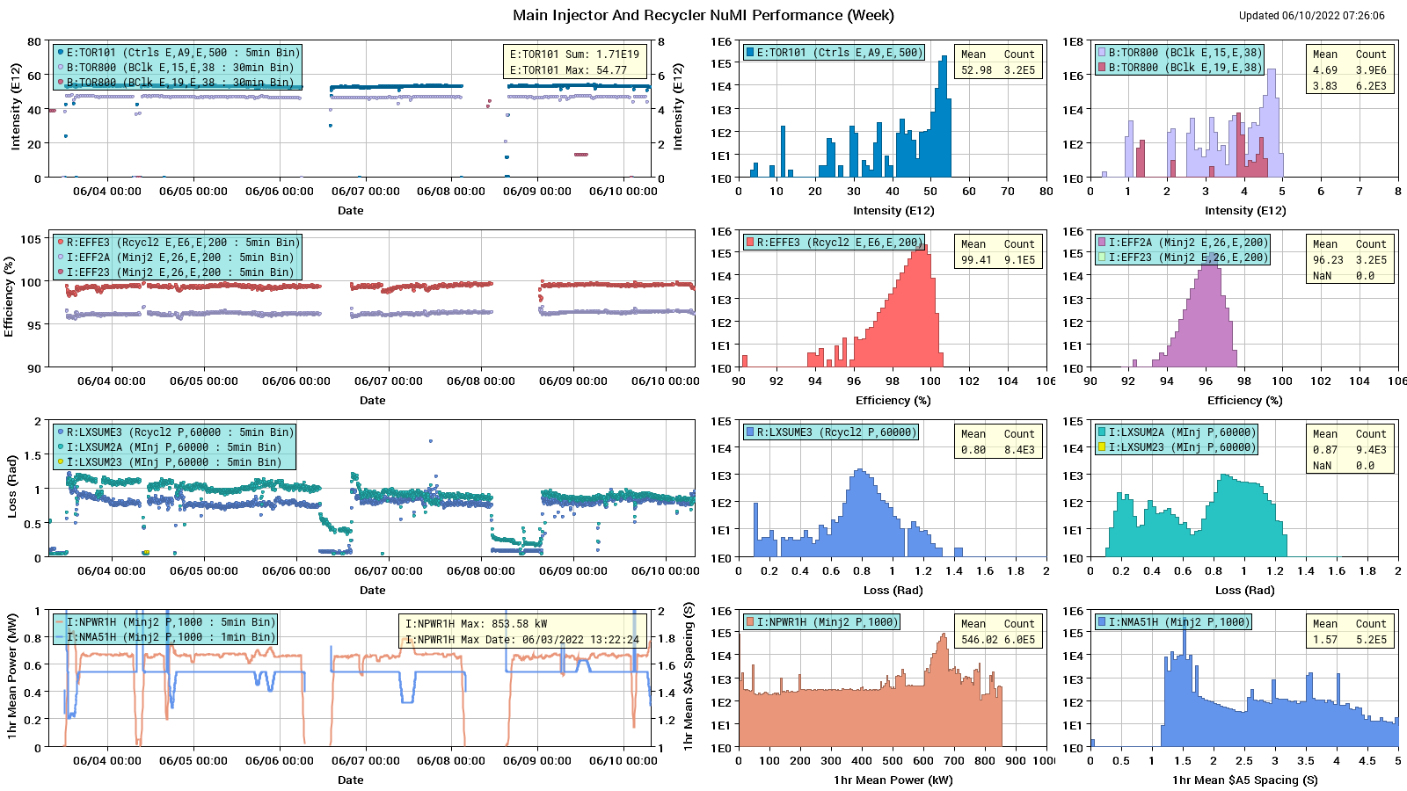
HEP Beam to NuMI

Slide 3
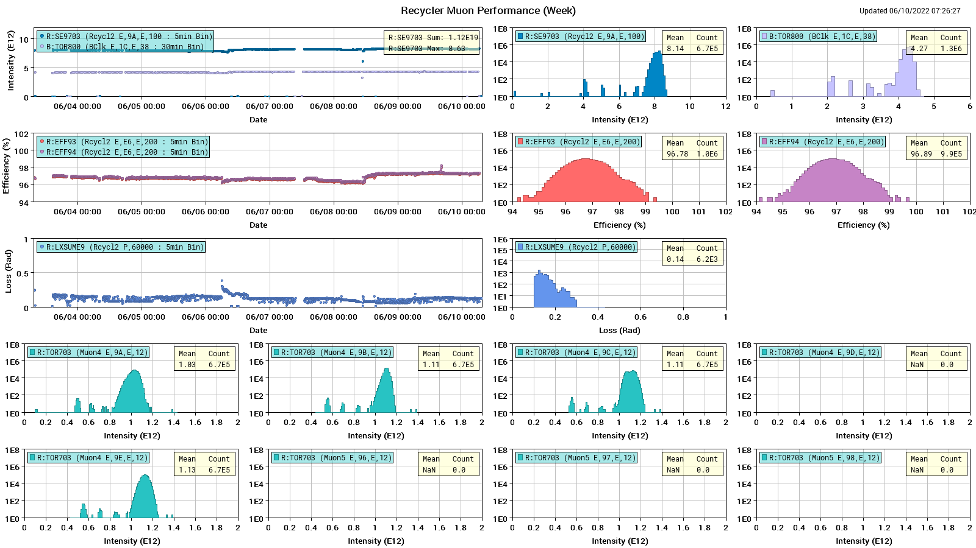
Protons to g-2

Slide 4
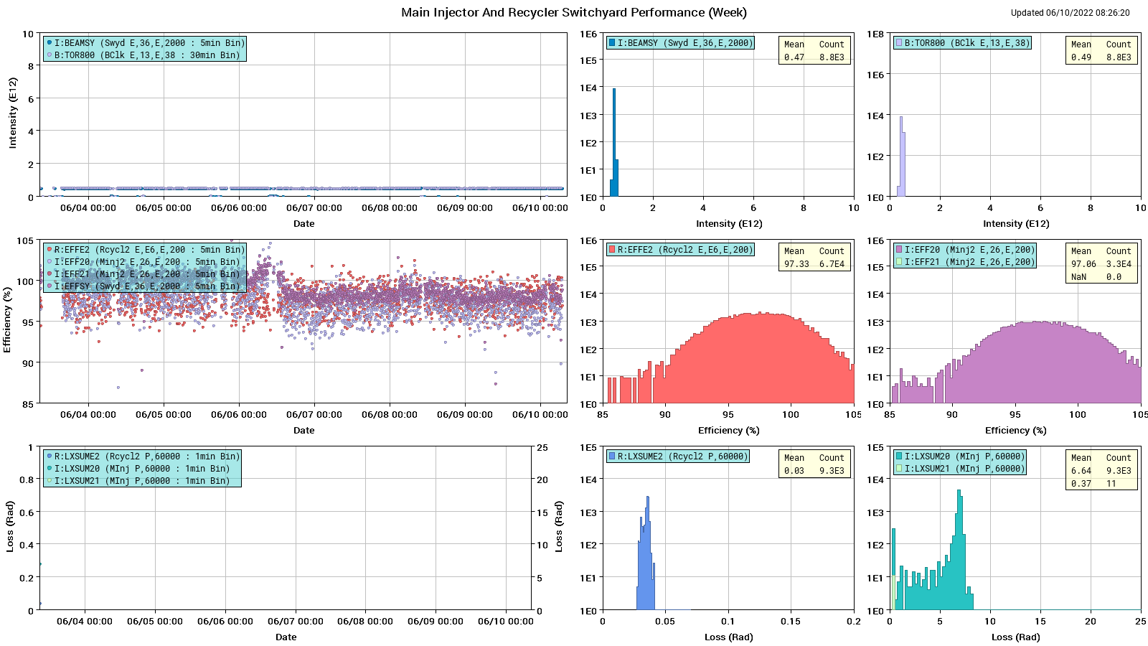
Protons: MI to SY

Slide 5
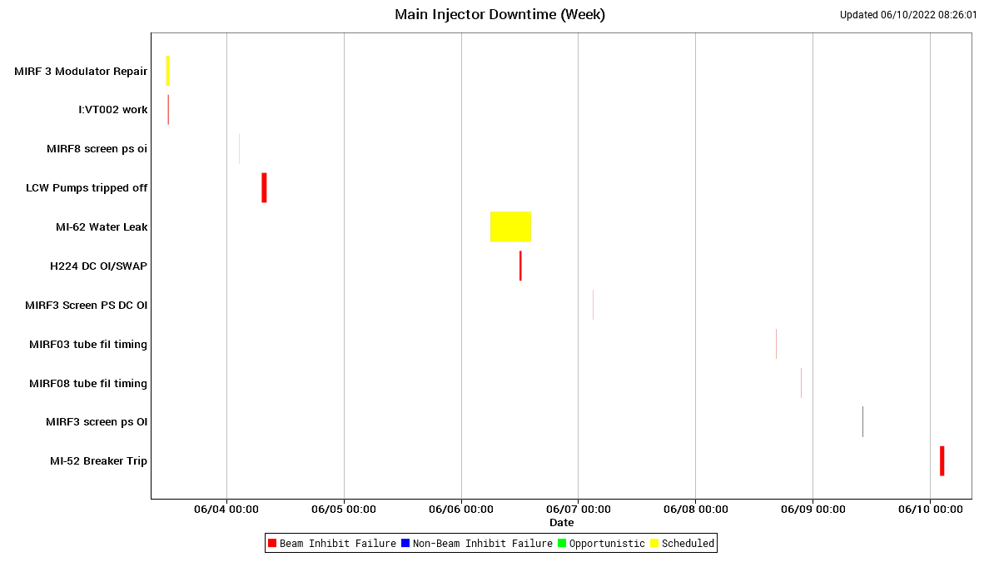
MI Down Time

Slide 6
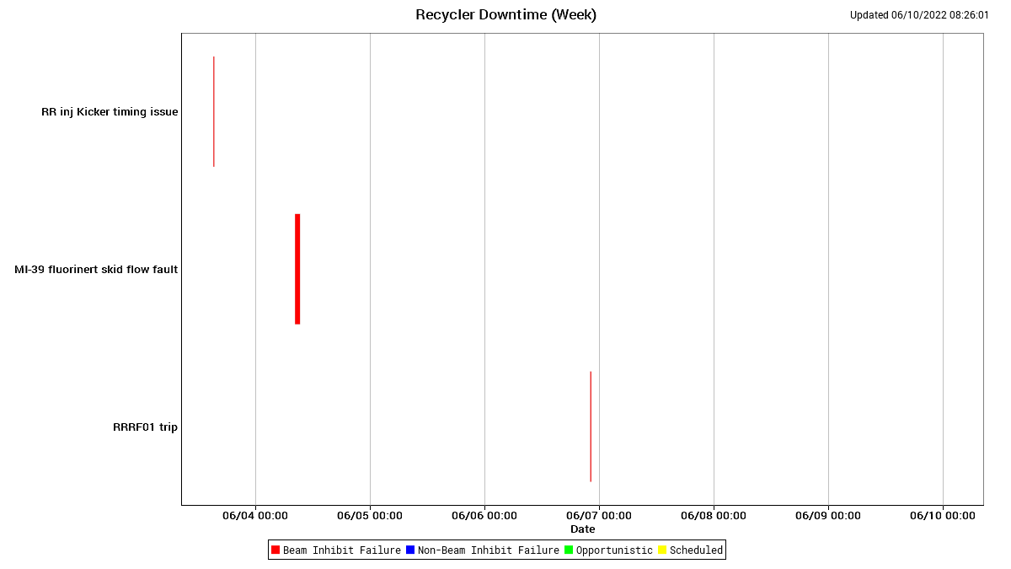
RR Down Time

Slide 7
This Week
Running fine from MI/RR side
RF Station 5 still down
Outside breaker at MI52 tripped and took down supplies again, reset ok so far locally (AD electricians and FESS) – monitoring and looking for a spare breaker
Studies went well
Muon
  2.5 MHz cavity temperatures
  Looked at FF and noticed the bump reduction if stations 2, 4 and 6 are disconnected
  Joe Dey is aware
Studies this week and next
  Thank you for supporting continued studies
  RR: $E0/$E1 studies under SY event (parasitic)
  RR: Tune scans measuring affect of MI bend/quad ramps on beam in RR (2 pulses of $2$A) once every week about 4 hours

