Slide 1
Muon Campus Status
D. Vander Meulen
June 10, 2022

Slide 2
This Week …
Continuing to look at why G-2 CTags are low. Muon Campus tuning and G-2 looking at their equipment. Recycler people looking at RF system rebunching. The Booster cogging module change out on Wednesday improved things!
CAMAC repeater crate power supply failure at AP-0
Muon CAMAC front end MUONFE required a reboot
Proton clean-up timing in Delivery Ring tuned up. This was due to the beam arrival time in M1 drifting down, putting the bunch out of sync with our abort kicker.
Looking at controls problem with three Delivery Ring power supplies - D:QD, Q:QF, and D:QSS. Setting values jumping around when changes made from a parameter page.
8 GeV proton studies today:
Delivery Ring chromaticity mult calibrations
High intensity WCM measurements
TBT system investigation work
Investigate power supply control issues with Delivery Ring supplies D:QD, Q:QF, and D:QSS
Delivery Ring aperture scans
Scope TBT system tests
New Delivery Ring BPM frontend tests
Hi LCW leak rate continues. Make up is now between 250 – 280 gal/day.

Slide 3
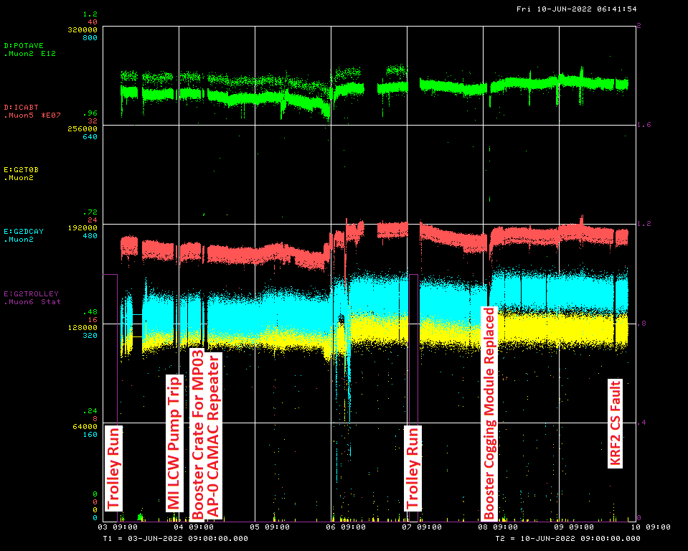

Slide 4
Down Time ...
Muon Campus: (14 min)
PRAC35 front end reboot: 14min
G-2: (11hrs 23min)
Trolley runs 9hrs 53min
MC-1 Controlled Access: 1hr 30mi

Slide 5
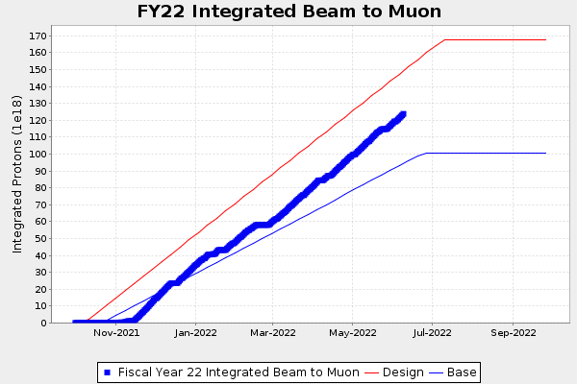
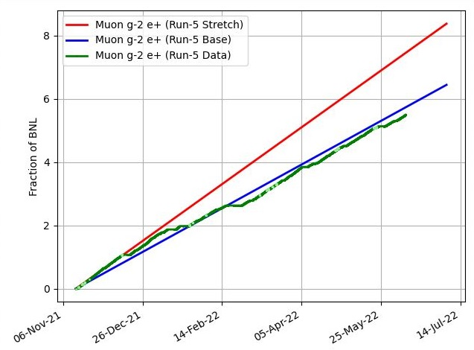
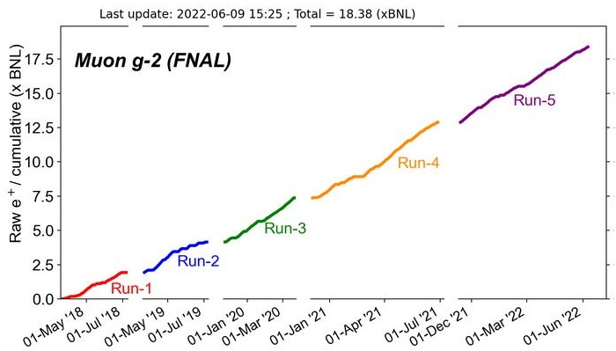
G-2 Performance – Integrated for Run 5
Run 5 # POT
G-2 Experiment POT Run Goal: ~4.2E20 POT
Run 5 period is Nov 2021 – June 2022
Run 5: Goal of ~x6 BNL
Total Run: Goal of x20 BNL
Run 5 Integrated ~ x 5.5 BNL
Total Integrated x 18.38 BNL

Slide 6
Today / Weekend Plan …
Todays 8 GeV studies continue to 17:00.
Reconfigure for G-2 running and be ready to deliver beam to G-2 when they are ready.
Run to G-2 as requested.

