Slide 1
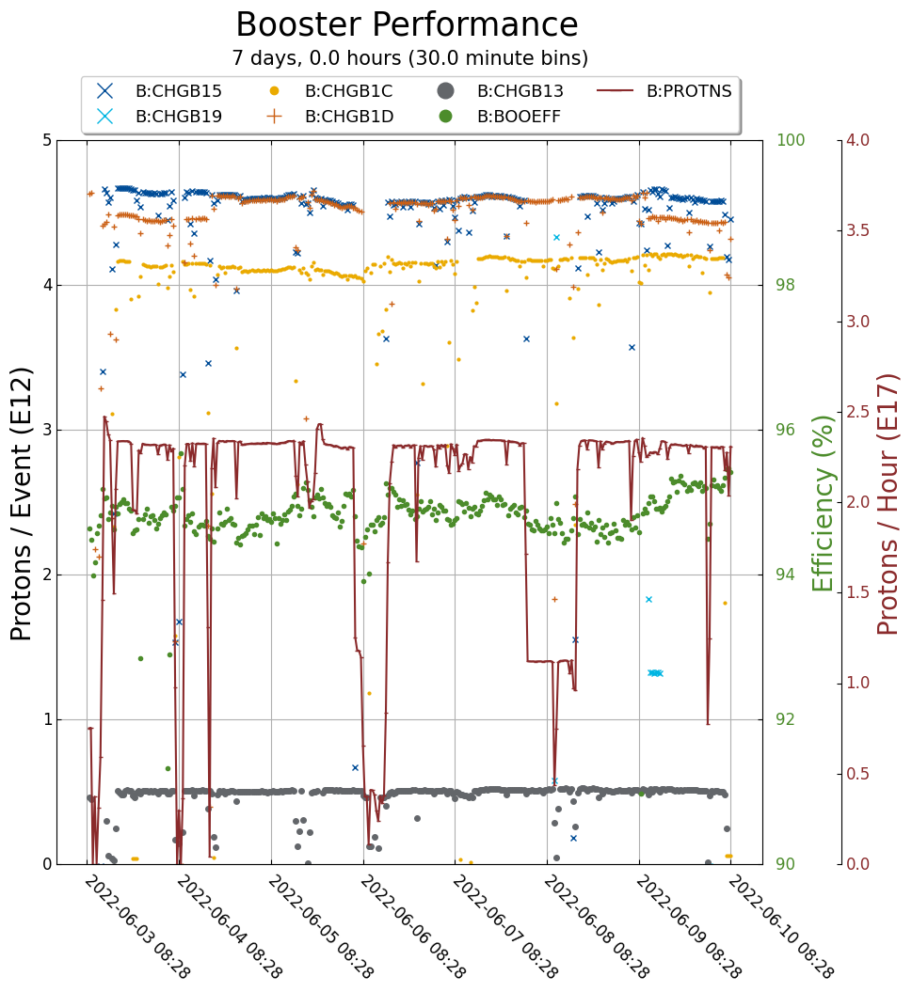
Booster Operations
Unplanned downtime: 17 minutes
Minor RF trips
Other downtime: 1h10m
LLRF reboot
Cogging module swap
$1D: 4.4 e12
$15: 4.6 e12
$1C: 4.0 e12
$13: 0.5 e12
Throughput 2.4e17/hr
Efficiency 95%

