Slide 1
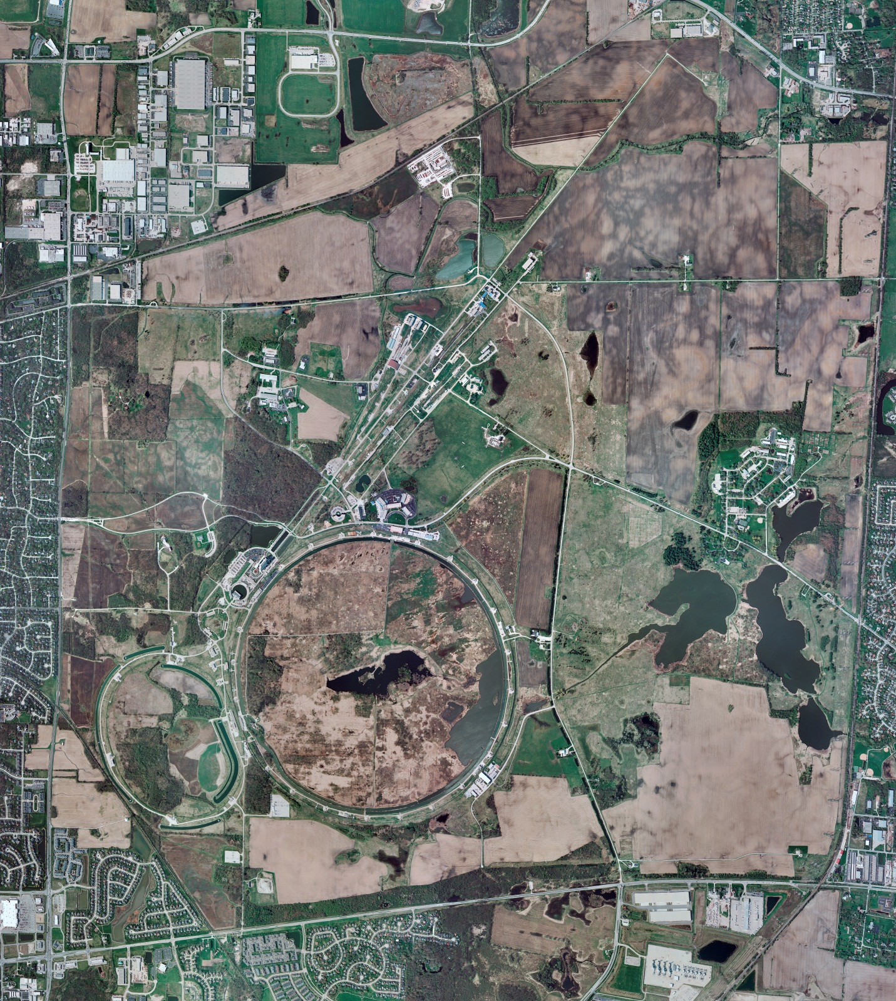
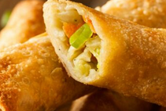
Helium Cryogenics
Status 6/10/2022 J.Makara
CMTF: SCP cryo system shut down as prep for next week’s power outage
CMTS: 1.3 GHz HECM21 warmed up and LOTOed
PIP2TS: SSR1 at RT
HB650 installation prep continues
MCTF: cryo system cooled down to 5 K
MDB/HTS: at RT
MDB/STC: cooldown has started for LB650 cavity
MDB Magnet: at RT
NML/FAST: Cryo system cooldown was halted to conserve LN2
CC1/CC2/CM: CC1, CC2 at RT
and CM at RT to conserve LN2
IB1: cryo system is shut down at RT for maintenance/development
HAB: BA comprs and Fridge shut down at RT and isolated; system under dry N2 purge
STF: isolated and not active
Muon Campus: A0 comprs (3) online with MC-1 g-2 cryogenic system cold at 5 K and running fine
Misc: Helium deliveries in liquid dewars or gas cylinders are allocation limited causing anxieties.
LN2 deliveries on schedule as supply improved

