Slide 1
72 Hour Summary
Patrick Dowdle
June 13, 2022

Slide 2
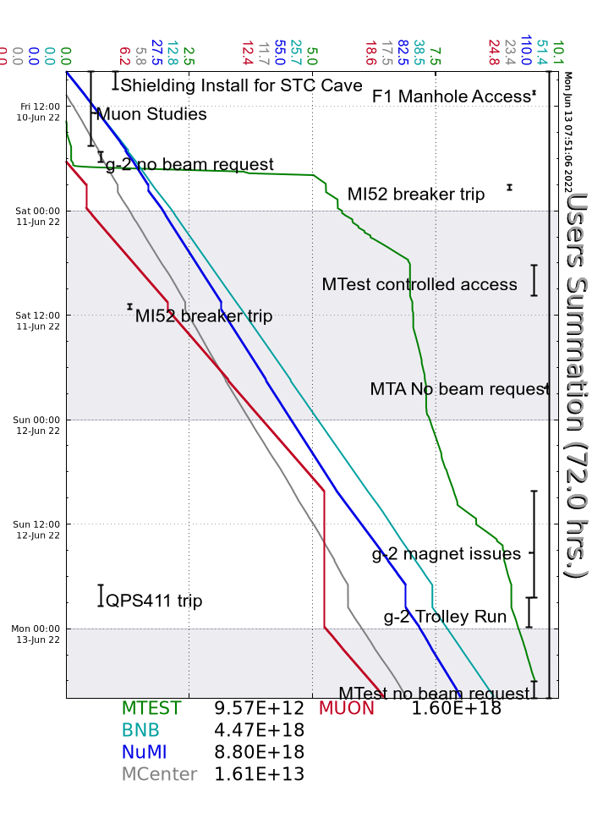
Summary
In general:
Adjusting beam to BNB to keep RD1139 below its limit
Tuning to keep machines efficient
Keeping the Source B Extractor voltage at -33.3KV
Friday:
MI52 breaker trip
RLAM52 contactor issue resurfaced and resolved itself once again
Saturday:
MI52 breaker tripped again, experts came on site and will need to formulate a plan to diagnose the issue
No issue with RLAM52 this time
Telecomm issue with outgoing calls, being looked into but has disappeared for now
Sunday:
g-2 magnet issue
L:QPS411 showing overtemp indication, LMC and Ops swapped PS
Monday:
Persistent Recycler RF station 3 trips, RF group looking into it
LRF5 quads all tripped off, recovered by Linac group
Current Status:
Beam to NuMI, Muon, SWYD 120 and BNB

