Slide 1
Snowmass Program Committee Meeting
June 17, 2022
J. Butler, Fermilab

Slide 2
Day 1 Agenda
09:00 – 9:30:
CSS Welcome and meeting logistics 15 minutes – Gordon and Shih-Chieh
  UW Welcome (UW Vice Provost of research) (5 min)
  UW Welcome (UW Dean of Arts and Sciences) (5 min)
  UW Welcome (UW physics department Chair) (5 min)
09:30 – 09:50: Introduction and Organization from DPF (Joel)
09:50 – 10:20: Two frontier workplans
Accelerator
Community Engagement
10:20 – 10:50: Coffee beak
10:50 – 11:35: Three frontier workplans
Computational
Cosmic
Energy
11:35 – 12:00: Vision Talk [Where will the next discoveries come from, are the drivers ok, should they be changed, augmented? ]
12:00 – 14:00: Lunch
14:00 – 14:30 Two Frontier Workplans
  Instrumentation
  Neutrino
14:30 – 14:45 Early Career viewpoint
14:45­ – 15:15 Science talk
15:15 – 16:00 Three frontier Workplans
  Rare Decays and Precision Measurements
  Theory
  Underground Facilities
16:00 – 16:30: Coffee break
16:30 – 18:30:
Snowmass/P5 2013/2014 retrospective, lessons learned
  Snowmass2013, Why it worked, what is the same/different about tsnowmass21
  P5, How it became a model for a successful prioritzation process and how we repeat its success
  View from NSF
  View Fermilab Plans (from New Director)
  View from DOE
  View form HEPAP

Slide 3
Purpose of the various types of talks
We envisage the that the blocks labelled “I” will be where the Frontier groups deliver their main message to the entire community in simple, direct terms, including conveying the excitement and greatest challenges
  There should be ample time for discussion, at least 20 minutes
  We will hold speakers to their time so that the discussion and Q&A does not get sacrificed
  We will use ways of allowing questions to be submitted in advance and allow remote participation, with priority given to those who are attending in-person
The blocks labelled S will be for more detailed, but still of wide interest, issues
The blocks labelled “G” are for community wide issues,
  including information transfer, plans from international partners, funding agencies, national and international laboratories
  topics that are shared by all, or many, frontiers or are field-wide issues
    Career issues
    DEA
    Training the next generation
    …

Slide 4
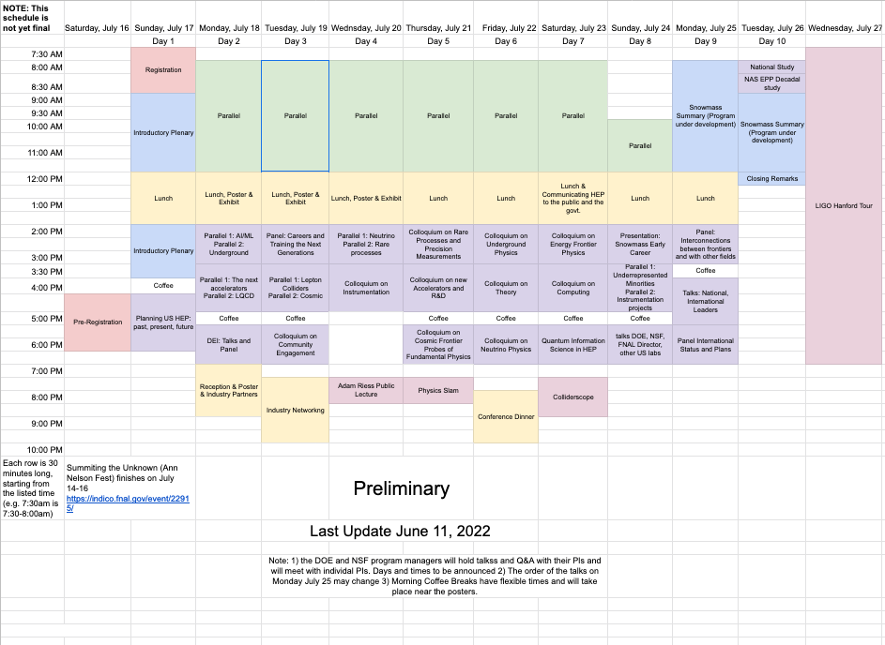

Slide 5
DOE/NSF Meetings during the CSS
There are three types of activities. While this may not be what one thinks of for a Snowmass, there is precedent from 2013, where these meetings were felt to be valuable and were well attended. This year, the agencies are trying ot reconnect in-person with their Pi’s and this Snowmass provides a good opportunity. All the Program Managers from the main science sectors are showing up in-person, along with much of OHEP upper management.
DOE Program Officers (HEP, Intensity, Cosmic, Theory) each want two hours to meet with their constituencies, i.e., PIs they support. The size of the groups will vary but will not exceed 100. They expect two of these to be in parallel on two evenings (e.g. Tuesday and Thursday). So, we need two rooms on each day for two hours.
Small meetings with individual PIs or their groups, so up to 10 people. They need access to 5 small rooms for a few days. Could be during the mornings or afternoons.
(This may not be something they decide they want) rooms for 1-2 hours for a large number of people to hear about major DOE programs such as FOAs, budget outlook early career issues,… Possibly during lunch, now that we can order in.
Even without group 3, this requires a lot of rooms and occupy people for a lot of their time. However, the meetings were reasonably well attended in 2013. Tuesday and Thursday evening are the best days to do group 1. Group 2 would probably need to be over a few lunches during the week, if they are in fact needed.
Need to find out what NSF needs!

Slide 6
Days 9 and 10: Preliminary Thoughts – I
We have 5 hours possibly available for Frontier summaries and other talks
  This is reduced to 4.5 hours by the need for a morning coffee break
If we allow 20’/frontier, we use , 3 hours and 20 minutes and have time for another talk session
  The goal of the talk is to remind people of the major recommendations but mainly to focus on the state of your report for the Snowmass book, which should in general be “almost done”, so you could provide a “punchlist” of important tasks that are incomplete.
.This does not seem very attractive to me

Slide 7
Days 9 and 10: Preliminary Thoughts – II
We have 5 hours possibly available for Frontier summaries and other talks
  This is reduced to 4.5 hours by the need for a morning coffee break
Maybe we could focus on the 5 drivers (and any others we want to add) and have one 30 minute talk on each in which we cover all our proposals form this Snowmass and describe how we will advance HEP
We could also say how we feel about the charge for P5 and whether we would like them to consider or even make recommendations on other issues critical to realizing the visions that are not project-like
  HEPAP may want to work with the DOE and NSF and DPF outside of the find a way to addressing these issues

Slide 8
Organizing General Sessions
Quantum: Maria Spiropulu, Martin Savage (with a long list of stakeholders to contact)
Careers and Training the Next Generations: Petra Merkel, Vladimir Shiltsev (TBC) (with a list of stakeholders)
Recruiting International participants for panel sessions

Slide 9
Useful Information
https://docs.google.com/document/d/11F9W5JwVZLp9JfUN7EhVUg5orycYMNOO36i1saqoFrg/edit - heading=h.80ikt0q8fhm3

Slide 10
Backup Slides

Slide 11
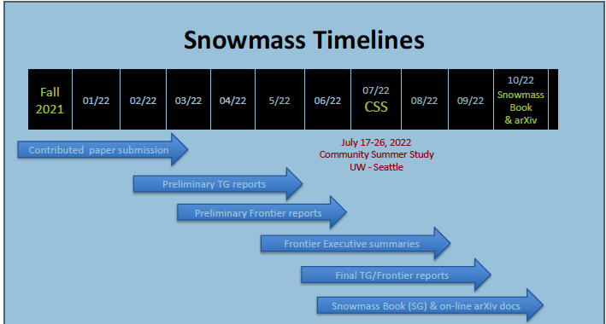
Timeline for Snowmass Book
March 15: Contributed papers (a.k.a. White Papers)
May 31: Preliminary Topical Group Reports
June 30: Preliminary Frontier Reports
July 17 – 26: Converge on reports for all the frontiers and produce executive summaries representing the views of their communities and providing the basic input needed for P5
September: draft Executive Summary and Report Summary
October- November: Snowmass Book finalized and ready for submission

Slide 12
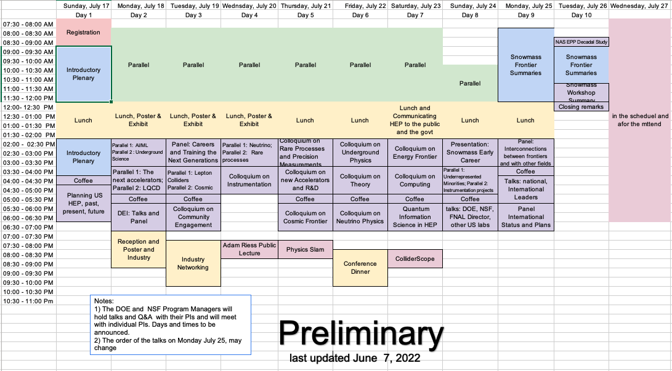

Slide 13
Some scheduling issues
The speakers at the general session are agency or international people or members of the political system or public that have constraints.
  They may not be able to be at Snowmass for the whole time
  ECFA meeting at CERN on July 20/21
  We have information about three important leaders from Europe
    Fabiola Gianotti (CERN DG), Karl Jacobs (ECFA chair) plan to be full time for the 24 and the 25 and leave early on the 26th.
    Eliezer Rabinovici, president of the CERN Council will arrive on July 23, so wil have approximately the same stay
There are other constraints, such other conferences and workshops
We are likely to get new requests
  We expect a request from DOE/NSF for the types of meetings they have held at previous conferences and workshops, including Snowmass 2013.
  Same is true with NSF
If some Frontiers may be willing to reduce their requests that would help (no takers so far)

Slide 14
Notes
Lunch break is two hours
There is a 30-minute coffee break in the afternoon
Some of the evening events have been moved around and their starting time and duration may be changed to make sure that there is adequate time between the afternoon session and the event, and the event is placed appropriately for the intended audience.
Some rest and relaxation time is added on Wednesday, Friday, and Sunday
I think some of the evening activities should be moved 30-60 minutes later

Slide 15
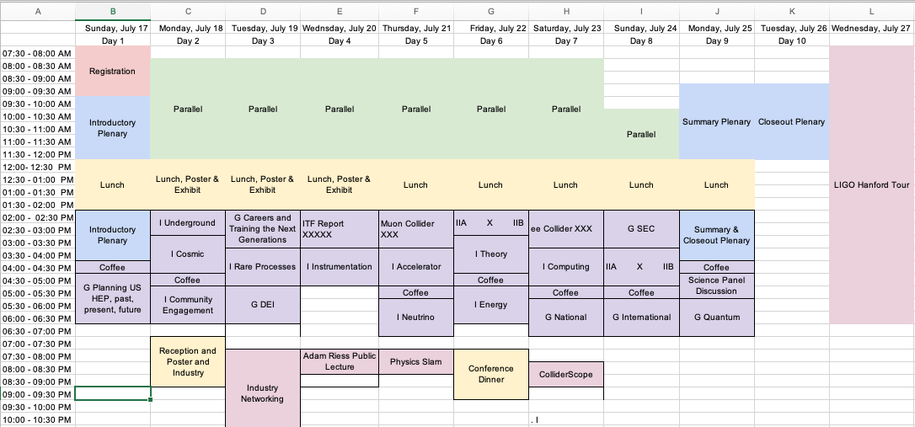
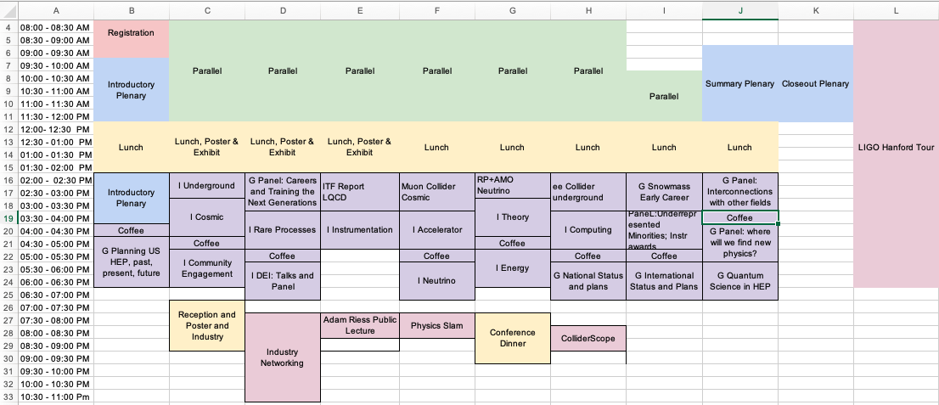
I ➔ Long plenary for Primary presentation of the Frontiers (10)
II → Split session (two topics in parallel. Secondary presentations by Frontier (5x2)
G → General topic (not specific to any frontier) (7)

Slide 16
Suggestions for Plenary Sessions Organized by the Program Committee – Some examples
RPF
  Colloquium 1 (full plenary block):
    Flavor physics and QCD
    Discrete symmetries, baryon, and lepton number violation
    Dark matter and rare processes
  Colloquium 2 (shared block):
    RPF+AMO
CF
  Colloquia 1: Dark Matter as a Science driver for fundamental physics (community wide, with representatives from energy, rare processes, theory, and neutrino, ~3 hours).
  Colloquia 2: Cosmic Probes of Fundamental Physics (community wide, with representatives from energy, rare processes, theory, and neutrino, ~2 hours)
CEF
  Colloquium 2.5h. CEF will propose the topics and format after their April 29 meeting. This could be arranged as a panel discussion.
IF
  Special CPAD Awards ceremony with invited talks by 2021 DPF Instrumentation Award winners and GIRA award winners, highlighting recent achievements in instrumentation and current key challenges, as well as career pipeline
  Colloquium: motivational talks about direction, technological key issues, career pipeline, facilities
https://docs.google.com/document/d/11F9W5JwVZLp9JfUN7EhVUg5orycYMNOO36i1saqoFrg/edit
Snowmass SLACK channel: ssss-program-committee

Slide 17
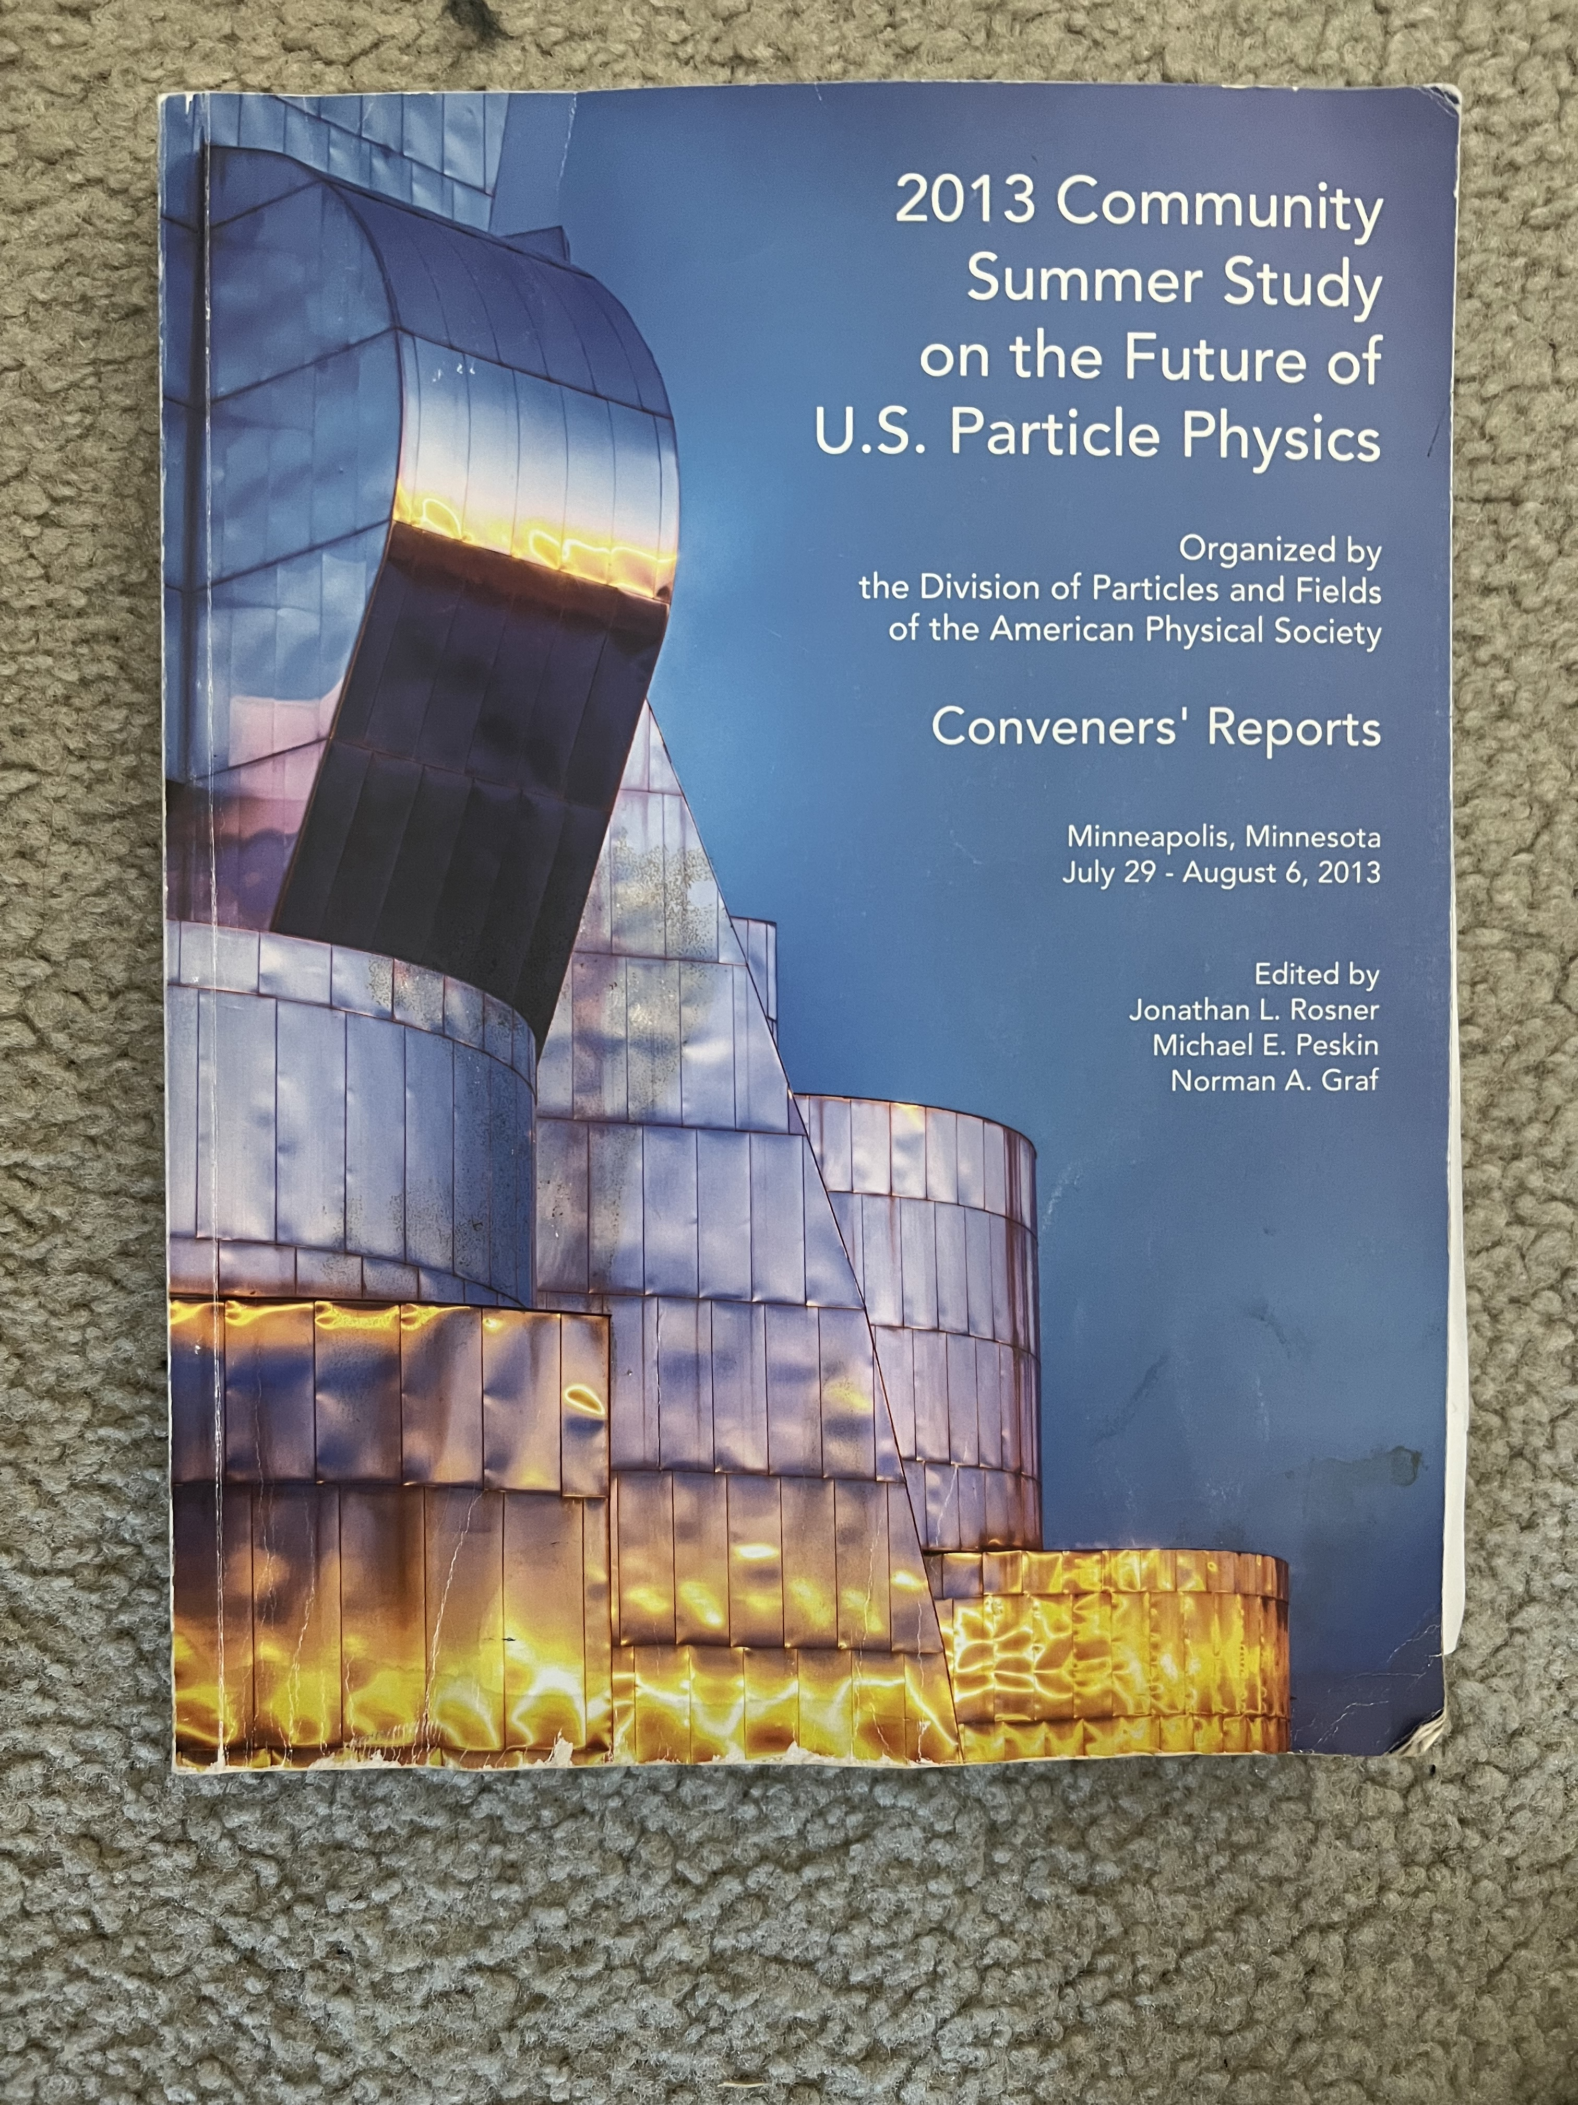
The Snowmass Book - 2021
Contributed paper 1
Topical group 1
Frontier 1
Report
Topical group N
Summary
and
Book
Contributed paper M
Topical group
reports
Frontier 10
Report
Report cover from Snowmass 2013, report is~ 350 pages
The new report is expected to be ~500 pages
All Contributed Papers will remain part of the permanent record of Snowmass

Slide 18
Categories for General Sessions – Preliminary Thoughts - DPF Chair Line
Domestic Program:
  Overview from US funding agencies
  Overview from US Lab directors
  View from HEPAP and Previous P5 chairs and members
  DOE and NSF also want to do some focused activities, such as meeting with PIs to discuss grant issues
  Perhaps a perspective from some people in Government, Congress,
International and Interdisciplinary Program
  Presentations and panels of foreign lab directors
  Plans and planning process in other regions and nations
  ICFA, ECFA, perspective etc
  CERN and US collaboration
  Possibly Ukraine, Russia impacts
  Collaboration with Astrophysics (DAP), Nuclear (DNP), Gravity (DGRAV), DPB (also AF)
Special sessions on New and Evolving Technologies
  Special session on Quantum including academic and commercial participation. how can HEP contribute?
  Special session on Gravitational Waves - HEP community is excited about this new way to experimentally probe the universe. How can HEP make the most out of this new opportunity?
  Special session on AI – how can HEP contribute?
Engagement
  STEM,
  Promoting DEI: Gender, race, sexual orientation,
  supporting people with disabilities,
  Careers issues in HEP,
  How can we encourage people to work on “enabling technologies” in HEP? Instrumentation, computing, etc
  Sustainability in the next round of HEP projects, current operations, etc,
  A report on the US Congressional visits and other outreach activities to the government,
  Outreach: do we do it well enough

