Slide 1
Muon Campus Status
D. Vander Meulen
June 17, 2022

Slide 2
This Week …
AP-0 target blower maintenance
8 GeV proton studies this week:
High intensity WCM measurements
Delivery Ring injection loss measurements
More work on power supply control issues with Delivery Ring supplies D:QD, Q:QF, and D:QSS
Delivery Ring aperture scans
New Delivery Ring BPM system tests
M4 beam line lattice measurements
BPM studies to continue Friday morning ...
Lightening strikes on Thursday owlshift messed up controls, diagnostics, and power supplies in M4 line, delaying the start of studies.
Hi LCW leak rate continues. Make up is now between 250 – 280 gal/day. Plans for repairing this before the summer shutdown starts are being considered.

Slide 3
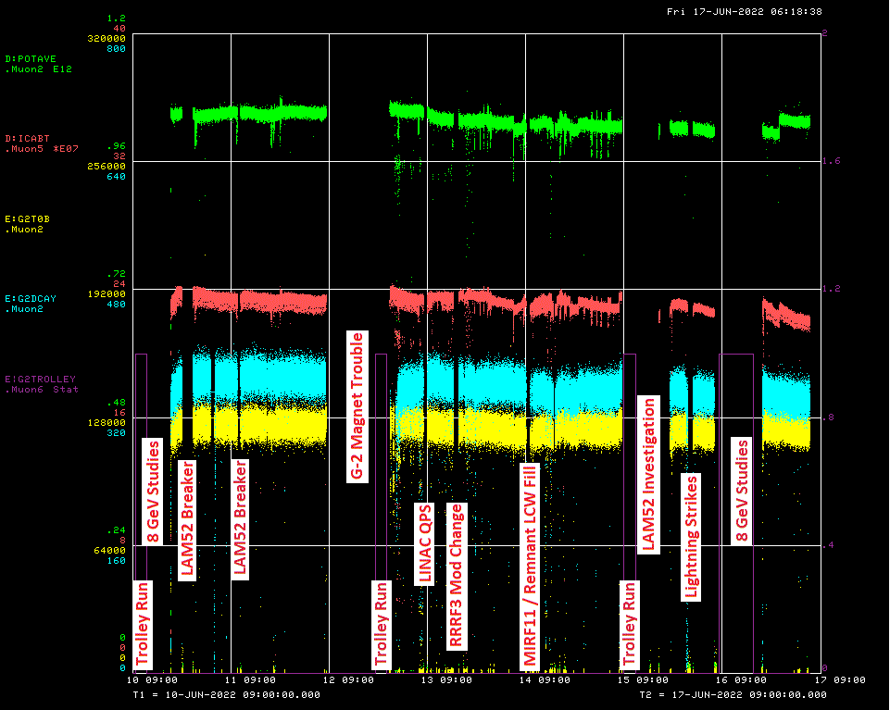

Slide 4
Down Time ...
Muon Campus: (19hrs 51 min)
8 GeV Studies: 19hrs 20min
Power supply problems: 31min
G-2: (22hrs 6min)
Trolley runs: 3hrs 21min
MC-1 Controlled Access: 4hrs 15min
Magnet problem: 12hrs 14min
No beam requests: 1hr 40min
MC1 secures: 36min

Slide 5
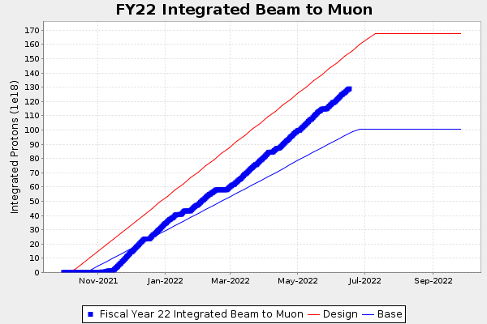
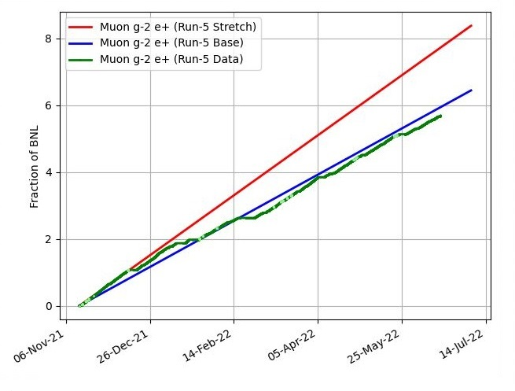
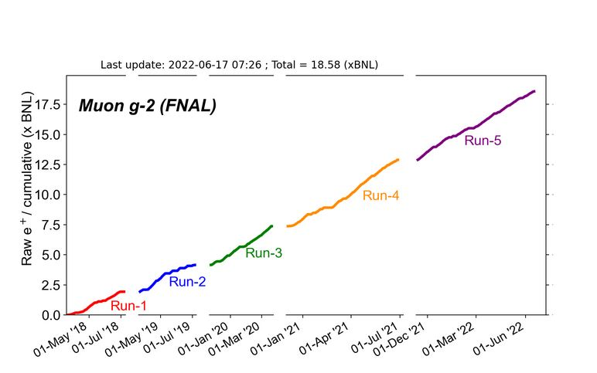
G-2 Performance – Integrated for Run 5
Run 5 # POT
G-2 Experiment POT Run Goal: ~4.2E20 POT
Run 5 period is Nov 2021 – June 2022
Run 5: Goal of ~x6 BNL
Total Run: Goal of x20 BNL
Run 5 Integrated ~ x 5.687 BNL
Total Integrated x 18.58 BNL

Slide 6
Today / Weekend Plan …
More 8 GeV studies today from 08:00 – 12:00 (BPM system commissioning).
Reconfigure for G-2 running at 12:00 and be ready to deliver beam to G-2 when they are ready.
Run to G-2 as requested.

