Slide 1
Dune-ND
ArgonCube 2x2 @ LArTF
Low-Noise AC Power Grounding Status
Matt Micheli on behalf of Grounding team
(Bagby, Harris, Mastro)
2x2 @LArTF Electronics Integration
June 30, 2022

Slide 2
Outline
Low-Noise AC Power System Design
Issue Identification
Mitigation Efforts
Plans

Slide 3
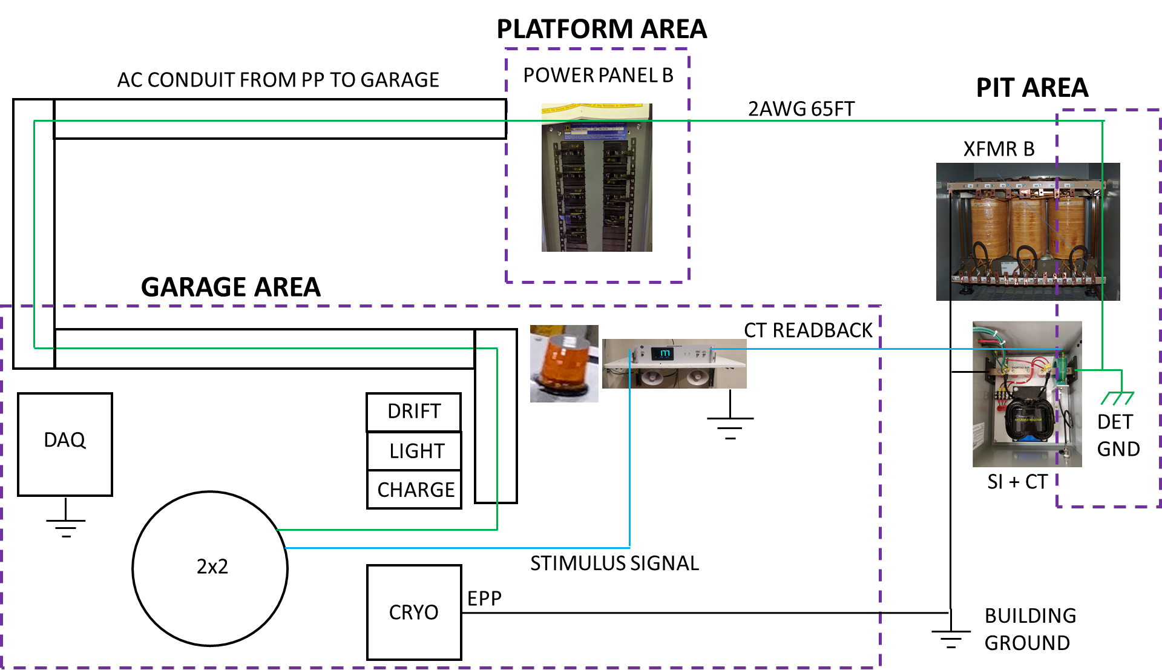
Low Noise AC Power Distribution Proximity
NOT INSTALLED

Slide 4
Simple graphic of system
PP A
~12 Conduits
uBooNE Power
SI
XFMR A
CT
XO
Detector Safety
Ground cable
PP B
4 Conduits
2x2 Power
XFMR B
SI
CT
XO
Detector Safety
Ground cable

Slide 5
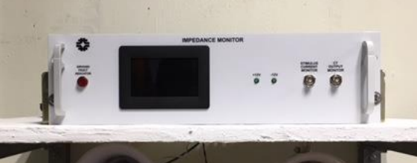
The Ground Fault
PP A
~12 Conduits
uBooNE Power
SI
XFMR A
CT
XO
When impedance monitor was initially powered on, a 10Ω ground fault was discovered
Detector Safety
Ground cable
PP B
4 Conduits
2x2 Power
XFMR B
SI
CT
XO
Detector Safety
Ground cable
Impedance Monitor

Slide 6
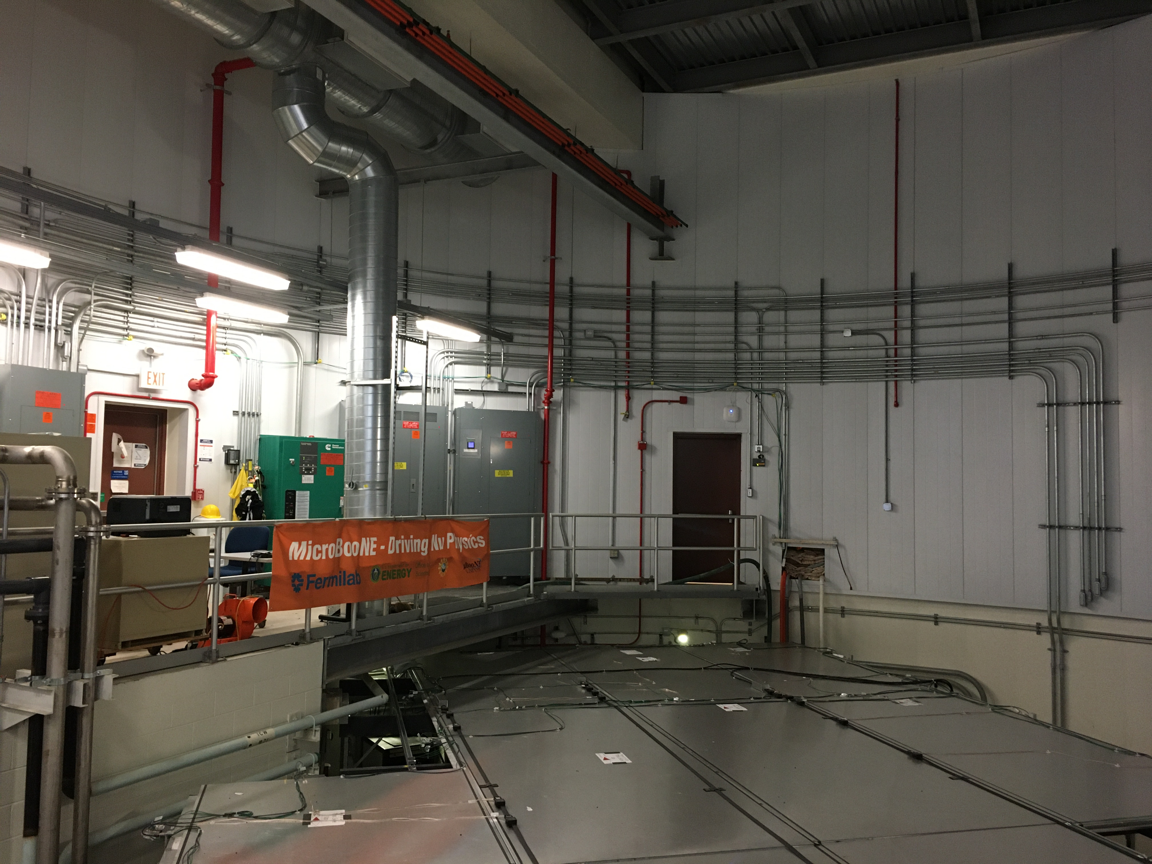
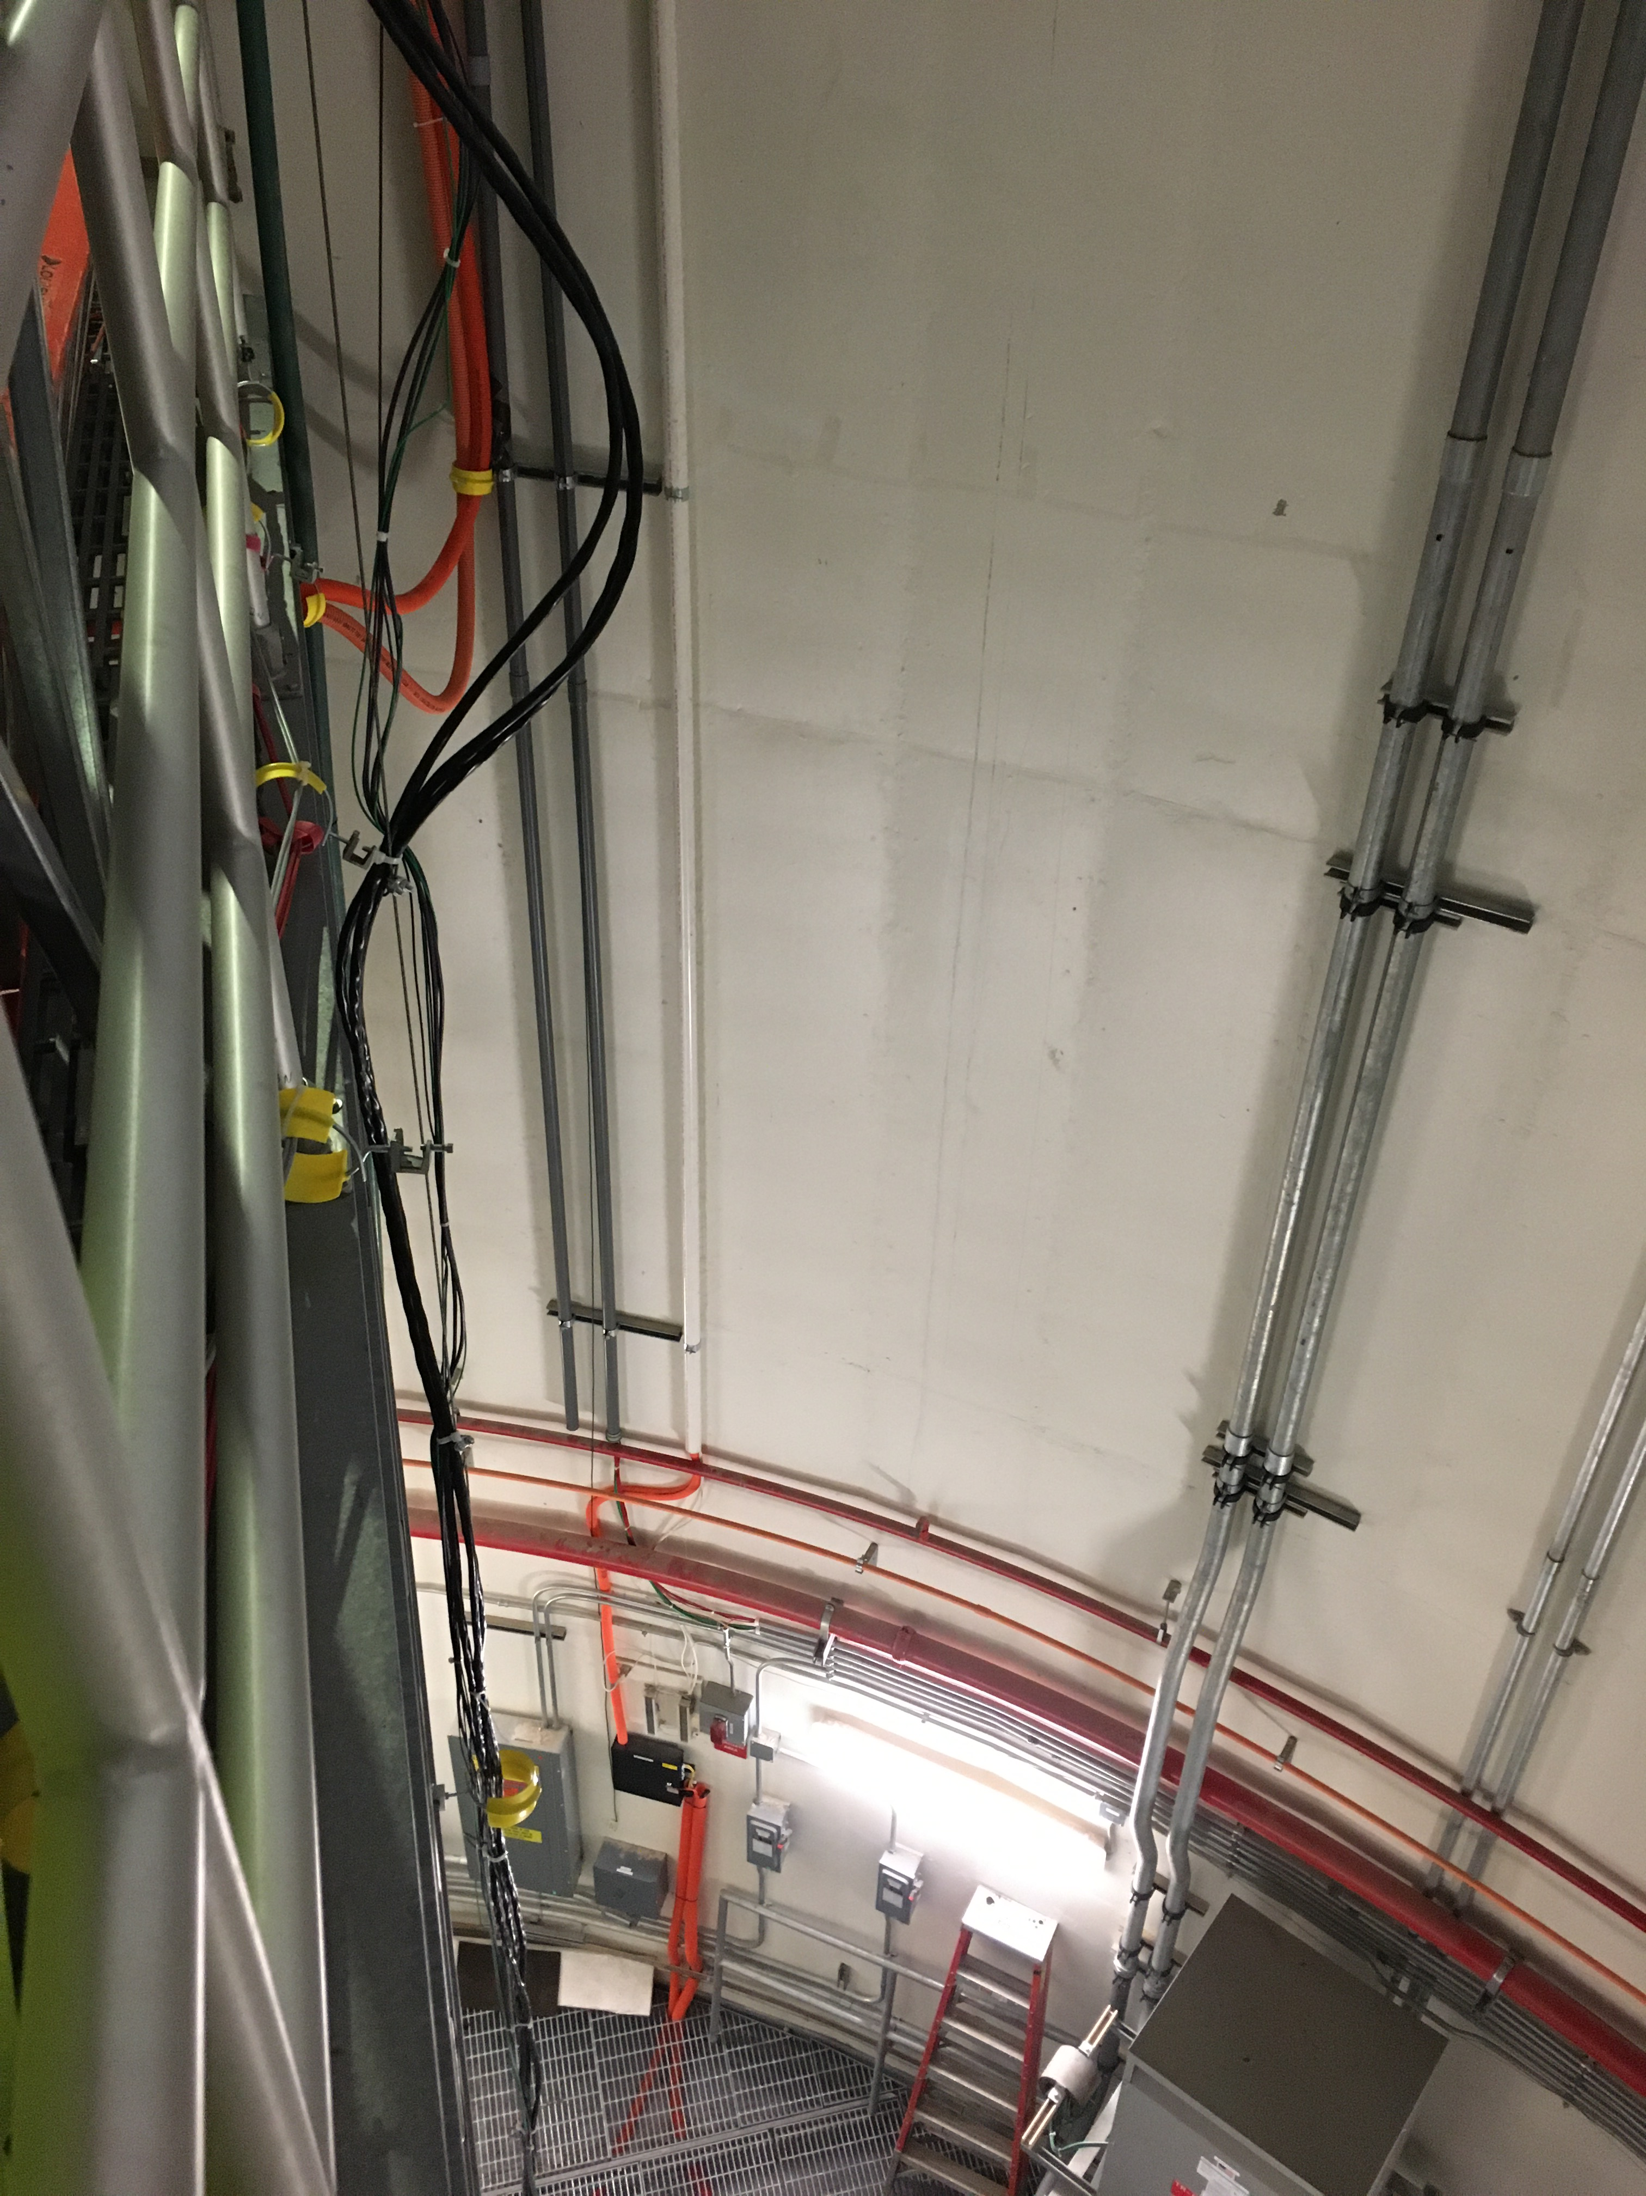
Reality of mission

Slide 7
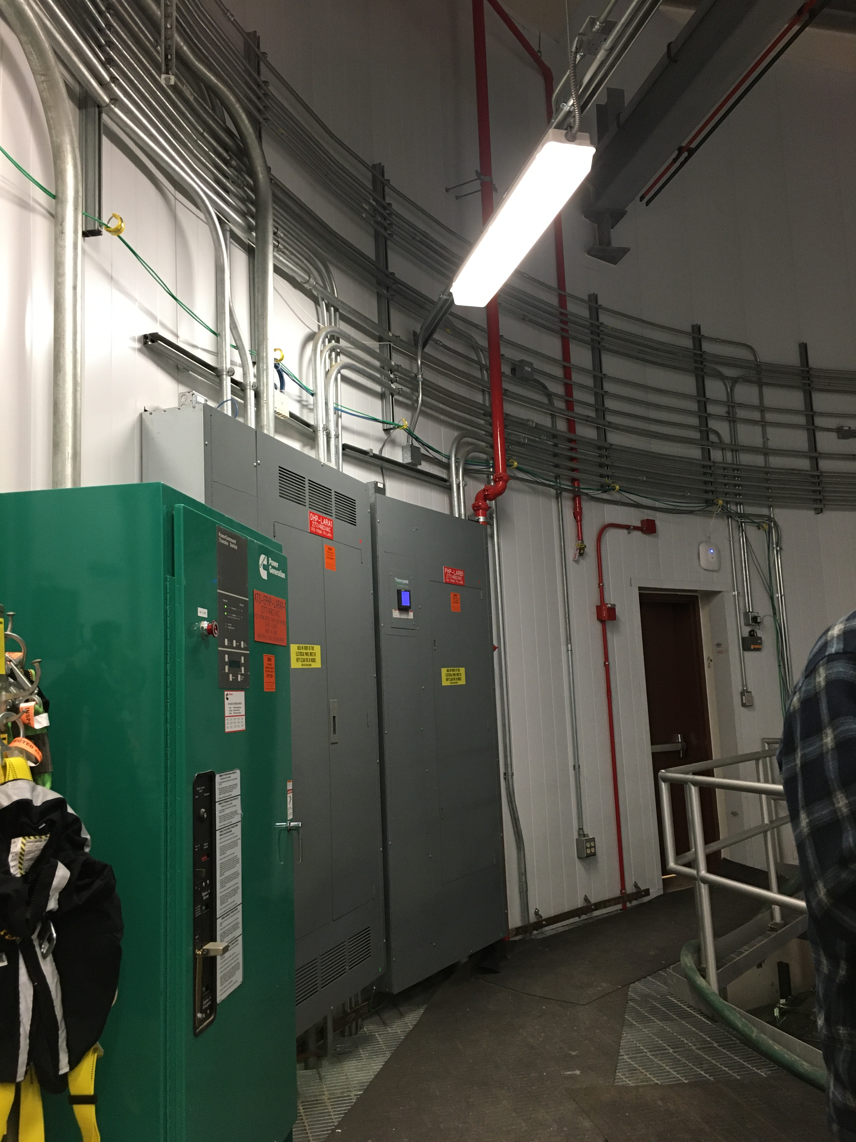
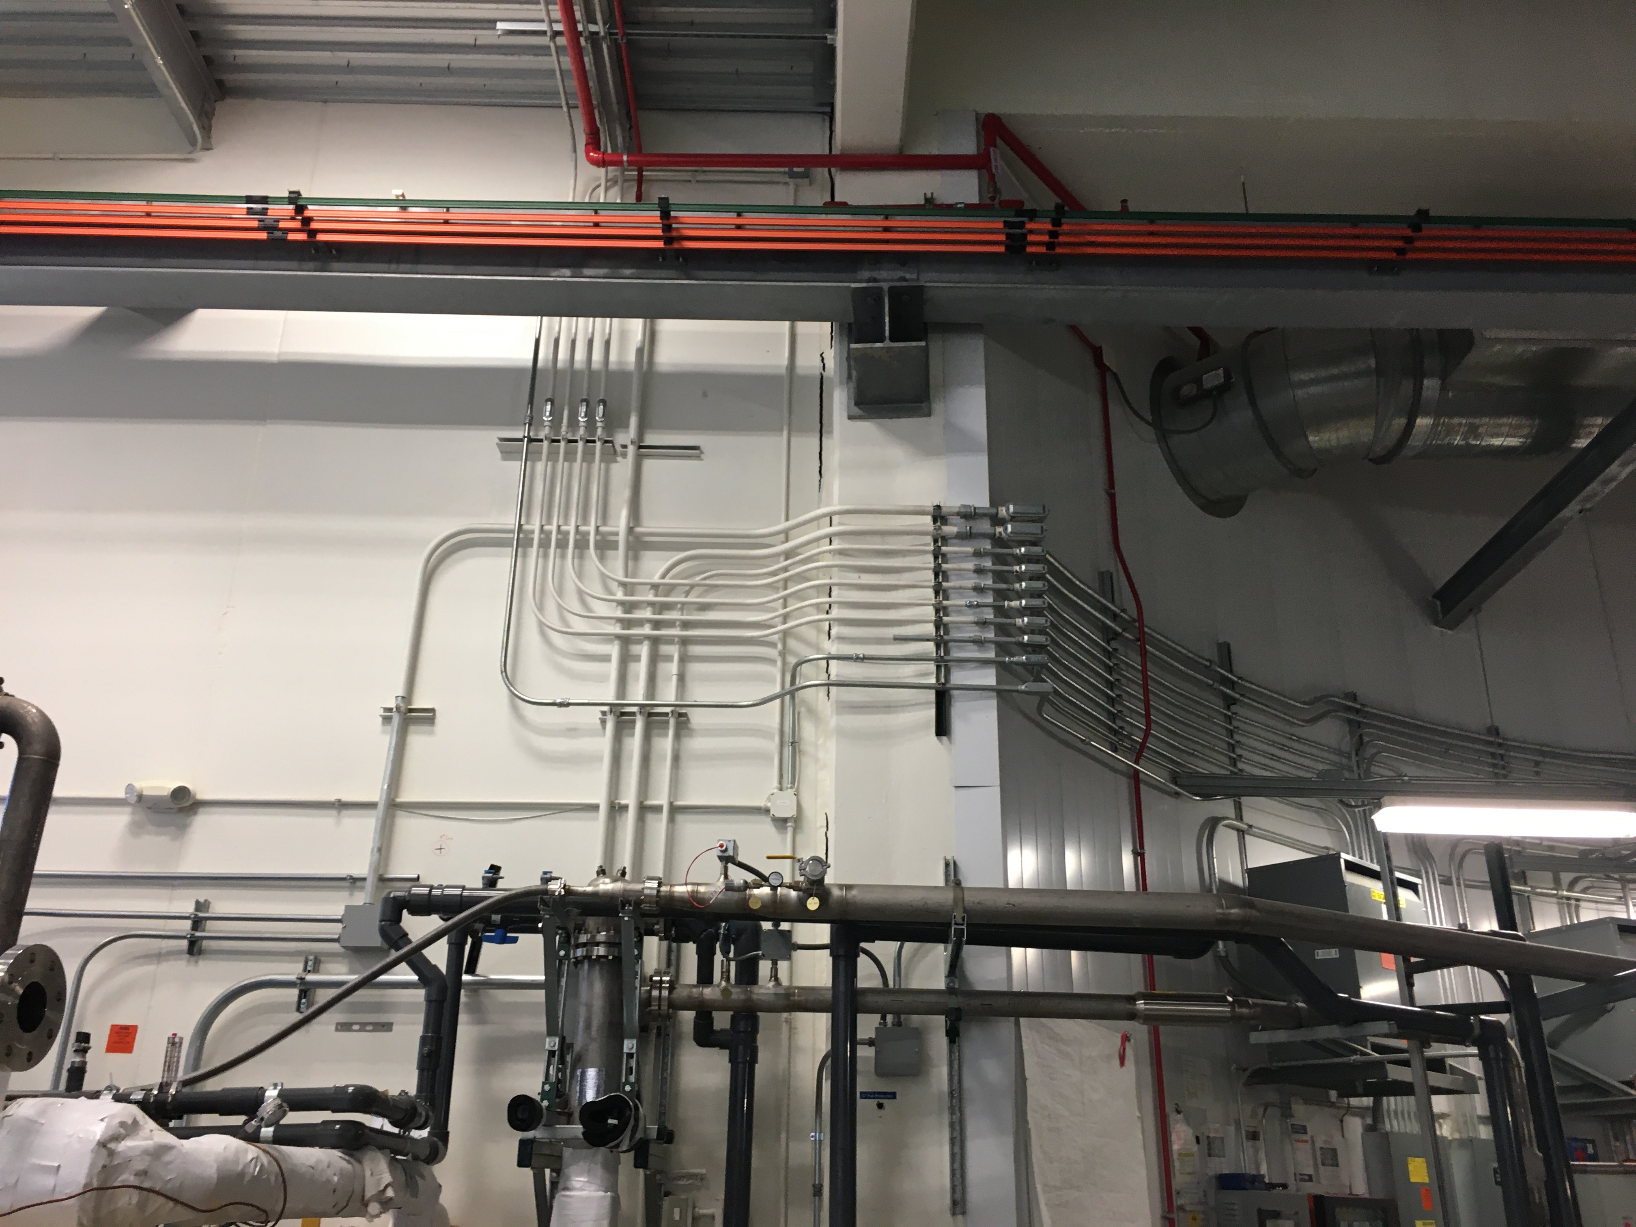
Conduit Route: Around the wall and up

Slide 8
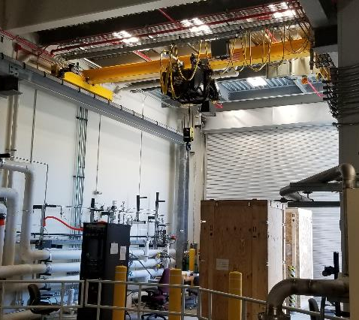
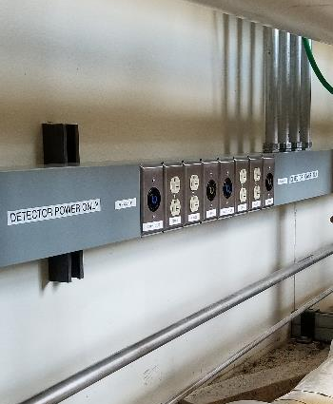
Conduit Route: Across to east side wall and down

Slide 9
Issue Identification: 10 Ω short
PP A
~10 Circuits
uBooNE Power
Detector Safety ground cable was the first to be lifted and tested
No problems were found with cable, no changes to impedance monitor
SI
XFMR A
CT
XO
Detector Safety
Ground cable
PP B
4 Conduits
2x2 Power
XFMR B
SI
CT
XO
Cable was then lifted at CT/SI box, no changes occurred
Detector Safety
Ground cable

Slide 10
Issue Identification: 10 Ω short
PP A
~10 Circuits
uBooNE Power
SI
XFMR A
CT
XO
Conduits and ground lifted at panel
Detector Safety
Ground cable
PP B
4 Conduits
2x2 Power
XFMR B
SI
CT
XO
Conduits and wireway became isolated
Detector Safety
Ground cable

Slide 11
Problem Locations

Slide 12
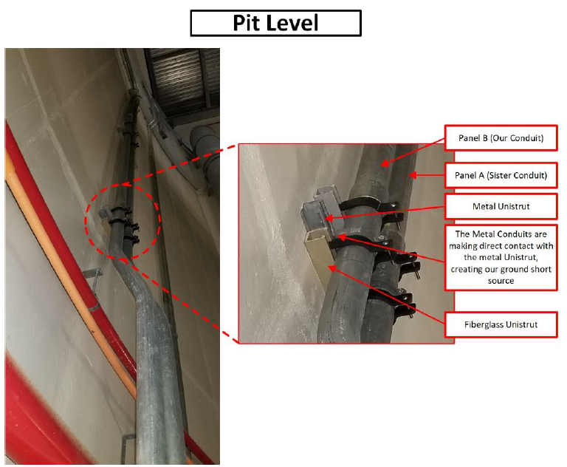
Problem Locations

Slide 13
Issue Identification: 10 Ω short
PP A
~10 Circuits
uBooNE Power
SI
XFMR A
CT
XO
Detector Safety
Ground cable
Best option to verify was to lift at the CT
PP B
4 Conduits
2x2 Power
XFMR B
SI
CT
XO
Detector Safety
Ground cable

Slide 14
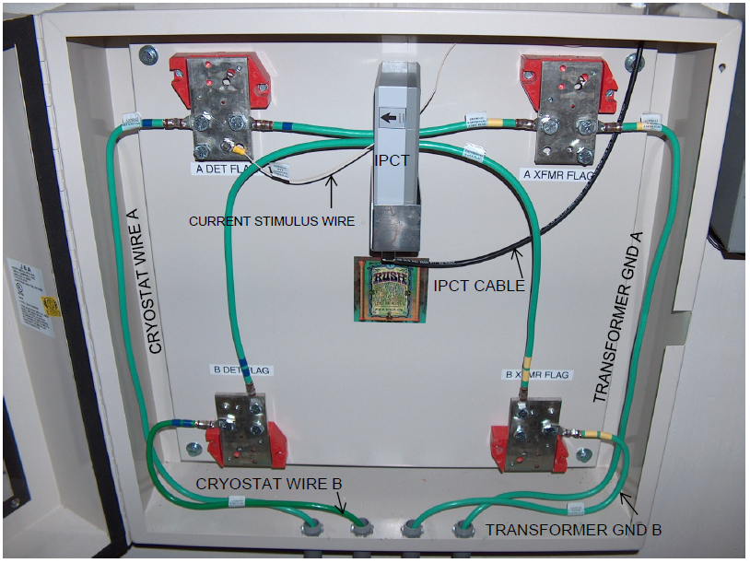
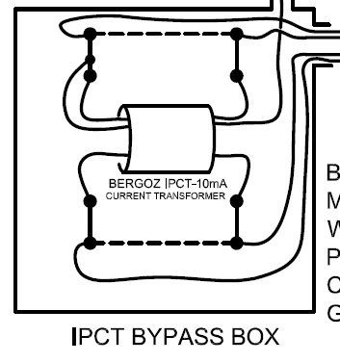
Mitigation Efforts
CT Lift Spot
Panel A
Panel B
Note: Panel B was lifted from CT prior to work

Slide 15
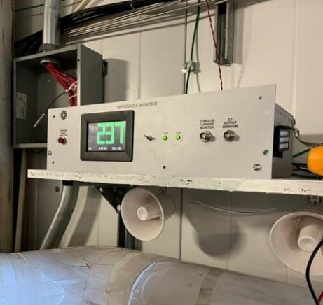
Testing the results
Success!
Impedance monitor was turned on and was working as intended
Detector Safety ground cable, CT/SI box, conduits, and wireway grounds were reconnected to verify isolation
Impedance monitor continued working as intended

Slide 16
Plans
While Impedance monitor is now functional, we need to isolate the conduit run so that Panel A can properly function
Install fiberglass unistrut at 3 locations
Procedure composed
HA Submitted and approved
Work is commencing today
Quick verification of Impedance monitor operation
Arrange ORC review
Many conduit and wiring connections were lifted to find problem.
All need to be re-reviewed before powering system.
Conduct characterization measurement
Release system to Operations

