Slide 1
Study for DUNE STT Gas Systems
R.Guida
on behalf of the EP-DT-FS/Gas Team
CERN June 22nd, 2022

Slide 2
Outlook
Introduction
Gas systems for LHC experiments:
Automation
Modularity
Reliability
Gas systems description:
Construction
Building blocks
One example: a closer view to TRT gas systems
The STT case
Conclusions

Slide 3
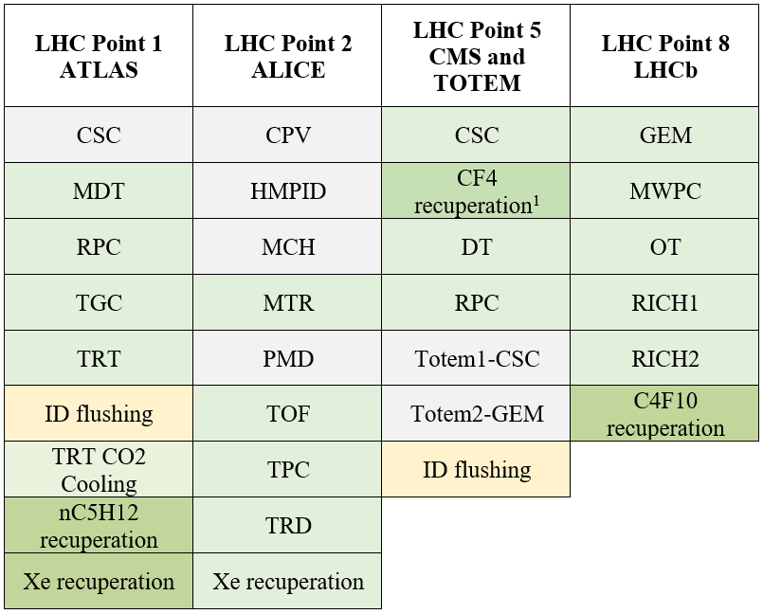
Gas systems for the LHC experiments
The basic function of the gas system is to mix the different gas components in the appropriate proportion and to distribute the mixture to the individual chambers.
30 gas systems (about 300 racks) delivering the required mixture to the particle detectors of all LHC experiments.
Summary of the sub-detector gas systems at the LHC experiments
Grey: single pass detector gas systems; light green: detector gas recirculation system;
dark green: gas recuperation plant; orange: detector flushing systems.
Gas mixture is the sensitive medium where the charge multiplication is producing the signal.
Correct and stable mixture composition are basic requirements for good and stable long-term operation of all detectors.
Notes:
In red systems with similarity wrt STT

Slide 4
The “Gas Team”
The gas systems were built according to a common standard allowing minimization of manpower and costs for maintenance and operation.
Construction started early 2000
Operational since 2005-2006
The CERN gas team:
a join collaboration between EP-DT-FS, BE-ICS
Notes:
Recently built systems:
ALI-MTR
LHCb-GEM
CMS-GEM
BE-ICS writing software controls

Slide 5
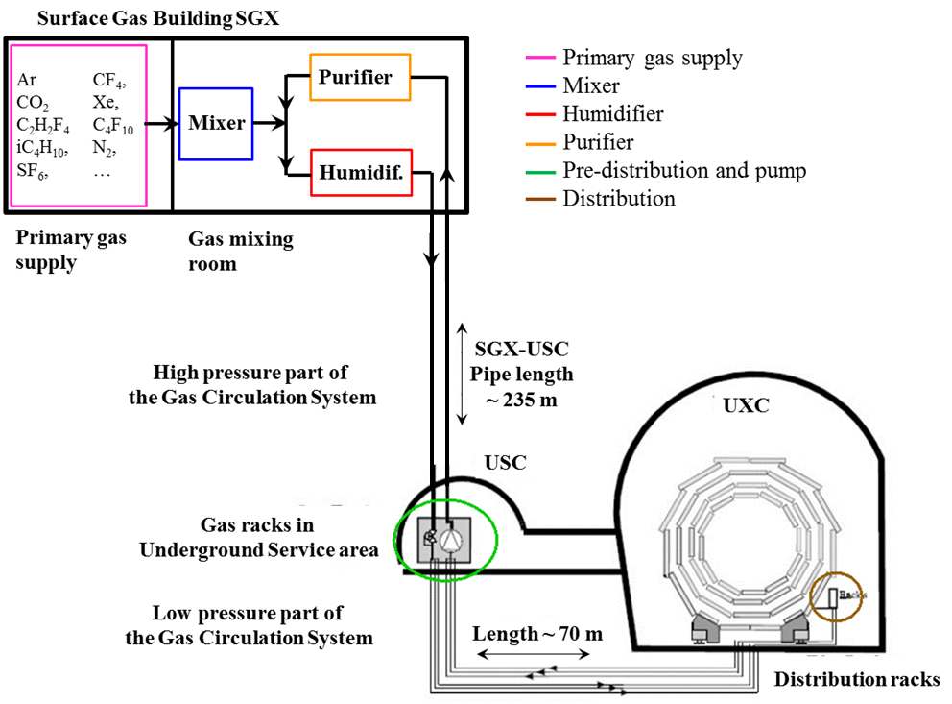
Gas systems for the LHC experiments
Gas systems extend from the surface building to the service balcony on the experiment following a route few hundred meters long.
Primary gas supply point is located in surface building
Gas system distributed in three levels:
Surface (SG)
Gas Service room (USC)
experimental cavern (UXC)
Large detector volume
(from m³ to several 100 m³) and
use of expensive gas components:
→
The majority is operated in closed loop gas circulation with a recirculation fraction higher than 90-95 %.

Slide 6
Gas system: design requirements
Gas systems (as detectors) are subject to severe requirements on material & gas for safe detector operation:
Mainly (or exclusively) stainless steel pipe and components
Need to validate most of the gas system components
Documentation for QA and operation/maintenance follow up
Monitoring of gas system operation
Monitor of supply gases and mixture composition
Evaluation of operational cost
Flexible design to accommodate detector requirements/upgrades
Careful evaluation of
resources for operation
resources for maintenance activity
Stability required
Balance requirements vs safety (as much as possible)
Notes:
Need to validate most of the gas system components: functionalities & ageing

Slide 7
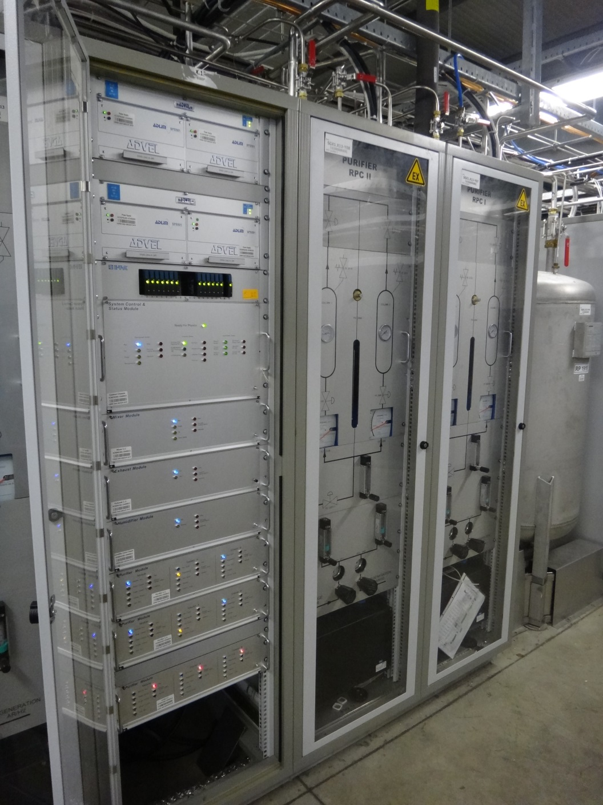
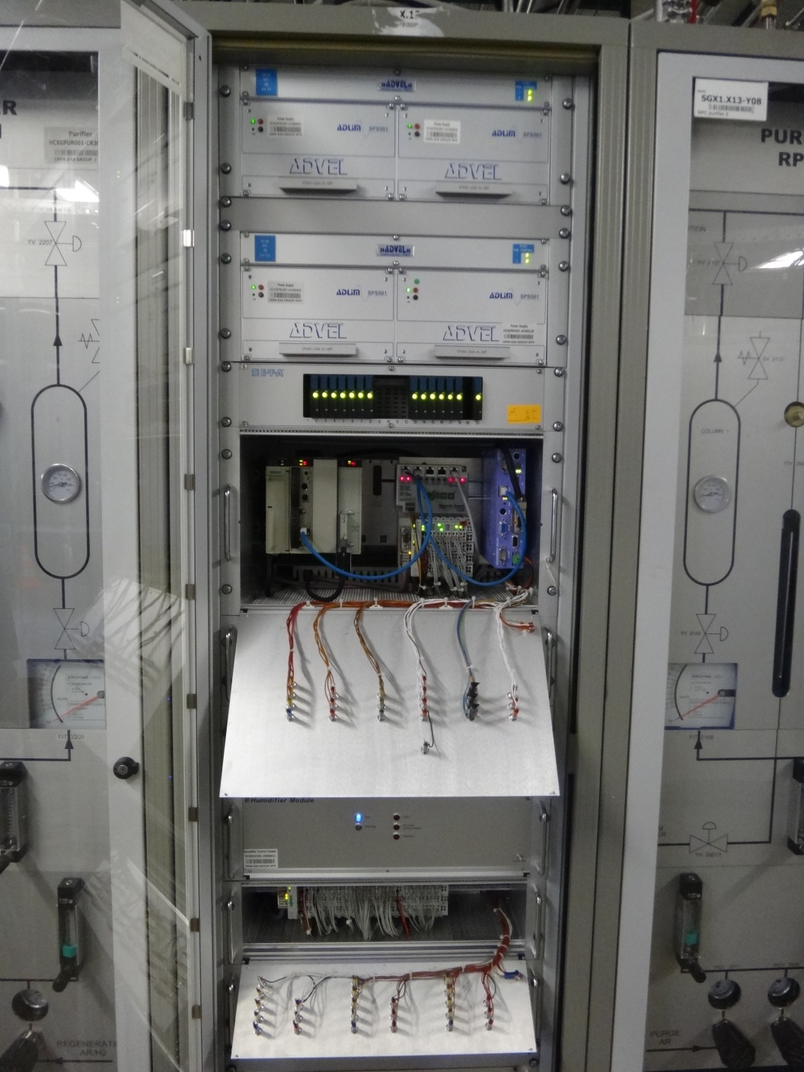
Gas system construction: modularity
Gas systems are made of several modules (building blocks): mixer, pre-distribution, distribution, circulation pump, purifier, humidifier, membrane, liquefier, gas analysis, etc.
Functional modules are equal between different gas systems, but they can be configured to satisfy the specific needs of all particle detector.
Implementation: control rack and crates (flexible during installation phase and max modularity for large systems)
Control rack
Control crate
(PLCs)
Modules crates
Profibus connection to control crate

Slide 8
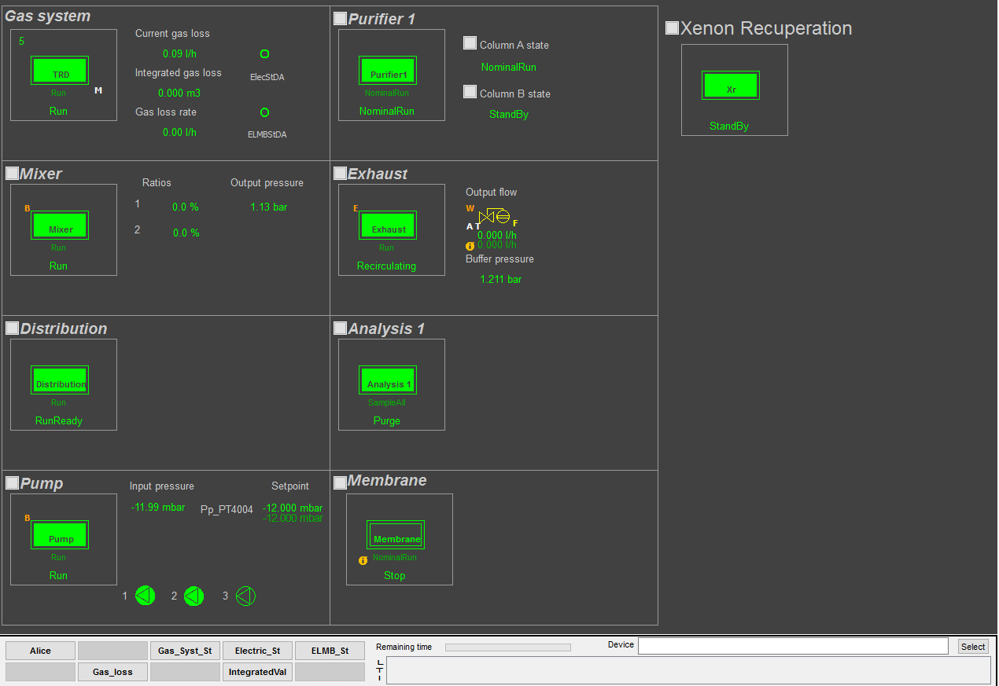
The TRT gas system: overview
Similar systems to STT case: ALICE-TRD and ATLAS-TRT
Overview of the modules from the Gas Controls Software interface:
Functional modules

Slide 9
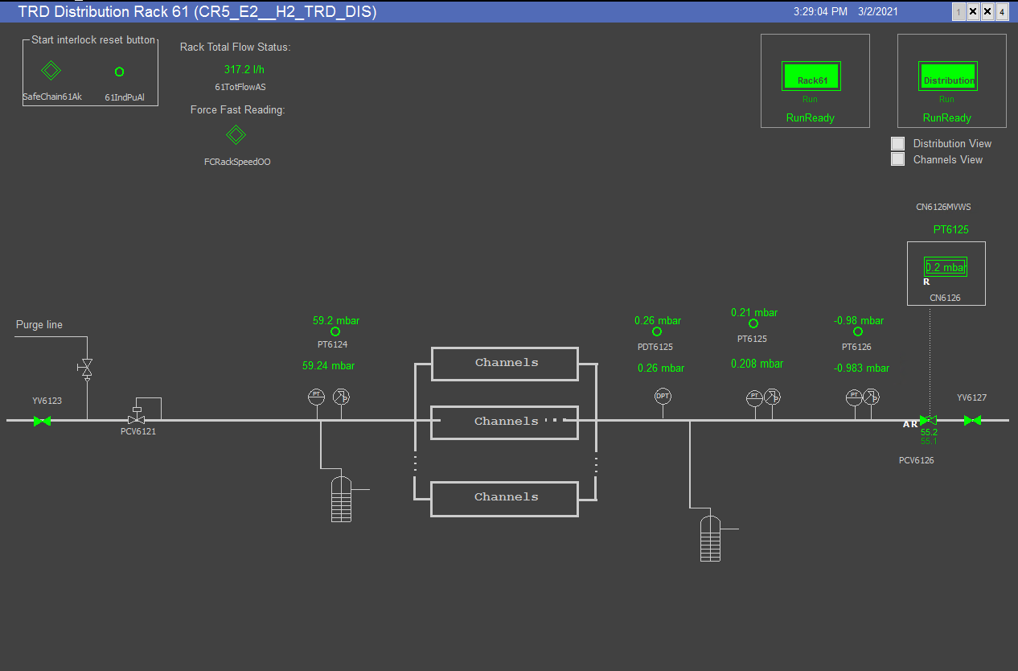
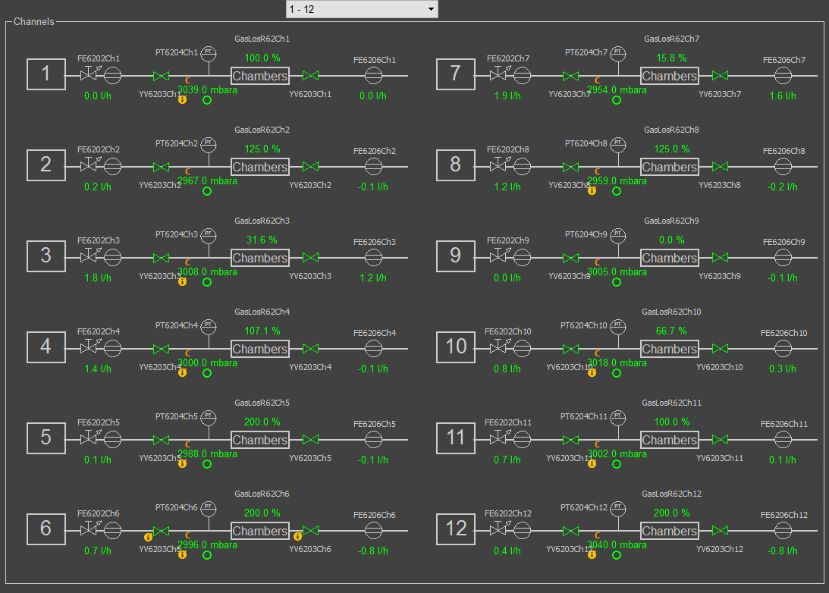
The ALICE-TRD gas system: Distribution
ALICE-TRD total detector volume (30 m³)

Slide 10
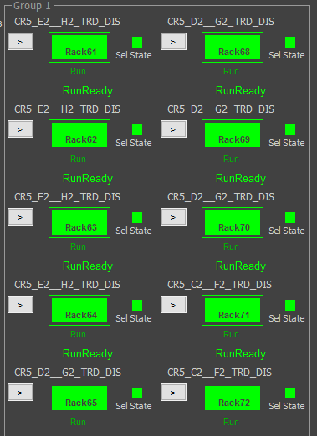
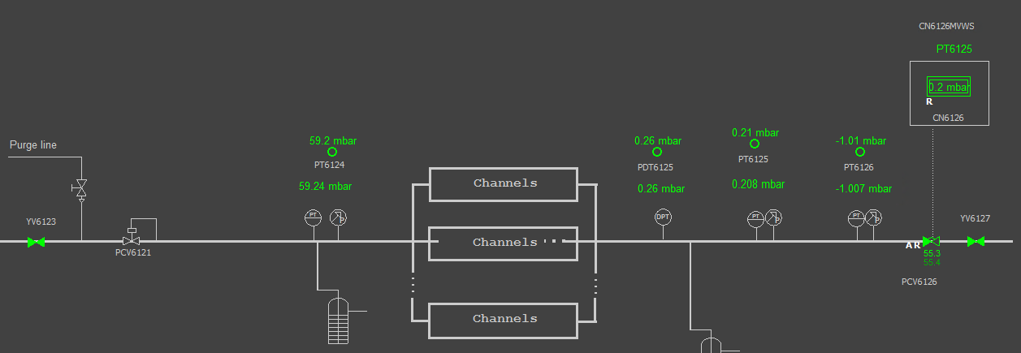
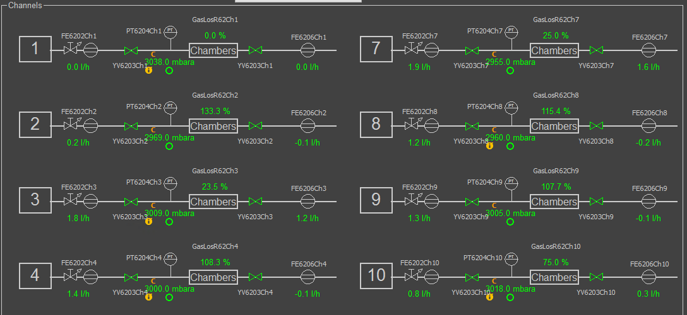
The DUNE ND-STT: Distribution
Distribution: 10 circuiti Xe/CO2
View of 1 distribution circuit
8 STT modules per circuit
Example from LHC:
Flow readout
Individual valves per module
Absolute pressure for leak test
To be seen what is really needed

Slide 11
The DUNE ND-STT
Some numbers:
Total detector volume: 14 m3
Ar/CO2: 14 modules
Xe/CO2: 70 modules
With gas flow used to cool electronics, needed 10 nl/min/module
Total Xe/CO2 flow: ~ 42 nm3/h
flow per detector module ~ 600 nl/h
10 distribution circuits (each one serving 8 detector modules)
flow per distribution circuit ~ 4 nm3/h
Still need to confirm if 2 or 3 racks needed for the gas distribution

Slide 12
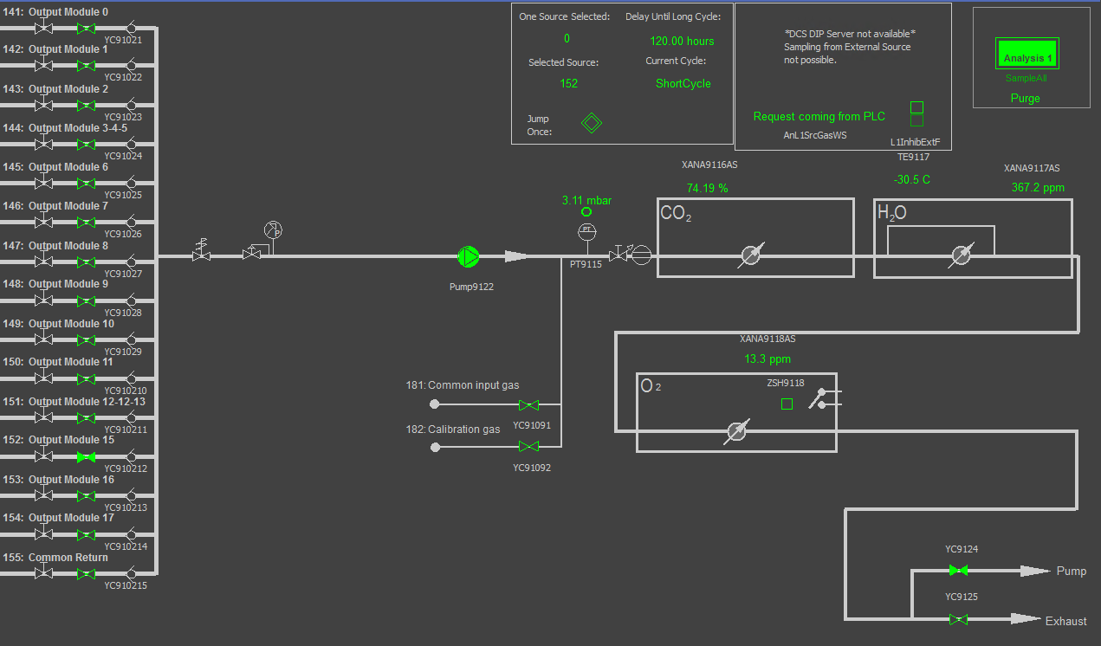
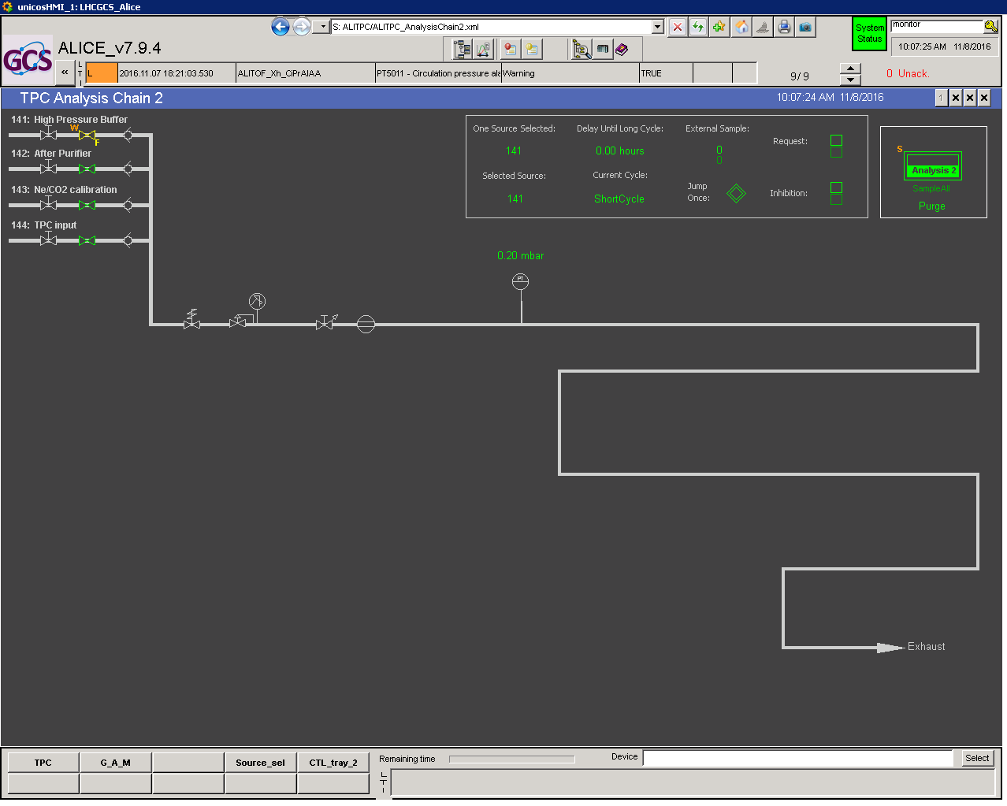
The ALICE-TRD gas system: Analysis
Chemical analysis
Typically O₂, H₂O, IR analysers
Detector based analysis
Typically a detector provided by the collaboration

Slide 13
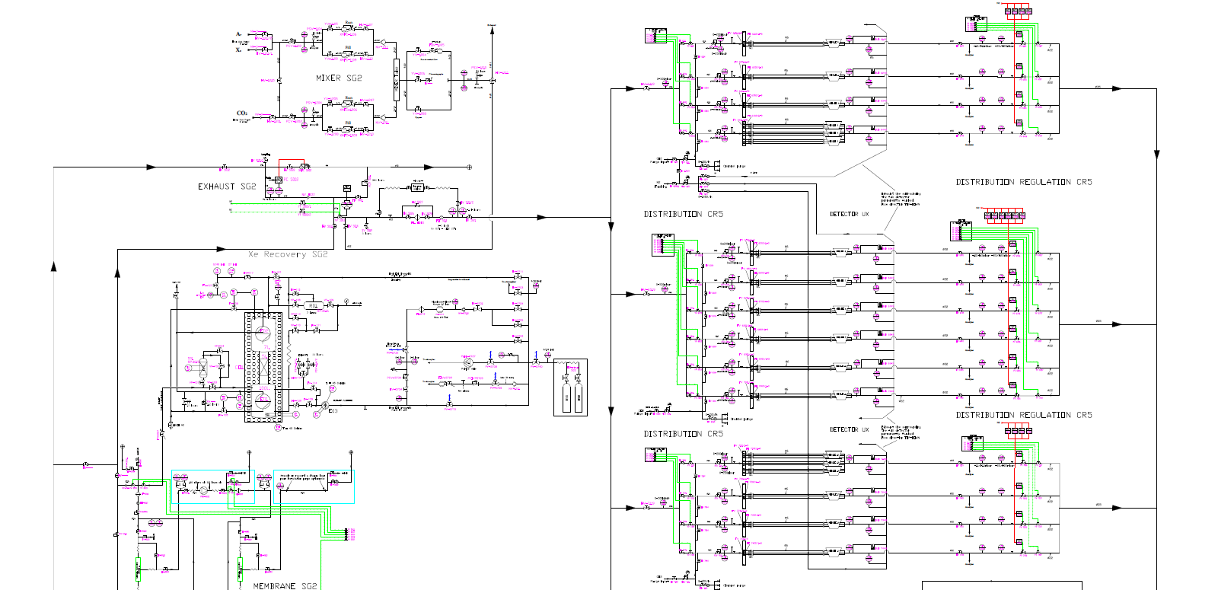
The ALICE-TRD gas system: P&ID
Mixer
Distribution
Exhaust
Xe recup
Analysis
Purifier
Pump

Slide 14
The gas system for STT: a first order evaluation
Hardware cost and technical resources needed: a first order evaluation, including time line
Module | Hardware¹ (kCHF) | Construction work² (week)
Control rack | 40 | 10
Mixer Ar/CO2 | 30 | 4
Mixer Xe/CO2 | 30 | 4
Distribution | 50-60 | 5
Pump | 30 + 2 * ~50 | 3
Exhaust | 20 | 2
Analysis | 40 | 2
Purifier | 50 | 5
Xe recuperation | 60 | 5
Buffers | 20 | (done outside)
Software | 20 | 4
Tot | ~ 500 kCHF | 44 weeks
7
14
21
28
35
42
50
Design
Procurement
Supervision
Electrical
Mech./Pipe/Weld
Chemical analysis
¹ assuming price of components used for the construction of the LHC gas systems
² assuming 100% availability of all people involved, team fully competent/trained and assuming CERN standard implementation for the LHC gas systems
Software Controls: PLC, server, software licenses (WinCCOA and Oracle db) – CERN standard implementation.

Slide 15
Supervision & knowledge transfer
It is mandatory to have personnel from DUNE collaboration at CERN during the construction and pre-commissioning (at CERN) phases to ensure follow-up of the project and knowledge transfer for the future operation and maintenance at Fermilab. Minimum:
Technical engineer or equivalent
Commissioning, maintenance and operation of gas systems
Knowledge of leak detection
Mixed skill (mechanical, electro-mechanical)
Knowledge of gaseous detector
PhD, Software expert
Commissioning, operation of controls system (PLC, WinCCOA user knowledge, DB user knowledge)
Commissioning, maintenance and operation of gas systems
Knowledge of gaseous detector

Slide 16
ND280-TPCgas system
The first gas system built for an experiment not on CERN site
Nowadays commissioning ongoing in our lab
Shipment expected after summer (installation before end 2022)

Slide 17
Conclusions
The development, construction and operation of the gas systems for the LHC experiments has contributed to the creation of CERN expertise in this domain
Gas systems are designed and built according to functional modules:
Simplified maintenance and operation activities for the team
Fully automated systems with remote control/monitoring
impressive reliability level
Approximate cost and resource estimate presented
Very important to have one experienced technical engineer or equivalent and one software expert following production and test phases to ensure the start up of a good knowledge transfer process in view of maintenance and operation in USA. We need to build an onsite expertise to ensure good operation conditions.
Assuming 100% availability of all people involved and team fully competent/trained the full process will take about 50 weeks
1 month commissioning at production site needed (not included in the 50 weeks)
Cost estimate based on CERN gas team present knowledge. In case DUNE would express wish for CERN to build the system, the following steps would be needed:
Agreement with the EP department about the CERN contribution to DUNE
Assessment of timing and schedule compatibility with team present activities (To be considered the critical period LHC-LS3: 2025-2027).
Collaboration agreement between DUNE and EP-DT in form of a Workpackage, specifying the injected DUNE resources (personnel, funds) and the EP-DT deliverables and milestones.

