Slide 1
ROOT Output caching studies in atlas
erhtjhtyhy
Alexei tam
SULI Intern
High Energy Physics Division
August 2, 2022
Notes:
!!Picture Ideas?

Slide 2
Introduction

Slide 3
Introduction
A few words about ATLAS
46 m long, 25 m in diameter
100 m underground
7000 tonnes
1,000,000,000 collisions every second
Notes:
ATLAS detector = very large, very complex ➔ Generates very large, very complex datasets
Need to analyze, visualize large datasets

Slide 4
ROOT
A data analysis framework for high energy physics
C++ and Python (PyRoot)
Visualization
More than 1 exabyte stored in ROOT Files (1,000,000,000 GB!)
Notes:
1st point: may use for others
2nd point: ROOT mainly written in C++, but has powerful Python-C++ binding
3rd point: Can use in different ways, as above (Discover Higgs, Draw exclusion plots, draw geometries of detectors, like ATLAS)

Slide 5
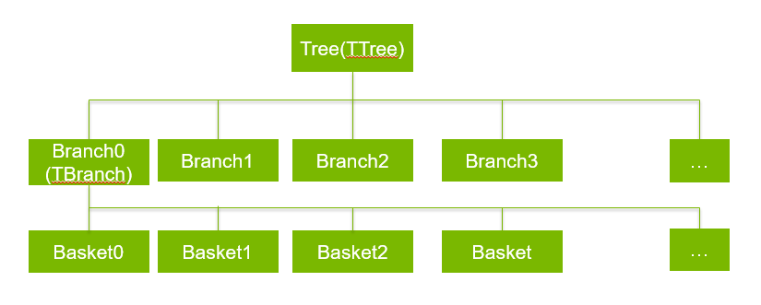
Introduction
Columnar Data: can use trees and branches
Tree = a list of independent, synchronized columns
Branches = columns with data
Leaves = holds actual data
Baskets = hold data of branch in form of bytes
Trees, Branches, and data
Notes:
We have all this data: how do we organize it?
Can use all kinds of ways: one way of interest: using TTree
Want columnar data?
Tree = list of independent, synchronized columns,
Branches = said columns, with rows in which you can hold all kinds of data (integers, floats, doubles, etc.)
Leaves = give access to actual data
So this is how data is organized, but how is it written and stored to disk? These baskets play a role!

Slide 6
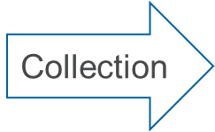
Introduction
Streamer: converts data objects to bytes
Bytes stored in Buffer
Buffer is full: closed and compressed (Basket)
Baskets stored in clusters
Buffers, Baskets, and Clusters
Data Objects
(int, float, etc.)
Streamer
(a collection of bytes)
Store to cluster
Compression
Notes:
Can think of data structures (shorts, doubles, chars, etc.) as Lego structures (towers, star wars ships, etc.)
Streamers breaking up objects into bytes (like breaking up lego structures into individual legos)
These bytes are then stored in buffers.
And once these buffers are full, they’re compressed into Baskets, stored in clusters and written to disk
Streamers: break down data structures to bytes (individual Legos)

Slide 7
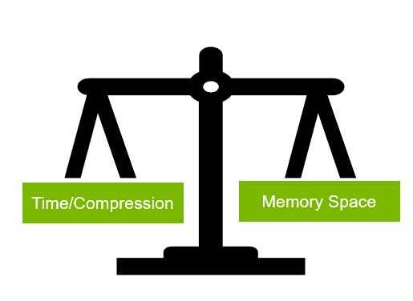
Motivation
Basket Count and Buffer Size
The balancing act
X amount of baskets, of size Y KB
X, Y may not be optimal!
Small Branches: Y defaults to 32 KB; greater than necessary!
(memory is being allocated, but not being used)
Large Branches: Y optimizes, but becomes too large and occupies too much memory space
Small baskets (less memory)=> more baskets (more time, poorer compression)
Fewer baskets (less time, better compression) => larger baskets (more memory)

Slide 8
How to resolve the balancing act?

Slide 9
METHODS
AutoFlushing and Optimizing Baskets
Default/Configured Basket sizes
AutoFlush
By default, ROOT uses 32 KB (*)
Branches vary in size (A few large branches + A lot of smaller branches)
Default may be optimal for some, but may not be for others
Creating Branch: user can configure basket size
However: difficult to manually set custom basket sizes for >1,000 branches
Can call after a certain number of bytes are stored
Can call after a certain number of entries
On first flush, tells ROOT to optimize baskets
Optimize Baskets
Changes basket size, tries to fit as much as it can into one cluster

Slide 10
Methods
Output Caching Tests
Create tree, with 10 branches, filled with N many vectors (N=10,000)
Can determine elements of vectors in different ways (random, pseudorandom, Gaussian, etc.)
Each branch filled with vectors of different lengths (Branch1 has vectors of 10 elements, Branch5 has vectors of 100 elements, etc.)
Scan through different configurations of AutoFlush (0,10,100,1000 entries)
Observe differences in Basket Counts, Basket Sizes, and Compression
Can read data from each branch

Slide 11
Results: ELement Distributions
Notes:
!! Add Axes Titles
Distributions vary a little from run to run, but the general trends are the same
Some branches are filled very randomly (N1/A1) and some repeat a lot (N25/A25) => some are more compressible than others, will reflect in coming results

Slide 12
Branch 2: 25 elements per entry

Slide 13
Branch 5: 200 elements per entry

Slide 14
Branch 9: 2000 elements per entry

Slide 15
Outlook

Slide 16
Outlook
Don’t want baskets to get too large
- maximum buffer size is hardcoded
- I/O and compression are okay at 10 to 100 kB, but maximum is 25,600 kB
- OptimizeBaskets() : make relevant components configurable
ROOT:
- Locally patch, implement, and test

Slide 17
Experience
Steep Learning Curve
X terminals and alogin
Shell
Git, ROOT, C++
Documentation, Documentation, Documentation

Slide 18
Thank you!

