Slide 1
TMS magnetic field simulation studies
erhtjhtyhy
CHINMAY MURTHY and Aleena rafique
Young Scientist Symposium Series
08/02/2022
1

Slide 2
ABOUT DUNE
Long Baseline Neutrino Experiment (1300 km)¹
Two detectors: near and far
Physics goals:
Mass hierarchy
CP violation
Beyond standard-model physics
1. DUNE Collaboration, A. Abed Abud et al. Deep Underground Neutrino Experiment (DUNE) Near Detector Conceptual Design Report (2021), arXiv:2103.13910.

Slide 3
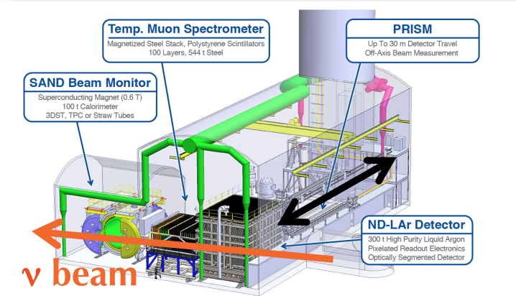
About near detector
Several chambers with different detection capabilities
Liquid Argon Time Projection Chamber (ND-LAr TPC)
Temporary Muon Spectrometer (TMS)
SAND Beamline Monitor
Neutrinos generated from proton beam on target
Neutrinos interact with argon atoms, produce new particles
Higher-energy products detected in TMS

Slide 4
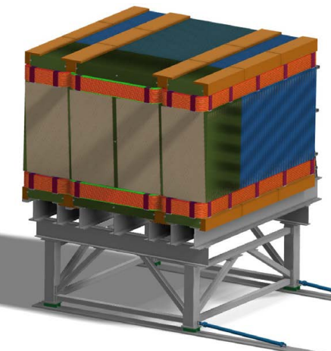
TEMPORARY MUON SPECTROMETER (TMS)
Magnetized range stack of 100 layers
Alternating steel and scintillator
40 plates with 15mm steel, 60 with 40 mm steel
Designed to catch muons too high-energy for ND-LAr TPC
Direction of current
Field-generating coils
40mm steel plates
15mm steel plates

Slide 5
Magnetic field
Argonne engineers designed 6 coils for magnetic field
Field for determining muon charge
Engineers simulated field using ANSYS software
Created field map
Ideally a uniform 1T magnetic field
We wanted to understand how field impacts particle detection
Example field map for a central steel row in thick plates of TMS

Slide 6
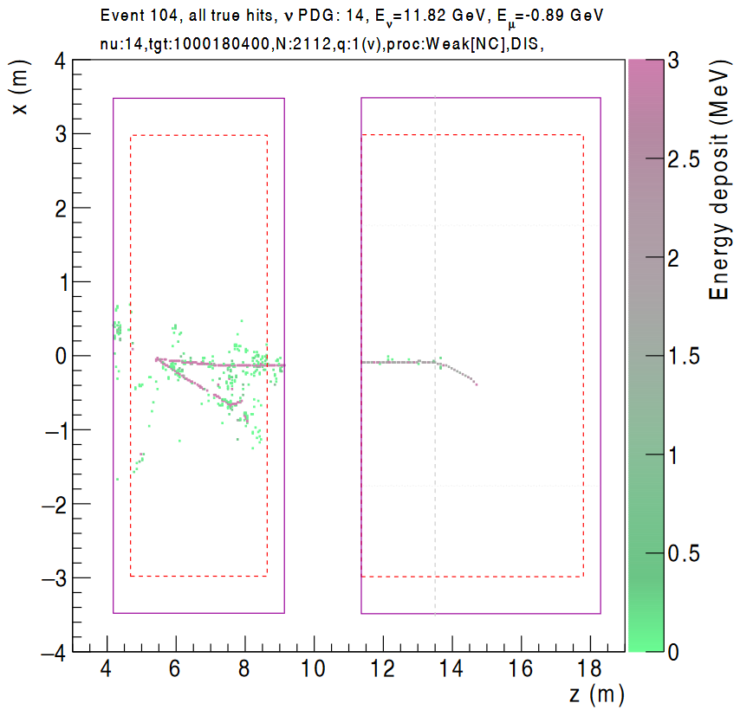
Simulation procedure
Generated neutrino events using GENIE²
Simulated neutrino interactions using an energy deposition simulation
Done twice: using 1T field and then “updated magnetic field” map provided by Argonne engineers
Used latest track reconstruction to identify particle tracks
Simulated neutrino event display in ND-LAr and TMS
2. Andreopolous et al. “The Genie Neutrino Monte Carlo Generator”, Nuclear Instr. Methds. In Physics, vol. 614, 1, 2010, pp. 87-104.

Slide 7
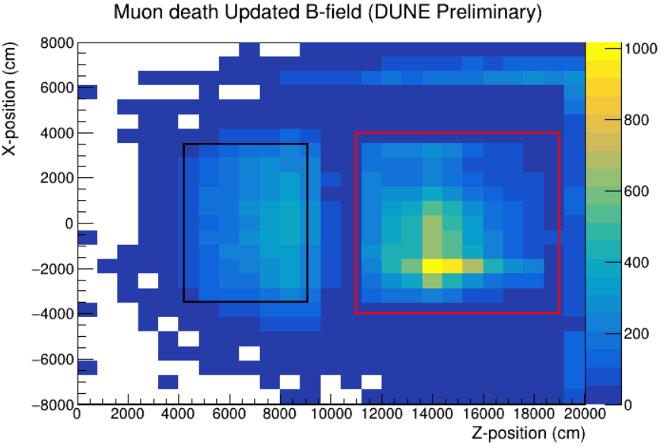
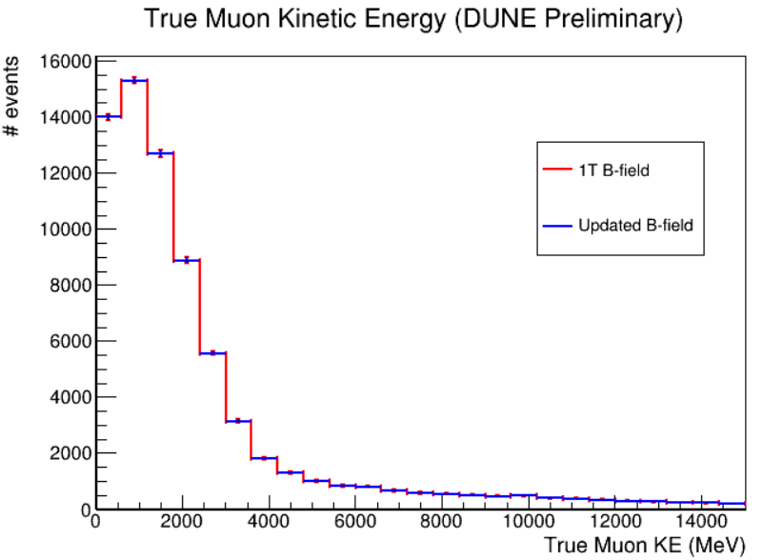
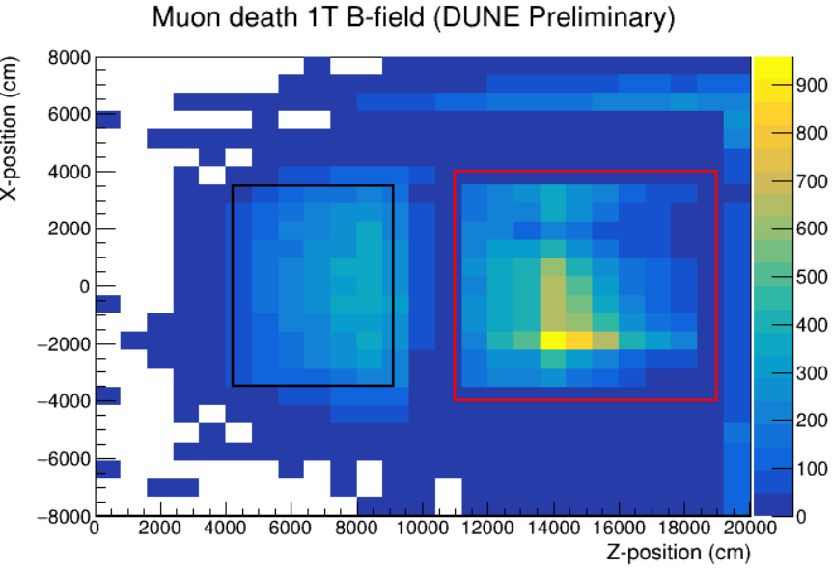
Results

Slide 8
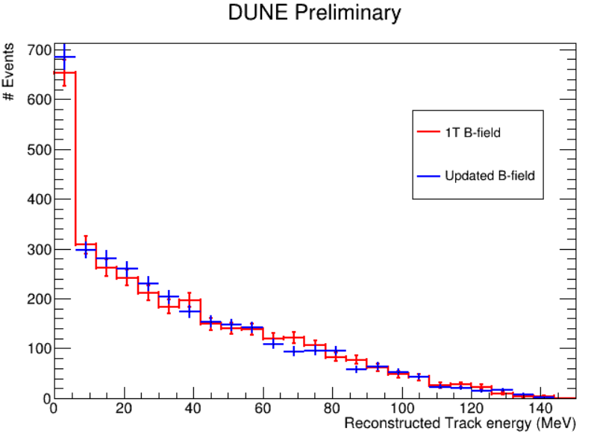
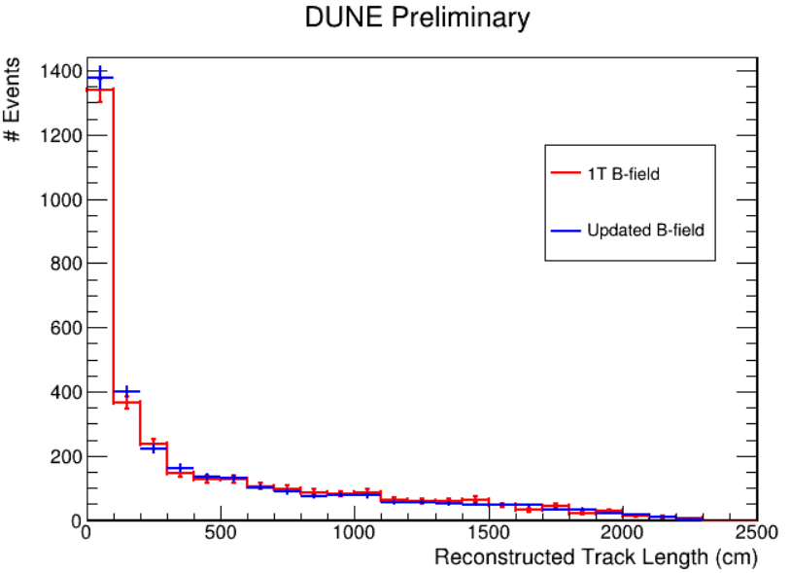
Results

Slide 9
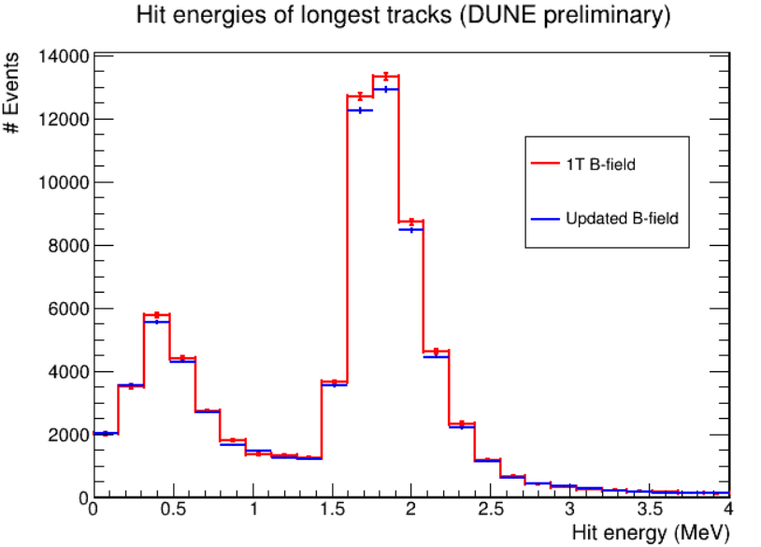
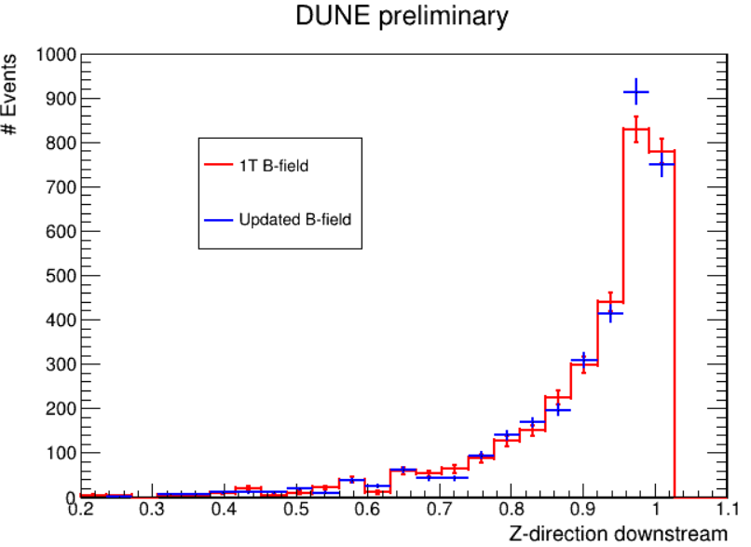
results

Slide 10
Summary
There appears to be no significant difference between updated and 1T B-fields for most events
We are currently investigating events where track lengths or other parameters differ substantially
We plan to implement the updated B-field in the official TMS simulation after testing

Slide 11
Backup slides

Slide 12
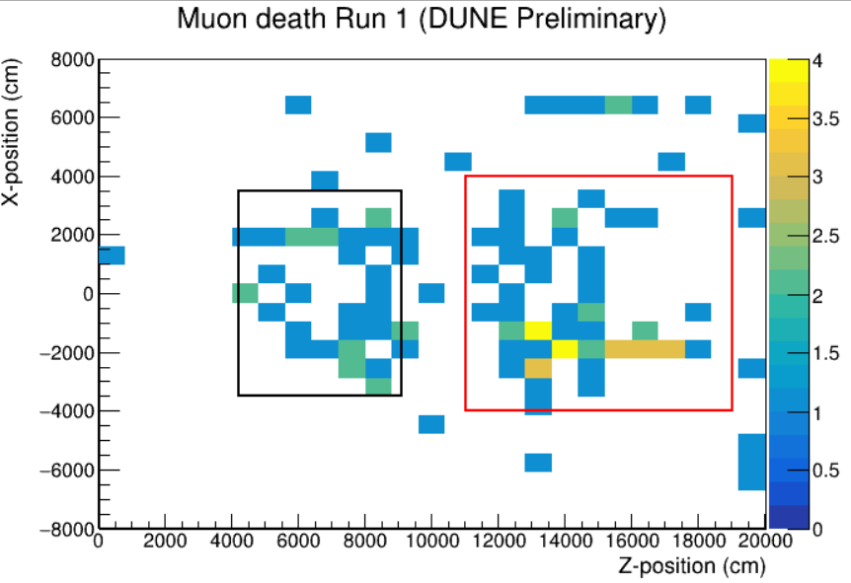
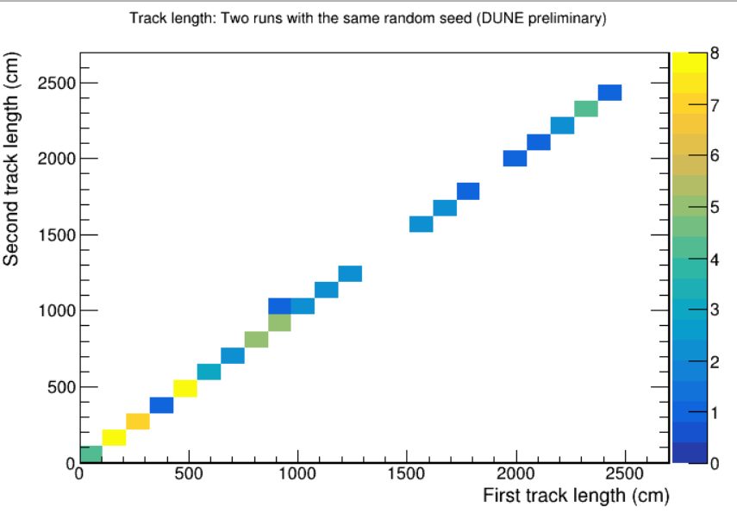
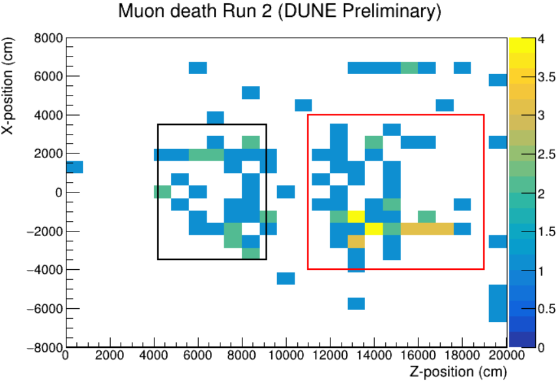
Results: example baseline
With the same random numbers generated, multiple runs of edep-sim produced the same output events
Both runs are simulated assuming the updated B-field

Slide 13
Correlation plots

Slide 14
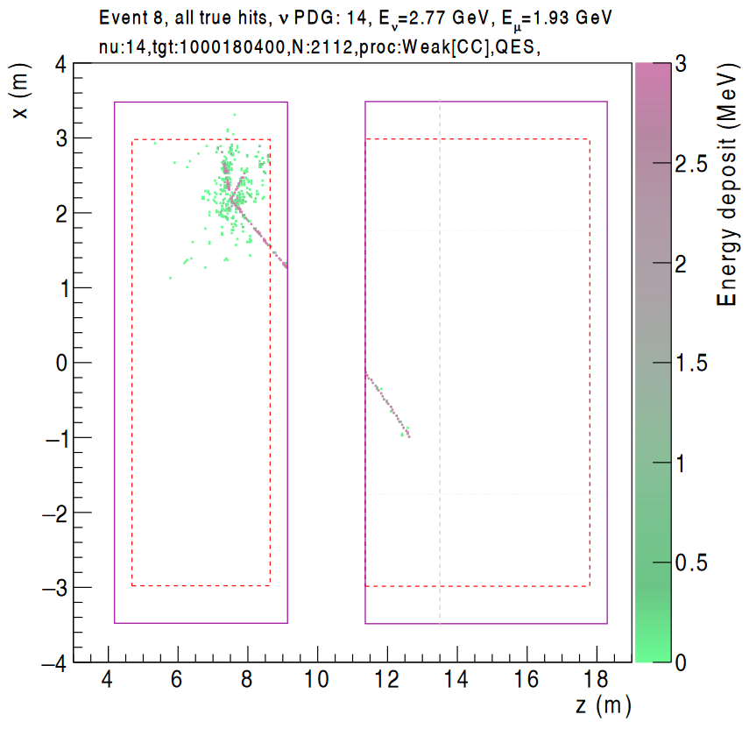
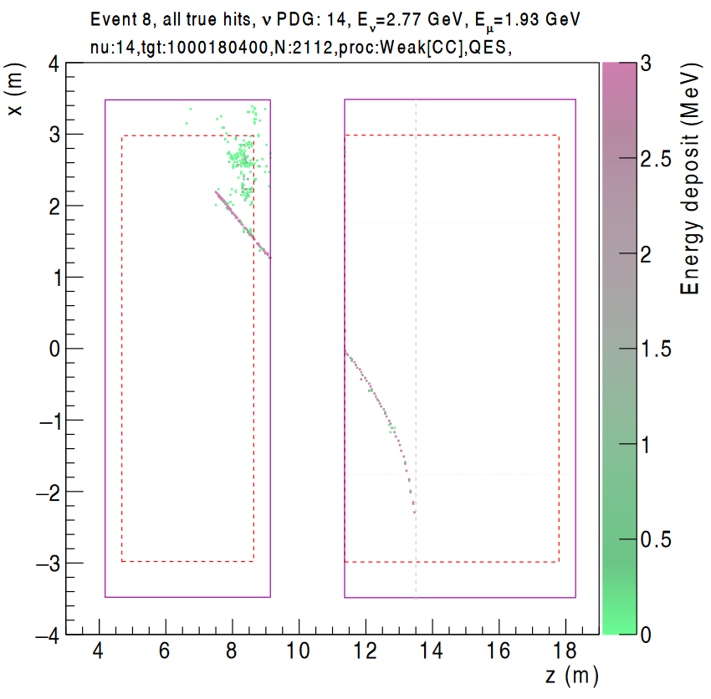
Results: example difference
1T B-field
Updated B-field

