Slide 1
Connection Node Workshop
Noah Curfman
30 June 2022

Slide 2
Connection Node Requirements
Provide a vacuum connection between adjacent modular sections
Connect and support a suitable ion pump
Allow for connections between adjacent bias bar coils
Allow for a vacuum level of 1e-10 torr or better
Prevent any laser light from escaping outside the connection node
Mount 3 cameras within ±1mm and ±1° of nominal position (locally)
Provide a connection point for gauge(s)?
Support and locate alignment fiducials?

Slide 3
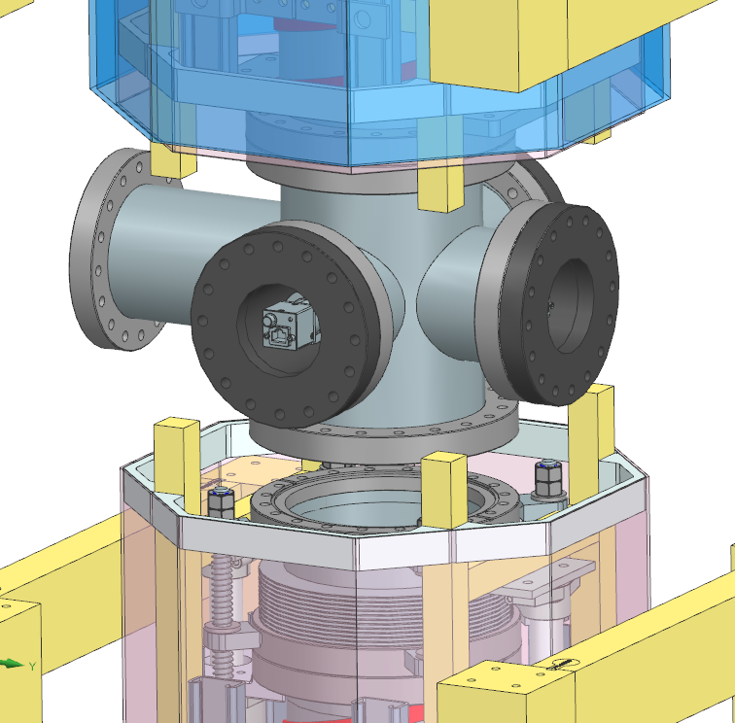
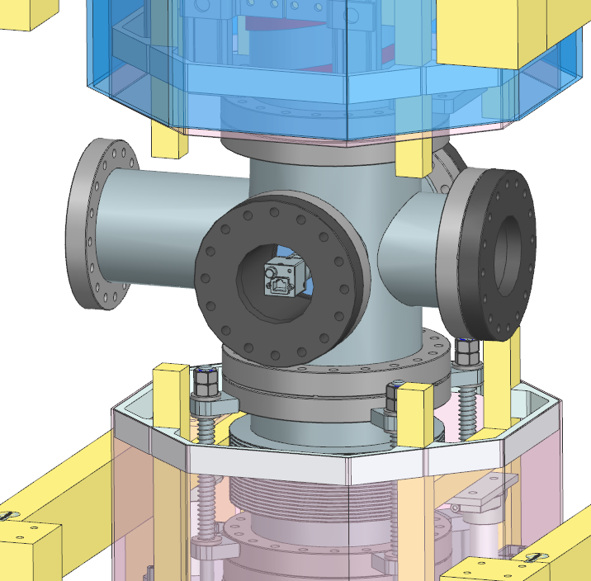
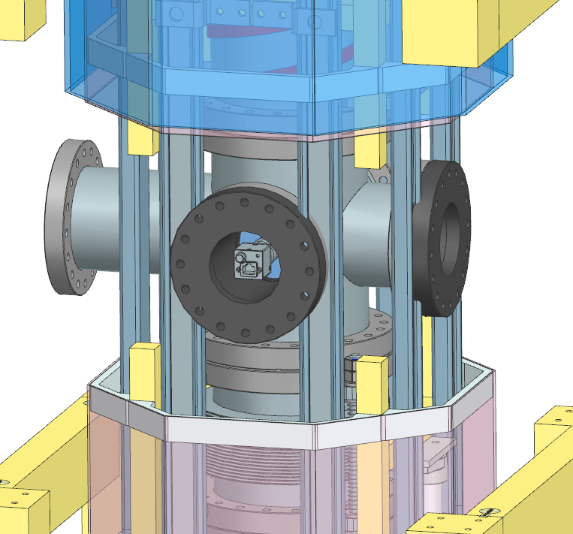
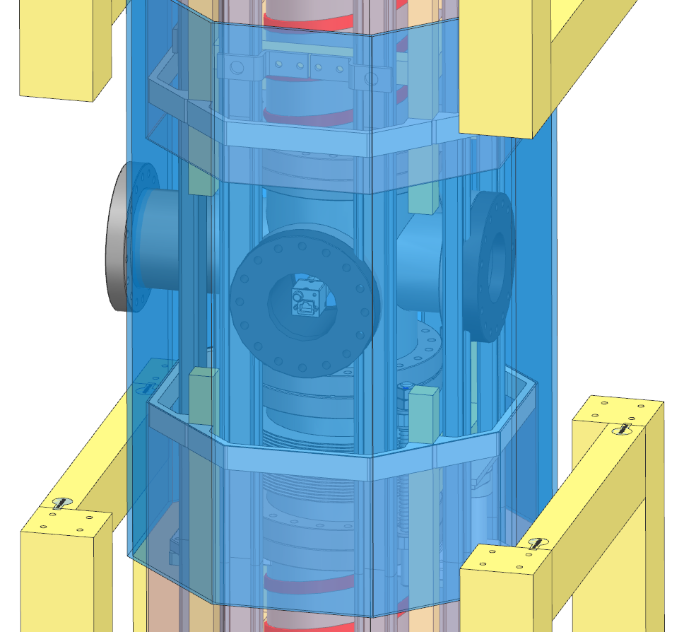
Connection Node Assembly Tasks
Vacuum Connections
Rear bolt access issues
Bias coil connections
Significant interferences
Camera Installation (not shown)
Potential access issues
Coupler Installation
In development
Connect bakeout devices?
Procedure outline needed
Degaussing operations?
Procedure outline needed
1
2
4

Slide 4
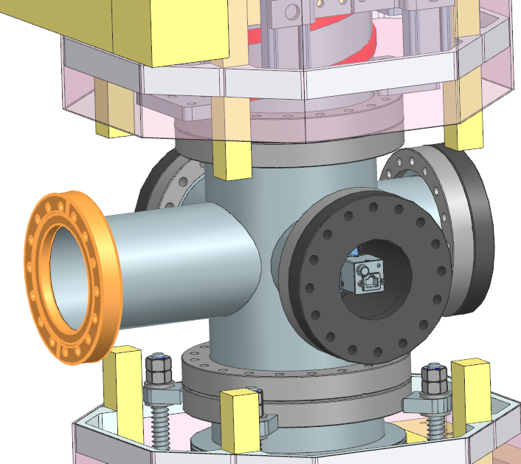
Ion Pump Port
6” OD Flange (DN100CF)
Fixed or rotatable?
4” tube max for bias coil interference
Suitable for vacuum requirements?
Could be elliptical tube to 8” OD flange
Length not yet determined
Gauge connections?
Coupler size?
Applied loads not yet confirmed
Ion pump weight pending
Support gusseting may affect assembly

Slide 5
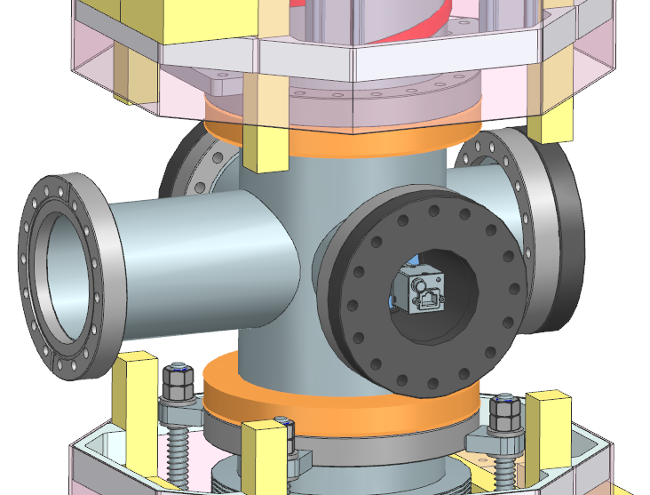
Primary Vacuum Connection Ports
8” OD captive, rotatable flanges (DN160CF)
Only lower flange made up in shaft
Pipe length reasonably well defined
Sufficient clearance for fasteners
Access issues remain for rear fasteners

Slide 6
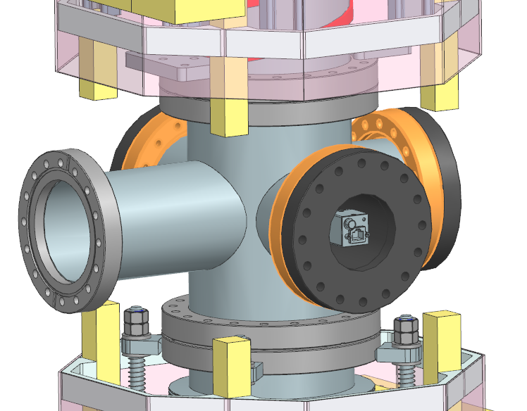
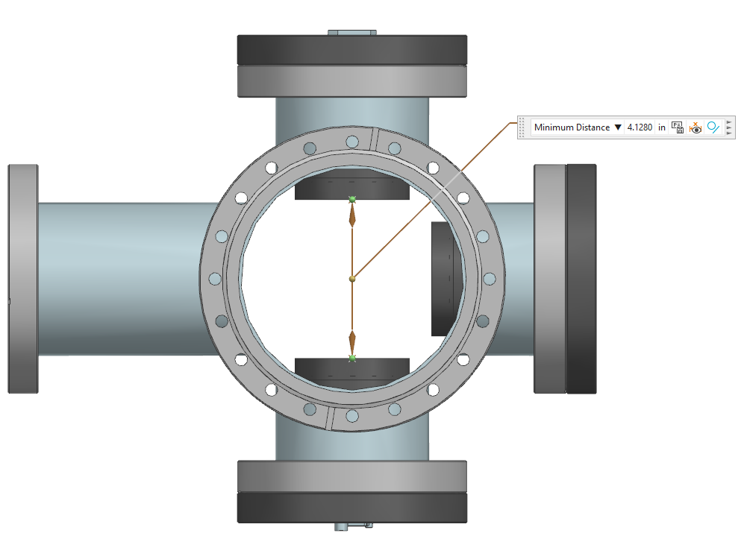
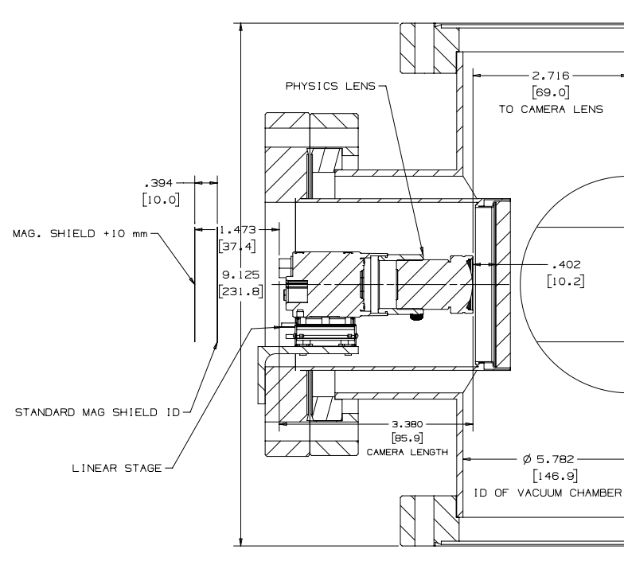
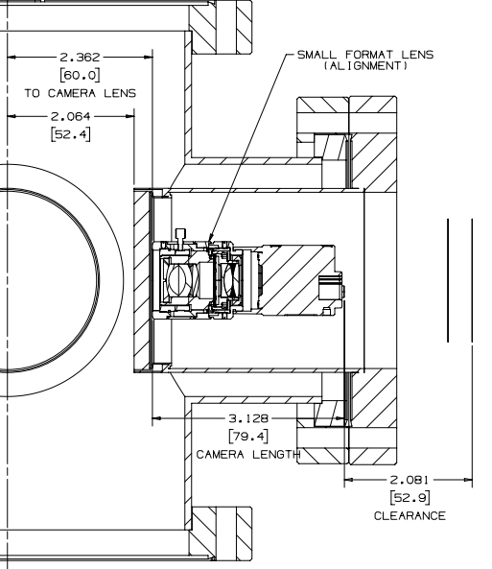
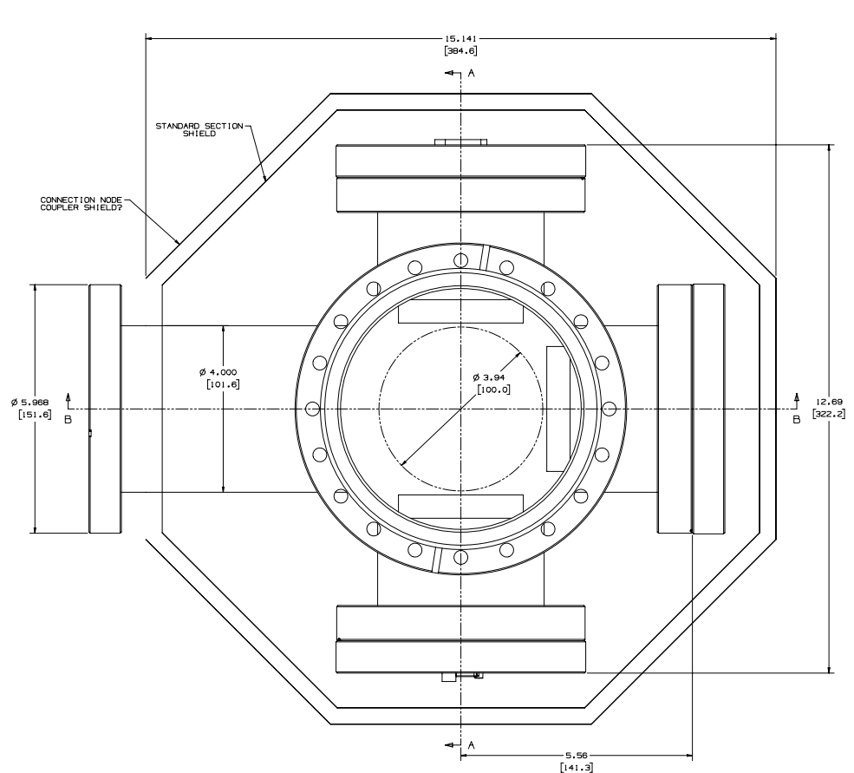
Camera Ports
6” OD Fixed Flanges (DN100CF)
Re-entrant flanges create 100mm clear aperture
Flanges well-aligned to nominal cross axes
±1mm and ±1° of nominal position
Length well defined by re-entrant flange length
Camera lengths set?

Slide 7
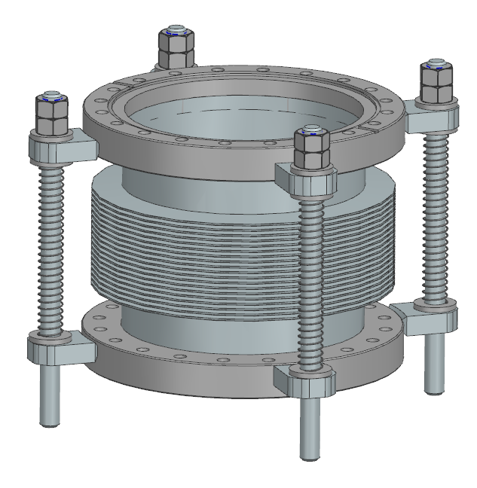
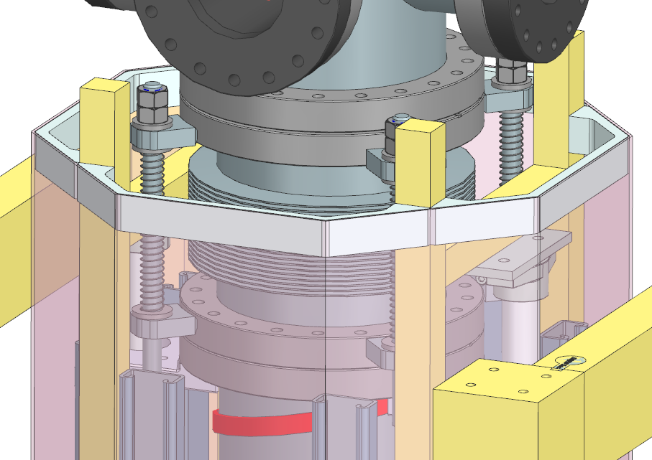
Bellows Spool
±2” Travel (convolution count may not be accurate)
Bellows must be compressed during section installation
Clearance for 1” of insulation around bellows
Spring loaded restraint features
Easy restraint disengagement from basket
Additional nuts added for horizontal section assembly
Welded tab construction
Single piece machined construction being investigated

Slide 8
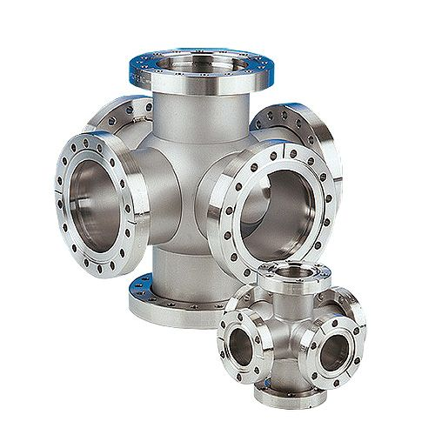
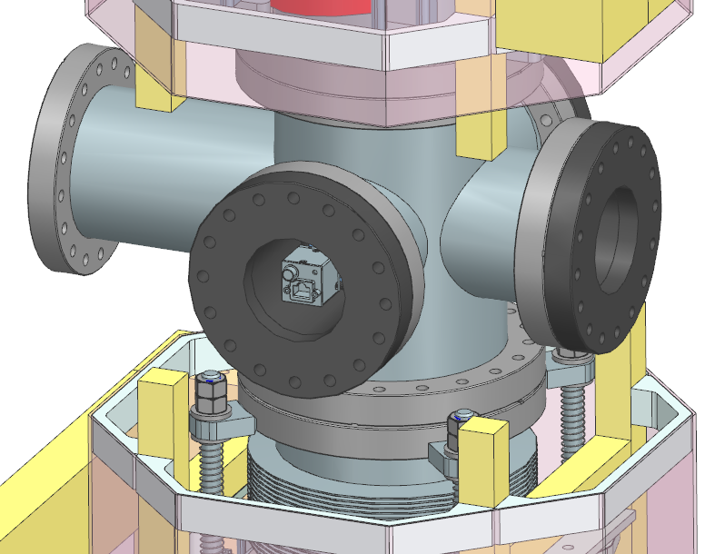
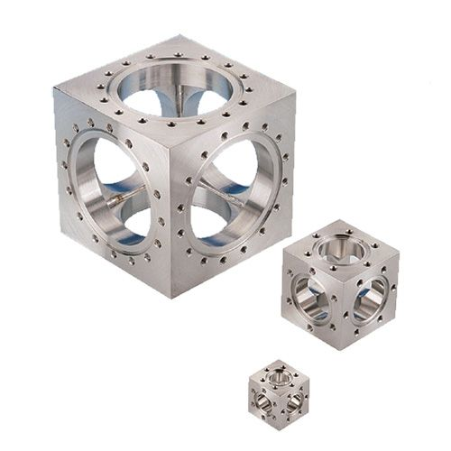
Cross Construction Methods
Welded Sphere/Tube Construction
$3,750 DN160CF/ $2,120 DN100CF
Though or tapped holes in fixed or rotatable flanges possible
Potential bracing for ion pump needed
Rotatable flanges or flange clocking required
Machined Cube Construction
More accurate camera placement
Well defined flange orientations
Custom cubes may be heavy/expensive
Possible bellows restraint interference
Tapped holes only
$6,185 DN160CF (+$40k)/ $3,250 DN100CF (+$20k)
Hybrid cube with welded upper, lower, and ion pump ports?

Slide 9
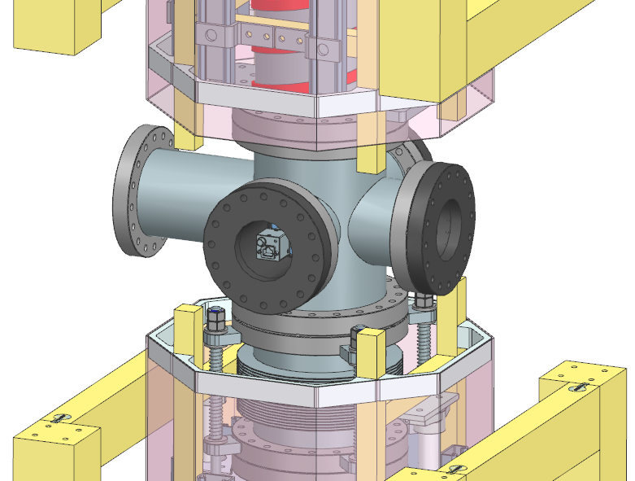
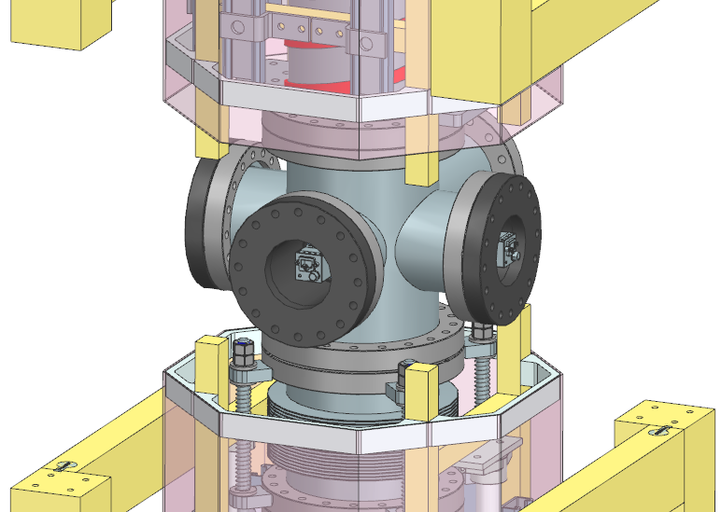
Ion Pump Orientation
Ion pump port facing towards atom sources
Easier access from shaft for maintenance/repair
Significant access issues to rear camera
Ion pump harder to install when section is horizontal
Ion pump port facing towards back wall
Improved camera access
Ion pump arrangement matches atom source connections
Easier to install ion pump when section is horizontal
No access to ion pump after section is installed
*Impact of either arrangement on installation is unclear

Slide 10
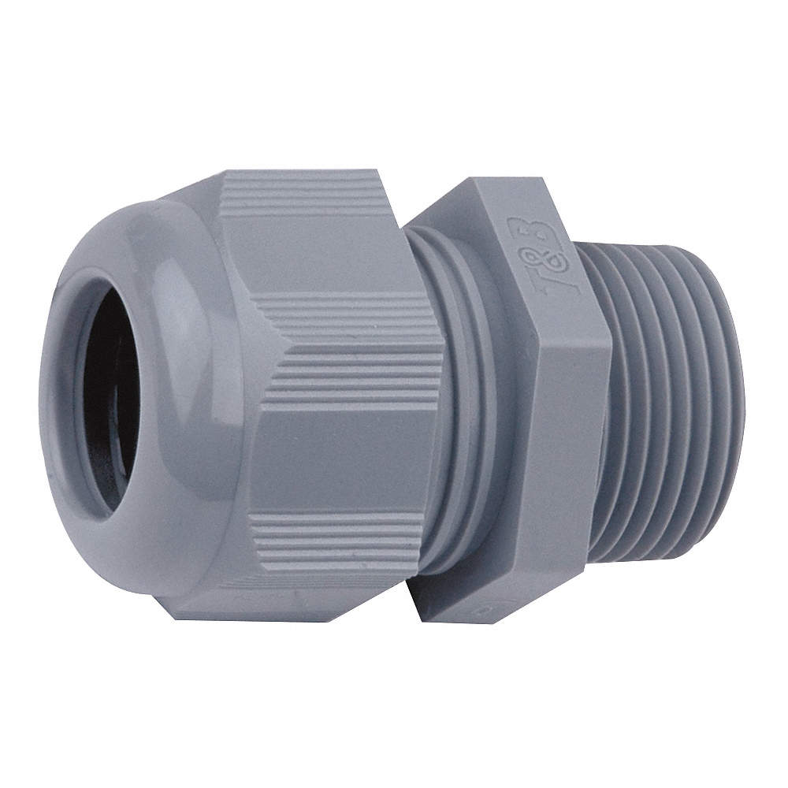
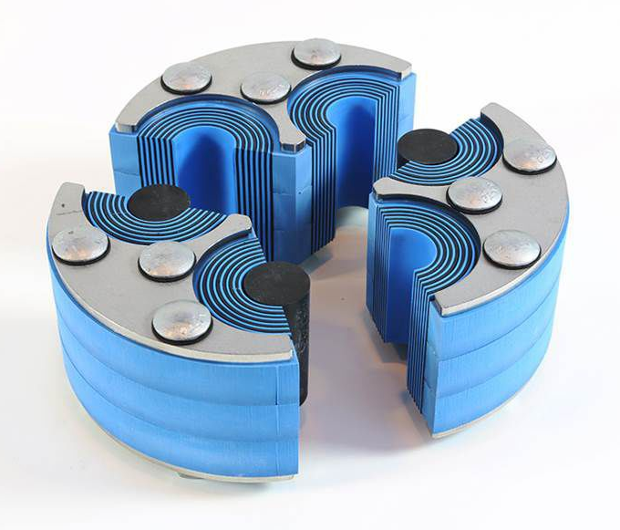
Laser Safety
Lasers may escape through viewports
Cross must be light-tight
Making shielded regions light tight not feasible
Thin cable seal needed
Significant space limitations
Roxtec feedthrough

Slide 11
Items to Address
Camera flange/Bias coil interference – Updated coil details?
Ion pump , pump port, and gauge specifications
Coupler envelope and mounting details – Pending Simulations
Degaussing procedure specifics – wire routing may drive designs
Bakeout procedure specifics
Laser safety design items

