Slide 1
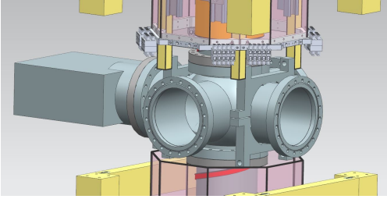
MAGIS-100 Magnetic Shield Coupler Iteration
Eric Jin
Victor Guarino
Roger Kellogg
Argonne National Laboratory
March 22, 2020
Notes:
My name is Eric Jin, working for Argonne National Lab. Today I will talk

Slide 2
Requirements and Specification
Coupler will overlap vertically with shields belonging to sections above and below (12” overlap to be confirmed with magnetic simulations).
Coupler will have ~1 cm radial gap from main section shields.
Nominally, coupler should be .080” thick: 4 layers of .020” material.
Coupler is to be made with zero gaps:
  the magnetic effect of a single seam at the center from top/bottom overlapping halves is going to be investigated, this would allow a single piece rather than layers.
No bending or machining of shield is allowed after annealing.
Material will be Mu metal
Minimal loads allowed on mu metal because this could affect magnetic permeability.
One hole in coupler expected for ~4” tube which connects to vacuum pump located outside shield.
Coupler to be installed after vacuum bake and camera installation in shaft.

Slide 3
Requirements and Specification
Coupler will be pre-mounted to strongback frame and moved into position when ready.
There are holes in the main shield where flat plates of main shields connect to ribs. These holes and ribs can be used to hold coupler if desired.
There will be one magnetic coil pair used with this coupler - requirements TBD.
Radial space to main shield tolerance ±.xxx inch
Strength analysis should consider a 0.15 g seismic load.
Installation of the shield coupler must occur with 2 people working from a hoist.
Maximum temperature:150 C.
Maximum service temperature: 150 C.
humidity condition:
Surface finish:

Slide 4
Design Considerations
The Design was iterated based on discussion from the meeting on February 28, 2022 among the participants of FNAL, Stanford and ANL:

Slide 5
Design Considerations
  Two-piece Coupler design.
  Nearly fully overlapping by extending the length of both couplers.
  Linear movement by using Teflon slide block.

Slide 6
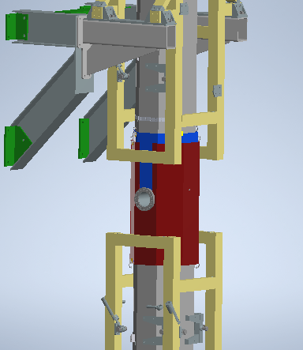
The Design

Slide 7
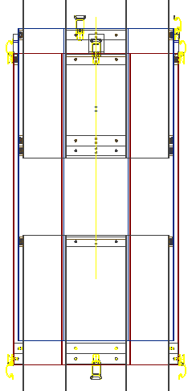
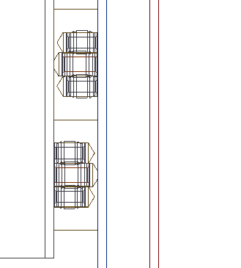
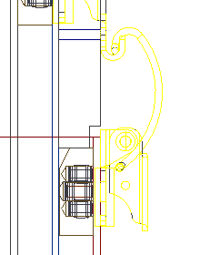
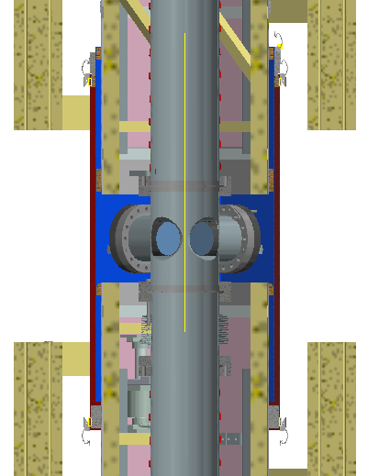
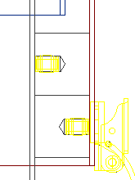






The Design
Thin Block-Locking Latch Hook (Attached to UCS) (4)
Thin Block-Locking Latch Hook (Attached to UCS) (4)
Locking Latch (Attached to LCS) (4)
Thin Block-Locking Latch (Attached to LCS) (4)
Upper Magnetic Shield ASSY (UMSA).
Thin Block (Attached to UCS) (4)
Thin Stop Block (Attached to UMSA) (4)
Upper Coupler Shell (UCS)
Thin Block (Attached to LMSA) (4)
Lower Coupler Shell (LCS)
Lower Magnetic Shield ASSY (LMSA).
Thick Block (Attached to LMSA) (4)
Thick Block-Locking Latch (Attached to LCS) (4)

Slide 8
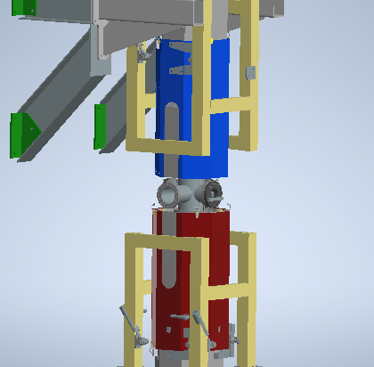
The Design

Slide 9
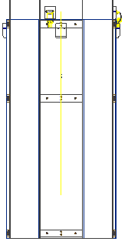
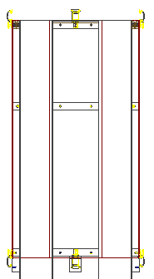
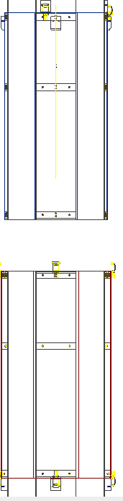
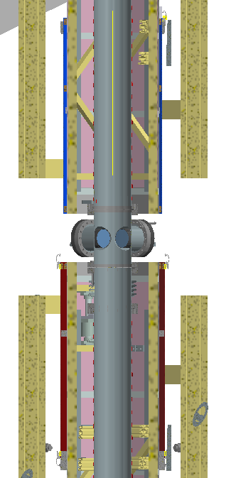
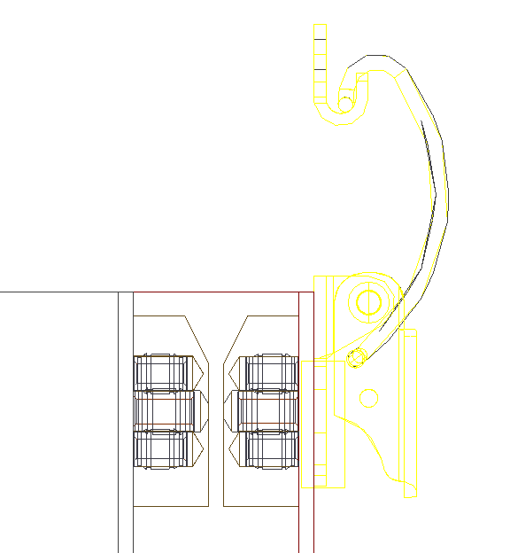
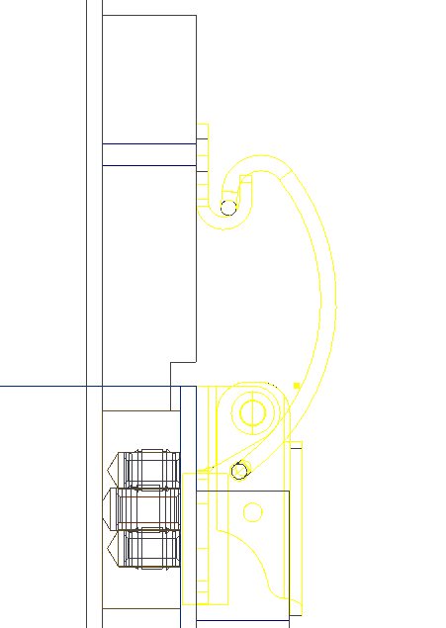
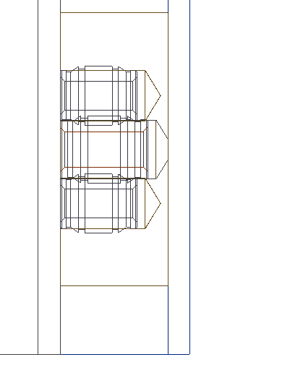
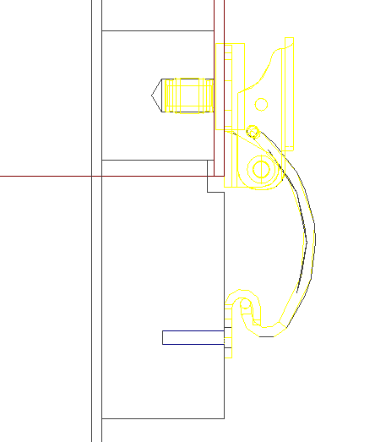
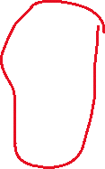




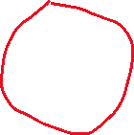


The Design
Thin Block-Locking Latch Hook (Attached to UMSA) (4)
Locking Latch (4)
Thin Block (Attached to LMSA) (4)
Thin Block (Attached to LCS) (4)
Thick Block-Locking Latch (Attached to LCS) (4)
Thin Stop Block (Attached to UMSA) (4)
Thick Block-Locking Latch Hook (Attached to LMSA) (4)
maintenance position

Slide 10
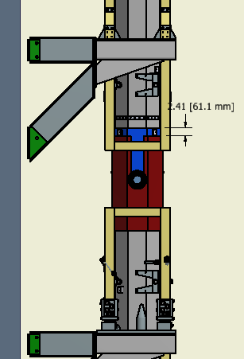
Dimensions

Slide 11
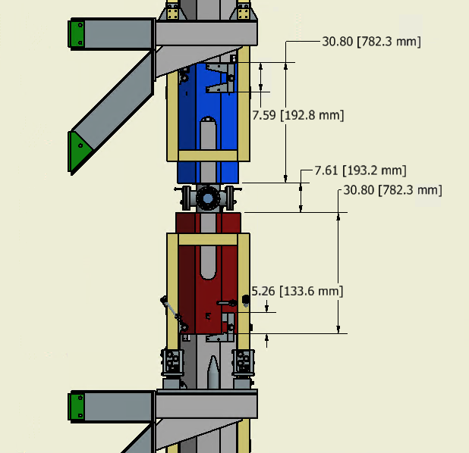
Dimensions

Slide 12
Summary
  Simplified from previous design
  May need some temporary fixtures to stabilize the lower coupler before installation and erection.

