Slide 1
MAGIS Bakeout Design Workshop June Update
Ron Kellett -Fermilab
MAGIS involvement - Bakeout planning – Vacuum consult – Installation consult

Slide 2
General Rough (very rough) Outline
The plan is to bake the vacuum system at 150°C with a ramp rate of 2°C / min
Are there any concerns with 150°C temperature on specific components? Please add them to the chat.
The controllers will be made in-house and controlled and monitored via ACNET control system.
The main vacuum tubes will be heated with two 40’ long 1040W silicone rubber insulated heaters, with two spares installed as back up due to inaccessibility.
The Connection node components will be heated collectively inside of a removable bake out box w/two finned bar heaters.

Slide 3
The top telescope section will not be baked. Bottom mirror will be baked.
The magnetic permeability limit for bake components is
<1.040µ. (Tubes measured as high as 1.065µ at weld)

Slide 4
Concerns
Concern on how to seal the box around components shown by Noah. Maybe fill in the gaps or openings with foil?
Concern on how to build the box and support it. Does it have to be removed?
Concern the ion pump won’t fix in the box.
Concern the sliding shields shown by Eric don’t leave much room for the box
Concern how to route power & TC cables from inside shield

Slide 5
Action Items
Will update the detailed bake procedure located in MAGIS sharepoint
https://fermipoint.fnal.gov/project/MAGIS/_layouts/15/guestaccess.aspx?guestaccesstoken=xBn54eLZHaagXoMxlJgGuOP5%2bSGFqlNA9BepXL2AWRE%3d&docid=2_163d8a1b100c2442a88dd08329dec1c94&rev=1

Slide 6
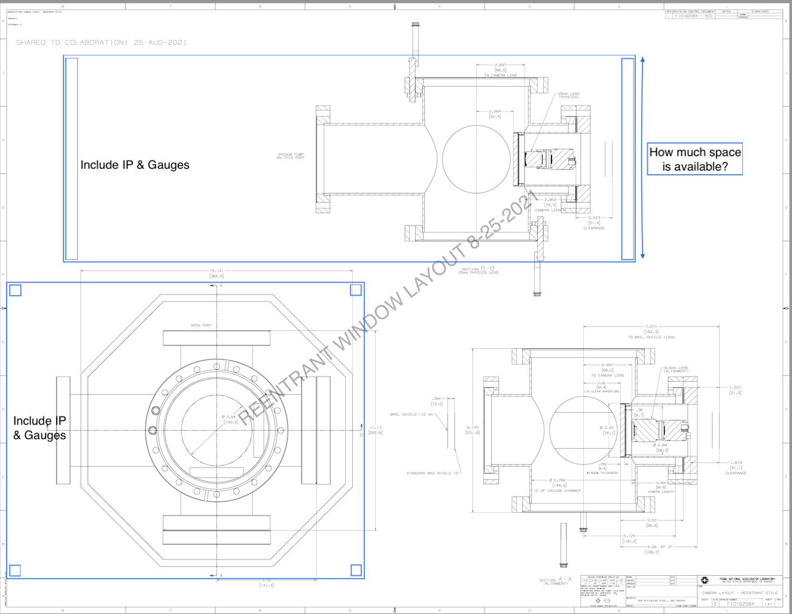
Connection Node Bake box outline possibilities

Slide 7
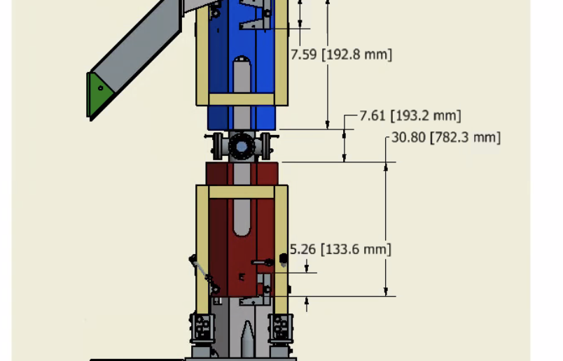
Showing shielding gap – Eric from Argonne

Slide 8
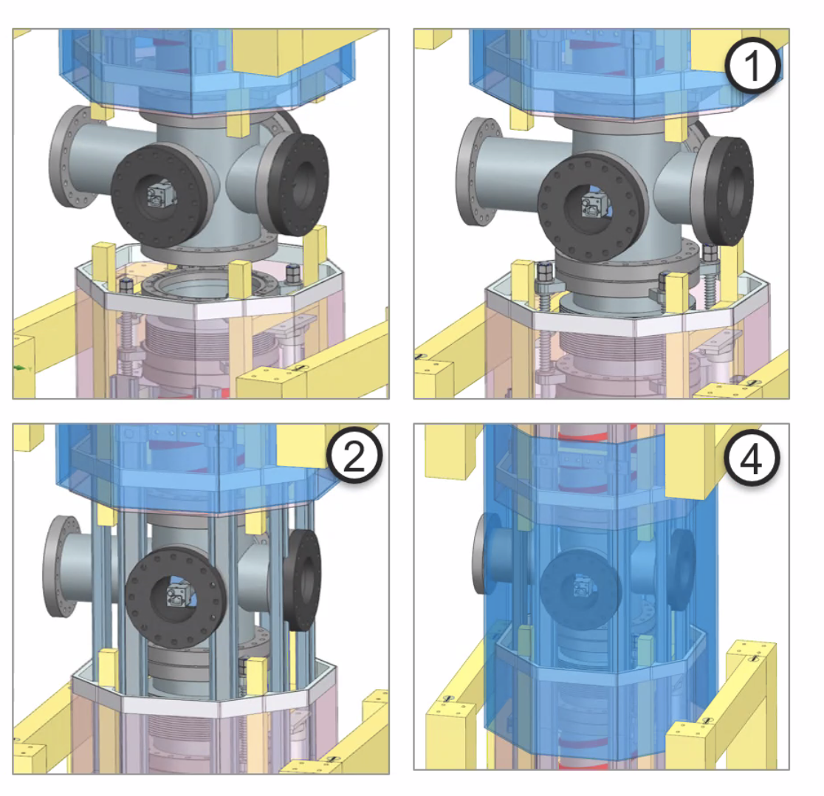
More details - Noah

