Slide 1
DAPHNE Changes
T Shaw
1 JULY 2022
V2a

Slide 2
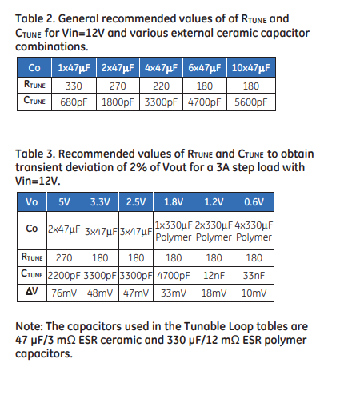
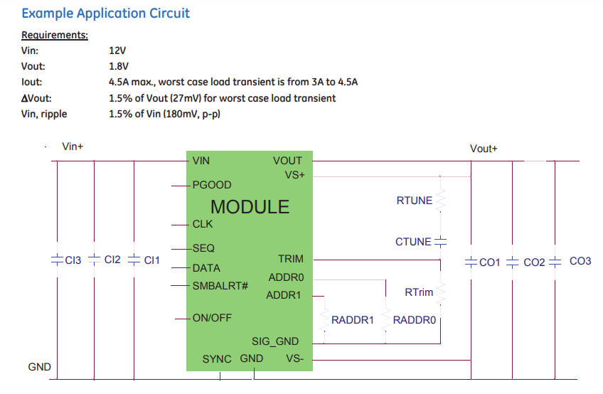
PDT006A Recommendations
Sheet 10
PDT006A DC/DC converter recommendations ->
Not sure where current values came from
Milano group requests:
For +5.5A(voltage) U43
Lower output to +5V by changing R351 to 2.7Kohm
Change Rtune from 100 ohm to 270 ohm
Change Ctune from 10nF to 2200pF

Slide 3
PDT006A Recommendations
Sheet 10
PDT006A DC/DC converter recommendations ->
Not sure where current values came from
For +5A(voltage) U42
Change Rtune from 100 ohm to 270 ohm
Change Ctune from 10nF to 2200pF
For +3.3V U39
Change Rtune from 100 ohm to 180 ohm
Change Ctune from 10nF to 3300pF
Do we want to change anything else – multiple DC/DC converters on that page?

Slide 4
PDT006A Recommendations
Do we want to do anything with low voltage digital rails?
Sheet 10
PDT006A DC/DC converter recommendations ->
Not sure where current values came from
For +1.8V U36
Change Rtune from 100 ohm to 180 ohm
Change Ctune from 10nF to 4700pF
Adjust Co?
For +1.0V U33
Change Rtune from 100 ohm to 180 ohm
Change Ctune from 10nF to 3300pF
Adjust Co?

Slide 5
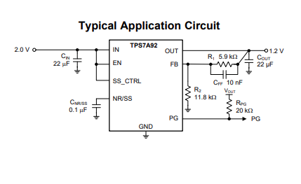
TPS7A9201 layout – U17, U19, U35, U37, U40, U44 sheet 10
We are NOT currently following recommendation for 10nF capacitor placement - FIX

Slide 6
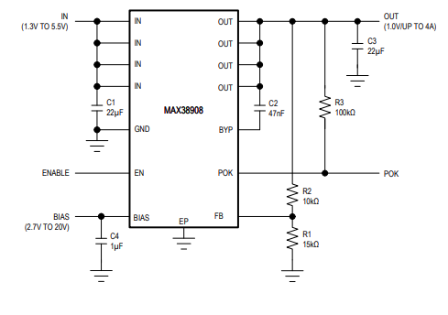
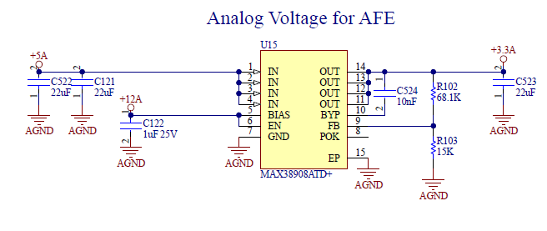
MAX38908 – U 15 sheet 10

Slide 7
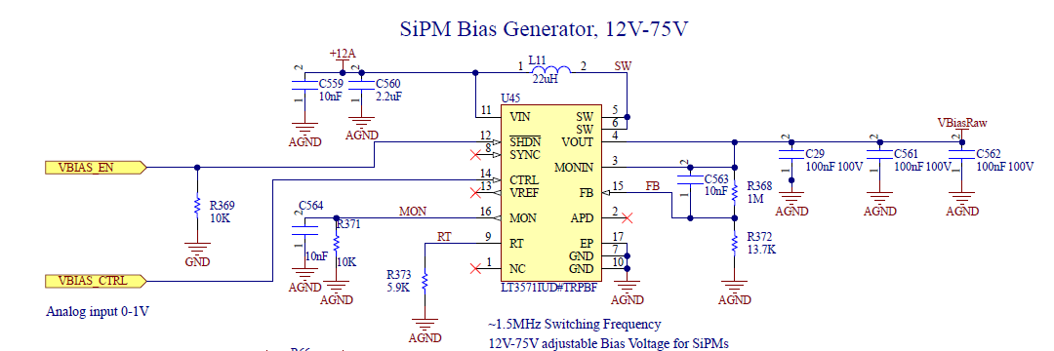
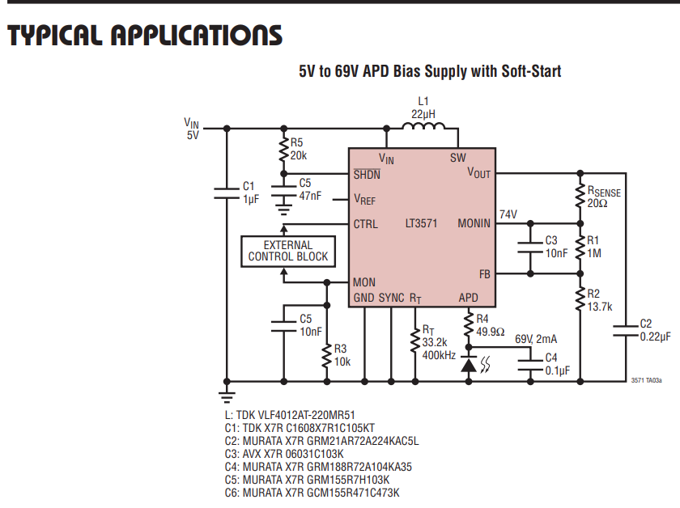
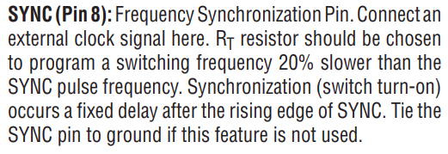
LT3571
Tie Sync to GND?

Slide 8
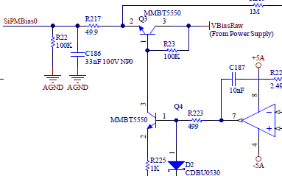
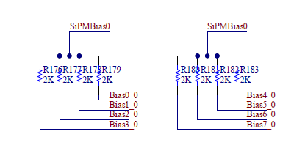
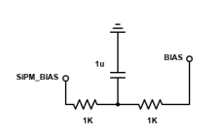
SiPM Bias filter
Sheet 2 (x5)
Change R217 from 49.9ohm to 1Kohm
Change R186 from 33nF to 1uF (200 WVDC)
Sheet 2 (x5)
For Bias, split 2Kohm resistor and add DNS 1uF (200 VDC) capacitor to ground at mid point.
Mark as DNS in schematic

Slide 9
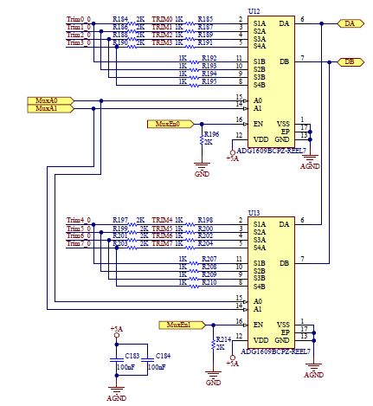
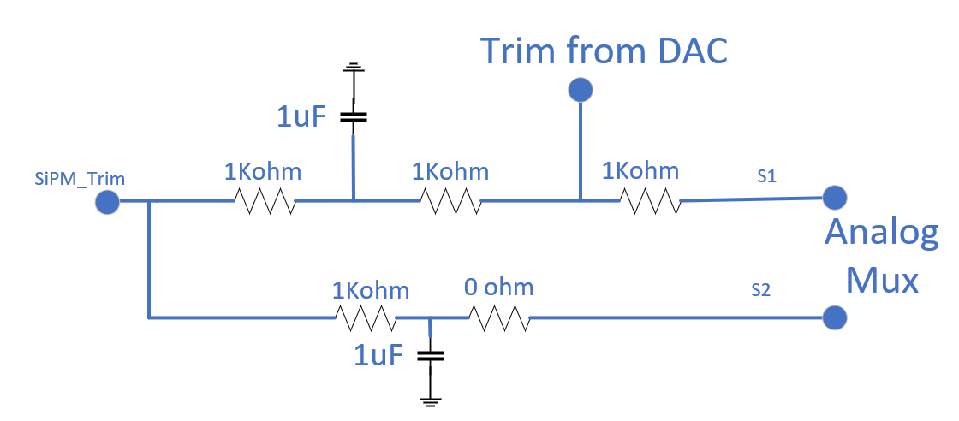
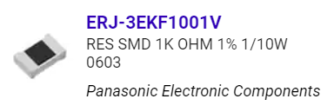
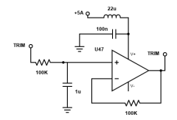
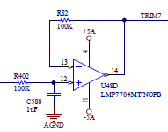
Trim Voltage filtering near analog Mux
Sheet 2 (x5)
Put in filter circuit which allows for selection of Patch 1,2,or 3
For Trim. Need to decide before sending to assembler.
Sheet 3 (x5)
Add power supply filter to Trim op amp – BOTH power rails V+ and V-
100nF capacitor
22uH Ferrite
IHLP2020CZER220M11 L inductor SMT Fixed Inductors Commercial Low DCR Series 22uH 1.9A 270mΩ 20%

Slide 10
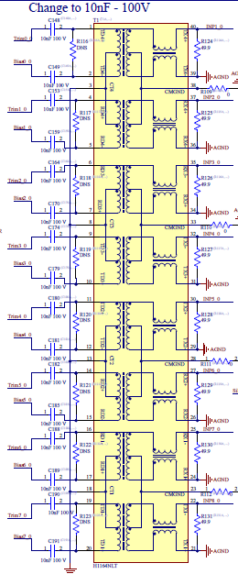
DC blocking Capacitors
Sheet 2 (x5)
Change 10nF capacitors to 100nF
Suggest selecting 200DCWV

Slide 11
Other
Sheet 8
Two Dual transmit SFP+ packages changed to four 10GBASE-SR SFP+ 850nm transceivers
Looks like above included in 28 JUNE schematic. Need to verify new FPGA connections as well.

Slide 12
Other
Sheet 6
Check open pin 9 on SFP package J3 – should be grounded
Sheet 2
For xfmr chip, R116-R123 should be DNS - OK
Also, R124-R131 should be changed from 49.9 ohms to 100 ohms
Sheet 10
Verify L10 footprint fixed
Sheet 6
Does X1 output need 49.9ohm termination at load?
Verify X5 output clock termination at load.
Sheet 11
J23 pin 3 is a “TX_Disable” pin, it is noted as TX enabled. Correctly connected to GND. (Text only correction)

Slide 13
Other
Sheet 10
Verify cell shape of U15 MAX38908 (analog voltage for AFE) – also verify layout has no choke points for current

Slide 14
Optional GND connections
Sheet 5
Change R72 from 0 to 100 ohms for consistent GND to AGND connections

Slide 15
Chassis Fab
Need to make this priority as soon as all connector placements locked in.
No connector shell or mating connector should make electrical/conductive contact with the chassis other than LVDC input – J12 (Sheet 10)

