Slide 1
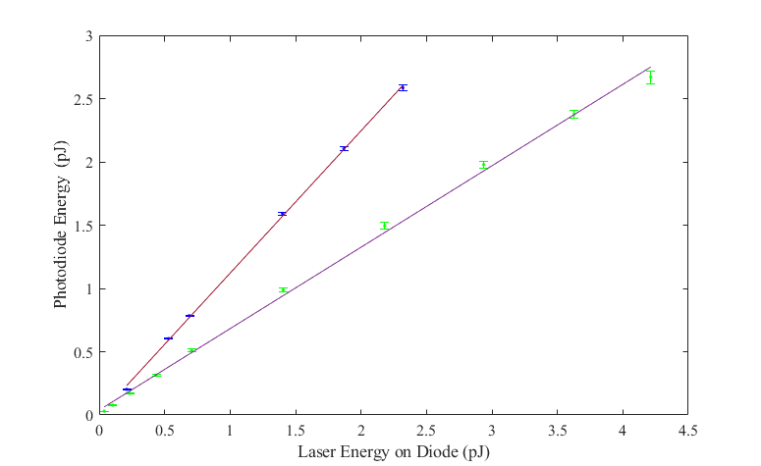
I took the integrator conversion of 2.73 pF from the first benchtop measurements
I used a photodiode conversion of 0.66 C/J for 1054 nm and 0.99 C/J for 1500 nm
1500 nm
1054 nm (most recent data)

