Slide 1
Insulation for REBCO and Bi2212 conductors
Workshop on High Temperature Superconducting Magnets for Muon Collider
Fermi National Accelerator Lab
May 30-31, 2012
Andrew Hunt
nGimat, LLC, Lexington, KY
Work sponsored by DOE – Office of Science STTR Grant No. DE-SC0004657-001
And Performed in Collaboration with
the Schwartz Team at North Carolina State University

Slide 2
Requirements for HTS Magnet Wire Insulation
Electrical
Sufficient dielectric strength to prevent current leakage and turn-to-turn and layer-to-layer breakdown under potential quench voltages of several kilovolts
Influenced by thickness, mechanical and field stresses, aging
Thermal
Sufficient thermal conductance to allow rapid transverse removal of heat from a quench zone and enhance stability.
Needs high thermal conductivity
Needs to be thin
Thermal expansion compatibility
Mechanical
Toughness to withstand the rigors of fabrication, Lorentz forces, and thermal cycling
Radiation
Radiation tolerance to high accumulated doses of neutrons and gamma rays

Slide 3
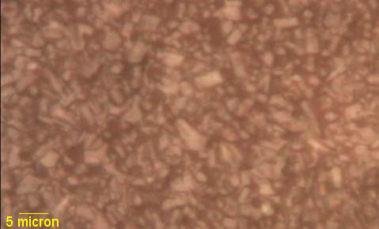
New Insulation Coating for Bi2212
Bi2212 strand is spool-to-spool dip-coated from a slurry.
Green base coat is oxide ceramic nanoparticles with an organic binder.
Green base coat thickness is typically ~13 µm.
~3 µm top coat of the same binder polymer is applied for better winding durability.
During reaction heat treat, the organic binder dissociates cleanly and is either removed as monomeric vapor or gets oxidized to CO₂ and H₂O.
The oxide ceramic sinters to a continuous, typ. 8 µm, adherent layer.
As-coated Bi2212 base coat + topcoat
Surface of sintered ceramic coating

Slide 4
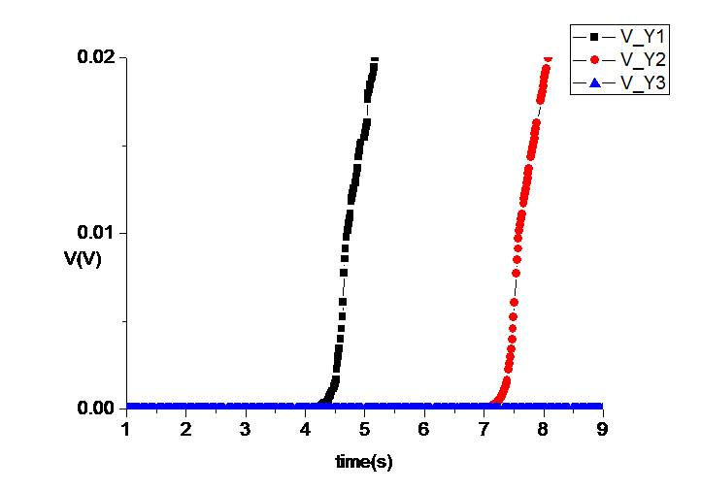
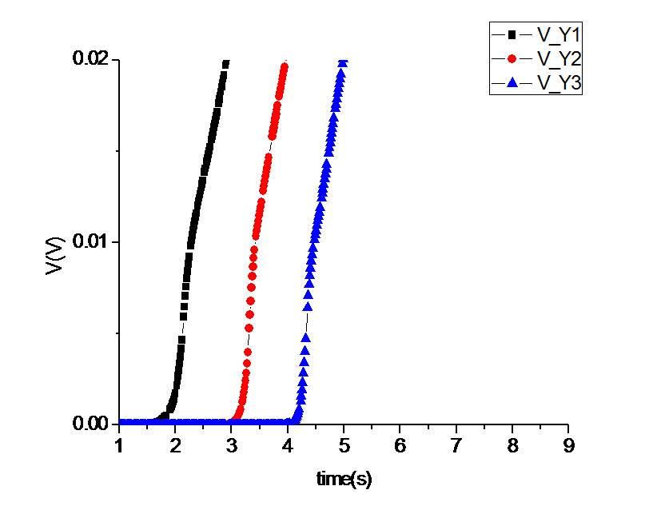
New Insulation Coating for Bi2212
Advantages
Sintered ceramic ➔ an insulation with high thermal conductivity
Thin layer ➔ low layer thermal resistance
Intimate bonding to conductor ➔ low interface thermal resistance
⬇
Fast transverse heat dissipation in a coil
Quench data (from NCSU, our STTR partner) from coils insulated with this dip-coated ceramic insulation showed 2.8 times faster layer-to-layer quench propagation (transverse NZPV) compared to braid-insulated Bi-2212.
Voltage evolution in coil of OST Bi2212 with braided insulation
Voltage evolution in coil of OST Bi2212 with nGisulate insulation

Slide 5
New Insulation Coating for Bi2212
Advantages
Good voltage breakdown strength ➔ ~1400 V av. (88 kV/mm) at 77 K
Low current leakage ➔ <1 µA before breakdown
No effect on Bi2212 ➔
Good coating speed ➔ has been typ. 2.7 m/min (working to increase)
Simple process
Not costly
FNAL has shown that the same nGimat coating on reinforcement wire enables cabling and heat treatment of Bi2212 without I_{c} degradation.
IGC Bi2212 Conductors | I_{c} (A) | n-value
Bare | 232 | 11.6
nGisulate Insulation | 233 | 11.1
Braided Mullite Insulation | 144 | 8.2

Slide 6
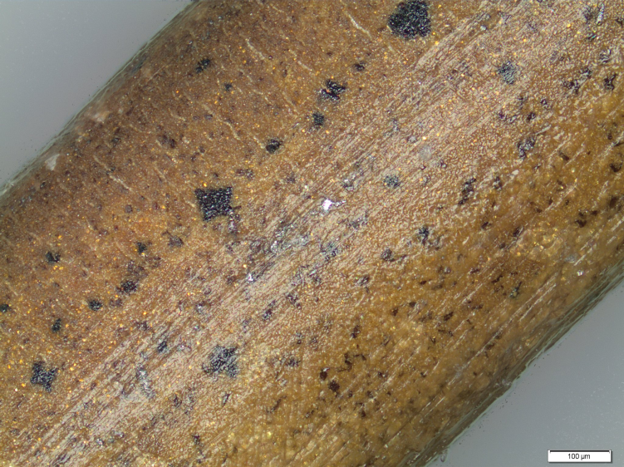
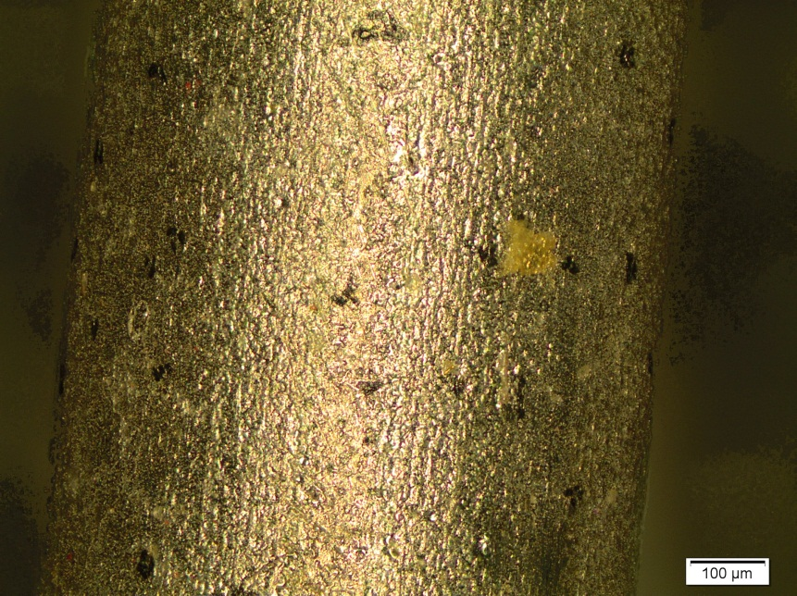
Possible Issues with the New Bi2212 Insulation Coating
Disclaimer – None of the performance measures for the insulation coated Bi2212 have shown an impact from the following.
nGisulate coated HT
Black Spots
Black spots shown at right are seen everywhere over the surface of heat treated Bi2212, at least of the 4 types of strand that we have worked with.
These were expected to be spots of Bi2212 leakage into the insulation, and in fact, EDS has shown higher levels of Cu in inclusions at these spots.
Cracks
Black spots
Cracks
Cracks in the coating are common. They are generally on one side of the wire and are assumed to be tensile cracks originating during coating. They do not reach to the wire surface and may be favorable as an oxygen path to the wire.
Bare HT
Cracks

Slide 7
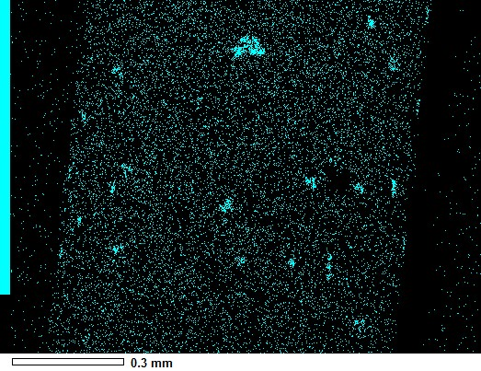
Possible Issues with the New Bi2212 Insulation Coating
Disclaimer – None of the performance measures for the insulation coated Bi2212 have shown an impact from the following.
White elongated inclusions
The EDS Cu map at right show these inclusions indicates them to have elevated levels of Cu which is not a constituent of the coating. The presence of Cu is again an indication of Bi2212 leakage. Also, we are assessing the advisability of refining the composition.

Slide 8
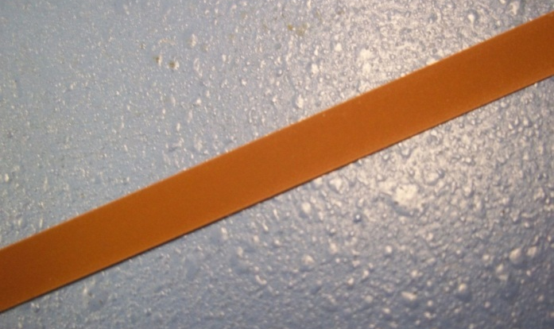
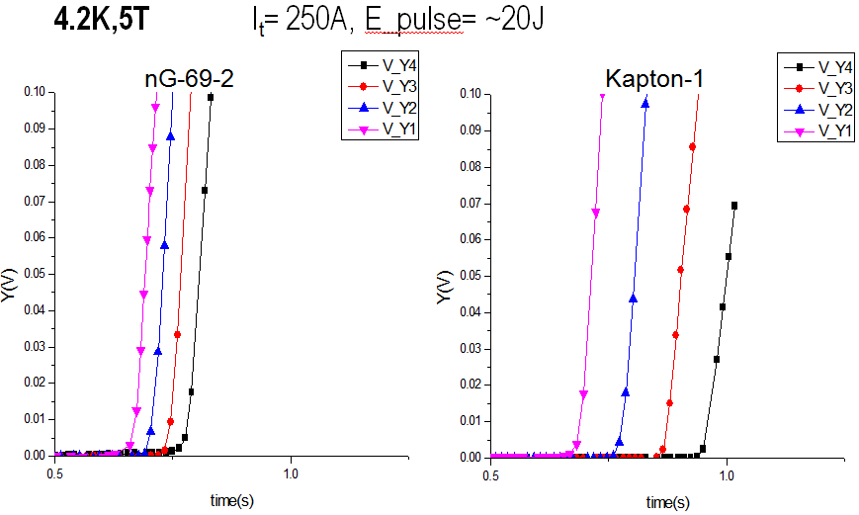
New Insulation Coating for YBCO
YBCO tape is insulated with a high dielectric strength polymer filled at over 50 vol% with a crystalline oxide ceramic nanopowder having exceptionally high thermal conductivity (17,000x the neat polymer) at 4.2 K.
Uniform and complete coverage on both sides
Av thickness - 11 µm
Thermal conductivity - 0.45 ± 0.05 W/m·K at 77 K (6.9x the neat polymer)
Av. voltage breakdown - 1733 V (79 V/µm) at 77 K
Quench transverse NZPV - 26 layers/s (4.2K, 5T)
Insulated 4 mm wide YBCO tape
2.5x faster transverse quench propagation than with Kapton tape insulation
⇦

Slide 9
Issues with the New YBCO Insulation Coating
Insulation of Tape Edges
In the present state of development, tape edges are coated completely, but too thinly to be adequately insulating.
This results from surface tension pulling the dip-coat slurry away from the edges.
We are working to increase edge thickness by:
decreasing slurry surface tension
modifying the slurry rheology
controlling the drying rate
multiple edge coats

Slide 10
Collaborations
NCSU
As the STTR partner, the NCSU team, led by Justin Schwartz, evaluates conductor insulation by building and testing quench coils, measuring thermal conductivity, and performing other characterizations.
SuperPower
SuperPower, Inc. has contributed the necessary YBCO tape for the Phase I and Phase II R&D efforts. Additionally, they (Drew Hazelton, el al) have conducted evaluations of nGimat insulated YBCO.
VHFSMC
The Very High Field Superconducting Magnet Collaboration has contributed 200 m of Bi2212 strand for the STTR Phase II, plus another 50 m to be insulated by nGimat and evaluated by the VHFSMC.
Fermi Lab
nGimat is collaborating with Fermi on Bi2212 insulation and cable reinforcement barrier coatings.
Others
nGimat has coated superconductor for the Magnet Lab, LBNL, and ANL, whose evaluations feed into the HTS magnet knowledge base.

