Slide 1
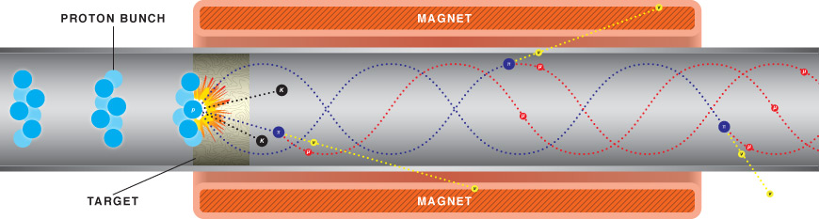
Conductors for HTS Magnets:
Why we need both REBCO coated conductors and round wire Bi-2212
David Larbalestier*
Applied Superconductivity Center
National High Magnetic Field Laboratory
Florida State University
Tallahassee, FL 32310 USA
*Opinions formed in many discussions with MagLab, BSCCo, VHFSMC, OI and SuperPower colleagues

Slide 2

Part 1: What do we need for a secure HTS magnet technology?
A real applications pull that can generate continuous conductor orders
Conductors worth continuous orders
Coils, R&D
Test Beds
27T with SuperPower
31T 2212 NHMFL
34 T YBCO NHMFL
Conductors
YBCO
2212
2223??
Fe-base??
HTS Magnet
Systems
32 T
Neutron scattering facilities
SMES + Muon Colliders
NMR

Slide 3
Part 2. What do we need for a secure HTS magnet technology?
Conductors in length with assured, uniform and predictable performance
Cabled versions of the conductor
Effective thin insulations
Resistance to Lorentz and other coil forces
Quench protection
Affordability
Reliable performance under plausible service conditions

Slide 4
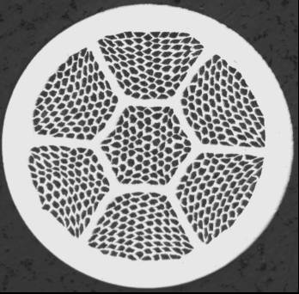



3 HTS conductors – so why only consider 2?
Bi-2223 multifilament tapes
Bi-2212 round wire ~ 1mm dia.
Bi-2223 tapes exhaustively studied for power applications 30-77K: How much more development is possible?
REBCO coated conductor tapes
2 μm Ag
1 μm HTS
~ 30 nm LMO
~ 30 nm Homo-epi MgO
20μm Cu
~ 10 nm IBAD MgO
SuperPower
< 0.1 mm
50μm Hastelloy substrate
20μm Cu

Slide 5
Why not 2223?
Like REBCO it is delivered in the superconducting state ……
Like REBCO it is a high aspect tape, typically 4 mm x 0.2 mm thick
It is available in lengths > 1 km….
The one vendor (SEI) is commercially aggressive, often undercutting REBCO in cost and not losing in performance in the 30-77 K range for low fields
But…
It cannot be cabled to high J_{e}
It appears near its asymptotic development (black box) limit

Slide 6
Advantages
REBCO CC tape
Round wire 2212
Ready as delivered
Multiple developers worldwide
Very strong substrate
High J_{w} feasible – 300-500 A/mm² in 20T
Could offer 30-60K operation – potentially transformative for magnet technology
Round wire form
Multifilament form
Isotropic properties
Easy path to cables
Low cost manufacture compatible with metal superconductor manufacture

Slide 7
Disadvantages
REBCO CC tape
Round wire 2212
Single filament tape
Anisotropic shape and J_{c} with large magnetization
Plated Cu is costly and dimensionally loose
Low perpendicular strength complicates winding, impregnation and insulation
Thin Insulation is difficult
Manufacture is very specific to each process (black box)
Capital and skilled team intensive
Path to cables without loss of J_{w} not yet clear
Long length J_{e} must be raised to best short J_{e}
Filaments within bundle are coupled
Much less strong than REBCO – needs separate strengthener
Complex HT in pure O₂ adds complexity at the magnet winder site
Insulations need development
Intrinsic anisotropy will limit use to less than 15 K

Slide 8
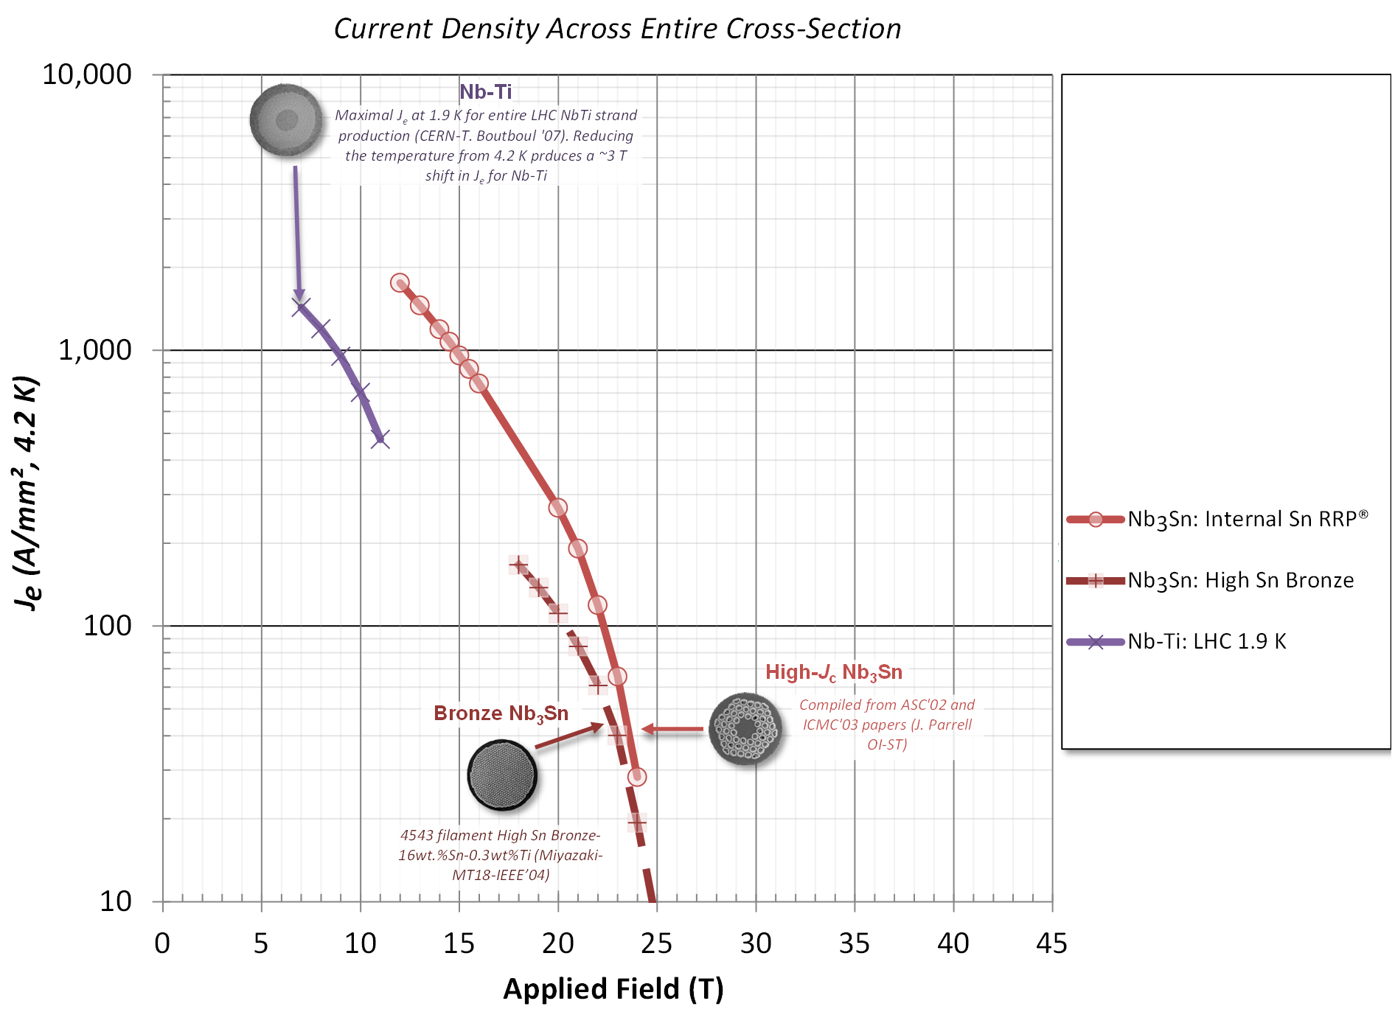
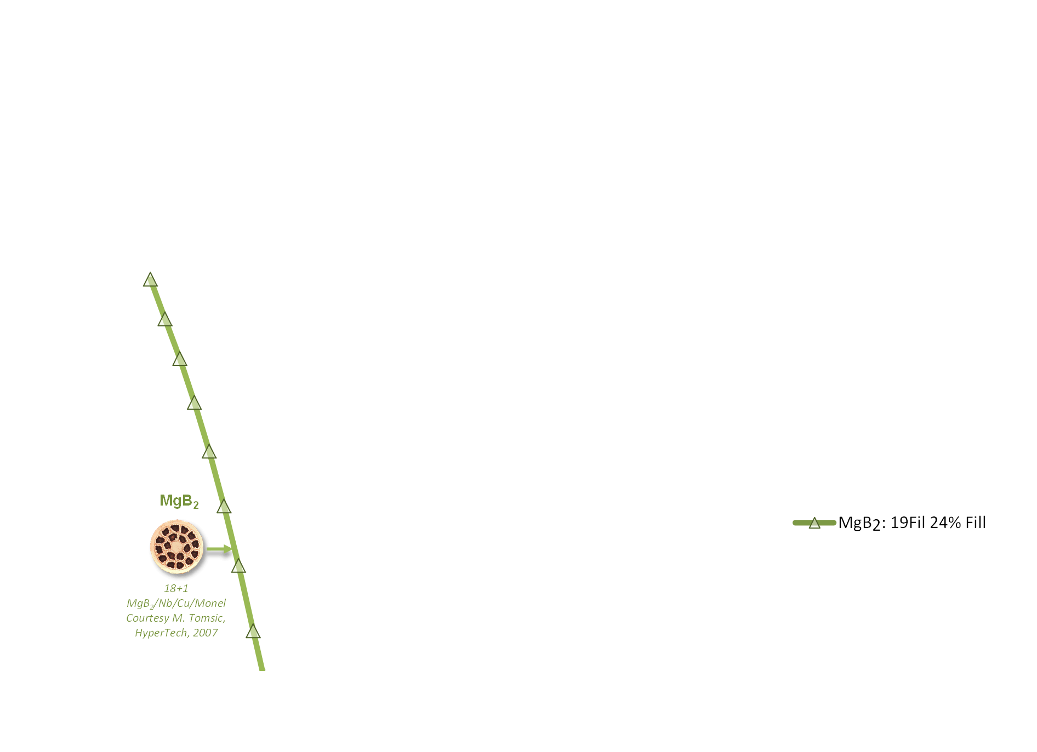
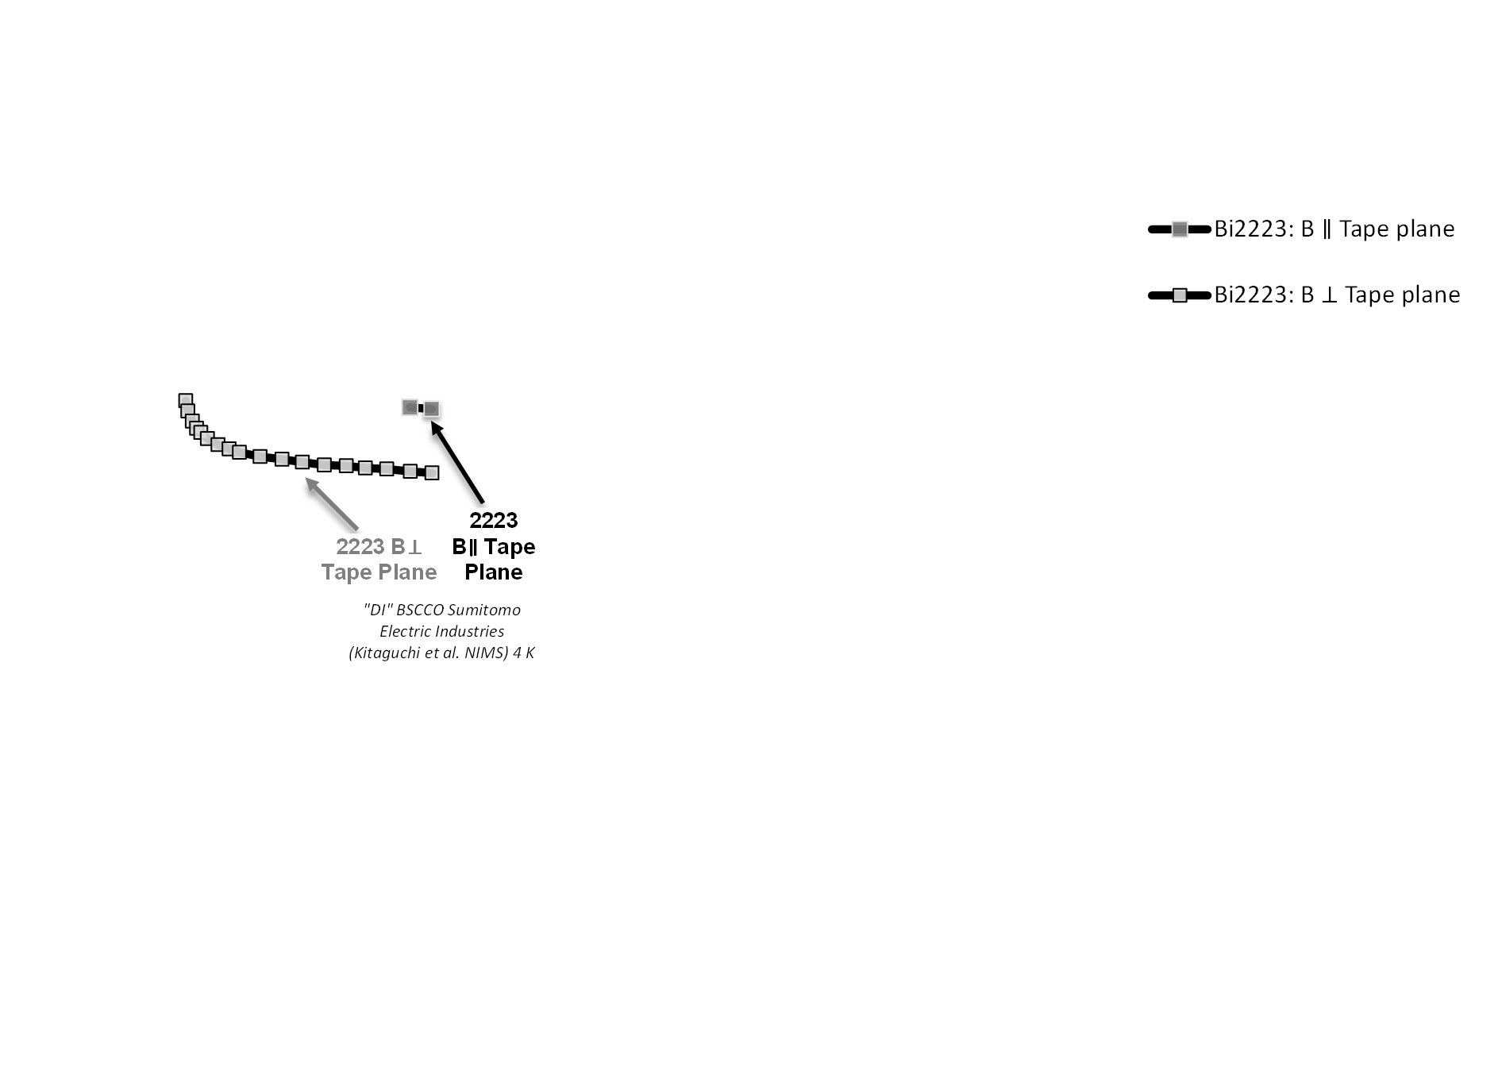
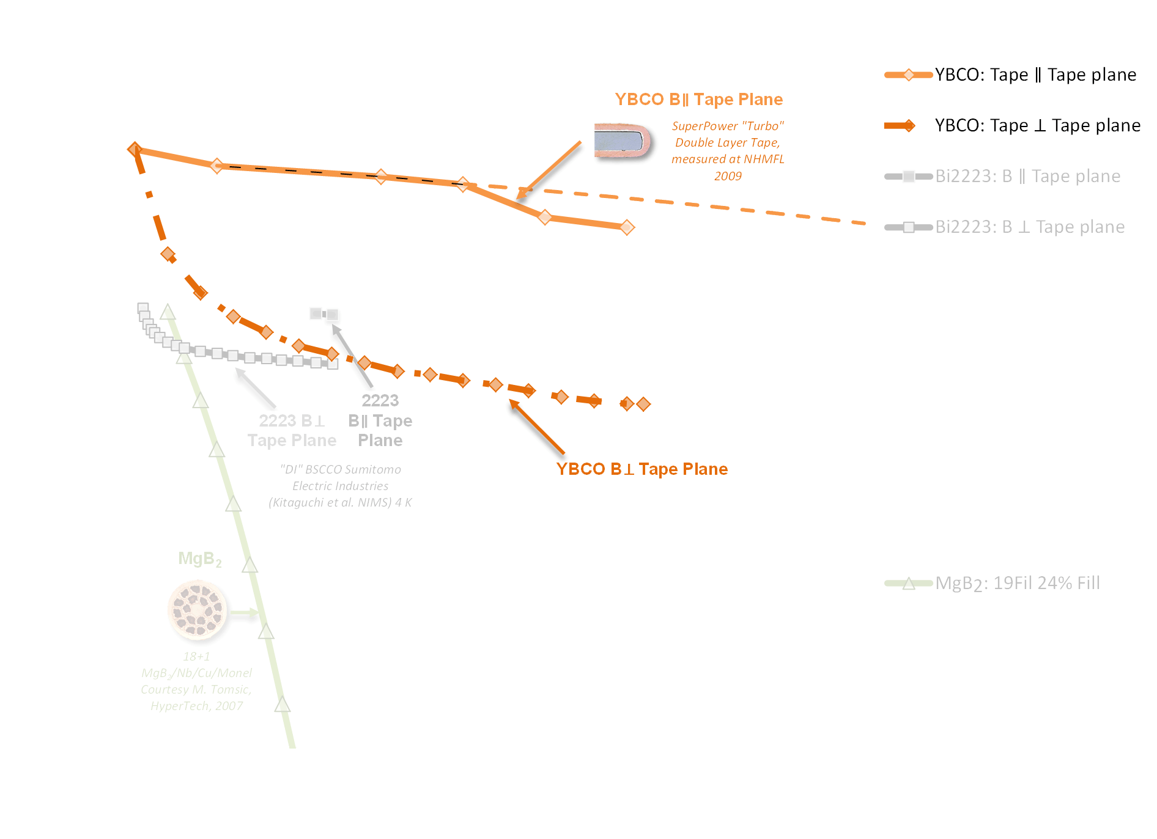
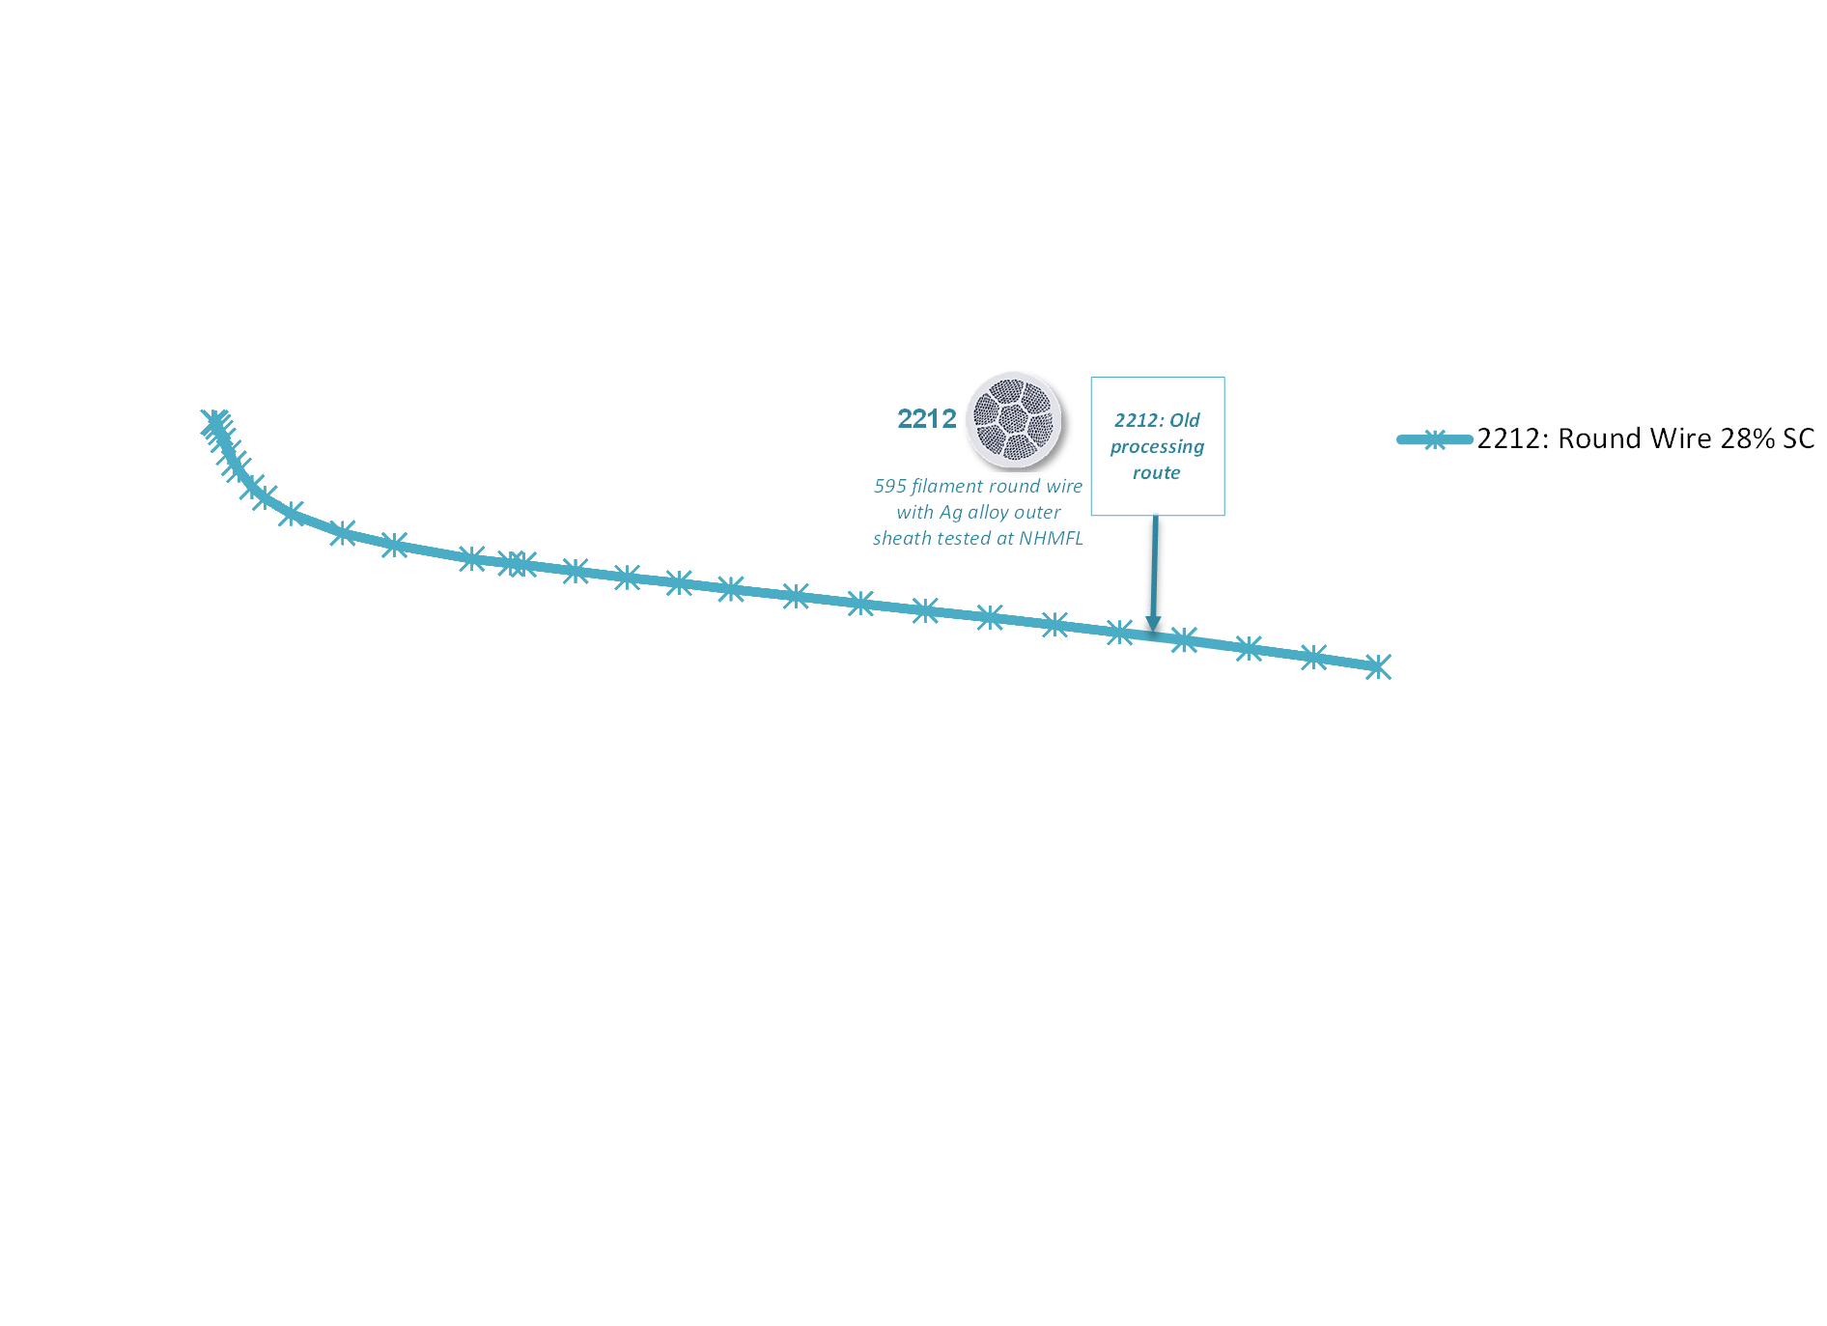
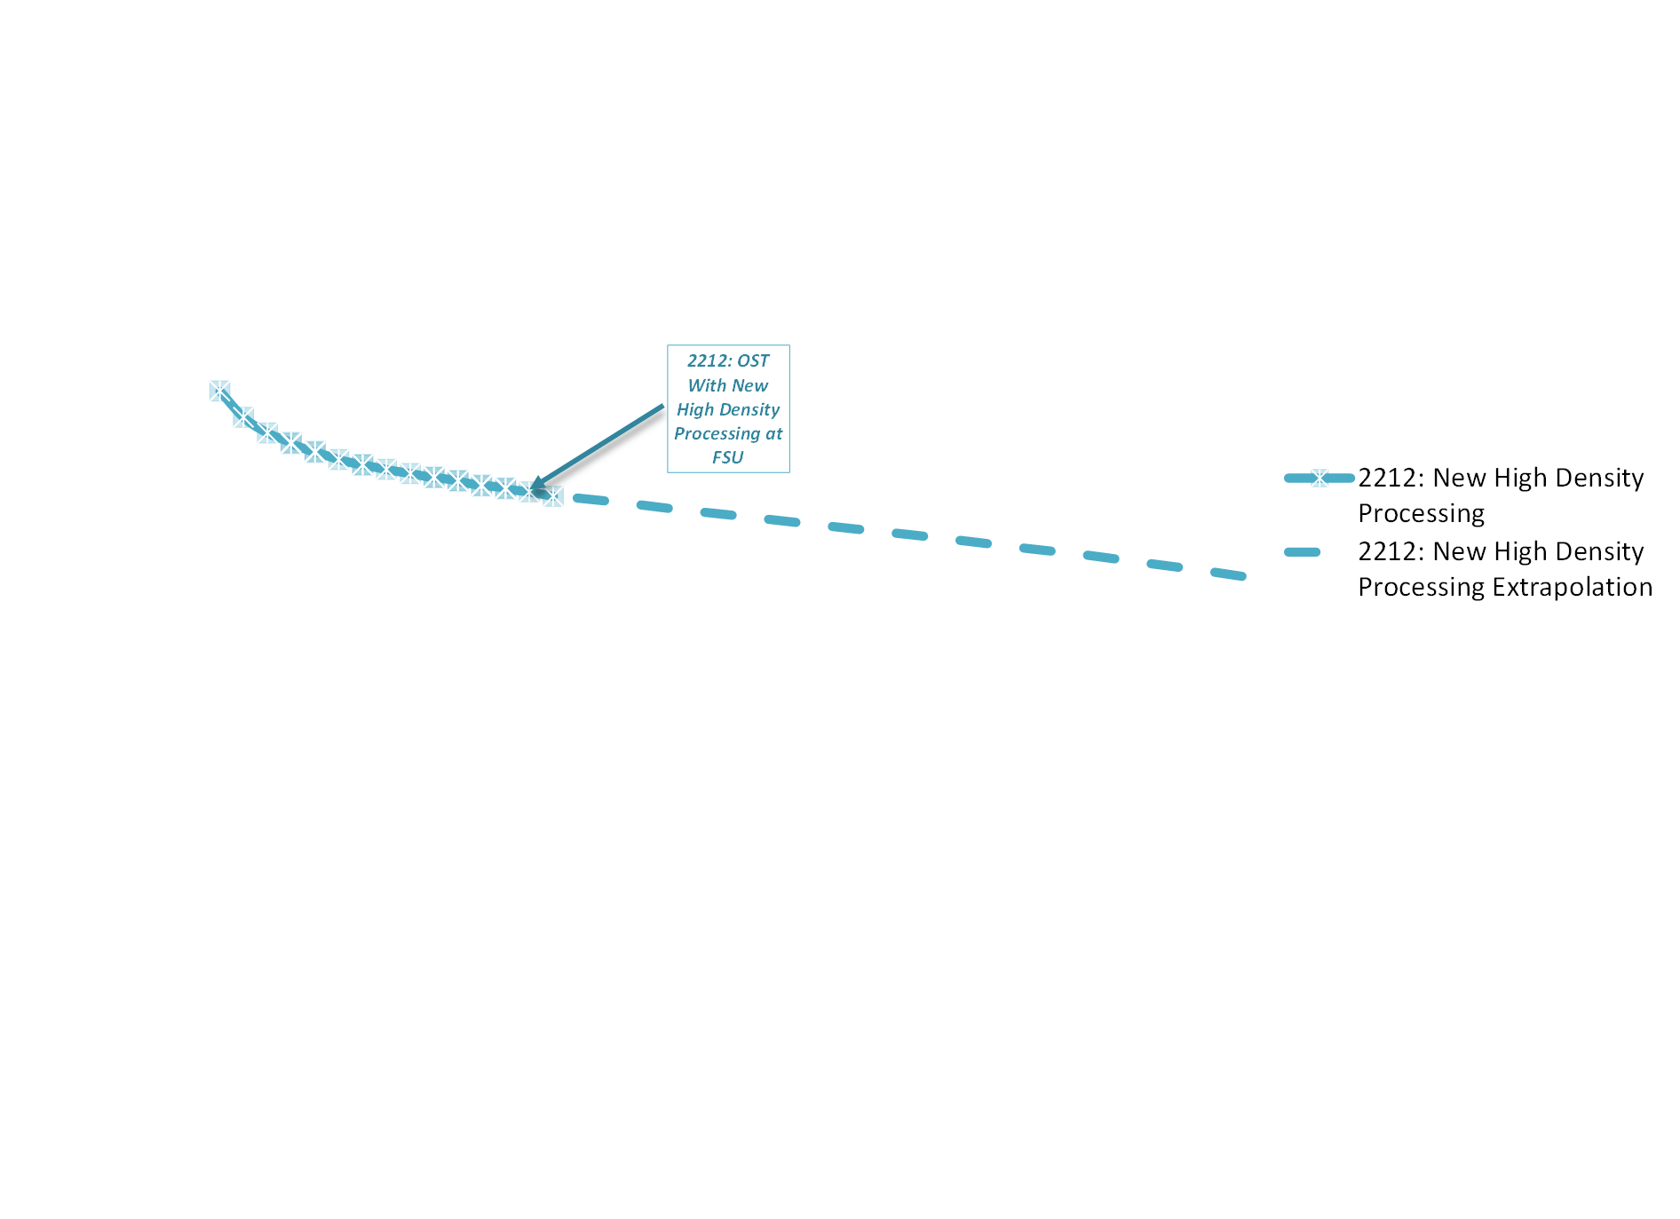
Peter Lee’s champion J_{e} plot – HTS is good!
Plot maintained by Peter Lee at: http://magnet.fsu.edu/~lee/plot/plot.htm

Slide 9
An alternative view of the plot
Peter Lee plot is self-chosen best case plot
  What is typical?
  What is the mission critical result?
Length dependence and process dependence are very different for REBCO and 2212
REBCO test coils allow an overall J_{cu} that is unrealistic EXCEPT under circumstances where active quench detection and PROTECTION works and/or loss of the coil is tolerable – defects matter

Slide 10
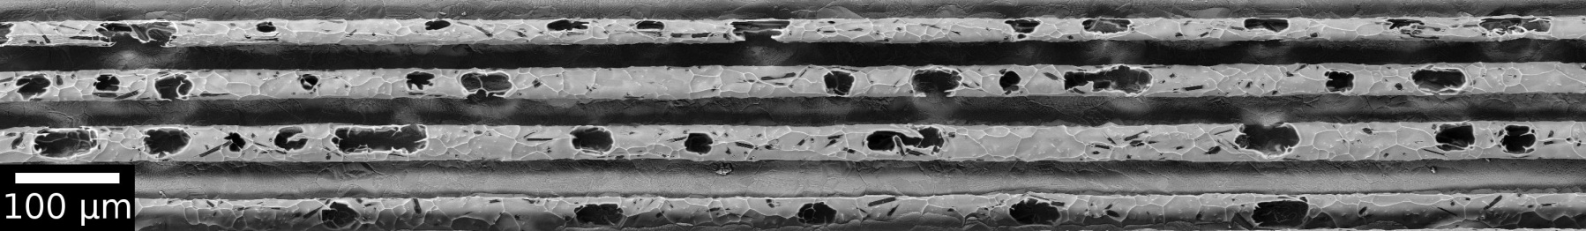
Snapshot of 2212 problems
Dedensification is the big problem
It can be controlled – see 2011 papers
See Hellstrom and Shen talks today
Malagoli et al in preparation

Slide 11
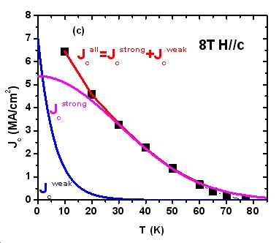
Poor correlation for REBCO between Ic @ 77 K SF and 4.2 K 14 T||c
140 A
Jaroszynski
de-convolution approach
(fitting exp(-T) and exp( –T² )
weak/strong
shows different pinning
mechanism at low T
uncorrelated but samples >100 A @77 K
are better than 140A @ LHe @ 14 T B||c
Aixia Xu et al, arXiv:1111.1268

Slide 12
SuperPower production chronology
By accident – this is our most heavily characterized conductor
averages over many samples
4.2 K 14 T ||c
BZO
140 A
Jaroszynski
77 K SF
BZO
no BZO
M3
M4
>100 A @ 77 => > 140 A @ 14 T L He with a few exceptions

Slide 13
20K anisotropy
Aixia Xu and Dima Abraimov

Slide 14
Length and variability issues
Both are getting understood
But the process and competitive drivers are very different

Slide 15
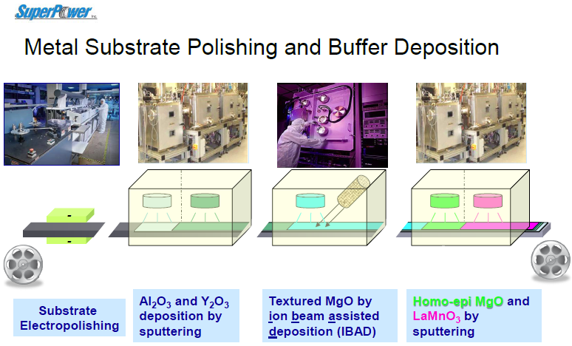
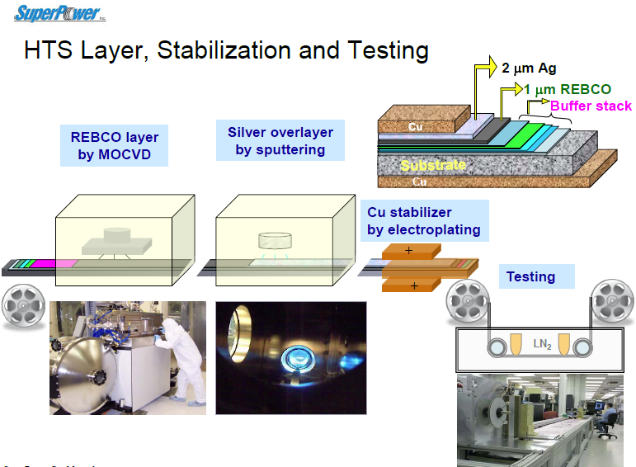
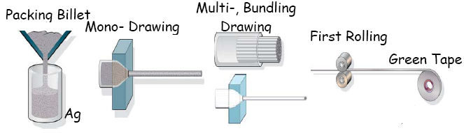
Manufacturing processes are quite different in scale and cost
IBAD-REBCO
Powder in tube:
2212 and 2223
Can use standard metal fabrication lines

Slide 16
Manufacturing processes are quite different – so what?
Each REBCO process requires its own dedicated team and production line
Each process has its own challenges
Each line costs tens of millions
Each fab line is a black box
REBCO is the ONLY conductor to offer high temperature magnets
2212 uses standard metal fabrication routes
Team needed is much smaller
Scale up is easier (2212 can use ITER scale up route)
2212 could survive on magnet users – is this possible for REBCO?

Slide 17
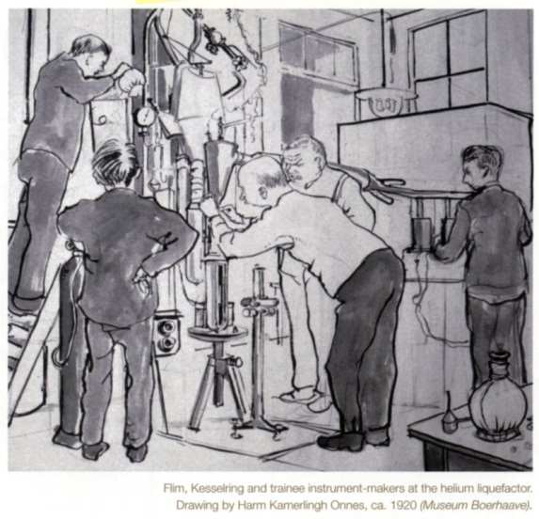
Conductor and Coil technologies are intimately linked
Coils, R&D
Test Beds
27T with SuperPower
22.5T OI and 31T 2212 NHMFL
34 T YBCO NHMFL
Conductors
YBCO
2212
2223??
Fe-base??
HTS Magnet
Systems
32 T
Neutron scattering facilities
SMES + Muon Colliders
The key challenge of today is to build test or user coils that drive the technology without failure risking black-marking of HTS magnet technology

Slide 18
A personal take on imminent key technology challenges
Understanding how to safely quench magnets like the recent NIMS-RIKEN 24 T, BNL 15 T and NHMFL 32T magnet
Developing viable cables of REBCO
Bringing bubble formation in 2212 under control so that recent short sample J_{e} values can be obtained in long lengths
Ensuring that insulation technology proceeds in parallel with conductor and magnet technology

Slide 19
