Slide 1
Proposed Access Methods
Noah Curfman
12 July 2022

Slide 2
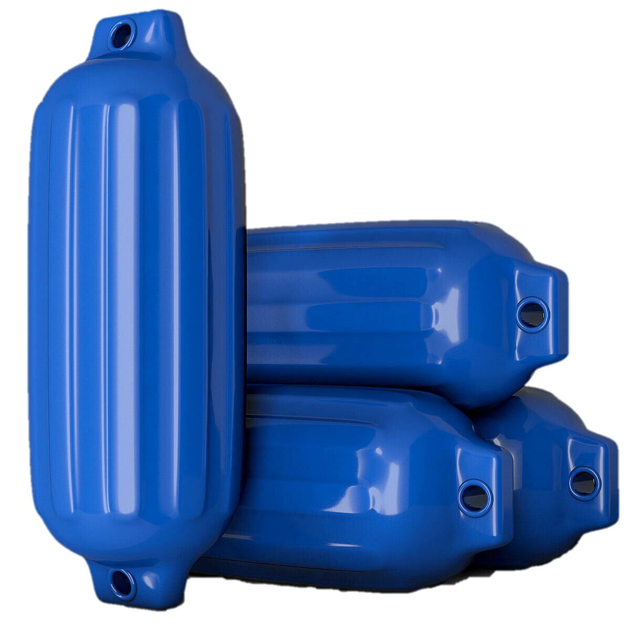
Unrestrained Basket Access
The weight of the basket is relied upon to keep things steady and bumpers are fitted to allow light contact with the experiment.
If basket rider is incapacitated the basket can be raised easily.
No design required beyond the personnel basket design.
Aligns well with currently used basket procedures.
Pinch hazards may still be present.
No stabilization provided for assembly tasks.
Assembly tasks include tightening bolts to 200 ft-lbf.
Basket impact with sections could affect alignment (unlikely).
When basket begins to sway time to settle is very long affecting productivity
Technicians are generally not in favor of this solution.
PERSONNEL BASKET
5.3M SECTION
5.3M SECTION

Slide 3
Unrestrained Basket Access
The weight of the basket is relied upon to keep things steady and bumpers are fitted to allow light contact with the experiment.
If basket rider is incapacitated the basket can be raised easily.
No design required beyond the personnel basket design.
Aligns well with currently used basket procedures.
Pinch hazards may still be present.
No stabilization provided for assembly tasks.
Assembly tasks include tightening bolts to 200 ft-lbf.
Basket impact with sections could affect alignment (unlikely).
When basket begins to sway time to settle is very long affecting productivity
Technicians are generally not in favor of this solution.
5.3M SECTION
PERSONNEL BASKET
5.3M SECTION

Slide 4
Restrained Basket Access
The basket is restrained to the experiment or dedicated wall supports at discrete points. Basket restraints must be disconnected before moving.
Wall mounted restraint points provide 5-6 axis stability for assembly.
Eliminates pinch hazards if implemented correctly.
Cost effective stabilization if overhead crane can be used.
Separate stabilization points possible for modular sections and atom sources.
Adhesive restraint points could be employed for civil construction.
Basket cannot be moved without disconnecting restraints in an emergency.
Accidental crane movement while basket is restrained very dangerous.
Strict procedures or interlocks required for safe operation.
PERSONNEL BASKET
5.3M SECTION
5.3M SECTION

Slide 5
Restrained Basket Access
The basket is restrained to the experiment or dedicated wall supports at discrete points. Basket restraints must be disconnected before moving.
Wall mounted restraint points provide 5-6 axis stability for assembly.
Eliminates pinch hazards if implemented correctly.
Cost effective stabilization if overhead crane can be used.
Separate stabilization points possible for modular sections and atom sources.
Adhesive restraint points could be employed for civil construction.
Basket cannot be moved without disconnecting restraints in an emergency.
Accidental crane movement while basket is restrained very dangerous.
Strict procedures or interlocks required for safe operation.
5.3M SECTION
PERSONNEL BASKET
5.3M SECTION

Slide 6
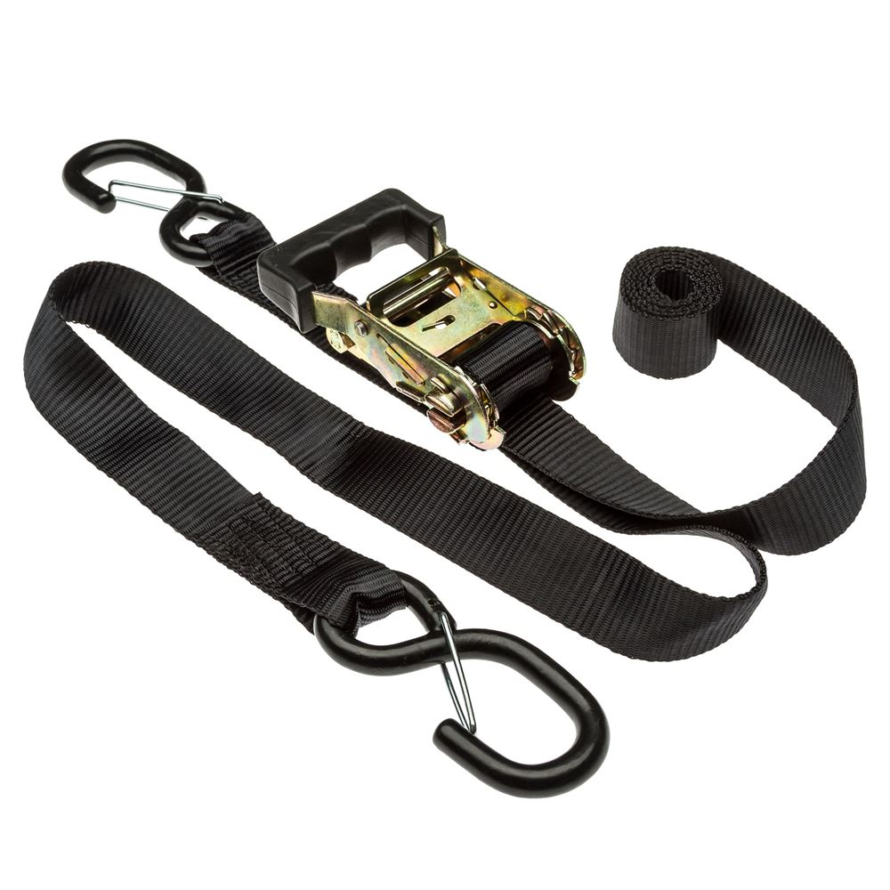
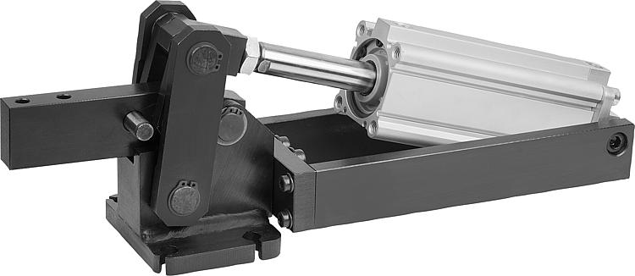
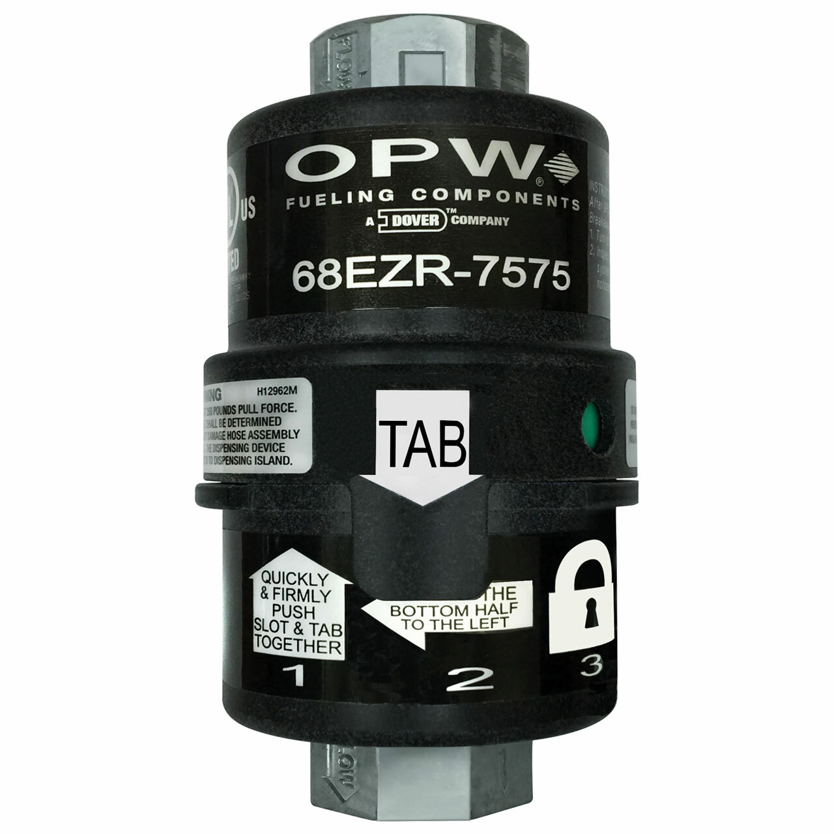
Restraint Mechanisms
Manual – bolts, latches, ratchet straps
Simple, cost effective
No way to disconnect easily if personnel incapacitated
Remotely Operable – electric, pneumatic, etc.
Complex design task with likely no OTS options
Must have unquestionable reliability or manual override
Must be very robust to handle assembly forces
Breakaway – limited strength straps, shear pins, unconstrained axes
Possible last resort if personnel in PAS incapacitated
Complex design task with likely no OTS options
Potentially dangerous under unintentional breakaway conditions
Breakaway would need to be designed for high forces

Slide 7
Rail Guided Basket Access
The basket is attached to a rail or rails to provide stability. Rail attachment could be only at the top of the shaft, or as needed in the shaft.
If basket rider is incapacitated the basket can be raised easily.
Dual rails can provide robust stabilization.
Basket may be disconnected from rails for normal operations.
Rail(s) must be well aligned over the 100m to prevent binding.
Alignment of a rail over 100m is challenging!
Rail binding may result in an extremely dangerous situation.
System performance reliant on crane alignment by crane operator
Stabilization may not be possible when accessing Atom Sources.
PERSONNEL BASKET
5.3M SECTION
5.3M SECTION

Slide 8
Rail Guided Basket Access
The basket is attached to a rail or rails to provide stability. Rail attachment could be only at the top of the shaft, or as needed in the shaft.
If basket rider is incapacitated the basket can be raised easily.
Dual rails can provide robust stabilization.
Basket may be disconnected from rails for normal operations.
Rail(s) must be well aligned over the 100m to prevent binding.
Alignment of a rail over 100m is challenging!
Rail binding may result in an extremely dangerous situation.
System performance reliant on crane alignment by crane operator
Stabilization may not be possible when accessing Atom Sources.
5.3M SECTION
PERSONNEL BASKET
5.3M SECTION

