Slide 1
QXFA225 Coil Review
Jesse Schmalzle
July 12, 2022

Slide 2
Outline
Coil Fab DRs
Additional Info
Coil length, Pole gaps
Reaction plots
Electrical Data

Slide 3
QXFA225
Series coil.
After to change for B6 adjustment.

Slide 4
QXFA225 - DRs
DRs posted to interface traveler.
Critical = Affecting Form, Fit or Function
(as found)

Slide 5
-
Additional Info…

Slide 6
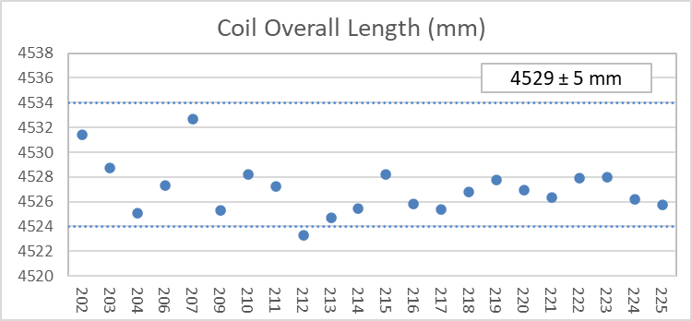
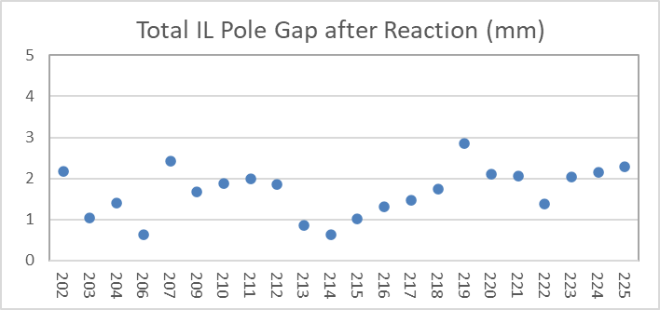
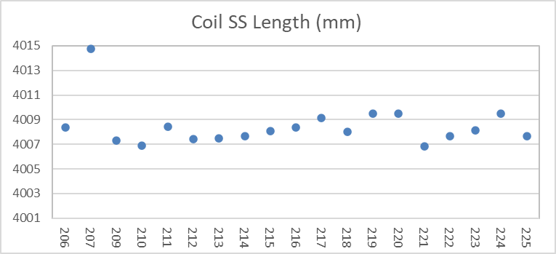
QXFA225 – Length, Gaps
Coil length within spec.
(207 error in initial pole gap setting)

Slide 7
QXFA225 - Reaction
Temperatures and dwell times all within spec.

Slide 8
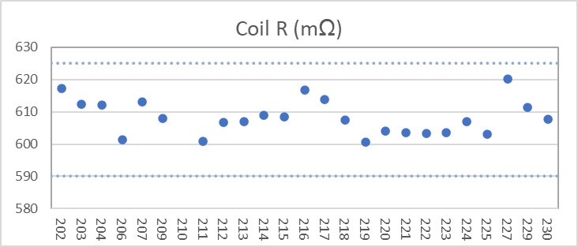
QXFA225 - Electrical
Final electrical checks – all passed

Slide 9
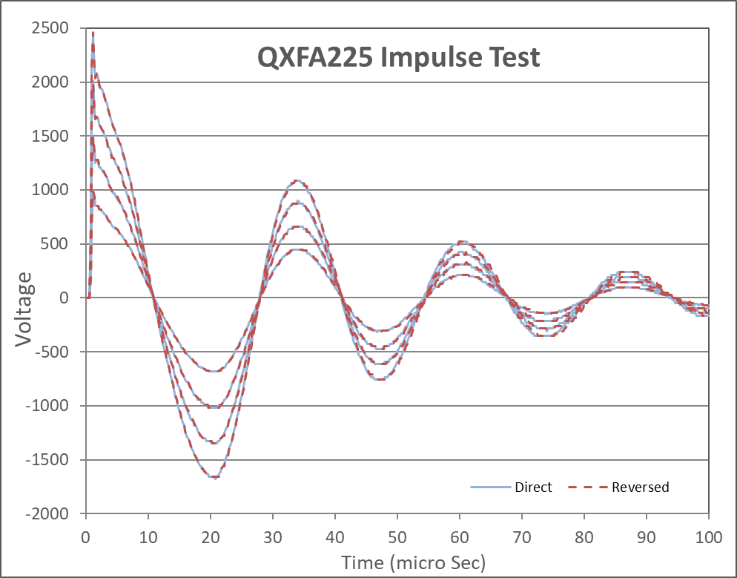
QXFA225 - Electrical

