Slide 1
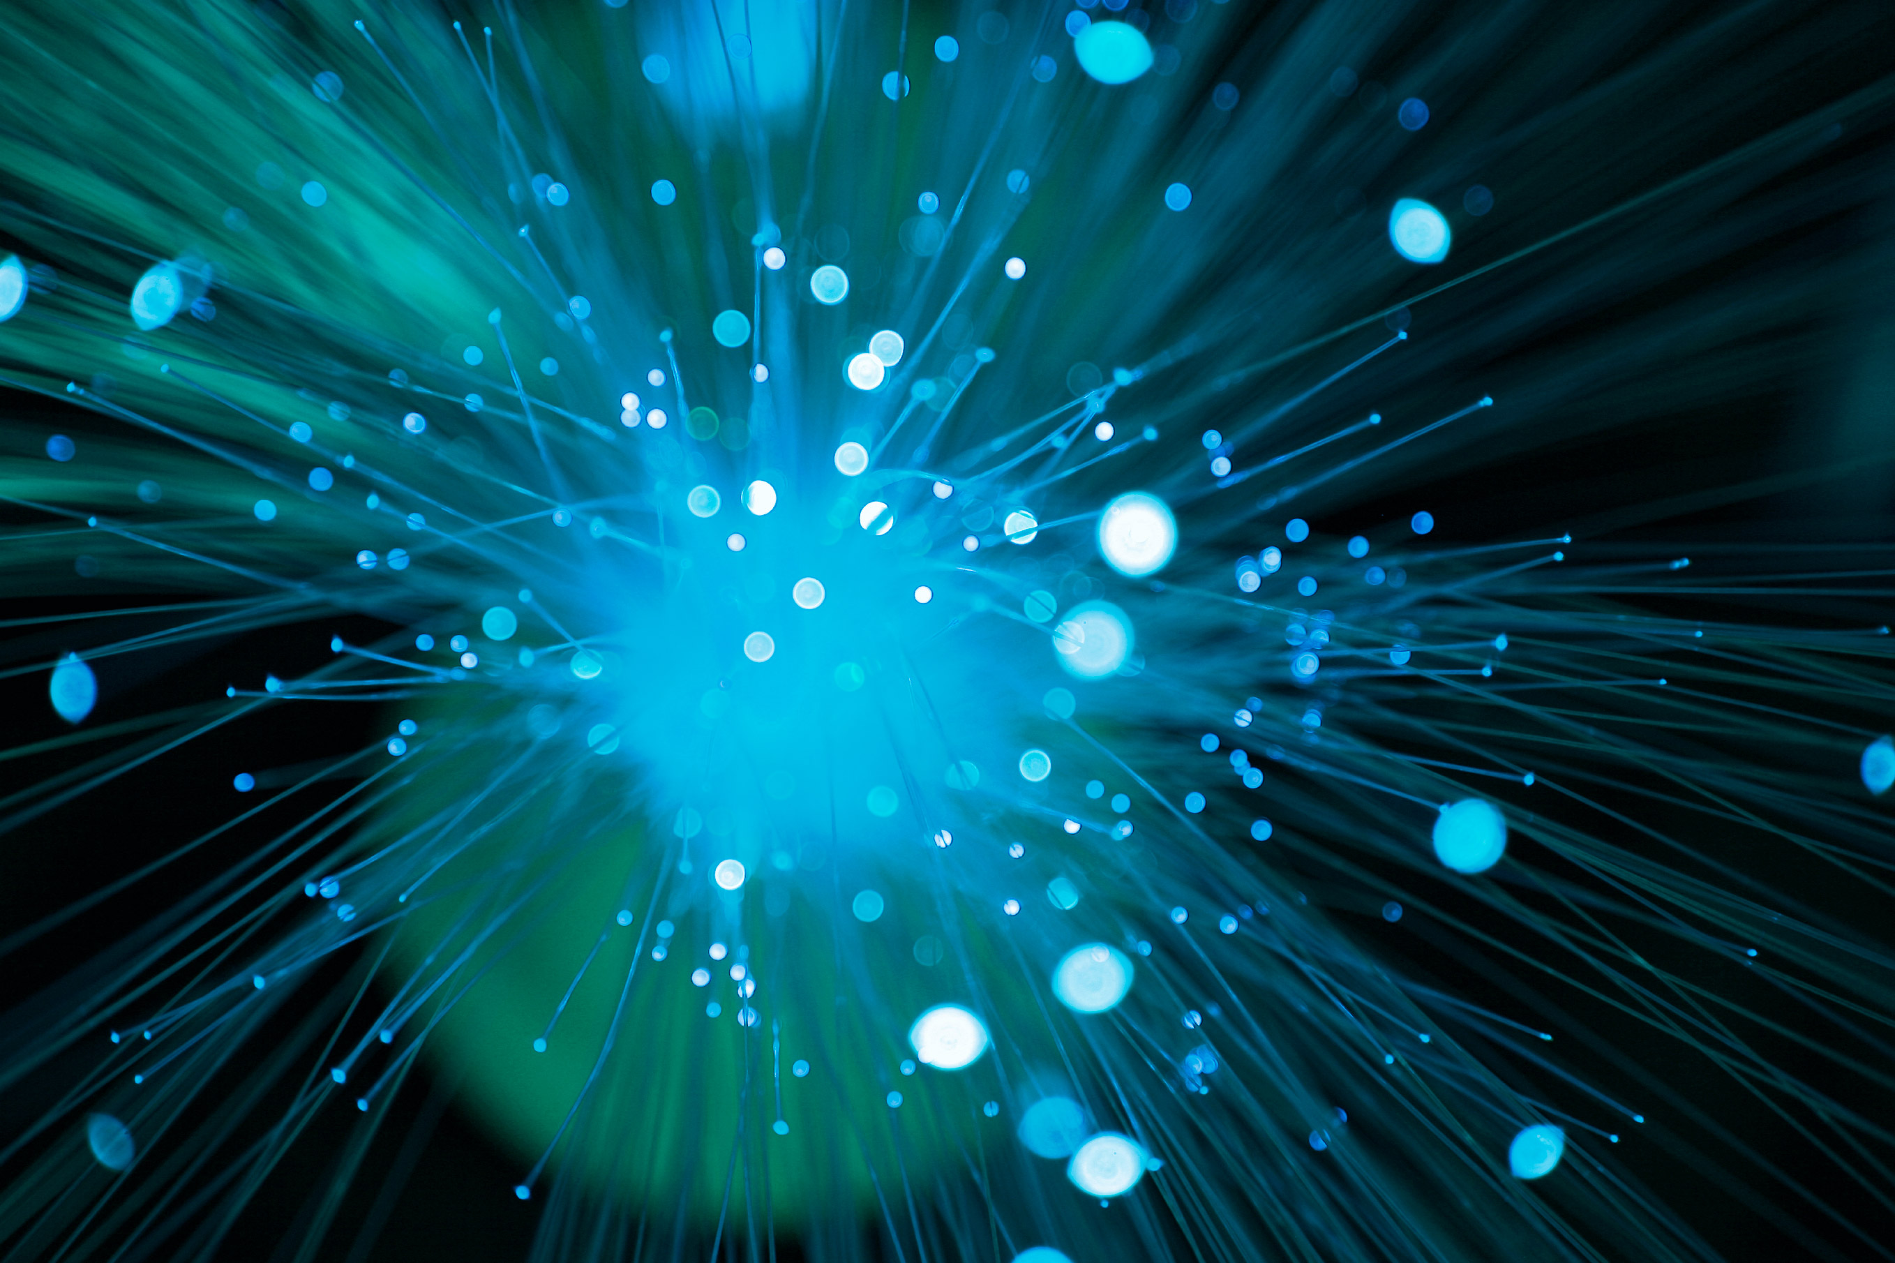

First look at supernova neutrino reconstruction with Pandora
Matthew Osbiston
11/01/23
Notes:
Good morning everyone, In this presentation we’ll be taking the first look at supernova neutrino reconstruction with Pandora. By the end of this presentation, I hope you’ll have a better understanding of the contrastin reconstruction effort between beam and supernova neutrinos. Before we start, I’ll give a brief personal introduction for context

Slide 2
Personal introduction
New first year PhD student at University of Warwick (Started my undergrad there in 2018)
Working as part of the DUNE group at Warwick under John Marshall
  In cooperation with
    Andy Chappell (PDRA)
    Maria Brigida Brunetti (PDRA)
    Isobel Mawby (Soon to be a PDRA at Lancaster)
Working alongside the Low Energy working group convened by Dan Pershey and Clara Cuesta

Slide 3
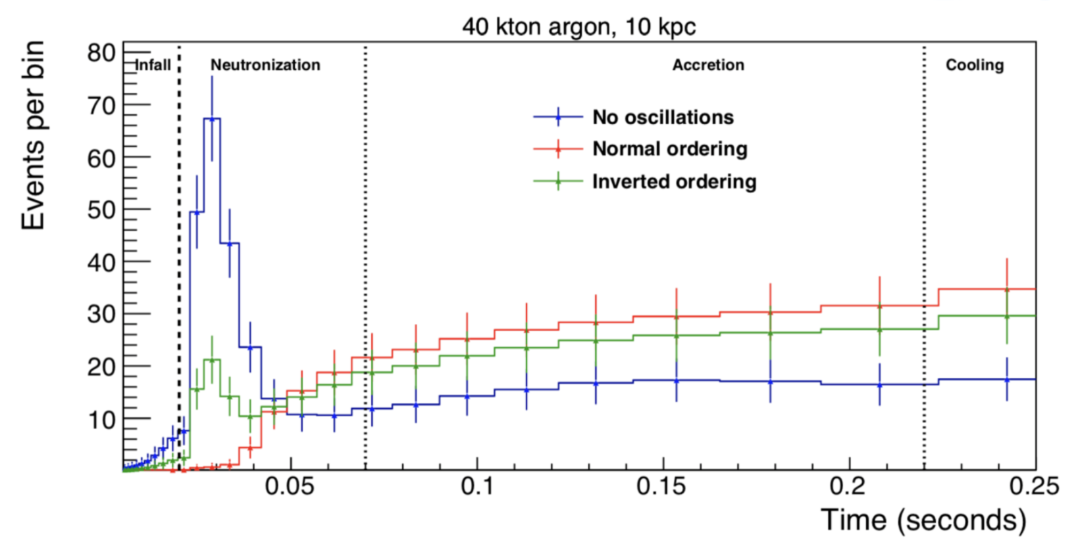

Current supernova theory
    Detection and measurement of the electron neutrino flux from a core-collapse supernova within our galaxy.
Core-collapse supernova - large flux of neutrinos released, carry 99% of the energy.
Estimated with 40kt fiducial mass of DUNE’s far detector – will record 3350 neutrinos (according to the “GKVM” model from a supernova 10kpc away from Earth)
Signal dominated by electron neutrinos and detected in the process:
Neutrino ‘telescopes’ and early warning systems
Would be looking at neutrinos order ~10 MeV
DUNE far detector TDR - https://cds.cern.ch/record/2709273/files/fermilab-pub-20-025-nd.pdf
Notes:
This spectrum here comes from the TDR - don't necessarily need to describe - Expected event rates as a function of time for the electron-capture model in [249] for 40 kt of argon during early stages of the event – the neutronization burst and early accretion phases, for which self-induced effects are unlikely to be important. Shown is the event rate for the unrealistic case of no flavor transitions (blue), the event rate including the effect of matter transitions for the normal (red) and inverted (green) orderings. Error bars are statistical, in unequal time bins.

Slide 4
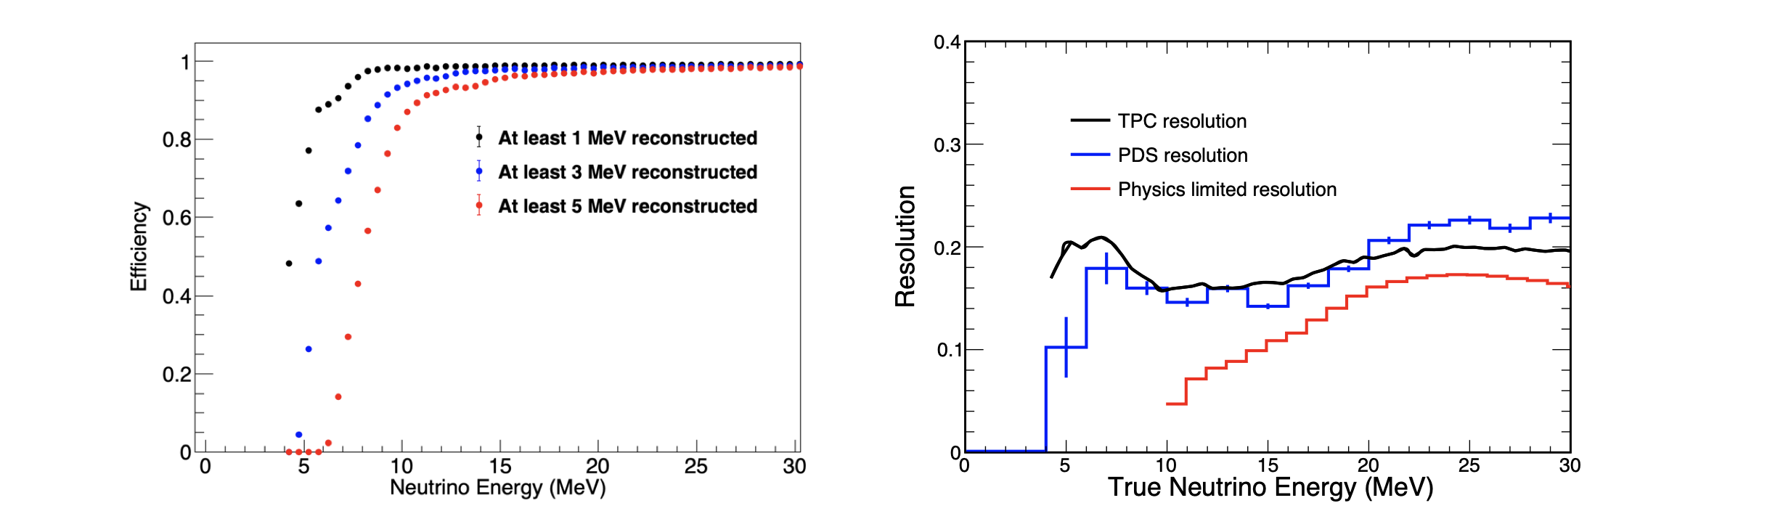
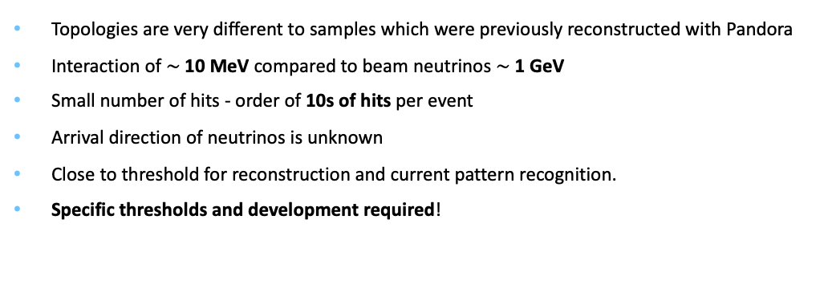
Differences in Pandora pattern recognition
Topologies are very different to samples which were previously reconstructed with Pandora
Interaction of $\sim$10 MeV compared to beam neutrinos $\sim$ 1 GeV
Small number of hits - order of 10s of hits per event
Arrival direction of neutrinos is unknown
Close to threshold for reconstruction and current pattern recognition.
Specific thresholds and development required!
DUNE far detector TDR - https://cds.cern.ch/record/2709273/files/fermilab-pub-20-025-nd.pdf

Slide 5
What are the reconstruction processes?
Signal processing
Hit finding – identifying hits by fitting Gaussians to the signal processing output
Pattern recognition
  Cluster creation, splitting and merging in 2D, then a 3D clustering process
  (Changes to threshold criteria for reconstruction and new clustering algorithms required!)
  PFO (Particle Flow Object) creation
  Hierarchy, ID and shower/track tagging
Higher level reconstruction
  Estimating energies and direction, dE/dx and momentum of reconstructed PFOs.
Notes:
For more detail – ProtoDUNE single phase paper. Say - (Thresholds are where my work takes place) – energy deposition by unit length

Slide 6
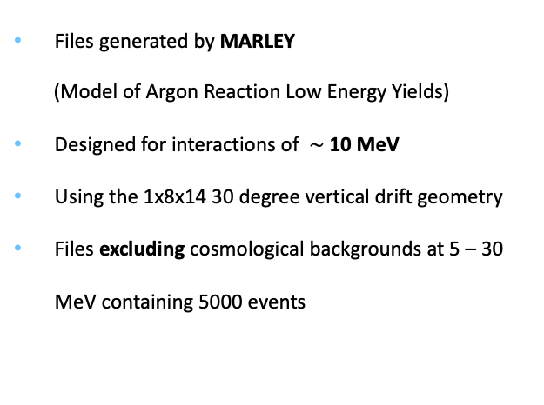
Generated sample information
Files generated by MARLEY
(Model of Argon Reaction Low Energy Yields)
Designed for interactions of $\sim$ 10 MeV
Using the 1x8x14 30 degree vertical drift geometry
Files excluding cosmological backgrounds at 5 – 30 MeV containing 5000 events
Thanks to Laura Paulucci for samples
Notes:
4 Charge Readout units angled with strips oriented at 30 degrees to the detector form a charge readout plane. Example event display for a single simulated 10.25MeV electron, with track reconstruction in time vs wire, with colour representing charge. Top panel shows the collection plane and the bottom panels show induction planes. The red boxes represent reconstructed hits.

Slide 7
An intuition for the reconstruction – a single event
MC truth
Reconstruction
Proton
 | MC Truth | Reconstruction | Comments
Proton | 100 hits | 99 hits | 99% complete 100% pure - Reconstructed
Electron | 100 hits | 51 hits | 50 % complete 98% pure - Poor reconstruction
 |  | 30 hits | -
 |  | 20 hits | -
Photon | 5 hits | - | - Not reconstruction
Reco 1
Electron
Reco 3
Reco 4
Reco 2
Photon
Notes:
Be clear on what purity and completeness are

Slide 8
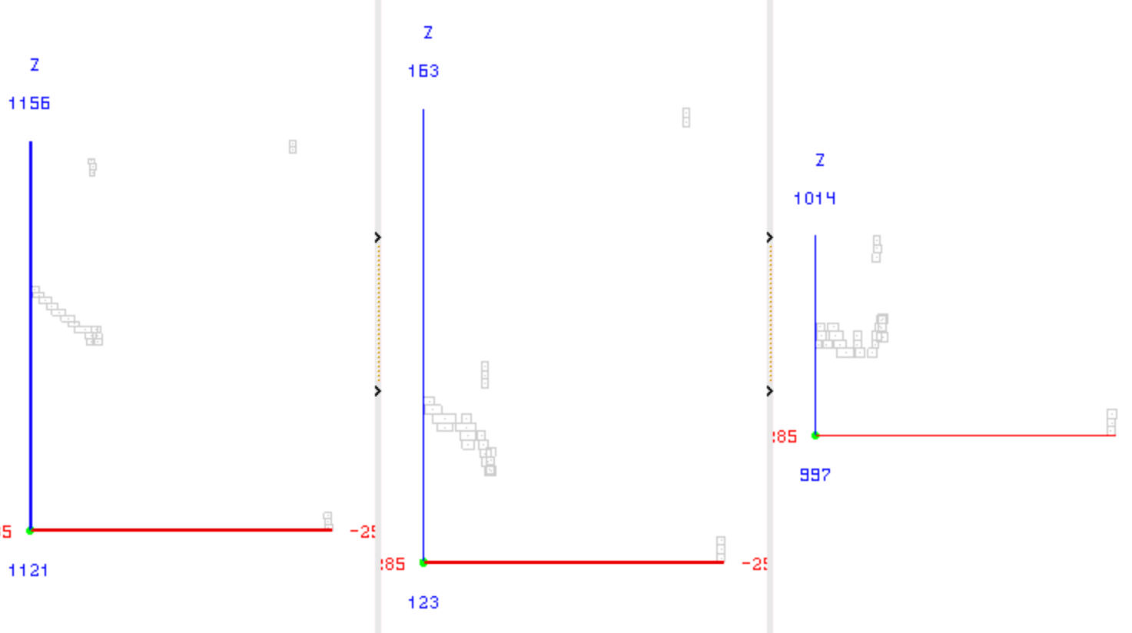
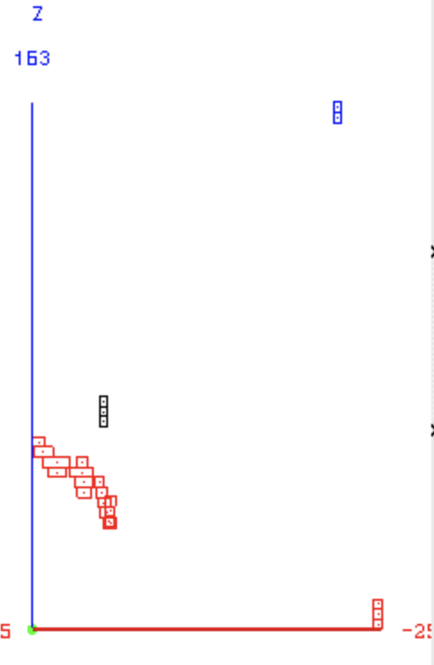
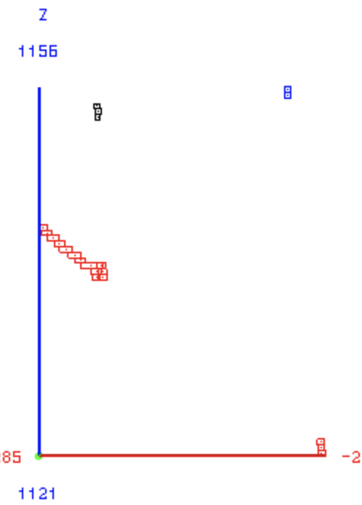
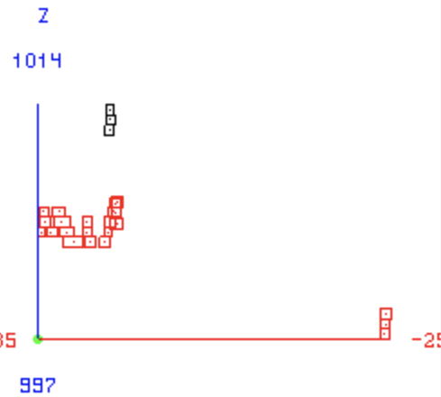
Pandora event display
An event display in Pandora from a 30 MeV file
Input hits before Pandora pattern recognition
Post 3D cluster matching

Slide 9
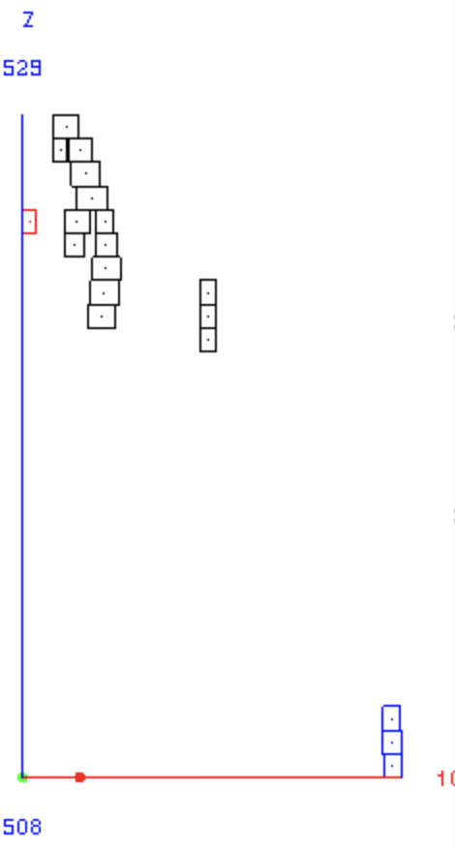
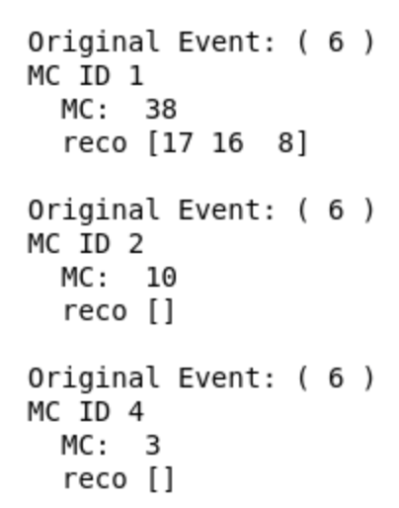
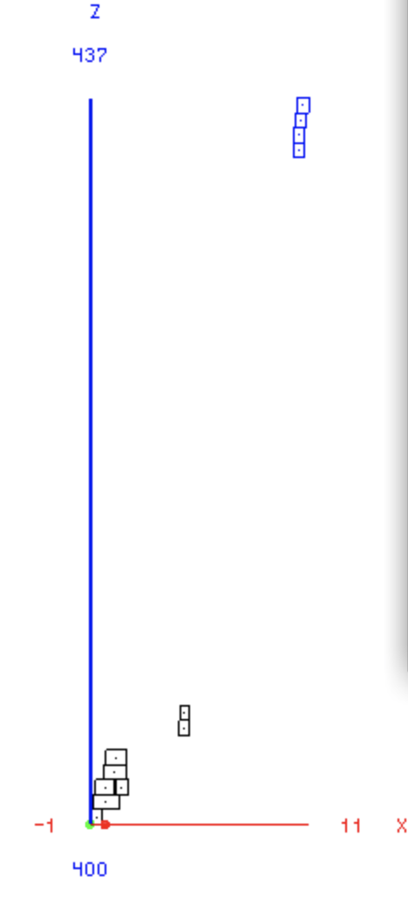
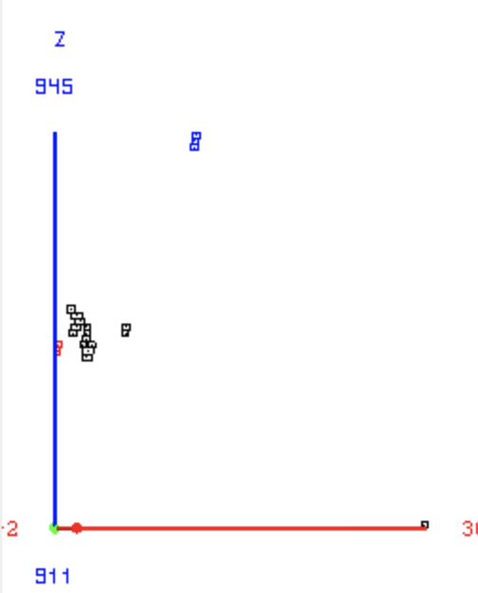
Something to work on
The issues:
MC ID 3 skipped
First MC particle split into three

Slide 10
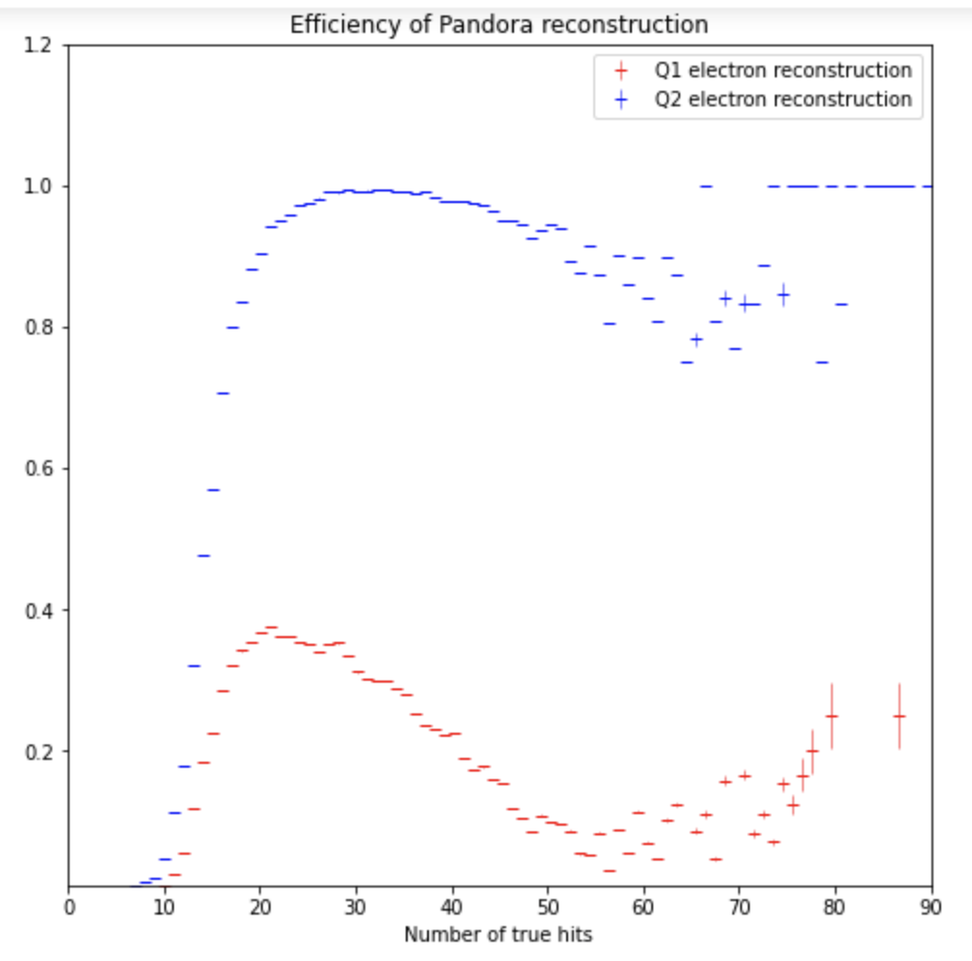
Metrics - Efficiency
Q1 - the number of hit in the reconstructed is within 5 hits of the number of hits in MC true particle
Q2 - a reconstructed PFO has been created and meets a 50% completeness and 80% purity threshold
Notes:
Say reconstruction efficiency rather than ‘software effiency’
Don’t say reconstruction, say reconstructed object, PFO

Slide 11
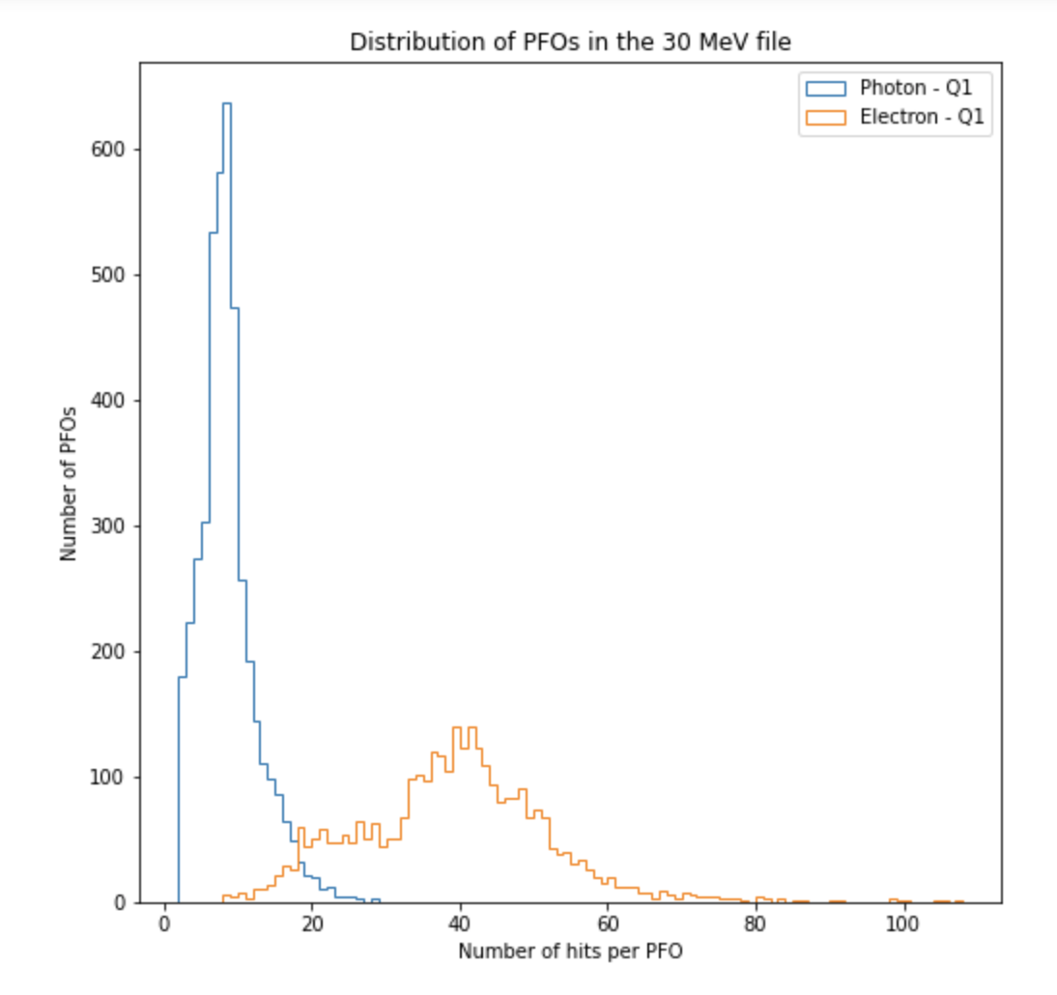
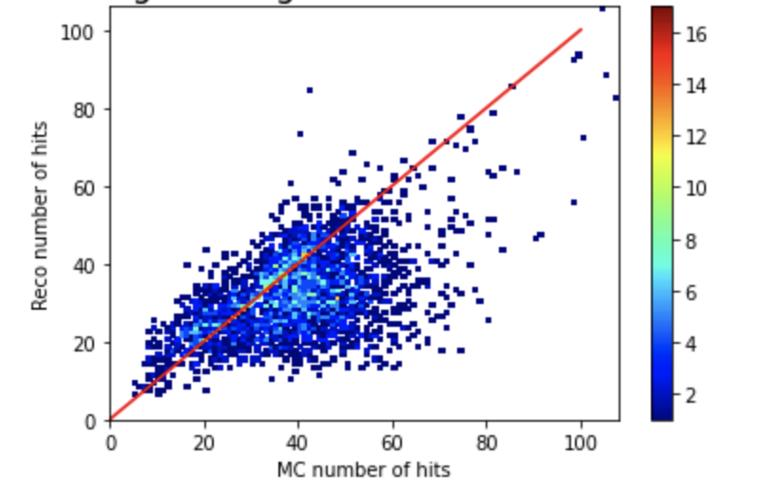
Metrics – hit numbers
We can use plots like these to benchmark our progress with improvements to the reconstructions in conjunction with the DUNE Low Energy Working group
Want to improve algorithm metrics:
Efficiency
Purity and Completeness
Pandora for MicroBooNE - https://link.springer.com/content/pdf/10.1140/epjc/s10052-017-5481-6.pdf?pdf=button%20sticky

Slide 12
First steps for improvement
Need to set new thresholds for reconstruction (for the performance metrics/evaluation)
Currently, to be deemed reconstructable, Pandora requires:
  Minimum of 15 hits per event total
  Minimum of 5 hits per 2D plane to be deemed a ‘good’ view
  Minimum of 2 ‘good’ views required.
This is fine for beam neutrinos since files have many hundreds of hits
However, for the supernovae event files, these are majority of events
Want to remove the thresholds and examine exactly how these low hit events are reconstructed
How does Pandora perform for these low information events?

Slide 13
Future plans and timeline
Implement some cheating algorithms (vertex, clustering, etc.) and examine the change in metric plots to to see which aspects of the reconstruction could provide the largest gains after targeted development – In Progress
Make changes to the regular algorithms (vertex, clustering etc.) with an hand firmly on the underlying physics as guidance – To do
Iterations of cheating for different algorithms and adjustment to reconstruction thresholds and to further develop algorithms – To do
Provide LArContent/LArReco GitHub branches with the new developments and the corresponding XML settings file for testing and wider use – To do

Slide 14
Back up slides

Slide 15
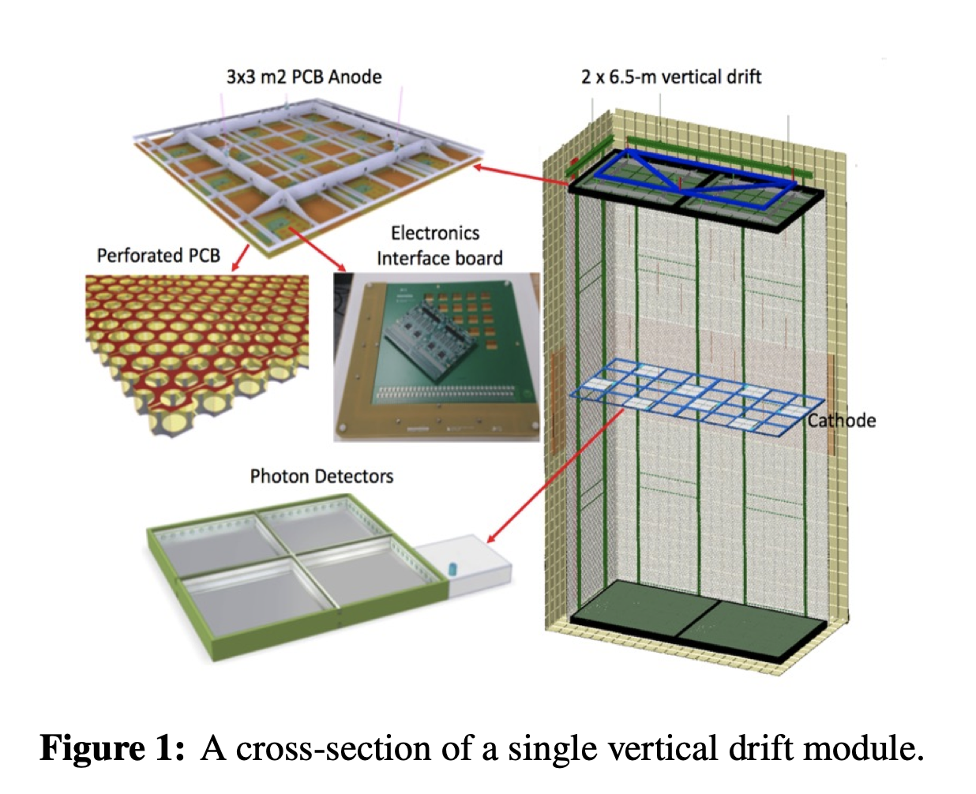
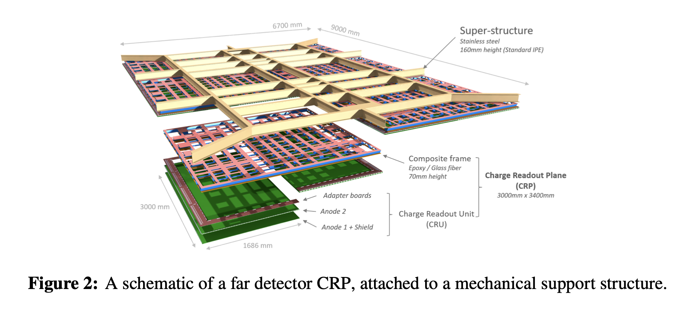
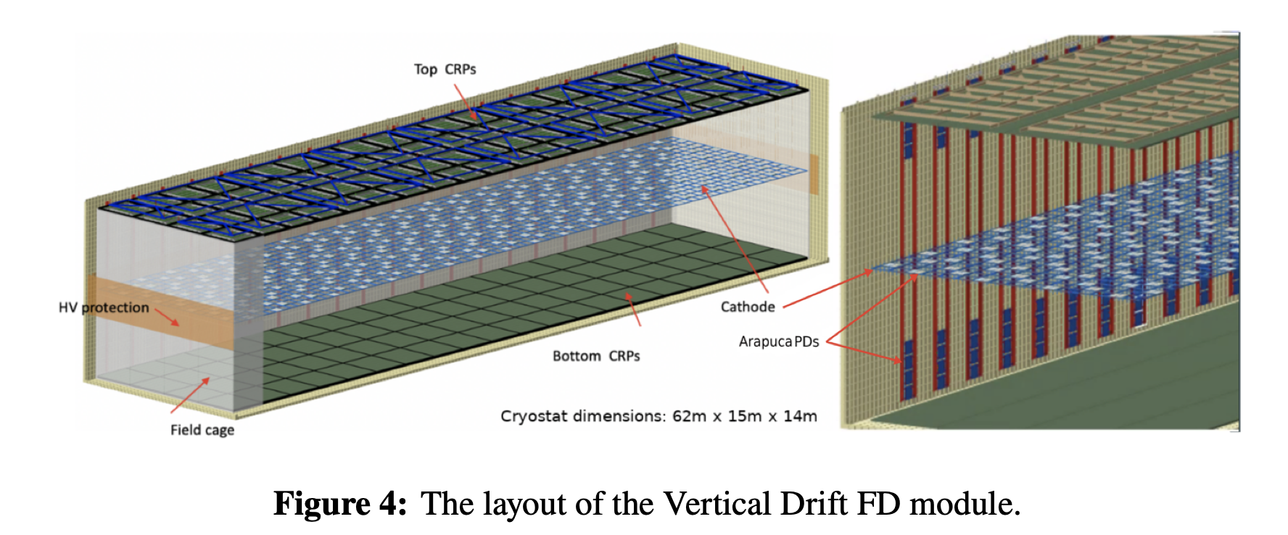
Vertical drift info
Some information on detector geometry…

Slide 16
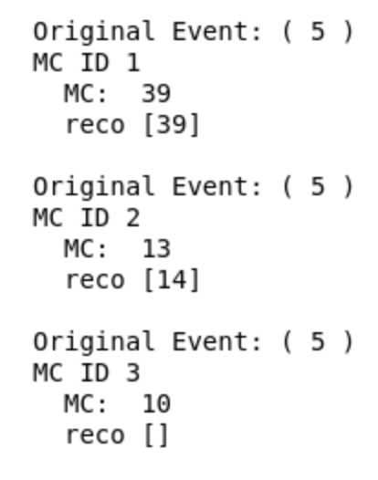
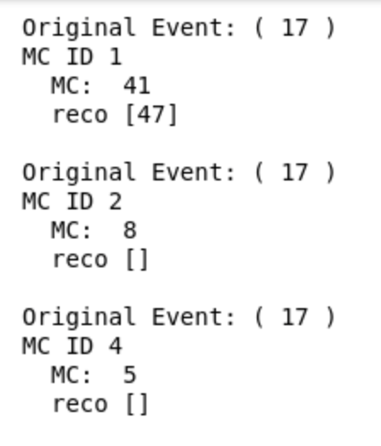
First insights and areas to tackle
Third MC Particle doesn’t appear in terminal
MC ID 3 skipped and first MC particle split in three
MC ID 3 skipped and all three MC particles added to single reconstructed PFO

