Slide 1
Tungsten Targets in the MTA Hall And PIP-II
M. Glochowsky, Rob Ridgway and C. Johnstone
ITA Planning Workshop
Aug 9-10
Fermilab, Batavia, IL

Slide 2
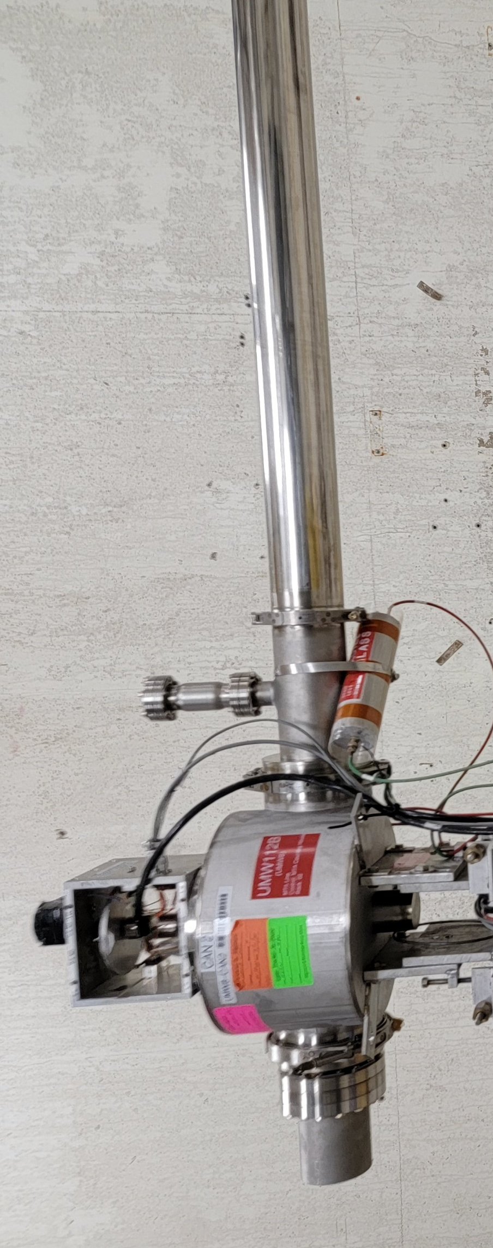
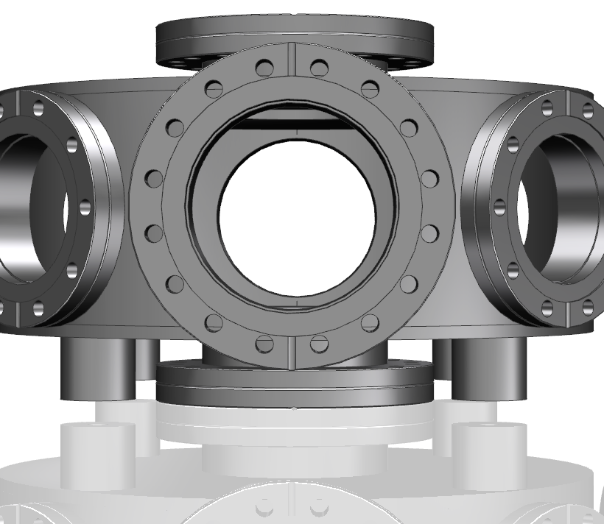
Target Housing and Positioning
Multiwire 8
Target Housing
Approx. 2.12 ft. from center to center of MW 8 to target housing

Slide 3
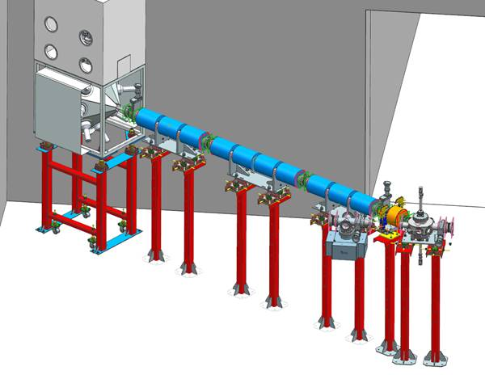
Exact location of 3 cm W target (30% IL)
≅ location of MuCool target
x (Ideas) =30325.46134= y (northing)*
y (Ideas) =30297.04958 = x (easting)
Encl to MW112B center
16.188’
40’
4.188’
12’
~2.12’ to tgt chamber center
~21.812’ (measured)
30.6°
~25.3’ = 7.711 m
View towards SE corner
~12.9’
*note: DUSAF uses a survey foot; 1 meter ≡ 39.37”

Slide 4
Initial Target Geometry and Mechanical Analysis
Optimal target length is currently estimated to be 3 cm
  3 cm horz x 1.5 cm wide (measured) x 3 cm vertically
    equal horz and vert spot sizes generated by target
    Horz width will be reduced in Figure and vert increased
Mechanical design, thermal analysis and engineering complete
Double minimum in horz and vert

Slide 5
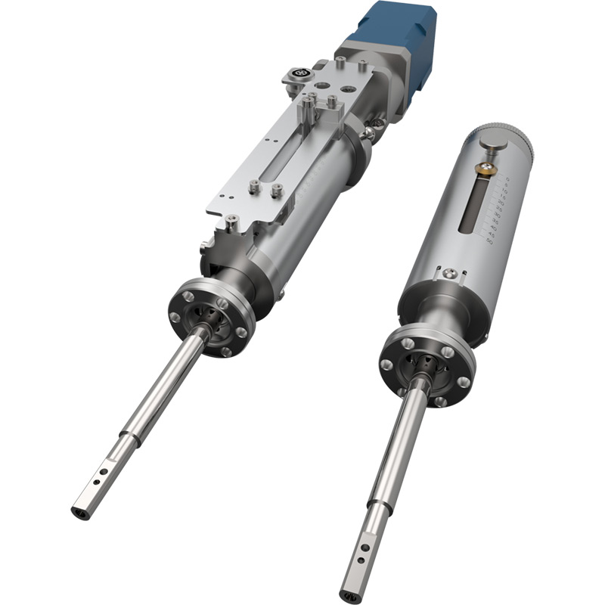
Retractable Target – linear actuator
Product data | Linear Bellows Drive
System mounting flange - Standard | CF16 (1.33" OD CF) with clear holes
System mounting flange - Option | CF35 (2.75" OD CF) with clear holes
Resolution - Manual | 10 microns
Resolution - Motorized | 1 micron
Maximum cantilevered load | 0.5 Nm
Maximum axial load | 25 N (5.6 lbf)
Lateral float of shaft in retracted position | 0.3mm max
Bakeout | 250°C
Leskar Linear Bellows Drive:
Estimated date of delivery 9/16/22
Specifications

Slide 6
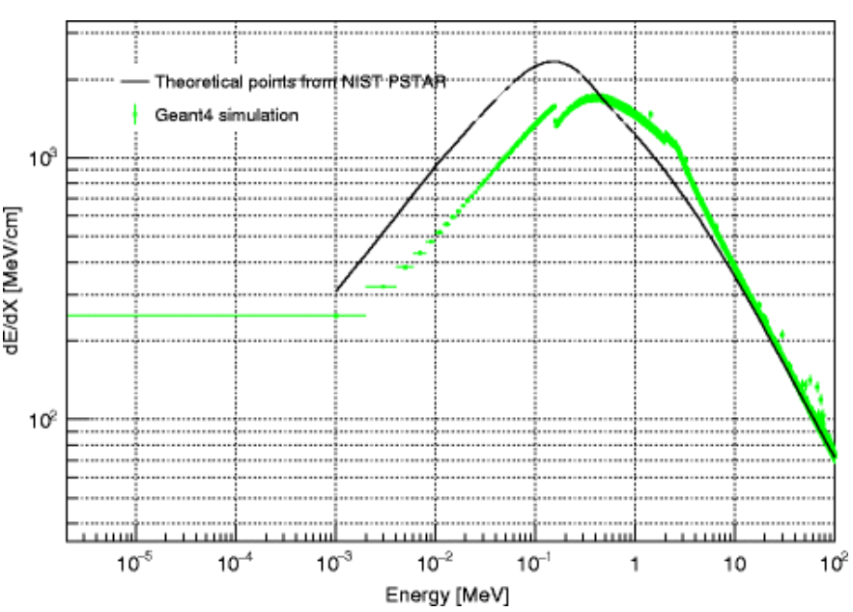
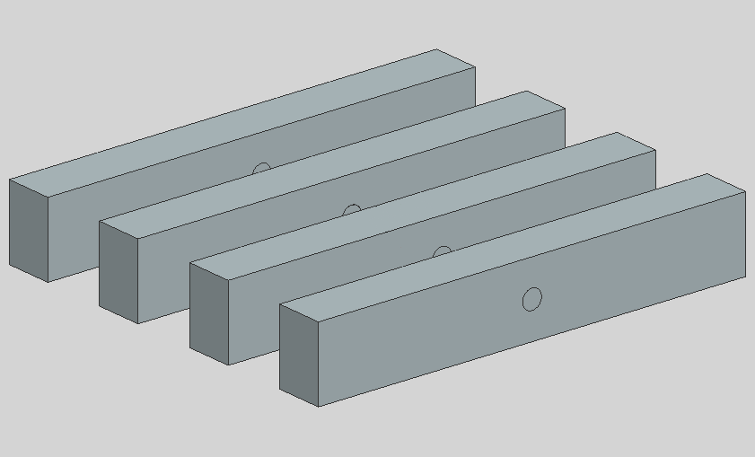
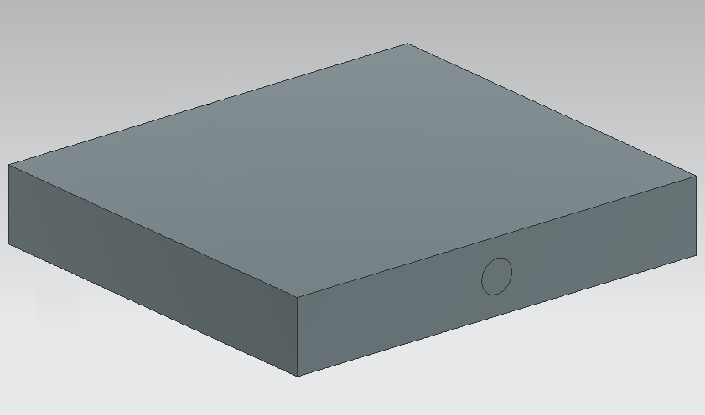
Proposed Muon Beam Production Targets
In the MTA the first 3-4 cm of tungsten produce muons, so a new four 9 cm x 1 cm x 1.5 cm tungsten slice target is proposed, as it will be more optimized for radiating off heat. A 9 cm x 8 cm x 1.5 cm target is also tested for the MTA.
PIP-II’s 800 MeV beam will be able to take advantage of ~8 cm of tungsten for muon production, so a 9 cm x 8 cm x 1.5 cm target is proposed for it.
The MTA beam is a pulsed beam, so the analyses are done at 9, 18, and 900 (full Linac intensity) pulses per minute to give a greater understanding of the upper limits of the targets.
For PIP-II’s continuous beam, first the analysis will be done at full 2 mA current, and will be adjusted as necessary.

Slide 7
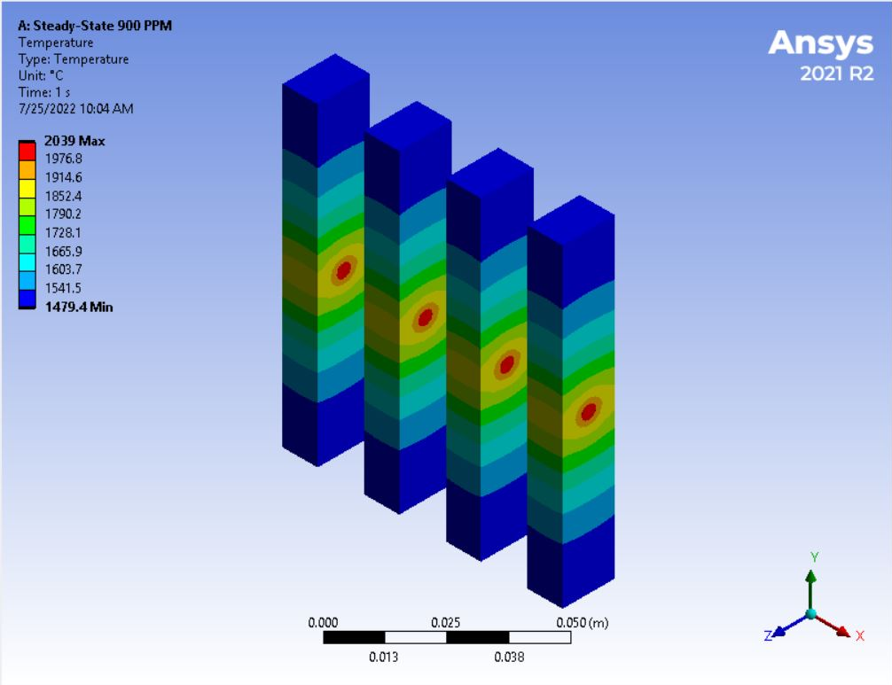
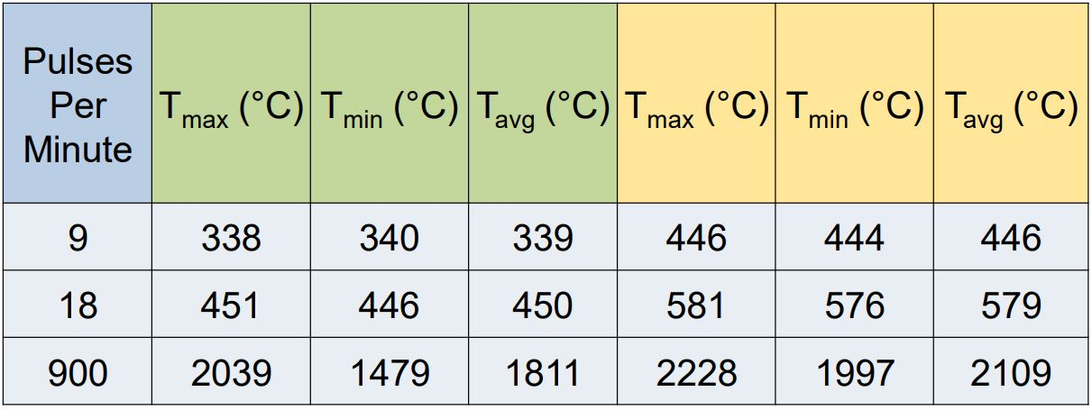
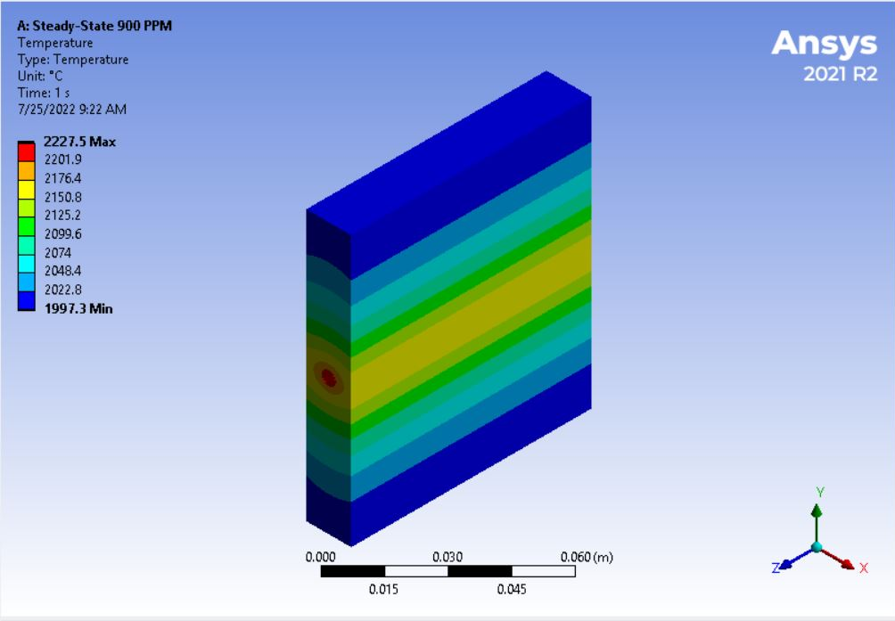
MTA Test Results
Even when taking the full Linac intensity the tungsten targets do not melt (tungsten melts at ~3400 °C). The results of the analysis concur with the reasoning that the slice target would be cooler.
Maximum, minimum, and average temperatures for different target geometries under different pulse conditions. A green header signifies the 4 slice targets, and a yellow header signifies the singular target.

Slide 8
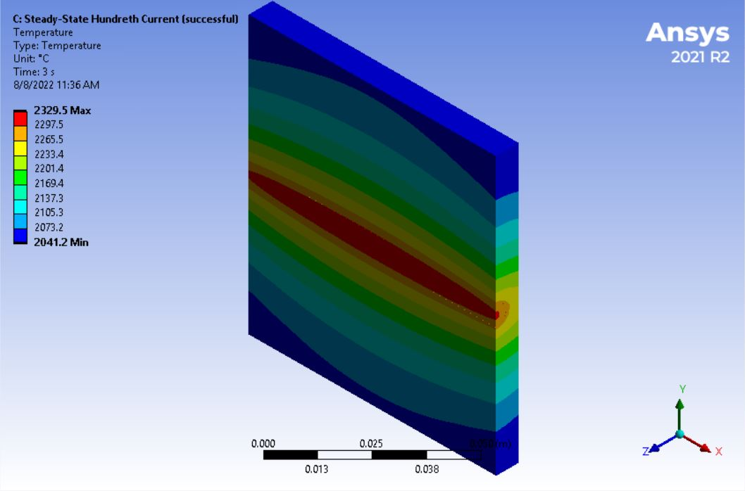
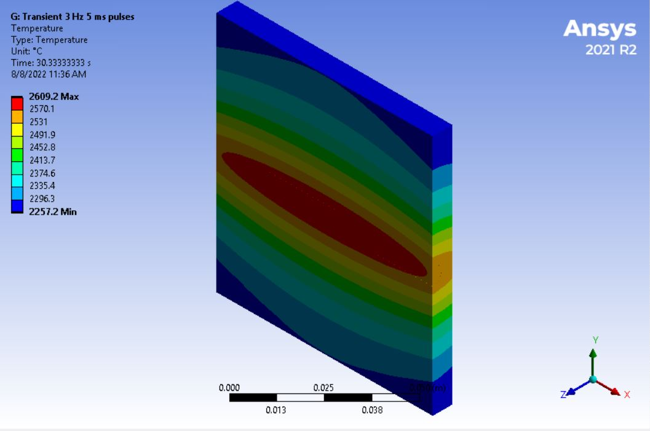
PIP-II Test Results
The PIP-II beam is too powerful at the full 2 mA current, generating a peak temperature of 17937 °C. Instead, PIP-II must have its current reduced, be pulsed, or both.
It was found that 0.02 mA of current would not melt the tungsten, and that, when pulsing at full 2 mA current, 3 Hz 5 ms pulses did not melt the target. The former reached 2300 °C, and the latter peaked at 2900 °C.

Slide 9
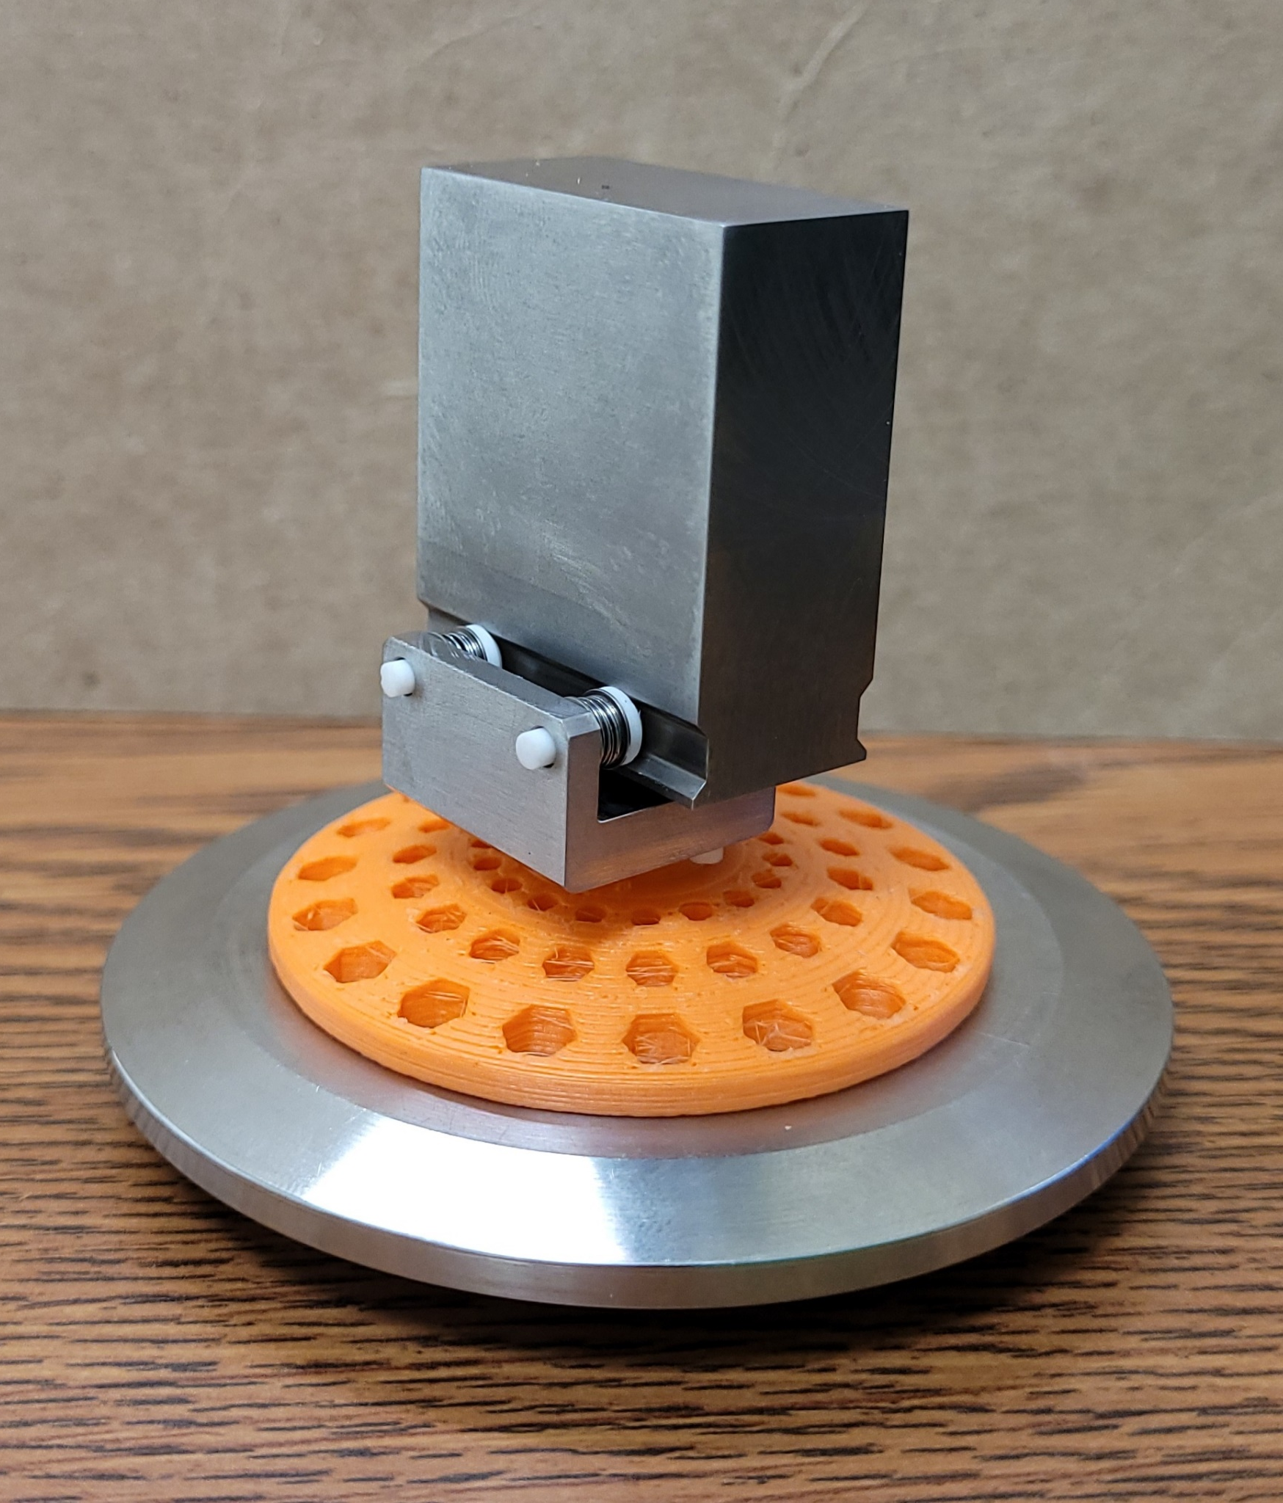
Conclusions
The MTA muon beam will work for both target geometries investigated, but the four slice geometry will be more optimized for cooling. Both targets will not melt when exposed to the full Linac intensity either.
For PIP-II to not melt the 8 cm thick tungsten target during muon beam production, the PIP-II beam will either require 0.02 mA of current if firing as a continuous beam, or will require firing at 3 Hz 5 ms pulses at 2 mA of current. This pulsing could be done by removing H- particles from the PIP-II beam, perhaps via infrared lasers and magnets
For ITA applications, different targets can be designed to produce a primary beam adapted to different experiments, i.e.:
A curved target can create a uniform beam with a specified width, or in general changes flux profile
A lower energy beam – the average primary beam energy drops ~40 MeV/cm in tungsten (the energy spread will be large)
A neutron-rich beam or general mixed beam (pions, muons, electrons in addition to protons)

Slide 10
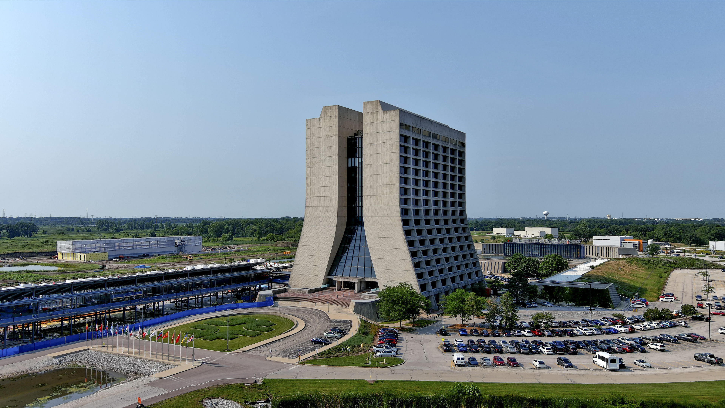
Thank You!

