Slide 1
Irradiation Test Area
“Diode position monitor”
Paul Rubinov
Aug 9 2022

Slide 2
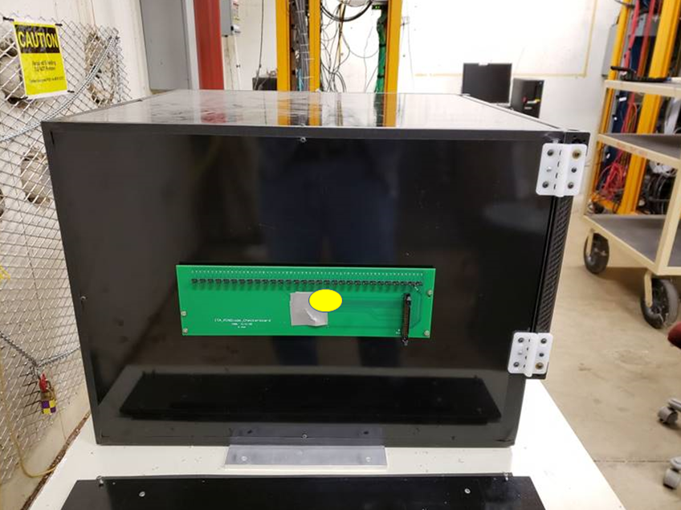
We made a position monitor from COTS NIR photodiodes.
(probably other diodes would work too)
The system consists of 2 parts:
A MotherBoard
with cable connectors and
A DaughterBoard with 60 diodes
Mounted on back of the box (which makes DB hard to replace)
Readout by a Keithley switch matrix located in the counting room using a long ribbon cable.
Leakage current is ~ proportional to TID but annealing makes this more complicated.
Calibration is difficult but sensitivity to beam position is good. But “working range” only lasts 2 to 3 days of beam.

Slide 3
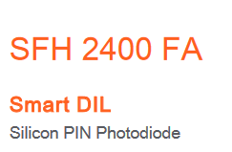
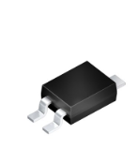
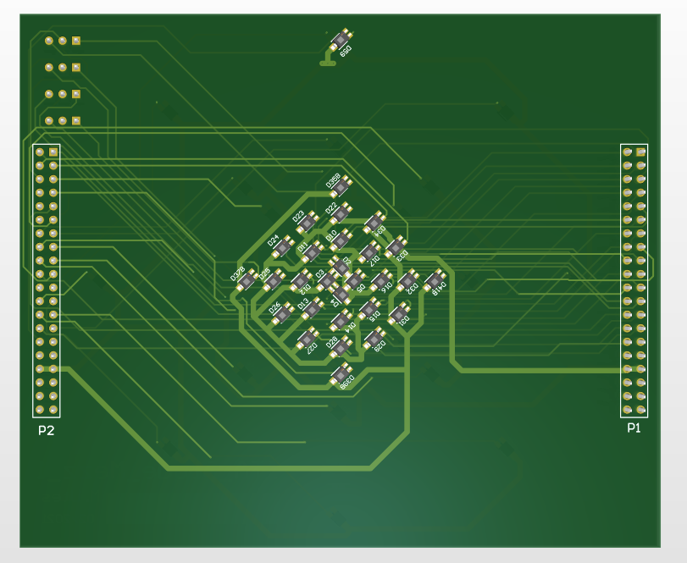
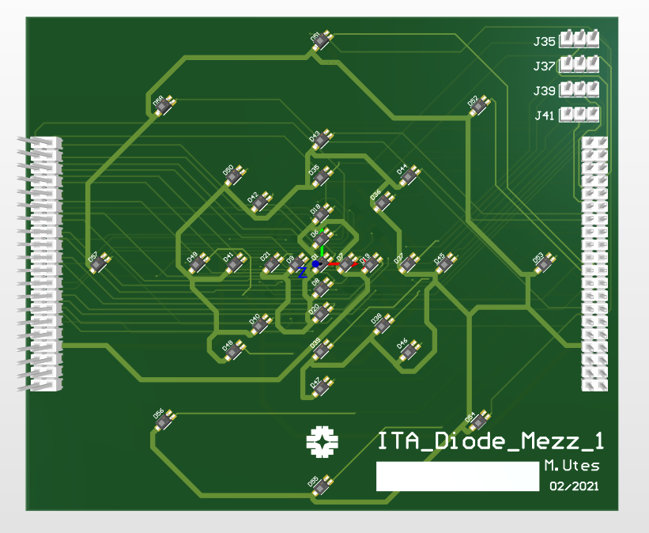
Diode daughter board
Silicon PIN photodiode:
Cheap (<$0.50), uniform, very low leakage current. 1x1mm sensitive area
Unfortunately (a little bit) sensitive to visible light
Diodes are positioned 5mm apart.
Typical signals are mV scale
Front
Back

Slide 4
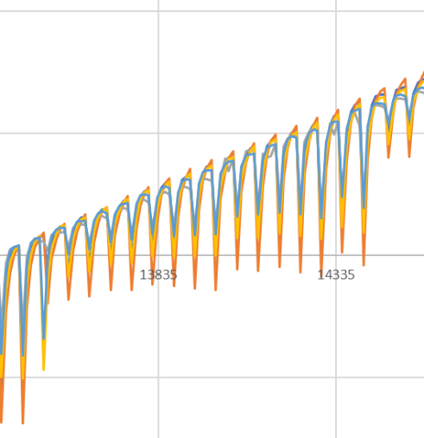
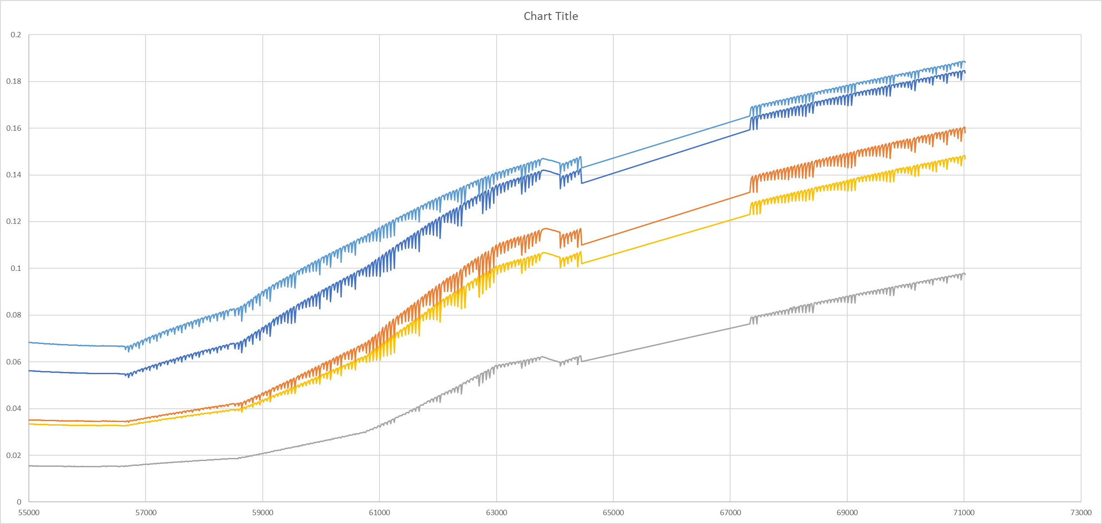
15:44:13
beam starts
16:17:23
Move 1
16:52:29
Move 2
17:31:15
Move 3
17:42:57
beam off
17:42:57
beam at final position?
April 6, 2021
The slope tells you relative position. The spikes are caused by individual spills.
Sampling of each diode is ~once per 10 seconds.
zoom to show individual spills
DAQ recovers
DAQ fails
Seconds since 15:00 Apr 6

Slide 5
Final results we have been displayed like this:
color and number represent relative intensity. The position is approximately corresponding to position of the diodes
Next steps:
Make a DB with smaller, not light sensitive diodes
Make readout system faster – about 1KHz/16bit would be appropriate

