Slide 1
The MTA primary beamline description and performance
Alex Perez, Mentors C. Johnstone, J. Johnstone
ITA Planning Workshop
Aug 9-10
Fermilab, Batavia, IL

Slide 2
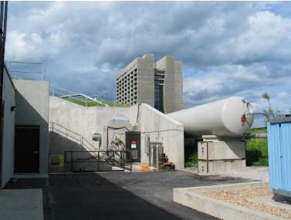
Original Purpose: MuCool Test Area and Beamline
The Muon Test Area (2003) was initially constructed to develop, test, and verify muon ionization apparatus using the 400-MeV proton beam from the Fermilab Linac
Since muon facilities involve the capture, collection and cooling of ~10¹³ muons at a repetition conclusive tests require ~10¹³ protons/pulse (full Linac beam):
THE ORIGINAL CONCEPT/REQUEST WAS FOR FULL LINAC CAPABILITY (~ 10¹⁴ p/sec)
The beamline designed for MTA experiments, however, includes specialized insertions for linac beam diagnostics and beam measurements, greatly enhancing the functionality and complexity of the beamline.
Installation of the beamline was complete fall, 2008.
It represents the only facility in which experiments have direct access to a primary beam
Parasitic to HEP OPERATION!

Slide 3
Overview of Beamline Operation and Capability
Extraction from Linac
Entire 400-MeV Linac pulse must be cleanly extracted
Any additional losses trip labyrinth chipmunk near 400-MeV lambertson
Pulse length/intensity can be controlled with 750-MeV Linac chopper from ~7 μsec – potentially full 50 μsec Linac macropulse
Westerly/up bend
Takes advantage of existing civil construction from the Linac upgrade
~40º of horizontal bend required for curved west-bearing ramp
1.5-2º of vertical bend up the ramp to shield wall
Shield Wall
Separates Linac enclosure from MTA experimental hall
Allows access to hall during Linac operation
The 12’ has been utilized as part of a long (10m) magnet-free straight to measure Linac beam properties
This long straight is flanked by DFD quadrupole triplets to form a phase space tomography section capable of changing the phase-advance to provide progressive views of the phase space topology
Linac Stub
30’ of beamline beyond the shield wall; 2.5 step down into 40’ exp. Hall.
Contains half of the phase space tomography section
DFD quadrupole triplet to control experimental beam parameters
Capable of focusing to any point along the beam direction in the experimental hall

Slide 4
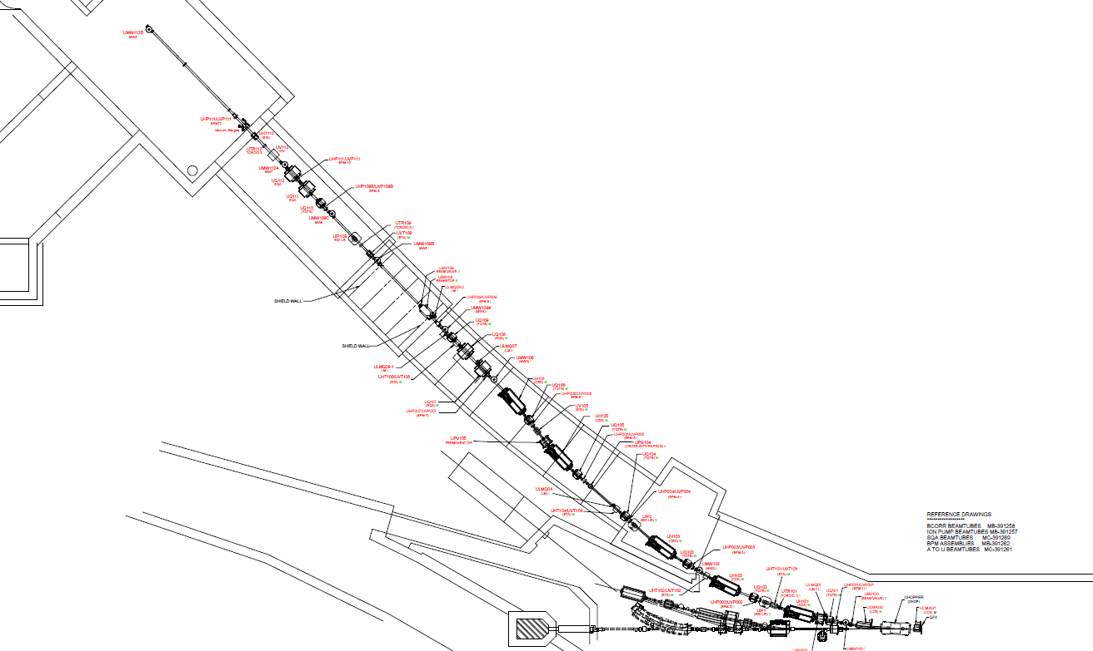
MTA experimental area
$$H^{−}$$
Shielding wall
C-magnets which grab pulses from the Linac for the MTA primary line
Booster/synchrotron. Won’t be used for MTA experiments

Slide 5
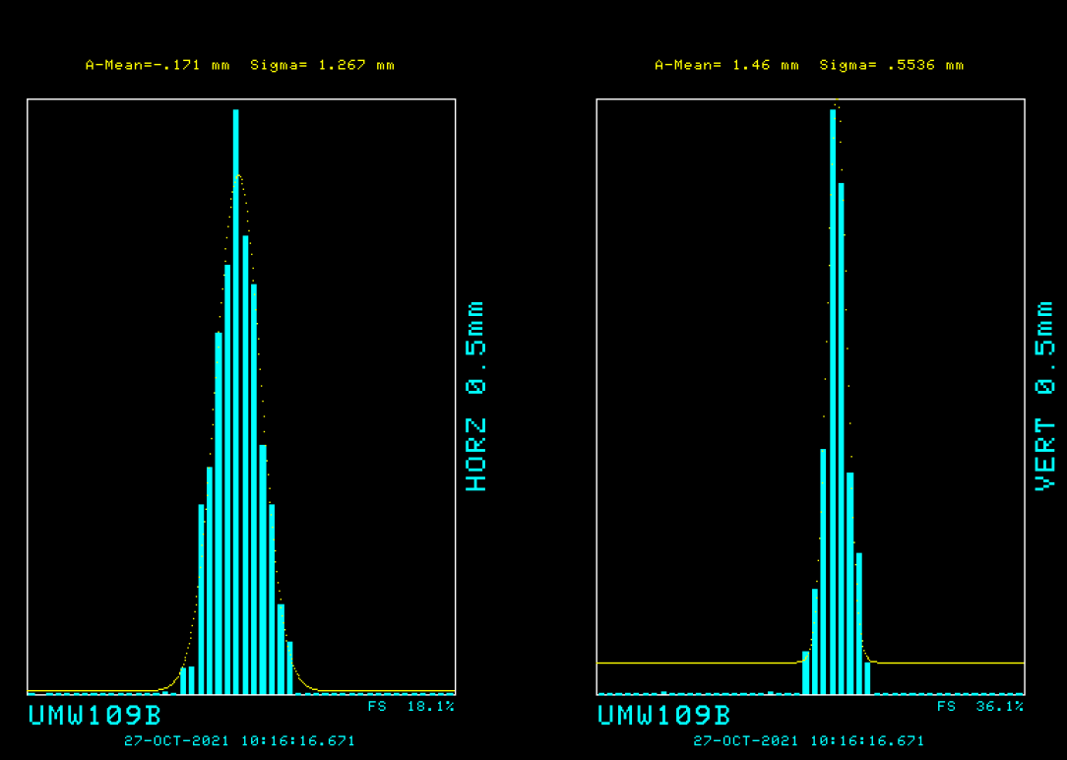
Beam Profiles
Profiles taken immediately after the shield wall on the experiment hall

Slide 6
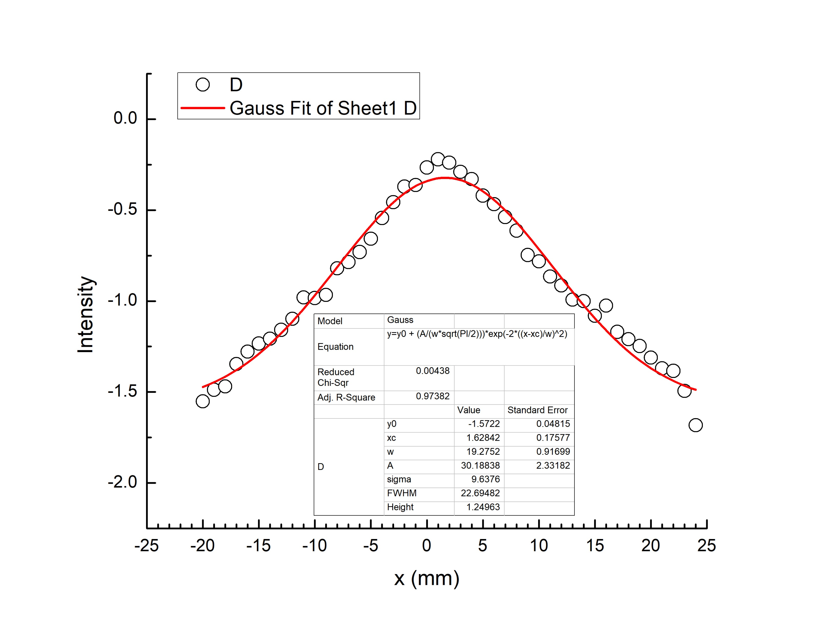
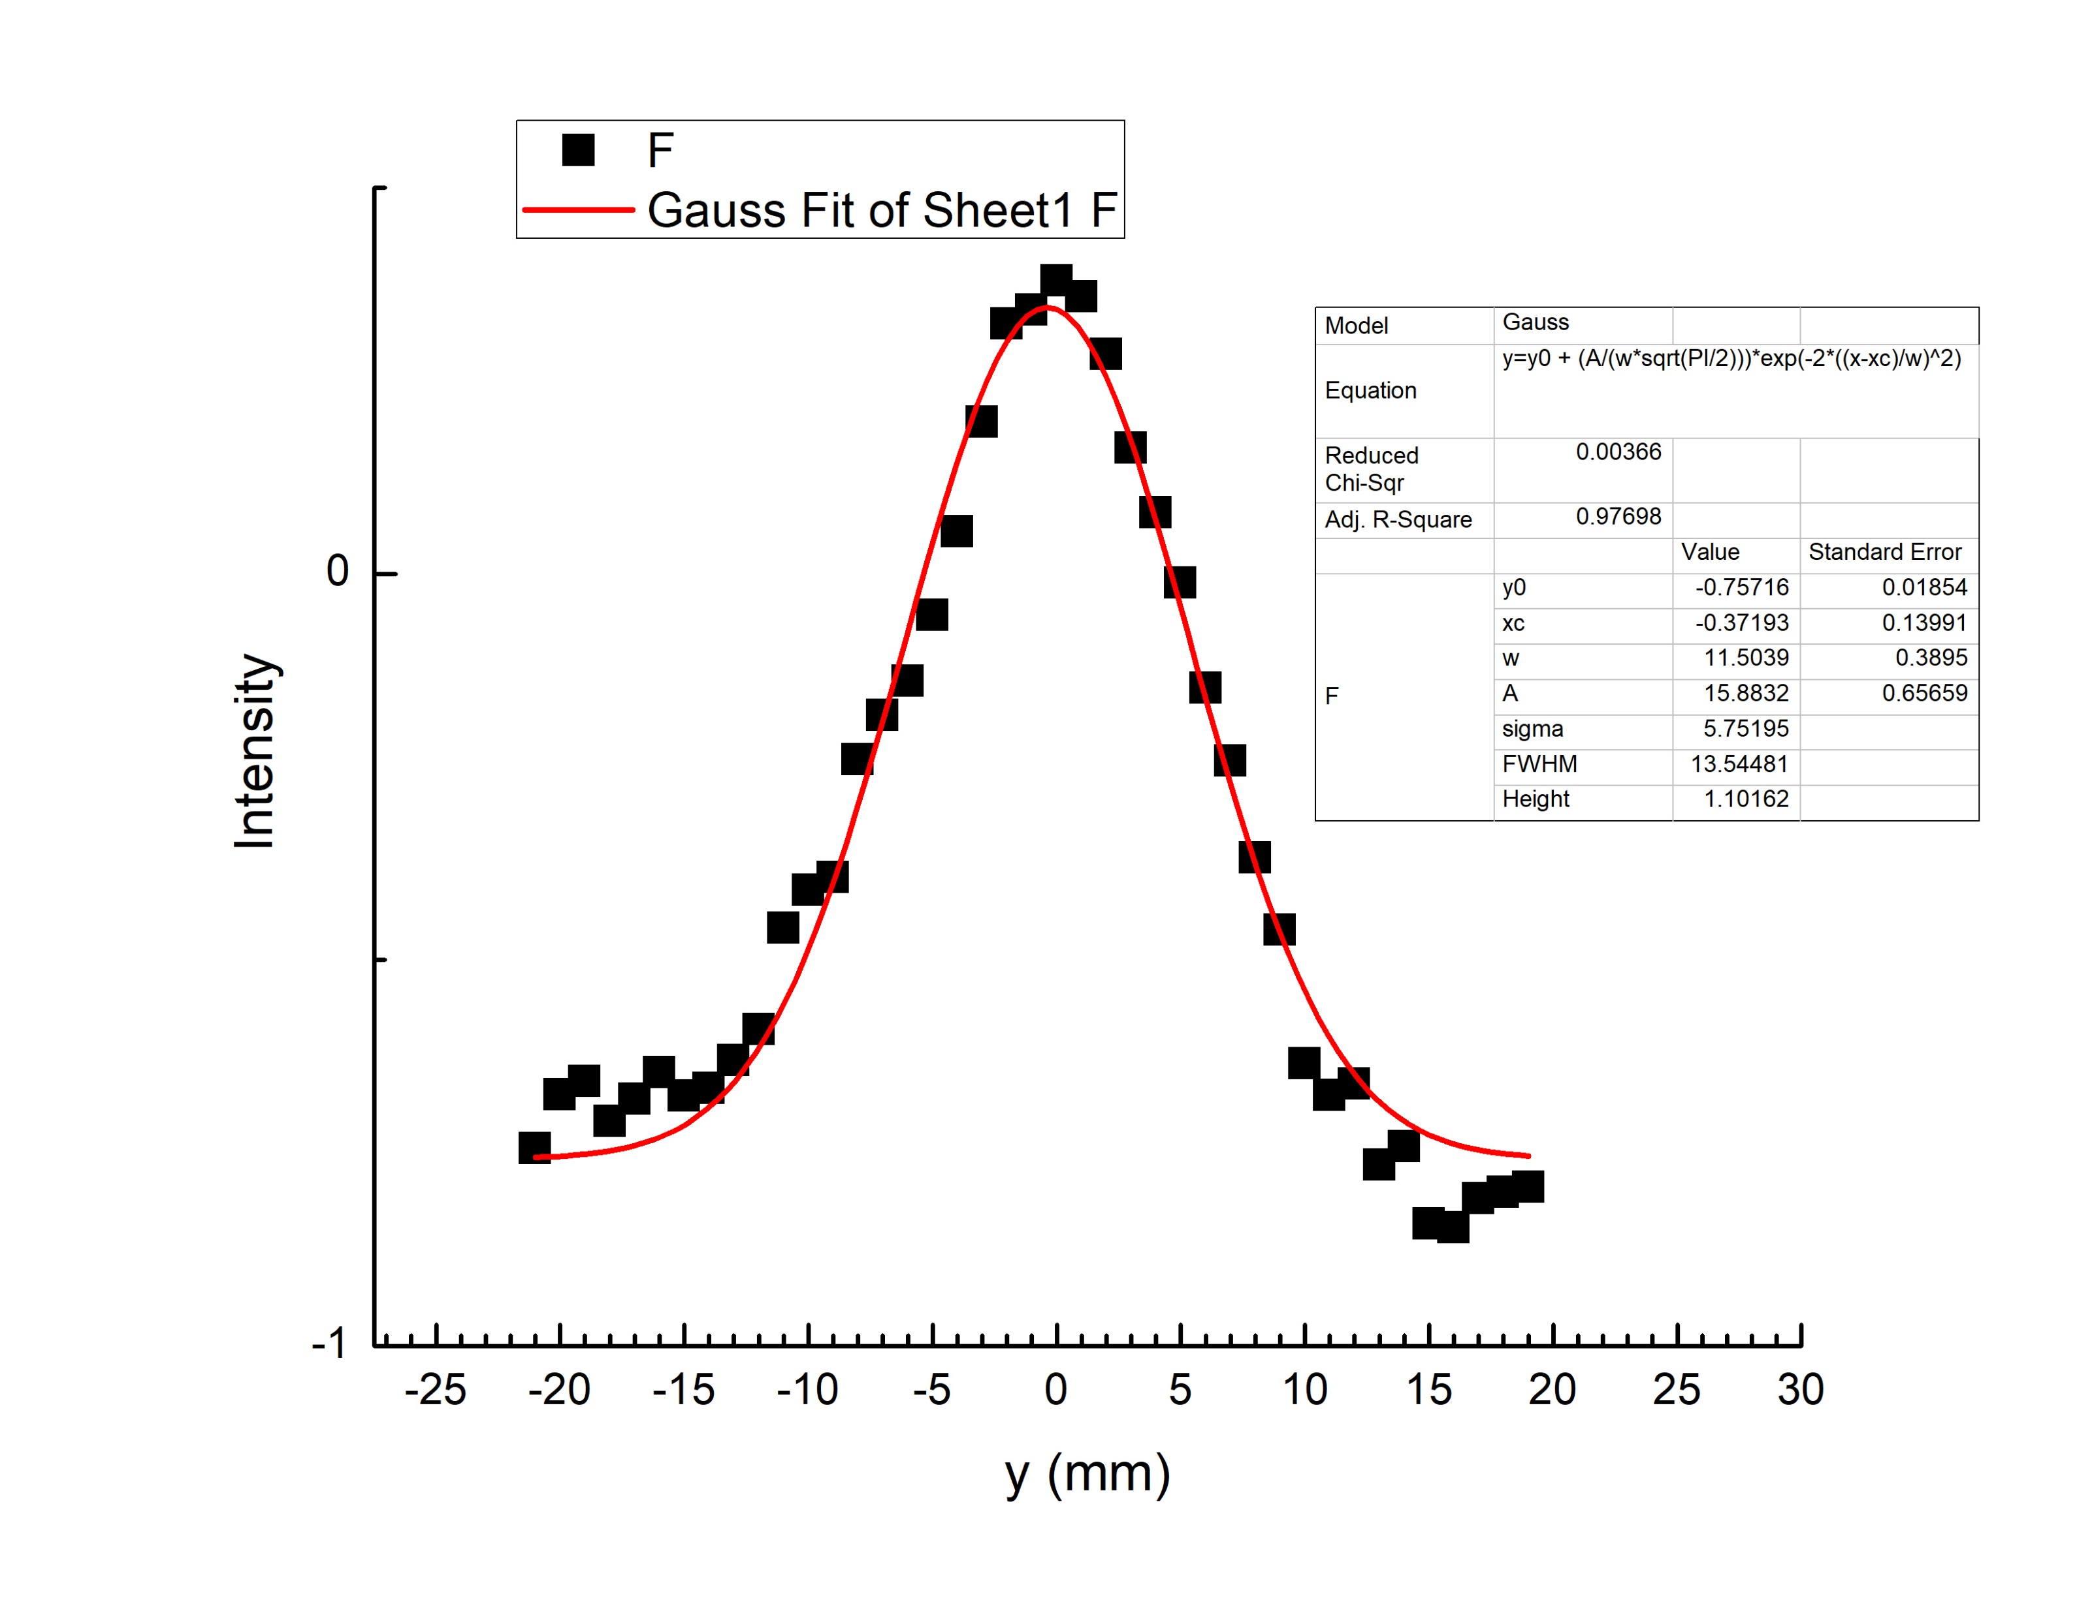
Beam Profiles
Beam profile taken from the end of the beam line at MW 8

Slide 7
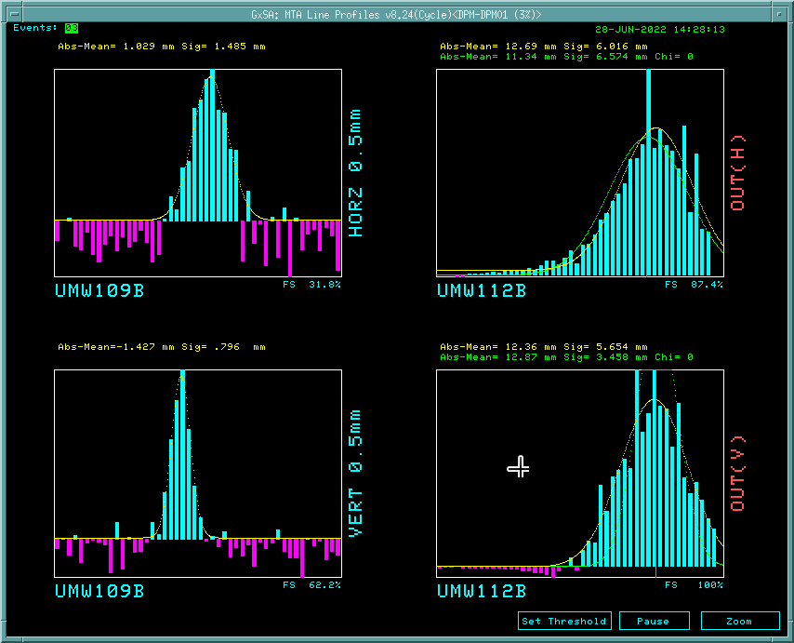
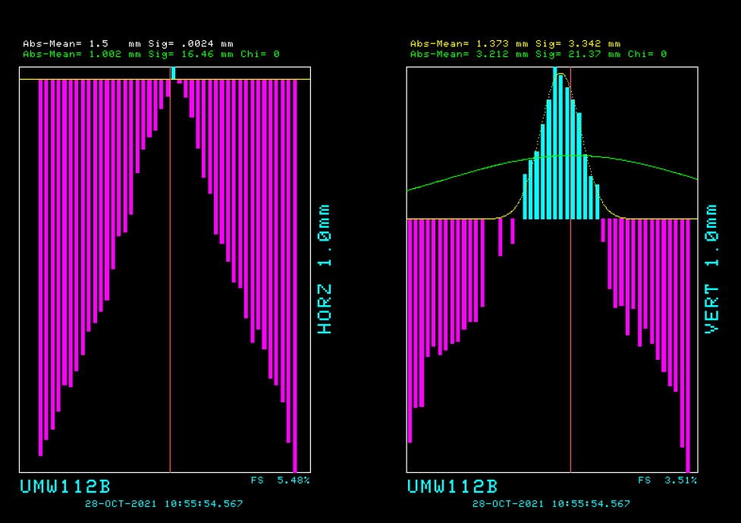
Beam Profiles
Multiwire 5
Multiwire 8 (PWC)
Multiwire 8 W/O Electron Back Filtering

Slide 8
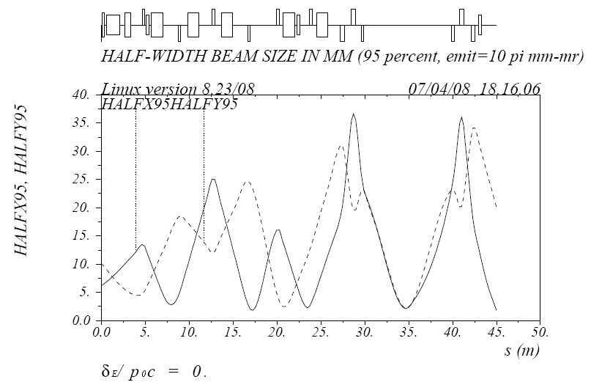
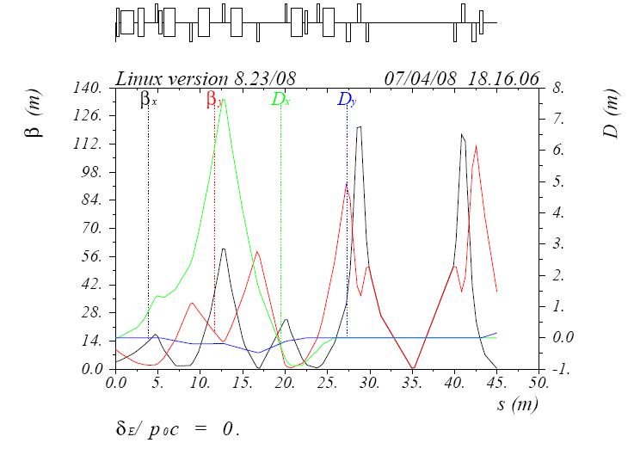
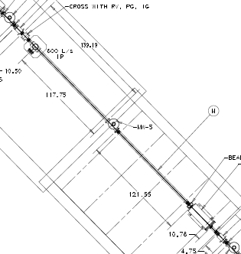
Design Optics of the MTA primary Beamline
3 profiles
MTA hall
10 m straight between quads
3 MW profile monitors for tomography
disp suppressed straight: 2mm, 0.5mm and 1mm pitches for optimal profile resolution
Beam direction

Slide 9
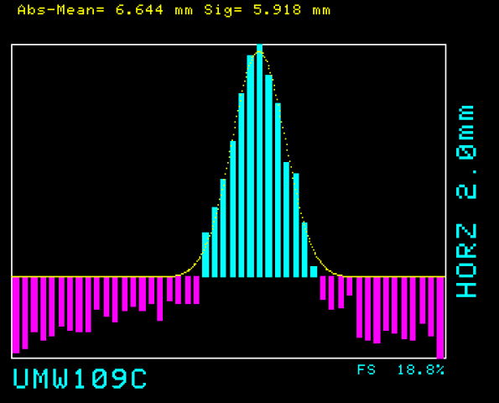
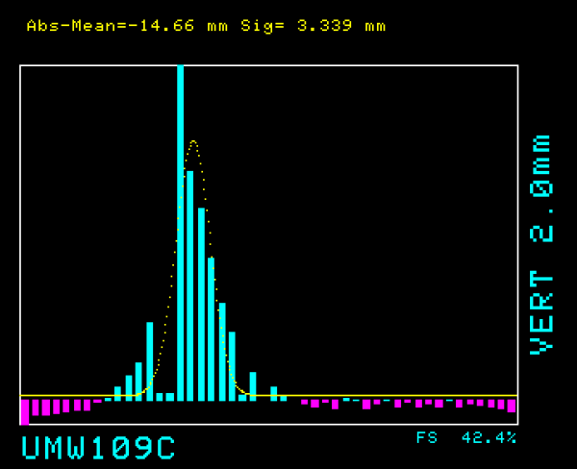
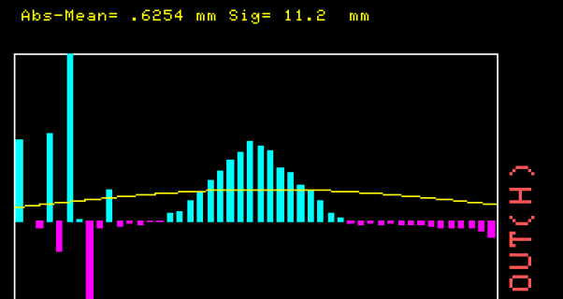
Multiline where we analyze the beam and receive beam profiles from
Dipole Magnet that causes final vertical bend to target
Quadrupole Magnets

Slide 10
Beam Envelope, Emittance and Courant Snyder functions (Twiss)
The beam envelope is described by the elliptical functions and the emittance
The beam envelope; i.e. sigma matrix is equivalent to the twiss functions which describe the beam envelope; their matrix transformations along the beamline are identical
Fitting a sigma matrix to profile data or twiss functions with emittance should give identical results
Taking the derivative with respect to x’
$$γ_{0}x_{0}^{2}+2α_{0}x_{0}x_{0}^{′}+β_{0}x_{0}^{′2}=ε$$
$$x^{′}=\frac{−α}{β}x gives the\max{value for x}$$
$${x_{max}^{2}= σ}^{2}=βε ; σ is half beam width$$
This width is what you measure on a profile monitor
$$\left[\left[\begin{matrix}σ_{11} & σ_{21} \\ σ_{12} & σ_{22}\end{matrix}\right]=ε\left[\begin{matrix}β & −α \\ −α & γ\end{matrix}\right]\right]$$
In practice, you often know the emittance and the variation along the beamline in a plane is confined to fitting two parameters, β and α. However, the emittance can also be fit if there are sufficient profile measurements.

Slide 11
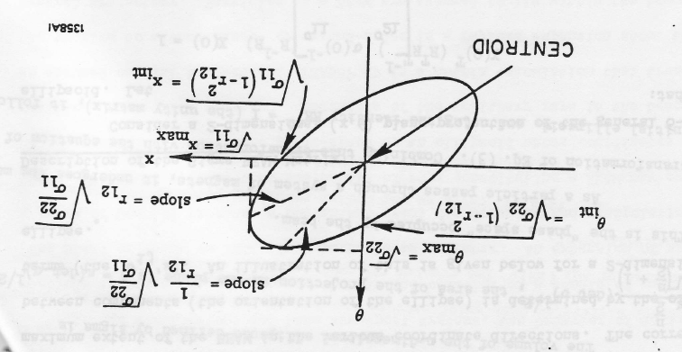
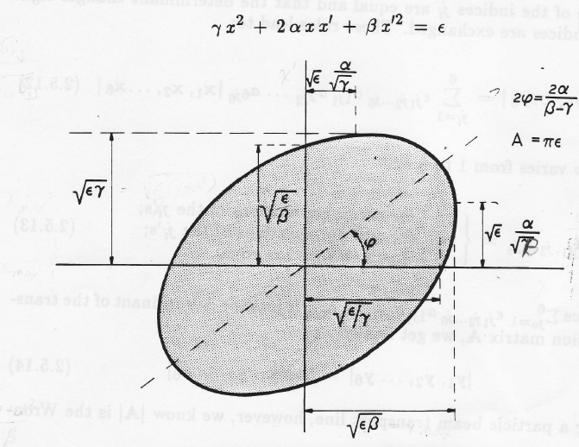
The envelope function: in sigma & twiss parameters
; ε = σ²/β
ε = σ θ α

Slide 12
Important take aways
Magnetic fields even nonlinear ones always conserve phase space: ∑ x x’
Linear equations of motion (dropping the kinematical or angular term in the Hamiltonian) constrain particle motion to a phase ellipse, where x,x’ are the individual coordinates of a particle in one plane (midplane symmetry preserves independent particle motion in a plane)
ε, is the area of the phase ellipse, α, β, and γ are the Courant Snyder, so-called Twiss parameters which like the matrix represent the envelope of the beam not individual particle motion.
Note! In strictly linear dynamics individual particle motion is confined to the ellipse: it moves around the ellipse according to the phase advance (focusing / defocusing) but does not travel inside or outside the perimeter of the ellipse.

Slide 13
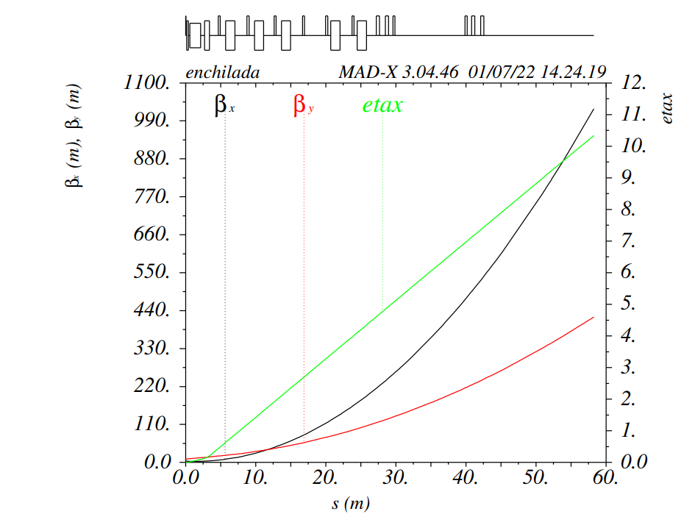
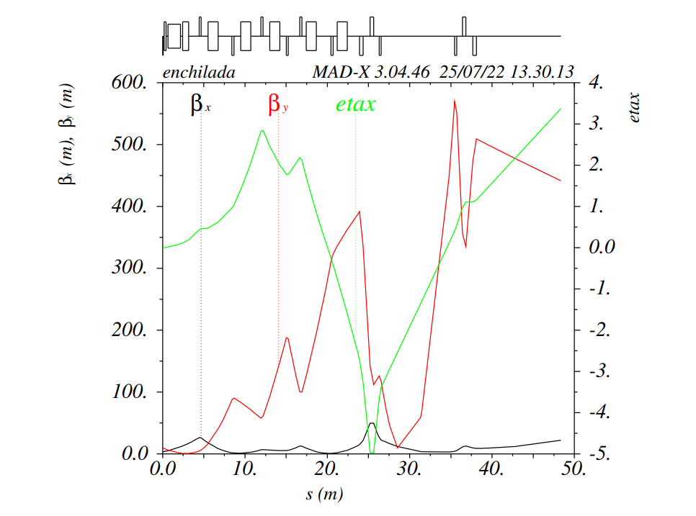
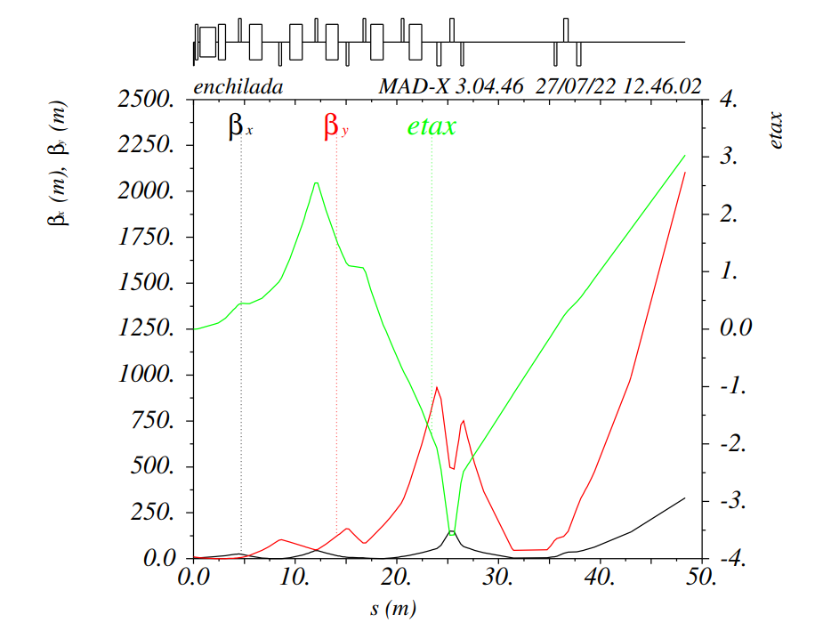
Current Twiss Functions
Initial given Alignment Deck
4th Iteration of Alignment deck
8th Iteration of Alignment deck

Slide 14
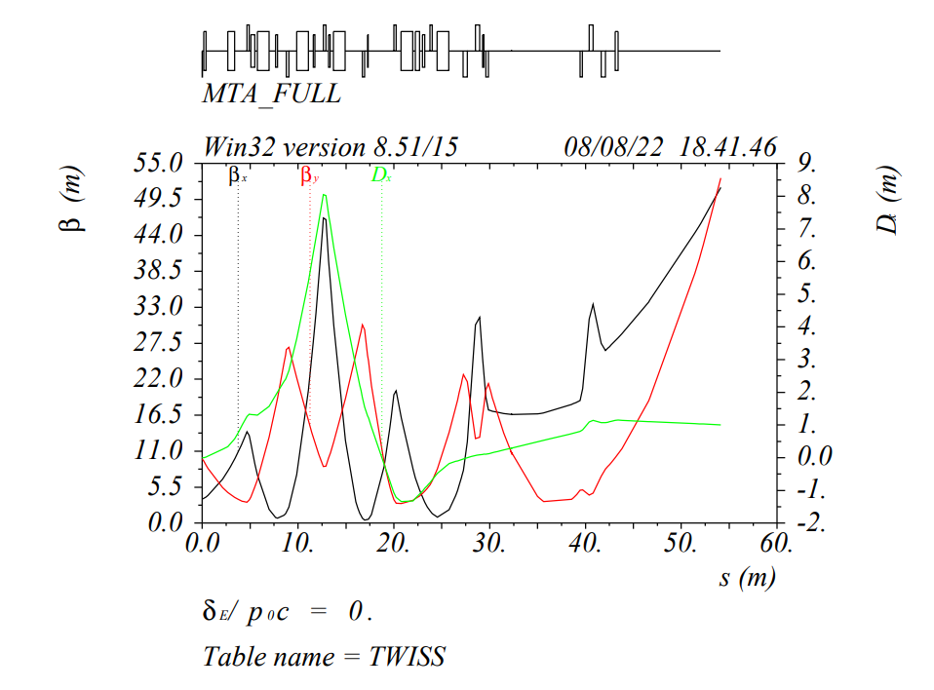
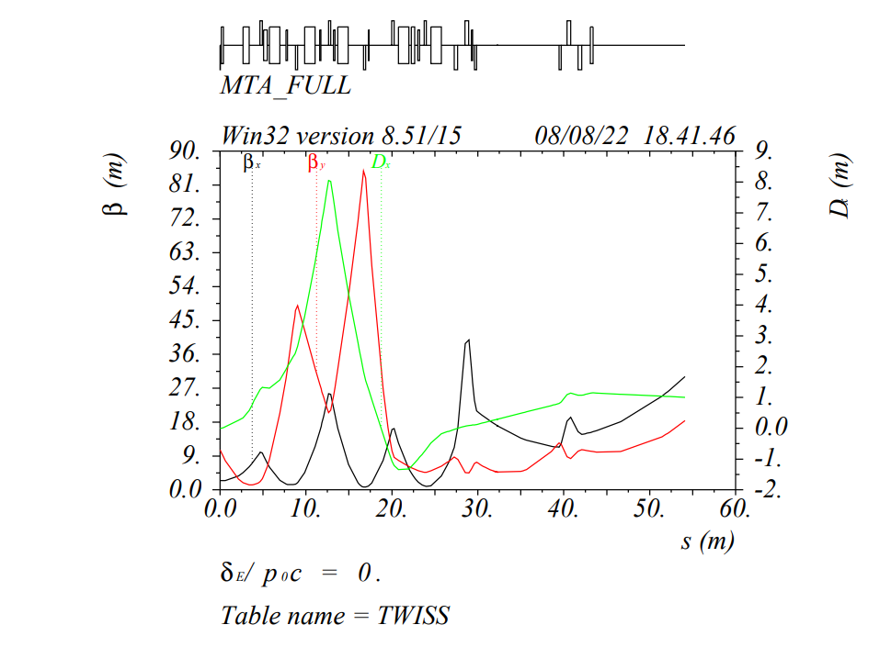
Twiss Functions Plots
Predicted Twiss Plot
Fitted Twiss Plot

Slide 15
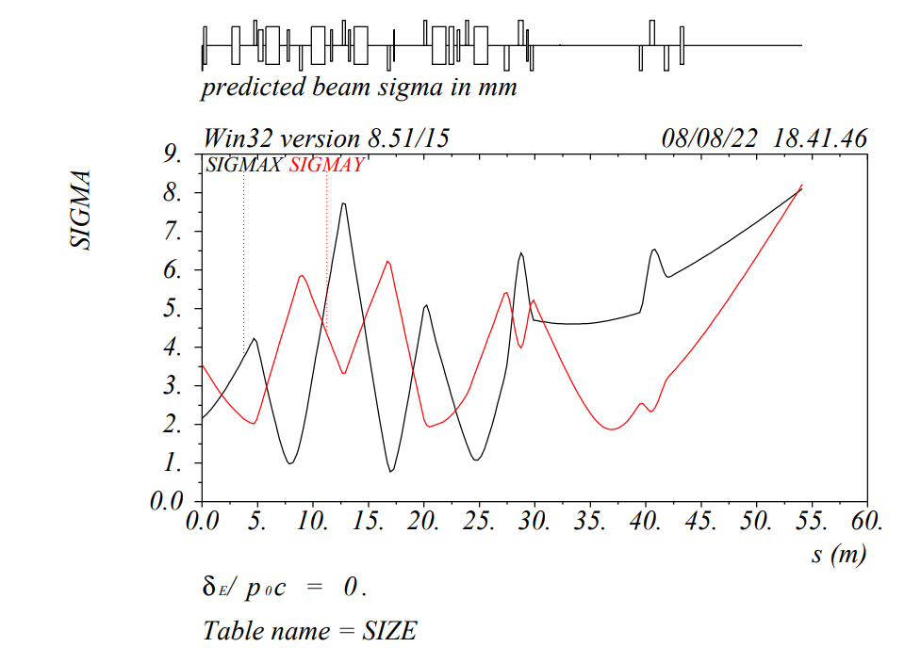
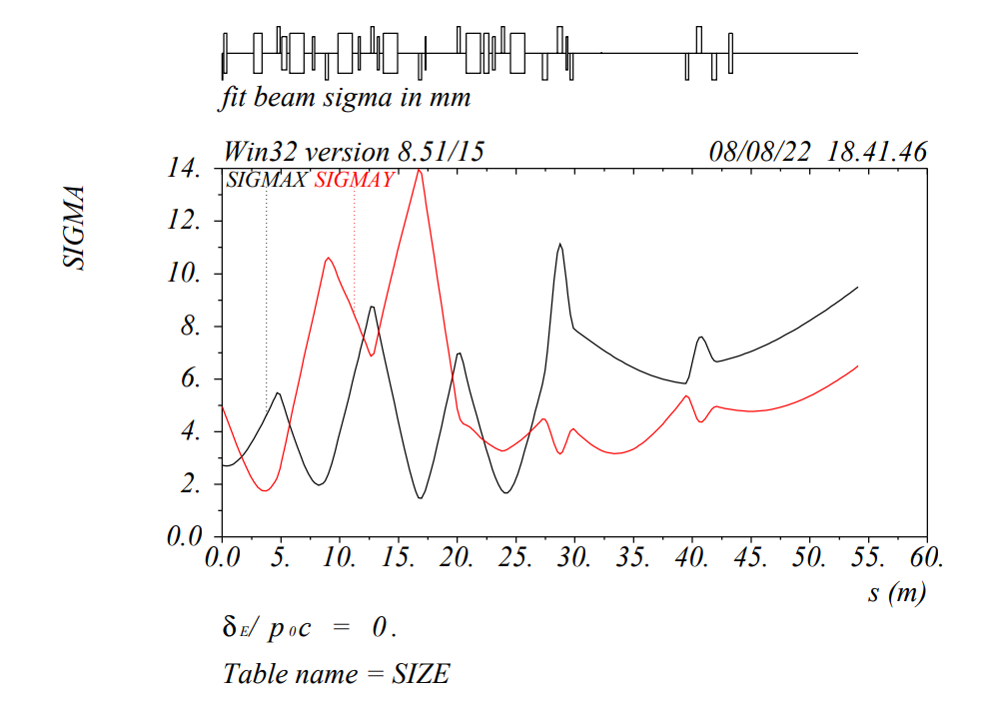
Beam Sigma
Predicted Beam Sigma
Fitted Beam Sigma

