Slide 1
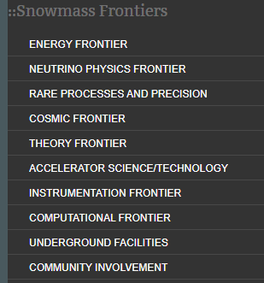
Snowmass Goals and Organization
Opportunity for the entire particle physics community to come together to identify and document a scientific vision for the future of particle physics in the U.S. and its international partners
https://www.snowmass21.org
Provides input to the P5 (Particle Physics Project Prioritization Panel) which develops a strategy for the US HEP Program
Organized in 10 “Frontiers”

Slide 2
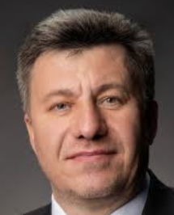
Accelerator Frontier - AF
Co-Conveners
Steve Gourlay (LBNL)
Tor Raubenheimer (SLAC)
Vladimir Shiltsev (FNAL)
Topical groups:
AF1: Beam Physics and Accelerator Education
AF2: Accelerators for Neutrinos
AF3: Accelerators for EW/Higgs
AF4: Multi-TeV Colliders
AF5: Accelerators for PBC and Rare Proc.
AF6: Advanced Accelerator Concepts
AF7: Accelerator Technology (RF, magnets, sources/targets)

Slide 3
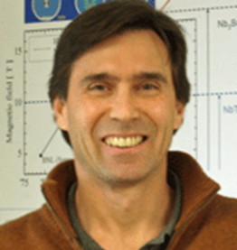
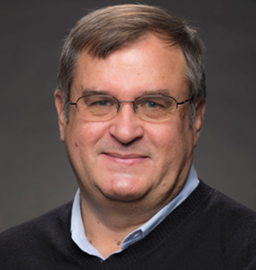
AF7: Accelerator Technology – Subgroup Magnets
Goal
Address the potential contributions of magnet technology to future HEP facilities, the R&D required to enable these opportunities, the time and cost scales of these efforts, and the needs for associated fabrication infrastructure and test facilities.
Conveners
Susana Izquierdo Bermudez
CERN
GianLuca Sabbi
LBNL
Alexander Zlobin
FNAL
Notes:
https://indico.fnal.gov/event/43520/

Slide 4
Main steps and Timeline

Slide 5
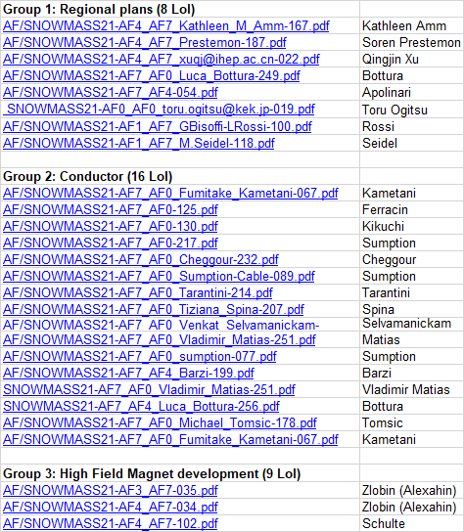
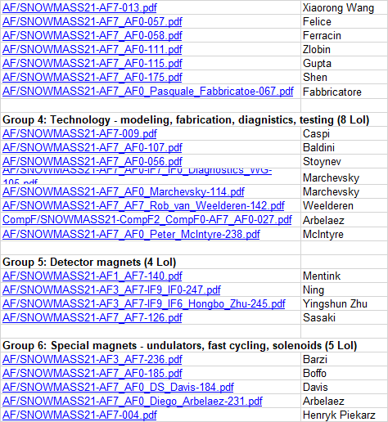
AF7-Magnet Letters of Interest

Slide 6
AF7m Letters of Interest
50 LoI received and organized under 6 themes:
Global collaboration (6 LoI)
High-field arc and IR magnets (15 LoI)
Conductor and cable (13 LoI)
Detector magnets (5 LoI)
Special magnets - solenoids, undulators etc. (7 LoI)
Test facilities and measurements/diagnostics techniques (4 LoI)
Main goals:
Provide a forum for presenting/discussing proposals
Coordinate writing of white papers, fostering potential collaboration across institutions (Labs, University, Industry) and geographical regions

Slide 7
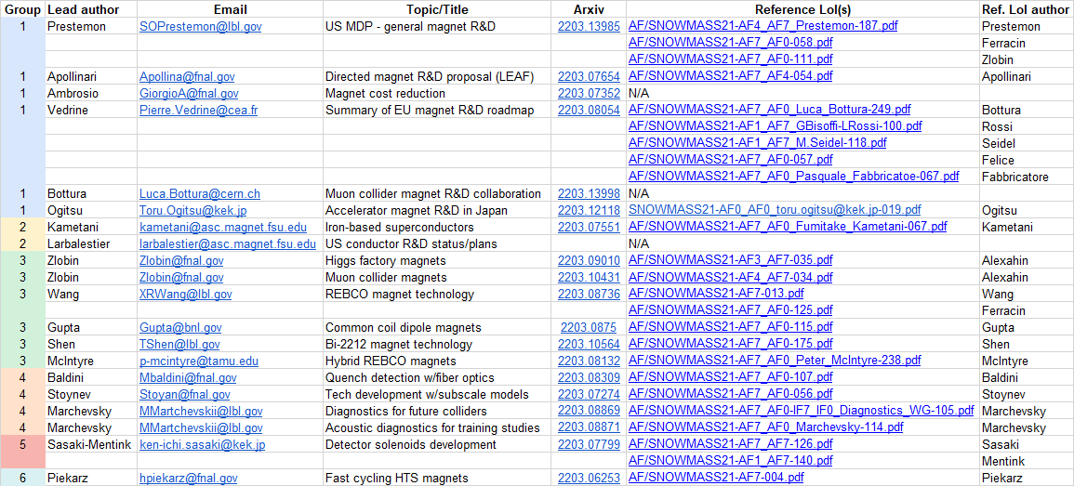
List of AF7-Magnets White Papers
https://indico.fnal.gov/category/1118/attachments/134066/198543/AF7m-WP-tracker-20220315cor.xlsx

Slide 8
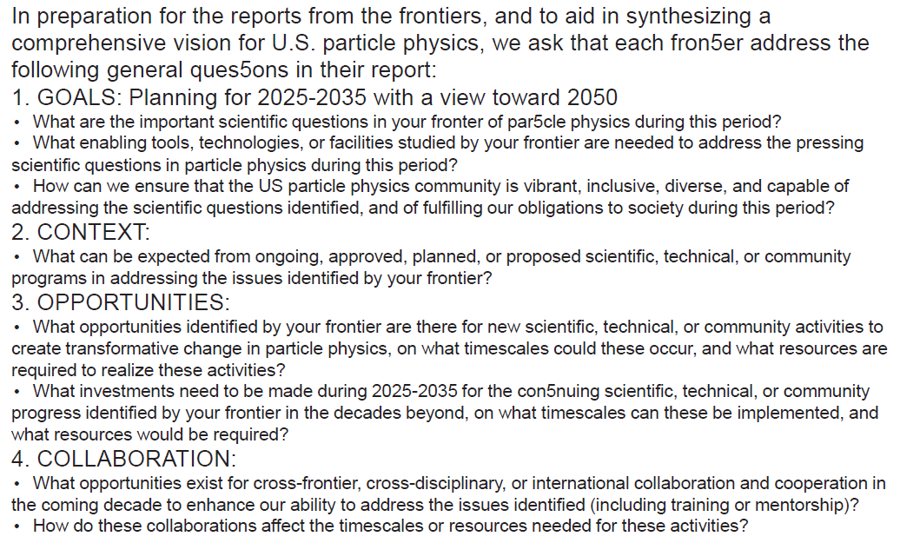
Summary Report Guidelines

