Slide 1
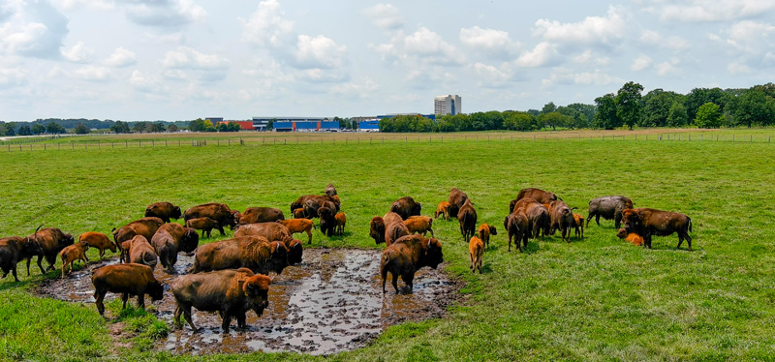
FNAL UEC Monthly Meeting
July 2022

Slide 2
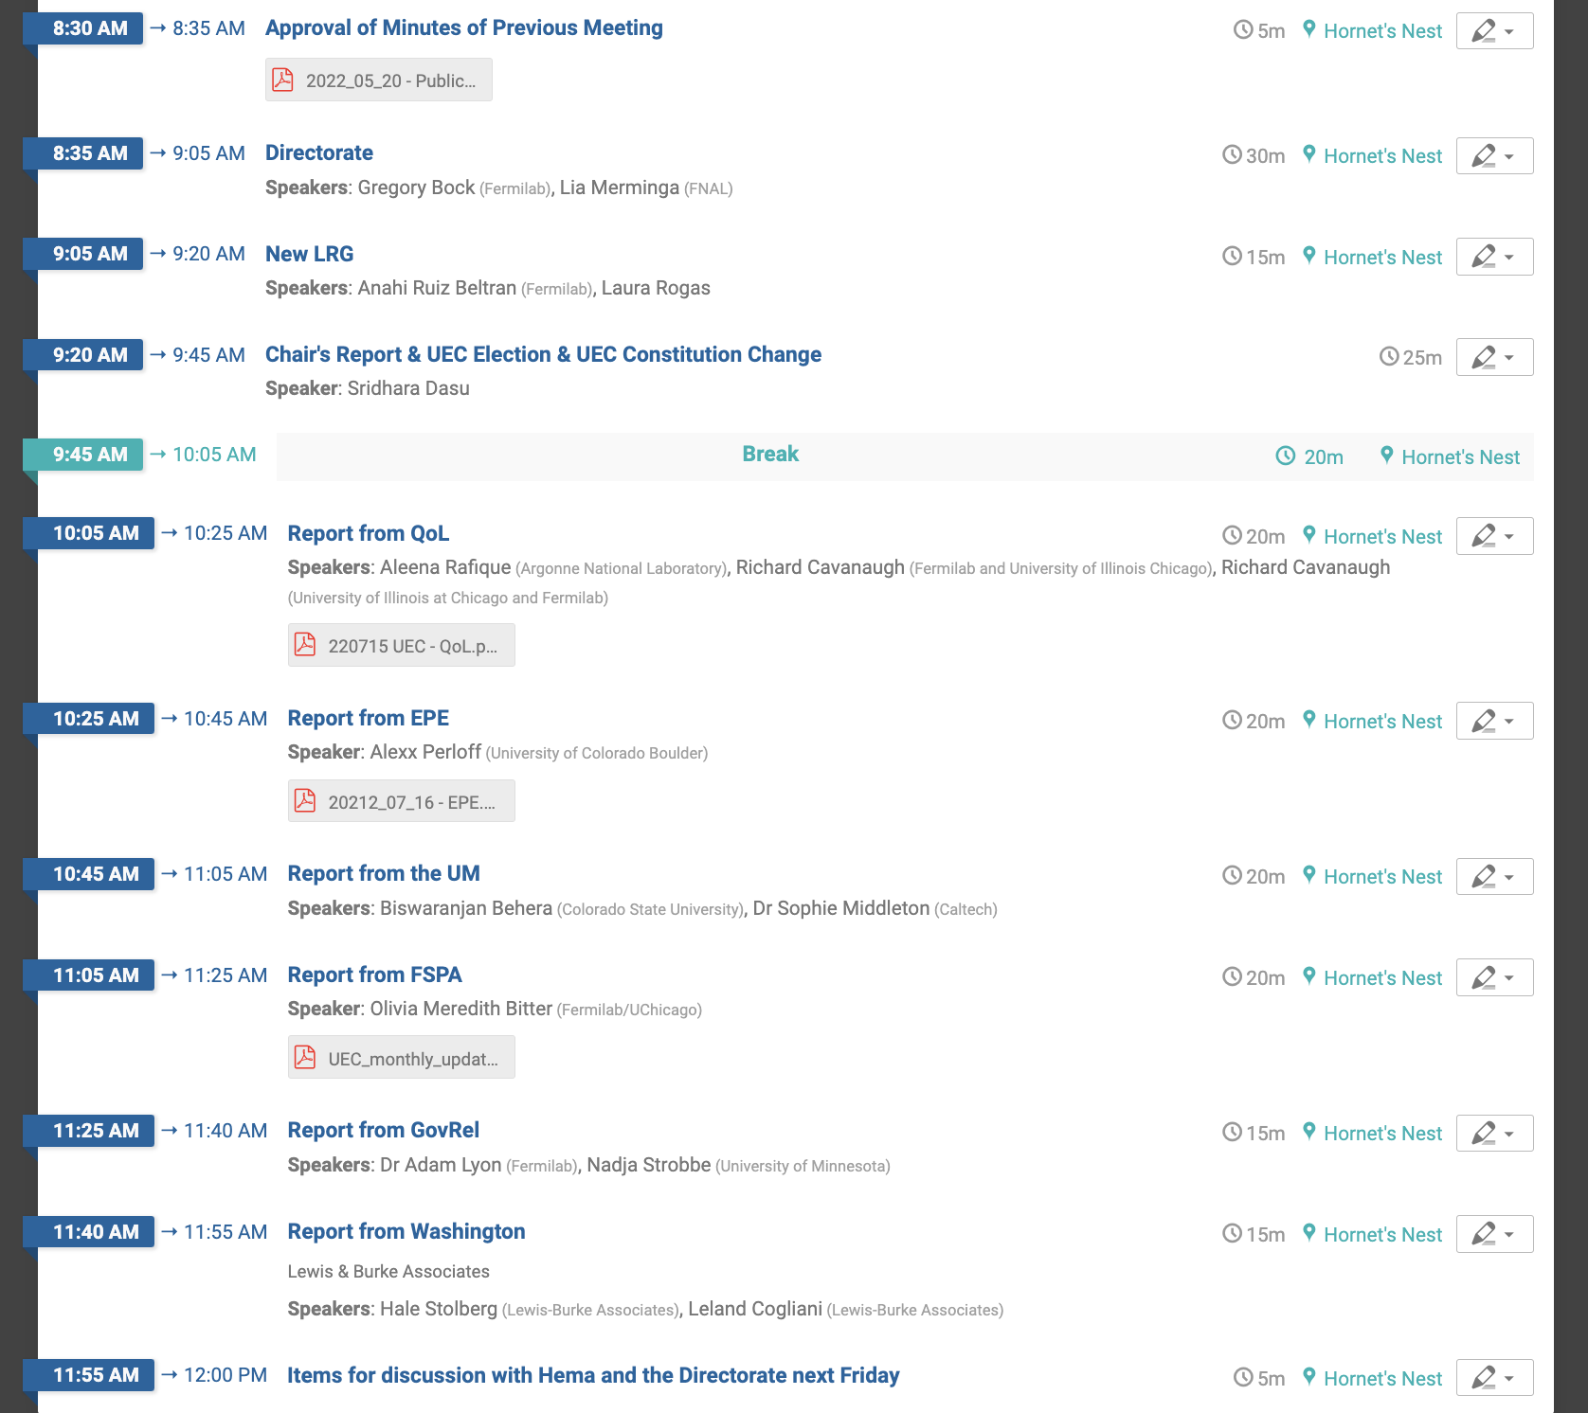
Agenda
Thank You Alexx
for Keeping Minutes
Approve Minutes?
Will send to FermiNews when approved.

Slide 3
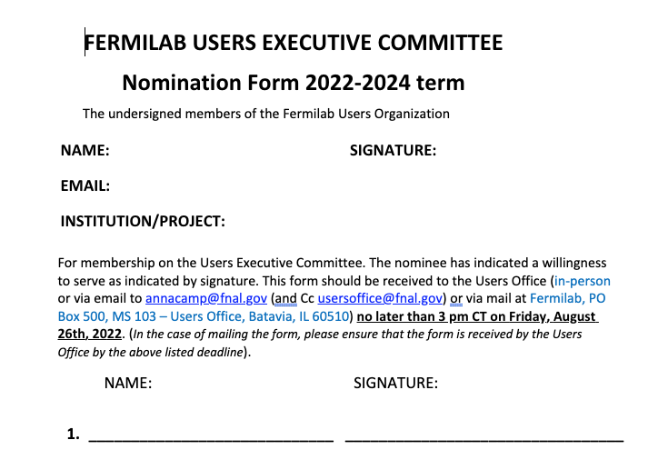
Annual UEC Election
Next Steps
Email Users & FNAL Scientists
Canvas Division Directors and Experiment Spokespeople
Should we setup an online form for encouraging people to run?

Slide 4
Constitution Change
Current Wording:
Between meetings of the general membership, the affairs of the Organization shall be handled by an Executive Committee. This Committee shall be composed of members elected by membership. The Executive Committee shall consist of 12 members elected for two-year terms. Six terms shall become vacant each year. Nominations for new members shall be made by the Executive Committee; additional nominations may be made by a written petition signed by or email from any 10 members. The Chair of the Executive Committee will be asked to continue to serve as a committee member for one year after the term as Chair expires, if necessary, as the 13th member. It is expected that the Executive Committee will appoint additional committees to study technical and administrative matters of concern to the Organization.
Suggested Wording:
Between meetings of the general membership, the affairs of the Organization shall be handled by an Executive Committee. This Committee shall be composed of members elected by membership. The Executive Committee shall consist of 12 members elected for two-year terms. Six terms shall become vacant each year. Nominations for new members shall be made by the Executive Committee; additional nominations may be made by a written petition signed by or email from any 10 members. The Chair of the Executive Committee will be asked to continue to serve as a committee member for one year after the term as Chair expires, if necessary, as the 13th member. It is expected that the Executive Committee will appoint additional committees to study technical and administrative matters of concern to the Organization. If any member of the EC becomes unavailable within six months of the annual election, the next highest vote getter from that election will be requested to replace that member. In the event a member becomes unavailable after six months, an additional member will be elected in the following year to maintain 12-member UEC.

Slide 5
Constitutional Amendment Rule
… constitution may be amended by a vote of the members. Any proposed amendment shall be introduced at a general membership meeting. The mail vote shall be taken no sooner than one week after such introduction. A two-thirds majority of the members voting is required for passage.
It appears we should add a question regarding the approval of the constitutional amendment to the annual ballot.

Slide 6
Monthly Issues for Discussion
Site Access Issues – Some Thoughts
Redesign of Site Access Application Web Pages
Guide the user through page-by-page form, a la, tax websites like TurboTax?
Users can pickup where they left off on return
Training of the guards
Could the security personnel be trained to be more empathetic to the users?
They are the first people the new members see – to be more welcoming to the users is good for the lab
When a badged User or Employee is accompanying a User with possibly broken paperwork, could the guard give a temporary ”escorted access”?
Annual refresh training is too onerous – could the Users have the same requirement as the Employees regarding training
Annual revalidation of User employment status can be requested

