Slide 1
Year 1 Goals/Deliverables - I
Our main goal is to demonstrate longitudinal segmentation with timing using a fiber calorimeter in two stages this and next year.
The first phase involves R&D on establishing the requirements on readout (photosensors and electronics). We plan to use a small (2-m long) existing absorber structure for bench tests and possibly a beam test.
The second phase entails instrumentation of the original DREAM module with the appropriate readout (SiPM arrays and electronics) and beam tests.
We will collaborate with ORNL on dSiPM, with NALU/CAEN and Calvision on electronics.
We have ongoing simulations (NN) and fiber R&D.

Slide 2
Year 1 Goals/Deliverables - II
Characterize SiPMs from different vendors and verify our SiPM simulation with TCAD.
Simulate dSiPM variants with TCAD to study the potential of the dSiPM technology in future calorimetry with emphasis on timing.
Develop expertise in using the NALU AARDVARC and CAEN FERS front-end electronics readout system coupled to a limited number of SiPMs. Evaluate the SoC (system-on-chip) on the AARDVARC and explore further use of SoC technology for ML with fast SiPM on fiber calorimeter.
Work on fiber+SiPM coupling. Use existing scintillating (SCSF-81J and Polymicro Ce-doped fused-silica) and clear (fused-silica) fibers embedded in a 2-m long copper absorber structure for longitudinal segmentation by timing (waveform analyses). Use a hot beta source (90Sr) and pulsed lasers.

Slide 3
Year 1 Goals/Deliverables - III
Establish a GEANT4 simulation framework for a multi-readout fiber calorimeter. Work towards a proof of concept for 3D shower reconstruction with CNN. Evaluate RNN+CNN reconstruction performance on a fiber calorimeter with non-pointing geometry. Optimize GNN (as an alternative ML model) for a fiber calorimeter: define the optimal form of the timing information (time-slices, leading edge, ToT, etc.) and the hyper-parameters of the GNN. Probe separately the improvement due to high granularity (2D alone) and precise timing (3D imaging) with GNN. Evaluate GNN performance on single, multi-particle hadronic showers and pure EM initiated showers to ensure no bias.

Slide 4
Year 1 Goals/Deliverables - IV
Study the 2D+time to 3D reconstruction using RNN with the early real-world data from pulsed (70 ps) lasers at the APD-Lab (signals with known structure as reference for train- ing/testing). Investigate the timing performance dependence on S/N, SiPM pulse shape and sampling rate in case of 2 and more detected photons.
Formalize the calibration constant set needed and study the stability and sensitivity to noise and mis-calibration effects on advanced reconstruction methods.

Slide 5
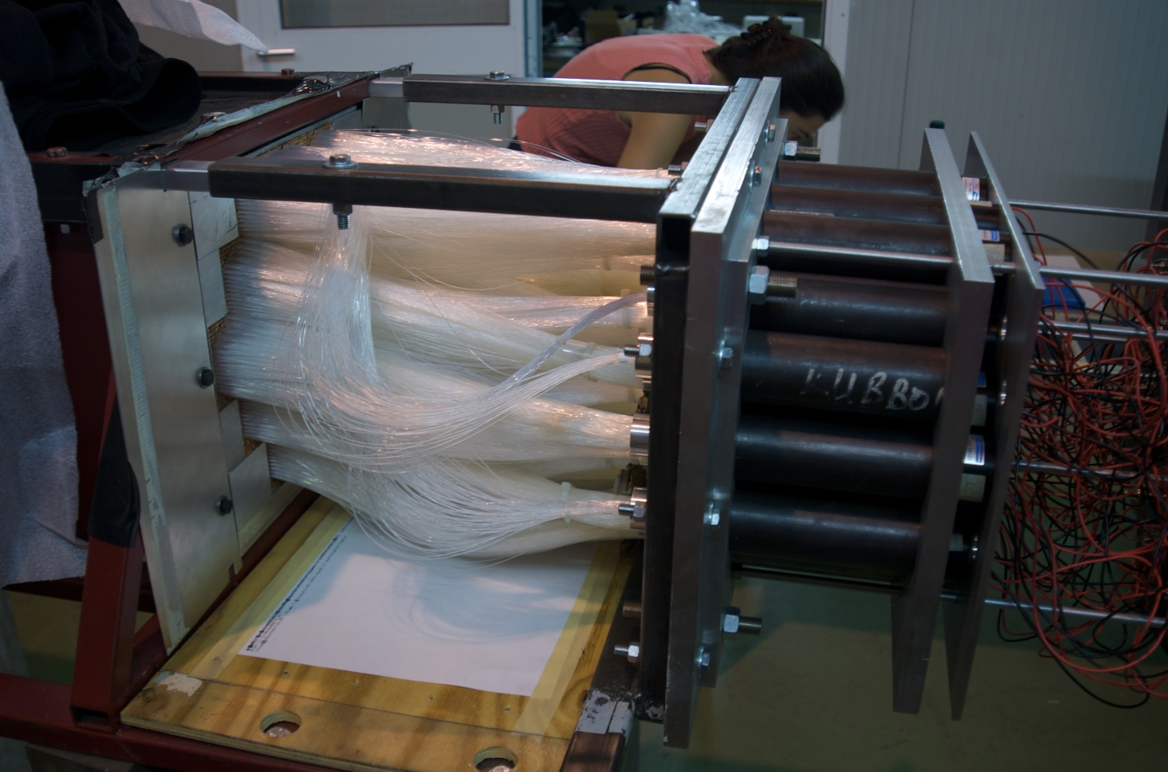
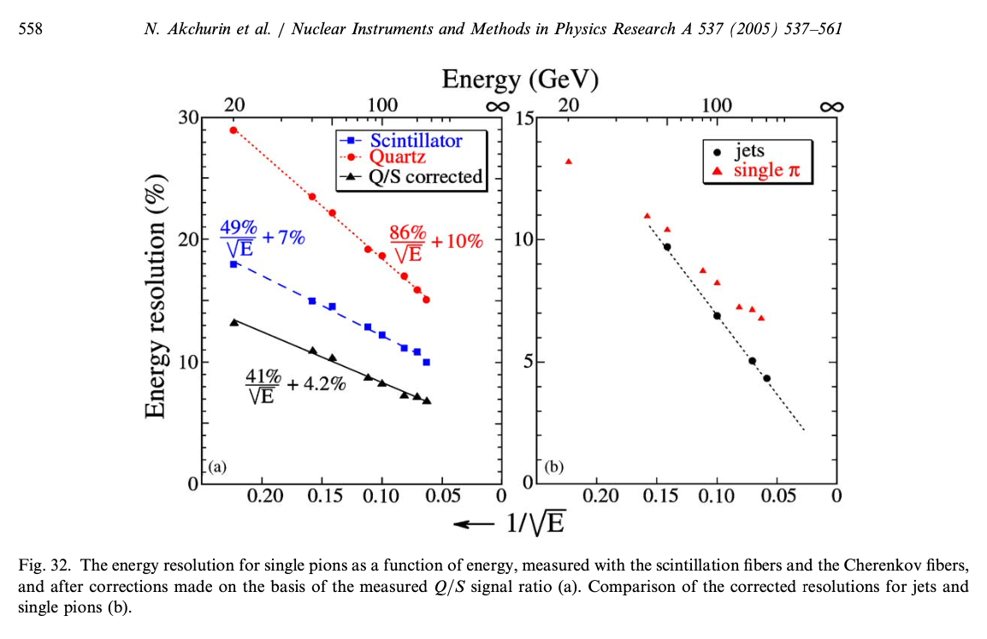
4x4 mm²/Rod, 4 c-fibers, 3 s-fibers
3x3 Rods(9)/SiPM, 36 fibers/SiPM, 12x12 mm² area
270 Rods/Tower
30 SiPM/Tower
Inner section: (1+6) Towers with SiPM
Outer section: 12 Towers with PMT
total= 210 SiPM (6x6 mm²)

Slide 6
Year 1 Goals/Deliverables - V
On hand:
SiPMs
Hamamatsu S13361-3050AE-08 (64 ch array, 3mm, 50 micron) +CAEN A5252 header for CAEN FERS
SensL 3 mm, 20 micron, single ch; SensL ARRAYC-30035-16P-PCB (3mm, 35 micron, 16 ch array)
Readout boards
CAEN A5202 (64 cn)
NALU AARDVARC (4ch- testboard)
CAEN V1742 (DRS), 32 ch x 2 units
70 ps laser
Test setup-1: SiPM (array) -> Amplifier board -> Waveform digitizer (NALU ARDVARC, CAEN V1742)
Test setup-2: SiPM (array) -> CAEN FERS 5200 system
New/needed:
(1) OnSemi ARRAYJ-30035-64P-PCB (3x3 mm, 35 micron) $1560/ea
(2) OnSemi ARRAYC-60035-64P-PCB (6x6 mm, 35 micron) $3398/ea
(3) OnSemi ARRAYJ-BOB3-64P-GEFK (evaluation board for (1)) $466/ea
(4) OnSemi ARRAYJ-BOB3-64S-GEFK (evaluation board for (2)) $466/ea
(5) CAEN A5254 SIPM header with FAST out to connect (2) with CAEN FERS A5202 $428.00/ea
(6) amplifier board for FAST output on (5) (tbd)

