Slide 1
PIP-II 2nd Technical Workshop Closeout,
WG#2 Cavity Processing and Testing
HyeKyoung Park, Fermilab
25 July, 2022

Slide 2
Workshop Agenda
Agenda was modified to allow longer discussion after each presentation.
Tuesday July 12, 2022
Time | Topic | Presenter
8-9:15 AM | Plenary
9:15-9:30 | Break
9:30-9:45 | Cavity overview, IKC deliverables, design evolution | Park/FNAL
9:45-10:05 | FNAL cavity procurement experience RI & EZ | Eremeev/FNAL
10:05-10:35 | Processing histories and test results HB | Furuta/FNAL
10:35-10:50 | Break
10:50-11:05 | Processing histories and test results LB | Furuta/FNAL
11:05-11:30 | STC test results | Sukhanov/FNAL
11:30-12:00 | Open discussion
Wednesday July 13, 2022
Time | Topic | Presenter
8-8:10 AM | Workshop logistics
8:10-8:30 | Jacketing experience at FNAL | Grimm/FNAL
8:30-8:50 | RRCAT processing and test experience | S. K. Suhane & P. Mohania/RRCAT
8:50-9:05 | VECC status | Seth/VECC
9:05-9:20 | INFN cavity configuration | D'Ambros/INFN
9:20-9:40 | Prototype experience at INFN (processing, test, facility…) | Bertucci/INFN
9:40-10:00 | UKRI STFC procurement experience Nb, Jcav | Shabalina/STFC
10:00-10:20 | Cavity test infrastructure at UKRI STFC | Akintola/STFC
10:20-10:35 | Break
10:35-10:50 | Roadmap to determine 800C vs 900C HT | Wu/FNAL
10:50-11:10 | Transportation study | Holzbauer/FNAL
11:10-11:30 | Flux expulsion study results | Wu/FNAL
11:30-12:00 | Open Discussion
Thursday July 14, 2022
Time | Topic | Presenter
8-8:10 AM | Workshop logistics
8:10-8:40 | EP parameter study | Chouhan/FNAL
8:40-9:00 | Recent lessons from other projects regarding processing N2 doping/mid T bake | Wu/FNAL
9:00-9:15 | Break
9:15-9:40 | Cavity engineering analysis | Narug/FNAL
9:40-9:55 | Plans for FNAL procured cavities | Park
9:55-10:10 | Break
10:10-12:00 | Test (incl FE) harmonization between STFC/INFN/DESY/FNAL and open discussion, workshop summary

Slide 3
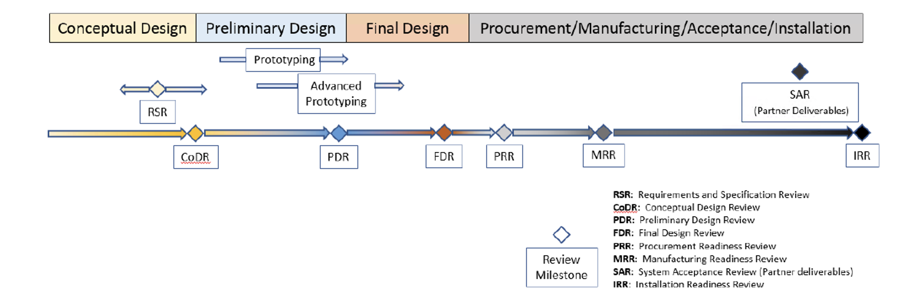
FNAL cavity procurement experience RI & EZ G. Eremeev
FNAL procured 4 B61 and 3 B92 cavities
Reviews taken before procurement
Approval of contractor’s MIP and fabrication drawings
MRR zoom meeting – easy to miss fine differences between fabrication plan and design
In person visit acquired lots of information – key meetings should be in person

Slide 4
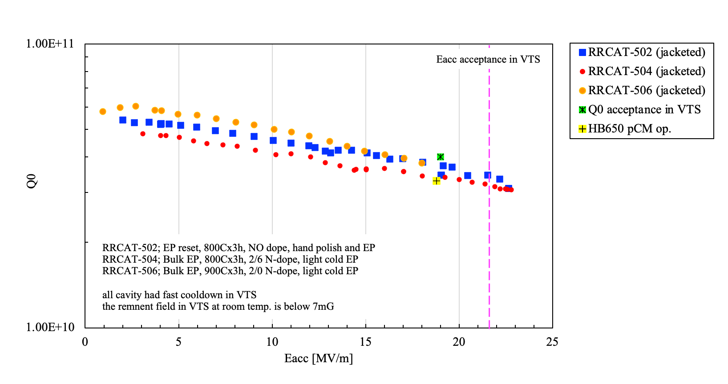
Processing and Test Histories of B92 F. Furuta
Four B90 and three B92 5-cells were processed and tested at FNAL so far.
Six of them were qualified and assembled as HB650 pCM string.
One (B9A-AES-010) was used for STC commissioning, and now at RRCAT to commission their horizontal test system.
B92 cavities showed less MP compared with B90. FE issue was also lighter than B90 cavities.
FNAL has three new B92 cavities, will have more statistics.
HPR and EP parameter optimization will also be continued.
Three B92 Cavity Test Summary
Cavities by RRCAT

Slide 5
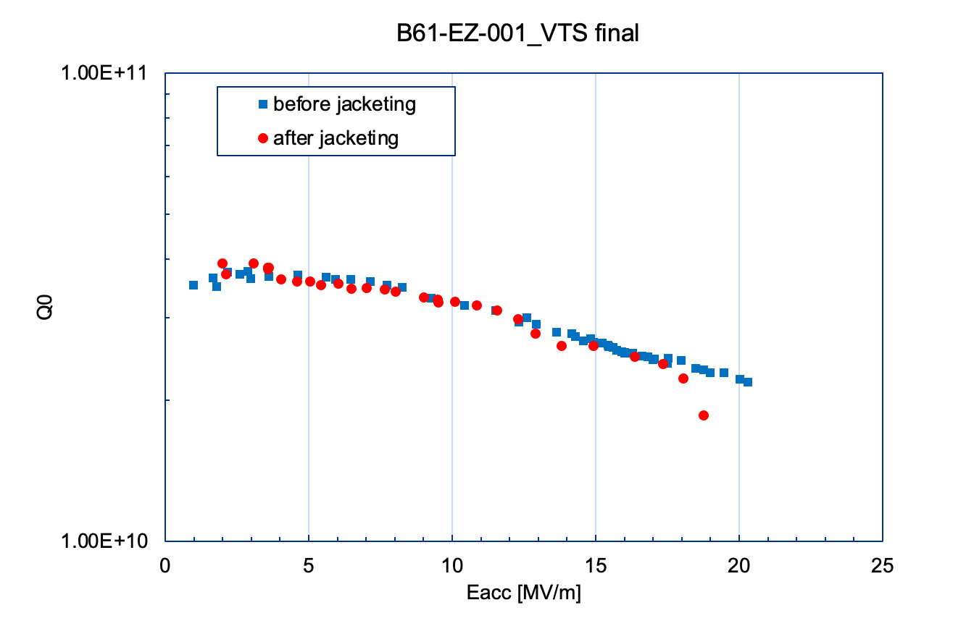
Processing and Test Histories of B61 F. Furuta
VTS | date | Eacc max | Q0 | notes
VTS1 | 2/5/2021 | 8 | 1.00E+10 | EP(160um), 800Cx2hrs, EP (70um in total), tuning, USC, HPR
VTS2 | 3/11/2021 | 8.70 | 1.50E+09 | tuning, revise antenna length, full re-HPR
VTS3 | 3/26/2021 | 12.3 | 1.45E+10 | re-HPR
VTS4 | 4/19/2021 | 2K leak | n/a | re-HPR
VTS5 | 5/25/2021 | 12.7 | 2.47E+10 | full re-HPR
VTS6 | 7/2/2021 | 16 | 1.16E+10 | re-HPR, mode mixing mitigation
VTS7 | 8/24/2021 | 11.4 | 3.00E+10 | 120C bake, mode mixing mitigation
VTS8 | 9/17/2021 | 20.3 | 2.19E+10 | digital / analog PLL to mitigate mode mixing
VTS9 | 2/25/2022 | 18.8 | 1.86E+10 | jacketing, flatness=94% post jacketing
Cavity cage installation is critical for LB650 cavity. Field flatness degradation was an issue with B61 5-cell. Improvement of hardware and procedures being performed.
4pi/5-mode was excited during pi-mode meas. of LB650 5-cell.
Digital PLL system is modified to suppress parasitic mode during VTS measurement

Slide 6
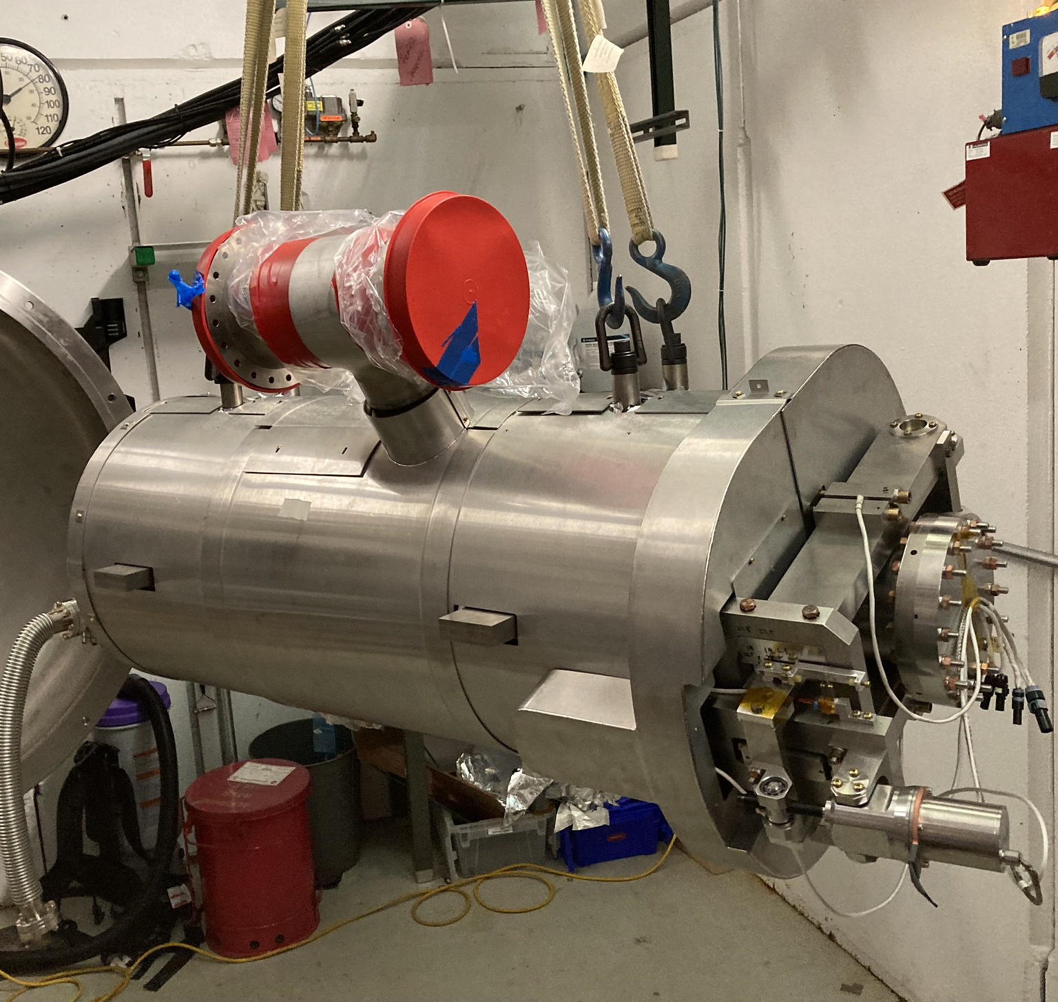
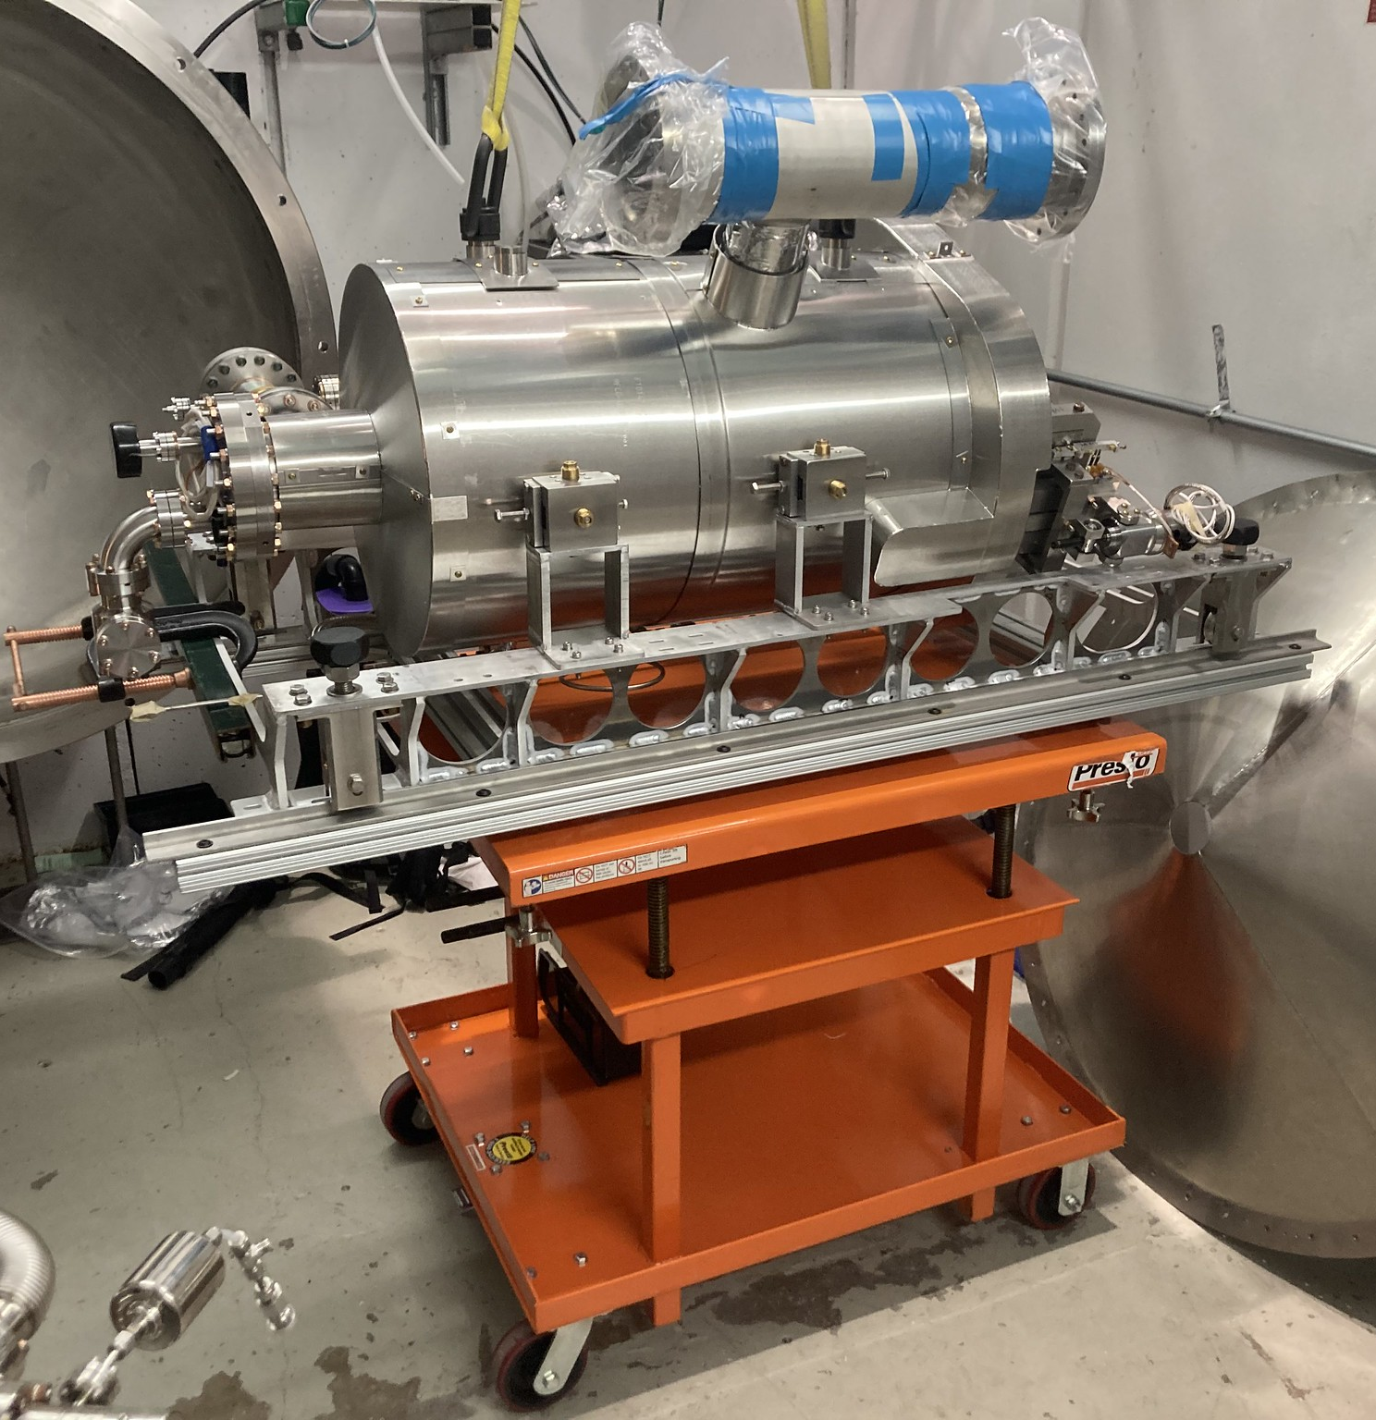
Tests of 650 MHz cavities in STC A. Sukhanov
3 tests of 650 MHz cavities (3rd one ongoing now)
HB650, beta=0.9, B9A-AES-001
January-March 2020
STC commissioning for 650 MHz operations
Prototype coupler/tuner validation/testing
Prototype cavity characterization
HB650, beta=0.92, B92D-RRCAT-502
October-November 2021
Prototype coupler/tuner validation/testing
Prototype cavity characterization, qualification for prototype HB650 cryomodule assembly
LB650, beta=0.61, B61-EZ-001
June-July 2022 (ongoing)
Preproduction coupler/tuner testing
Prototype cavity characterization
HB650 B9A-AES-010
HB650 B92D-RRCAT-502
LB650 B61-EZ-001

Slide 7
STC Test Summary A. Sukhanov
Cavity | B9A-AES-010 | B92D-RRCAT-502 | B61-EZ-001
MP conditioning time, h | 30 | 34 | 20
Max Eacc, (CW) MV/m | 18 | 19.2 | 16.5
Limited by | RF power | RF power | Radiation
Max Eacc (pulsed mode), MV/m | 22.9 (admin. limit) | 22.9 (admin. limit) | 19.4 (admin. limit)
Radiation at max Eacc, mR/h | n/a | 36 | 3400
Radiation onset field, MV/m | n/a | 18.5 | 11.5
Q0 at max Eacc, 1e10 | 1.9 | 3.5 | 1.9
Q0 at low field, 1e10 | 3.2 | 4.0 | 4.2
LFD coefficient, Hz/(MV/m)**2 | 1.6 | 1.0 | 2.4
df/fp, Hz/Torr | 6.0 | 15 | 27

Slide 8
Jacketing Experience at FNAL C. Grimm
Fermilab has a well-established team that has jacketed over 60 cavities of many frequencies and beta versions.
RRCAT-502 cavity jacketing was successful with very minimal frequency and field flatness changes from start to finish. This was true for all seven 650 cavities jacketed at FNAL.
Decision to use an Argon gas flow through the internal cavity surface helped to reduce time between weld segments and helped eliminate further RF drift changes after welding stopped.
All tooling, equipment, and infrastructure developed and validated to jacket 650 MHz cavities. Ready to transfer to industry.

Slide 9
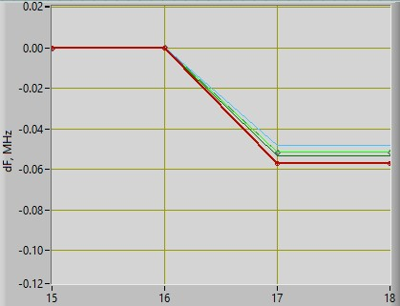
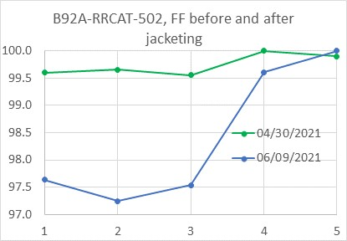
Jacketing Experience at FNAL C. Grimm
Final Frequency Shift and Field Flatness (RRCAT-502)
  All within specifications
Final RF Spectrum
Field Flatness Measurements
Beginning Measurement: 649.064 MHz
Ending Measurement: 649.013 MHz
~-50kHz Shift
Modes Separated by only 10 kHz
Beginning Average: 99.7%
Ending Average: 98.4%
Small loss of only ~1.3%
Both Graphs Courtesy of Timergali Khabiboulline

Slide 10
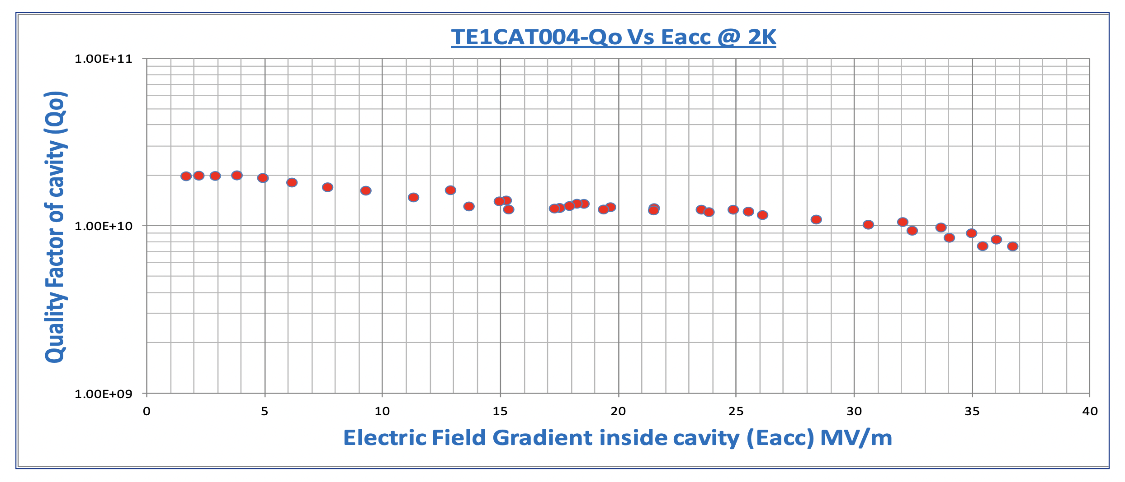
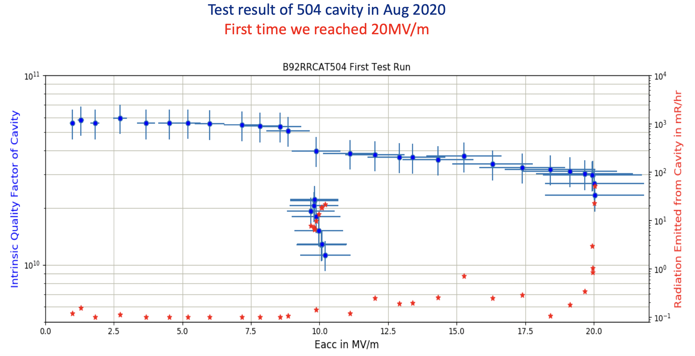
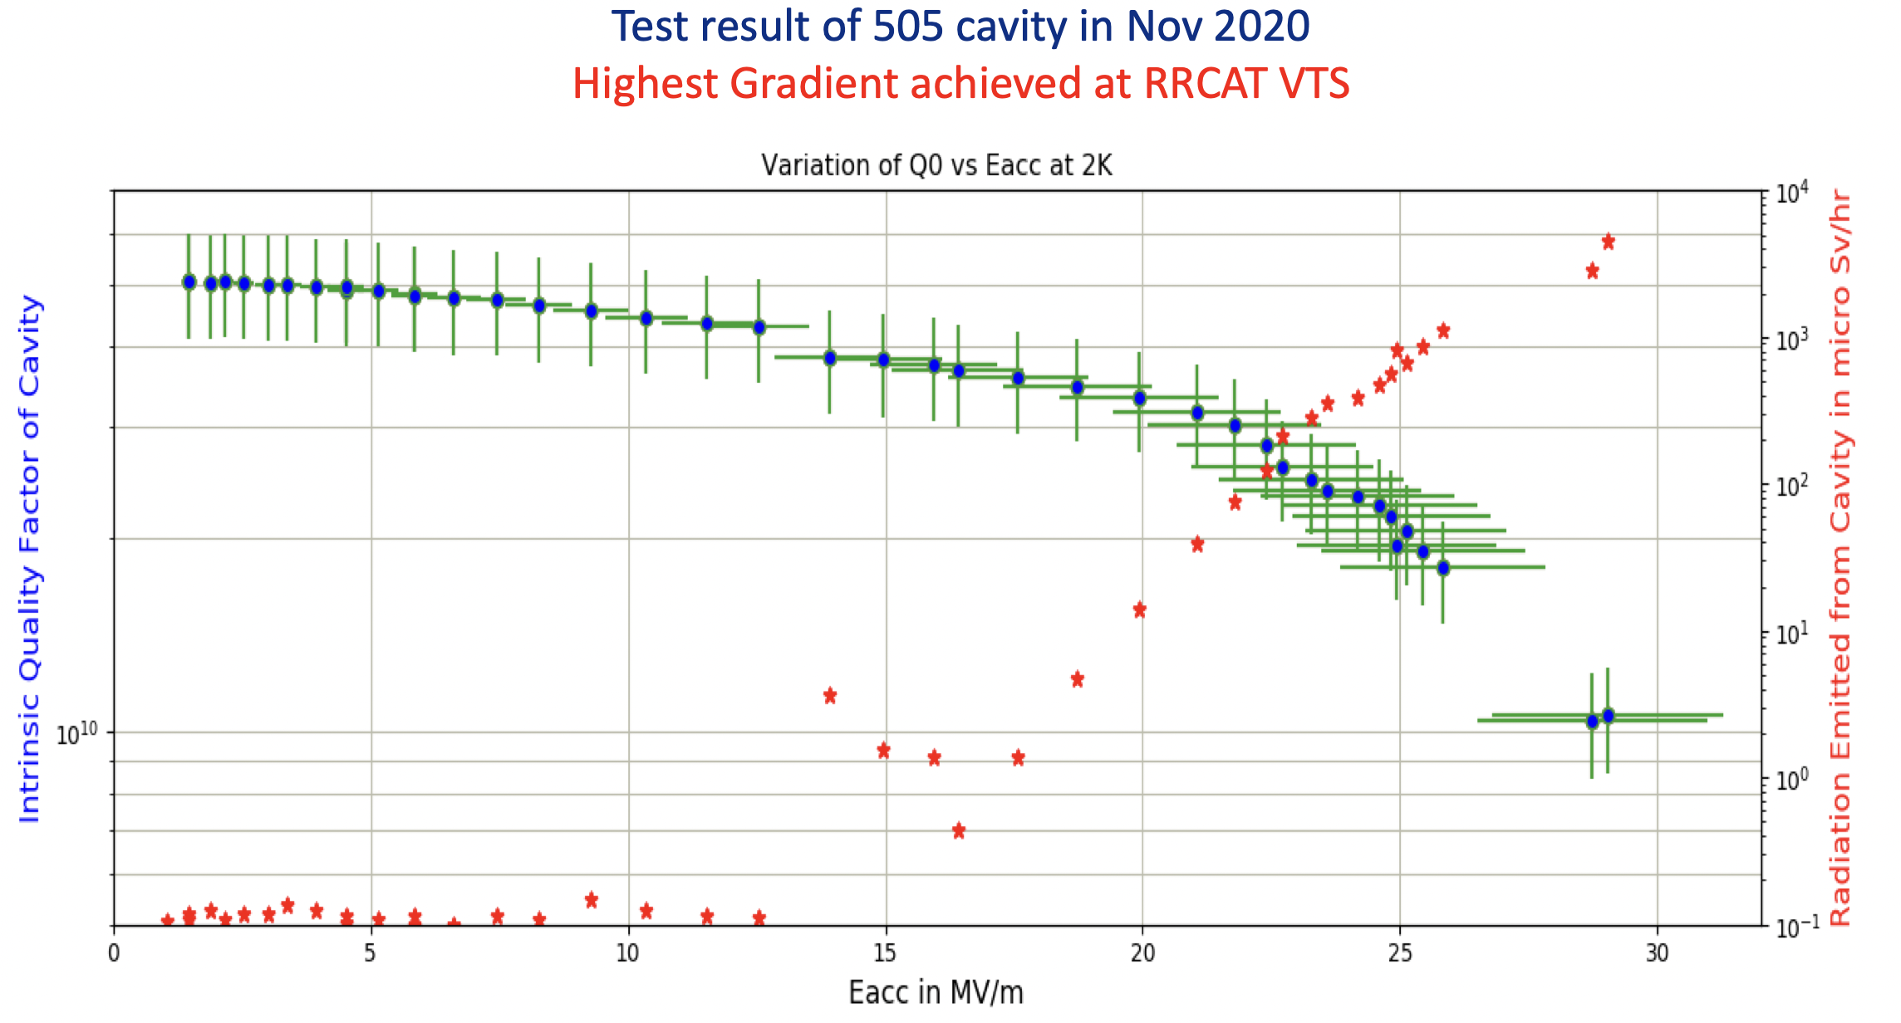
RRCAT processing and test experiences P. Mohania
VTS commissioned in 2014, RF system of the facility was developed in collaboration with FNAL. Till date, we have tested single cell 1300 MHz and 650 MHz cavities, and 5-cell 650 MHz (Beta 0.92).
Single cell test results

Slide 11
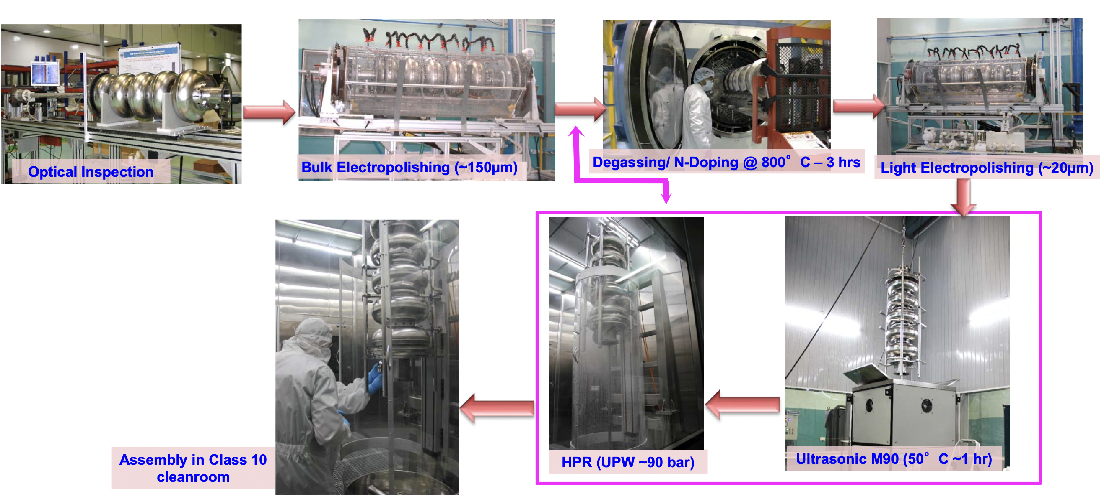
Processing Experience at RRCAT S. Suhane
Cavities processed
Two Single cell HB 650 MHz cavity (HB102 & HB104)
Seven 5-cell HB 650 MHz cavity (HB501 – HB507) (Mid 2018 – Till Jun 2022)
Three cavities assembled in pCM at FNAL

Slide 12
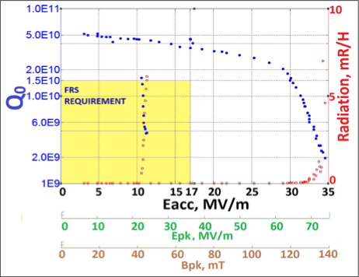
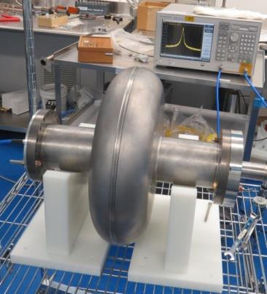
LB650 Cavity Fabrication Experience and Status Update -VECC
S. Seth
Single-cell LB650 niobium cavity (EBW done at IUAC,Delhi)
VTS Results : VECC First Single Cell LB650 SRF Cavity

Slide 13
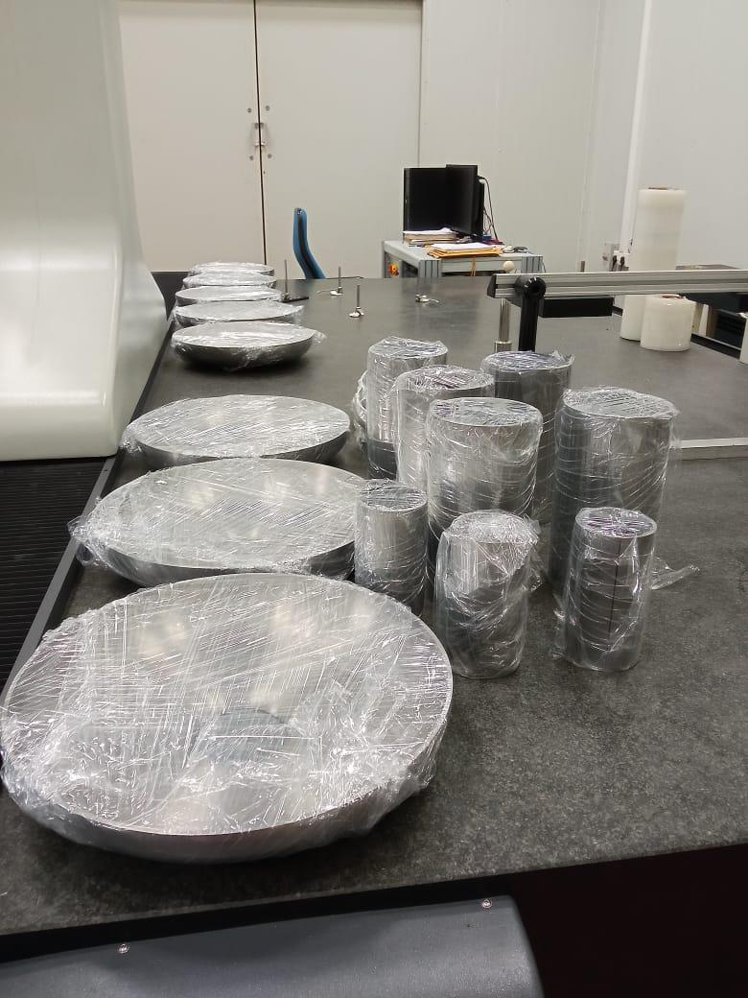
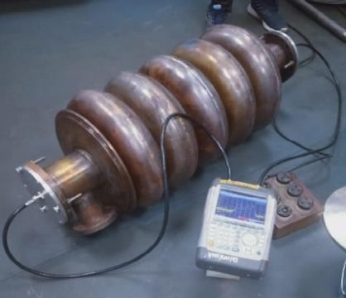
LB650 Cavity Fabrication Experience and Status Update -VECC
S. Seth
For fabrication of two prototype LB650 cavities, 12 niobium mid halfcells , 4 niobium pen halfcells and 4 niobium end halfcells, 12 set of of stiffener rings are developed.
At present, all the niobium components and fixtures, properly packed for welding at IUAC.
Copper prototype
Formed Nb cavity parts

Slide 14
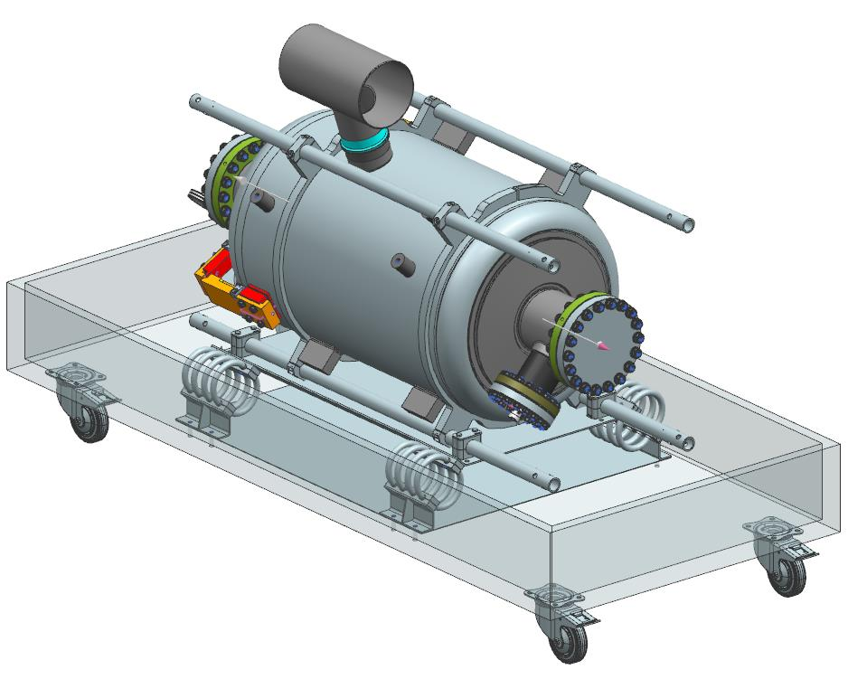
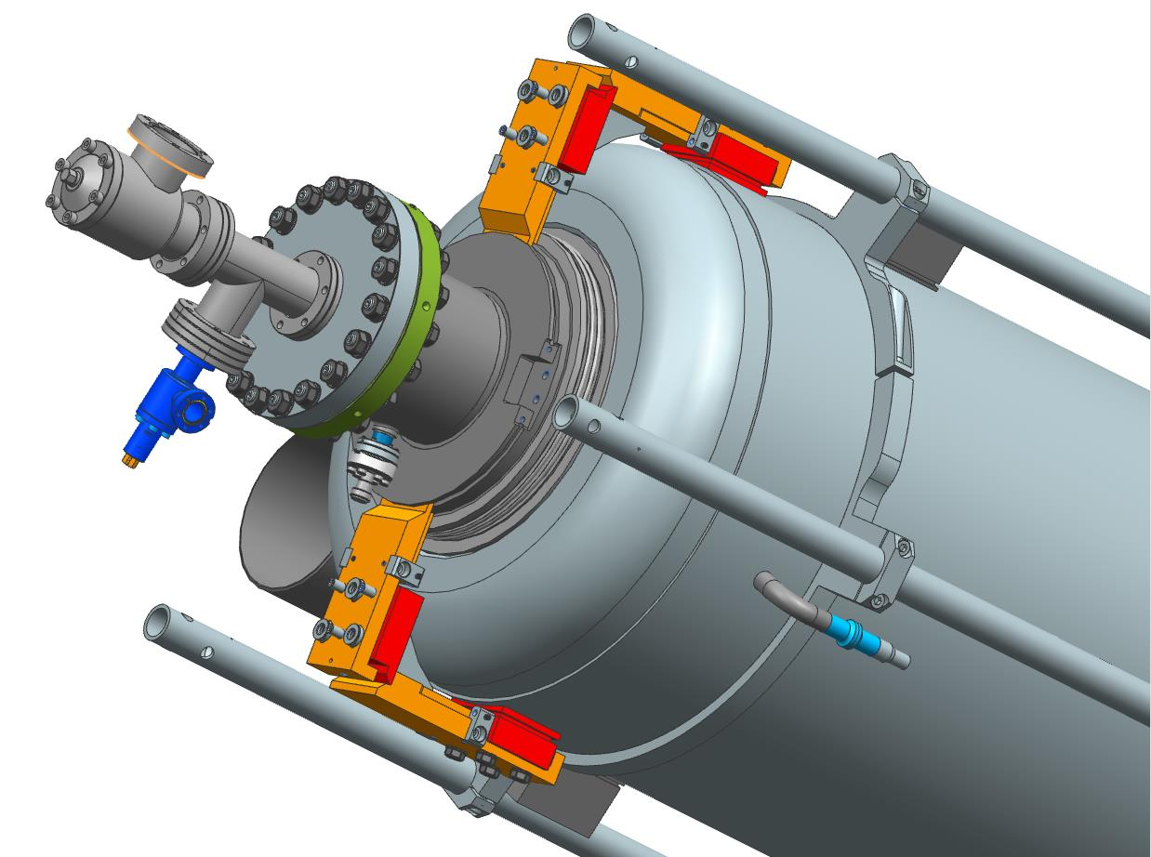
Cavity interfaces, handling and transportation/INFN A. D’Ambros
Vibration and shock dumping system improved with steel wire dumpers
No more need of straps or rubber foam bumpers
Transportation proposal
Cavity delivery configuration

Slide 15
Prototypes experience @ INFN LASA M. Bertucci
INFN LASA R&D activity on cavity treatments is ongoing: the goal is to establish a high-Q recipe suitable in the industrial context.
INFN LB650 single-cells:
• B61S-EZ-001: treated with high-Q recipe (N2 doping+900°C) and tested at FNAL
• Next: re-test at LASA toward harmonization of testing infrastructure
B61S-EZ-002 with baseline recipe (XFEL) qualified at LASA
• Next: retreat with mid-T bake recipe, then VT at lasa
B61S-EZ-003: foreseen to be treated with high-Q treatment (N2 doping-based), then VT
at LASA
INFN LB650 5-cell cavities:
B61-EZ-001 successfully qualified at Fermilab VTS both naked and jacketed
• Next: targeted for dressed, horizontal cavity test in STC
B61-EZ-002 treated with mid-T bake recipe, then VT at LASA

Slide 16
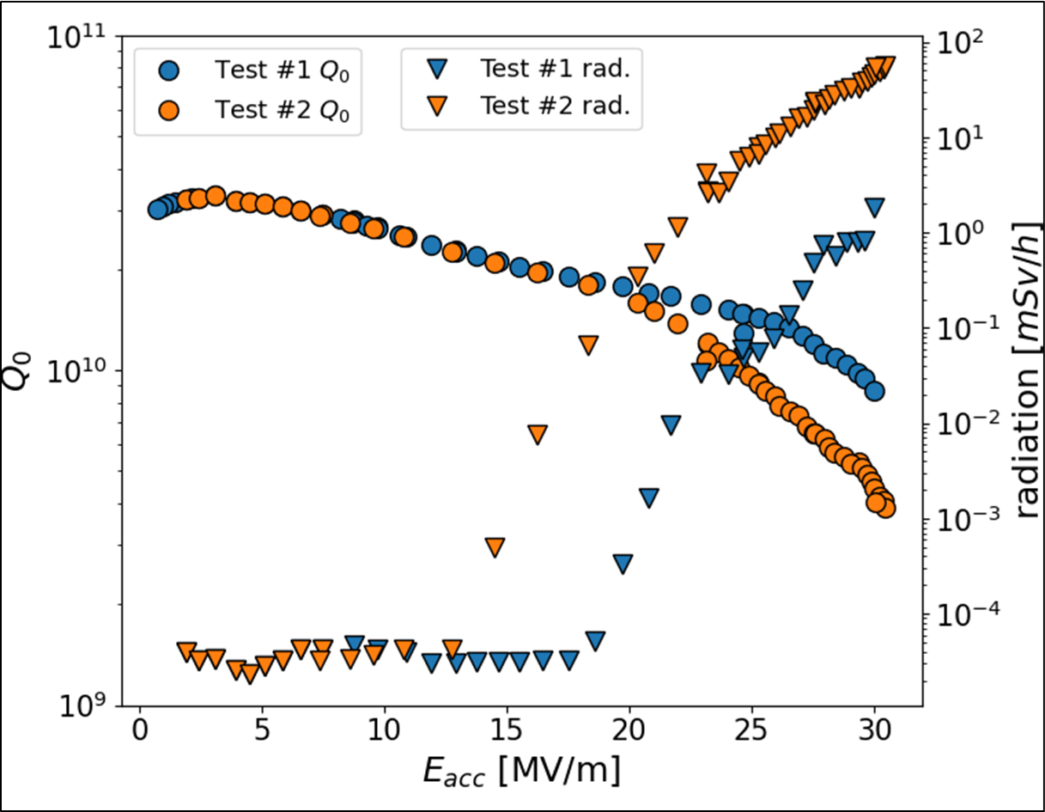
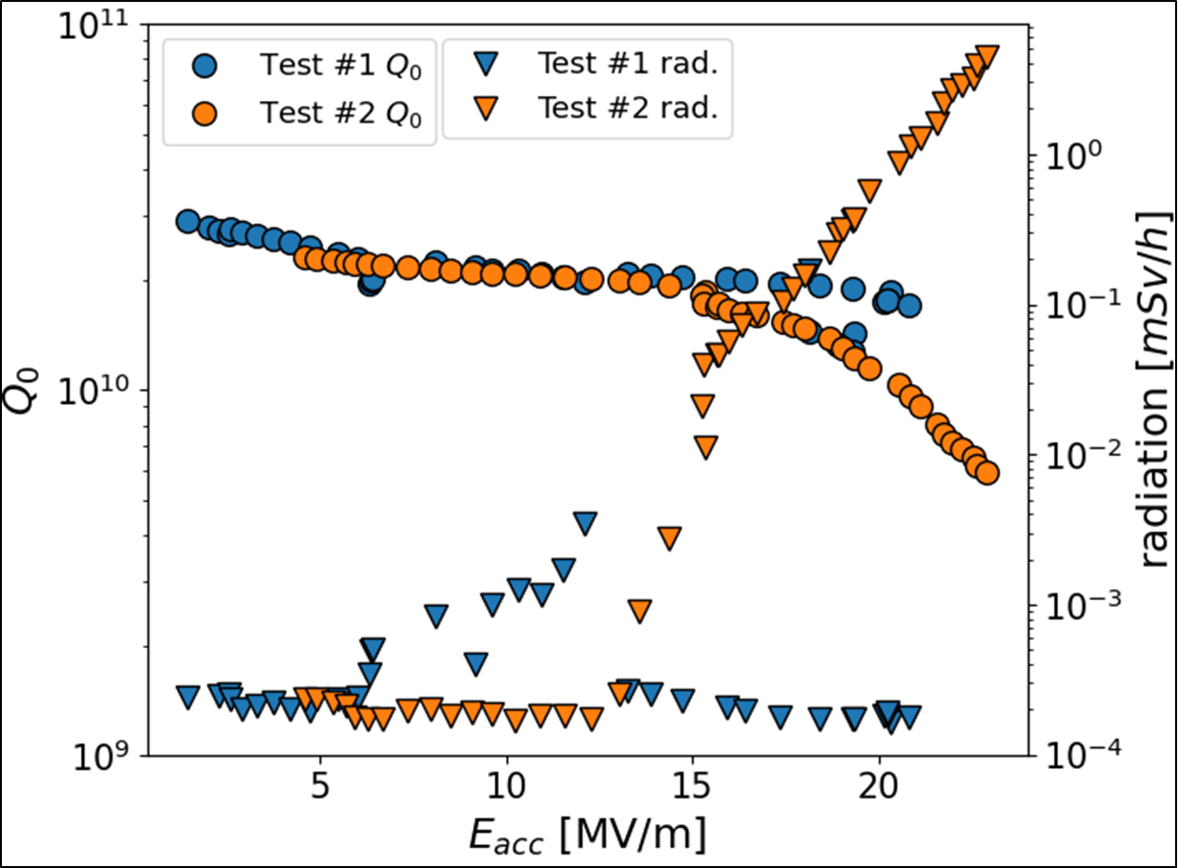
Prototypes experience @ INFN LASA M. Bertucci
Single cell test results B61S-EZ-002
XFEL like recipe
200 μm bulk EP + 800 °C 2h heat treatment+25 μm final EP (15 μm warm+10 μm cold)+ 120°C 48h bake
Mid T bake recipe
150 mm bulk EP + 800 ̊C HT + final EP (5 μm cold)+ 300 ̊C 3h bake

Slide 17
Prototypes experience @ INFN LASA M. Bertucci
5 cell test results B61-EZ-002
Slow cooldown (1K/min) across critical temperature (9.2K)
5 mG of residual field at cavity equator
assuming 0.3 nΩ/mG for baked niobium
@650 MHz: Rfl=2.4 nΩ
1° test: some MP with radiation, then sudden rise of radiation at 20.8 MV/m and Q degradation
Test repeated from low fields
2° test: same behavior as the 1° test up
𝑄𝑄until 14 MV/m....
...0then, sudden rise of radiation and drop of
Cavity quench at 23 MV/m with FE
Irreversible activation of a field emitter!
Mid T bake recipe
150 mm bulk EP + 800 ̊C HT + final EP (5 μm cold)+ 300 ̊C 3h bake

Slide 18
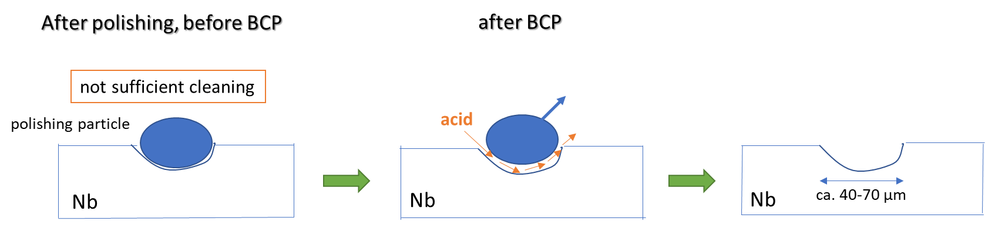
STFC HB650 cavity and Nb procurement A. Shabalina
Production Niobium procurement
Market survey
  Tokyo Denkai (Japan) – some technical limitations
  ATI Metals (USA) – at full capacity
  OTIC Ningxia (China) – some technical limitations
  Heraeus (Germany) – not on the market
Manufacturing specifications adjustments
  Hardness
  Elongation
  Strain Hardening Coefficient
Tender exercise
  OTIC – cheap and fast
  ATI – cheap and slow
  TD – expensive and very slow
  Nb Quality issues and repair
  Samples of PIP-II and SHINE material
  Various etching and polishing combinations
  Acceptable recipe found ~January 2022
  Final adjustments made in May 2022

Slide 19
STFC HB650 cavity and Nb procurement A. Shabalina
Cavity procurement strategy
Confirm your ability to meet the specs – flexibility for the vendor to suggest changes and relax some requirements, freedom for me to reject and still be sure they can make it
Provide a statement outlining the technical challenges of this project, and opportunities for improvement – vendors need to analyze the specs and show me they know which parameters are critical
Can you meet the schedule – pre-series focuses on quality, series focuses on the delivery rate, vendors need to prove it with a schedule management plan
Capacity for performing work – do they have the machinery, how busy is the plant going to be, equipment redundancy
Necessary skillset – staff availability through the life of the project, understanding of the necessary skillset, plan for unexpected loss of expertise
Quality Assurance and Control plan example and statement – requires distilling the QA/QC manual to a couple of lines per topic from our specs, assesses vendor’s attention to details

Slide 20
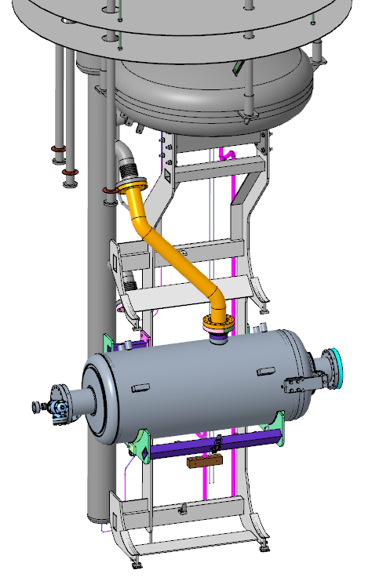
Modifications to STFC-DL cavity test infrastructure for PIP-II
A. Akintola
The results of the magnetic field measurements show that in the top and middle position – under a number of top and bottom coil configurations – the ambient magnetic field within the VTF is within PIP-II. As the middle position exhibits the lowest ambient field measurements, this cradle position was chosen as the testing cradle of the HB650 cavities.
Target Cooldown Rate to be achieved is 20 K/minute
Modified CSI CAD for HB650 cavity testing

Slide 21
Modifications to STFC-DL cavity test infrastructure for PIP-II
A. Akintola
Operating Modes
Weekend
Shield
Cooling
AM
PM
Overnight
AM
PM
Mode 4
Mode 5
Mode 6
Cavity Cooldown
Mode 7
200K
Thermal
Cycling
35K [+/- 10K]
Mode 8
Fast
Cooldown [15g/s]
100 K
Cooldown to 2k
RF tests at 2K
RF tests at 4K
4 K
@
300L LHe
2 K
Figure 5: Newly Proposed Mode of Operations Plot

Slide 22
Roadmap to determine 800C vs 900C HT G. Wu
Re-HPR
160um EP + 900C 3h + 2/0 N-doping + 7um EP
B61C-EZ-103
VTS test
Successful ?
No
If performance issues
Yes
Task #11
Re-processing
Proceed with 900C on B61C-EZ-102
Transportation test
Yes
Successful ?
No
VTS test
Jacketing
B61-EZ-103 road test successful
B61-EZ-102 900C H-bake in progress
Will collect more data to determine the H-degas temperature.
Pressure Test
Yes
Successful ?
No
Recommend to not proceed with 900C
Recommend to proceed with B61C-EZ-102 jacketing

Slide 23
Flux expulsion study results G. Wu
CW
High Q
N-Doping or Mid-T baking
Magnetic Hygiene and Flux Expulsion
High Rs sensitivity of trapped magnetic field
ΔT ~ 4K
Cavity | Niobium material | 800 C HT (Bsc/Bnc) | 900 C HT (Bsc/Bnc)
B61S-EZ-001 | NX2.0 | Trapped (1.08) | Expelled (1.7)
B61S-VECC-002 | Heraeus | Trapped (1.35)
B61-EZ-001 | NX2.0 | Trapped
B61C-EZ-101 | NX3.0 and NX3.5 | To be tested
B61C-EZ-102 | NX3.0 and NX3.5 |  | To be tested
B61C-EZ-103 | NX3.0 and NX3.5 |  | Expelled*, re-test
B61C-EZ-104 | NX3.0 and NX3.5 | To be tested

Slide 24
Shipping Tests for LB650 Cavities J. Holzbauer
Goal
  To mimic a dressed cavity with a bare cavity and cage with only the end spiders
Finding
  B61-EZ-103 (heat treated), standard road, air ride trailer, Field Flatness did not shift
Lessons learned
  Air ride trailers are essential
  Heat treated cavities are more vulnerable to transport shocks
  Despite this, they can survive standard handling on normal roads with the existing crate
Plan
  Modify JCav crate with shock isolation pads
  Learn lessons from other cavity shipments and delicate equipment transport to include in LB650 JCav shipping spec

Slide 25
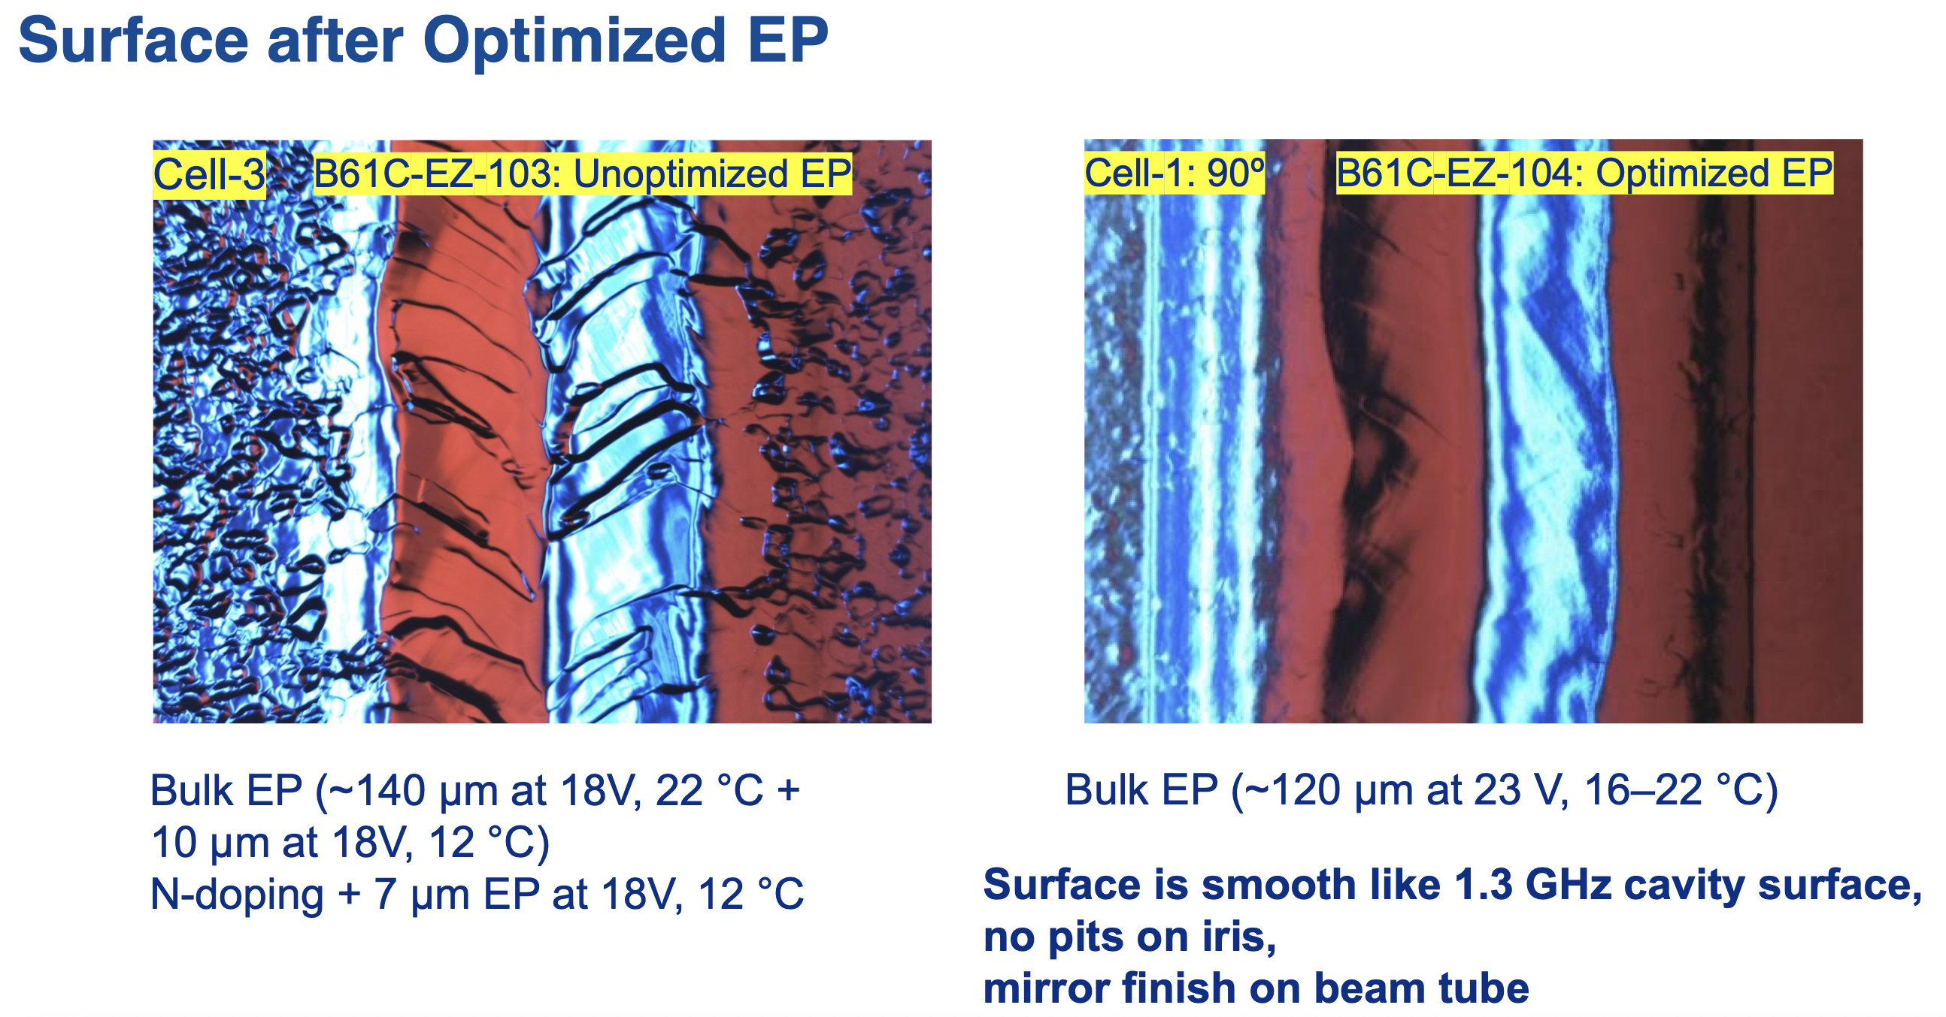
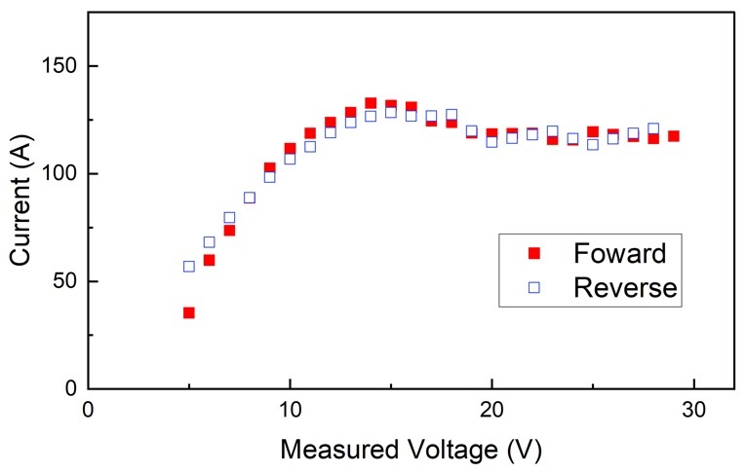
EP Parameter Study Including Motivation V. Chouhan
Motivation
  Recent result: A low-beta 5-cell 650MHz cavity (B61C-EZ-103) quenched at ~17 MV/m after the surface treatment (bulk EP + post N-dope EP).
I-V curve showing polishing regime

Slide 26
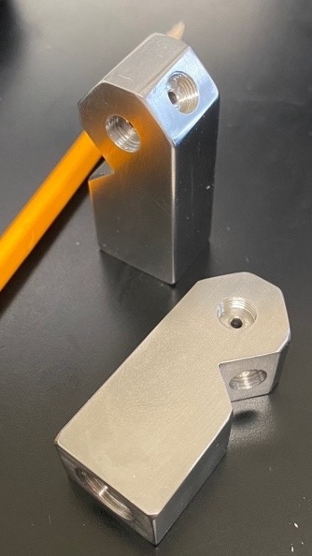
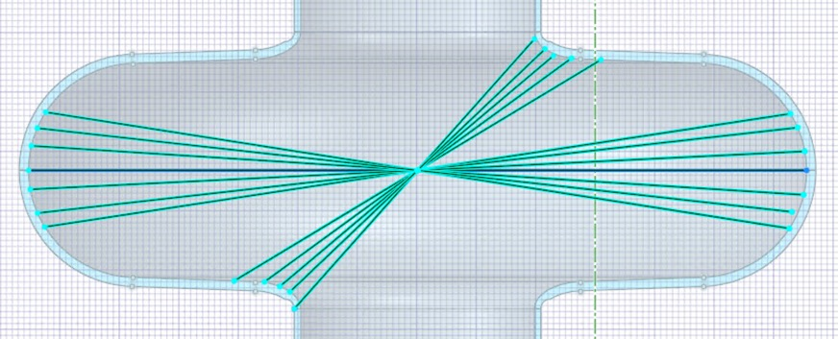
HPR Parameter Study Including Motivation V. Chouhan
Motivation
We are consistently observing field emission from 650 MHz cavities.
The goal of this study is to understand the effect of HPR parameters on surface cleaning/removal of particles from the surface.
Results
The spray-head was tested with the cavity B61C-EZ-103. No FE was observed up to the quench field (17 MV/m). More HPR tests on HB650 cavities are necessary to understand the effect of the modified spray-head.
New spray head and spray pattern

Slide 27
Prototypes Recent lessons from other projects regarding processing N2 doping/mid-T bake G. Wu
The PIP-II 650 MHz baseline is N-doping. Processing change requires more processing data to demonstrate the alternative processing.
Separation of N-doping and heat treatment showed improvement in LCLS-II HE production.
High Q at the medium field has several options.
  N-doping
  N-infusion
  Mid-T baking
Mid-T baking has the potential to be the simplest processing recipe.

Slide 28
Cavity Engineering Analysis C. Narug
Analysis Process
SRF Cavity
Protection Against Plastic Collapse
Protection Against Local Failure
Weld Joints
Design by Rule
Design by Analysis
ASME BPVC VIII, Div. 2
Protection Against Buckling
ASME BPVC IX
ASME BPVC VIII, UW
Classical equations
Engineering Standards
Protection Against Cyclic Loading
EJMA
ASME BPVC VIII, Div. 2 Part 4
ASME BPVC VIII, Div. 1

Slide 29
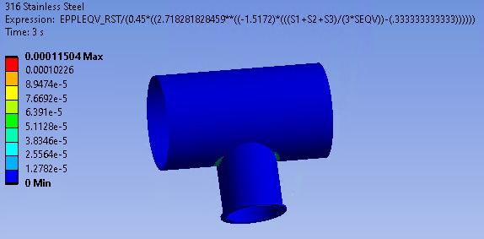
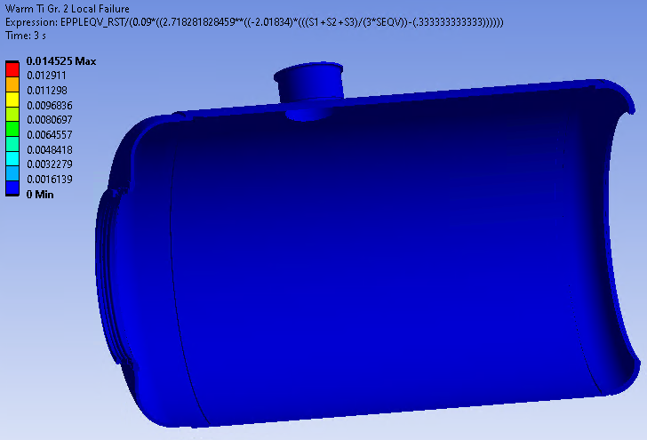
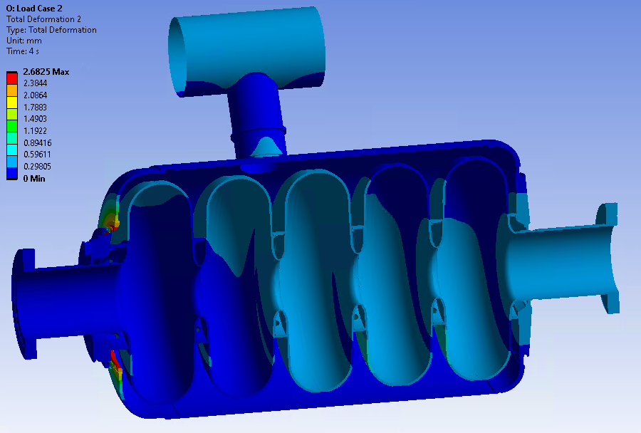
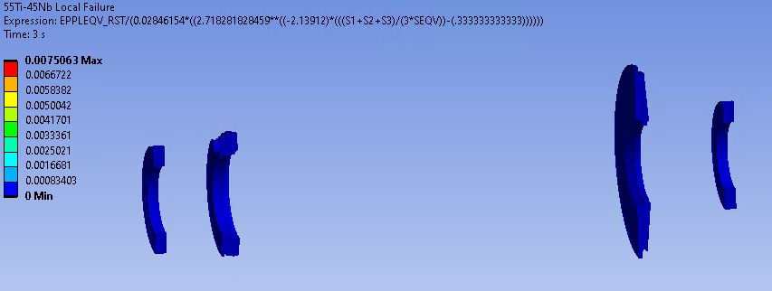
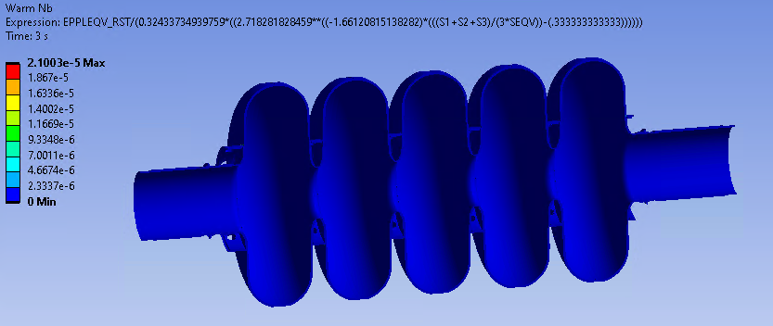
Cavity Engineering Analysis C. Narug
Example: Load Case 2, b= 0.61 Cavity Results

Slide 30
Test Harmonization Discussion
Vertical Cavity Test Facility Requirements (ED0013541)
The maximum ambient magnetic field magnitude of 5 mG on cavity surfaces.
Capable of cooling down cavities from 45 K to 4.5 K at a rate ≥ 20 K per minute.
Capable of cooling down cavities from 175 K to 90 K at a rate ≥ 20 K per hour.
Capable of warming up at a rate ≤ 20 K per hour.
Radiation calibration
At FNAL STC, move one fox in lateral position and measure
Cross calibrating detectors using known radiation source
Shipping detectors to FNAL and get measurement (1 unit preferably one sent to DESY)
FNAL send a detector to INFN
RRCAT’s dewar schematic same as FNAL except lead shielding

Slide 31
Possible tests calibrating cooldown rates
Testing one cavity under various conditions
One traveling cavity between facilities
  One single cell cavity was tested at FNAL and now will be shipped to INFN.
    This cavity is preferred to be test ready which means FNAL will HPR and test before shipping after acquiring approval.
  5 cell cavity?

Slide 32
Workshop Summary
About 20 in person participants, about 40 participants remotely
Very active discussion between in person and remote participants
However, extending the discussion to afternoon was hard due to time difference and other planned meetings/activities of visitors.
It was clear that the workshop is a great opportunity to learn from each other.

Slide 33
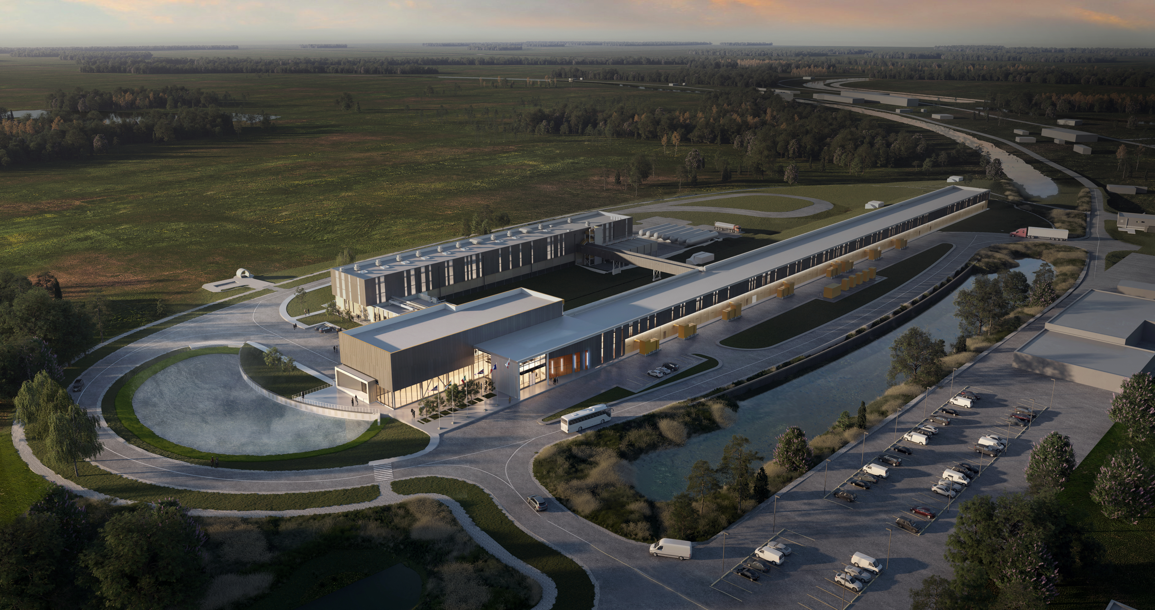
Thank You!

