Slide 1
WG4 – Cryogenic Distribution System
Ram Dhuley/Acting L3 manager
2nd PIP-II Technical Meetings Closeout
July 25, 2022

Slide 2
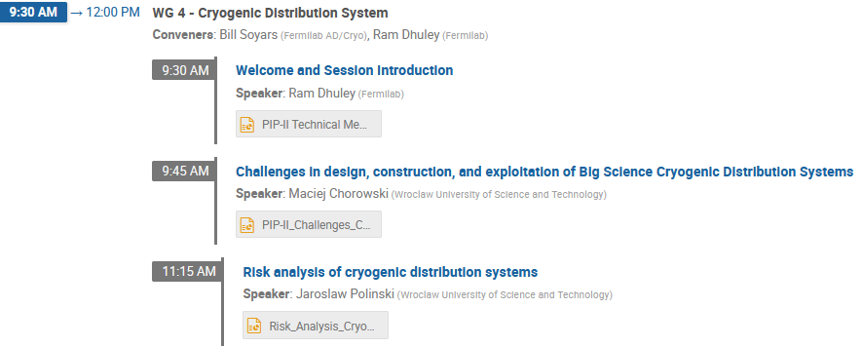
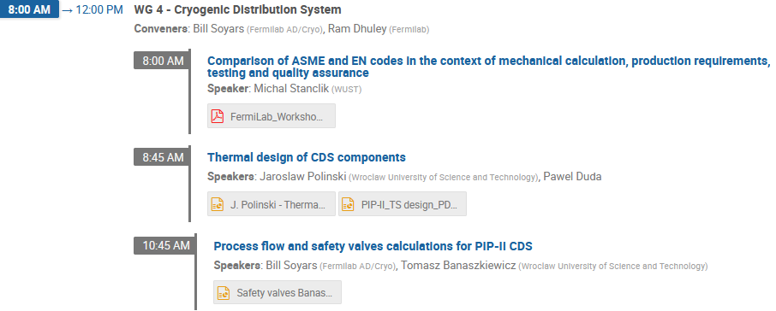
Session Agenda Overview
Day 1
Day 2
Each day WG4 was attended by
6-8 in-person
20-25 remote over Teams
Active Q&A
Follow-on meetings with WUST
colleagues in the afternoons
Day 3

Slide 3
Key Takeaways (positives, issues)
DAY 1: WUST design capabilities and experience (XFEL and ESS CTLs)
PIP-II CDS to certainly benefit from these
DAY 2: progress on PIP-II CDS CAD, thermal design, and installation plan
Overall, a workable design with manageable heat load
Some components need re-design; issues with the design for installation at Fermilab
DAY 3: EN vs. ASME code comparison and fab/cooling scheme for PIP-II CDS TS
Code comparison
WUST demonstrated good understanding of the design aspects of ASME codes
Need further work to understand testing and QA/QC aspects of ASME codes
TS fab/cooling scheme
WUST presented a collection of MLI heat load data and MLI installation techniques
Other PIP-II L3s may benefit from this data set
“Traditional” extruded TS vs. “tailored” conduction cooled TS (proposed for PIP-II CDS TS)
Conduction cooled TS tested and built by WUST for other CTLs
May need to revisit some thermal design and cost considerations for PIP-II CDS

Slide 4
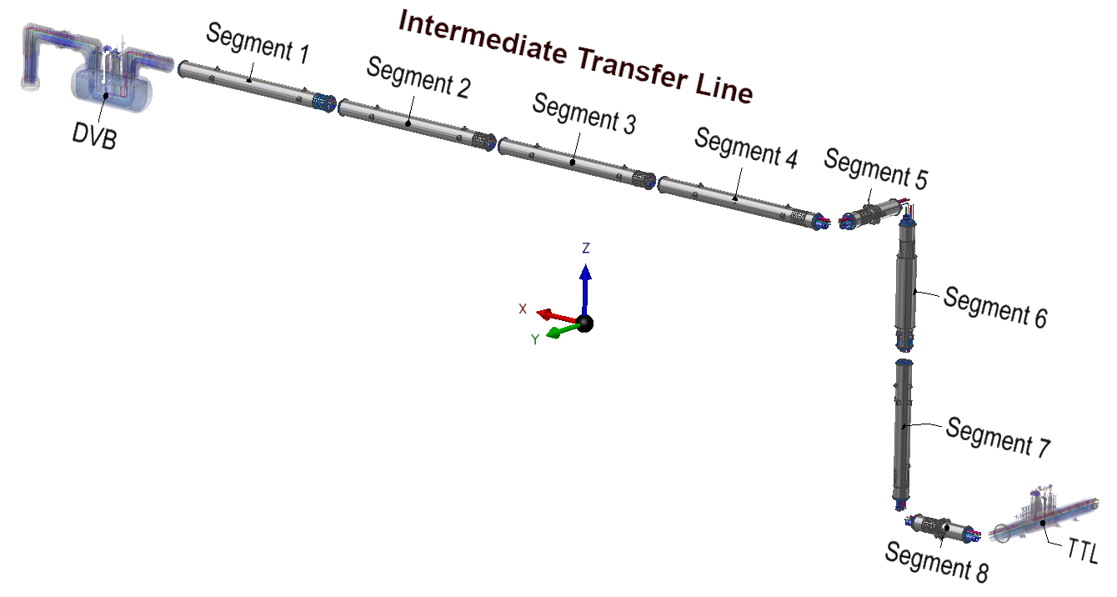
DAY 2: Redesign of ITL components
Twist module
Issues to be resolved
Twist module and vacuum bellows located in a narrow vertical shaft, several meters above tunnel floor
Welding will be difficult (contract welders may decline taking such a job)
Vacuum bellows
~8 m

Slide 5
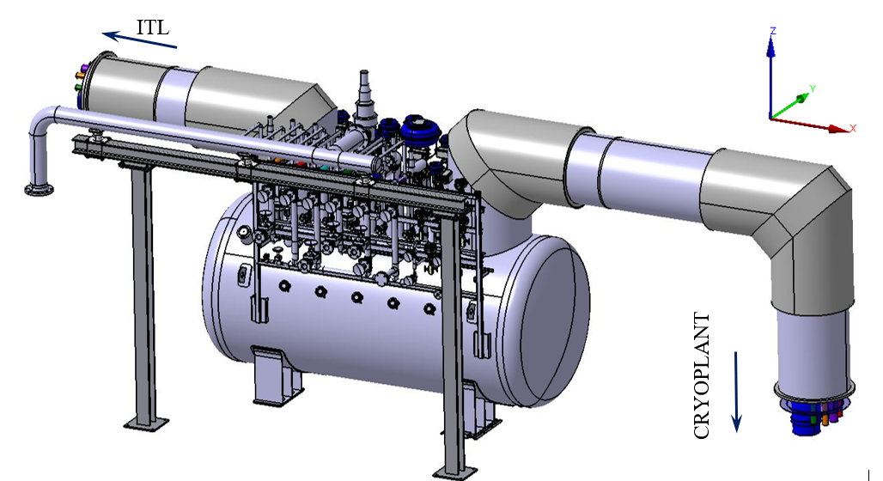
DAY 2: Redesign of DVB components
Warm valves appear to be cluttered
Accessibility needs to be checked for manual operation and servicing
Excessive load at the DVB-CP vacuum interface
The connecting branch needs an expansion joint
CDS Distribution Valve Box (DVB)

Slide 6
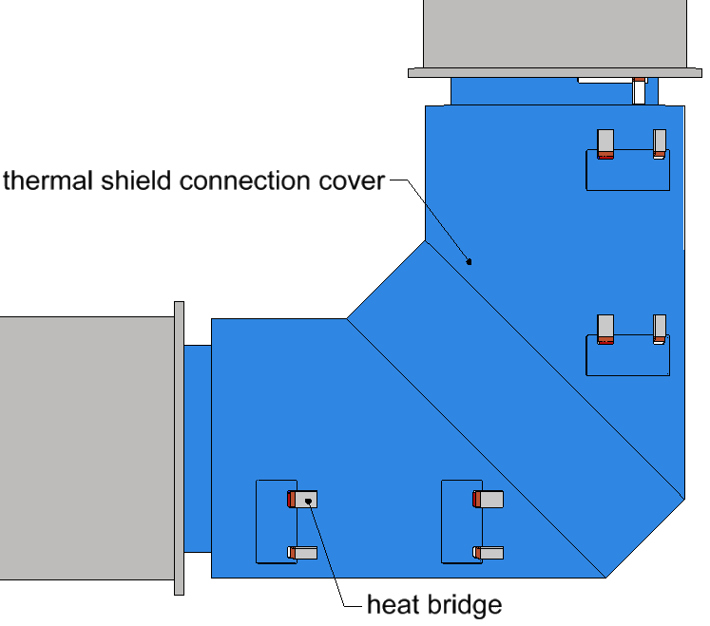
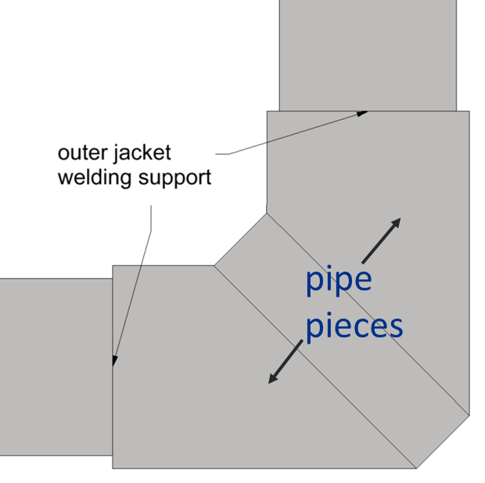
DAY 2: Redesign for installation
Elbows connections on the Intermediate Transfer Line
The current design
Straight modules and elbow components to be made in production (at vendor)
The components are then shipped to Fermilab
Final machining done at the installation site
Elbow connection is made as depicted below
Issues to be discussed/resolved
Field installation looks complicated, especially for the elbow in the vertical plain
Is expansion joint pre-stressing necessary to align the interconnecting pipes?
Can elbows be also made in production (at vendor) to minimize in-field welding?

Slide 7
DAY 3: Further work on EN vs ASME comparison
WUST engineers have ‘cracked the ASME code’ mechanical design aspects
Good understanding of the similarities and differences between design calculations, allowable stresses, load case and combinations, available FEA methods
WUST needs to work with Fermilab to further understand
Fabrication, in-field testing, QA/QC clauses of ASME
ASME pressure relief calculation
Example

Slide 8
DAY 3: WUST proposal for CDS Thermal Shield design
WUST confident on conduction-cooled CDS thermal shield design
First-hand data on flexible thermal straps used on the thermal shield for FAIR

Slide 9
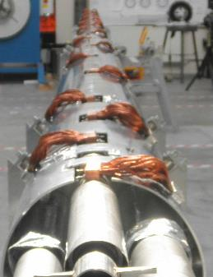
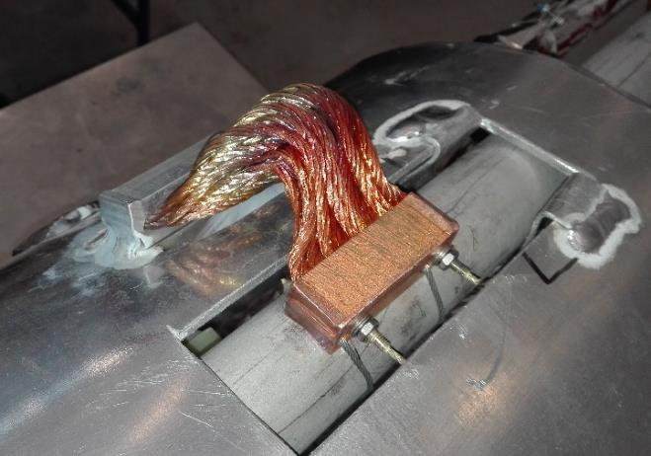
DAY 3: Further work CDS Thermal Shield design
Potential issues with thermal straps and conduction-cooling
PIP-II CDS TS will need 100s of straps (perhaps >1000)
Cost can be an issue
Quality control of strap fabrication needs to be properly thought out and expertly vetted
Minimize thermal resistance at pressure contacts
Cleanliness of surfaces to be weld; proper design of Al-Al welds
Al-Cu pressed contact
Al-Al weld

Slide 10
Path Forward/Next Steps
WUST and Fermilab will continue the collaborative design work
to resolve the open design issues with Intermediate Transfer Line components, DVB valve accessibility, coldbox excessive loading, thermal shield cooling scheme
Fermilab will continue to advise WUST engineers
to resolve any unclear ASME design aspects
to further understand ASME clauses for fabrication, inspection and testing, QA/QC
In parallel to the WUST-Fermilab ASME code exercise
WUST engineers will consult with their fab vendors to understand the vendors’ ASME design and fab capabilities, learning curve, cost premium, etc.

Slide 11
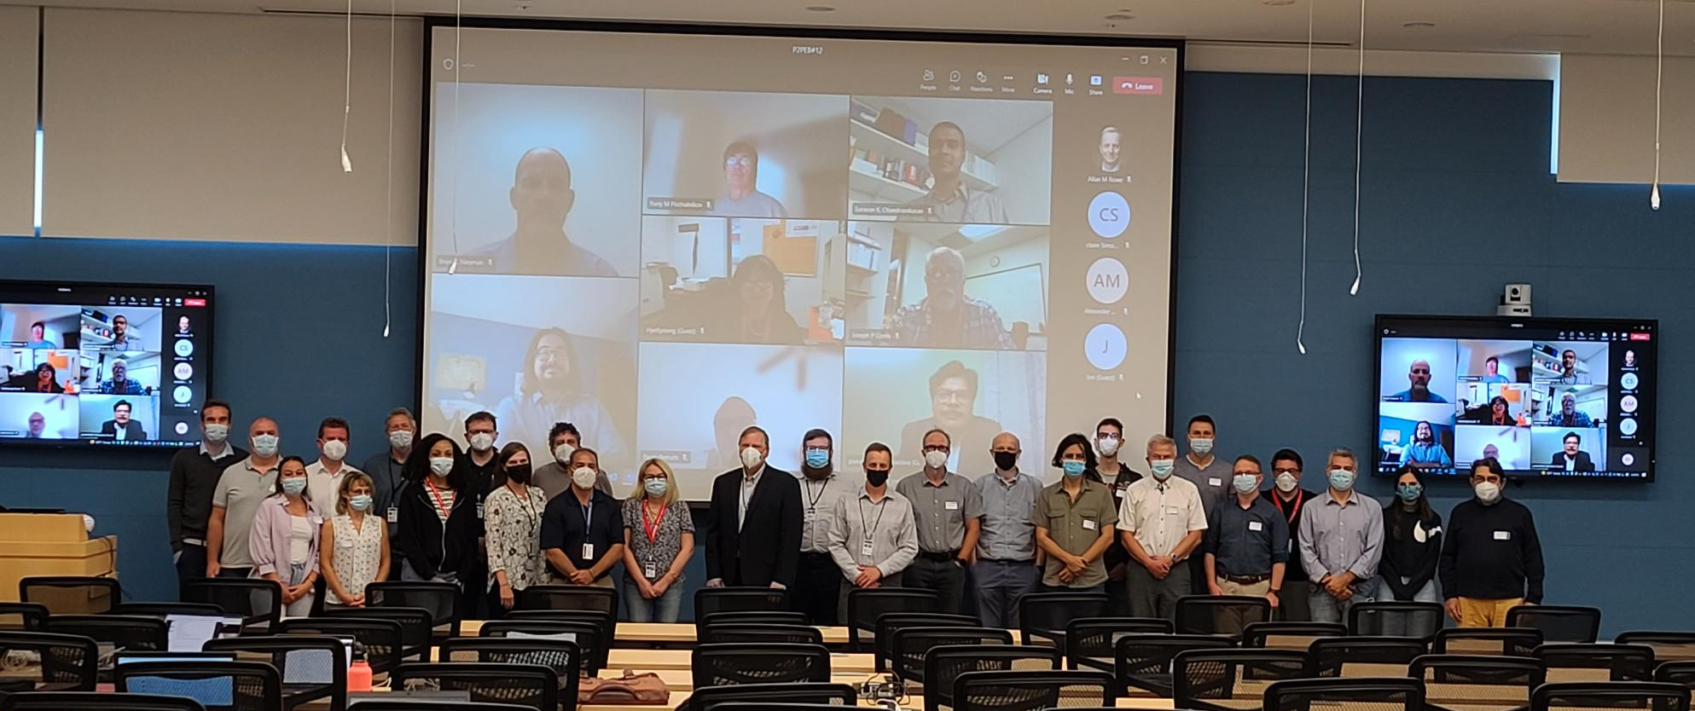
Thank you

