Slide 1
COUPP-60 Safety Review: Project Overview.
May 18, 2012
Andrew Sonnenschein
Fermilab

Slide 2
https://indico.fnal.gov Then go to “Experiments” and “COUPP”
Today’s review, focused on risk identification and mitigation, especially safety-related risks, but also including risks that would significantly impact resource requirements and schedule. What demands are made on SNOLAB?
Last week’s review at Fermilab, focused on readiness for move to SNOLAB, including physics background issues not discussed today. Were the problems identified in testing phase at Fermilab sufficiently resolved to warrant move to SNOLAB now?

Slide 4
Contents:
COUPP detector operating principle, history
Description of the COUPP-60 system.
Testing at Fermilab– problems found, responses.
Current work status.
Overview of planned installation at SNOLAB.
The COUPP collaboration– who does what; COUPP-60 project organization.
Schedule.
Funding.
Risk Register– includes safety, cost, schedule, quality
Discussion of highest risk items
Conclusion

Slide 5
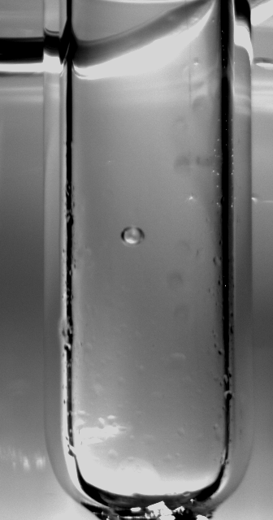
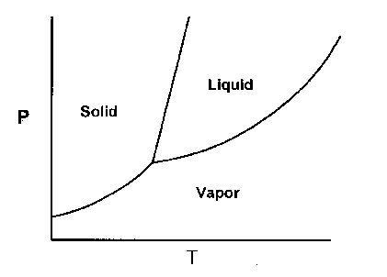
COUPP: Operating Principle
Prepare volume of target liquid in a very clean, smooth glass container. Eliminate surface bubble nucleation sites!
Reduce the pressure of the liquid until it becomes superheated.
Record video images and sound while waiting for a bubble to appear.
When a bubble does appear, immediately pressurize the liquid to stop the bubble from growing.
Repeat cycle.

Slide 6
High Speed Bubble Chamber Movie
1000 frames/ second
²⁴¹Am-Be neutron source

Slide 7
COUPP Timeline
 | 2003 |  | 2005 |  | 2007 |  | 2009 |  | 2011 |  | 2013
Mass | 18 g |  | 2-Kg |  |  | 4-Kg |  |  |  | 60-kg
Site | U. Chicago |  | Fermilab/ NuMI |  |  |  |  |  | SNOLAB
Depth | 10 m.w.e. |  | 300 m.w.e. |  |  |  |  |  | 6000 m.w.e.
Backgrounds | 7000 events/kg-day |  | 77 events/kg-day |  |  | 0.7 events/kg-day |  |  | 0.04 events/kg-day
Physics |  |  | Best spin-dependent (W-p) |  |  |  |  |  | Best spin-independent?
 |  |  | 10⁻¹⁰ gamma rejection
Technical
Developments | Continuously sensitive |  | Pressure balancing of |  |  |  |  |  | >99% accoustic
 | bubble chamber |  | inner/outer vessel |  |  |  |  |  | alpha rejection
 |  |  |  |  | Radon |  | Fused silica inner vessel
 |  |  |  |  | reduced |  | wall events eliminated
 |  |  |  |  |  | Retroreflective illumination
Active mass increased by 4 orders of magnitude 2003-2011
Backgrounds decreased by 5 orders of magnitude

Slide 8
at Fermilab
test site
~300 m.w.e.

Slide 9
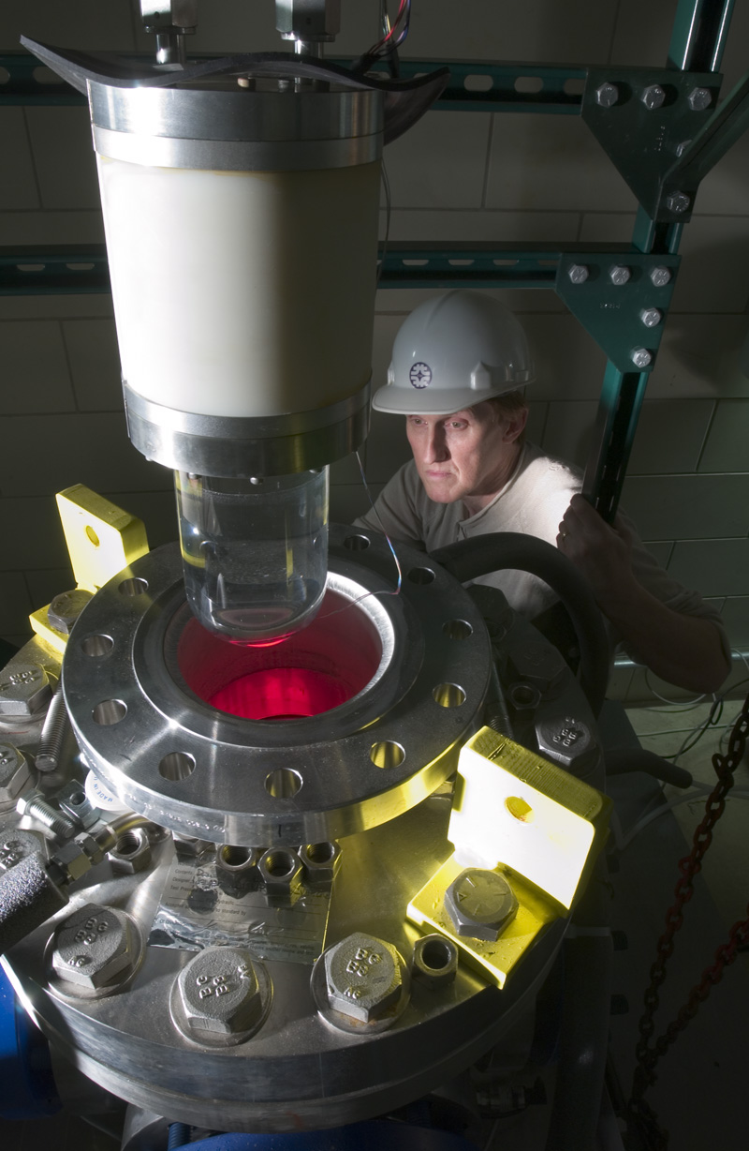
Small Chamber Runs at Fermilab 2005-2010
Small chamber initially installed at Fermilab NuMI tunnel in 2005. Served as R&D platform and proof-of-principle.
Rebuilt several times to incorporate new features-
Higher purity materials
External muon tagger
Acoustic sensors
Pressure and temperature control upgrades
Required early consideration of safety and operational issues related to running underground at a “remote” site.

Slide 10
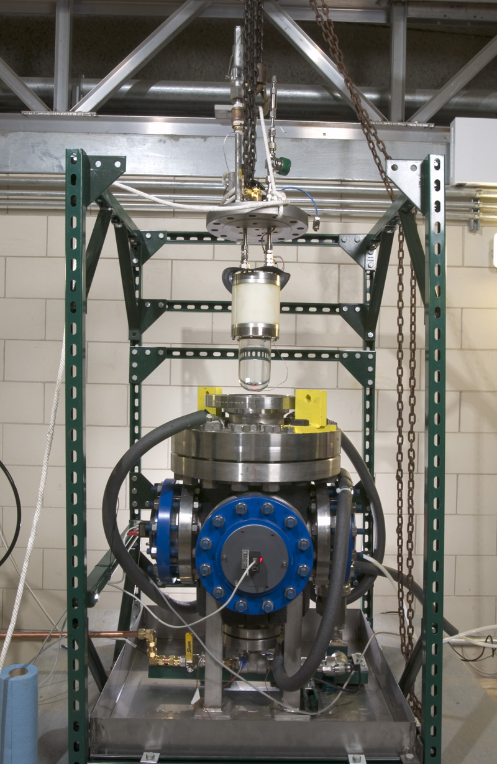
Inner fused silica vessel containing CF3I and H2O. Has a flexible bellows element to equilibrate with external pressure.
Outer conventional steel pressure vessel.
Space between vessels filled with hydraulic working fluid (propylene glycol)

Slide 11
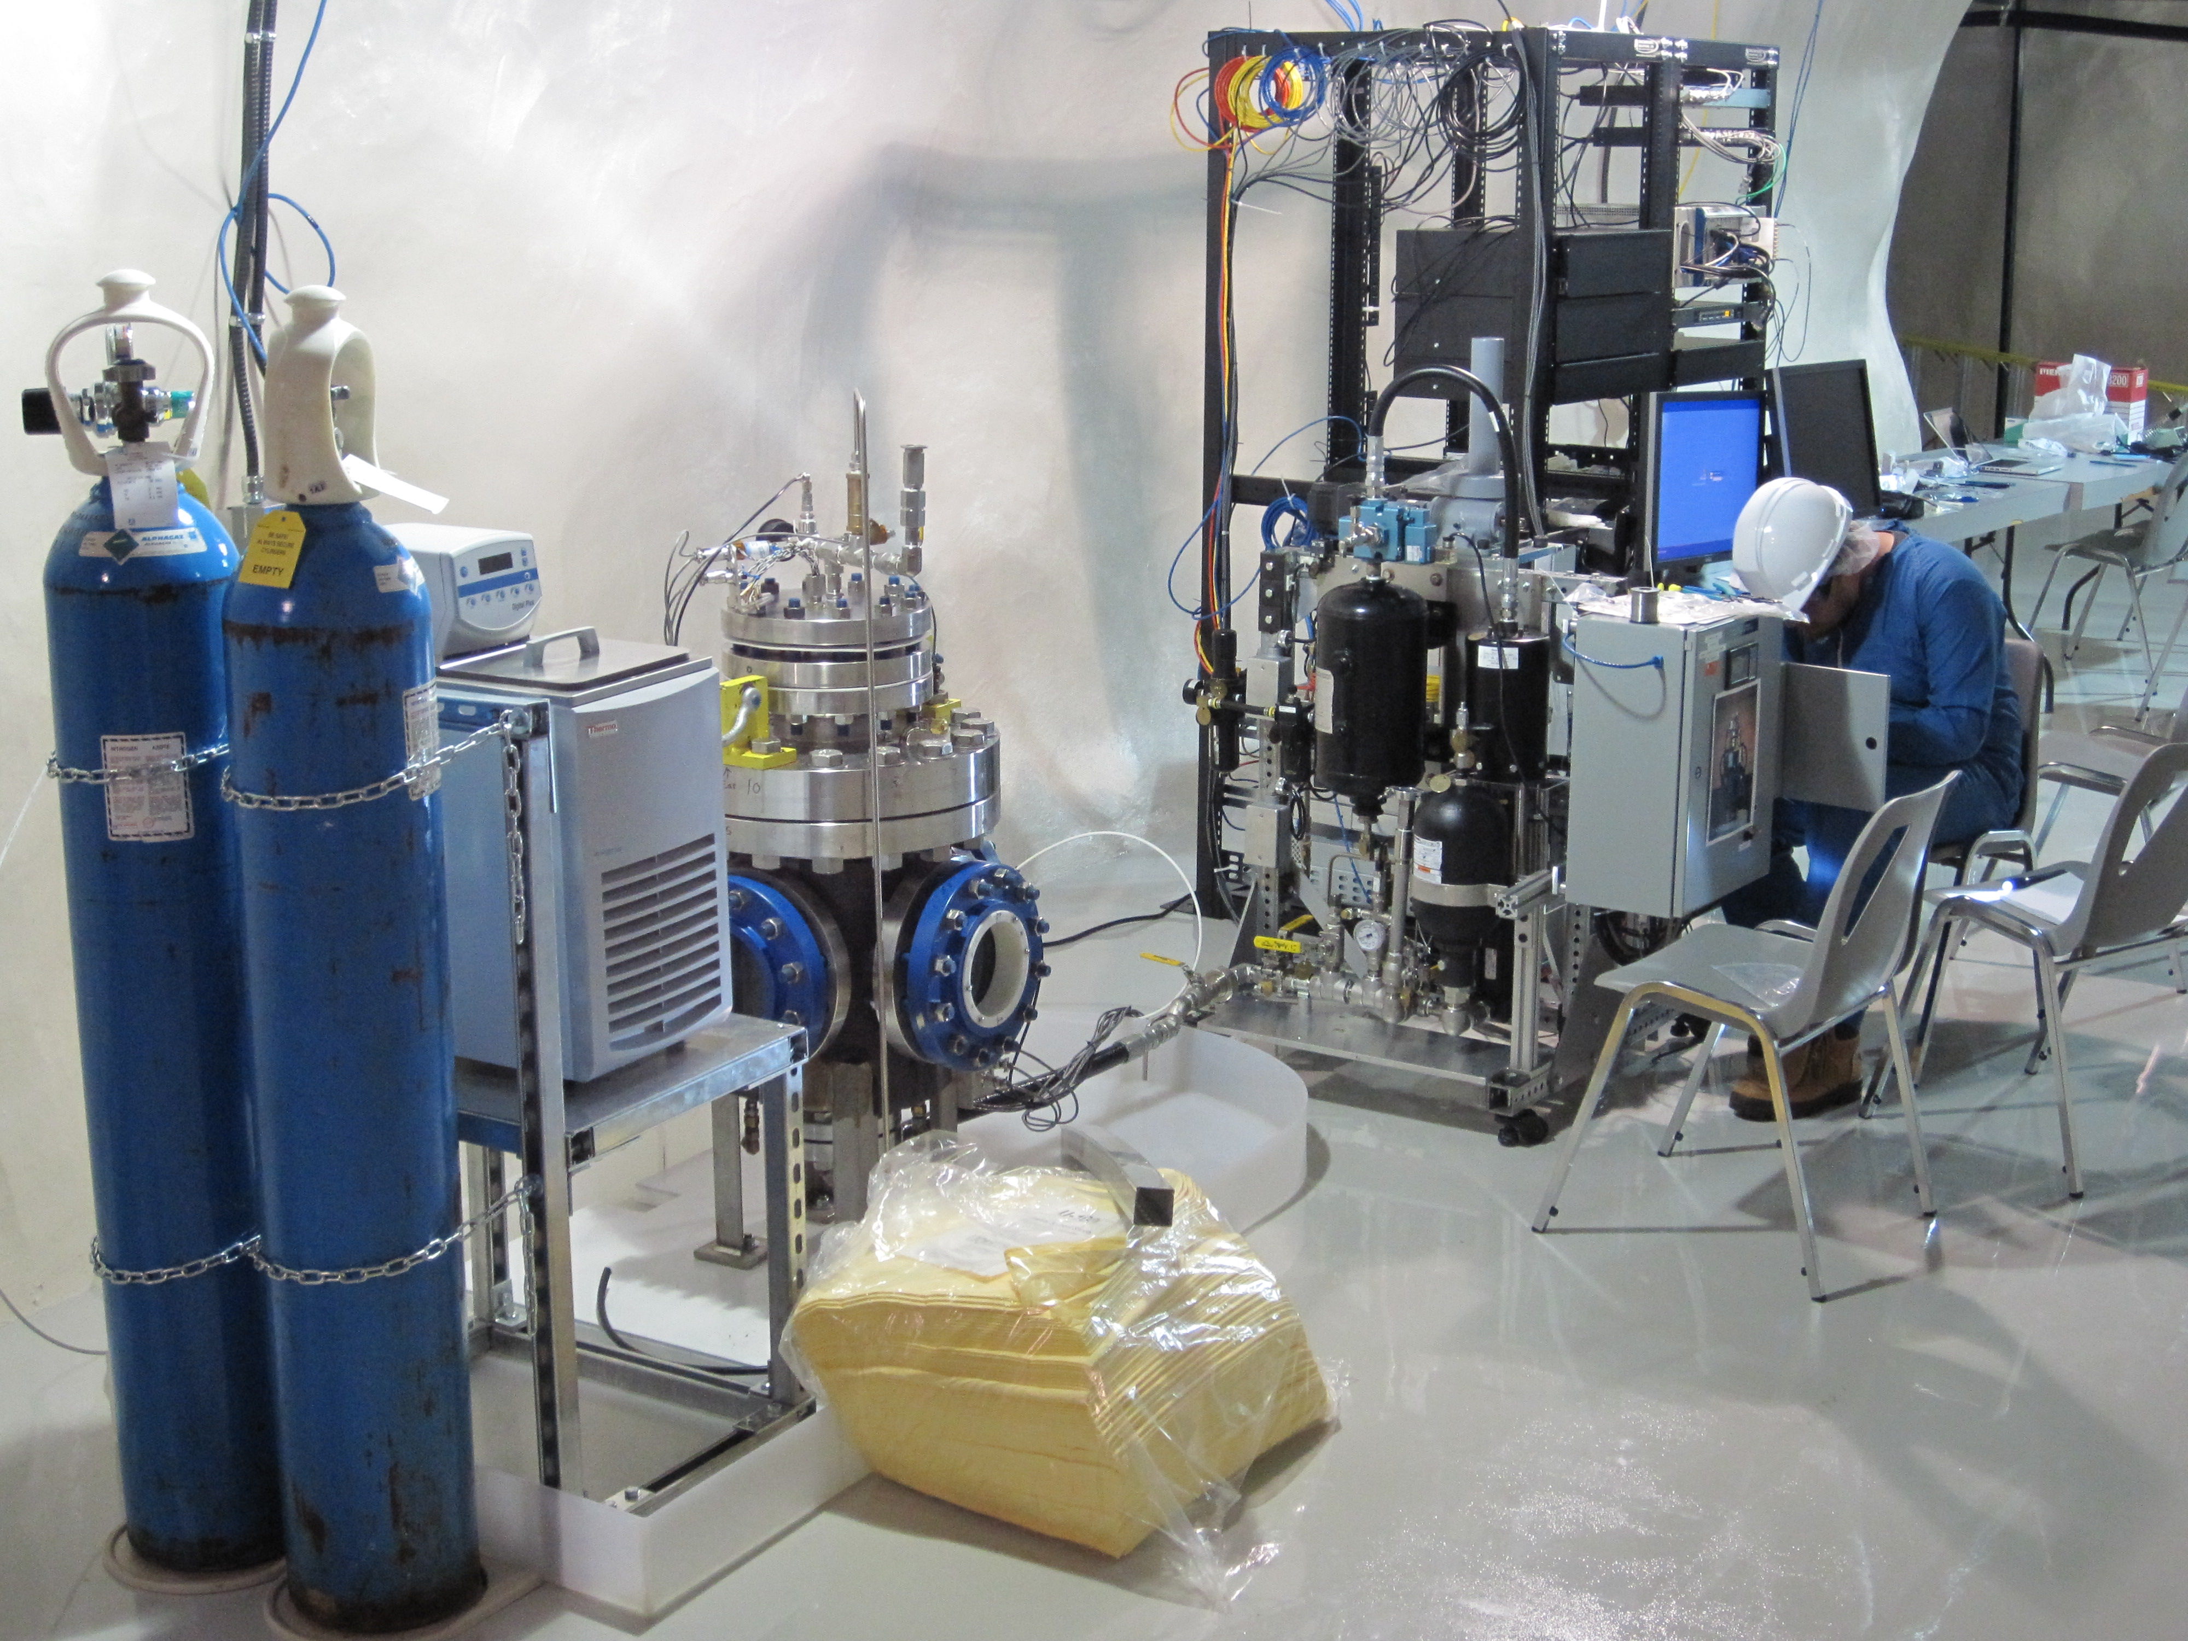
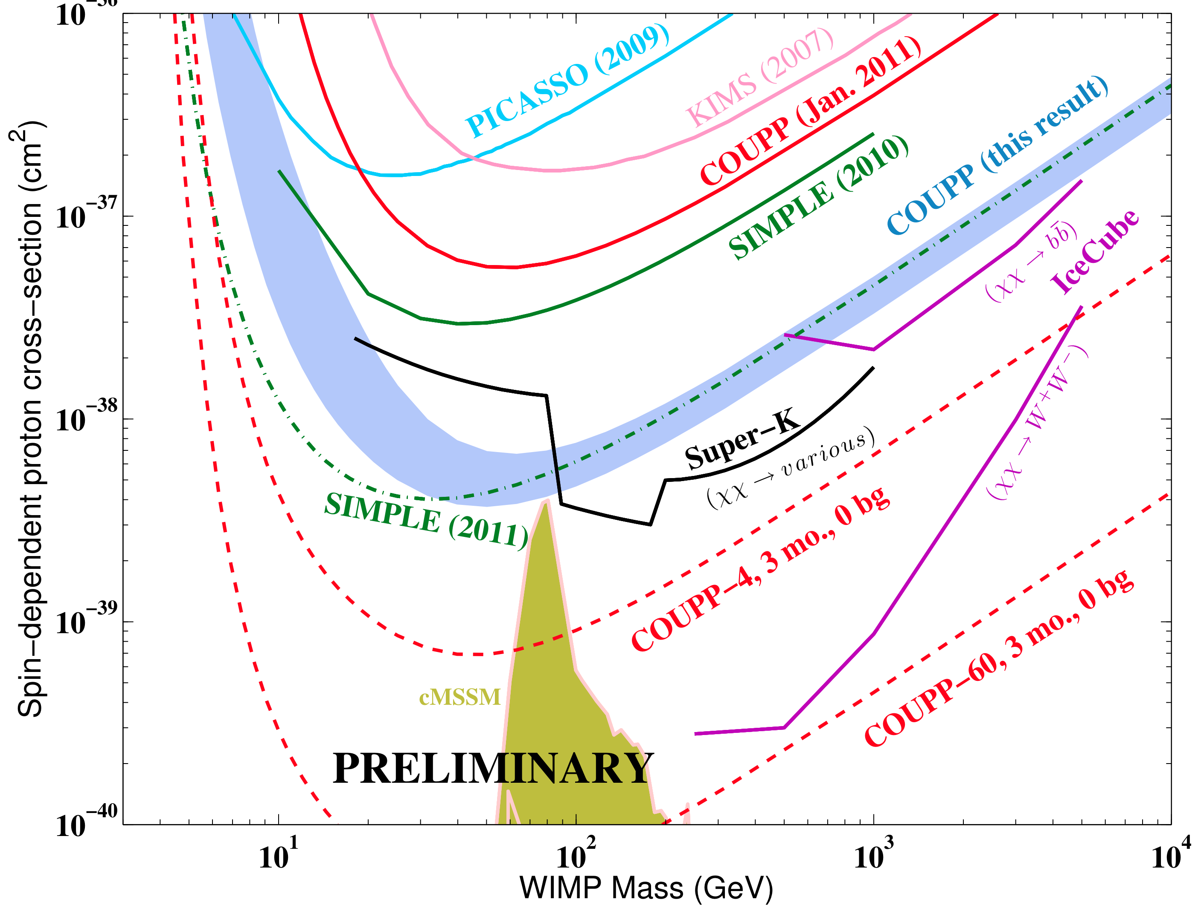
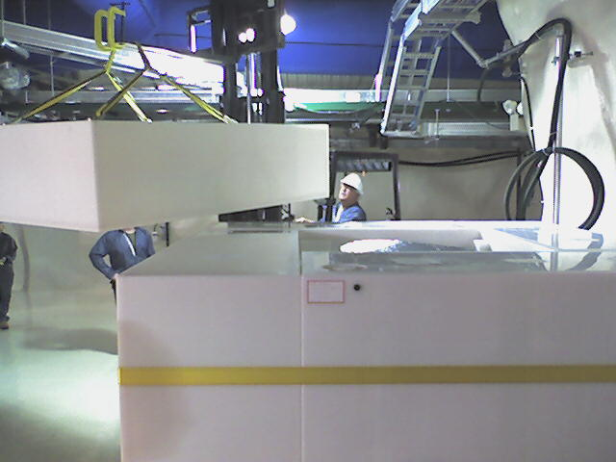
COUPP-4 At SNOLAB!
4-kg Detector transferred to SNOLAB in Summer 2010 after runs at Fermilab indicated that neutrons from cosmic rays had become limiting background.
First physics run ended June 2011. Important new physics result for spin-dependent WIMP search.
Discovery of unexpected sources of neutron backgrounds: glass windows, acoustic sensors. These are now being replaced with cleaner materials.

Slide 12
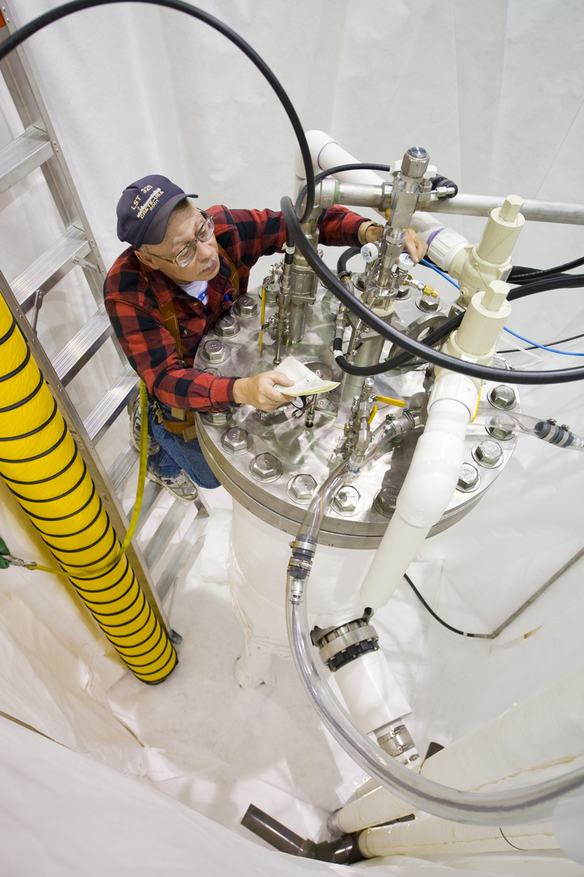
COUPP-60
Scale up of COUPP-2/4kg concept to larger volume (60 kg nominal target mass)
Outer Vessel
Inner Vessel

Slide 13
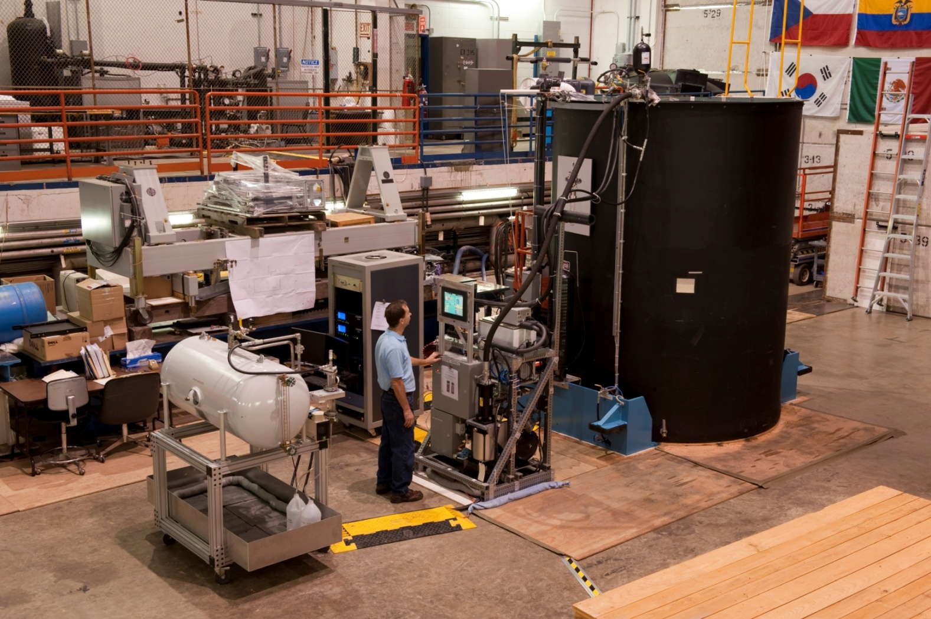
COUPP-60 System Test

Slide 14
COUPP-60 Current Status
Testing at Fermilab completed in Fall 2011, including runs above ground and runs at shallow depth (NuMI tunnel).
Revealed a number of problems which were described in May 8 Fermilab (See slides on Indico). The problems included:
Chemical instability of CF3I target liquid under intense illumination.
Impurities in CF3I supply causing excess surface bubbling.
Some parts of chamber were poorly illuminated.
Video cameras were too slow and resolution not good enough.
Vulnerabilities in hydraulic system, including hydraulic hose failures, pump control problems.
A plan was proposed to DOE to fix problems and deploy the detector at SNOLAB. Proposal was funded in FY11-FY12.
Implementation is underway (following slides)

Slide 15
Work Plan- As Proposed to DOE in FY11
Produce a comprehensive safety plan for the SNOLAB installation of COUPP-60. The critical issue for this study is the strategy for avoiding high levels of human exposure to CF3I in case of equipment failures... ✔ See Del Allspach’s talk in this review. We propose additional ventilation equipment to mitigate risk of exposure.
Work with SNOLAB to complete utility lines and the COUPP water shielding tank to anticipate the arrival of the COUPP-60 detector. These items are primarily the responsibility of SNOLAB, with Fermilab providing interface requirements. Work in progress. Drawings finished (Ramberg’s Talk). Parts ordered. Assembly started ✔
Materials screening program for radiopurity. Retrofitting and removal of internal neutron sources from both COUPP-4 and COUPP-60. After extensive radiopurity studies at U. Chicago, acoustic sensor material was fabricated at Virginia Tech. Sensors manufactured and test at IUSB. Now being installed on COUPP-4, with COUPP-60 sensors expected later in summer. Fused silica pressure vessel windows have been procured for both detectors, with the COUPP-4 retrofit now complete. COUPP-60 windows arrived at Fermilab last week.

Slide 16
Work Plan- Continued
Redesign of the COUPP illumination system to improve the quality of photography, while reducing the required amount of illumination power to a level which will avoid chemical changes in the CF3I. Includes new LED illumination array and reflector panel. Hardware is now complete, including retroreflector panel and LED illumination ring. Testing is planned in July on a full mockup of final optical system.
The video cameras will be replaced with higher frame rate, higher resolution cameras. New camera has been chosen and testing has begun. Mounting hardware prototype is finished.
Continue R&D on chemical purity and chemical compatibility issues, with goal of demonstrating stability of CF3I and acceptable levels of surface bubbling. Benchtop R&D in 2011 indicated that addition of Na₂SO₃ to water would prevent darkening of fluid by CF₃I photolysis. We also tested purification of CF₃I with molecular sieve, removing CO₂ suspected to cause excess surface boiling. Both chemistry improvements were successfully tested in 2011 COUPP-60 run at NuMI.

Slide 17
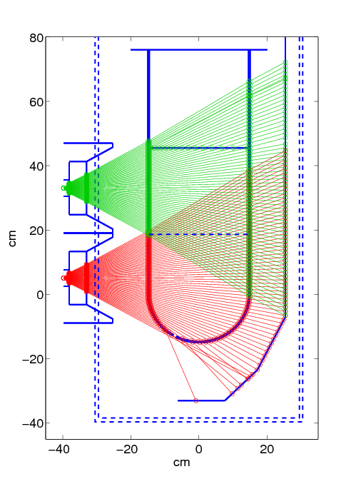
Optics Redesign Simulation
4.4 pixels/mm² (w/ 5.5 μm pixels on 6mm wide sensor)
38kg CF₃I visible by bottom row (w/ 90º field of view)
74kg CF₃I visible by two rows

Slide 18
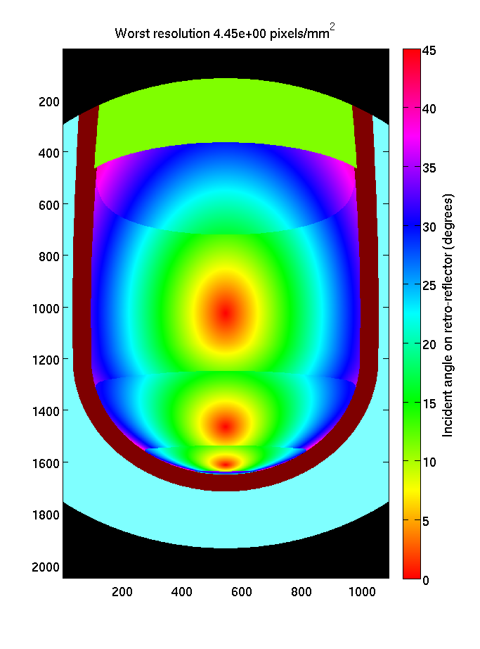
Optics Redesign Simulation
Typical angle on retro-reflector < 30º (> 40% max intensity)
Complimentary views between cameras
Dim spots at edge of one view are near-center in second camera
Basler Ace, 1088x2048, 340fps
Computar 4-8mm 1/2” lens (5mm zoom shown)

Slide 19
Camera Hexapod Mount
6 degrees of freedom
Allows adapters for multiple camera models, will initially use Basler Ace with Computar 4-8mm lens

Slide 20
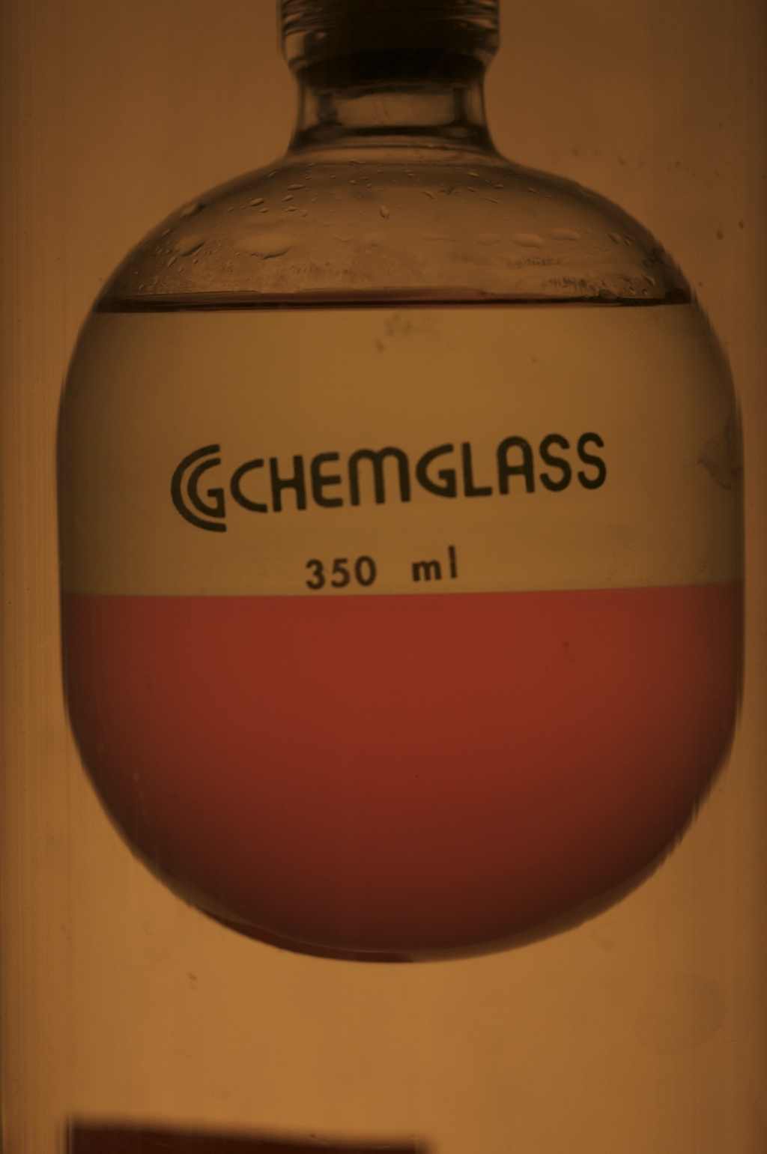
COUPP-60 Tests at Fermilab in 2011
Goals: avoid photodissociation of CF₃I, reduce surface boiling:
Added Na₂SO₃ to water at 5 mMol/L.
Removed CO₂ from CF3I with molecular sieve.
Results (Fall, 2011):
No observed image darkening after 50 day run.
Surface rate decreased from 150 cts per hour to 15 counts per hour at 7 keV threshold. Total residual rate (bulk+ surface) dominated by NuMI beam coincidences.
CF₃I breakdown under illumination

Slide 21
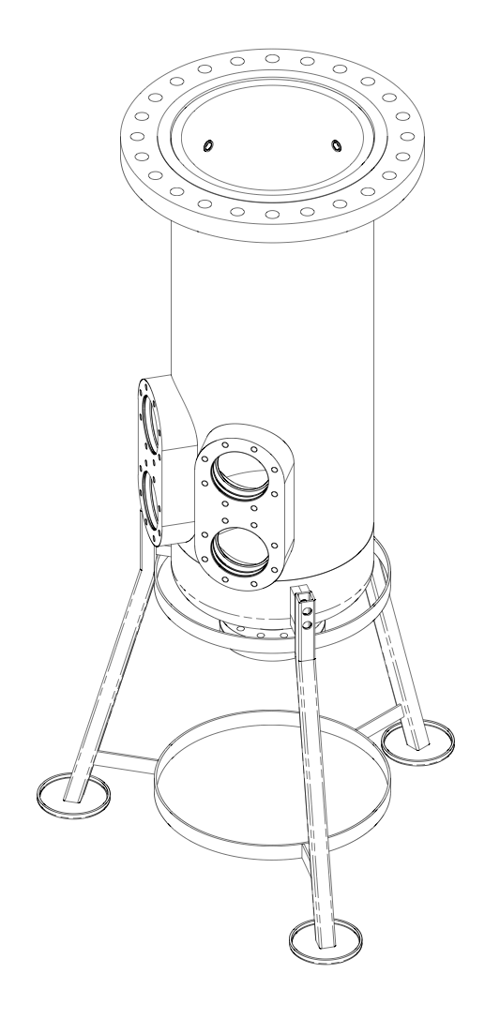
Work Plan Continued
We will study a possible upgrade to the COUPP-60 pressure vessel which would simplify the optical scheme and allow viewing of approximately twice as much target volume by adding additional windows and doubling the number of video cameras. We decided to go ahead and build this after initial investigations indicated potential for lower backgrounds, better optics, improved safety aspects. ✔
Meets Canadian codes. Will be TSSA approved and registered in Ontario.
Stainless steel from Outokumpu (supplier for Miniclean). Samples show < 1 ppb ²³⁸U, corresponding to <1 event per year from neutrons in COUPP-60
Fused silica windows for photography. Four ports allow imaging of 75 kg of CF3I.
Contract awarded to All- Weld (Toronto) in January.
Acceptance testing scheduled at All- Weld on week of June 11.

Slide 22
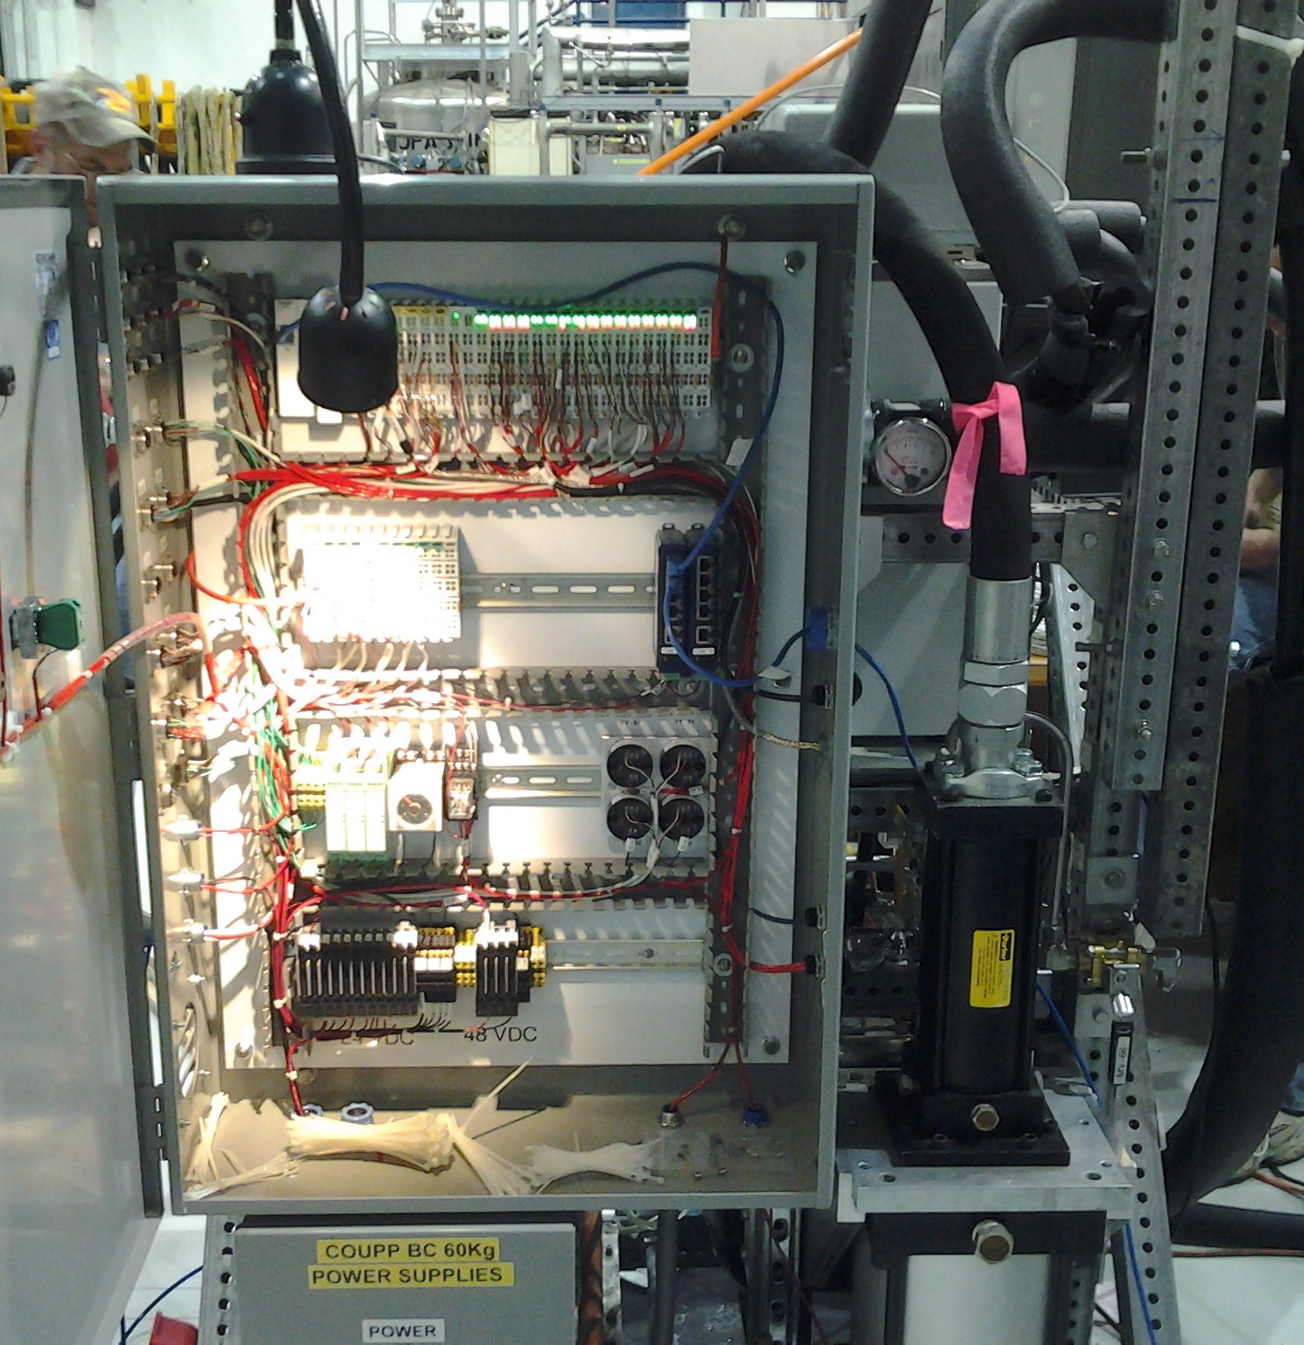
Work Plan Continued:
Control system upgrades. New instruments were added for remote monitoring, failure detection (e.g. glycol leak, CF3I leak, blocked pump), and better software for remote monitoring and alarms was added (iFix). These changes will improve our ability to operate the detector remotely.
New capability to automatically isolate glycol leaks from detector before damage occurs. Changes made to isolate line power from low voltage following SNOLAB standards.

Slide 23
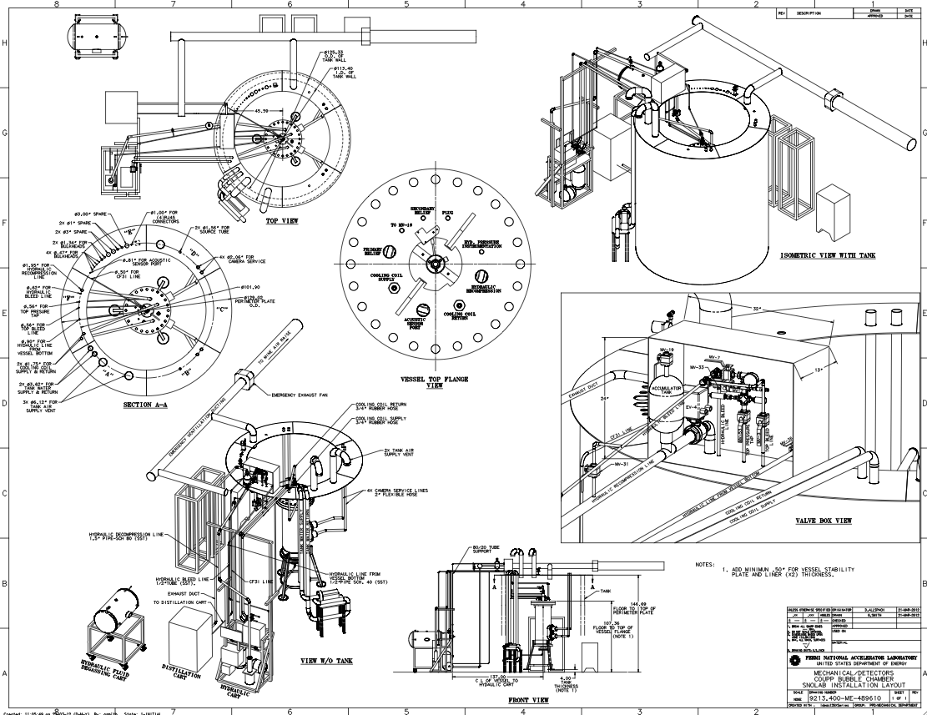
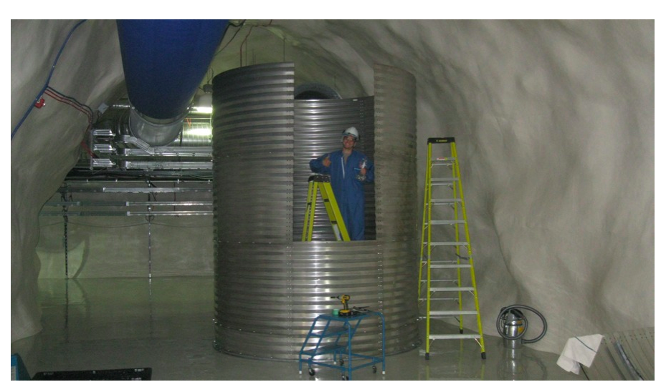
Next Steps: SNOLAB Assembly
Equipment at Fermilab is being prepared for shipment over summer. First parts to arrive in June. Last parts in August.
Lippincott talk details the assembly sequence.

Slide 24
COUPP-60 Project Management
Formal project management plan drafted in Fall, 2011. Defines roles and responsibilities for Project Manager and four Subsystem Managers:
Project Manager- Sonnenschein. Reports to Fermilab Particle Physics Division Head.
Bubble Chamber Components & DAQ - Dahl
Bubble Chamber Installation- Lippincott
Site Preparation- Ramberg
COUPP4 & Calibration- Brice
Most important project management tool is a detailed WBS linked to budget and schedule information. This is maintained using web-based software (www.clarizen.com) that allows project team to independently update plan as new information comes in.
We review schedule information each week and budget each month.
Project status is reported to Fermilab management and DOE on monthly basis.

Slide 25
Schedule
Schedule was developed from the bottom up using a detailed, resource loaded WBS.
Project Manager and Subsystem Managers can independently see and update the schedule at any time using Web-based Project Management software (Clarizen)
Software sends automatic reminders on what tasks are open to the responsible manager.
Progress is discussed in weekly collaboration meetings/ phone conferences.
Milestone reports are generated each month, allowing schedule drift to be tracked over time.

Slide 26
WBS Example
Tasks have assigned resources (people + money), schedule information and brief descriptions of the scope of the work. Level of detail and quality of information vary, with more attention paid to critical path items.

Slide 27
Milestone Report- May 7, 2012
Name | Due Date
Pass NuMI Chemical Test | 11/15/11
New Outer Vessel Vendor Selection | 12/06/11
CIRTE Chamber Ready | 02/01/12
New Camera Decision | 04/11/12
2nd Generation Acoustic sensors ready | 05/15/12
Pass SNOLAB Safety Review | 05/23/12
Start COUPP-4 Run 2 | 05/25/12
Outer Vessel Ready | 06/12/12
Water Tank Ready | 06/25/12
Pass Optics and Illumination Test | 07/04/12
Pass Video Acquisition Test | 08/15/12
System Test-- No IV | 08/17/12
Inner Vessel Ready | 09/11/12
Start Commissioning | 10/02/12
Ready for Physics Runs | 11/27/12

Slide 28
Milestone Tracking- Last 4 Months
Ready for physics
Commissioning
Inner Vessel
Milestone Due Date
System Test- No IV
Optics Test
Water Tank
Date of Milestone Report

Slide 29
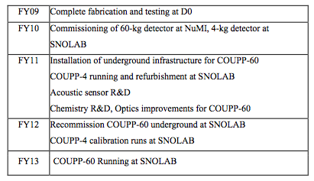
Schedule– The Big Picture
Schedule table from FY11 DOE Proposal

Slide 30
Funding
DOE
Base KA-13 funding covers 4 scientist FTEs at Fermilab.
1095 k$ received in FY11-FY12 for COUPP-60 installation. This fully funds the installation of the detector at SNOLAB according to current budget, with modest contingency for dealing with unexpected problems.
Additional KA-15 R&D funds (~ 100 k$ in FY12) help with COUPP-4 and calibration work.
NSF
Continuing base funding for students at U. Chicago and IUSB, postdocs at Chicago and Engineering at IUSB.
600 k$/year from DUSEL S4, last three years
NSF renewal of KICP– more student, postdoc support, some equipment.
NSF contribution pays for much of COUPP-4 operations, all of acoustic sensor development work.

Slide 31
COUPP60 Budget Status As of May 1st
Funding received (FY11 + FY12): 1095 k$
Obligated $ as of 5/1/12: 563 k$
Remaining funds: 532 k$
Estimated future costs: 442 k$
Contingency: 90 k$ (20.3% of estimated costs)
** However– estimated cost has risen over time. Contingency on remaining work has eroded from 30% at start of project to 20% now ***

Slide 32
Expected Future Non-Labor Costs
Includes all individual items costing more than 5 k$
 | K$
Travel | 82
CF3I | 50
Safety vent | 18
Crating and shipping | 13
Engineering for TSSA certification | 10
Labview licenses | 9
Access platforms, stairs | 8
Protective equipment | 5
Tubes & fittings | 5
Total | 200
=> About ½ of remaining 442 k$ budget is M&S

Slide 33
Risk Matrix Sorted by Probability* Impact
Red= safety related. P= probability score. I= impact score.
Risk | Cost | Schedule | Probability | P | I | P*I
 | [K$] | [Wks]
FY13 Funding delay | 200 | 26 | 0.25 | 5 | 4 | 20
Glycol leak >1 liter per hour, IV damage, silica intact | 100 | 26 | 0.1 | 4 | 4 | 16
Over budget for installation | 200 | 26 | 0.1 | 4 | 4 | 16
Break Inner Vessel During Operations | 250 | 52 | 0.05 | 4 | 4 | 16
Break Inner Vessel During Shipping | 250 | 52 | 0.05 | 4 | 4 | 16
Water tank construction delay | 0 | 12 | 0.5 | 5 | 3 | 15
Delay in utilities installation | 0 | 12 | 0.5 | 5 | 3 | 15
Delay in inner vessel | 0 | 8 | 0.5 | 5 | 3 | 15
Illumination system test fails | 30 | 12 | 0.25 | 5 | 3 | 15
DAQ system test fails | 30 | 12 | 0.25 | 5 | 3 | 15
Delay shipping glycol & water modules | 0 | 8 | 0.25 | 5 | 3 | 15
Additional safety systems required by stakeholders | 100 | 16 | 0.25 | 5 | 3 | 15
Outer Vessel vendor delivery delay or quality issues | 0 | 8 | 0.25 | 5 | 3 | 15
Seismic event with significant damage | 1000 | 100 | 0.01 | 3 | 5 | 15
TSSA approval delay | 30 | 12 | 0.1 | 4 | 3 | 12
Significiant lost time injury- no CF3I exposure | 50 | 12 | 0.01 | 3 | 4 | 12
CF3I significant release, safety vent turns on, no injury | 200 | 26 | 0.01 | 3 | 4 | 12
Glycol leak <1 liter per hour | 20 | 6 | 0.2 | 5 | 2 | 10
Minor injury- hands, feet, etc. | 0 | 1 | 0.1 | 4 | 2 | 8
CF3I release, small quantity, no signficiant operator exposure | 20 | 4 | 0.05 | 4 | 2 | 8
CF3I large release, safety vent system fails, operators exposed | 1000 | 100 | 1.00E-04 | 1 | 5 | 5

Slide 34
Top Ranked Risks
Budget overruns/ Funding delays
Contingency margins are tight– currently 90 k$ in reserve (20%). With unexpected probled, funding may not carry us much past the fiscal year boundary, may not be sufficient to operate the detector for long once installed.
Need better understanding of operations budget– what $$ may be needed to mitigate against the other risks in the table in FY13?
Keep up communication with NSF, DOE.
Successful outcome of this meeting will reduce one of major cost risks– are we building the right safety infrastructure?
Glycol leaks.
Have been a persistent problem in COUPP, including most recent run at NuMI of COUPP60.
Installing more control system features and alarm capabilities to guard against leaks when system unattended. Automatic isolation of pressure vessel from external plumbing if external leak is detected.
Need physical presence at SNOLAB by experts who can respond quickly, especially in first six months.
Planning month-long run without inner vessel to test leak integrity of system.

Slide 35
Top Risks- Continued
Beak inner vessel in shipping.
Inner vessel quartz would take 1 year to replace.
With labor, cost would be >200 k$.
Mitigation: Engineering note on shipping plan by Russ Rucinski (inner vessel designer). Peer review.
Will “hand carry” vessel to SNOLAB.
Break inner vessel in operations.
Can be caused by glycol leaks or CF3I leaks or operator mistake.
Control system interlocks have been programmed. To be tested without inner vessel in place.
Operator procedures need careful study, review. Considerable experience now from Fermilab running. No broken vessels!

Slide 36
People Working on COUPP
Fermilab: Engineering, construction, operations, project management, calibrations, physics data analysis.
Scientists & postdocs: Steve Brice, Dan Broemmelsiek, Mike Crisler, Erik Ramberg, Peter Cooper, Hugh Lippincott, Andrew Sonnenschein (Project Manager), Jeter Hall.
Engineering: Del Allspach, Herman Cease, Russ Rucinski, Rich Schmitt, Dan Markley.
Technicians: Mark Ruschman, Pete Simon + others
U. Chicago: Calibrations, R&D, operations, simulations, physics data analysis, radiopurity measurements
Faculty & postdocs: Juan Collar (Spokesman), Eric Dahl, Russell Neilson
Grad student: Alan Robinson.
IUSB: Acoustic sensors development, construction, testing.
Faculty: Ilan Levine. Engineering: E. Behnke. Students: Joshua Behnke, Tonya Benjamin, Austin Connor, Cale Harnish, Emily Kuehnemund, Timothy Moan, Thomas Nania
Virginia Tech: Piezoelectric materials.
Faculty Shashank Priya . Postdoc: Students
SNOLAB: Simulations, operations, water tank design and construction, utilities
Postdoc: Eric Vazquez Jauregui. Engineering: Ken McFarlane, Peter Liimatainen
Underground construction: Brian Morissette + others

Slide 37
Conclusions
COUPP program has been remarkably successful, especially the COUPP4 SNOLAB phase.
Several significant problems discovered in Fermilab testing of COUPP-60. Solutions seem now to be in hand, having passed critical tests in the fall.
Pending the outcome of this review, I believe we are in good shape to start assembling COUPP-60 at SNOLAB (critical safety issues and suggested mitigation to be addressed in other talks)
Schedule calls for assembly over the summer. We seem to have manpower available to do this (Lippincott talk). Contribution of SNOLAB staff is critical for water tank, utilities.
Budget shows signs of stress but is believed to be sufficient.
Most important technical risks involve fluid leaks, which can lead to mechanical damage to inner vessel.

