Slide 1
MTA Operations
Status Report

Slide 2
Beam Running
Successfully completed HPRF Test plan on 5/8 (& then some)
  Thanks to External Beams Group with help during the rough spots
Now
  Waiting for components in/around solenoid to cool down before survey and removal (to be done soon pending alignment crew availability)
  Data analysis underway
  Beam operations were not as smooth as we would like & issues with the beam line will now be addressed during the shut down.

Slide 3
RF Tests/Operations
Will spend most of June and July running no beam RF tests (need some tech labor to configure/move things)
  HPRF cavity without beam
  All-season cavity with RF pickup
  Test new diagnostics (acoustic sensors)
  Improve automated conditioning/DAQ system
  Gridded window on pillbox button cavity
Some RF-related issues:
  Need to fix circulator/switch in Linac Gallery
  Solenoid rail system update as needed
    For new 805 MHz RF cavity(ies) – next year’s running

Slide 4
Beam Line Retrofit & MTA Infrastructure upgrades
Shut down activities
  Jim Volk (External Beam lines) has taken responsibility to see that the beam line fixes are accomplished during the shutdown and that afterwards, operation of the line will not require expert participation.
    At the moment there a quite a few issues that need to be addressed
  Ryan Schultz (AD-Mechanical) is now working on the mechanical engineering issues needed for MTA infrastructure upgrades.
  These two additions are already having a positive impact!

Slide 5
Shutdown Work List
Task | project | resources | responsible person | depends on item(s) | Must be done by | Comments
1 | As Found MTA beam line | AMG crew | Jim Volk & Osheg |  | Jun-12
2 | Build Permanent magnet | Tech Division | Jim Volk & TD | 4 | Jul-12 | Need field strenght value
3 | Shield UB01 from Booster Lambertsons | AD Mech support | Jim Volk Gordon Koizumi | 1 | Nov-12 | Need magnet model and design may not need timing issues
4 | Re align beam line based on Carol J new Beam sheet | AMG crew | Jim Volk and Carol Johnston |  | Jul-12
5 | Install sufficient trim magnets in beam line | AD Mech support & EE Support | Jim Volk Gordon Koizumi | 1 and 4 | Nov-12
6 | Change or add power supplies for BV01 and BV04 | AD EE support | Jim Volk | 4 | Nov-12
7 | Get time line decoupled from LINAC and Booster | Operations | Stan Johnson, Duane Newhart |  | May-12 | on going need more understanding of time lines
8 | Add cables to readout all SWICs | Instrumentation | Dan Schoo |  | Nov-12
9 | Check all BPMs and SWICs for proper function | Instrumentation | Nathan Eddy and Tom Meyer |  | Nov-12
10 | Rename all beam line elements according to Beam sheet | Operations | Beau Harrison | 4 | Nov-12
11 | Obtain new beam line drawings | Operations | Beau Harrison and Jim Volk | 2,4 | Nov-12
12 | Fix beam stop UBS02 | AD mechanical | Ryan Schultz |  | Jul-12 | on going have Coop student to work on this
13 | Set up new beam line with restore files | Ext Beams & Operations | Gordon Koizumi and Jim Volk |  | Dec-12
14 | Install fixtures and supports as needed in MTA hall | AD Mech support | Jim Volk, Yagmur Torun, Al Moretti |  | Nov-12 | May need some AD Mech engineering
15 | Assemble MICE cavity Lab 6 and then in MTA hall | Experiment and AD Mech support | Al Bross |  | Dec-12 | Would like more information
16 | Install rigging fixtures in hall for MICE cavity and Solenoid | AD much support | Jim Volk, Ryan Schultz | 19 | Nov-12 | Would like more information
17 | Assemble new solenoid at CHL | AD Cryo | Mike Geynisman | 19 | Dec-12 | Would like more information
18 | Install new super conducting solenoid summer 2013 | AD cry Mech support | Al Bross, Jim Volk | 19 | Jul-13
19 | Do 3D mapping of all equipment in MTA hall | AMG crew | Jim Volk Horst Friedsam |  | Jul-12 | This could cost 1 to 2 k$
20 | Have timely safety reviews of all new equipment | ES&H | Jim Volk |  | Nov-12
21 | Get ORC for running experiment | Operations | Jim Volk |  | Nov-12
Yagmur Torun in charge of coordination
of MTA activities

Slide 6
MTA – Upcoming RF Work
201 MHz MICE Production Cavity
Test

Slide 7
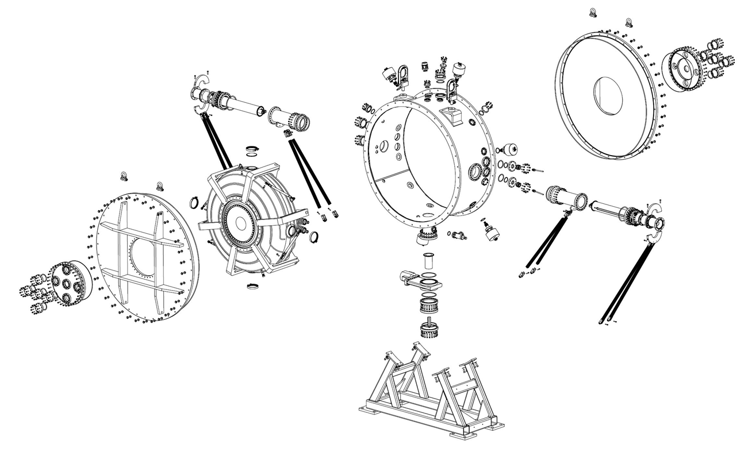
201 MHz MICE Production Cavity
Vacuum vessel at Fermilab
Cavity body has been processed
Tuners complete
Goal: under test by 9/1/12
Ryan & Jim assisting with assembly issues

Slide 8
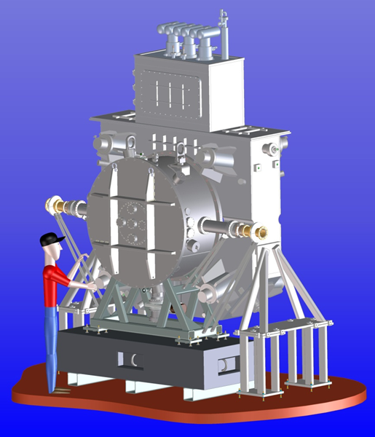
Test of 201 MHz cavity in B
FY14

Slide 9
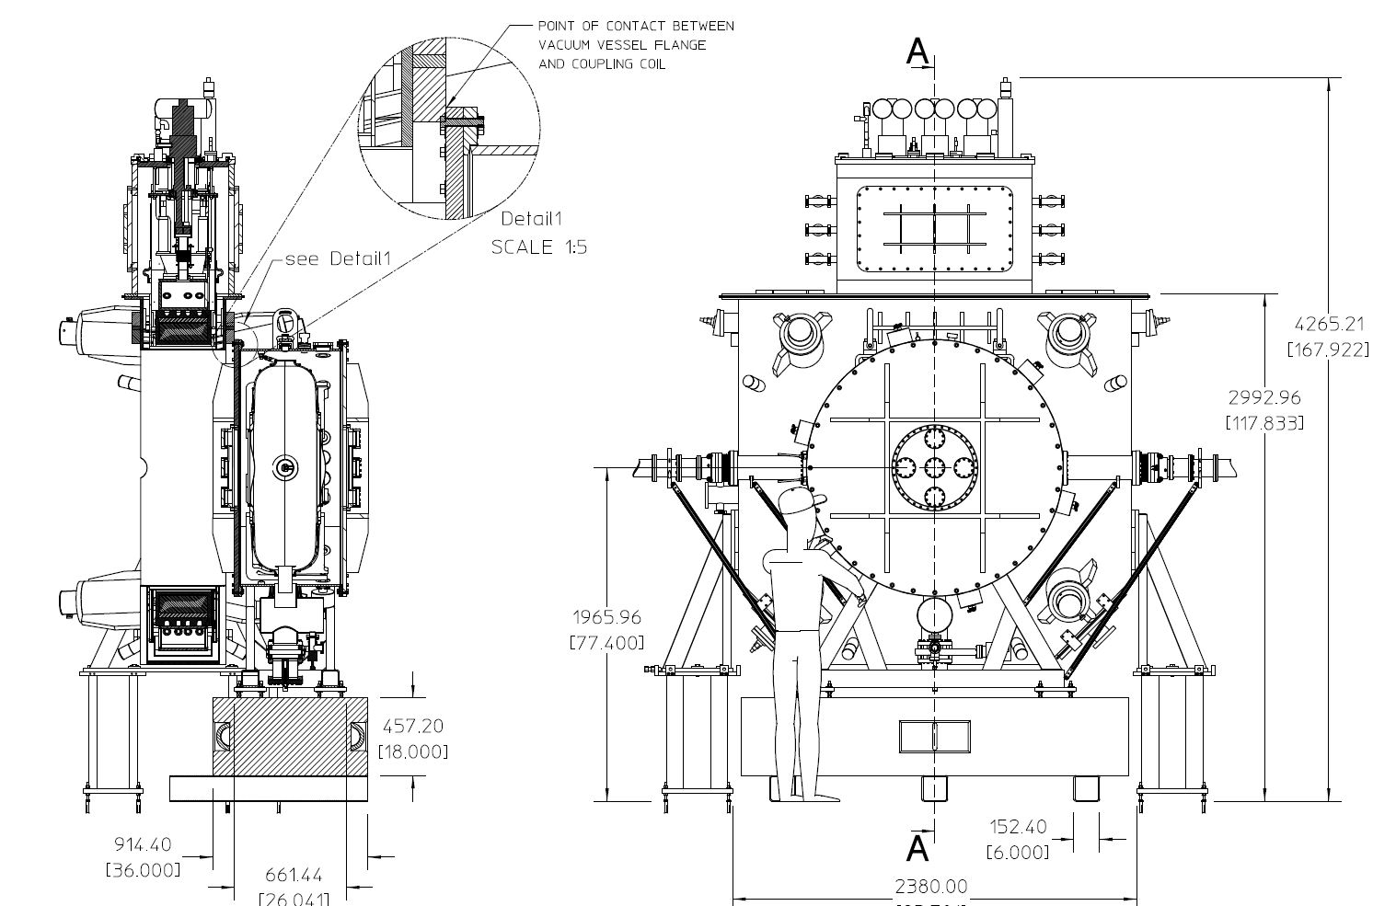
MICE RFCC_{Lite} System Test
Ryan has started looking into the engineering issues related to installation
and operation in the MTA hall

