Slide 1
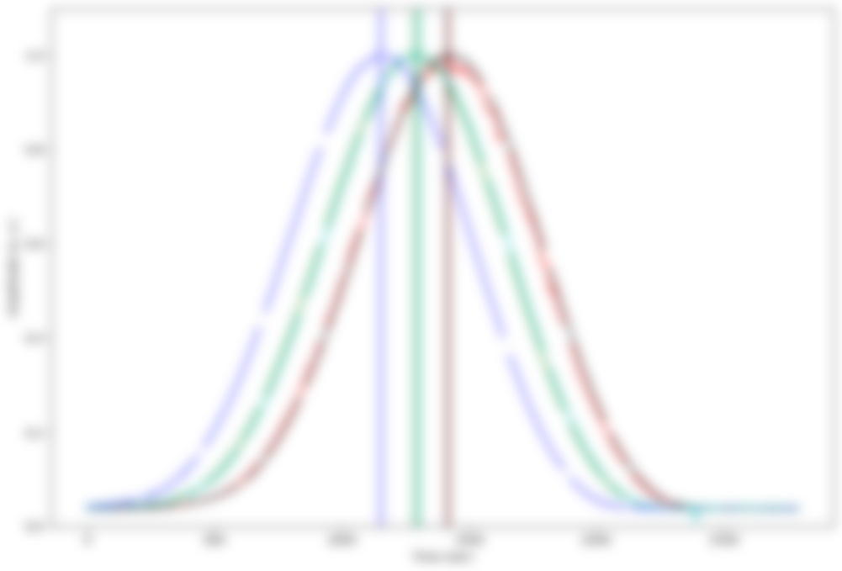
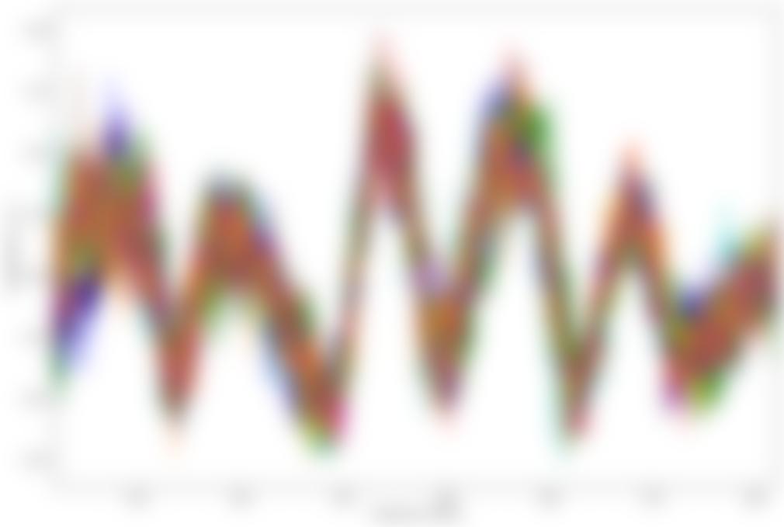
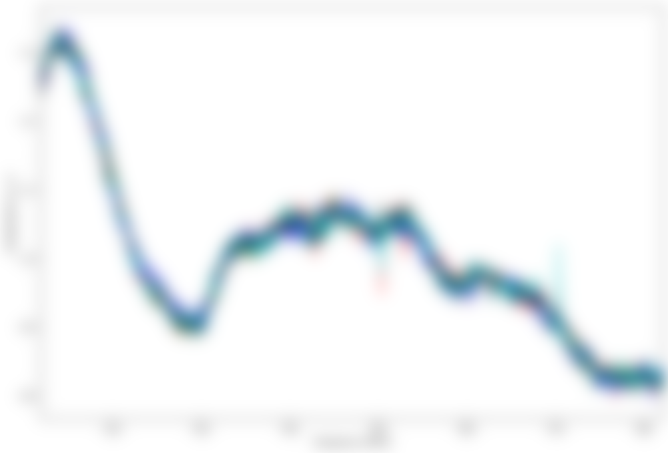
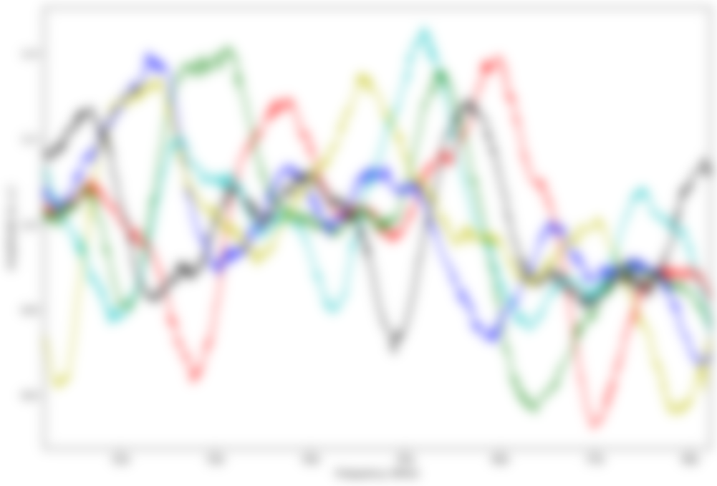
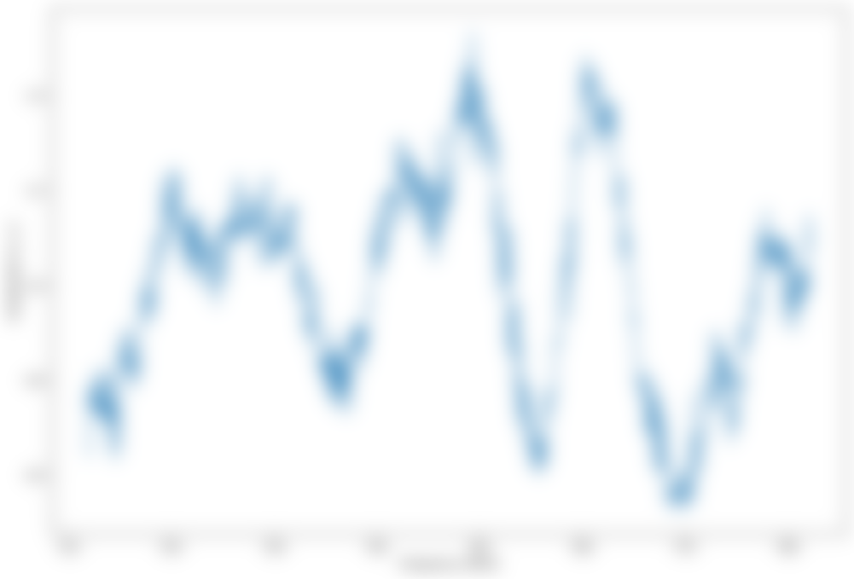
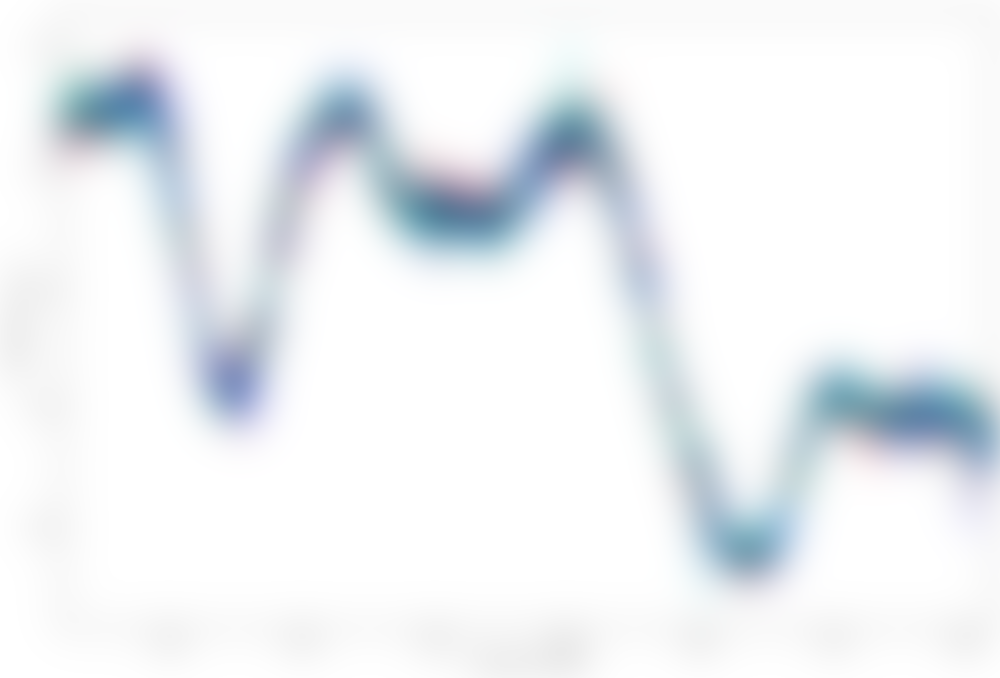
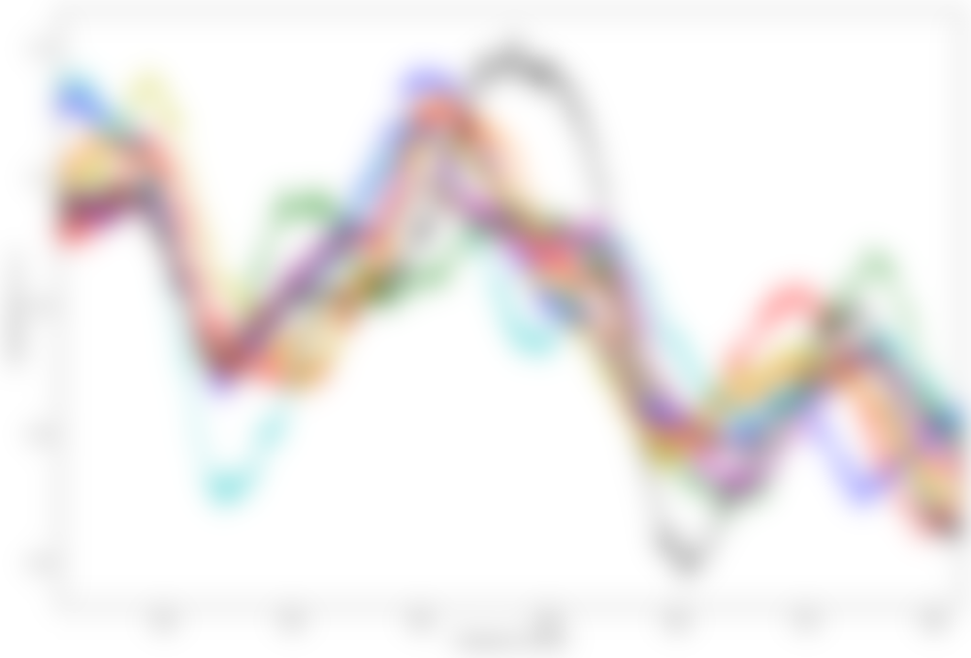
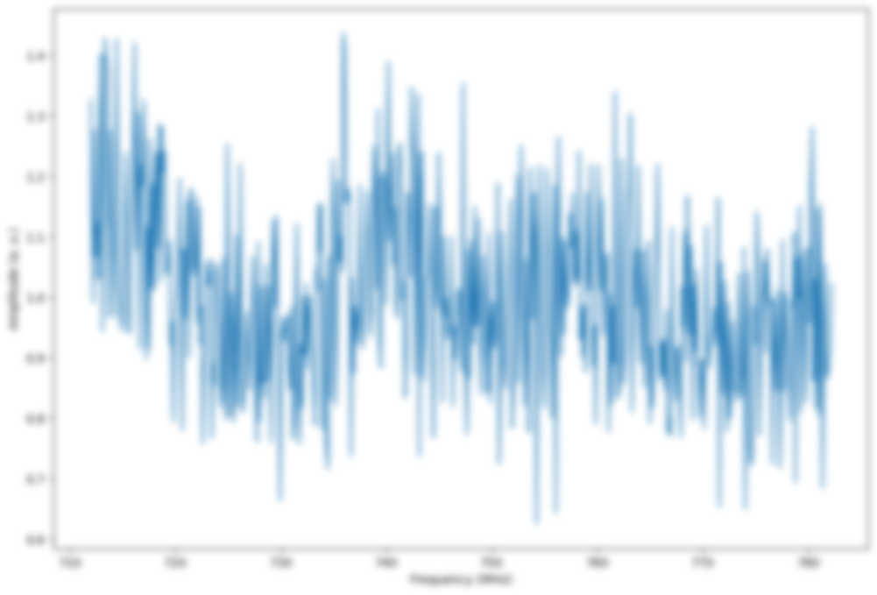
Analysis on Bandpass Calibration for Tianlai Cylinder
Jixia Li
NAOC
2022/8/29

Slide 2
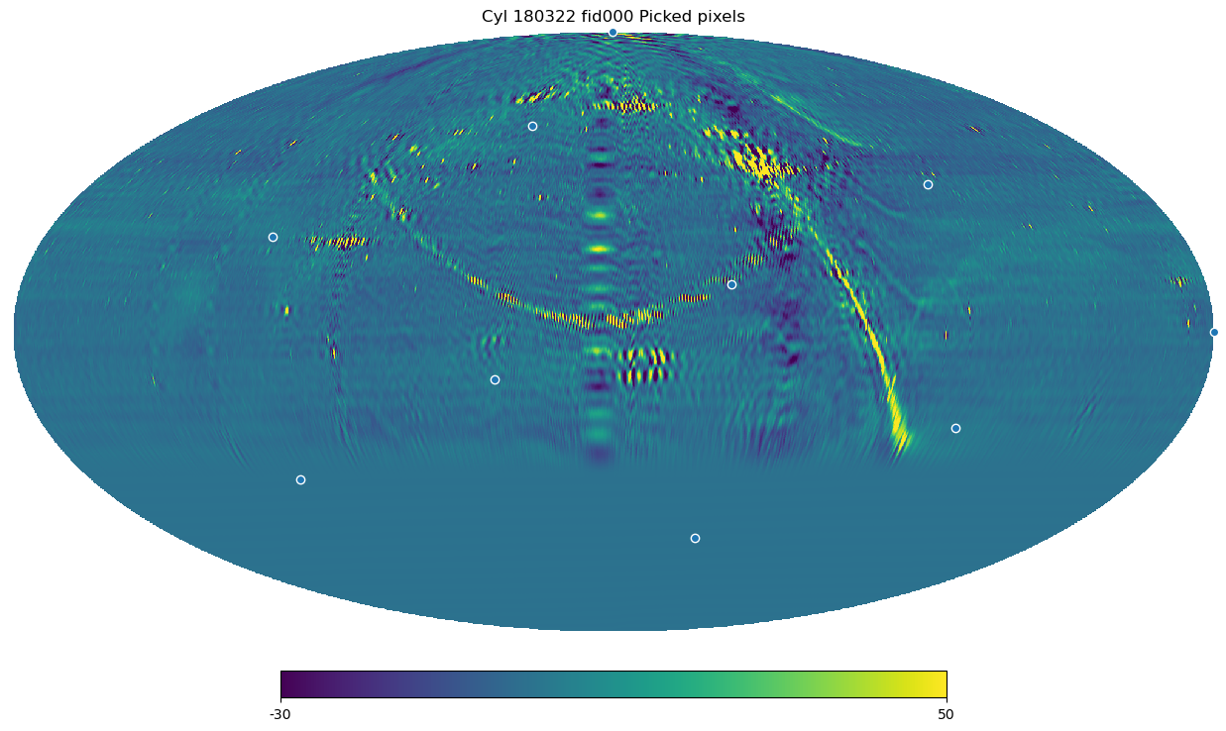
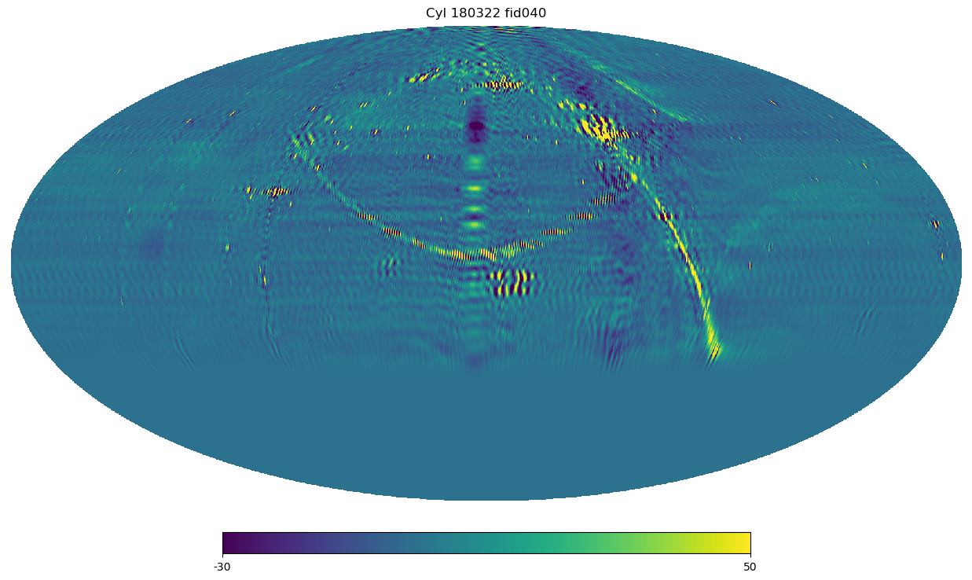
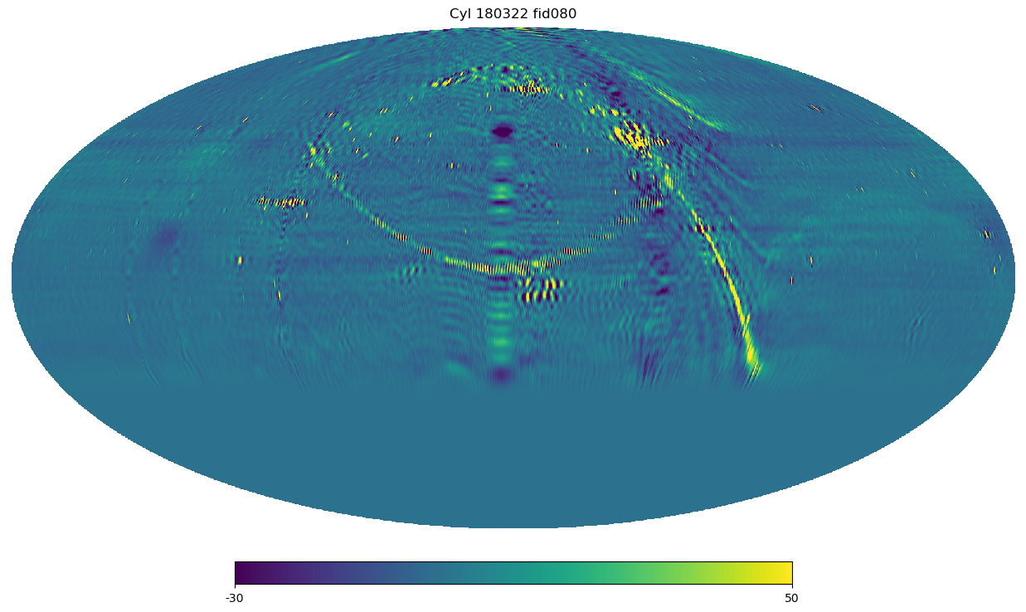
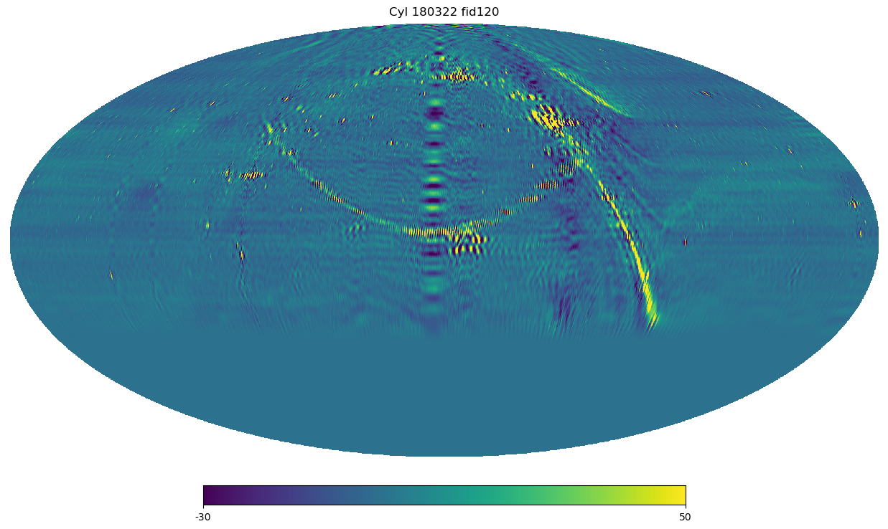
Bandpass Calibration
Smooth frequency is important for foreground removal.
180322 data
144 frequency points (For Tianlai cylinder: observed in 576 frequency points, i.e. 4 points averaged).
Randomly choose some pixels in the sky map, as shown in top left figure.

Slide 3
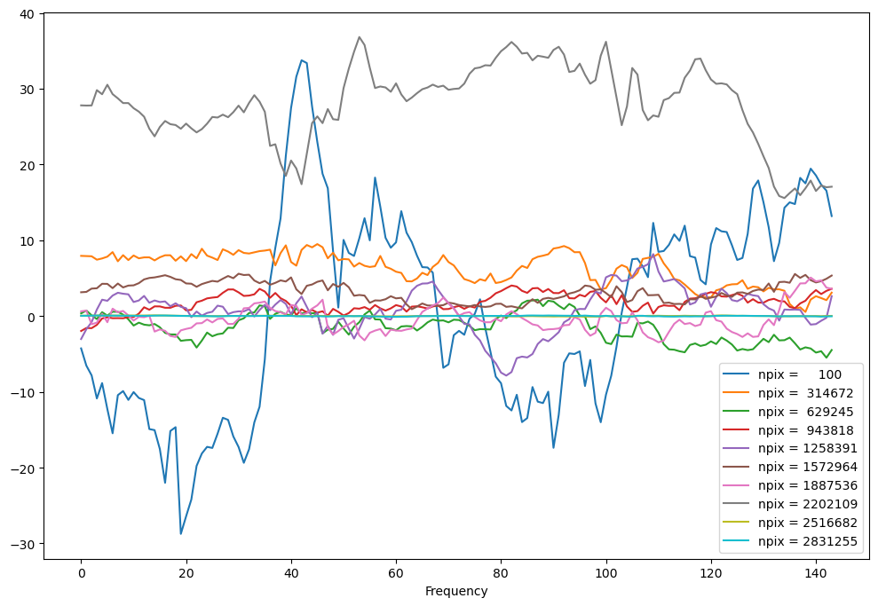
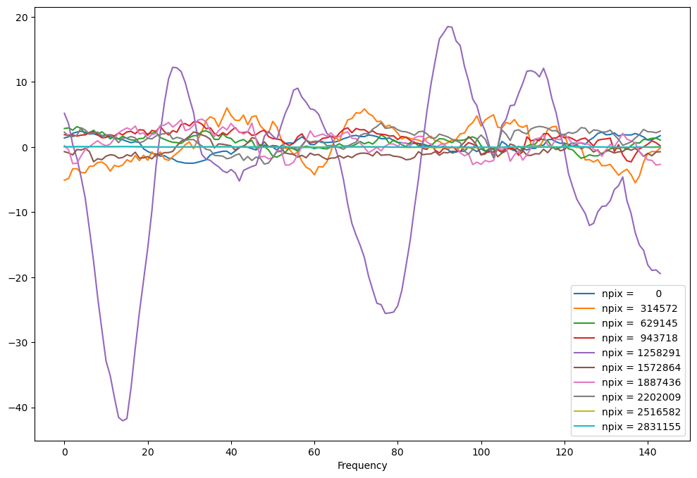
Bandpass Calibration
Smooth frequency is important for foreground removal.
180322 data
144 frequency points (For Tianlai cylinder: observed in 576 frequency points, i.e. 4 points averaged).
Randomly choose some pixels in the sky map, as shown in top left figure.
Spectrum of randomly chosen sky pixels – blank sky
(Left and right for different frequency channels)
Rapid fluctuations vs frequency!

Slide 4
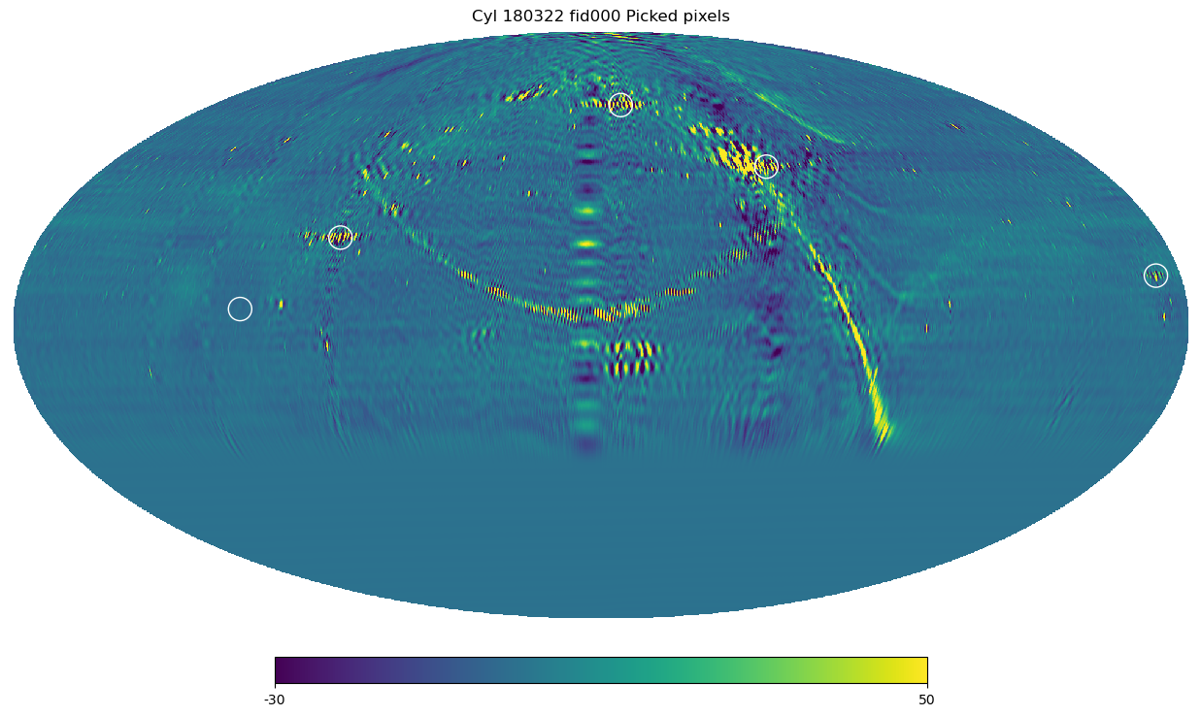
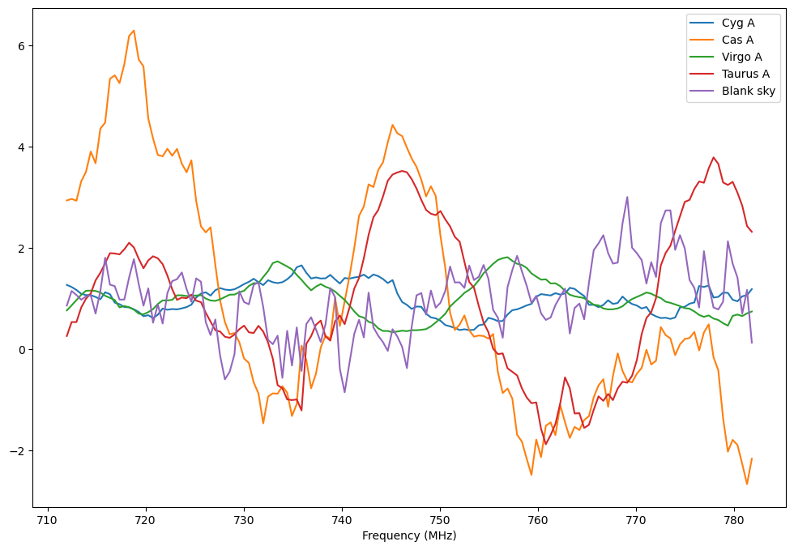
Bandpass Calibration
Smooth frequency is important for foreground removal.
180322 data
144 frequency points (For Tianlai cylinder: observed in 576 frequency points, i.e. 4 points averaged).
Cas A
Cyg A
Taurus A
Virgo A
Blank sky
Choose some pixels in the sky map containing bright sources, as shown in the left figure.
Spectrum of bright source sky pixels
(Left and right for different frequency channels)
Rapid fluctuations over frequency!

Slide 5
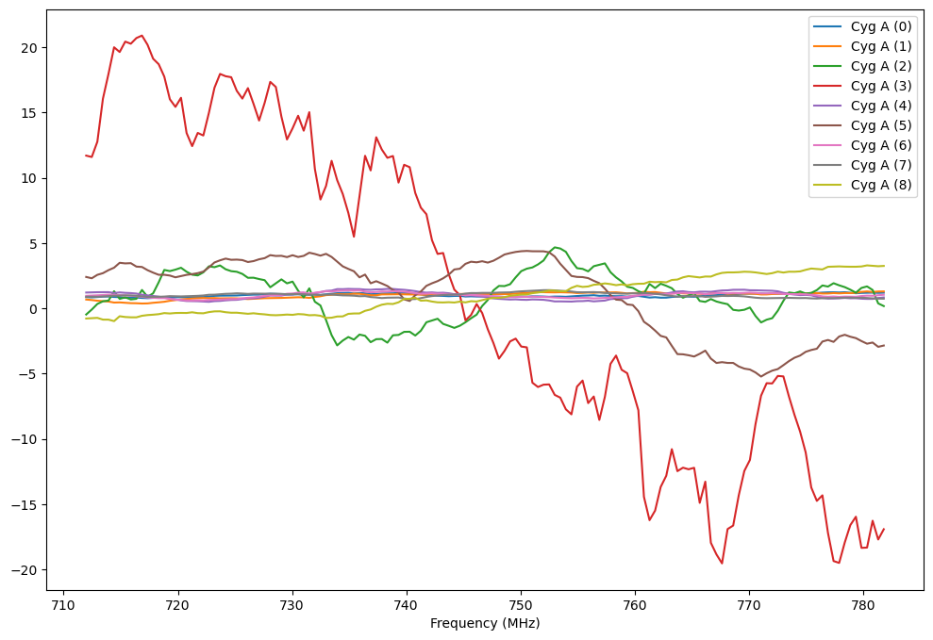
Bandpass Calibration
Smooth frequency is important for foreground removal.
180322 data
144 frequency points (For Tianlai cylinder: observed in 576 frequency points, i.e. 4 points averaged).
Cyg A
Choose some pixels in the sky map containing Cyg A, as shown in the left figure.
Spectrum of bright source sky pixels
(Left and right for different frequency channels)
Rapid fluctuations over frequency!

Slide 6
Bandpass Calibration
Calibration:
$V_{ij}{\left(t,ν\right)}_{obs} = V_{ij}{\left(t, ν\right)}_{true}∙G_{ij}\left(t\right)B_{ij}\left(t,ν\right)$
$t$: time, $ν$: frequency, $i,j$: a pair of antennas forming a baseline.
$G_{ij}$: complex gain, varying over time.
$B_{ij}$: complex frequency-dependent gain (bandpass).
Bandpass calibration: a process of measuring and correcting the frequency-dependent part of the gains, $B_{ij}\left(t,ν\right)$.
No single process of bandpass calibration in tlpipe, incorporated into $G_{ij}$ calibration.
Thought to be calibrated after point source calibration (i.e. flat spectrum expected), but the fact is not.

Slide 7
Calibrator information
Source | Flux (Jy) | Zenith Angle (degree) | Data (YYMMDD) | Transit Time (UTC+8h) | Sun contamination
Cyg A | 2980 | South 3.4 | 160927 | 09/27 21:25:46 | No
 |  |  | 170821 | 08/21 23:52:13 | No
 |  |  | 171209 | 12/09 16:35:47 | Yes
 |  |  | 180322 | 03/23 09:50:49 | Yes
Cas A | 2861 | North 14.7 | 160927 | 09/28 00:49:19 | No
 |  |  | 170821 | 08/22 03:15:47 | No
 |  |  | 171209 | 12/08 20:03:22 | No
 |  |  | 180322 | 03/23 13:14:24 | Yes
Virgo A | 353 | South 31.8 | 171209 | 12/10 09:08:39 | No
Taurus A | ~1000 | South 22.15 | 171209 | 12/11 02:09:43 | No
Low sensitivity $→$ limited bright sources

Slide 8
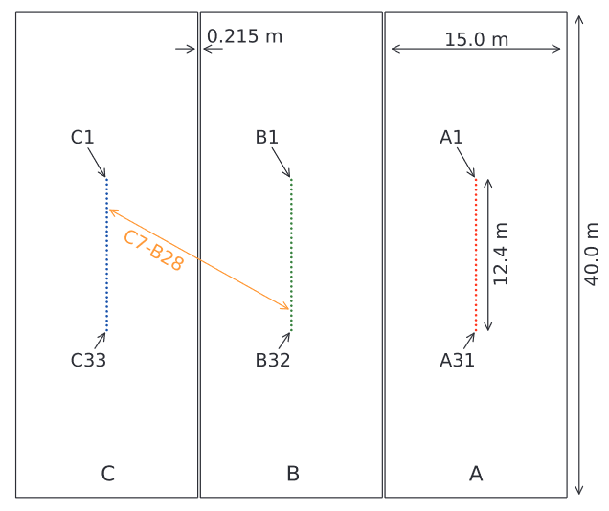
Bandpass – Amplitude over Time
Step:
1. Find transit peak time;
2. Choose 5 integration time;
~ 20 seconds.
3. Calculate amplitude of $v_{ij}$;
4. Average over frequency;
5. Normalize to 1;
6. Repeat days and baselines.
North
West
South
Cylinder naming convention

Slide 9
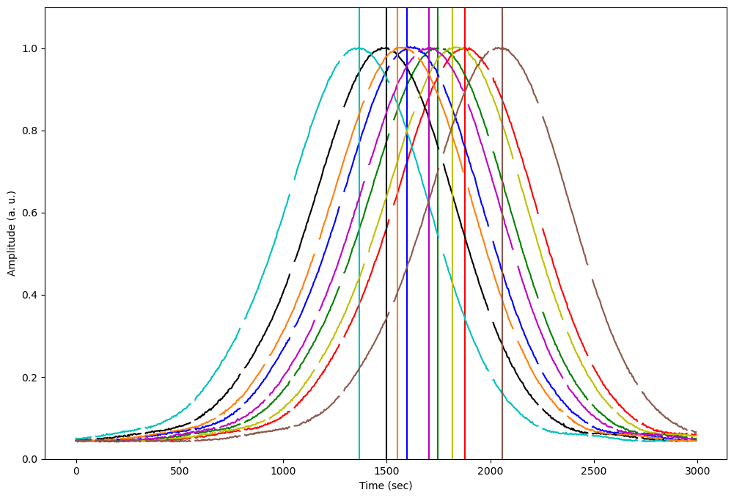
Bandpass – Amplitude over Time
Step:
1. Find transit peak time;
2. Choose 5 integration time;
~ 20 seconds.
3. Calculate amplitude of $v_{ij}$;
4. Average over frequency;
5. Normalize to 1;
6. Repeat days and baselines.
171209, Cas A, A1Y-B2Y

Slide 10
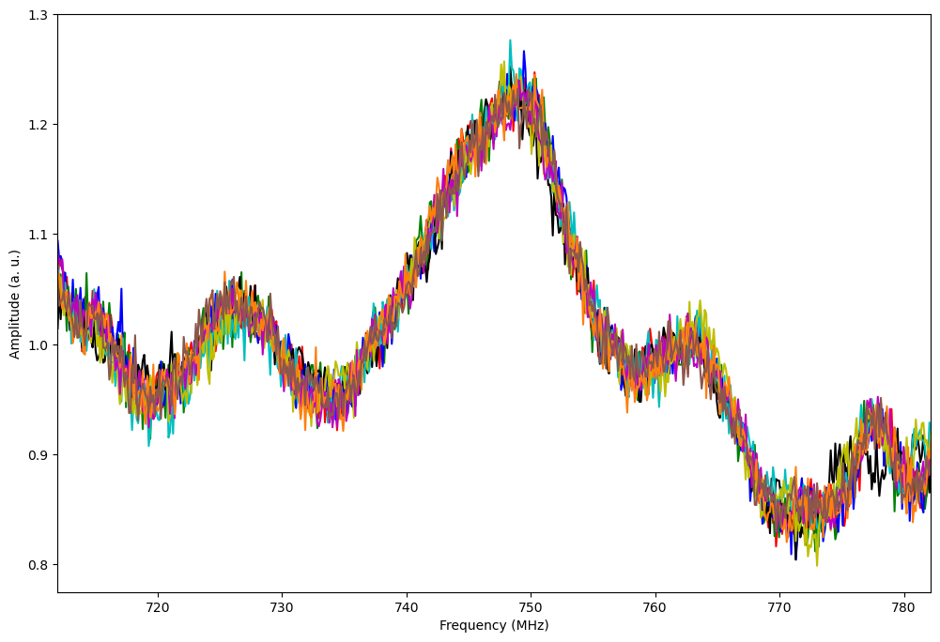
Bandpass – Amplitude vs Frequency
Step:
1. Find transit peak time;
2. Choose 5 integration time;
~ 20 seconds.
3. Calculate amplitude of $v_{ij}$;
4. Average over peak time;
5. Normalize to 1;
6. Repeat days and baselines.
171209, Cas A, A1Y-B2Y

Slide 11
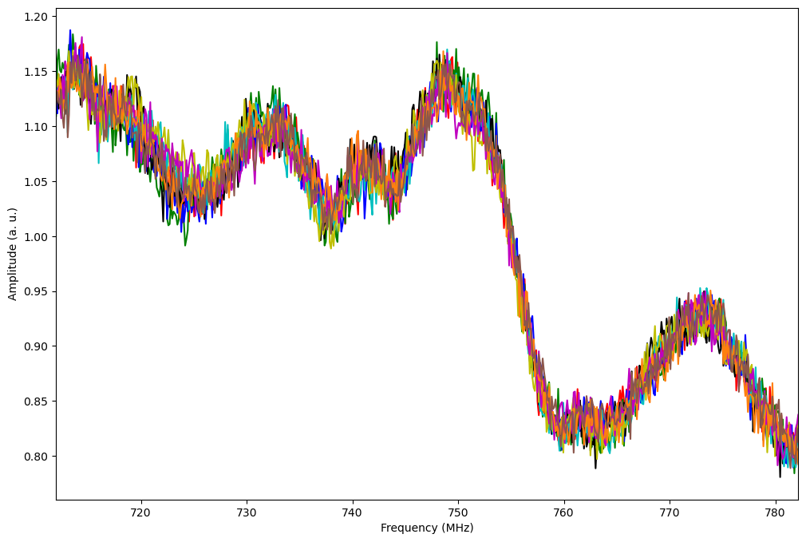
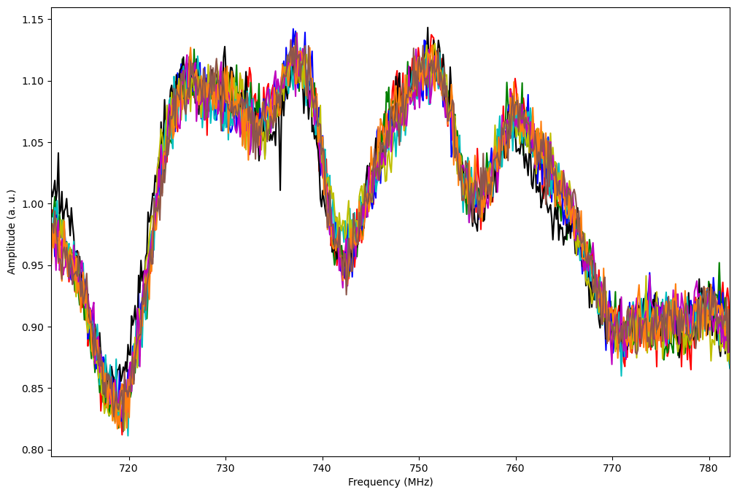
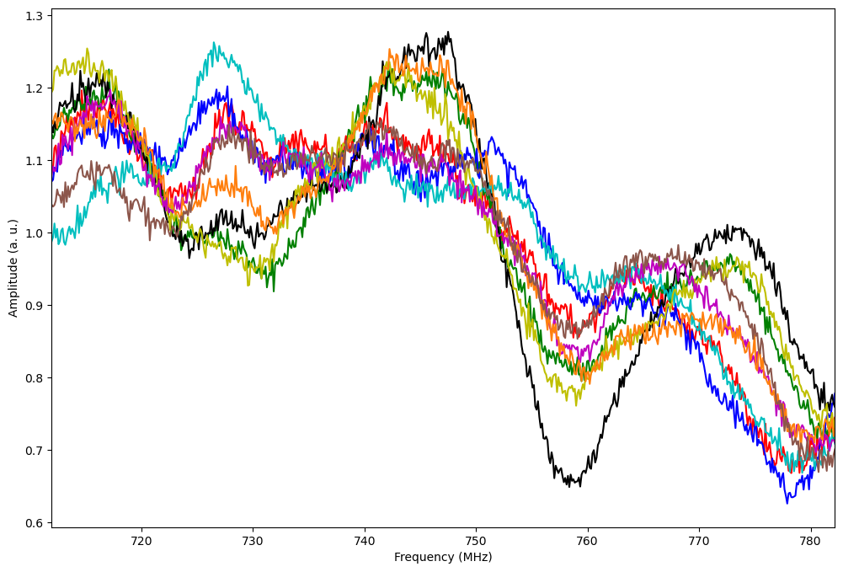
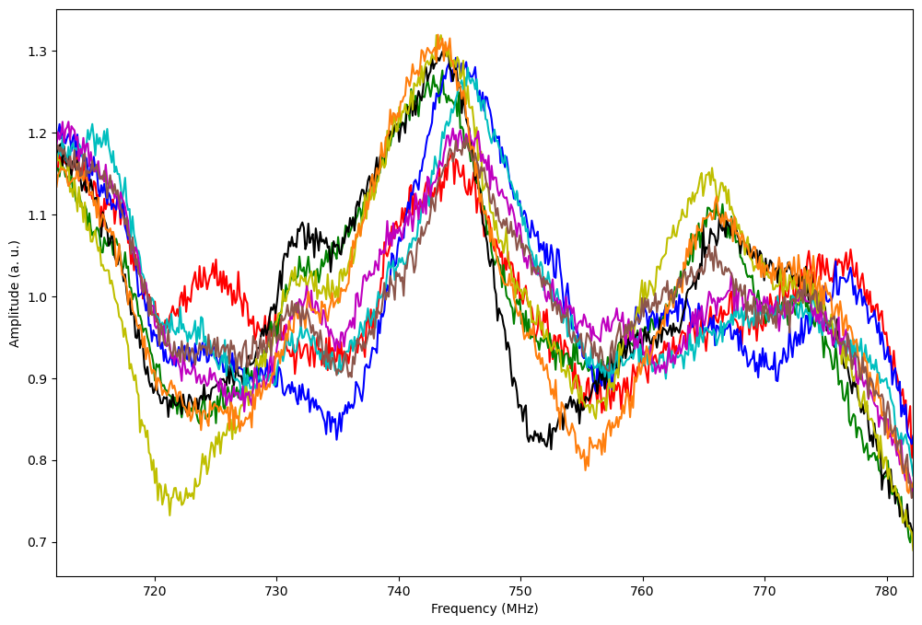
Bandpass – Amplitude vs Frequency (more results)
171209_CasA_A10X-B13X
171209_CasA_B21Y-C25Y
Conclusion 1:
Bandpass is stable over days.
Can average bandpass over days.
171209_CygA_A10X-B13X
171209_CygA_B21Y-C25Y
Conclusion 2:
Sun contamination is serious.
Use data when bright sources transit at night.

Slide 12
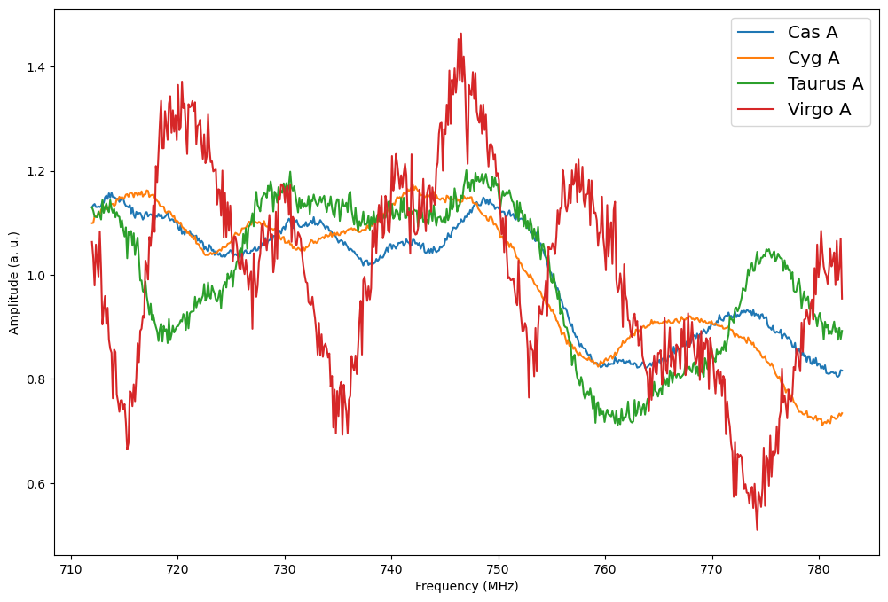
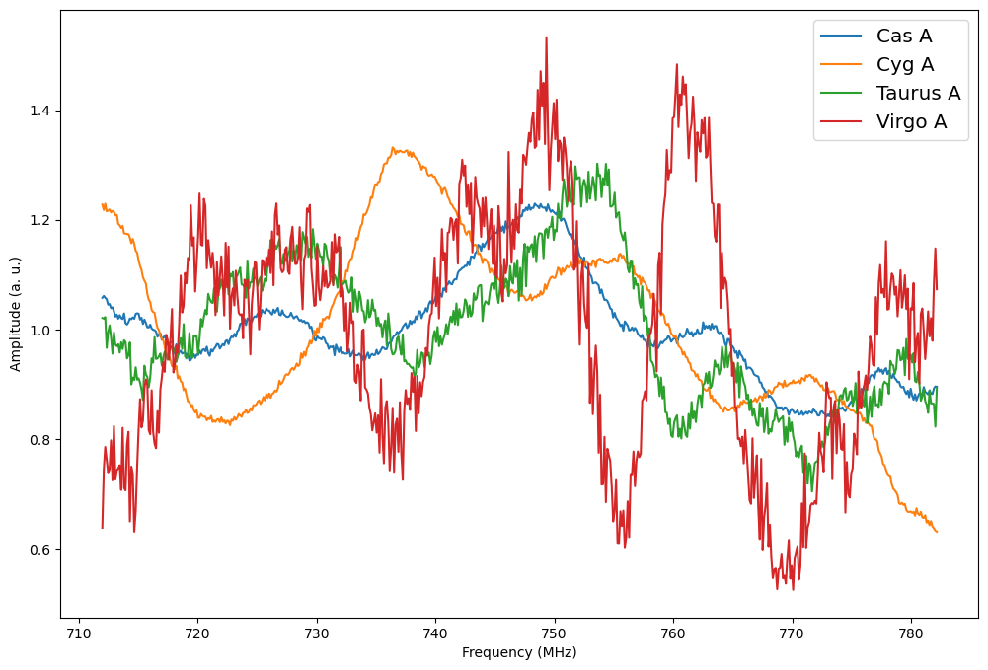
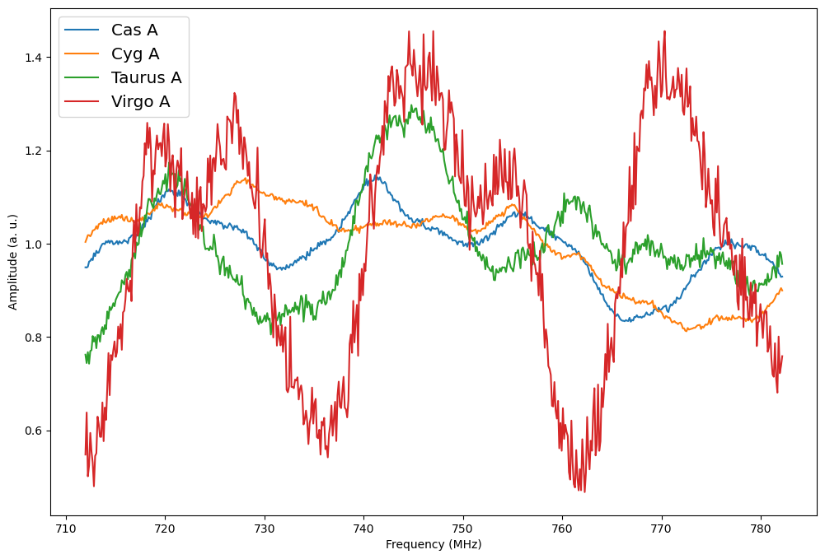
Bandpass Analysis on Sources
Src. | Z.A. | Sun
Cas A | N14.7 | No
Tau A | S22.15 | No
Cyg A | S3.4 | Yes
Vir A | S31.8 | Yes
Cas A, Taurus A
Inconsistent bandpass
171209_A10X_B13X
171209_A1Y_B2Y
Sources of different declinations results in different bandpasses?
Is Taurus A too faint?
171209_B11X_C33X
171209_B21Y_C25Y

Slide 13
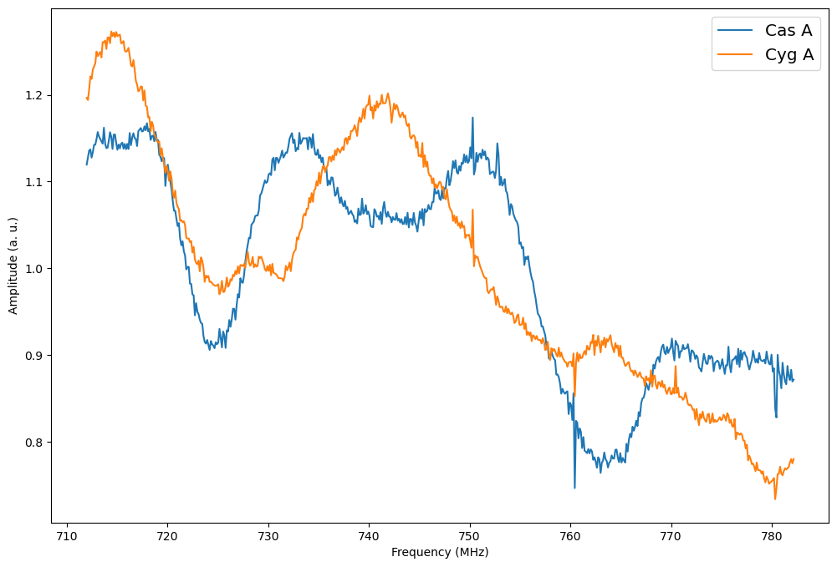
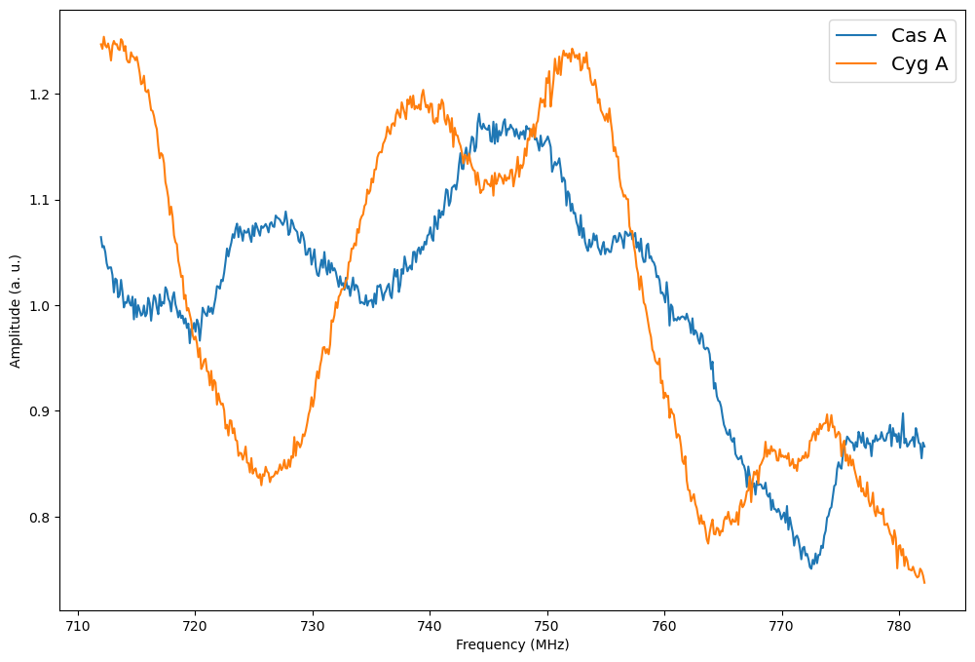
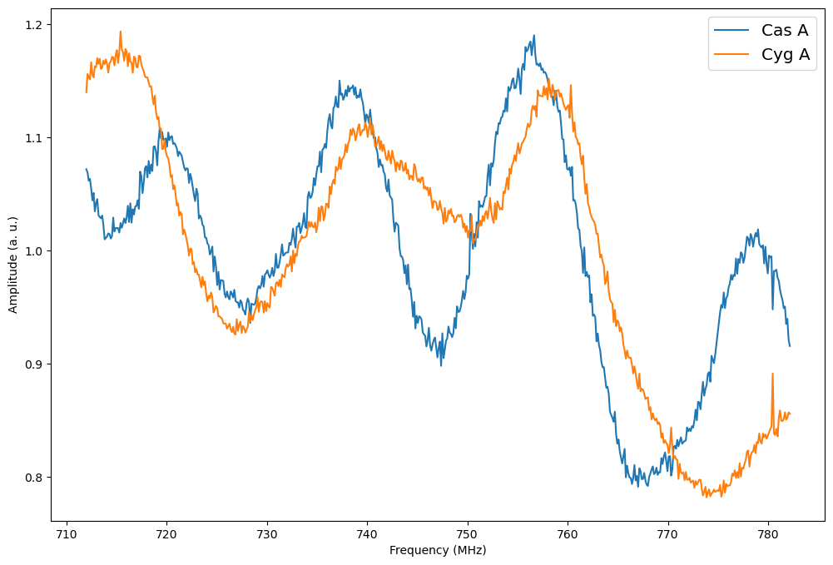
Bandpass Analysis on Sources
Src. | Z.A. | Sun
Cas A | N14.7 | No
Cyg A | S3.4 | No
Cas A, Cyg A
Inconsistent bandpass
160927_A10X_B13X
160927_A1Y_B2Y
Conclusion 3:
Sources of different declinations results in different bandpasses.
160927_B11X_C25X
160927_A15Y_C17Y

Slide 14
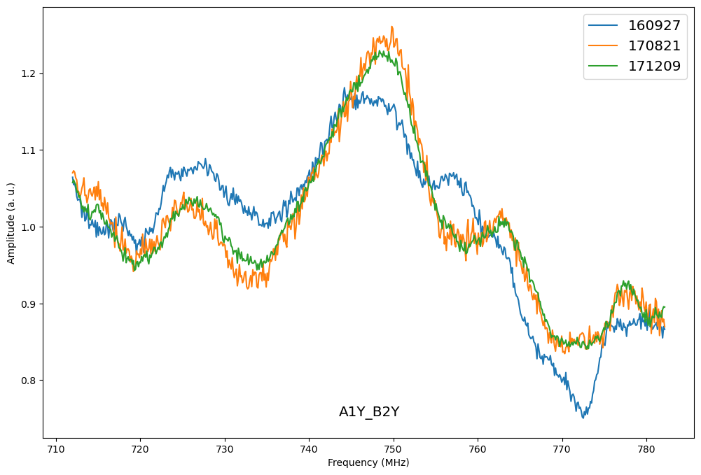
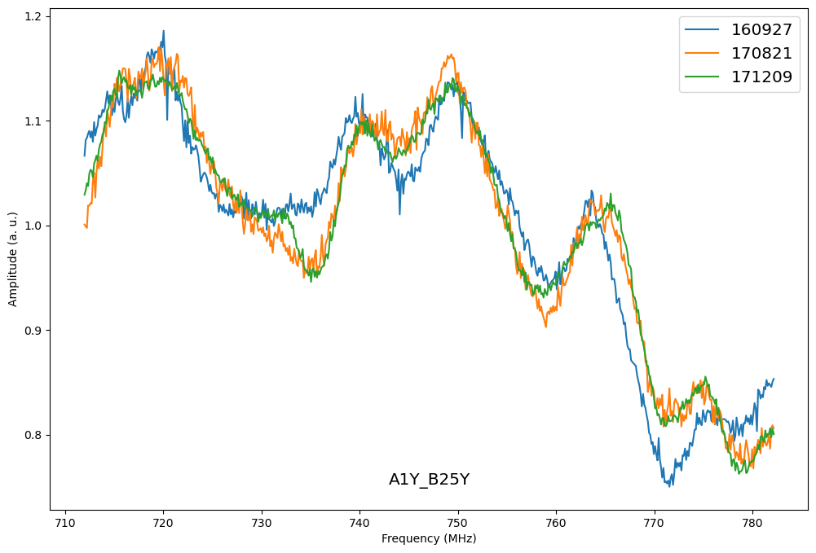
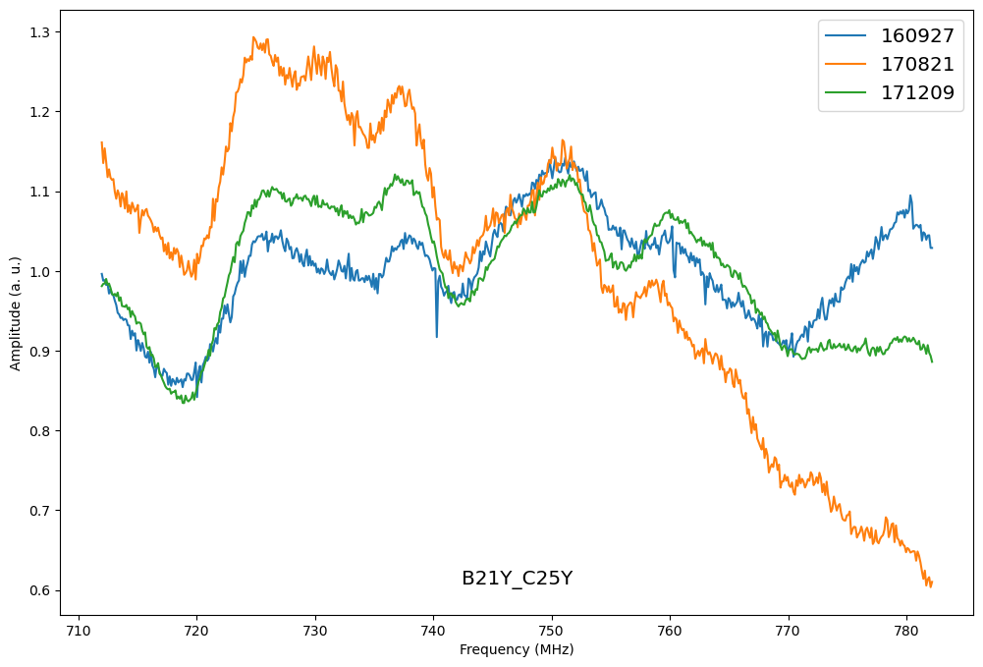
Bandpass Analysis on Time
Each curve is an averaged bandpass in its days’ observation.
Conclusion 4:
Bandpass is not stable over 3 weeks.

Slide 15
Conclusions/problems for Bandpass Calibration
Bright sources → Not enough, but BP is stable over days → Average over days’ observation, but not weeks.
Sun contamination is serious → only use night transit sources.
Bandpasses are different for sources at different declinations → How to obtain bandpasses?
Next work:
Bandpasses vs declinations:
Drone experiment?
EM simulation?
Analysis on phase.

Slide 16
Conclusions/problems for Bandpass Calibration
Bright sources → Not enough, but BP is stable over days → Average over days’ observation, but not weeks.
Sun contamination is serious → only use night transit sources.
Bandpasses are different for sources at different declinations → How to obtain bandpasses?
Next work:
Bandpasses vs declinations:
Drone experiment?
EM simulation?
Analysis on phase.
Thank you!

