Slide 1
Observation Frequency Band & Plan
Fengquan Wu

Slide 8
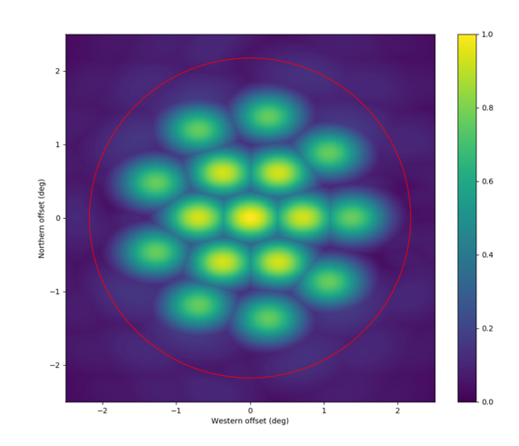
Beam distribution for FRB search
Cylinder array?

