Slide 1
Ba-Si-Gd:Ce and Gd-Si:Ce
Glass Scintillation Materials
V. Dormenev, K.-T. Brinkmann, D. Kazlou,
R.-W. Novotny, H.-G. Zaunick
II. Physics Institute, Justus-Liebig-University, Giessen, Germany

Slide 2
Motivation
Scintillating materials based on glasses and glass ceramics can be considered as alternatives for the crystalline scintillators currently used in radiation detectors for the detection of high-energy photons and neutrons in high-energy physics experiments and homeland security applications
Glass material can be fabricated in various sizes and shapes, such as blocks, plates, and thin fibers. Large quantities of the detection units can be produced in a relatively short period of time
The lead-free glass BaO·2SiO₂: Ce ( disilicate–barium, DSB: Ce) has a density of 3.7 g/cm³ and is found to be radiation hard. Further technology optimization showed that the loading of the DSB: Ce glass by gadolinium increases the material density up to 4.5 g/cm³ and results in an increase in the light output by a factor of five, significantly improving the efficiency of the electromagnetic radiation registration and making the material sensitive to neutrons.

Slide 3
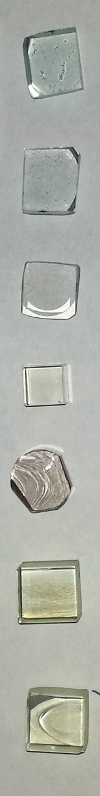
Physical properties of different heavy silica glasses
Material | ρ g/cm3 | Z_{eff} | X₀ cm | λ_{max} nm | Cut-off undoped material / nm
BaO*2SiO₂ | 3.7 | 51 | 3.6 | - | 310
DSB: Ce | 3.8 | 51 | 3.5 | 440-460 | 310
BaO*2SiO₂:Ce glass heavy loaded with Gd | 4.7-5.4 | 58 | 2.2 | 440-460 | 318
Technology: Typical glass production technology combined with
successive thermal annealing (800 – 900ºC). Technological process is manageable at any glass production facility worldwide.
Samples produced in INP, Minsk in 2012-2015

Slide 4
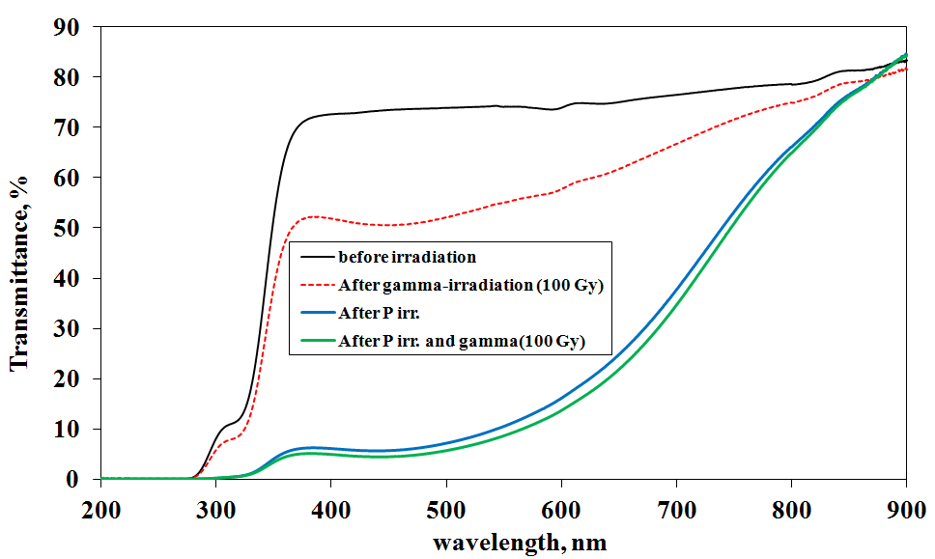
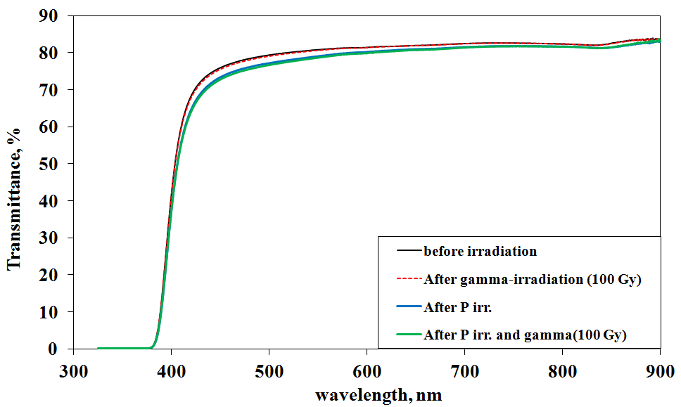
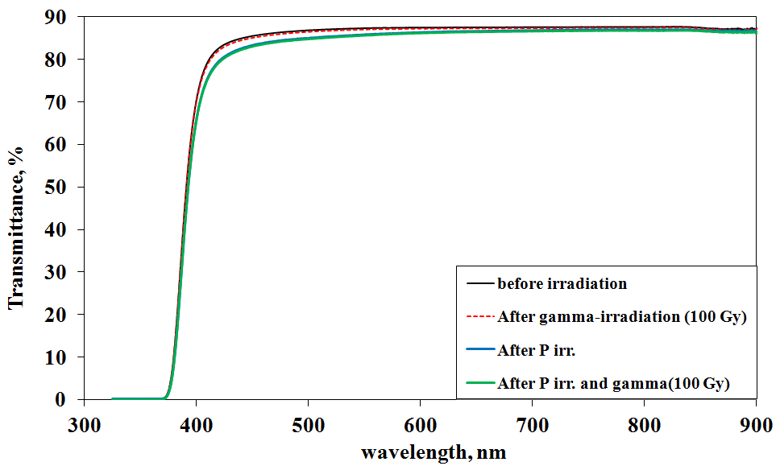
irradiation and recovery studies: with 150MeV protons
flux ≤ 2x10¹¹ p/s cm²
integral fluence = 5x10¹³ p/cm²
BaO x 2SiO₂
(mother glass)
BaO x 2SiO₂:Ce
(without thermal treatment)
DSB:Ce
(after thermal treatment)

Slide 5
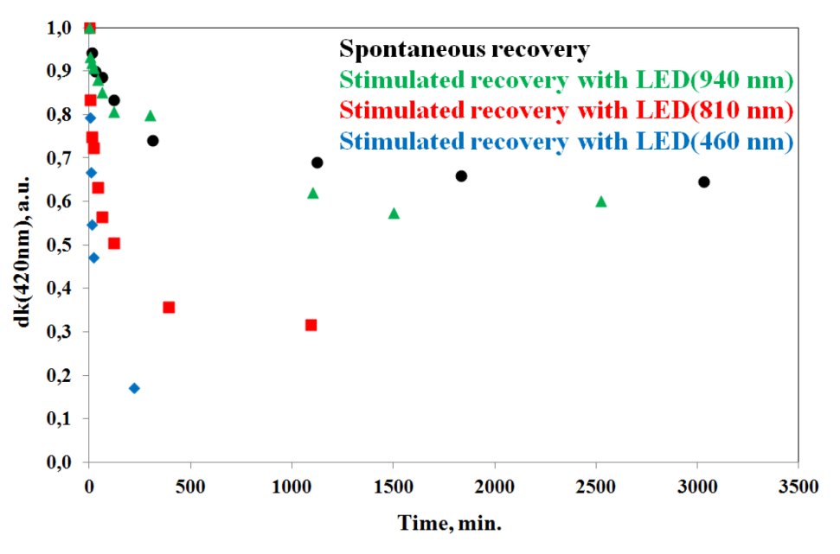
irradiation and recovery studies
DSB: Ce
(after thermal treatment)
flux ≤ 2x10¹¹ p/s cm²
integral fluence = 5x10¹³ p/cm²
Irradiation with γ-quanta
Irradiation with γ-rays and 150 MeV protons
The approach developed for stimulated
recovery in irradiated PWO also works for
the glass family under consideration.
spontaneous and
stimulated recovery

Slide 6
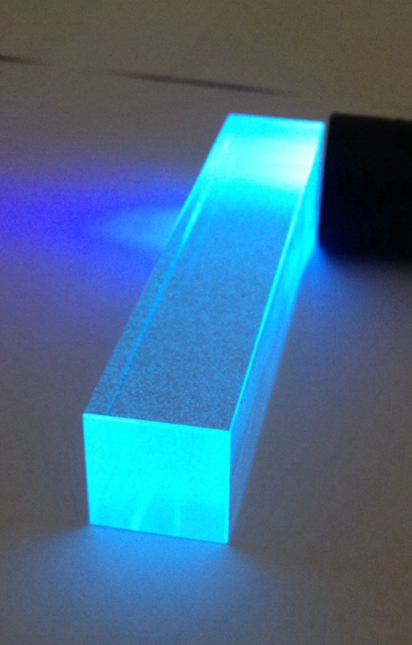
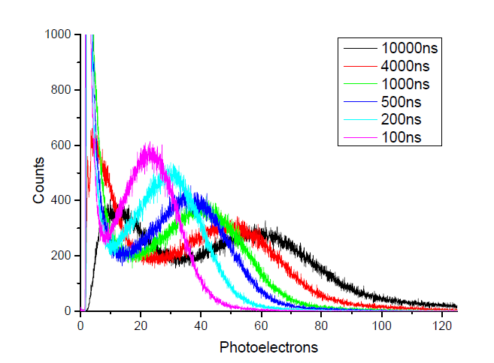
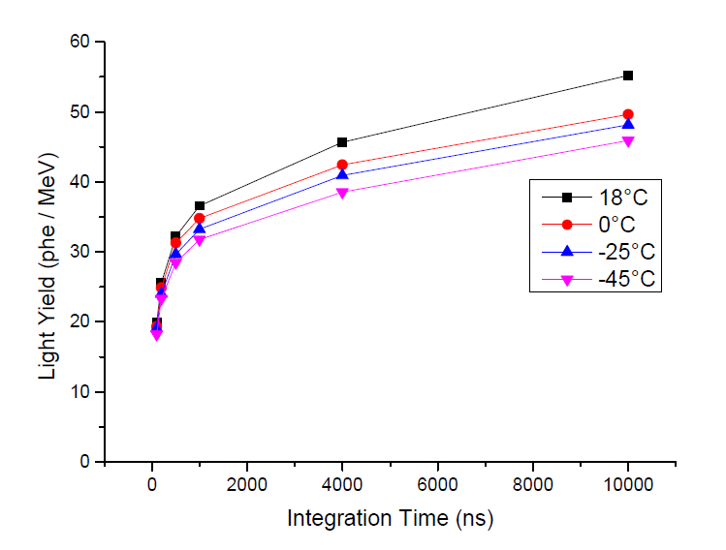
DSB:Ce block 23 x 23 x 120 mm³
produced from the bulk material worked
in the mold from the crucible 500 ml.
Essential problem was small bubbles inside due to an absence of
agitator mechanism for glass in the crucible
Pulse height spectra of the 662 kev (137-Cs) measured at room temperature
measured in different gates and gated light yield temperature dependence

Slide 7
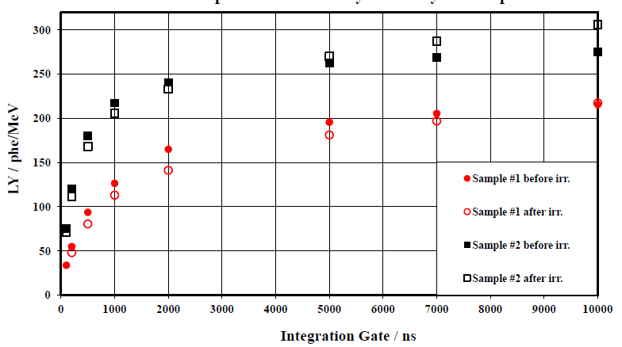
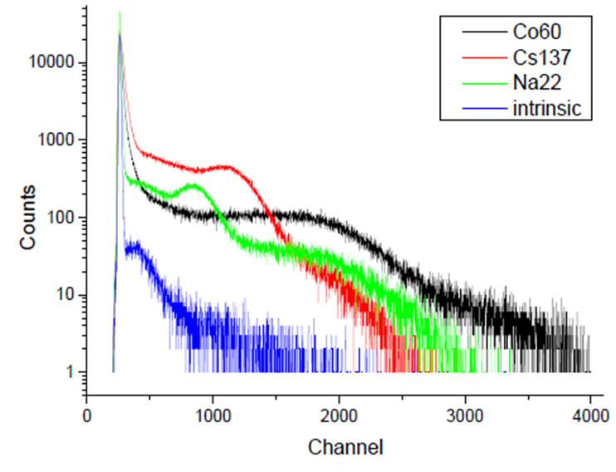
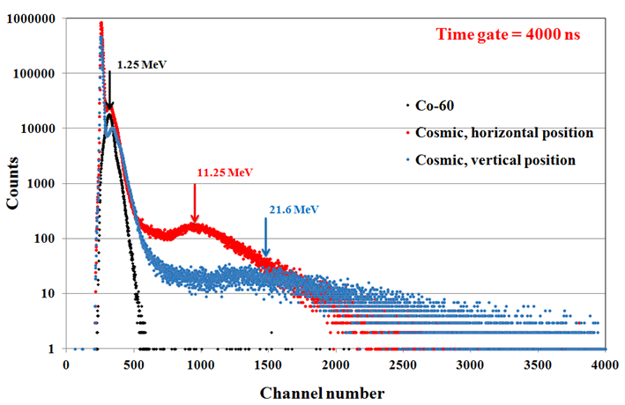
Scintillation properties of Gd-loaded samples
#1: 10 weight% Gd₂O₃
#2: 20 weight% Gd₂O₃
both: 0.5 weight% Ce
light yield as a function
of integration time
Two samples with 5 mm thickness
large volume samples : 25x25x125mm³

Slide 8
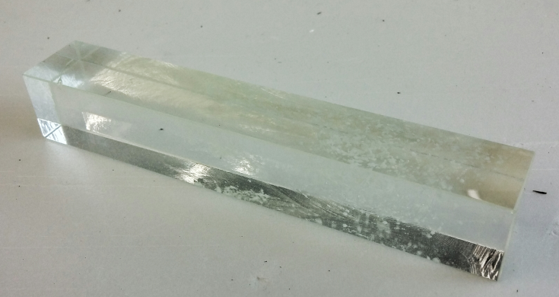
Block of DSB: Ce heavy loaded with Gd
The same problem: small bubbles inside due to an absence of
agitator mechanism for glass in the crucible

Slide 9
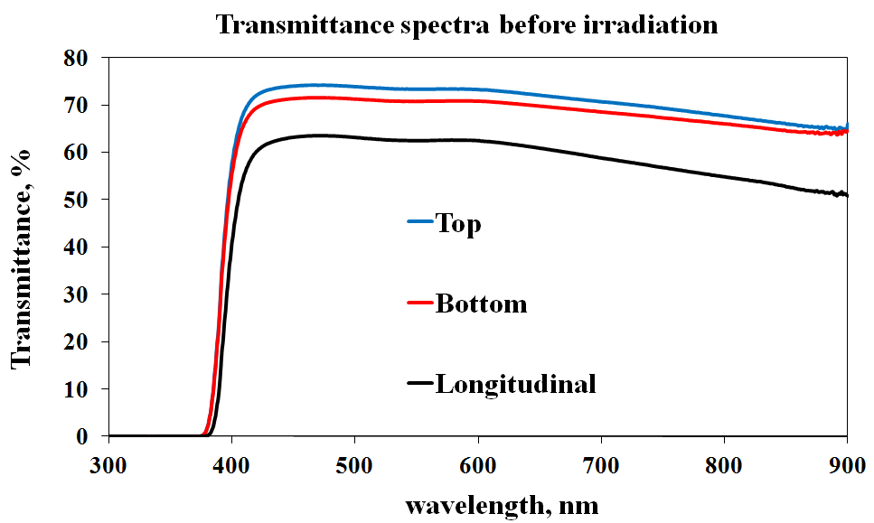
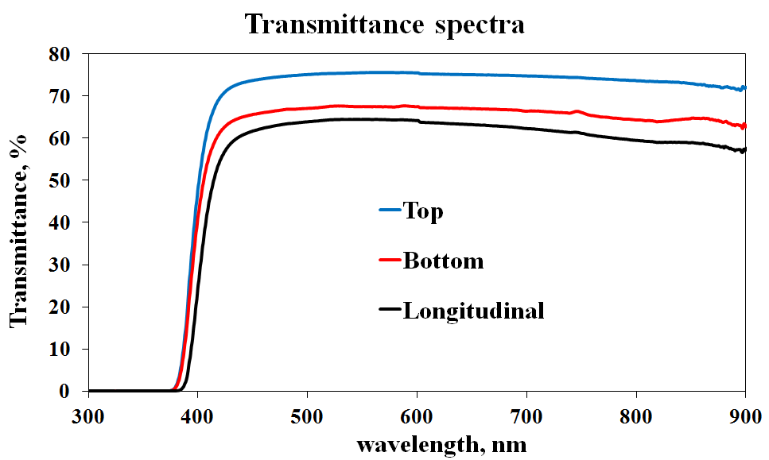
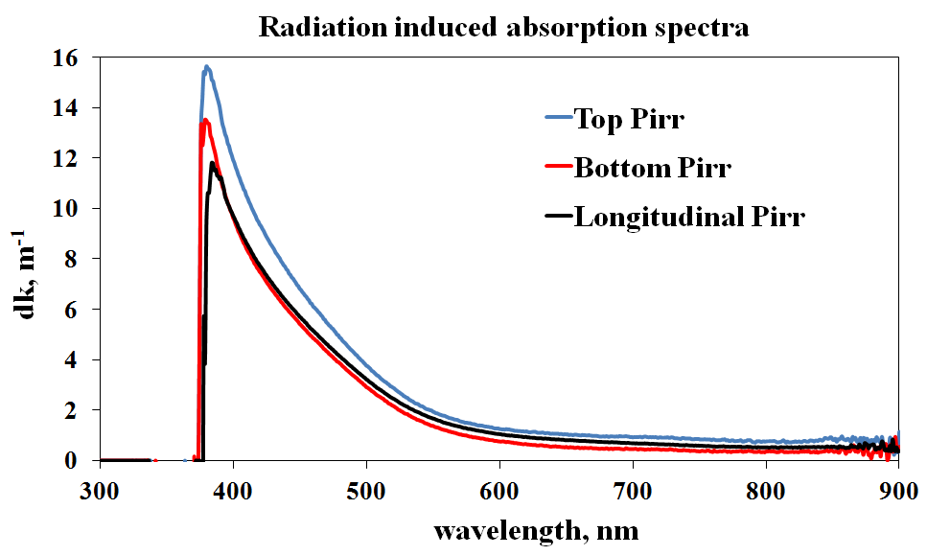
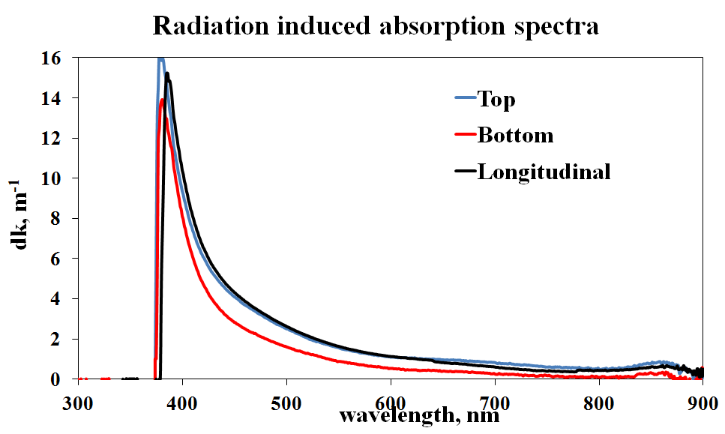
Irradiation tests with 190 MeV proton beam
“Pure” DSB:Ce (4 cm) DSB:Ce loaded by Gd (4.5 cm)
Results after irradiation with fluence = 10¹² protons/cm²
dk = Ln[T_{before}/T_{after}]/d

Slide 10

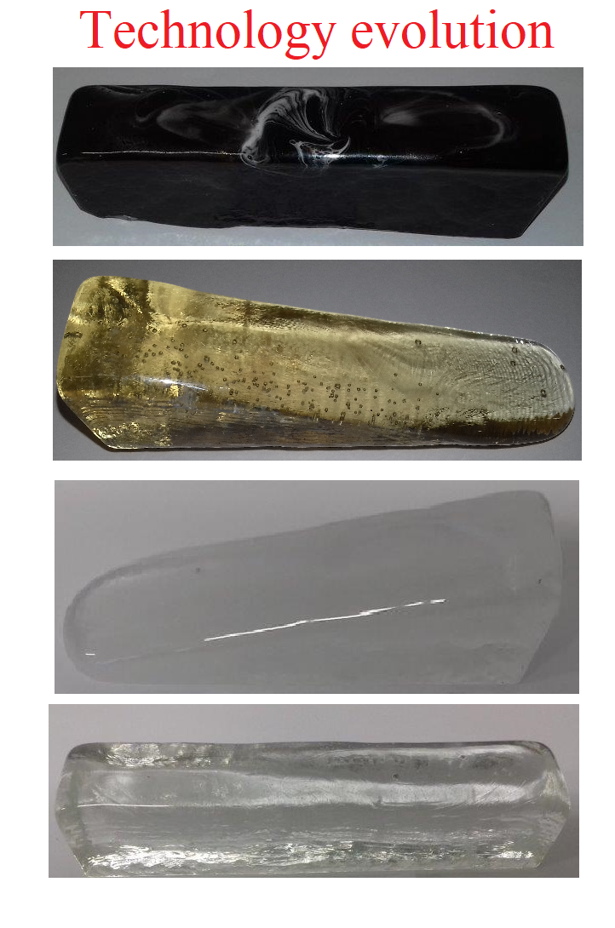
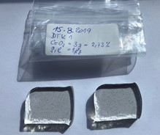
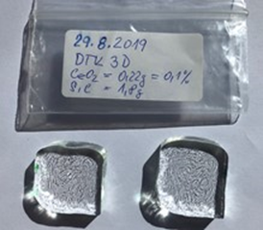
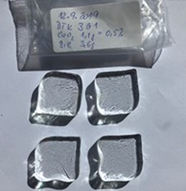
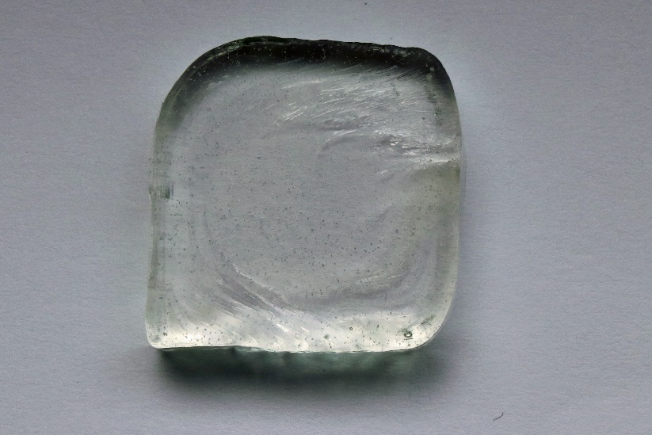
Next step in development with an industrial partner in frames
of ATTRACT Project:
One ingot from the first probes
www.preciosa-ornela.com
468 61 Desná, Czech Republic
produced:
Sept. 12, 2019
First ingot with reasonable
Light Yield obtained in 9 month
after start
Significant reduction of the macrodefects („bubbles“) was achieved

Slide 11
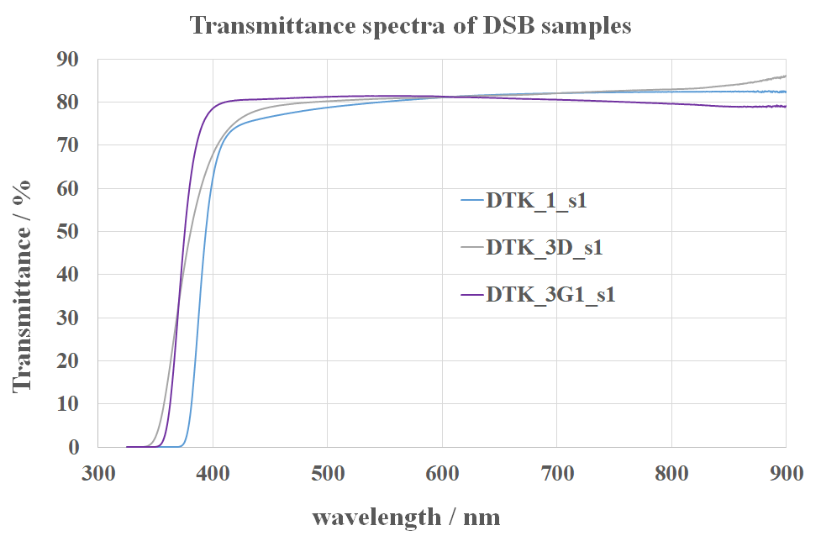
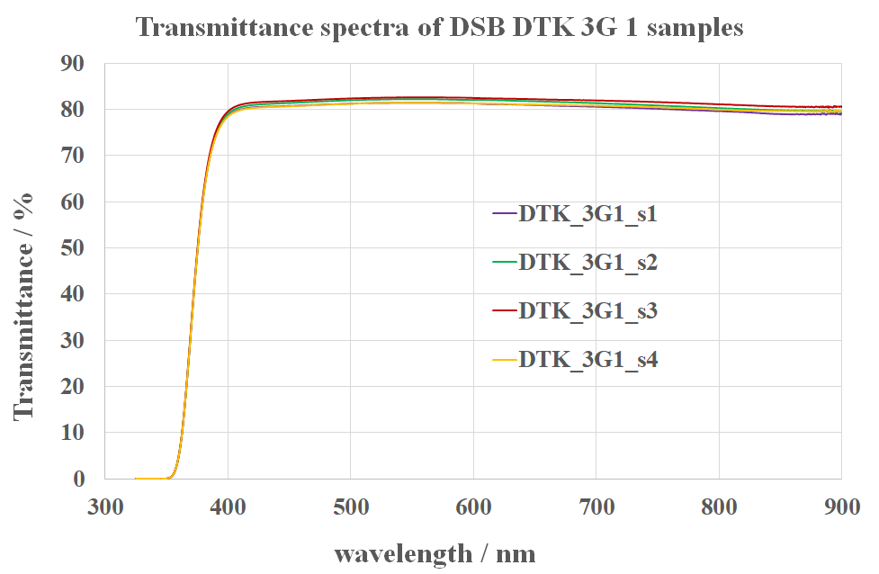
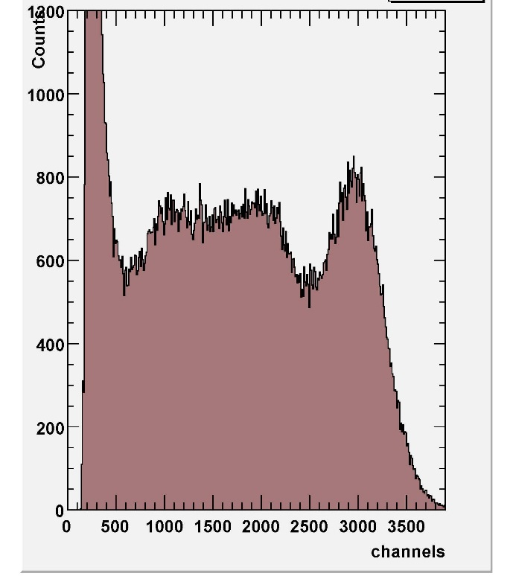

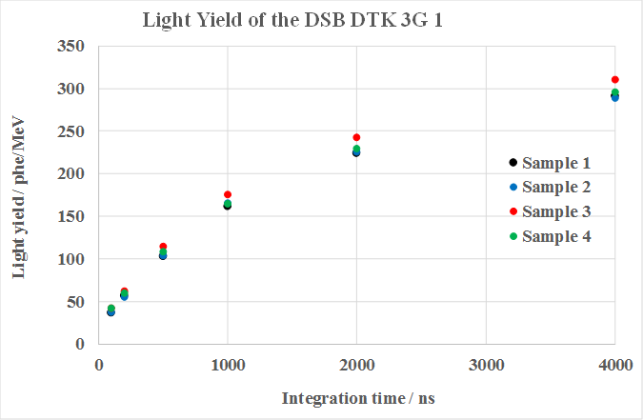
basic properties @ start of ATTRACT
response to ¹³⁷Cs
(4µs integration time)

Slide 12
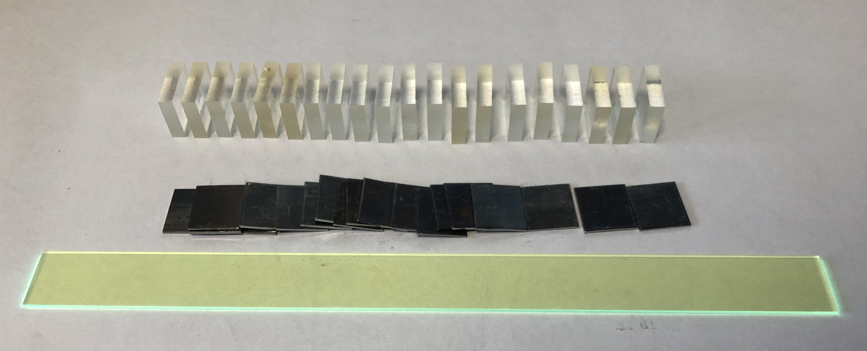
Start of the pre-production for first protypes
Main task: mass production of 190 plates with 17x20x5 mm dimensions to mount 3x3 sampling calorimeter array.
Each unit will consist of 20 DSB/19 Pb(1mm) plates with two WLS layers for light transportation to a photodetector.
Transmittance spectra
Correlation T (400 nm) vs nd the Light Yield

Slide 13
Start of pre-production for first protypes
¹³⁷Cs spectrum measured at T= +20 C,
integration time = 4 μs
Light yield vs integration time
measured at different temperatures
Light yield values measured at +20 C, integration time 4μs

Slide 14
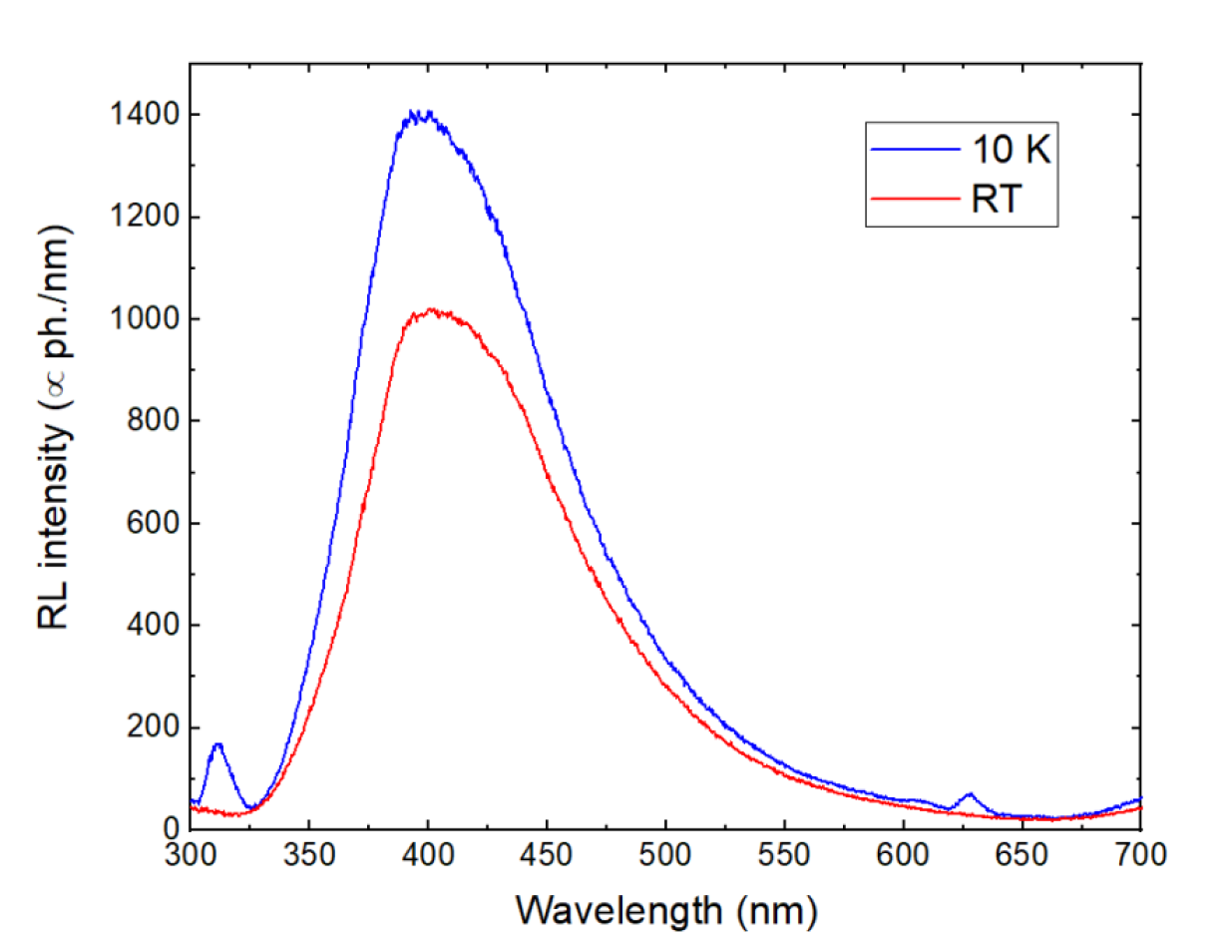
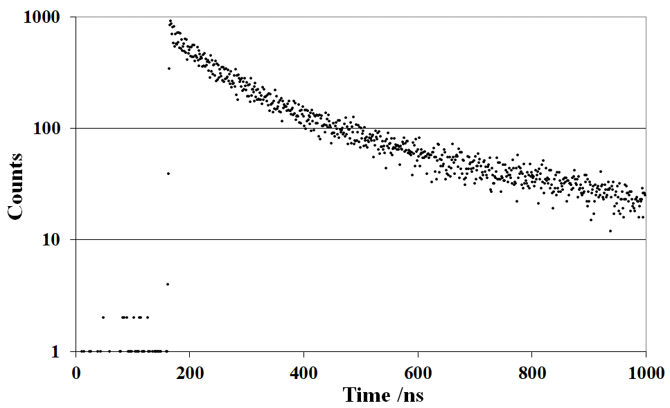
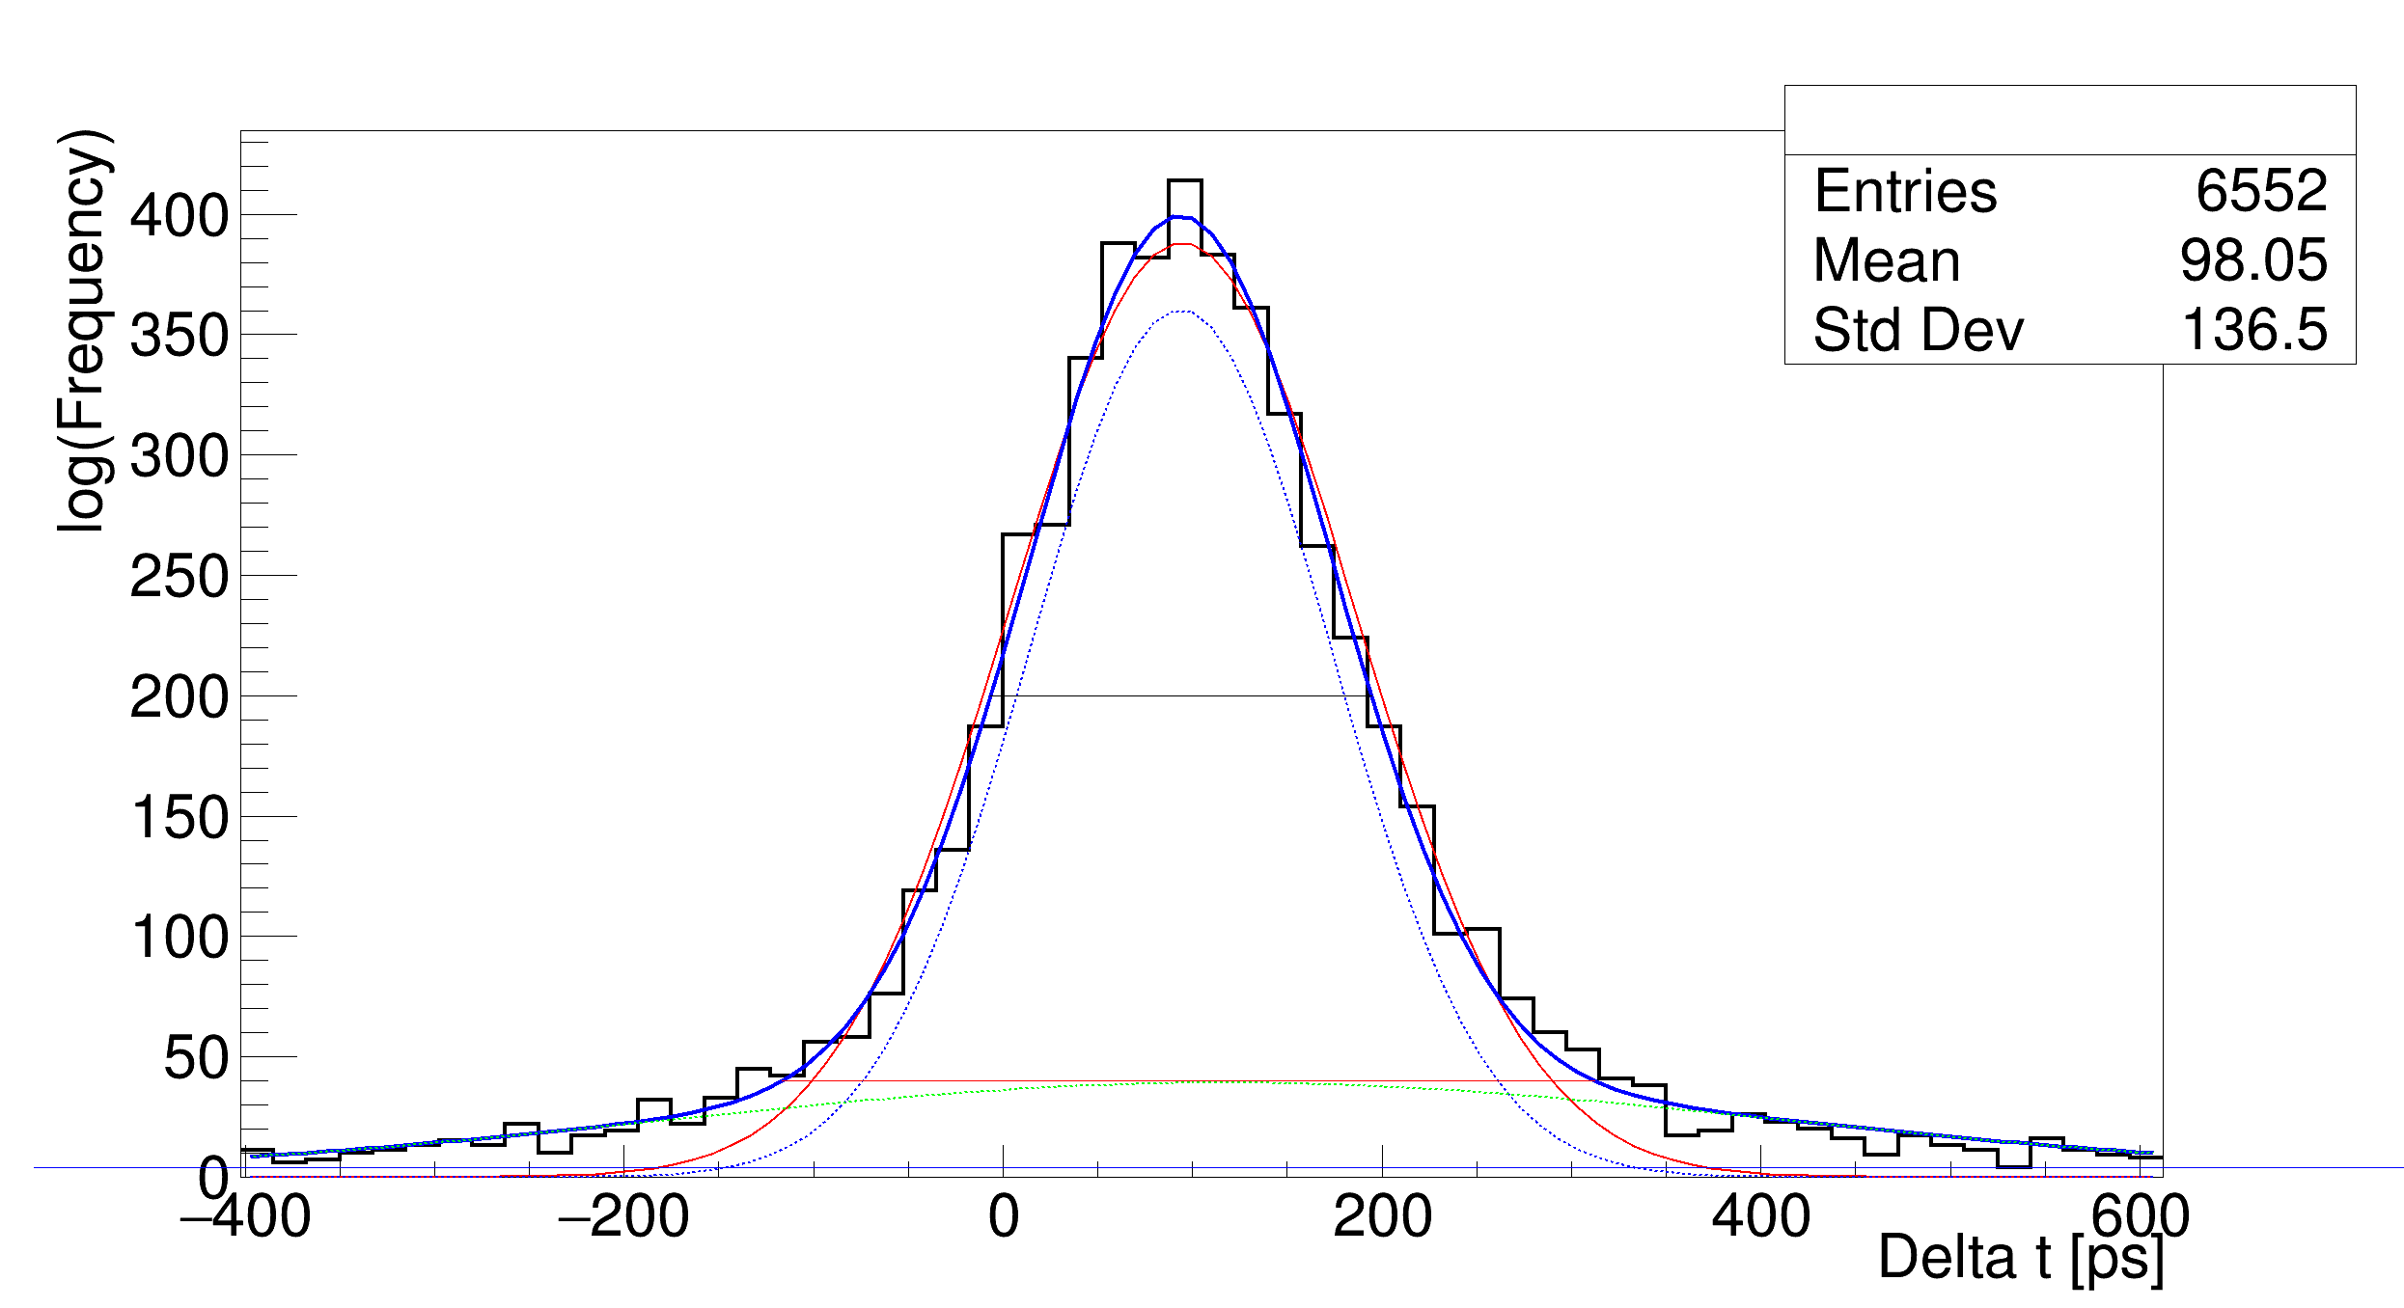
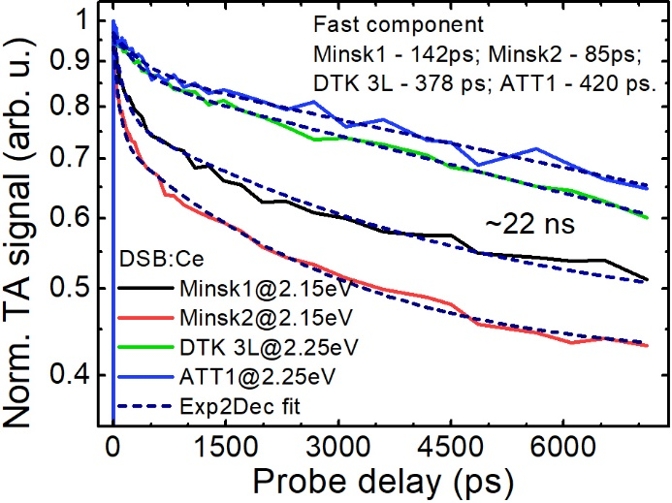
Scintillating properties characterization
Radio-luminescence spectra
Scintillation kinetics
Results of Milano-Bicoca Uni
Time delay distribution between two identical channels at CTR measurement acquired at RT and 10 mV leading edge threshold
Transient absorption kinetics
Results of Vilnius Uni
FWHM = 215 ps
Results of CERN
The decay time of the slow component is ~22 ns for all the samples

Slide 15
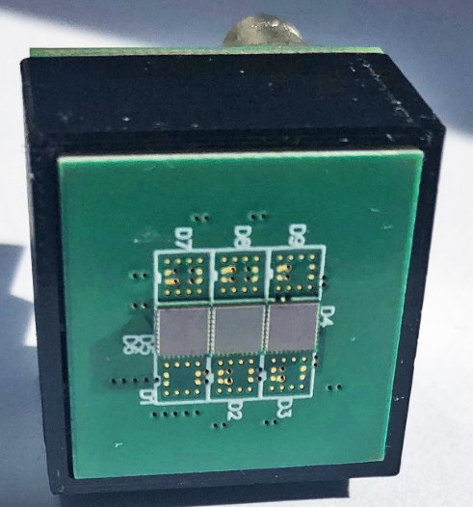
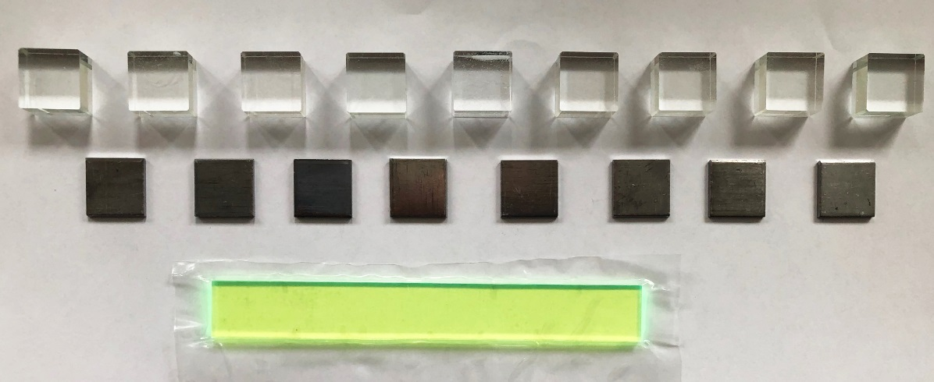
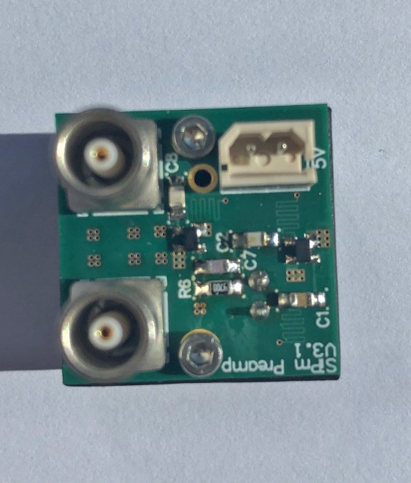
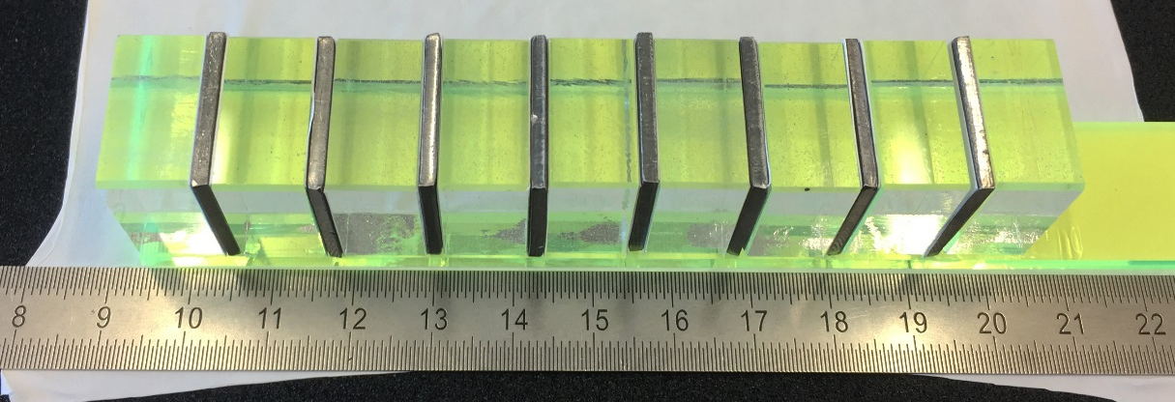
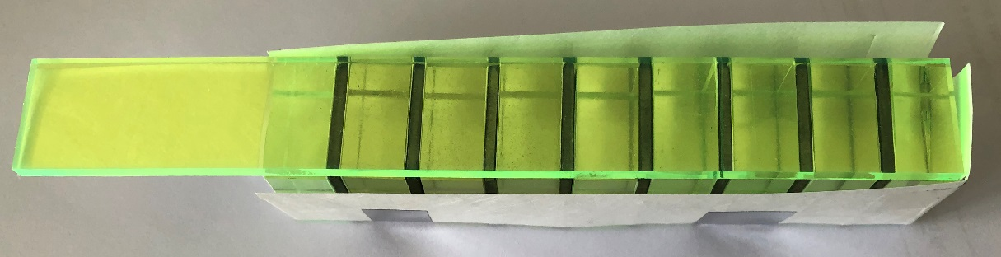
the first sampling prototype
photosensor
3 SiPMs
KETEK
PM3325-WB-D0
3 x 3 mm²
25µm
9 DSB:Ce
20x20x10mm³
WLS: EJ-280-10
Eljen
20x3x150mm³
Pb 20x20x1mm³

Slide 16
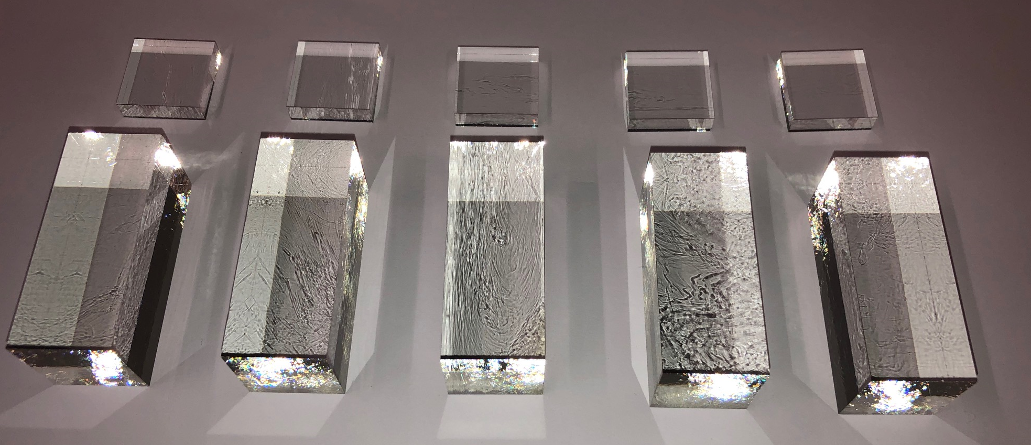
Samples produced by alternative industrial partner –
Company Scott (Germany), October 2021
Two types of the glass materials have been delivered and tested:
5 samples with 20x20x5 mm³ dimensions;
5 samples with 20x20x50 mm³ dimensions;

Slide 17
Samples produced by alternative industrial partner –
Company Schott (Germany), October 2021
Irradiation with gamma-quanta ⁶⁰Co source, doses: 100 and 500 Gy

Slide 18
Properties evolution

Slide 19
(Gd,Ce)₂O₃-Al₂O₃-SiO₂ scintillation glass
Results obtained by Kurchatov and Minsk groups. Published in Journal of non-Crystalline Solid V. 580 March 2022, https://doi.org/10.1016/j.jnoncrysol.2021.121393
Following glass composition was chosen: 2.267SiO₂ - 0.078Si₃N₄ - 0.6Al₂O₃ - 0.065AlF₃- (Gd_{1-x}Ce_{x})₂O₃
Cation composition of the glass, at. % |  |  |  |  |  |  | Kinetics parameters |  |  |  |  |  | Light Yield, ph/MeV
Sample Nr. | SiO2 | AlO1.5 | AlF3 | CeO1.5 | GdO1.5 | BaO | t1 | f1 | t2 | f2 | t3 | f3
1 | 54.82 | - | 2.45 | 1.32 | 22.72 | 18.7 | - | - | 90.8 | 45 | 415.6 | 55 | 2500
2 | 48.38 | 11.12 | 1.26 | 2.16 | 37.09 | - | - | - | 98.9 | 58.88 | 379.2 | 41.12 | 2000
3 | 48.11 | 11.75 | 1.24 | 3.25 | 35.65 | - | - | - | 96.6 | 61.32 | 317.5 | 38.68 | 1700
4 | 48.41 | 11.62 | 1.25 | 4.84 | 33.89 | - | 43.3 | 41.5 | 92 | 28.46 | 340.7 | 30.04 | 1800
5 | 48.41 | 11.62 | 1.25 | 5.81 | 32.92 | - | 40.9 | 64.05 | 90.8 | 35.95 | - | - | 1900
6 | 48.41 | 11.62 | 1.25 | 5.81 | 32.92 | - | 30.25 | 19.43 | 64.5 | 60.85 | 185.1 | 19.72 | 2000
with Ba
w/o Ba
The glass density of all the samples was measured to be 4.5 ± 0.1 g/cm3, which provides an effective charge Z_{eff}=52 and puts it in the line for the stopping power to ionizing radiation with alkali-halide and some oxide crystalline materials of the garnet and perovskite structure.
Optical absorption spectra of the samples #2-#5 measured at room temperature
Average scintillation time and light yield
Acknowledgments to Prof. Mikhail Korjik (INP BSU, Minsk)

Slide 20
Ba-less (Gd,Ce)₂O₃-Al₂O₃-SiO₂ scintillation glass
Photoluminescence excitation (λ_{em} = 430, 470 nm) and photoluminescence (λex = 330, 370 nm) of Gd-Si-Al: Ce glass
Pulse height spectra under 137Cs (662 keV) source of the Gd-Si-Al: Ce glass sample #6, with dimensions 15×15×3 mm3 (◆) and
Ba-Gd-Si glass sample with dimensions 20×20×5 mm3 (■)
Scintillation kinetics of the sample #6 measured at room temperature.
New scintillation Ce³⁺ -doped Gd2O3-Al2O3-SiO2 glass has demonstrated scintillation
kinetics with an average decay time 60 ns and a light yield ~2000 photon/MeV.
A Amelina, A Mikhalin, S Belus, A Bondarev et al, Journal of Non-Crystalline Solids 2022, 580, 121393, /doi.org/10.1016/j.jnoncrysol.2021.121393

Slide 21
Cost consideration of the ”non-human” drivers
Cost driver | Examples of the prices | Comment
Raw material | Gd oxide ~50 usd/kg S- oxide –less than 50 usd/kg Ba oxide- less than 30 usd/kg Al oxide-less than 10 usd/kg | All oxides of needed purity are commercially available
Crucible material | Not necessary Pt, Carbon glass can be a good alternative | Cheaper than Pt by factor 10
Energy | Low energy consuming process per kg of the glass mass produced | High rate of the commercial glass mass production
Mechanical treatment | Lower than for single crystals | Can be worked in the mold. So, the waste at mechanical treatment may be minimised

Slide 22
Conclusions
The gadolinium based glass materials are relatively cheap and can be produced at many glass-working facilities. Properties can be adopted to application conditions. It has 3-4 times higher density in comparison to plastic scintillators allowing variable scintillator shapes
Significant progress in technology optimization of the glass scintillation material was achieved
The Gd loaded DSB glass has higher density in comparison with barium-silica DSB glass.
Light yield value was increased due to further technology optimization:
2500 ph/MeV(with Gd) vs 500 ph/MeV (without Gd)
Further technology optimization showed possible improvement of the timing characteristics of the material without significant degradation of the light yield:
< τ > = 60 ns, LY = 2000 ph/MeV
High Gd contamination opens up an opportunity for neutron detection as well

