Slide 1
CALVISION Simulation Updates
with
dd4hep, CaTS, and Muon/ILCSoft
Wonyong Chung
Sept 2022

Slide 2
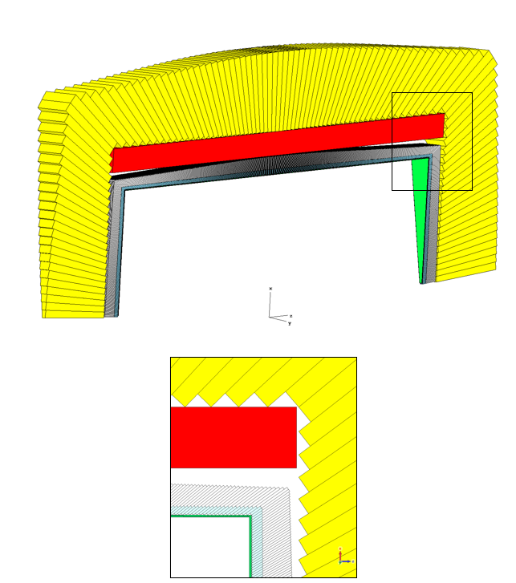
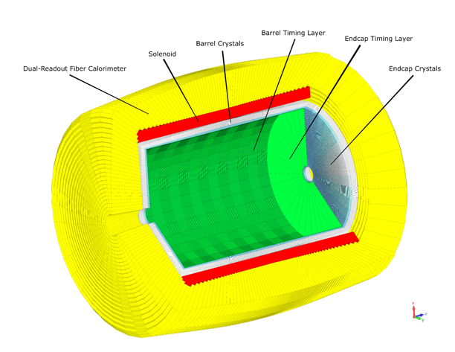
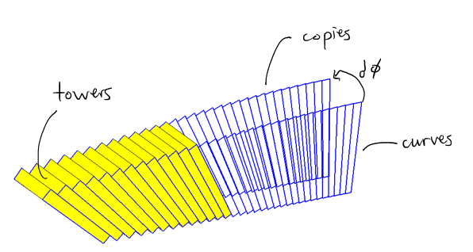
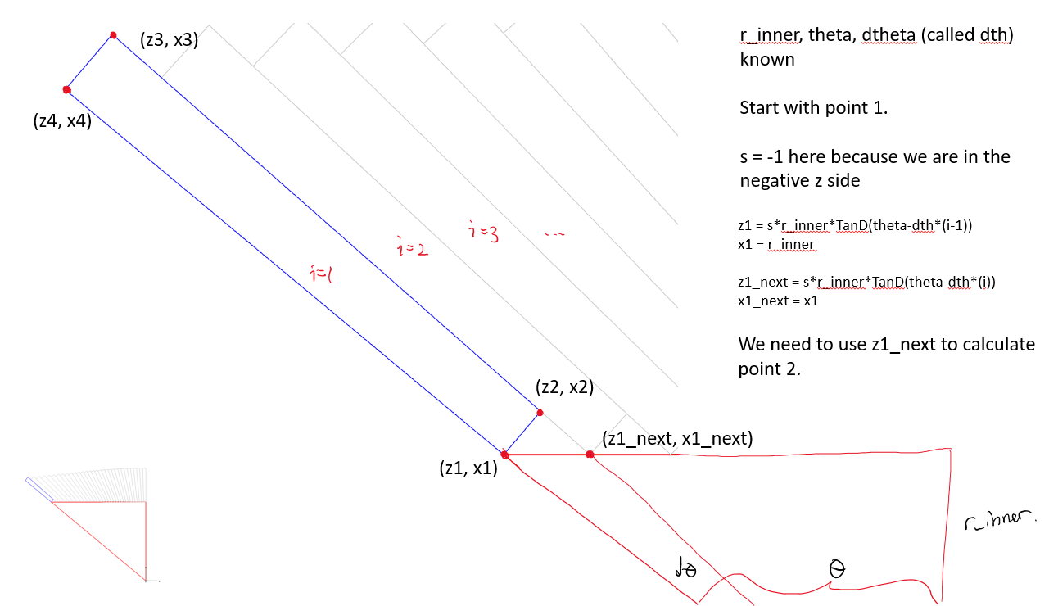
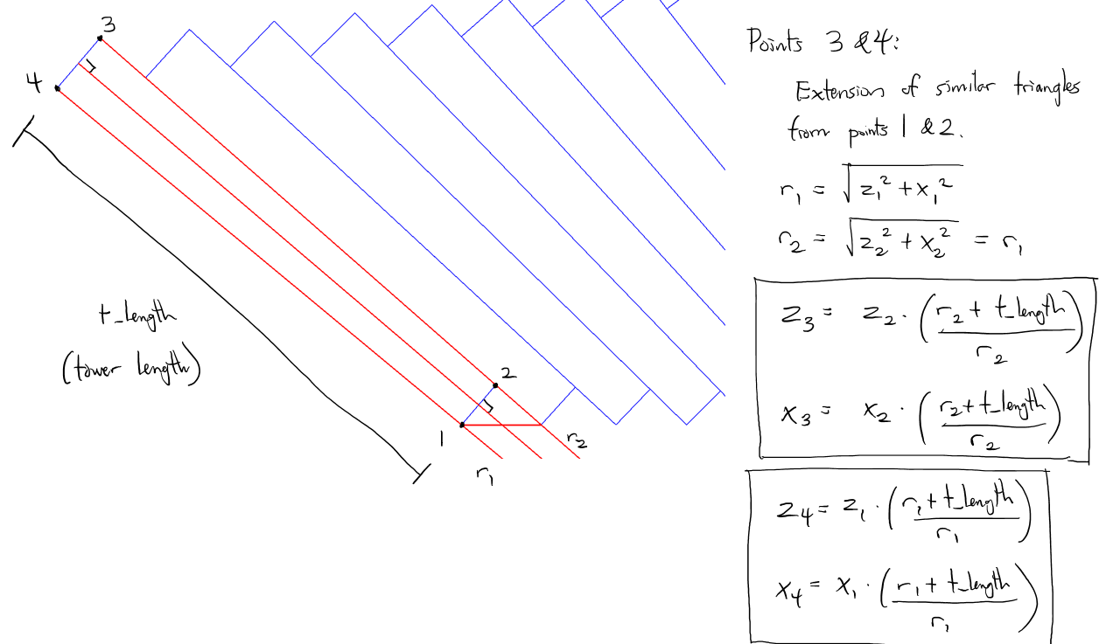
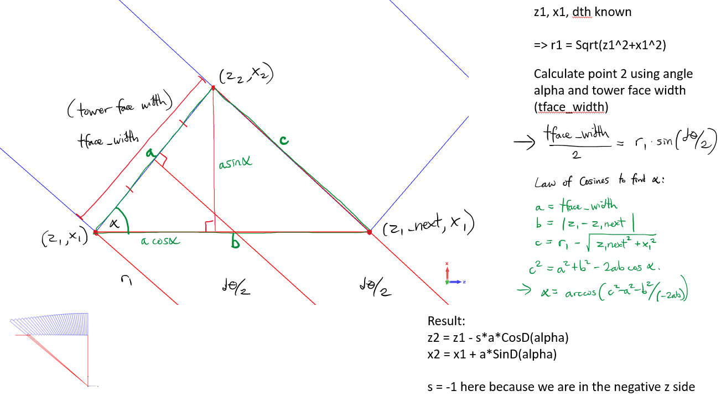
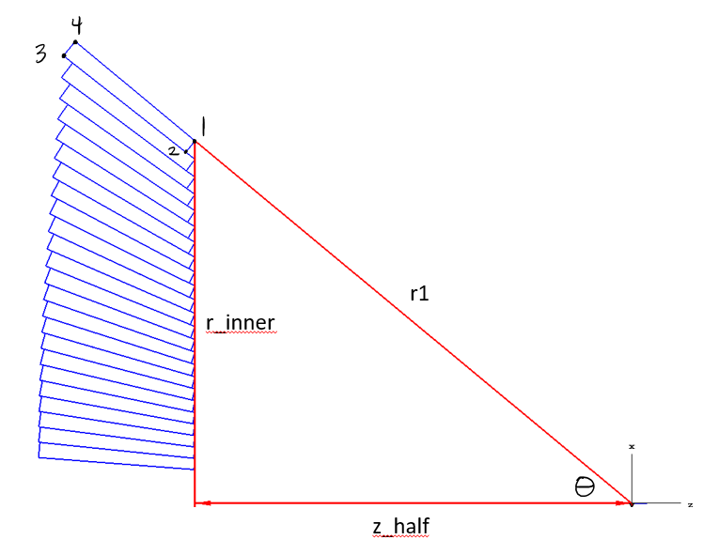
Summary
Testing full geometry performance/usability in dd4hep, CaTS, and Muon/ILCSoft
Have a “cookbook” for the geometry, so mainly a matter of fitting it into these new programs (WIP)
All still based on geant4 but easier to use
(Initial) setup effort is still about the same as a pure geant4 sim
High-level XML configs should make collab. easier after initial time investment
Aiming for new benchmarks to test Higgs self-coupling

Slide 3
Setup
WSL2 (Windows Subsystem for Linux) on Windows 11
Debian
NVIDIA graphics drivers, X11 forwarding may cause hiccups
Tried first on macOS with a range of old and new package managers (homebrew, macports, spack, conda, ...)
All advertised themselves to be slick solutions, all eventually broke as dependency chains got longer/had stricter requirements
Compiling from source gives peace of mind

Slide 4
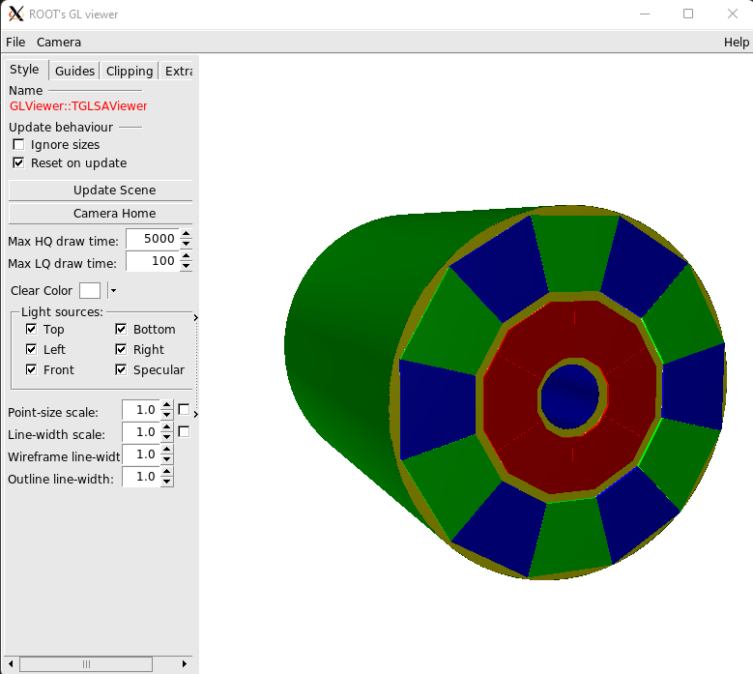
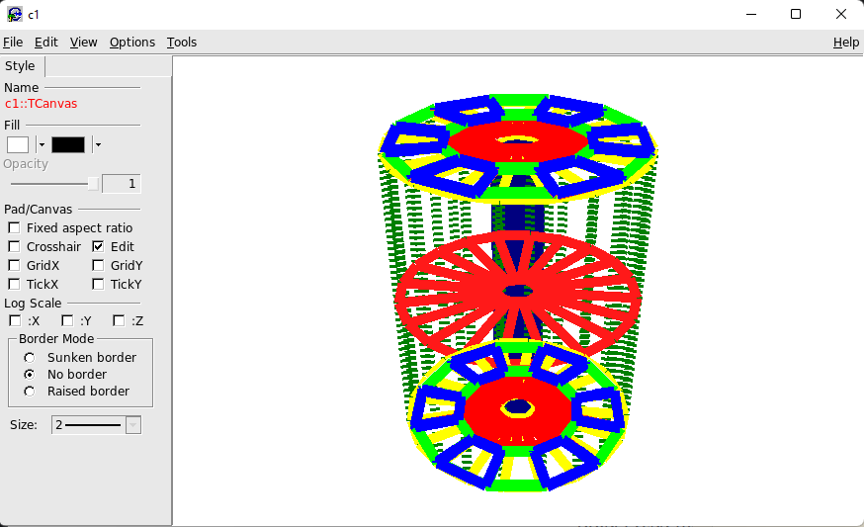
dd4hep
Works
Mix of XML configs and C++
Define custom detector components/shapes in C++
Use them as XML elements in high-level config
Better separation/abstraction, shorter config files, reduced code duplication
But still about the same initial effort as pure geant4
Rest of dd framework on alignment, timing, reco, evt display, should be promising
dd4hep AlephTPC example

Slide 5
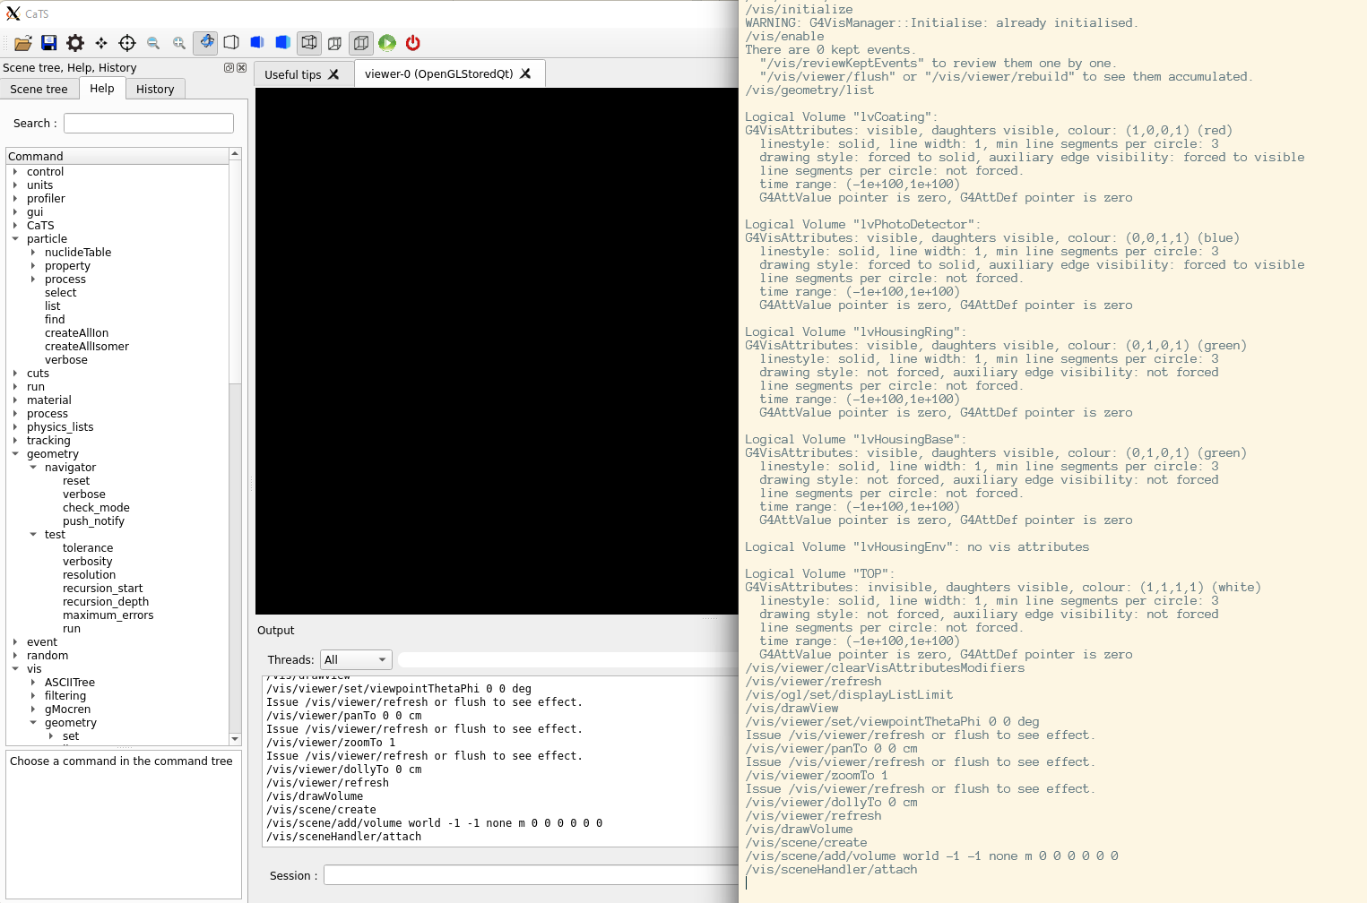
CaTS
Built on top of Geant4
Simulation works, but graphics may be buggy thru X11
Uses ray-tracing capabilities of newer GPUs for photons (Optick)
Uses geant4 gdml XML configs for geometry, G4 macros for sim
GUI performance is good

Slide 6
Muon/ILCSoft
Next up to try

