Slide 1
PIP-2 Linac Complex Process Power Arc Flash/Load Flow Analysis
Luis Bravo
Supervisor: Ryan Crawford
Northern Illinois University – Aspire Fellow
7/28/22

Slide 2
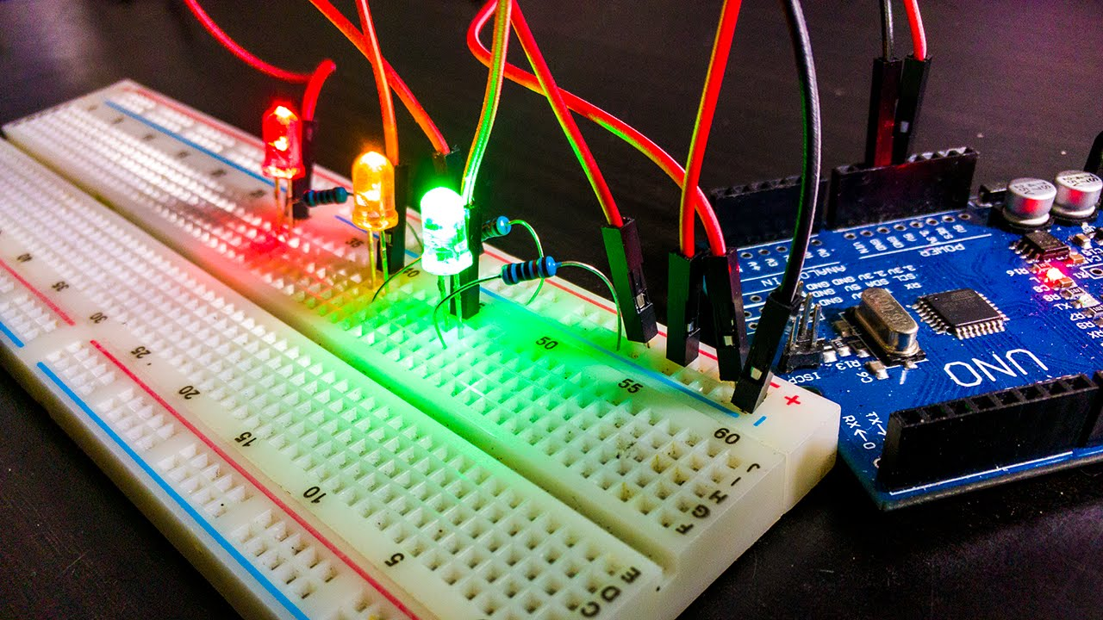
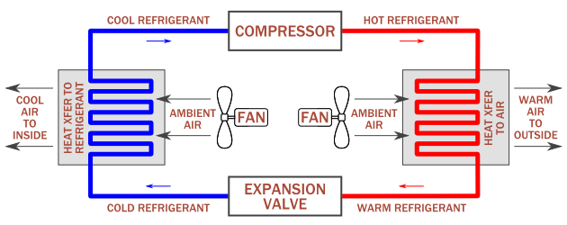
About Me
Luis Bravo
Northern Illinois University
Expected Graduation May 2023
Electrical Engineering Major
Aspire Fellow
Worked in HVAC and Maintenance ~ 6 years

Slide 3
Outline
PIP 2 Linac Complex Process Power
Etap Program
Load Flow Analysis
Arc flash/Blast information
Arc flash/short circuit analysis
NFPA labels on dangers from calculated results

Slide 4
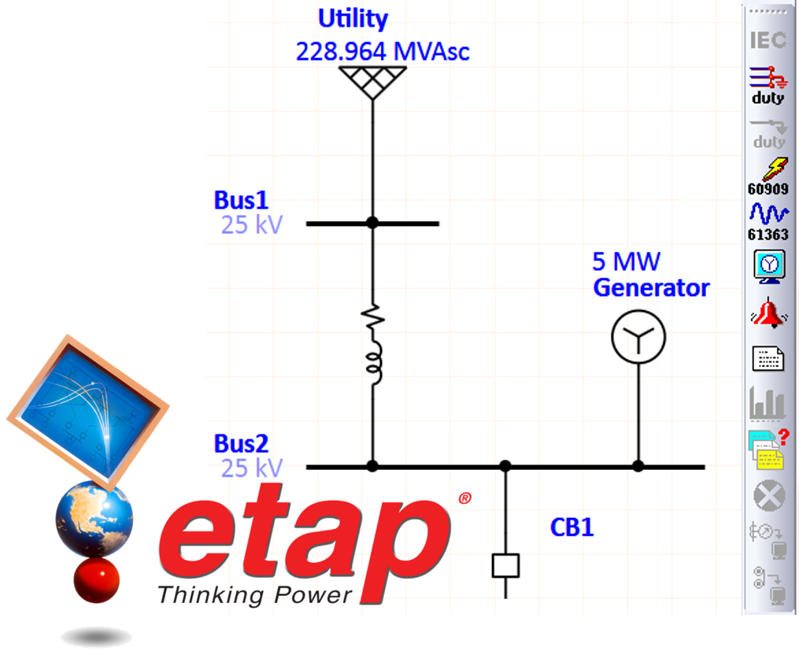
ETAP (Electrical Transient Analyzer Program)
Electrical Transient Analyzer Program is a software used making schematic and analyzing Single Line Electrical Diagrams (SLEDS)
SLEDs are the simplest symbolic representation of an electrical power system
A single line in the diagram often represent more than one conductor for simplicity and ease of view
Electrical components in three phase systems such as circuit breakers, transformers, capacitors, and bus bars are shown connected to a single line in the diagram to represent all three phases in application
Electrical components in DC also show only 1 conductor representing the supply and return paths
ETAP is used in a wide range of industries including generation, transmission, distribution, industrial, transportation, and Low Voltage.
Load Flow AC/DC analysis
IEEE, ICEA, NEC requirement tools
Renewables
Panel Schedules

Slide 5
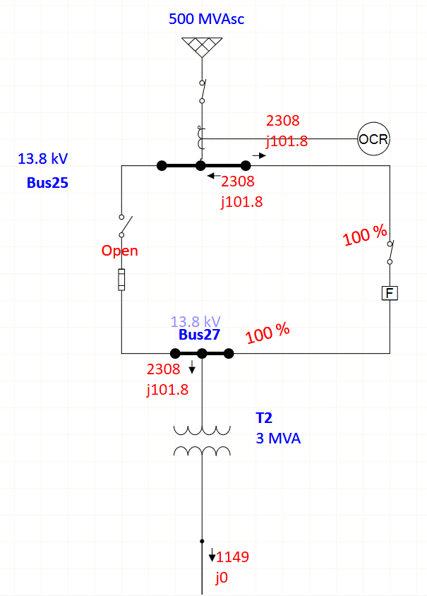
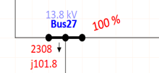
Load Flow Analysis
Load Flow analysis is a fundamental analysis
ETAP has the capability to simulate and calculate bus voltages, branch power factors, currents, and the flow of power throughout the electrical system
The red numbers represent the percentage of the power that flows through along with the real power number being P(Watts) and the imaginary part being Q (Reactance)
(2308+j101.8) = complex power

Slide 6
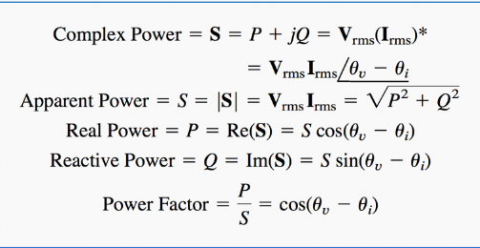
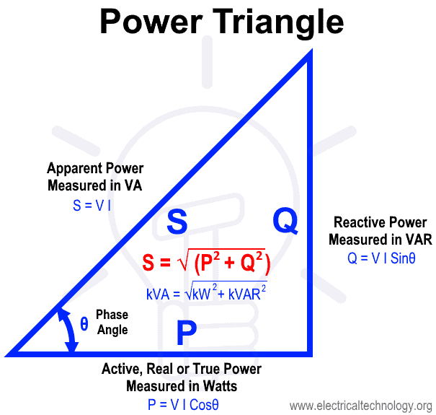
Load Flow Analysis (Cont.)
ETAP along with other engineering programs save a lot of time doing calculations and simulations
Very impressive Verified and Validated(V&V) results from Etap test groups compared to the published case studies
Less than 1% difference in calculations for ETAP vs Published study results for load flow
ETAP results and the MATLAB hand calculated results have a percent difference less than 0.001% in all cases for Arc flash

Slide 7
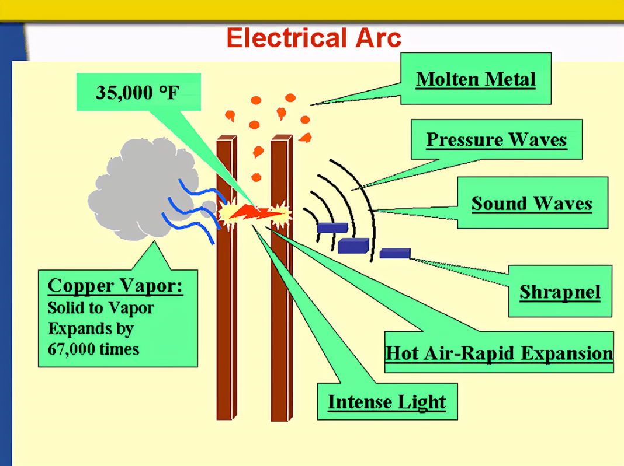
What is Arc flash/Arc blast?
Electrical current flowing through air gap (ionized air)
Turning on and off equipment (high voltage switches)
phase to phase or phase to ground
Arc flash temperatures can reach 19,400 C (35,000 F)
Arc flash is specifically the heat and light produced by the arc fault(skin burns and vaporization of metals may occur etc.)
Arc blast is the mechanical supersonic shockwave(Hearing loss due to pressure wave, blasts from debris etc.)

Slide 8
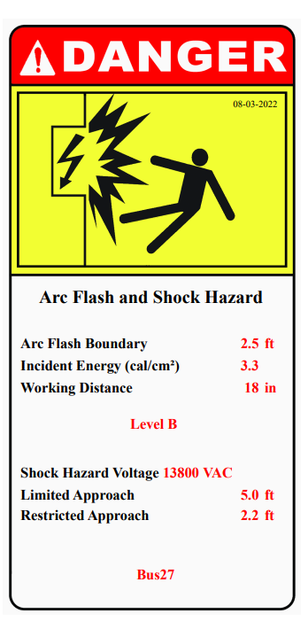
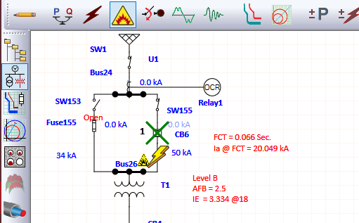
Arc Flash/ Short Circuit Analysis (Cont.)
Arc flash Boundary
Incident energies
PPE classification
Labels generated from etap along with simulation

Slide 9
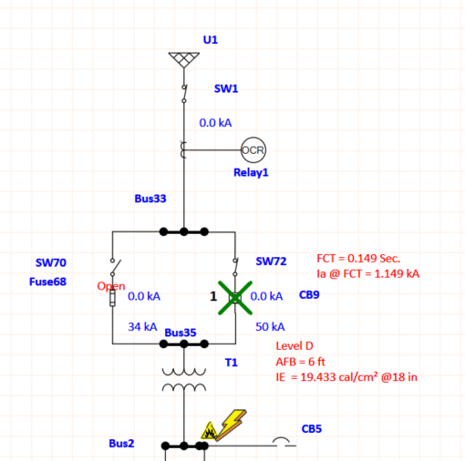
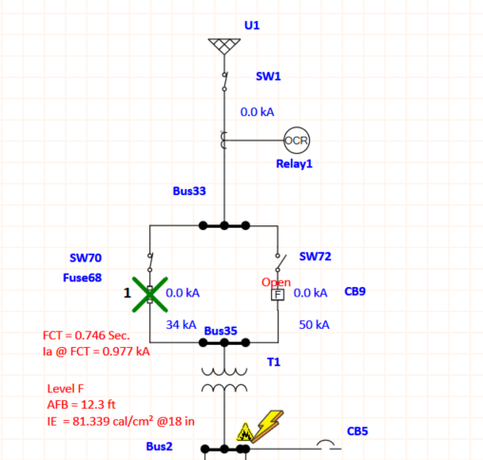
Arc Flash/ Short Circuit Analysis (example fuse vs circuit breaker)
PIP 2 LINAC Complex
Process Power Service A
 |  | IE(calories/cm²) |  | Fault Clearing Time(second) | AFB(ft) | I_{arc}(kA)
Fuse |  | 81.39 |  | 0.746 | 12.3 | 0.977
Circuit Breaker |  | 19.43 |  | 0.149 | 6 | 1.149

Slide 10
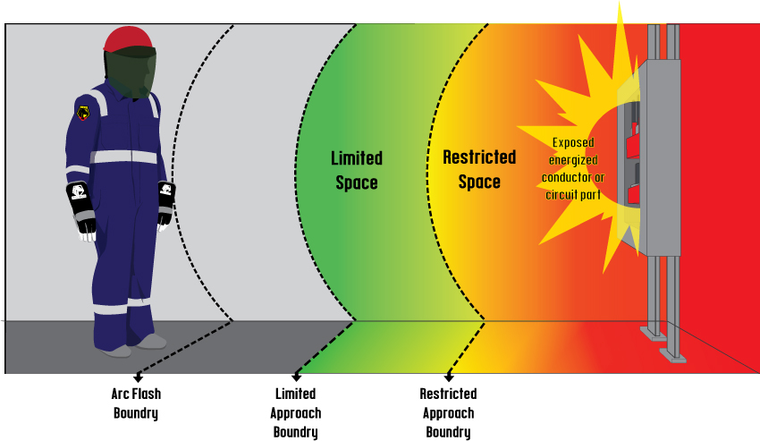
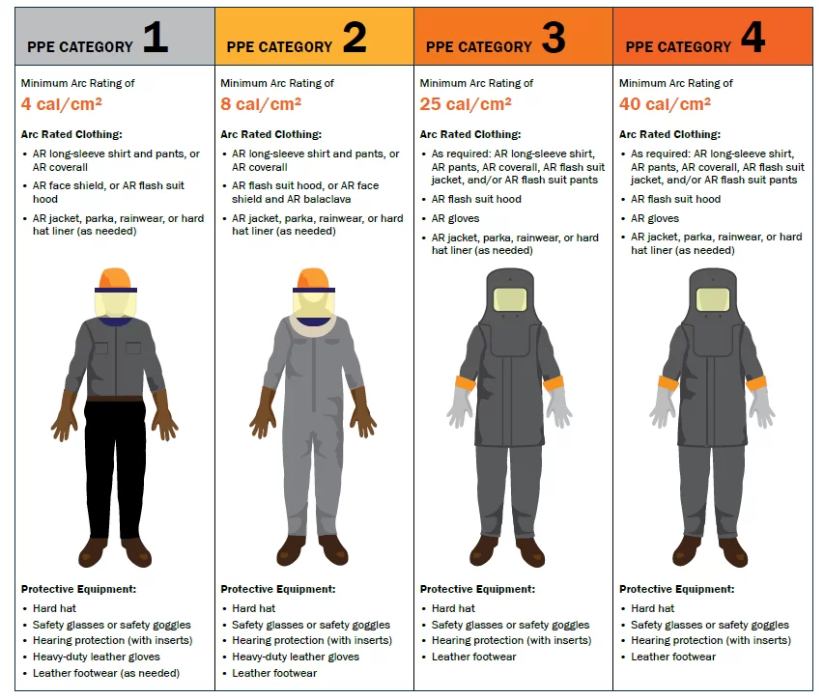
PPE for Arc Flash/Blast
Etap quickly assesses incident energies along with arc flash boundaries
Creates safety labels enforced by NFPA and OSHA

Slide 11
Moving Forward
Do arc flash and load flow analysis on all projects
Compare results with different power system devices to lower the incident energy and speed up FCT
Have documentation for all pieces of equipment with data from arc flash and load flow analysis
With more documentation and labels, we can make Fermilab a safer place

Slide 12
Acknowledgement
Thank you to
Ryan Crawford, Chris Jensen, and Ramfis Colon for their guidance and opportunity to be part of the team to work on PIP2
All the engineers on the team including Matthew Davidson, Siddharth Poopathi, Peter Drechsler, Ty Omark, Nick Gurley, and Dennis Barak for helping me with any issues I came across and very willingly passing along a lot of knowledge
The whole Team that coordinates the internships along with all the people that helped with the process and made this opportunity a reality

Slide 13
Questions?

Slide 14
Case study #1 for Load Flow Calculations (Etap vs Published results) extra slides

Slide 15
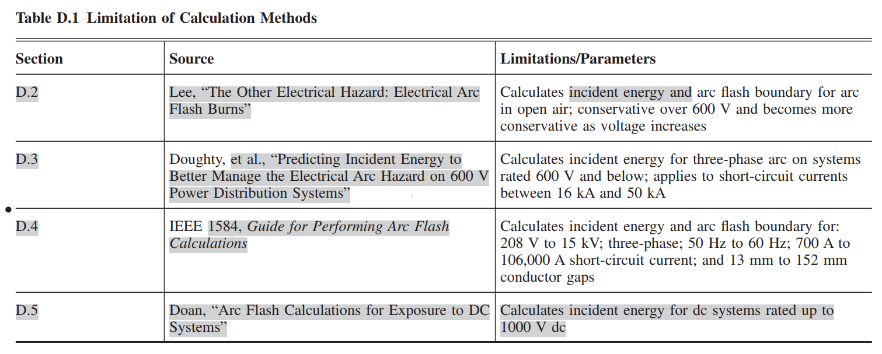
Arc Flash/ Short Circuit Analysis extra slides
15 years of development for all arc flash analysis in Etap
AC/DC Arc flash analysis
IEEE 1584 Method
Ralph Lee Method
Doughty Method
Doan Method

