Slide 1



Flexible Pilot Jobs Framework for Distributed High Throughput Computing
Candidate: Franco Terranova
Supervisor: Marco Mambelli
Fermilab Italian Summer School 2022
29/08/2022

Slide 2
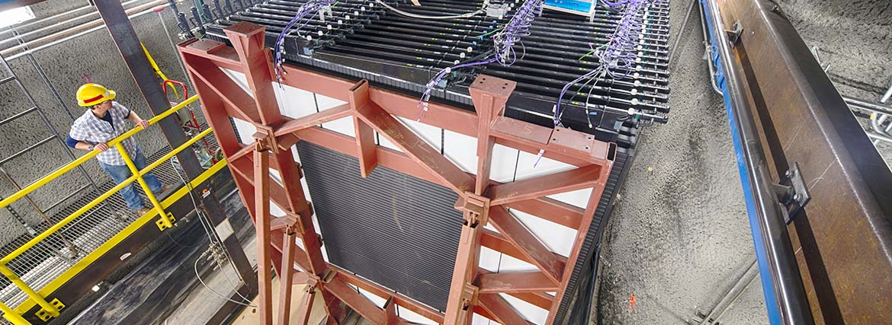
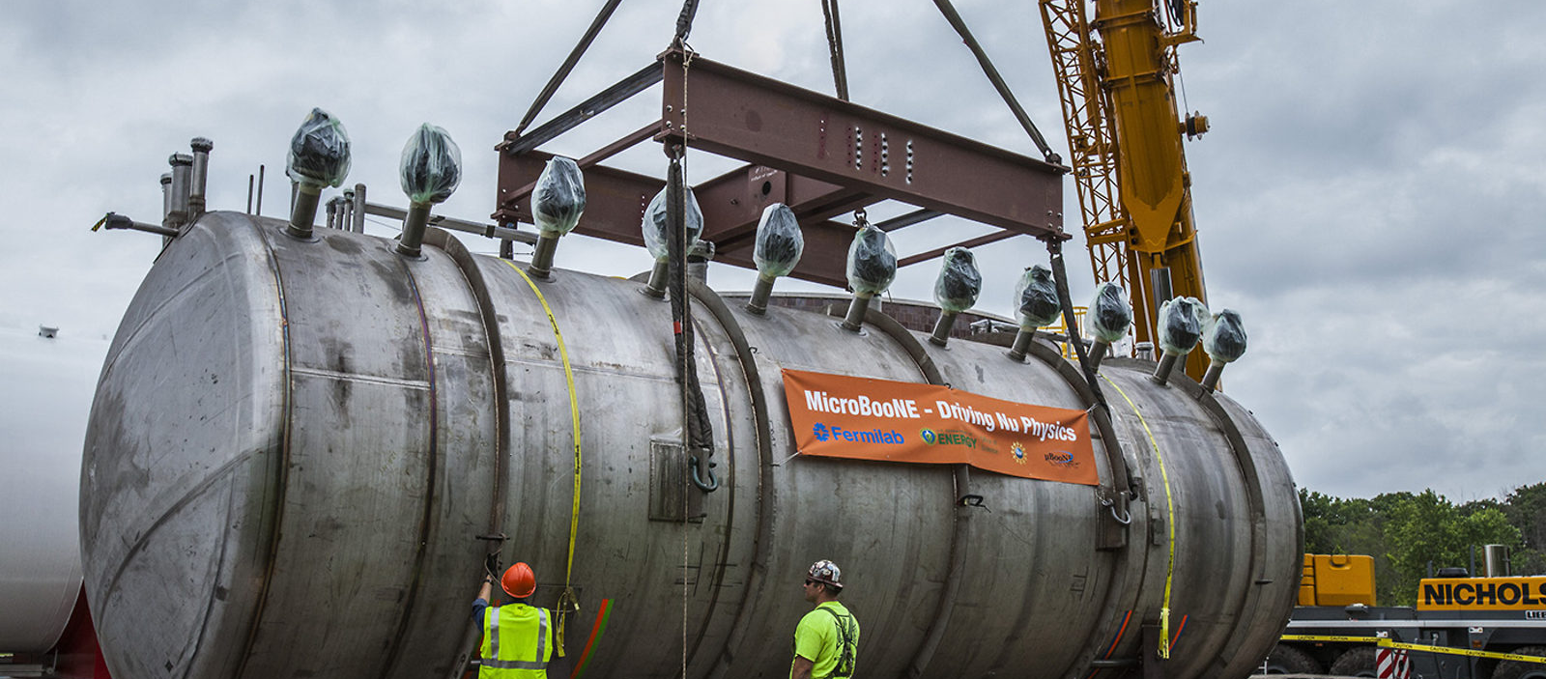
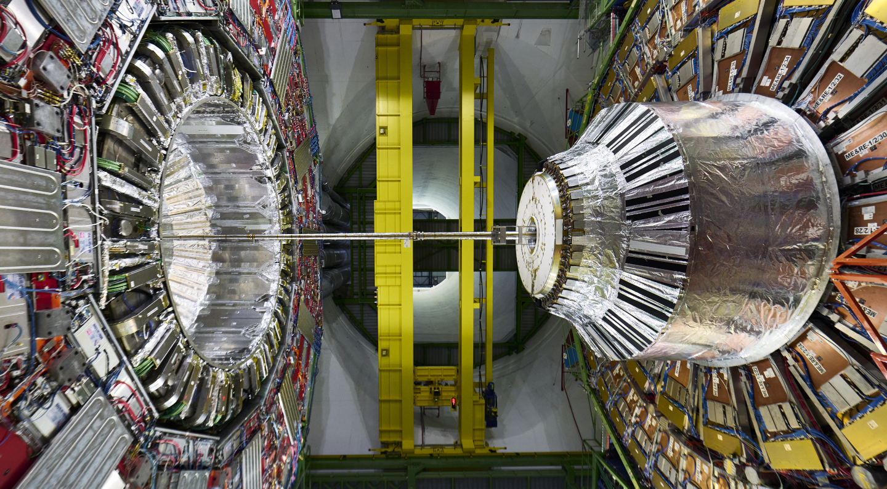
Computing resources as support to
HEP experiments
Scientific data stored at Fermilab: 266 Petabytes!
CMS, 89.69 Petabytes
NOVA, 53.65 Petabytes
uBoone, 28.48 Petabytes
gm2
CDF
….

Slide 3

Computing resources as support to HEP experiments
Solution: leveraging multiple computers, often geographically distributed
but connected by networks, to work together to accomplish joint tasks.
Grid Computing can incorporate grid sites (batch systems) on universities
and labs across the world into one grid, enabling distributed high-throughput
computing.
«We strive to deliver timely, innovative computing solutions and services that enable Fermilab to achieve its scientific mission, efficiently execute the business of the laboratory and provide a modern user experience.»
3

Slide 4
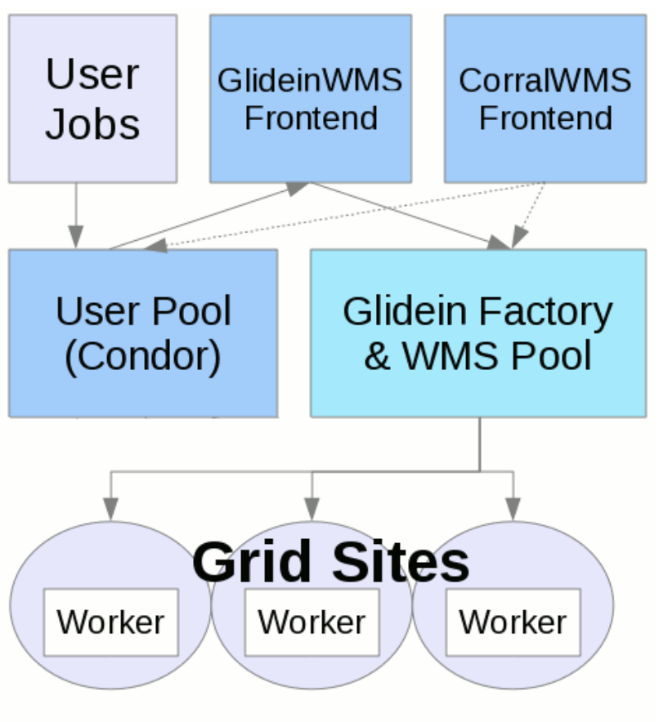
GlideinWMS
GlideinWMS is a Glidein Based Workload Management System that works on top of HTCondor.
The GlideinWMS is made of several services and its purpose is to provide a simple way to access Grid resources, submitting pilots to unreliable heterogeneous resources.
The result is that users can submit regular HTCondor jobs and the computing resources will be provided behind the scenes.

Slide 5
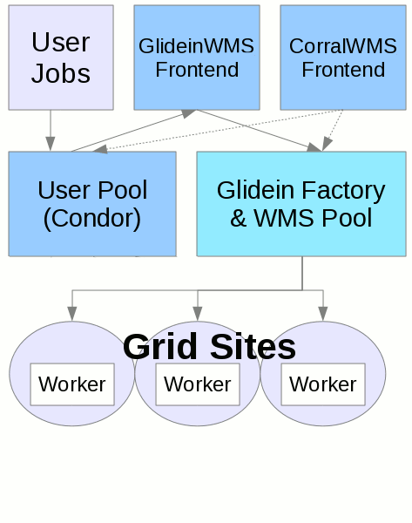
GlideinWMS
GlideinWMS is a Glidein Based Workload Management System that works on top of HTCondor.
The GlideinWMS is made of several services and its purpose is to provide a simple way to access Grid resources, submitting pilots to unreliable heterogeneous resources.
The result is that users can submit regular HTCondor jobs and the computing resources will be provided behind the scenes.

Slide 6





Worker nodes
A worker node is a machine managed by a resource manager characterized by its resources (CPU, RAM, Disk, etc.).
Virtualization allows you to take one piece of machinery and make it act like multiple pieces, increasing IT agility,
flexibility and scalability while creating significant cost savings.
Virtualization of computers as complete hardware platforms, certain logical abstractions of their componentry, or only
the functionality required to run various operating systems.

Slide 7

Glidein
A Glidein is a pilot submitted on the worker node that acquire and prepare the resources where the job will run.
Validates the worker node and test resources
Customizes the worker node (environment, libraries, containers, etc.)
They are requested by the Frontend, launched by the Factory and joins the virtual cluster.
VM
Glidein
HTCondor startd
job
glidein_startup.sh
Worker Node

Slide 8
glidein_startup.sh modularization
Modular programming is a software design technique that emphasizes separating the functionality of a
program into independent, interchangeable modules.
glidein_startup.sh
glidein_cleanup.sh
utils_io.sh
utils_crypto.sh
utils_tarballs.sh
utils_signals.sh
utils_filesystem.sh
glidein_startup.sh
~2083 lines of code
utils_params.sh
utils_xml.sh
utils_http.sh

Slide 9
glidein_startup.sh
glidein_startup.sh
do_start_all
spawn_multiple_glideins
setup_OSG_globus
create_glidein_config
get_data
source_data
list_data
extract_all_data
_main
glidein_cleanup.sh
glidein_cleanup
early_glidein_failure
glidein_exit
utils_gs_log.sh
print_tail
usage
print_header
parse_options
parse_arguments
utils_log.sh
log_warn
log_debug
print_header_line
utils_signals.sh
signal_trap_with_arg
signal_on_die
signal_ignore
utils_gs_signals.sh
signal_on_die_multi
utils_gs_tarballs.sh
get_untar_subdir
fixup_condor_dir
utils_params.sh
params_get_simple
params_decode
params2file
utils_crypto.sh
md5wrapper
check_file_signature
set_proxy_fullpath

Slide 10
glidein_startup.sh
utils_gs_filesystem.sh
automatic_work_dir
dir_id
prepare_workdir
add_to_path
copy_all
utils_gs_http.sh
get_repository_url
add_periodic_script
fetch_file_regular
fetch_file
fetch_file_try
fetch_file_base
perform_wget
perform_curl
utils_xml.sh
construct_xml
extract_parent_fname
extract_parent_xml_detail
basexml2simplexml
simplexml2longxml
create_xml

Slide 11
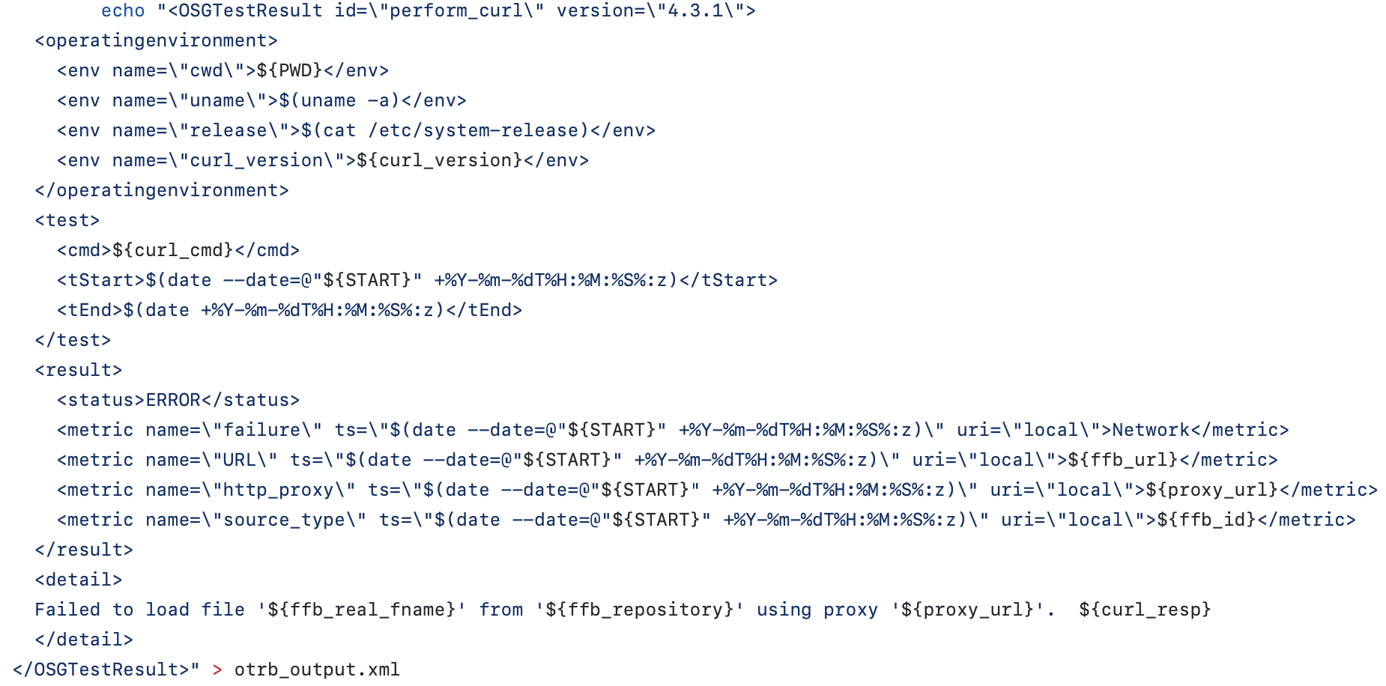
create_xml
usage: create_xml tag [--option option_value] .... [tag_value] [tag2 ..... { inner_tag ….. } ]
create_xml OSG --id perform_curl { oe { e --name cwd "${PWD}" e --name uname "$(uname -a)" e --name release "$(cat /etc/system-release)" e --name curl_version "${curl_version}" }

Slide 12
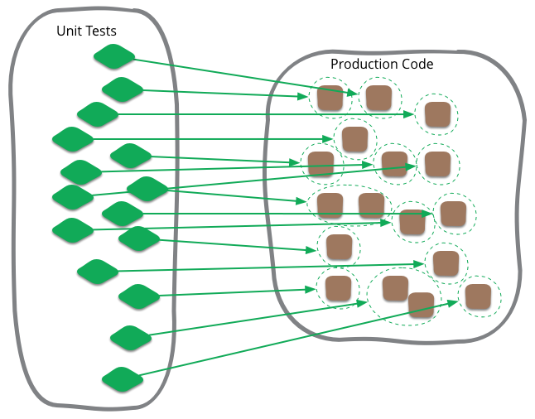
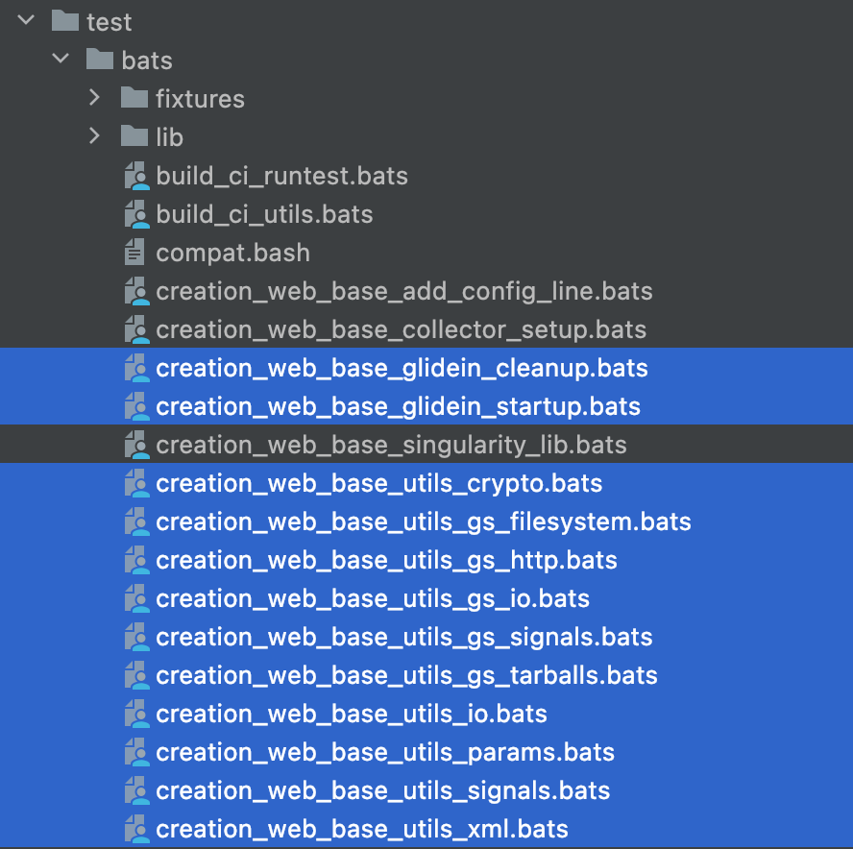
Bats Tests
Bats is a TAP-compliant testing framework for Bash.
It provides a simple way to verify that the UNIX programs behave as expected using unit tests.
bats tests
bash scripts

Slide 13

Bats Tests’ Timeout Feature
The runtest.sh script is a runner script for the different tests.
I’ve added the timeout feature to the script in order to avoid possible problems of non-responding tests.
-k TOUT
set a timeout of TOUT seconds for the execution of each test (BATS file).
A TERM signal is sent if the test is still running after TOUT seconds and a
hard kill (KILL signal) is sent 20 seconds after that if the test did not end.

Slide 14
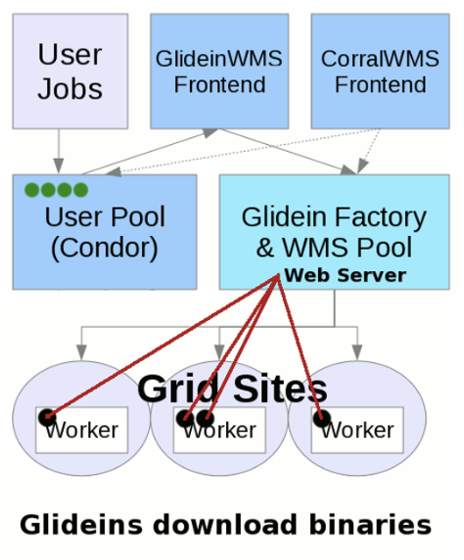
External files management in Glidein
<files>
<file absfname="filepath" relfname="filename" prefix="cron_prefix" executable="boolean" after_group="boolean" period="seconds(int)" />
…
</files>
The file parameters are used to specify the location, the download/execution order and attributes of additional files.
The script/file will be copied to the Web-accessible area and added to one of the glidein's file lists, and when a glidein starts, the glidein startup script will pull it, validate it and execute any action requested (execute, untar, just keep it, ...). after_entry and after_group can be used to affect the execution order.

Slide 15
External files management in Glidein
Improvements:
Execution of custom scripts during different parts of the lifecycle of the glidein
Coordination of the list of custom scripts
Definement of new files attributes
Definement of new methods for transferring script files

Slide 16
New release
release 3.11.0

Slide 17
Other subtasks
Review of the manual installation guide of the GlideinWMS Frontend and Factory
Installation and troubleshooting of the GlideinWMS Frontend and Factory in OpenStack VMs

Slide 18
Accomplished achievements:
Designed a flexible, modular and customizable structure of the glidein
Added unit tests
Redesigned the custom script management

Slide 19
Q&A
Session

