Slide 1
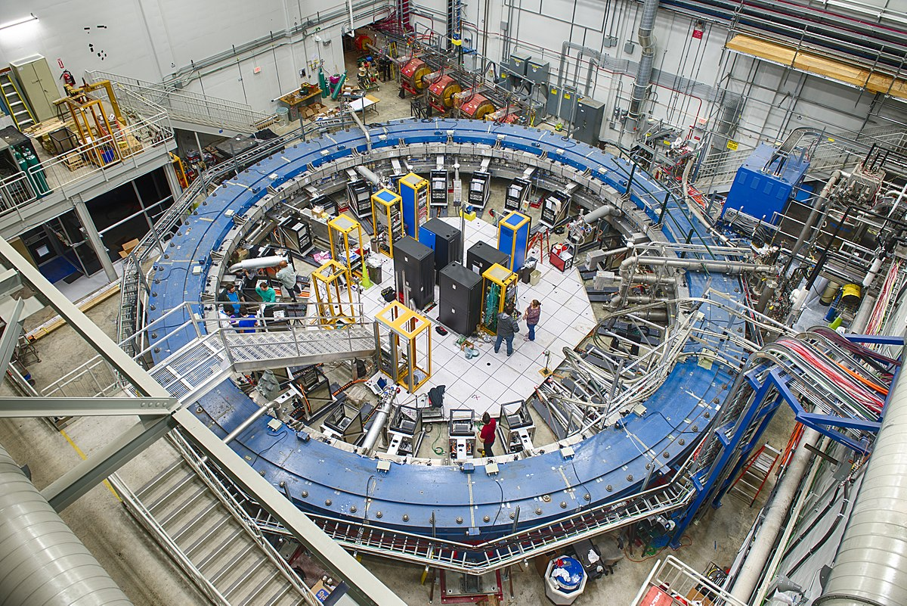
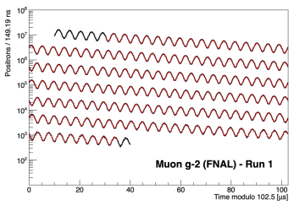
Analysis of the muon’s spin anomalous precession frequency
Midterm Report
Daniele Boccanfuso
29/08/2022

Slide 2
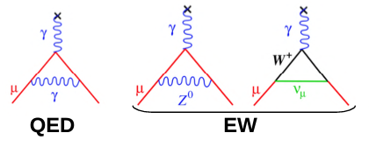
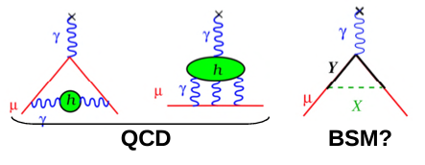
The muon magnetic moment
The muon’s magnetic moment is given by$\vec{μ}=g\frac{q}{2m}\vec{S}$
The g-factor of an elementary particle is predicted to be 2 at the first order. Higher order corrections shift this value by ~${10}^{−3}$.
We define the muon anomaly as:
$a_{μ}=\frac{g−2}{2}$
All particles interacting with the muon (high order loops) contribute to $a_{μ},$ even the ones we haven’t discovered yet! This makes any discrepancy between the theoretical and experimental value of $a_{μ}$ hint of new physics.
Notes:
The muon has a magnetic moment defined by this formula, the g-factor is predicted to be 2 at tree-level for every elementary particle like the muon, the corrections introduced by higher order loops shift this values by approximately 10 to the minus 3. This deviation is called the anomaly, in our case the muon anomaly. Every particle that can interact with the muon contribute to the anomaly, this makes any discrepancy between the theoretical value and experimental value of the anomaly a hint of physics beyond the standard model

Slide 3
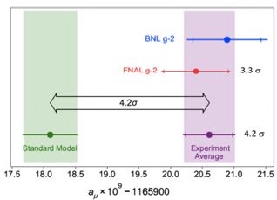
Muon precession
A magnetic field induces a precession motion of the particle’s spin.
The precession frequency is given by:
${\vec{ω}}_{a}= a_{μ}\frac{e\vec{B}}{m}$
The Muon g-2 collaboration aims to measure $a_{μ}$ with a 140 ppb uncertainty, by measuring with high precision both the spin precession frequency and the magnetic filed.
Note: the experiment uses electric fields to focus the muon beam, this makes the relation between ${\vec{ω}}_{a}$ and $a_{μ}$ more complicated. For muons with momentum ~3.1 GeV, this effect is cancelled!
Notes:
How can we measure the anomaly? We know that a magnetic field induces in a particle with magnetic moment a precession motion of the spin. The precession frequency is given by this formula. The muon g-2 collaboration aims to measure ai miu with an uncertainty of one hundred and fourty parts per billion. So it’s very important to measure with high precision both the precession frequency and the magnetic field. I will focus on the precession while my collegue Nicola on the magnetic field. It’s important to notice that the experiment uses electric fields to focus the beam, the presence of this field makes the relation between omega and a more complicated. But for muons at 3.1 gev this affect calncels out. This is why the muon beam has this energy

Slide 4
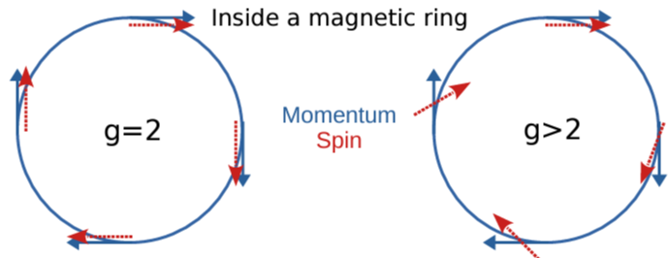
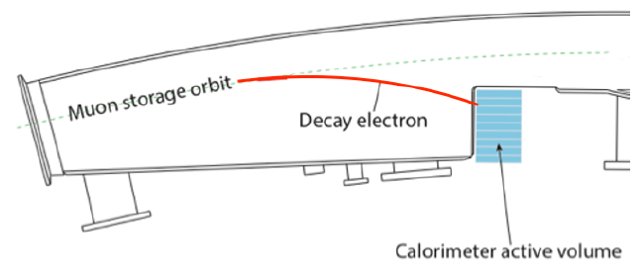
Measuring precession frequency
To measure the spin precession a beam of polarized muons is injected into a superconducting storage ring, where muons circulate for roughly 750 μs.
The spin rotates around the magnetic field direction.
Muons decay into positrons. High energy positrons have higher probability to be emitted in the muon spin direction: we detect more positrons when the spin faces towards the calorimeters and less when it faces away. The frequency of this oscillation is the signal we want to measure: ${\vec{ω}}_{a}$
Notes:
So the beam of polarized muons is injected in the storage ring, where they circulate for approximately 7 hundred and fifty microseconds. As you can see in this figure the spin rotates around the magnetic field direction. Muons always decay into positrons and higher energy positrons have more probability to be emitted in the same direction of the muon spin. This means that when the spin faces toward the inner of the ring, where calorimeters are positioned, we detect more positrons, and less when the spin faces away. The frequency of this oscillation is exactly the signal we want to measure.

Slide 5
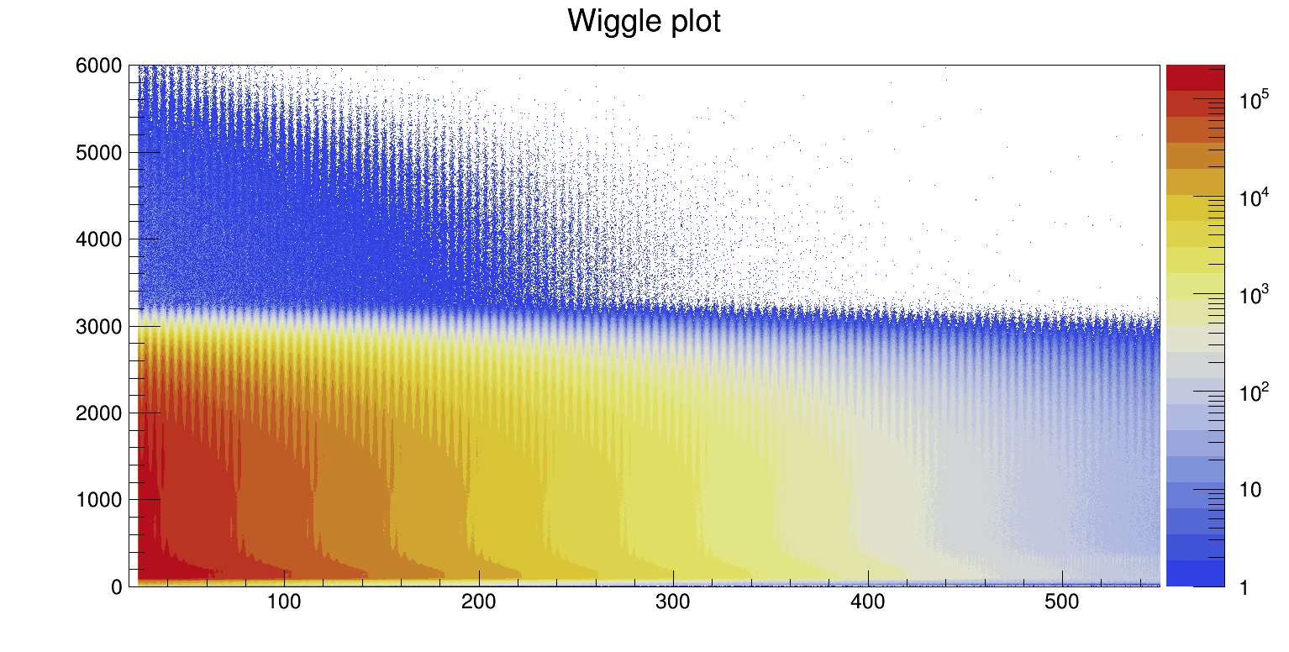
Positrons distribution
In the past weeks I have analyzed data from Run-2 acquisition period (2019). This plot shows the positron time of arrival (X axis) and its energy (Y axis) as measured by the calorimeters.
Events above 3100 MeV are due to pile-up.
Energy [MeV]
Time [μs]
Notes:
In the past weeks I have analyzed data from run 2 acquisition period. This plot shows the positron time of arrival on the x axis and positron energy on the y axis. This events over 3.100 mev are due to pile-up, two positrons that hit the calorimeters almost at the same time and are counted as one.

Slide 6
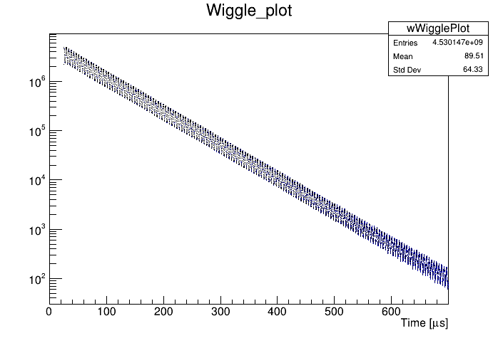
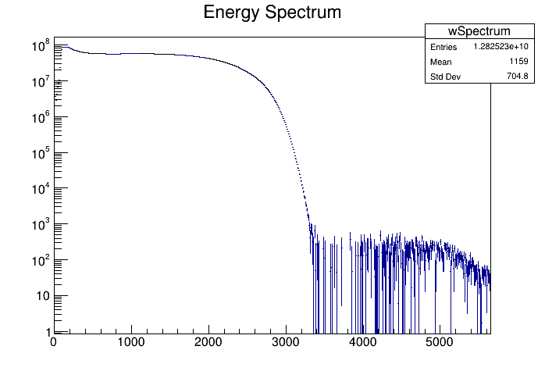
Wiggle Plot and Energy Spectrum
Positrons / 149.2 ns
Projecting on the Y axis we get the 1-D Wiggle Plot (this figure is obtained integrating events from 1700 MeV)
Projecting on the X axis (i.e. integrating from 30 μs to 650 μs) we get the energy spectrum.
Positrons
Energy [MeV]
Notes:
Both in logarithmic scale.

Slide 7
5 parameters fit function
The simplest equation that describes the number of positrons detected by the calorimeters is the following:
Where:
$N_{0}$is the number of muons at t=0
$γτ$ is the muon lifetime in the lab frame of reference
$A$ is the asymmetry, related to the probability that a positron is emitted in the same direction of the spin
$ω_{a}$is the precession frequency we want to measure
$φ$ is the phase at t=0
To avoid cognitive bias, $ω_{a}$ is blinded by a dimensionless parameter R, defined as the unknown offset in ppm from a reference value.
Notes:
In this presentation you will not see omega but R. This is because to avoid cognitive bias, omega is blinded by this parameter.

Slide 8
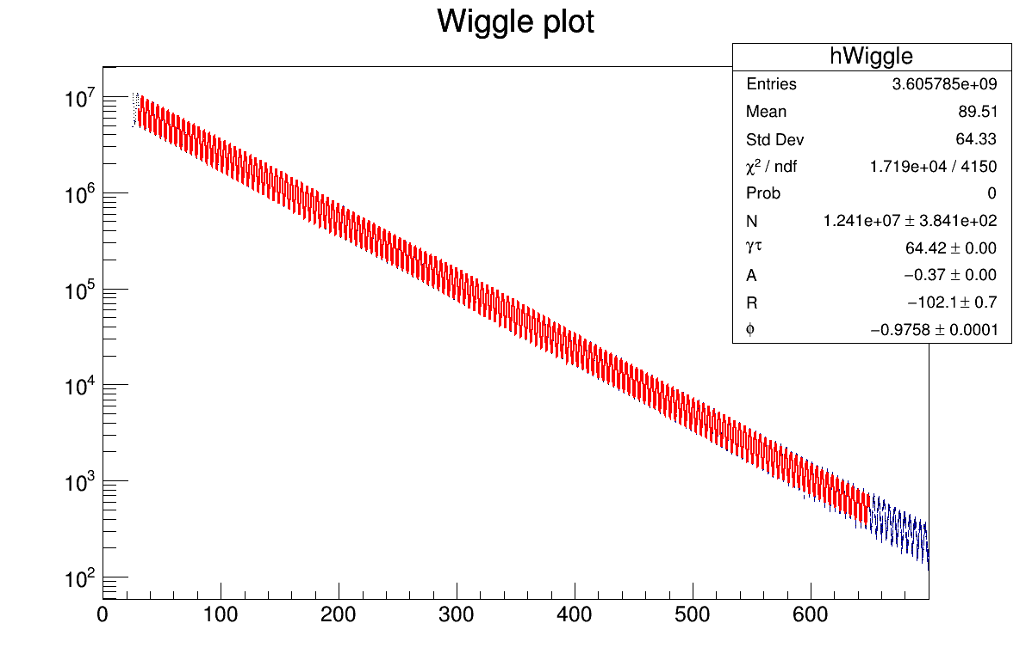
5 parameter fit results
Positrons / 149.2 ns
Time [μs]
Notes:
This is the result of the fit.

Slide 9
T-Method
The T-Method consist in building the wiggle plot summing all positrons above an energy threshold:
At high energy positrons have higher asymmetry, which is better for the fit, but there’s low statistics
At low energy positrons have lower asymmetry, but there is more statistics
It’s necessary to find a compromise between the two cases: we have to determine the ideal energy threshold that minimizes the error on R
We build different wiggle plots by changing the lower energy threshold
We fit every one of them and the figure of merit will be the smallest uncertainty on R
Notes:
The tmethod consists of building the wiggle plot by summing all positrons above an energy threshold. But we must be careful because

Slide 10
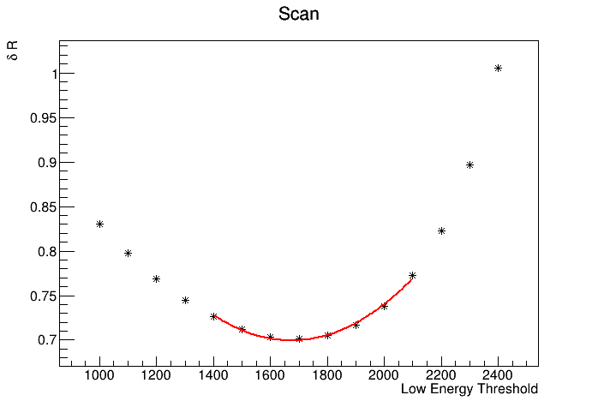
T-Method
The plot shows the uncertainty on the R parameter as a function of the energy threshold
The distribution is fitted with a quadratic function and shows a minimum at the optimal point
The minimum found for this dataset is at 1673 MeV
[ppm]
[MeV]

Slide 11
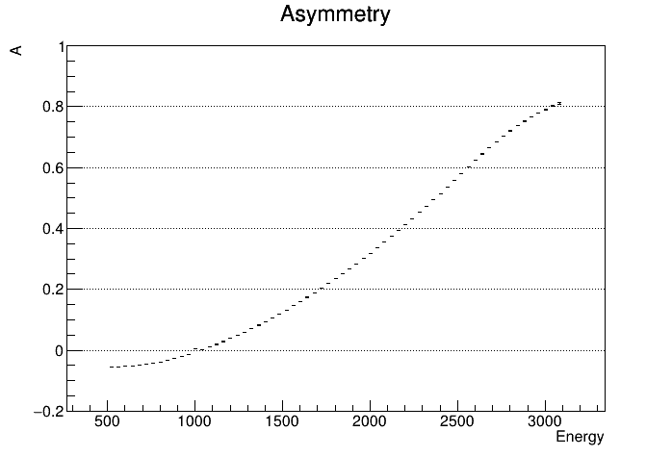
A-Method
The wiggle plot can be also built by weighting the positrons with their asymmetry (function of the energy). High energy positrons weight more, increasing the sensitivity to the precession frequency signal. This also allows to lower the energy threshold, hence the statistics increases.
To obtain the asymmetry the region from 500 MeV to 3100 MeV is sliced into bins of 40 MeV
From each slice a wiggle plot is produced
Each wiggle plot is fitted to extract the asymmetry
The fit is less precise near 1000 MeV because A is zero in that region.
[MeV]
Notes:
The wiggle plot can be also built by weighting the positrons with their asymmetry (function of the energy). High energy positrons weight more, increasing the sensitivity to the precession frequency signal. This also allows to lower the energy threshold, hence the statistics increases.
First we have to obtain the asymmetry curve, to do so we slice the 2d plot into bins of 40 mev and build a wiggle plot from everyone of this. This wiggle plots are then fitted to extract the asymmetry. Notice that is negative below 1000 mev.

Slide 12
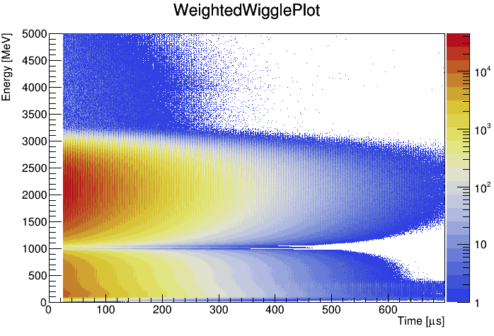
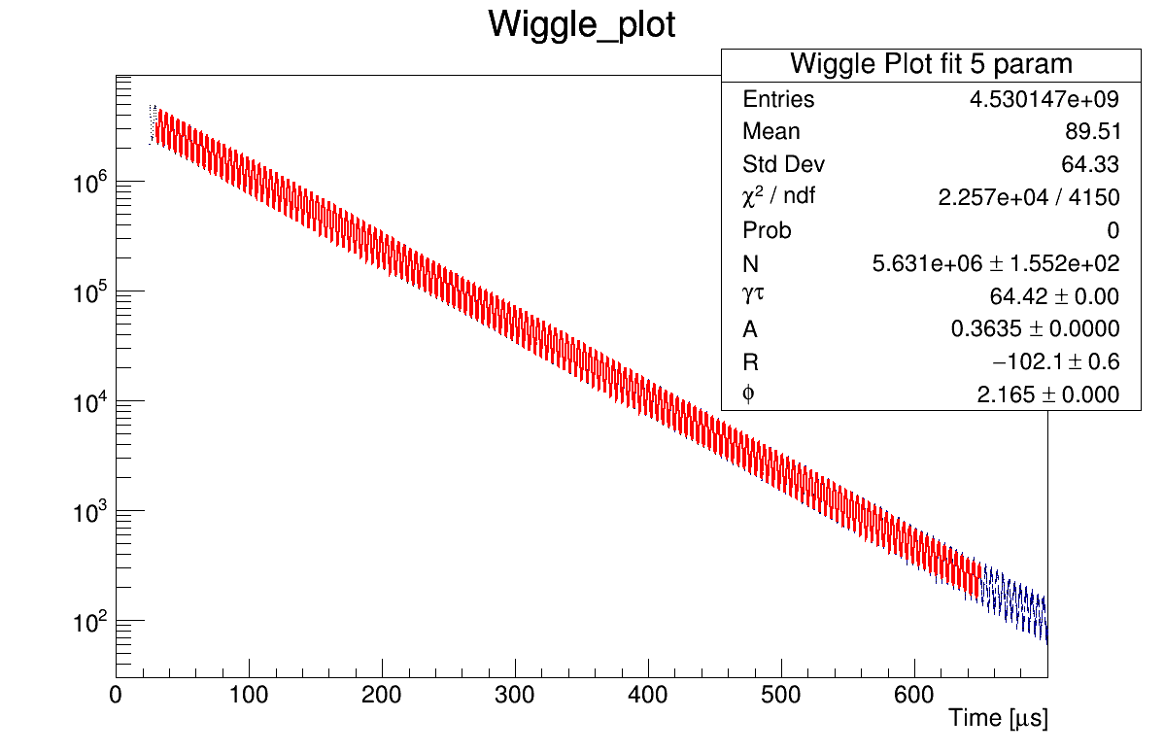
Weighted Wiggle Plot
Positron distribution where each entry has been multiplied by its asymmetry.
Note: the asymmetry below 1000 MeV is negative, here the absolute value is plotted for better visualization.
Weighted Wiggle Plot
Positrons / 149.2 ns
The wiggle plot is built integrating from 1100 MeV to 3000 MeV. The number of entries increased from $3.6×{10}^{9}$ to $4.5×{10}^{9}$
Notes:
This is the plot you have seen before but where positrons are weighted by their asymmetry. In this plot I have actually plotted the absolute value of the asymmetry but it is only for visualization purposes. Anyway only positrons with positive asymmetry are used, this picture shows the wiggle plot obtained integrating from 1100 mev to 3000 mev.

Slide 13
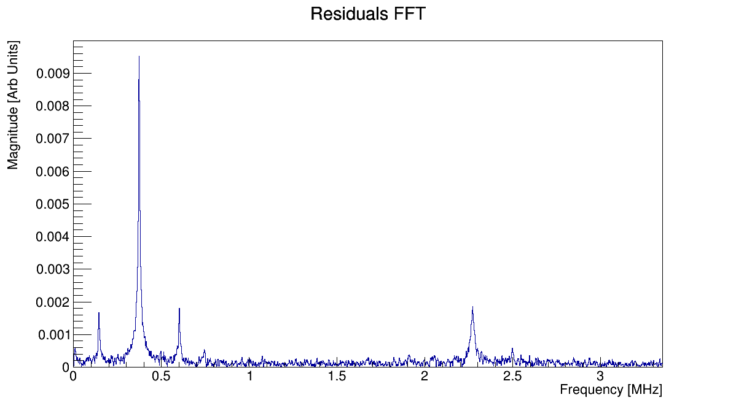
Beam motion effects
In this experiment, effects of beam dynamics have direct impact on the result. The most important one is the effect of coherent betatron oscillations (CBO): the oscillation of the beam along the horizontal plane.
The fit is also sensitive to oscillations in the width of the beam in the vertical plane (vertical waist) and of its mean.
The Fourier transform of the residuals of the fit highlights the frequencies of the beam dynamics oscillations:
$f_{CBO}∼0.37 MHz$
$f_{CBO}±f_{a}$
$f_{VW}∼2.3 MHz$
$f_{y}∼2.5 MHz$
Low frequency peak due to lost muons
Notes:
In this experiment, effects of beam dynamics have direct impact on the result. The most important one is the effect of coherent betatron oscillations (CBO): the oscillation of the beam along the horizontal plane.
Another important effect is the vertical waist, which is the oscillations of the beam width in the vertical plane, and the oscillations of the mean of the beam in the vertical plane.
The Fourier transform of the residuals of the fit highlights the frequencies of the beam dynamics oscillations:
$f_{CBO}∼0.37 MHz$
$f_{CBO}±f_{a}$
$f_{VW}∼2.3 MHz$
$f_{y}∼2.5 MHz$
Low frequency peak due to lost muons

Slide 14
9 parameters fit function
Since the FFT residuals show peaks at beam dynamics frequencies, the fitting function must be modified to include their contribution. This will also improve the fit $χ^{2}$.
The first step is to include the CBO term:
Where:
A_{CBO} is the amplitude of the CBO
$ω_{CBO}$ is the frequency
$φ_{CBO}$ is the phase
$τ_{CBO}$ is the decoherence lifetime
Notes:
We multiply the previous function for this term. That describes the CBO.

Slide 15
9 parameters fit function
The fit procedure we’re using is the following:
Fit with the 5 free parameters ($N_{0}, γτ, A, ω_{a}, φ$) function (see slide 7)
Fit with $N_{0}, γτ, A, ω_{a}, φ$ fixed to the values from point 1 and leave the 4 CBO parameters ($A_{CBO}, ω_{CBO}, φ_{CBO}, τ_{CBO}$) free
Release all parameters and initialize the CBO parameters with the values found in step 2
Perform the complete fit with all parameters floating
Notes:
To make sure the fit converges we use the following procedure. First we fit the 5 parameter function, than we fix the values of these parameters,

Slide 16
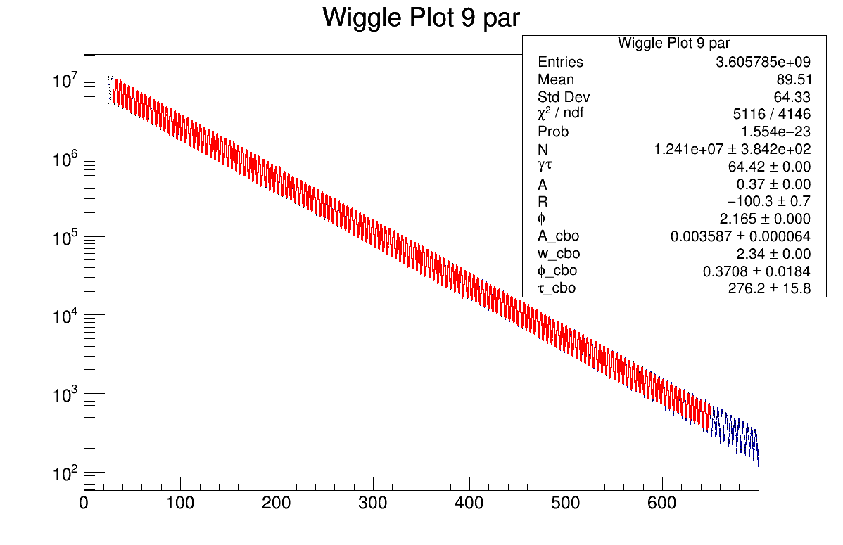
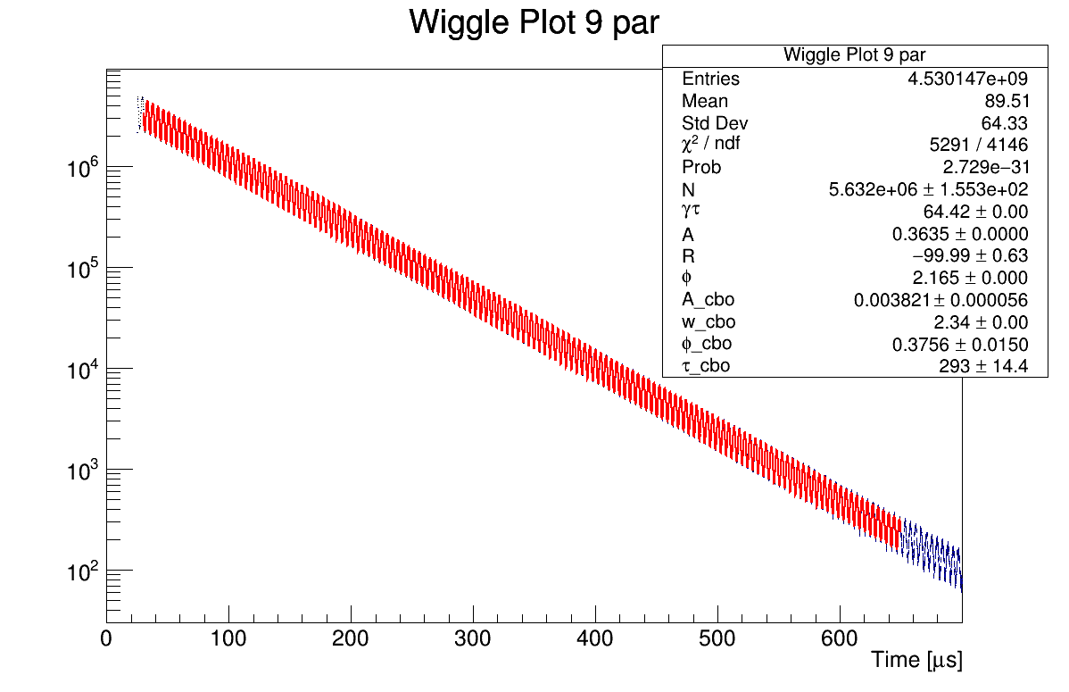
9 parameter fit results
T-Method wiggle plot
A-Method wiggle plot
Positrons / 149.2 ns
Positrons / 149.2 ns
Time [μs]
The 9 parameters fit improves the $χ^{2}/ndf$
 | 5 parameters | 9 parameters
T-Method | 4,1421 | 1,2339
A-Method | 5,4385 | 1,2759

Slide 17
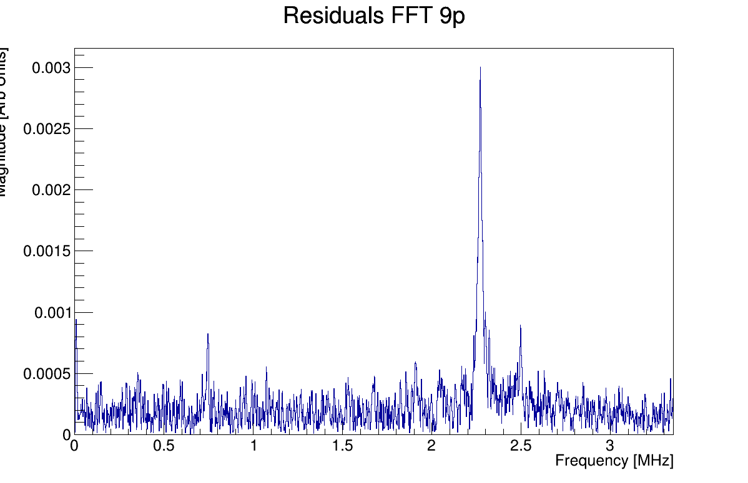
Fourier Transform
The analysis of the residuals of the 9 parameters fit shows that CBO is now correctly described by the function. The peak at 2.3 MHz is due to vertical waist and the peak at low frequencies is due to lost muons.
The complete fit is done with a 22 parameters function that takes into account every beam oscillation. The functional form of this oscillations will be the object of my future studies.
Magnitude [Arb Units]
Notes:
Now the CBO peak is gone and the most important one is the vertical waist, this (on the right) is the vertical oscillation and this one(central) is the first harmonic of the CBO. To take into account every beam dynamics affect the final function has 22 parameters, that I will use in the future for the rest of the analysis.

Slide 18
T and A methods comparison
The two methods give us these results:
 | R (ppm) | δR (ppm) | Χ²/ndf | Χ²/ndf
T-method | -100.257 | 0.701 | 5116/4146 | 1,2339
A-method | -99.989 | 0.630 | 5290/4146 | 1,2759
Agreement between the two methods is checked calculating the difference
$$|R_{T}−R_{A}|=0.268$$
Which should be lower than the allowed statistical deviation (the 1σ difference due to different amount of statistic used by the two methods)
$$\sqrt{{δR}_{T}^{2}−{δR}_{A}^{2}}=0.307$$
Notes:
These are the results, we can see that with the a-method we get a smaller error but a larger chi2, which is expected. If we there are no errors in the analysis: the two methods should give results that are in agreement. To check this we compute the absolute value of the difference between the two results. This difference should be lower than the allowed statistical deviation, which is computed here.

Slide 19
Coming soon
In the anomalous precession frequency fit, the description of the beam dynamics is crucial to obtain a precise result.
Next step: I will perform a fit including the full beam dynamics effects, i.e. with the 22 parameters function.
Moreover, the study of beam dynamics shows that CBO oscillations are dumped over time. In the fit function this trend is assumed to be exponential. I will study other functional forms to understand the systematic effect of this assumption on the fit.
Notes:
So what will I do next? To really reduce the error on R I will use the complete function with 22 parameters that takes into account every effect of beam dynamics. As I showed you before the CBO term decay over time with an exponential behaviour. But this is actually an assumption, different functional forms can be used to describe the dump.

Slide 20
THANKS FOR YOUR ATTENTION

