Slide 1
Design and test of a special magnet for the Mu2e experiment
Midterm presentation 29 August 2022
Aurora Di Giampietro
Supervisor Eng. Luciano Elementi

Slide 2
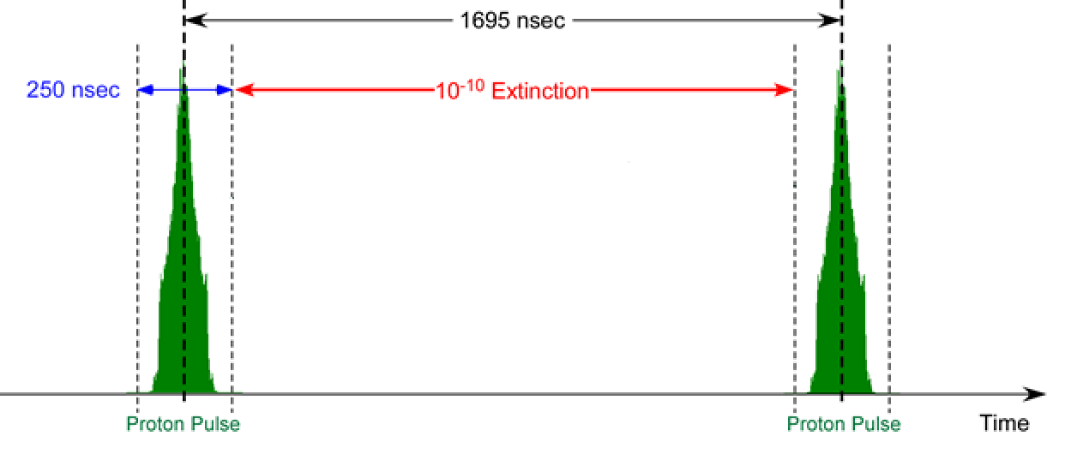
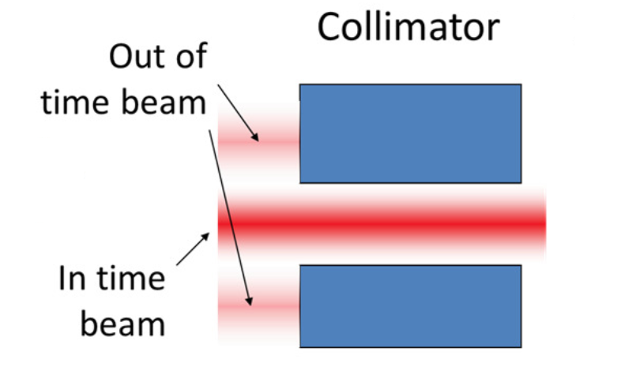
AC Dipole

Slide 3
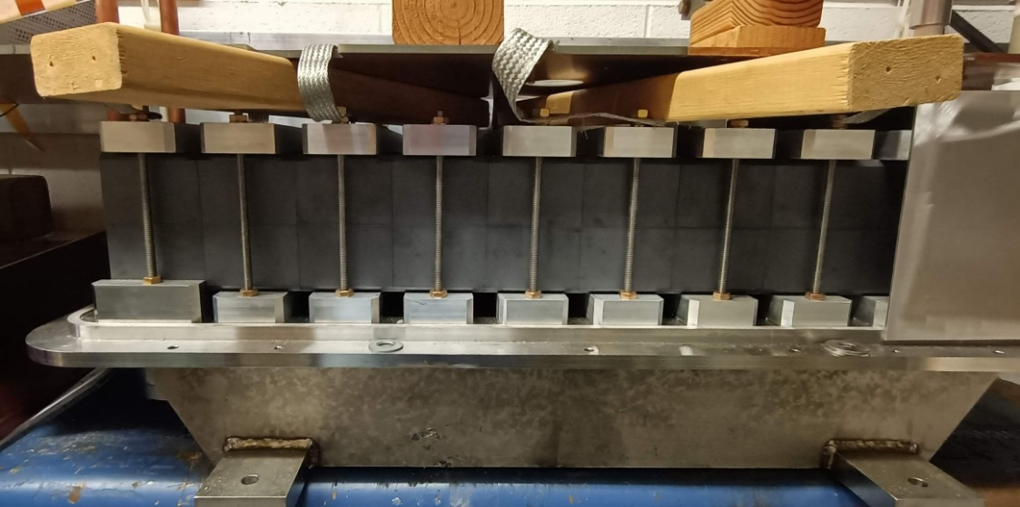
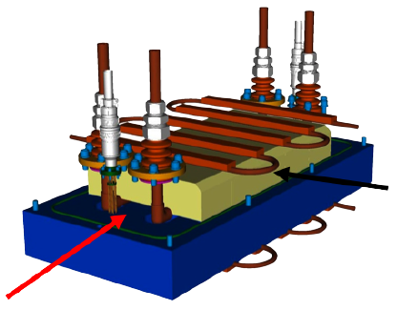
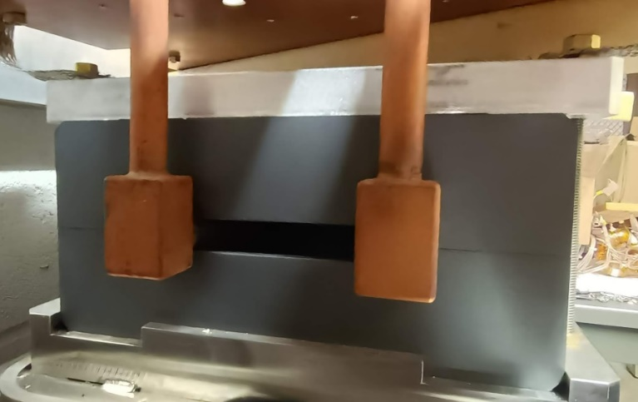
AC Dipole
Ferrite plates
Beam direction

Slide 4
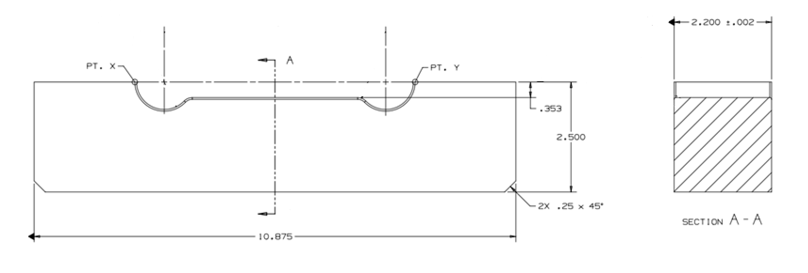
Ferrites
High magnetic permeability ($μ_{r}=620$)
Low Electrical Conductivity
Low eddy current losses

Slide 5
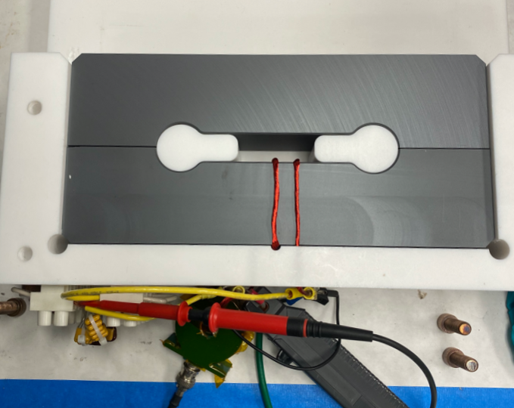
Ferrites
Toroid Mode
300kHz
4.4MHz
Dipole Mode
300kHz
4.4MHz

Slide 6
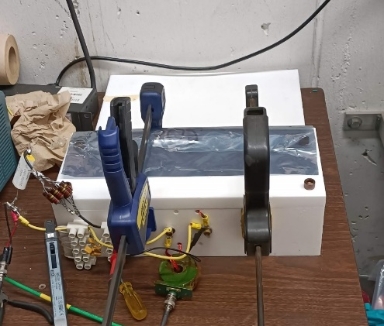
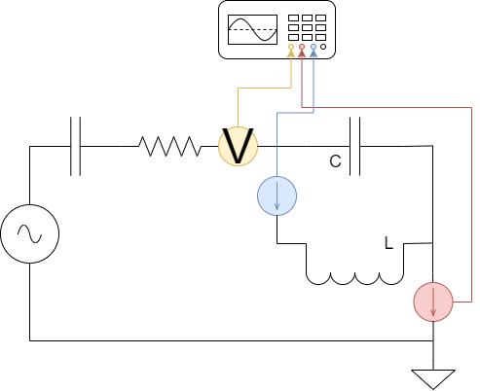
Toroide Mode setup
$$L=\frac{μNA_{c}}{l_{m}}≅15μH$$
$$C=\frac{1}{L\sqrt{2πf}}$$

Slide 7
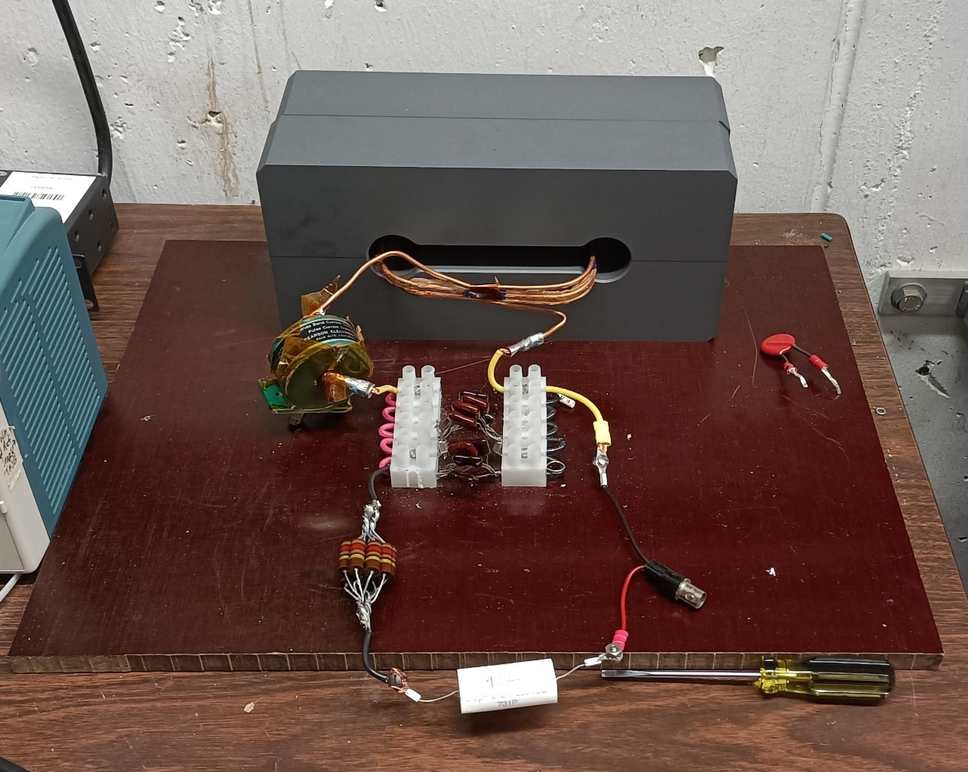
Dipole Mode setup

Slide 8
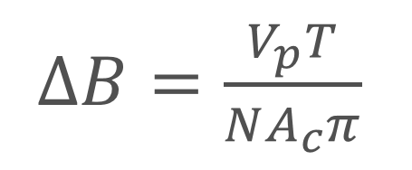
Analysis
Faraday-Neumann-Lenz Law:

Slide 9
Analysis
N = number of turns in the coil
A_{c} = area of the coil
B = magnetic field (Gauss units)
Faraday-Neumann-Lenz Law:
$$ε(t)$$
V_{p}

Slide 10
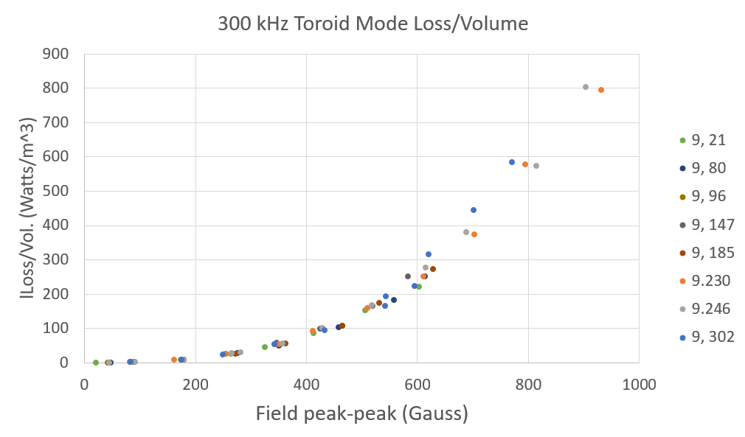
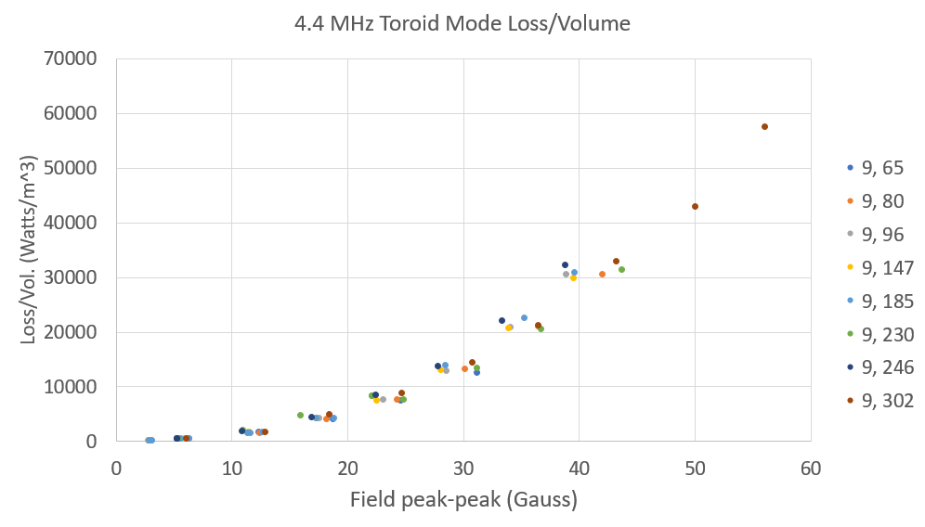
Results Toroide Mode
ΔB (Gauss)
ΔB (Gauss)

Slide 11
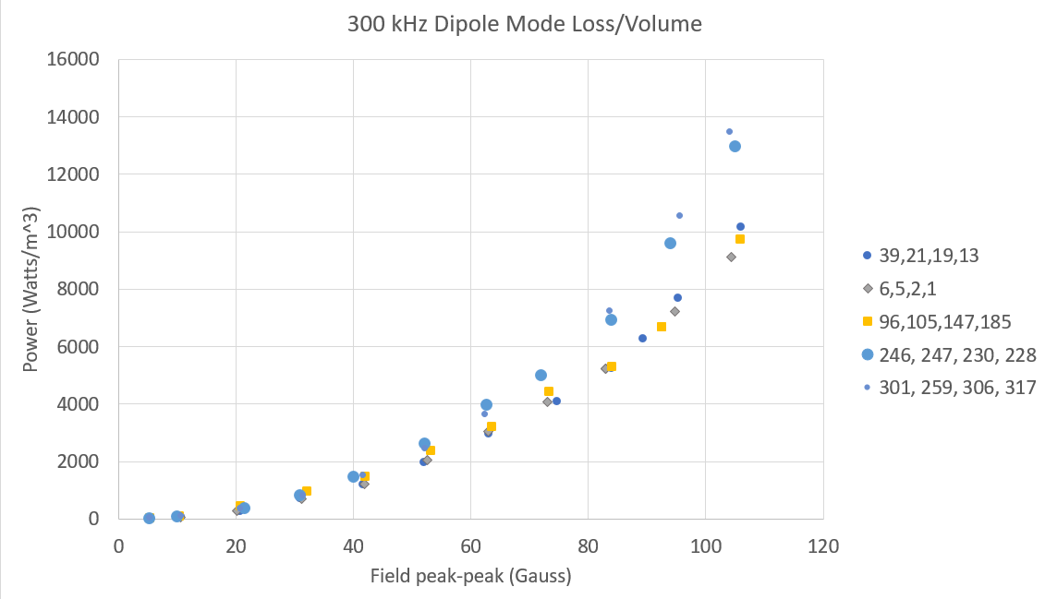
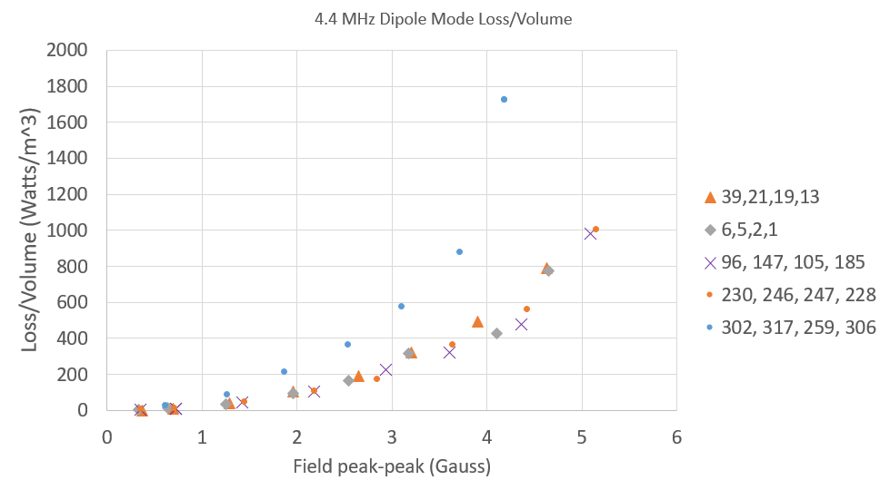
Results Dipole Mode
Loss/Volume (Watts/m^3)
ΔB (Gauss)
ΔB (Gauss)

Slide 12
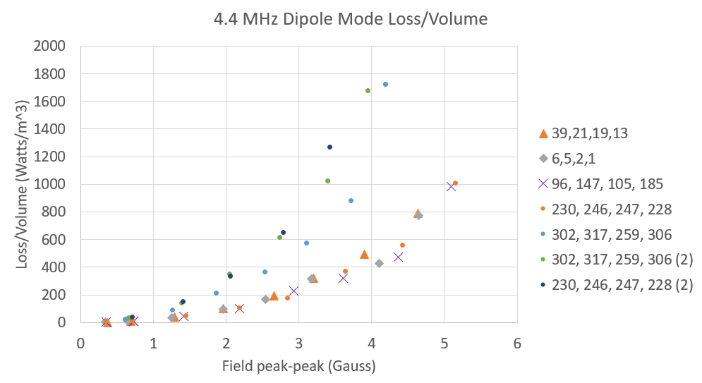
New results Dipole Mode at 4.4 MHz
ΔB (Gauss)

Slide 13
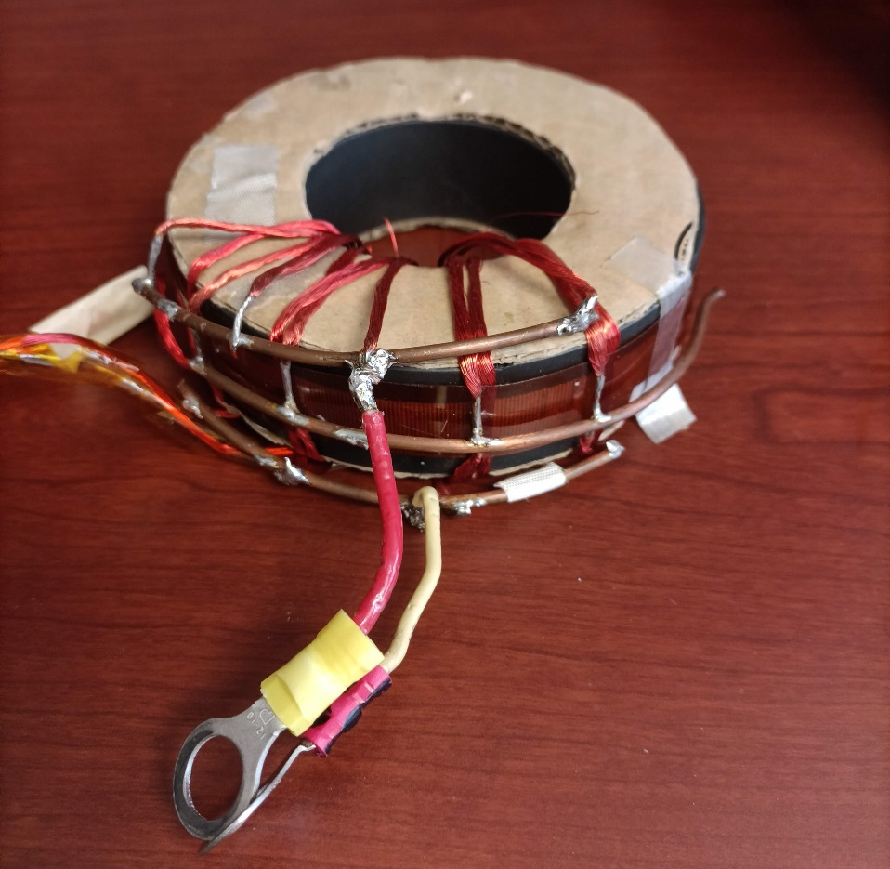
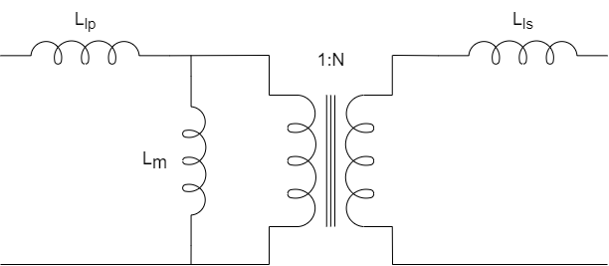
Future work

Slide 14
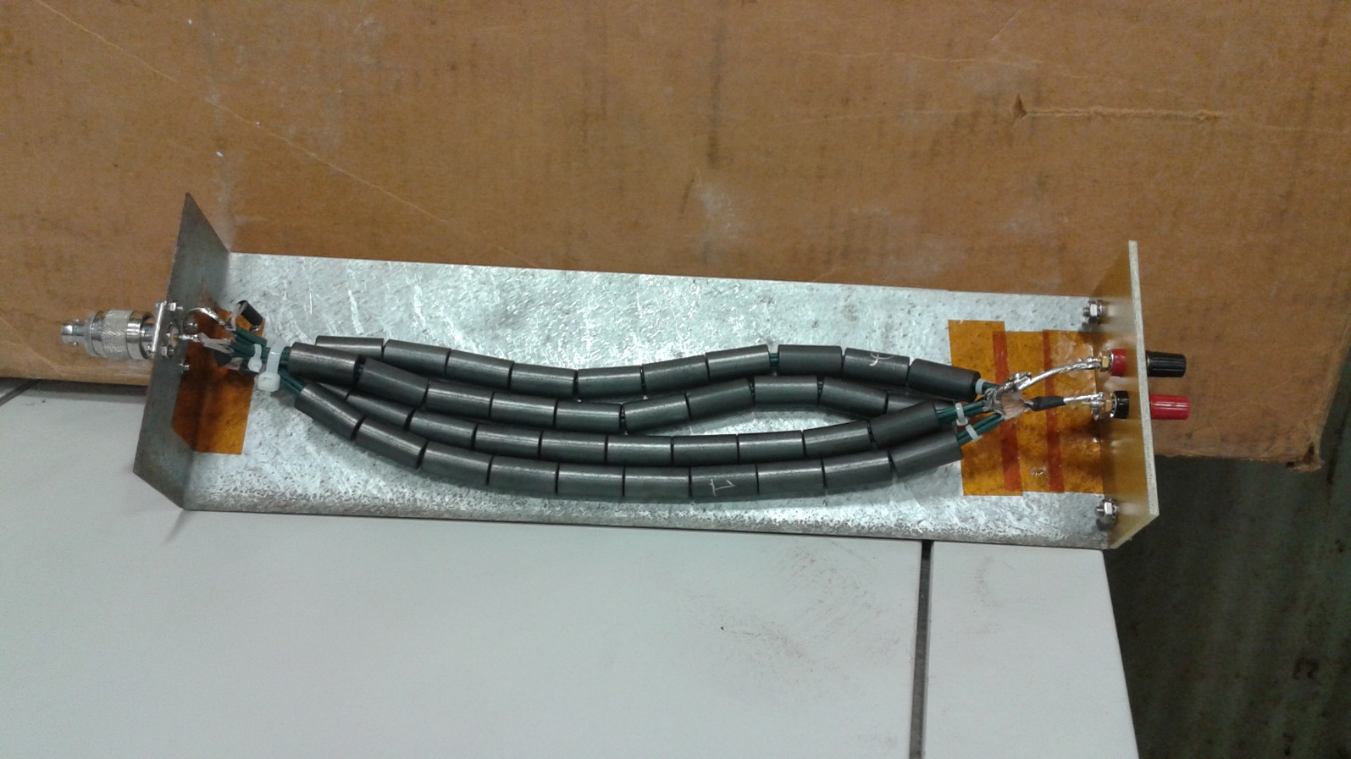
Future work
Transmission Line Transformer:
Higher bandwidth
Less losses

Slide 15
Thanks for the attention

Slide 16
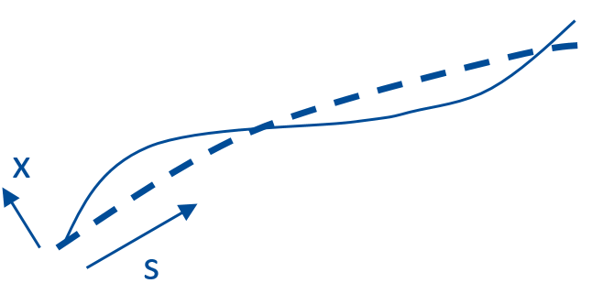
Backup
Particles undergo “pseudo-harmonic” motion about the nominal trajectory, with a variable wavelength.
An angular deflection at the AC dipole cause a position displacement 90° later in phase advance.

Slide 17
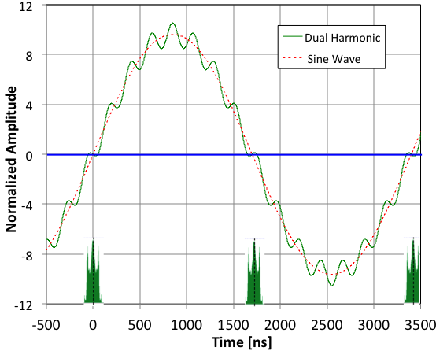
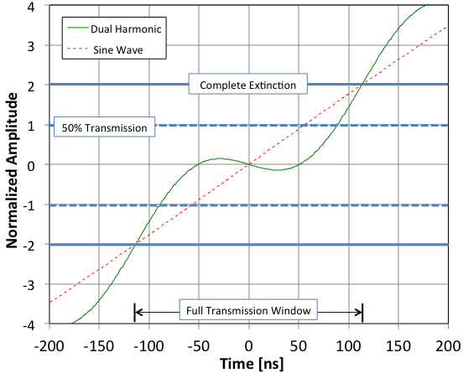
Backup
AC Dipole driven by two harmonics
300 kHz (half bunch frequency) to sweep out of time beam into collimators
4.5 MHz (15th harmonic) to maximize transmission of in-time beam
Single harmonic would hit collimator too soon

Slide 18
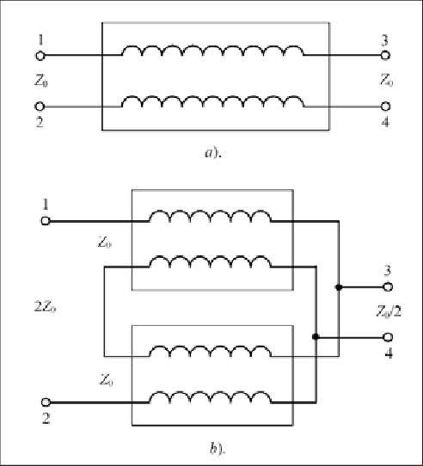
Transmission Line Transforem examples

