Slide 1
Measurement of the gas gain and understanding the gas flow in the Mu2e Tracker
Student: Giovanni Celotto
Supervisor: Vadim Rusu
Midterm presentaiton
29 August 2022

Slide 2
Overview
Mu2e experiment and tracker
Tracker’s Panel
Experimental setup
Results: old and new data from panel MN084
Conclusion and Perspectives
Notes:
The Mu2e experiment will search for coherent (i.e. , does not change the nuclear state) , neutrino-less conversion of muons into electrons in the Coulomb field of an aluminum nucleus with a sensitivity of four orders of magnitude better than previous experiments.
The signature of this process is an electron with energy nearly equal to the muon mass, a bit smaller taking into account the binding energy of the muon into the aluminum nucleus
High precision is required In order to achieve this goal, Mu2e has chosen a very low-mass straw tracker, made of 20,736 5 mm diameter thin-walled (15 µm) Mylar® straws, held under tension to avoid the need for supports within the active volume, and arranged in an approximately 3 m long by 0.7 m radius cylinder, operated in vacuum and a 1 T magnetic field.

Slide 3
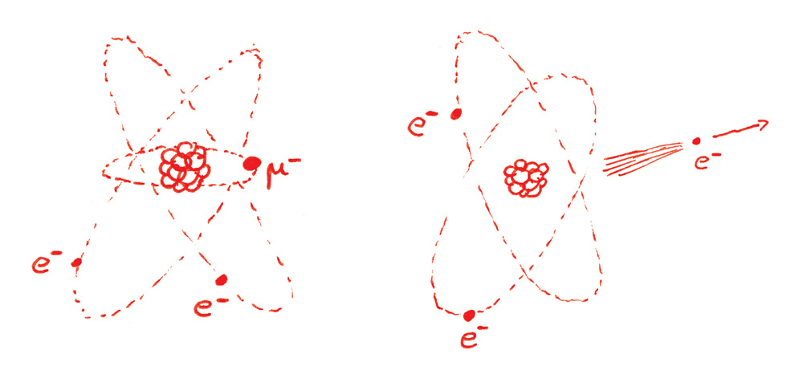
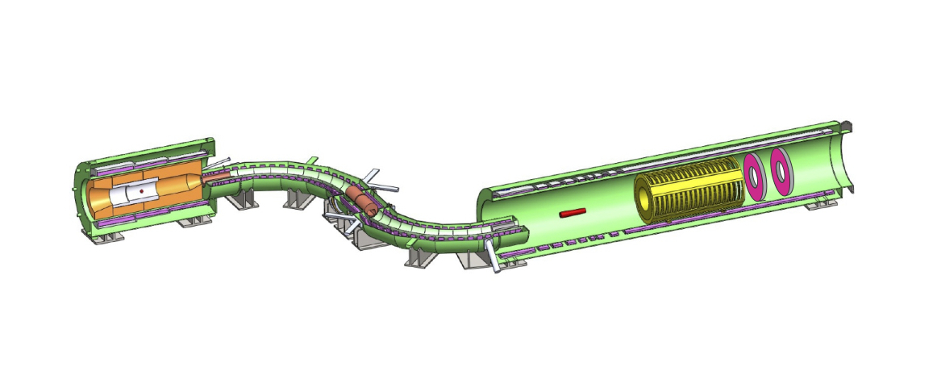
Mu2e Experiment
Neutrino-less conversion of muons into electrons in the Coulomb field of an Al nucleus
PS
DS
TS
Notes:
The Mu2e experiment will search for coherent (i.e. , does not change the nuclear state) , neutrino-less conversion of muons into electrons in the Coulomb field of an aluminum nucleus with a sensitivity of four orders of magnitude better than previous experiments.
The signature of this process is an electron with energy nearly equal to the muon mass, a bit smaller taking into account the binding energy of the muon into the aluminum nucleus
High precision is required In order to achieve this goal, Mu2e has chosen a very low-mass straw tracker, made of 20,736 5 mm diameter thin-walled (15 µm) Mylar® straws, held under tension to avoid the need for supports within the active volume, and arranged in an approximately 3 m long by 0.7 m radius cylinder, operated in vacuum and a 1 T magnetic field.

Slide 4
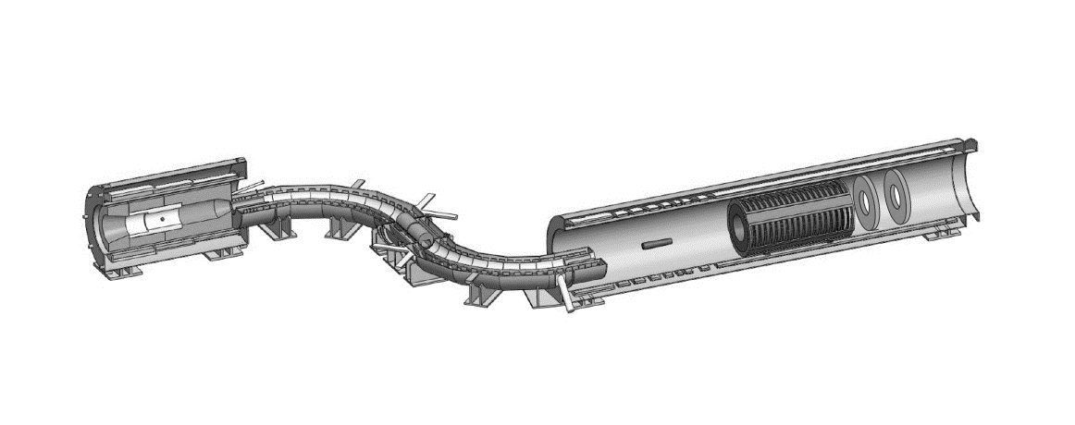
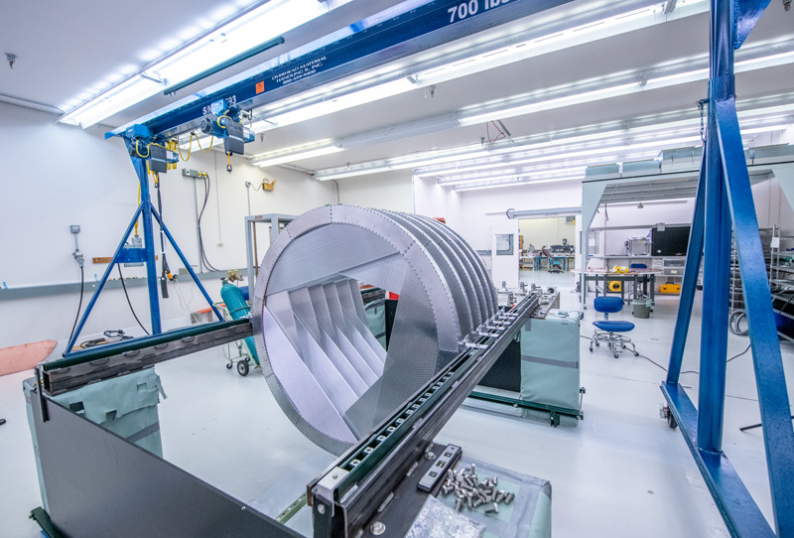
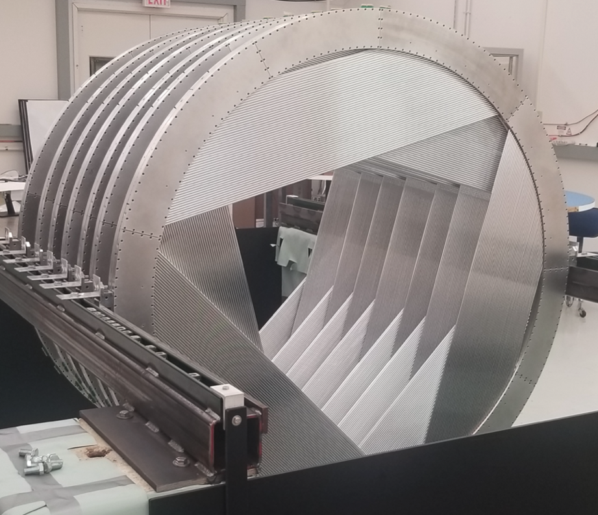
Mu2e Tracker
Low mass straw tube detector
Position and the momentum of the electron
Still under construction
Notes:
The Mu2e Tracker is a state of the art low mass straw tube detector that will look for charged lepton flavor violation (CLFV) by measuring the position and the momentum of the monochromatic
105 MeV/c electron from the µ − N → e − N neutrinoless electron conversion in the presence of
aluminum nucleus. To achieve this goal, the tracker needs to have momentum resolution of less
than 180 keV/c [1] for the conversion electron spectrum. The tracker is still under construction
with the joint effort of several institutes. This paper will detail technical information about the
Mu2e tracker and show early cosmics data taken with a production tracker plane.

Slide 5
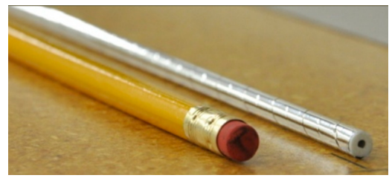
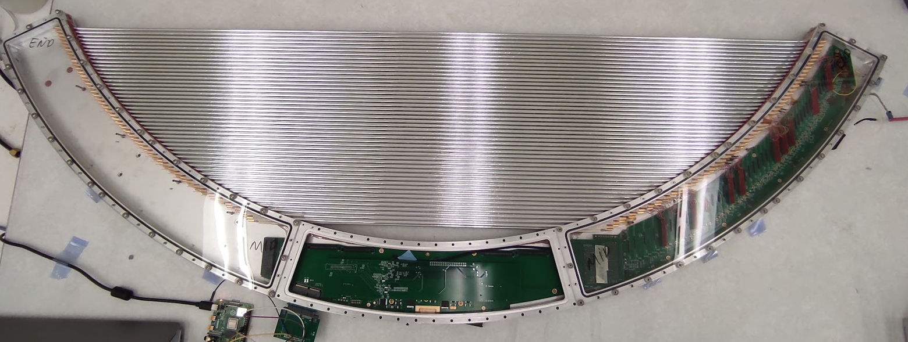
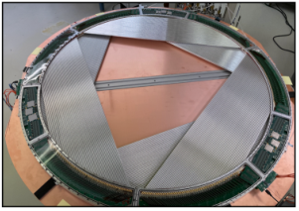
Mu2e Tracker’s panel
96 Mylar straws
5 mm diameter and 15 µm walls
25µm gold plated tungsten sense wire
Panel MN084
Notes:
The Mu2e tracker’s smallest module is called a panel. A panel has 96 aluminized Mylar straws with a diameter of 5 mm and 15 µm walls
6 panels form a plane and two planes form a station. In mu2e there will be 18 stations: 2planes each 6 panels each 96 straws each: 20736 straws
When an electron hits crosses the panel we get the information on which straw was hit. The readout is performed in both the ends of the wire and from the difference of time we get the information on the coordinate parallel to the wires,. Finally from the drift time of electrons inside the straw we also get the radial coordinate inside the straw.
The detector will operate with a gas mixture of Ar and CO2. The gas flows from the left to the right throught the straws. I this side here a series of preamplifiers with integrated adcs are used

Slide 6
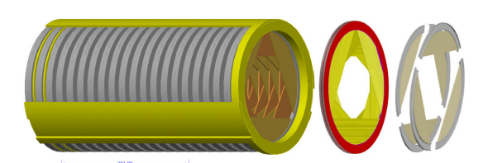
Mu2e Tracker’s panel
96 Mylar straws
5 mm diameter and 15 µm walls
25µm gold plated tungsten sense wire
Notes:
The Mu2e tracker’s smallest module is called a panel. A panel has 96 aluminized Mylar straws with a diameter of 5 mm and 15 µm walls
6 panels form a plane and two planes form a station. In mu2e there will be 18 stations: 2planes each 6 panels each 96 straws each: 20736 straws
When an electron crosses the panel we get the information on which straw was hit. The readout is performed in both the ends of the wire and from the difference of time we get the information on the coordinate parallel to the wires,. Finally from the drift time of electrons inside the straw we also get the radial coordinate inside the straw.
The detector will operate with a gas mixture of Ar and CO2. The gas flows from the left to the right throught the straws. I this side here a series of preamplifiers with integrated adcs are used

Slide 7
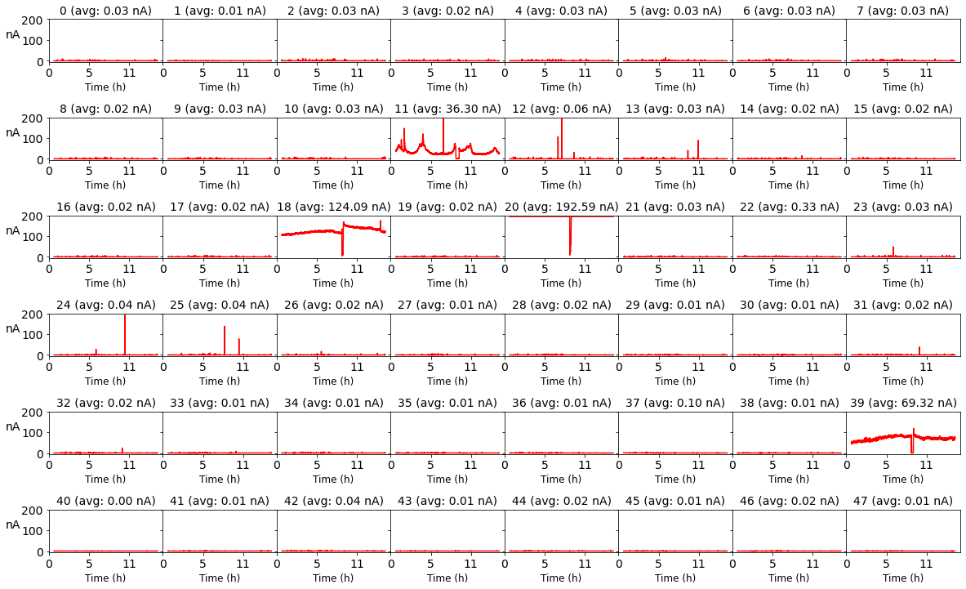
What’s the problem?
Higher Voltage
Higher gain
Measurement with no sources
No ionization products
Small current
Notes:
So what’s the prlbem?
96 straws→ 48 currents will be clear later
As weknow high voltage high gain
No sources we expect same current at HV as well as at 0 voltage

Slide 8
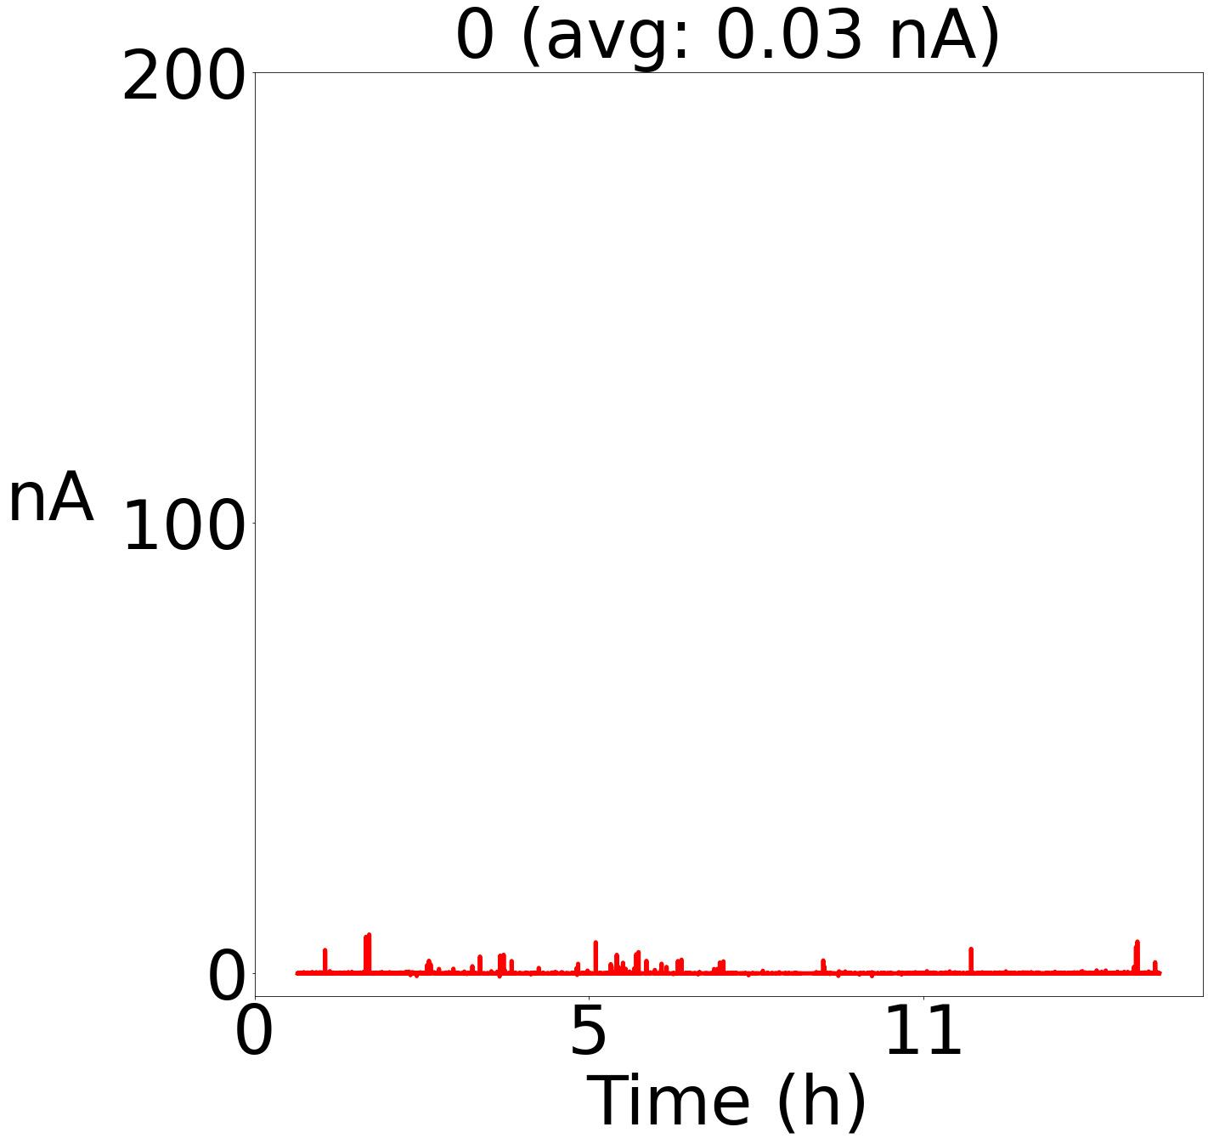
What’s the problem?
Higher Voltage
Higher gain
Measurement with no sources
No ionization products
Small current

Slide 9
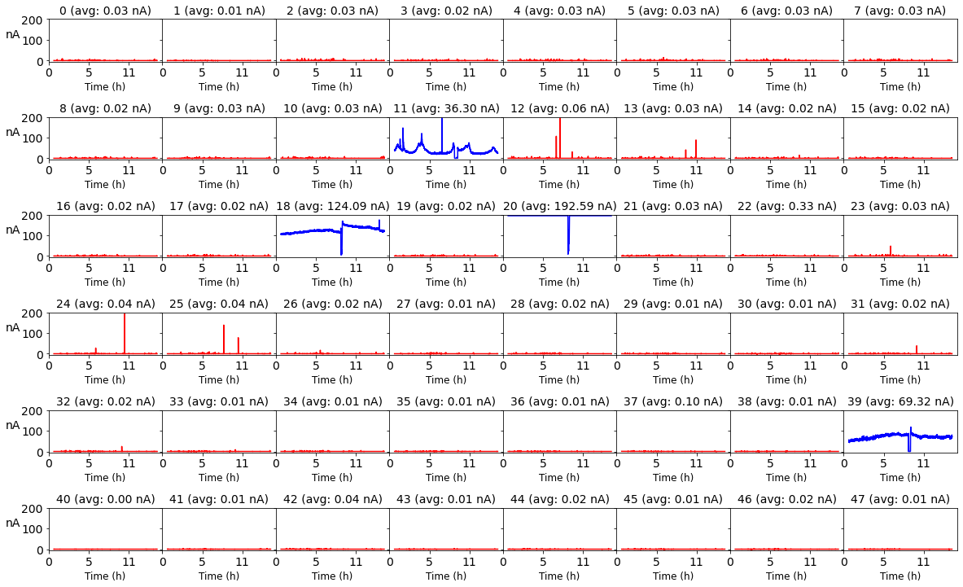
What’s the problem?
Higher Voltage
Higher gain
Measurement with no sources
No ionization products
Small current

Slide 10
The experimental setup
Gas Flowmeter
HV supplier
Gas flowmeter
Panel MN084
Droege HV supplier
Slow amplifiers
Raspberry PI
V = 1450 V
Pedestal measurement
Slow Amplifiers
Raspberry Pi
Notes:
Panel MN084 used to have high current in previous measurements.
Up to know the aim is to find consistencies with the previous measurements before introducing a small percentage of water vapour that can reduce this effect preserving high gain
From 2 straws we get one current measurement so we have in total 48 currents in one panel

Slide 11
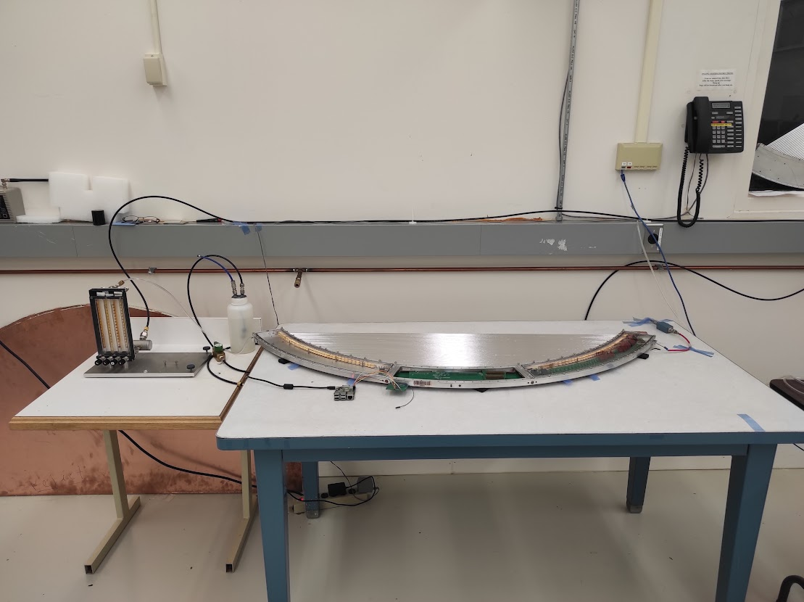
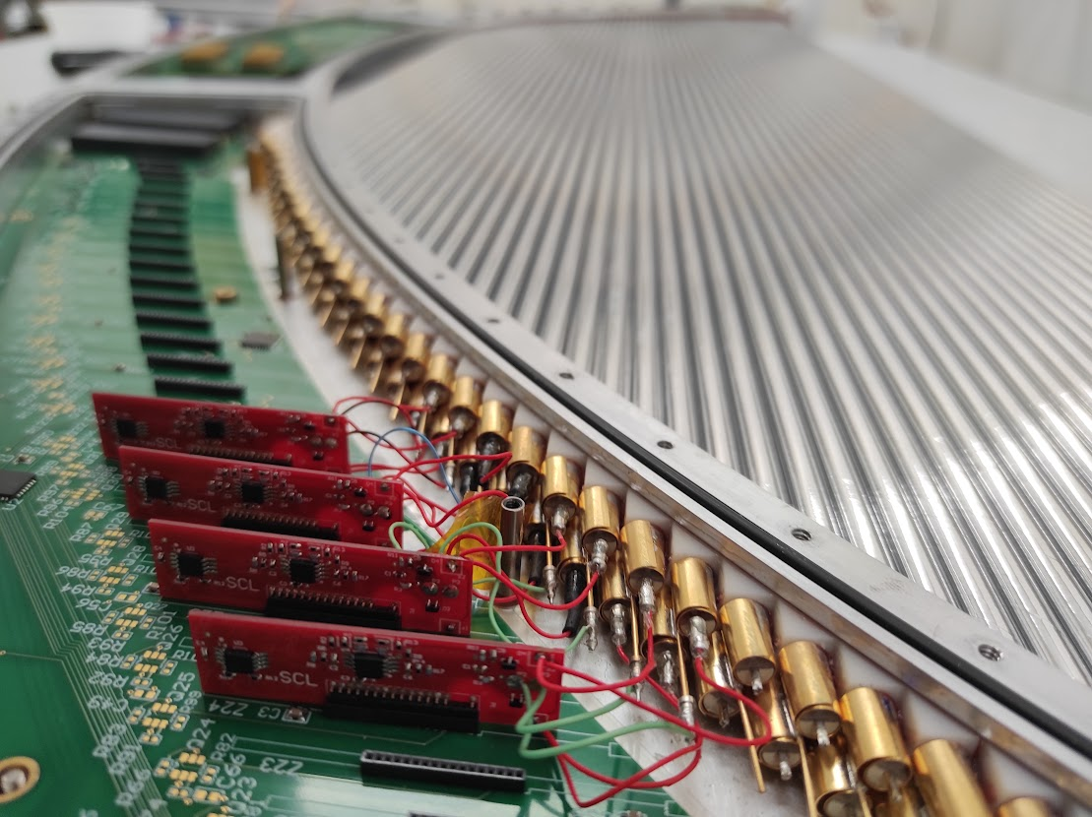
The experimental setup
Gas flowmeter
Panel MN084
Droege HV supplier
Slow amplifiers
Raspberry PI
V = 1450 V
Pedestal measurement
Notes:
Panel MN084 used to have high current in previous measurements.
Up to know the aim is to find consistencies with the previous measurements before introducing a small percentage of water vapour that can reduce this effect preserving high gain
From 2 straws we get one current measurement so we have in total 48 currents in one panel

Slide 12
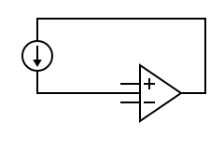
Measuring the current
ANODE
A
Two rows of straws
Measurement is performed on the cathode at low potential
CATHODE
C
ANODE
A
ANODE
CATHODE
Notes:
Panel MN084 used to have high current in previous measurements.
Up to know the aim is to find consistencies with the previous measurements before introducing a small percentage of water vapour that can reduce this effect preserving high gain
From 2 straws we get one current measurement so we have in total 48 currents in one panel

Slide 13
Measuring the current
ANODE
Two rows of straws
Measurement is performed on the cathode at low potential
CATHODE
ANODE
ANODE
CATHODE
Notes:
Panel MN084 used to have high current in previous measurements.
Up to know the aim is to find consistencies with the previous measurements before introducing a small percentage of water vapour that can reduce this effect preserving high gain
From 2 straws we get one current measurement so we have in total 48 currents in one panel

Slide 14
New data
Effect of conditioning
The first time HV is applied high currents are measured

Slide 15
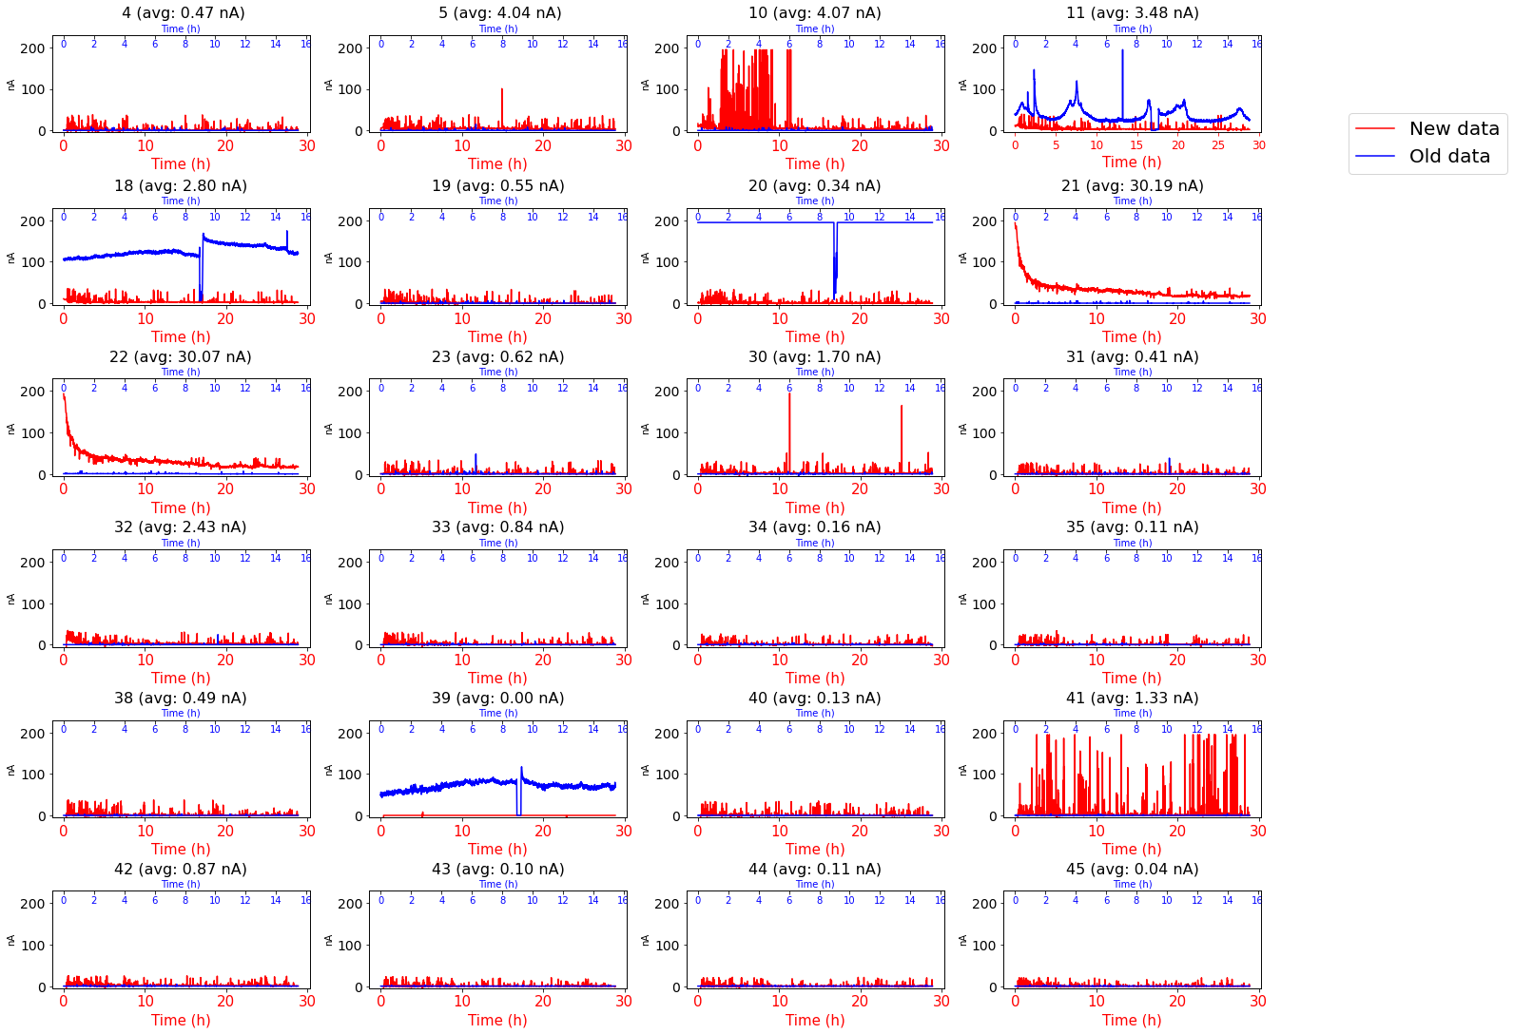
Comparison with old data

Slide 16
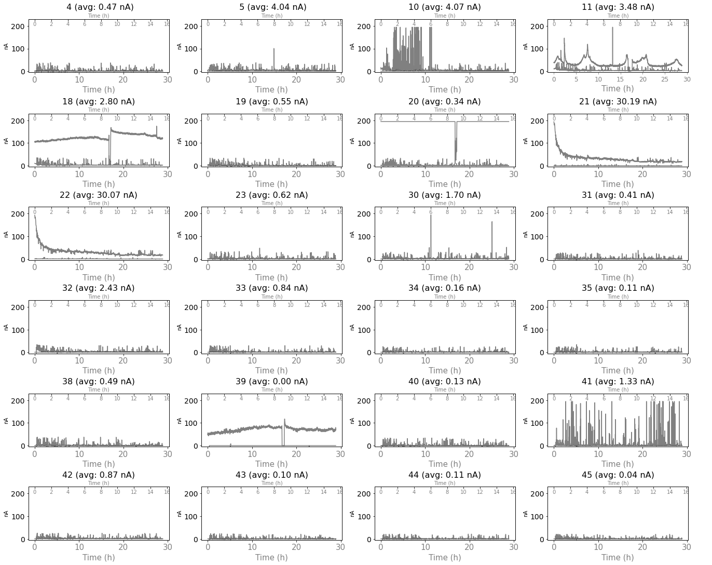
Comparison with old data

Slide 17
Comparison with old data

Slide 18
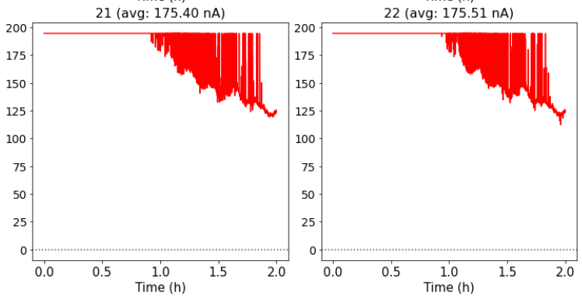
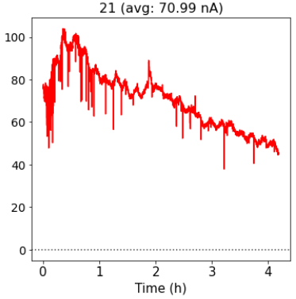
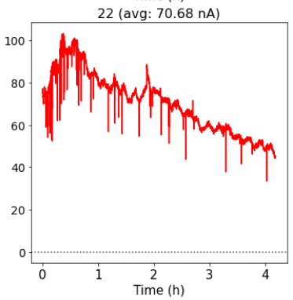
High and identical currents
Also in the past measurement

Slide 19
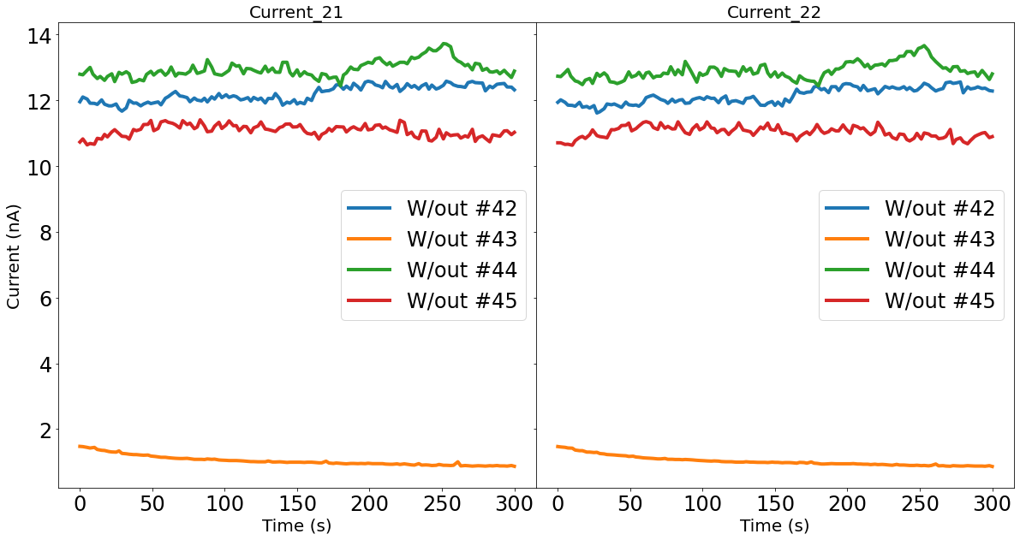
High and identical currents
Disconnecting
#42, #43, #44, #45 one by one
Disconnecting
#42, #43, #44, #45 one by one
Straw #43 draw high current

Slide 20
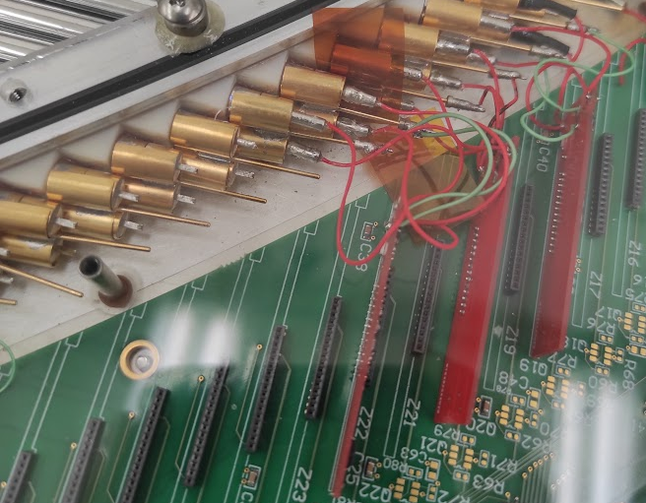
High and identical currents
Short and high current
Notes:
Omega clips were in touch

Slide 21
Perspectives
What happens when air is in the panel? Do we need to wait for a reconditioning time before taking data? How long?
What happens when HV is shut off? This must be taken into account as well. Again, do we need to wait before taking new data?
What’s the reason of the high current? Can it be reduced? What’s the compromise between reducing the high current and preserving high gain?

Slide 22
Thank you for your attention

Slide 23
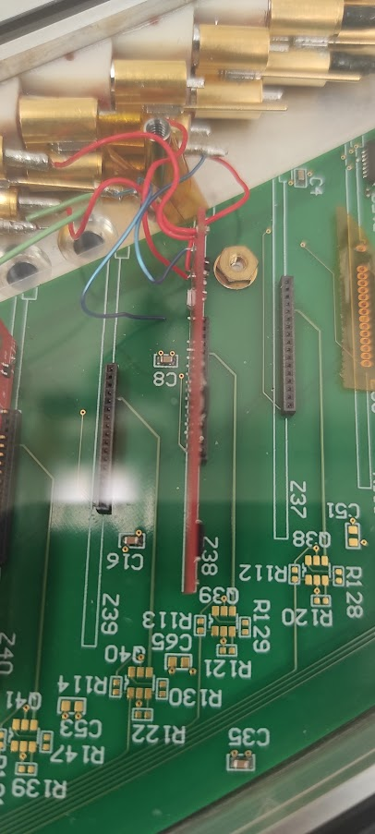
Comparison with old data

Slide 24
08/15 More measurements
2 cramps Z16, Z18
New data:
2 hours
Old data:
24 hours

Slide 25
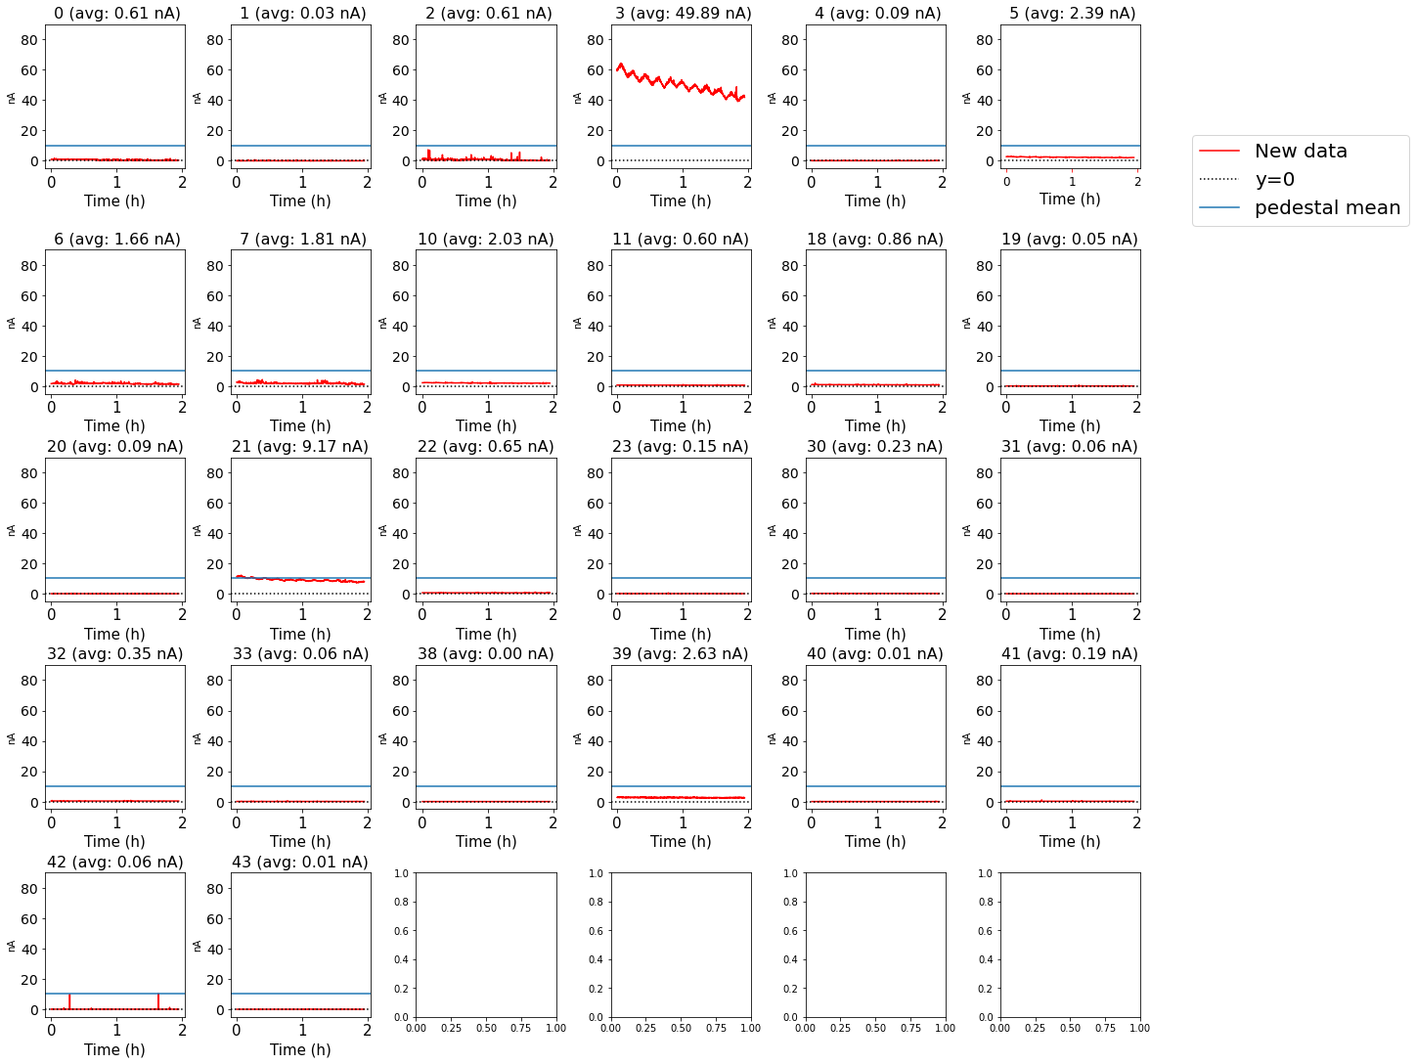
08/23 update

Slide 26
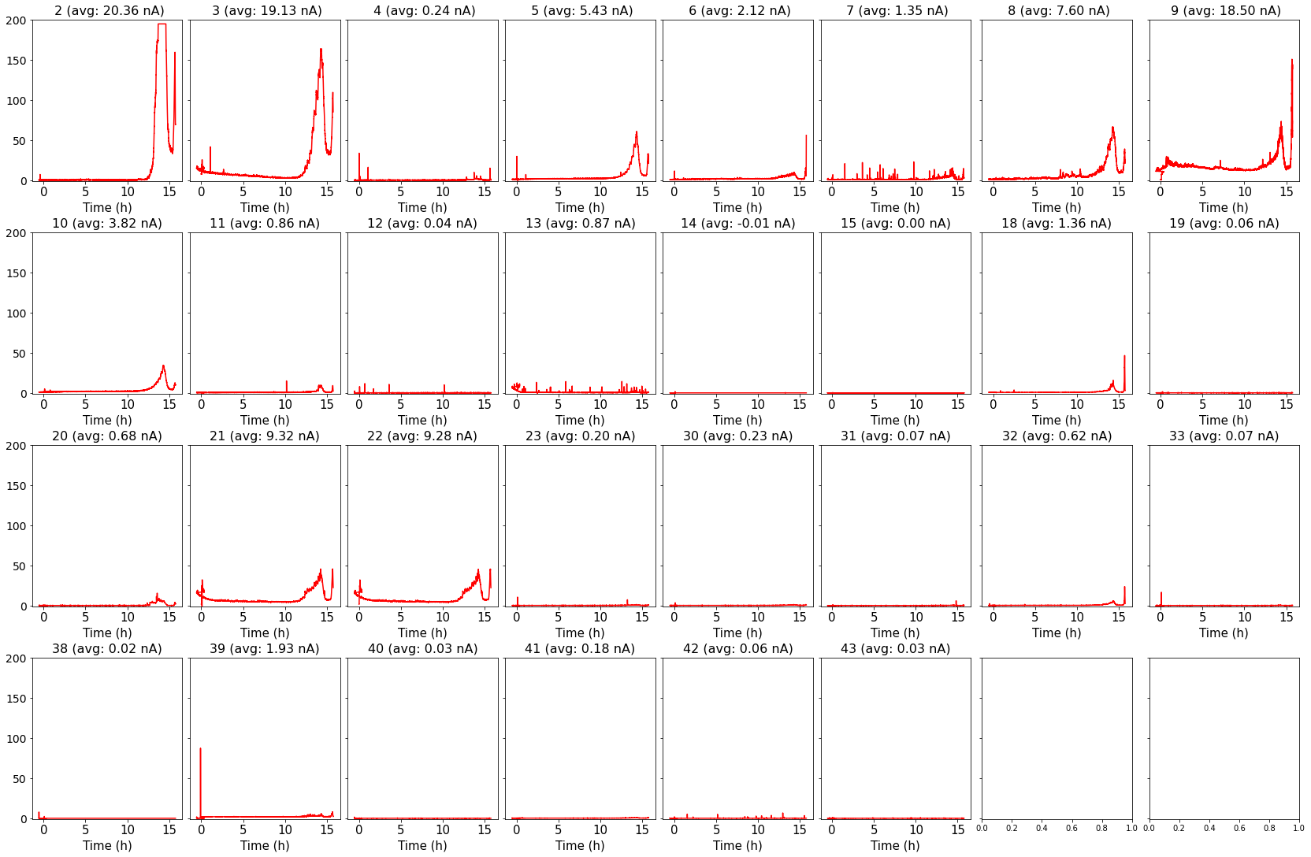
08/24 update: run out of gas
70mm 0.2 scfh
40 mm 0.11 Standard cubic feet per hour
Notes:
During the night we ran out of gas
Some doublets got high currents. It seems that they need again to be reconditioned

Slide 27
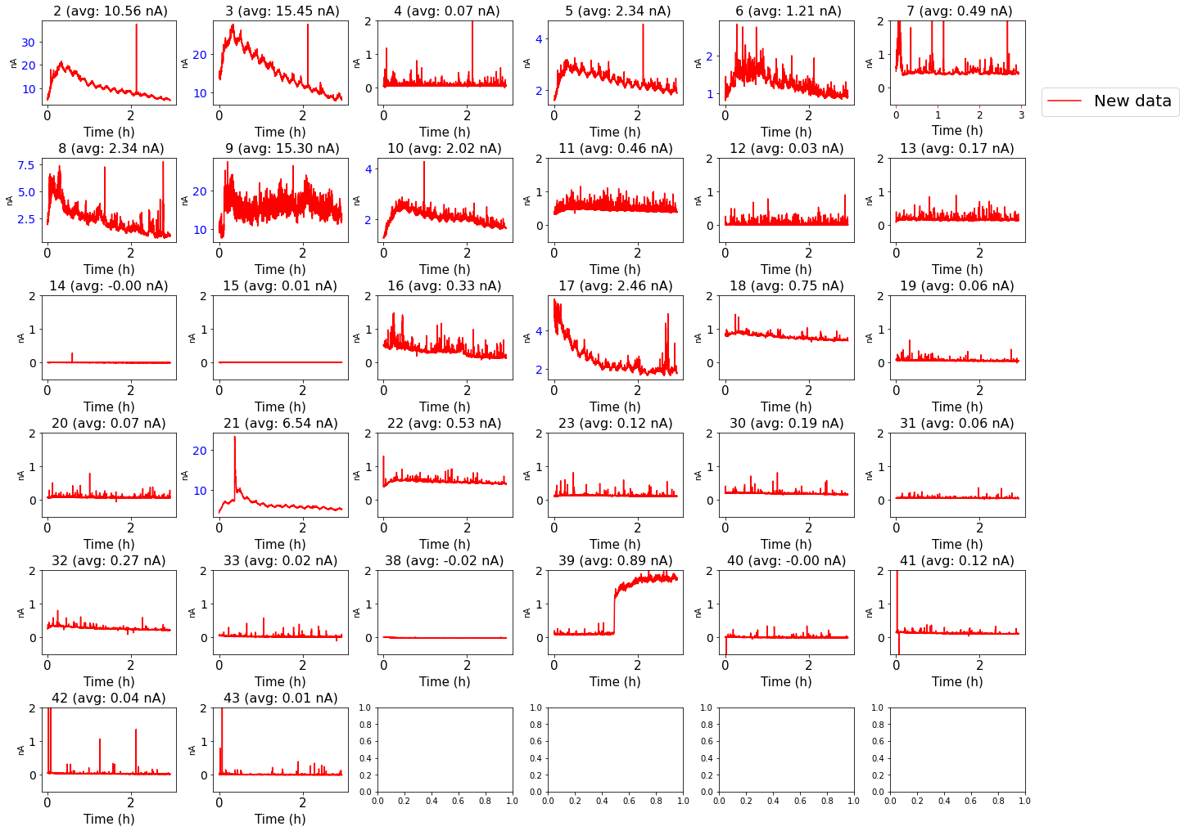
Gas refilled
Notes:
Reconditioning

Slide 28
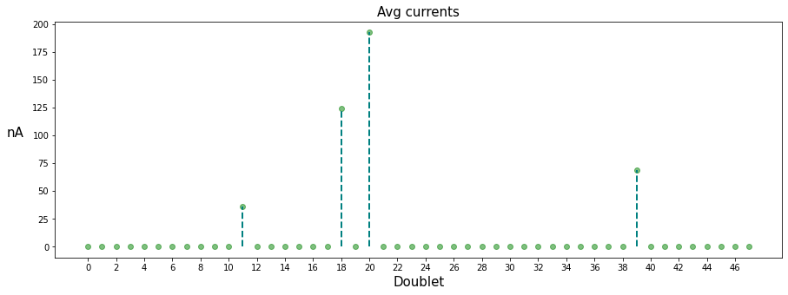
Full dataset of panel MN084
Notes:
11 18 39 are the doublets that draw high current. We don’t know why up to now
#20 saturates

Slide 29
Mu2e Experiment
Production Solenoid
Proton beam strikes target, producing mostly pions
Graded magnetic field contains backwards pions/muons and reflects slow forward pions/muons
Transport Solenoid:
Select low momentum, negative muons
Detector Solenoid:
Capture muons on Al target
Graded field “focuses” e- in tracker fiducial
Measure momentum in tracker and energy in calorimeter
Notes:
The Mu2e experiment will search for coherent, neutrino-less conversion of muons into electrons in the Coulomb field of an aluminum nucleus with a sensitivity of four orders of magnitude better than previous experiments.
The signature of this process is an electron with energy nearly equal to the muon mass, a bit smaller taking into account the binding energy of the muon into the aluminum nucleus
In order to achieve this goal, Mu2e has chosen a very low-mass straw tracker, made of 20,736 5 mm diameter thin-walled (15 µm) Mylar® straws, held under tension to avoid the need for supports within the active volume, and arranged in an approximately 3 m long by 0.7 m radius cylinder, operated in vacuum and a 1 T magnetic field.

Slide 30
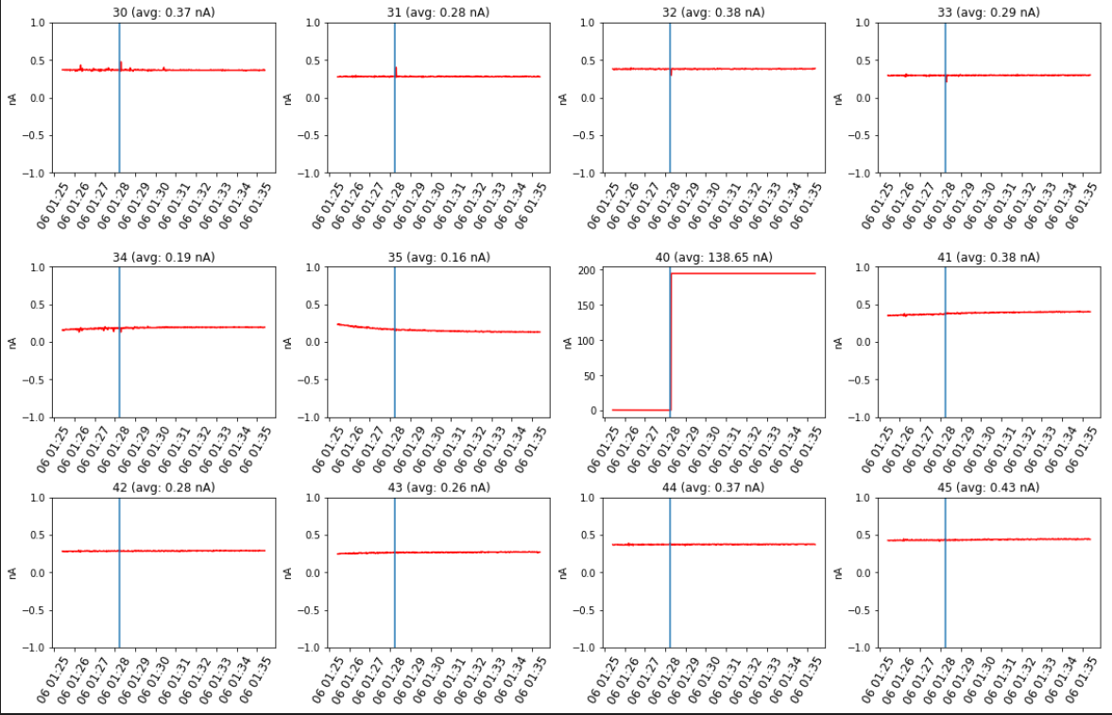
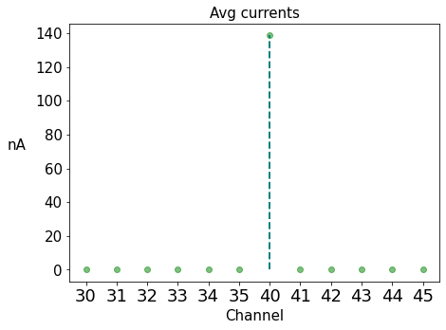
08/12 Pedestal measurement
6 S.A. connected Z30, Z32, Z34, Z40, Z42, Z44
Panel MN084 Nominal Voltage=5 V
3 min of measurements with the switch off (few mV)
7min of measurements with the switch ON but the voltage set to the minimum (5 Volts)

Slide 31
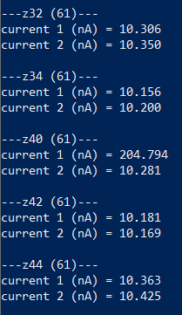
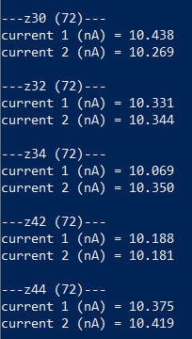
08/12 Pedestal measurement
The problem is not in the slow amplifier. Moving the same slow amplifier to another slot it works. Using different slow amplifiers in Z40 they have the same issue.

Slide 32
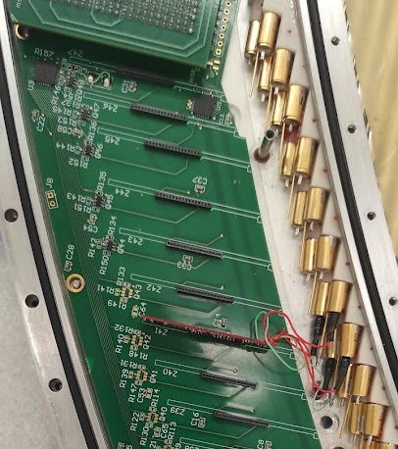
08/12 Pedestal measurement
The problem is not in the slow amplifier. Moving the same slow amplifier to another slot it works. Using different slow amplifiers in Z40 they have the same issue.
Placing the same cramp on Z39, Z40, Z41 connected to the same straws #80-83 saturates in current
Straws #80-83
Straws #80-83
Straws #80-83
Z39
Z40
Z41

Slide 33
08/12 Pedestal measurement
The problem is not in the slow amplifier. Moving the same slow amplifier to another slot it works. Using different slow amplifiers in Z40 they have the same issue.
Placing the same S.A. on Z39, Z40, Z41 connected to the same straw #80 saturates in current
The problem is not in Z40, it seems to be in the straw
We checked connectivity in the straw with the multimeter and that was good (same values of all the other straws)
We checked contact between the anode and the ground and the same behaviour was found in the other straws

Slide 34
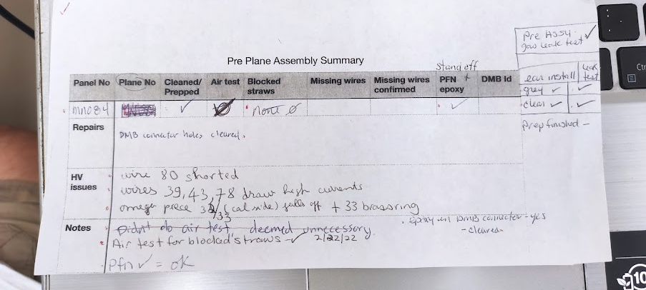
08/15 Short in straw 80 of panel MN084
Pigtail caused the short on wire #80 in panel MN084

